Slide 1


AIN-3009 · MLOps Term Project · Spring 2026
Real-Time Telco Churn Prediction
End-to-End ML Lifecycle Management with MLflow
XGBoost
MLflow
Hyperopt
SHAP
FastAPI
Streamlit
Evidently
Azure ML
Abdullah Hani Abdellatif Al-Shobaki
Student ID 2284612 · Bahçeşehir University
Instructor: Gökşin Bakır
AI Engineering Department · May 2026

Slide 2


01 · PROBLEM & DOMAIN
Why Churn? Why MLOps?
The Business Problem
MLflow Objectives Covered
Telecom companies lose ~5× more acquiring a new customer than retaining one. Predicting churn before it happens lets retention teams act early — but a model alone isn’t enough. We need a full MLOps pipeline: tracking, tuning, deploying, monitoring.
1
Experiment Tracking
4 models · params · metrics · artifacts
2
Training & Tuning
Hyperopt TPE · 50 nested runs
3
Model Deployment
FastAPI service + Azure ML endpoint
7,043
21
26.5%
customer records
raw features
churn rate
4
Performance Monitoring
Evidently drift · 3 windows logged
Dataset: IBM Telco Customer Churn (Kaggle)
5
Model Registry
None → Staging → Production
Class imbalance handled with SMOTE + class_weight balancing.
Telco Churn MLOps · Abdullah Al-Shobaki · AIN-3009
2 / 10

Slide 3







02 · PIPELINE OVERVIEW
End-to-End System Architecture
Data Layer
Experiment Tracking
Model Registry
Deployment
Monitoring
Telco CSV → preprocess.py
SMOTE · scaler · split
train.py · tune.py
MLflow runs + artifacts
ChurnPredictionModel
None → Staging → Prod
FastAPI :8000
Streamlit :8501
Evidently drift
3 windows logged
Azure ML Cloud Layer
Workspace + Compute Cluster + Registered Model (live in Sweden Central)
ain3009-churn-ws
churn-cluster · DS3_v2
ChurnPredictionModel v1
Every stage is reproducible via the MLproject file — mlflow run . -e <stage>
Telco Churn MLOps · Abdullah Al-Shobaki · AIN-3009
3 / 10

Slide 4


03 · TOOLING
MLflow Setup & Tech Stack
MLflow Configuration
Tech Stack
Tracking Server
Local server on port 5500 (macOS-safe)
Modeling
Imbalance
Explainability
scikit-learn · XGBoost
imbalanced-learn (SMOTE)
SHAP 0.45
Backend Store
SQLite — mlflow.db
Artifact Store
Local filesystem — mlartifacts/
Tuning
Tracking
Monitoring
Hyperopt (TPE)
MLflow 2.13
Evidently AI 0.4.30
Experiments
Telco_Churn_Experiments · HyperTuning · Churn_Monitoring
API
Dashboard
Cloud
Reproducibility
MLproject file — 6 named entrypoints
FastAPI + uvicorn
Streamlit + Plotly
Azure ML SDK v2
Telco Churn MLOps · Abdullah Al-Shobaki · AIN-3009
4 / 10

Slide 5
04 · TRAINING & RESULTS
Experiment Tracking — 4 Baseline Models
BASELINE WINNER
Random Forest
F1 0.6303 · AUC 0.8434
5-fold CV F1 0.8249 ± 0.030
Logged per run
Hyperparameters & seeds
F1, AUC, precision, recall, accuracy
5-fold CV mean ± std
Confusion matrix + ROC curve PNGs
SHAP beeswarm plots
Serialized model (.pkl)
Telco Churn MLOps · Abdullah Al-Shobaki · AIN-3009
5 / 10

Slide 6

05 · OPTIMIZATION
Hyperparameter Tuning with Hyperopt
TPE Search · 50 Trials
BEST TRIAL — TUNED GRADIENT BOOSTING
Tree-structured Parzen Estimator searches the GradientBoosting space. Each trial is a nested MLflow run under one parent — fully comparable in the UI.
0.6015
0.8443
F1 Score
ROC-AUC (best of 50 trials)
Search Space
→ Highest AUC across the entire experiment — promoted to Production.
n_estimators
[100, 200, 300, 400, 500]
max_depth
[3, 4, 5, 6, 7]
Best Hyperparameters
learning_rate
loguniform(0.01, 0.3)
n_estimators
400
max_depth
3
subsample
uniform(0.6, 1.0)
min_samples_split
[2, 5, 10, 20]
learning_rate
0.0545
subsample
0.712
Telco Churn MLOps · Abdullah Al-Shobaki · AIN-3009
6 / 10

Slide 7
06 · REGISTRY & SERVING
Model Registry → Deployment
None
Staging
Production
newly logged
candidate review
live & served
ChurnPredictionModel · v1 promoted via register.py
Local — FastAPI Service
Cloud — Azure ML
POST /predict
GET /health
Interactive Swagger UI at /docs
Returns: probability · risk badge · retention strategy · ROI %
Resource group · Workspace · Compute cluster
Region: Sweden Central · DS3_v2 · auto-scale 0→2
ChurnPredictionModel v1
Registered live in the Azure ML model registry.
Telco Churn MLOps · Abdullah Al-Shobaki · AIN-3009
7 / 10

Slide 8
07 · MONITORING
Performance Monitoring & Drift Detection
Drift Simulation
Window 1
Baseline · clean test data
Window 2
Gaussian noise σ=0.3 on features
Window 3
σ=0.8 noise + 20% label flip
F1 drops 0.60 → 0.43
Clear retraining signal · Evidently HTML reports logged as MLflow artifacts.
Telco Churn MLOps · Abdullah Al-Shobaki · AIN-3009
8 / 10

Slide 9


08 · DEMO INTERFACE
Streamlit Dashboard — The Front Door
Customer Predictor
Model Performance
Monitoring
19-field input form
Probability gauge 0–100%
Risk badge: High / Medium / Low
SHAP waterfall per customer
Retention strategy + ROI
Side-by-side bar charts
F1 · AUC · Precision · Recall
5-fold CV scores table
All 4 baseline models
Tuned model comparison
Drift trend across windows
F1 + Accuracy line chart
Evidently HTML report links
Logged as MLflow artifacts
Retraining alert signals
Example API response
prob: 0.8741 · risk: High · strategy: "Offer 20% upgrade to 1-yr contract" · ROI: 1906%
Telco Churn MLOps · Abdullah Al-Shobaki · AIN-3009
9 / 10

Slide 10
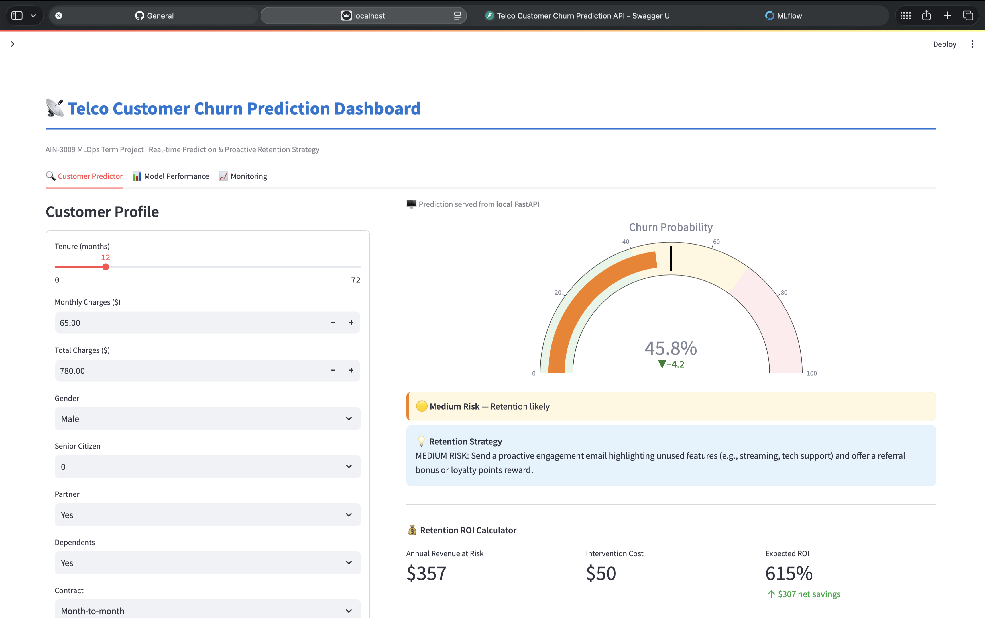

Slide 11


OBJECTIVES MET · KEY TAKEAWAYS
End-to-End MLOps — Delivered.
Experiment Tracking
Training & Tuning
Deployment
Monitoring
Model Registry
4 models · params · metrics · SHAP · CV — all in MLflow
50 Hyperopt trials · best AUC 0.8443
FastAPI service + Azure ML registered model
3-window drift · Evidently HTML in MLflow
v1 promoted: None → Staging → Production
0.8443
50
3
Best ROC-AUC (tuned GB)
Hyperopt nested runs
Drift windows monitored
github.com/3bdulah/telco-churn-mlops
Thank you · Questions?

