Slide 1

DEPARTMENT of MECHANICAL ENGINEERING GRADUATION PROJECT
Design and Implementation of a Semi-Autonomous RC Car
Advisor: Asst. Prof. TOLGA ÖZASLAN
Abdelrahman Khaled Mohamed Ali Elamin Hassan
Abdullahi Ayanbukola Ayandiran

Slide 2

Content
Scope & Objective
Introduction
Ackerman Steering Analysis & Optimization
Mechanical Design & Manufacturing
Electronics Design & Implementation
Control & Embedded System
Conclusion
Results & Discussion
References
www.aybu.edu.tr

Slide 3
Scope & Objective
Primary Objective: Design, manufacture, and implement a functional semi-autonomous RC car.
Mechanical Scope: Steering Analysis, Optimization
Electronics Scope: EMF, PCB design , I2C , Filters
Software & Control Scope : PID Control ,Filtering, FreeRTOS , dual core
www.aybu.edu.tr

Slide 4
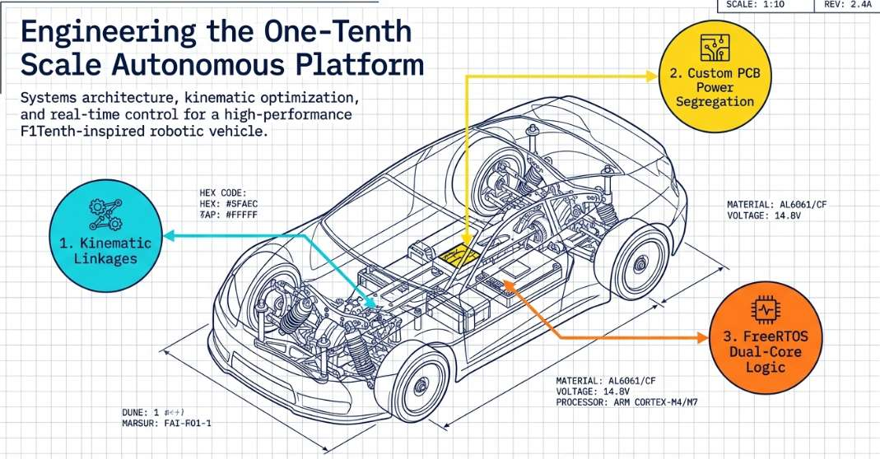
Introduction
www.aybu.edu.tr

Slide 5
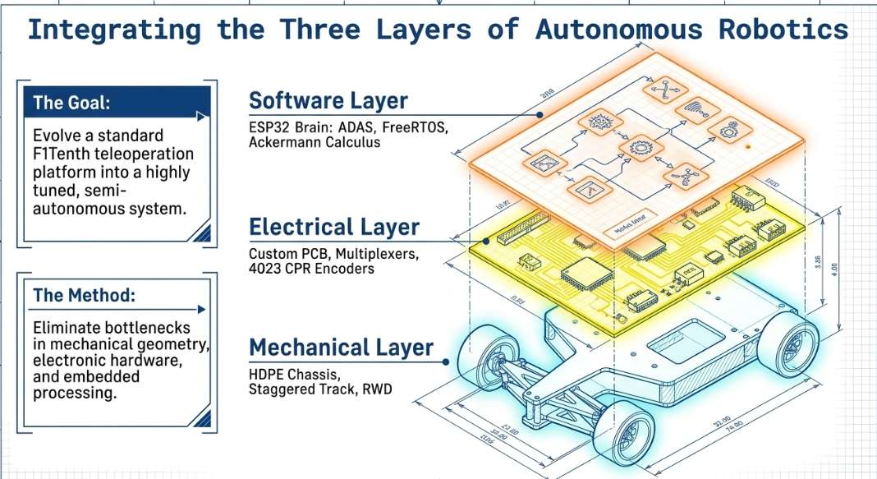
Introduction
www.aybu.edu.tr

Slide 6
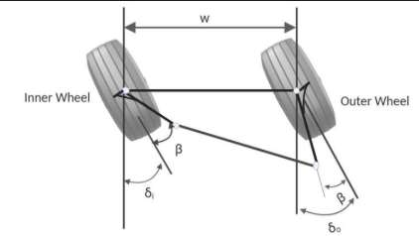
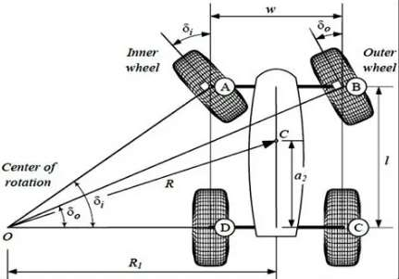
Ackerman Steering Analysis & Optimization
Ackerman Geometry (AKA Trapezoidal Linkage); 4-bar mechanism
Inner & Outer Angle relationship.​
The Ackerman ( and Trapezoidal) Analysis limitations[1]:
Ideal (Ackerman equation)
Relation between just the inner & outer wheel (Ackerman & Trapezoidal equation)
Leading to:
Physical constraints with the servo Input
Designing a custom 6-bar mechanism
www.aybu.edu.tr

Slide 7
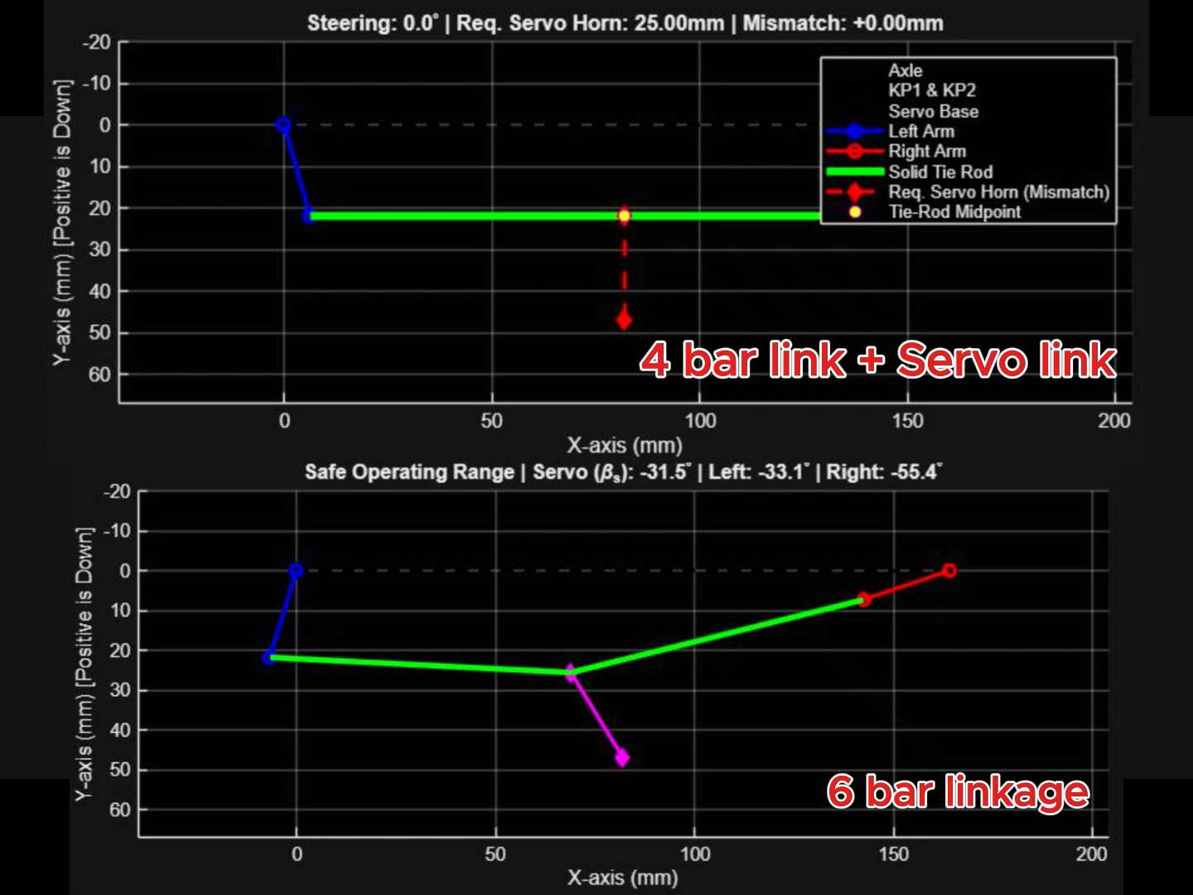
The Custom 6-bar Mechanism
Method: Vector Coordinate Equation + MATLAB SIM.
www.aybu.edu.tr

Slide 8

Optimization
Objective: Minimize the difference between ideal Ackermann steering geometry and actual 4-link / 6-link steering mechanisms.
DOE Method: Applied Full Factorial Design (Grid Search) to test all variable combinations due to high system sensitivity.
Objective Function: Used RMSE to measure error between actual and ideal inner/outer wheel angles, giving higher penalty to larger errors.
Optimization Variables: $β$ and d
Search Range:$β=$ 10°– 30° and d = 2–30 mm
Constraints :Large d causes chassis interference and slower steering response
.β > 30° leads to kinematic singularity, causing loss of controllability.
www.aybu.edu.tr

Slide 9
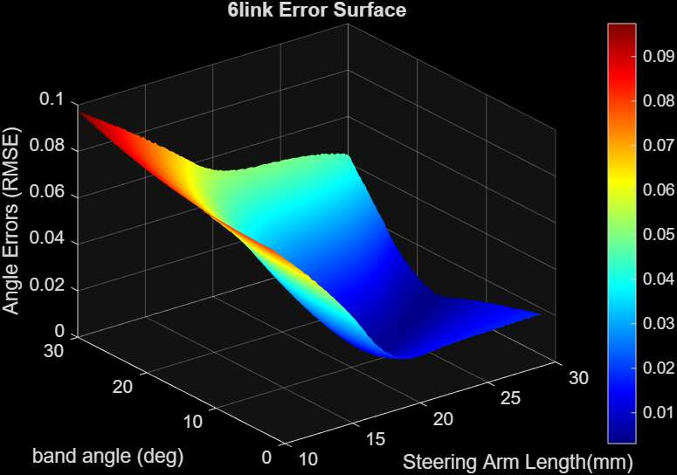
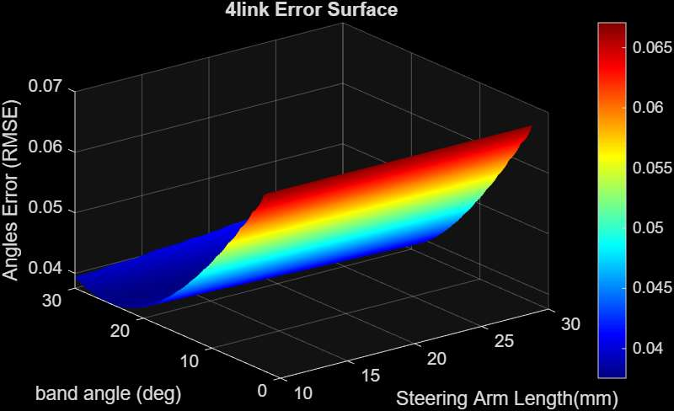

Result of 6-link & 4-link surface Optimization
$e_{ESM}={(\frac{1}{n}\sum_{i=1}^{n}{{(δ_{actual}−δ_{Ackermann })}^{2})}}^{0.5}$ [2]
www.aybu.edu.tr

Slide 10
Optimized Linkage Comparison of 6-link & 4-link
4-link system: showed divergence from ideal Ackermann behavior.
6-link system: showed better convergence to ideal steering geometry.
www.aybu.edu.tr

Slide 11
Grid size &optimization performance
Grid size was adjusted to improve optimization accuracy and observe solution behavior. Choosing the step size involves a trade-off with round-off error
www.aybu.edu.tr

Slide 12
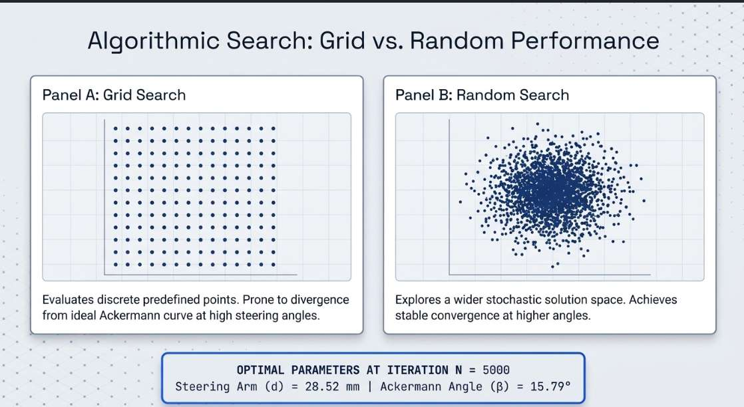
Random Search : was selected to introduce variability in the results.
It helps explore a wider solution space compared to structured methods like Grid Search. [3]
This allows checking if better solutions exist outside the fixed grid points and improves robustness of the optimization.
www.aybu.edu.tr

Slide 13
Random Search Optimization
Like Grid Search, Random Search requires a predefined number of iterations
A parametric study was performed using different iteration numbers: N = 500, 5000, 50000.
www.aybu.edu.tr

Slide 14
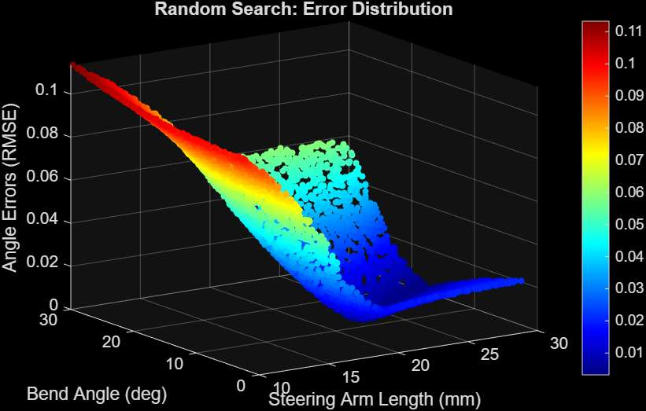
Comparative Random Search & Grid Search Optimization
www.aybu.edu.tr

Slide 15
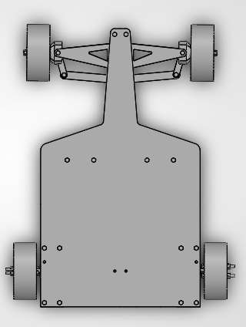
Mechanical Design & Manufacturing
Staggered Car Track
Rear Wheel Drive
Front Steering System
All design were done in SolidWorks
www.aybu.edu.tr

Slide 16
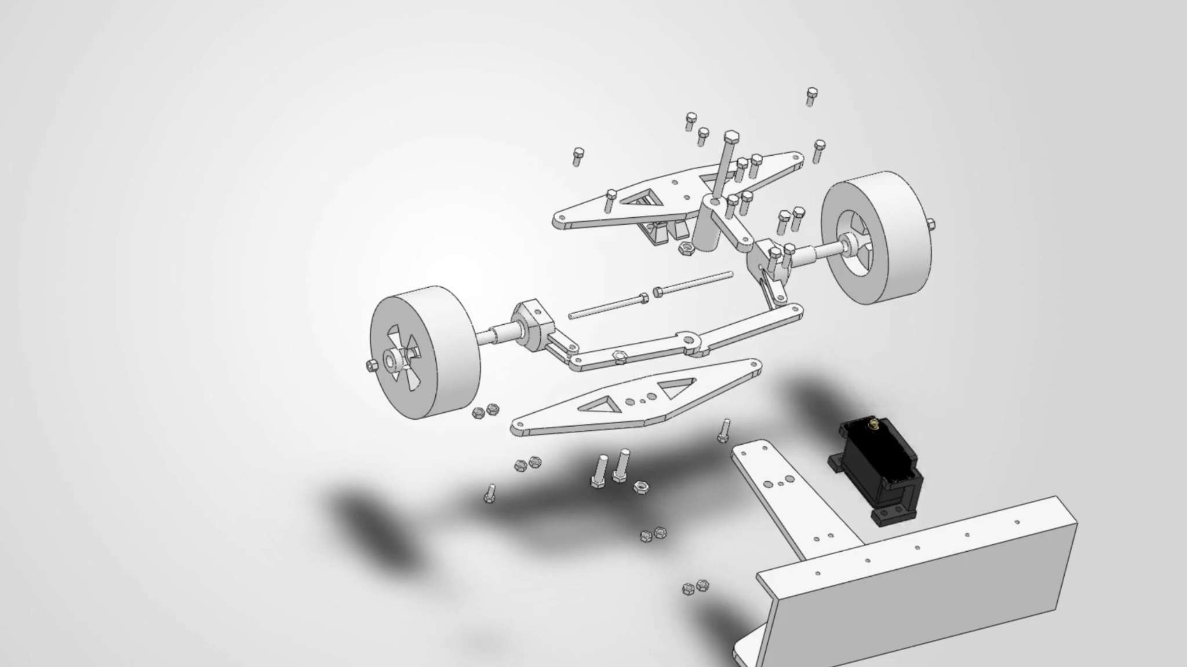
Manufacturing The Car
The chasses were cut out from HDP plastics
All other parts were 3D printed
Manual assembly.
www.aybu.edu.tr

Slide 17
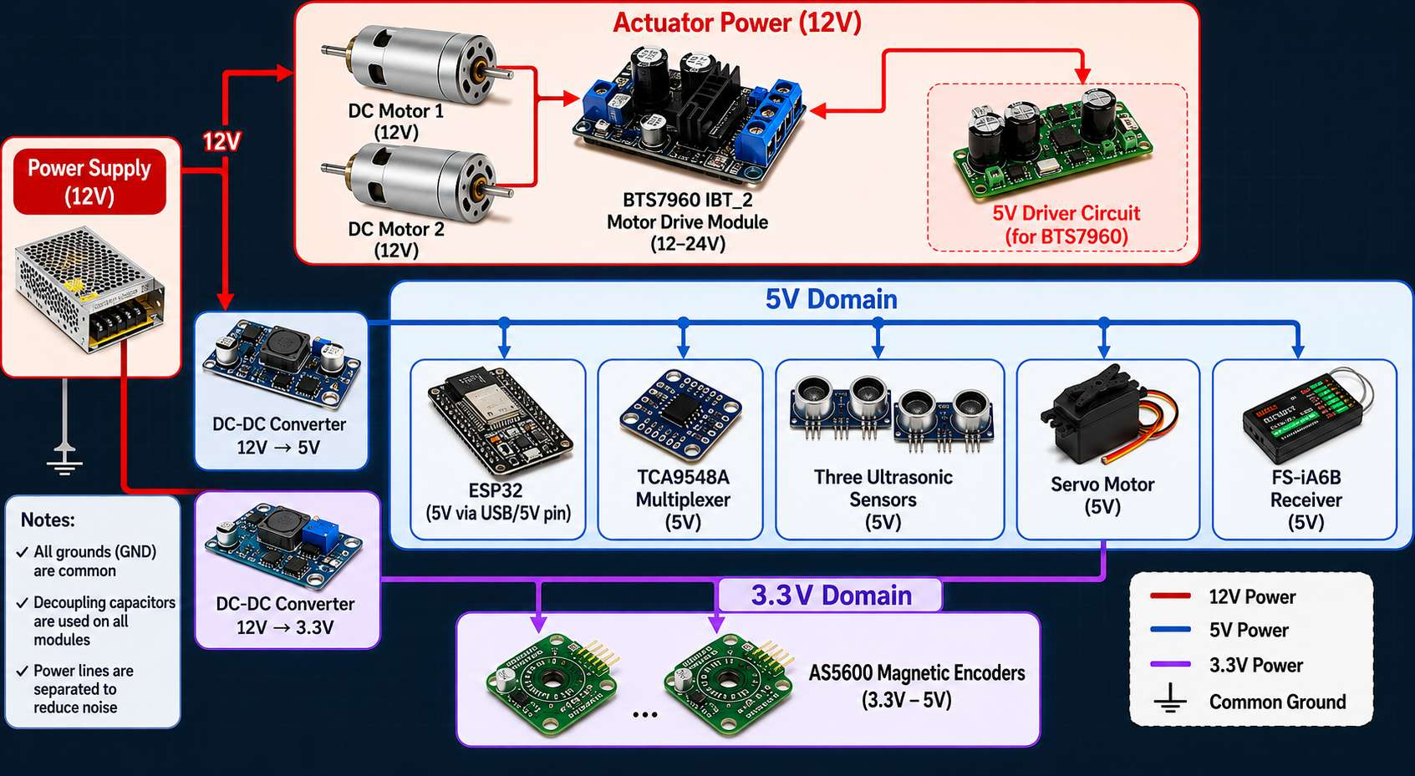
Electronics Design & Implementation
Electronics
www.aybu.edu.tr

Slide 18
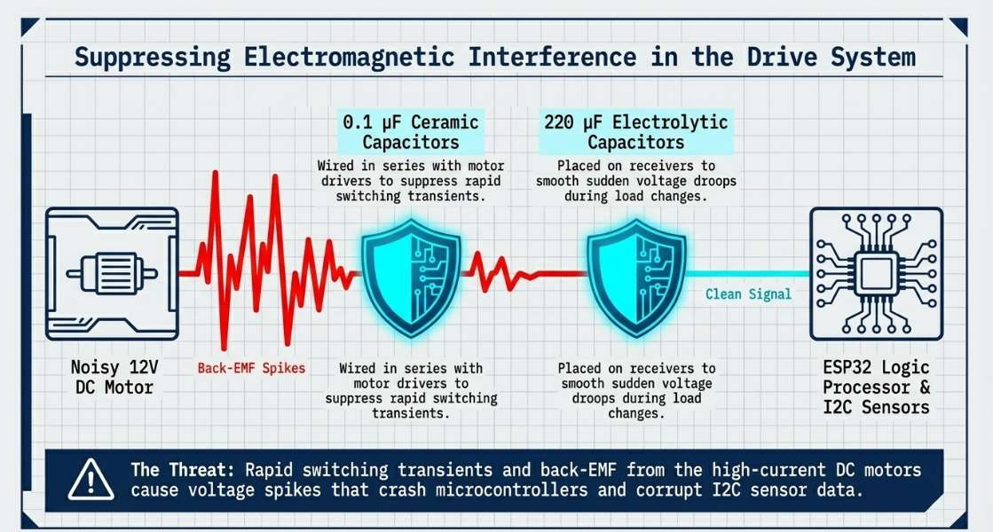
electromagnetic force
is the voltage that a motor generates as it spins, acting like a generator. It opposes the input voltage, which naturally limits the current.
www.aybu.edu.tr

Slide 19
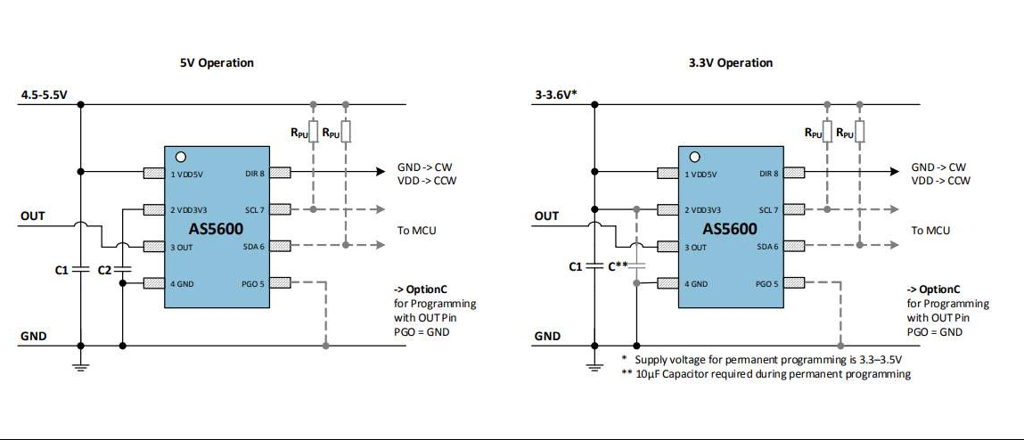
I2C Communication
I²C is a communication protocol between a microcontroller and multiple peripherals using only two lines: SCL and SDA. [6]
The bus uses an open-drain structure, meaning devices can only pull the line LOW
Pull-up resistors are used to pull the signal HIGH and ensure proper logic levels
External pull-up resistors are added in parallel to reduce equivalent resistance and improve noise
This helps mitigate EMF effects and ensures stable data transmission.
www.aybu.edu.tr

Slide 20
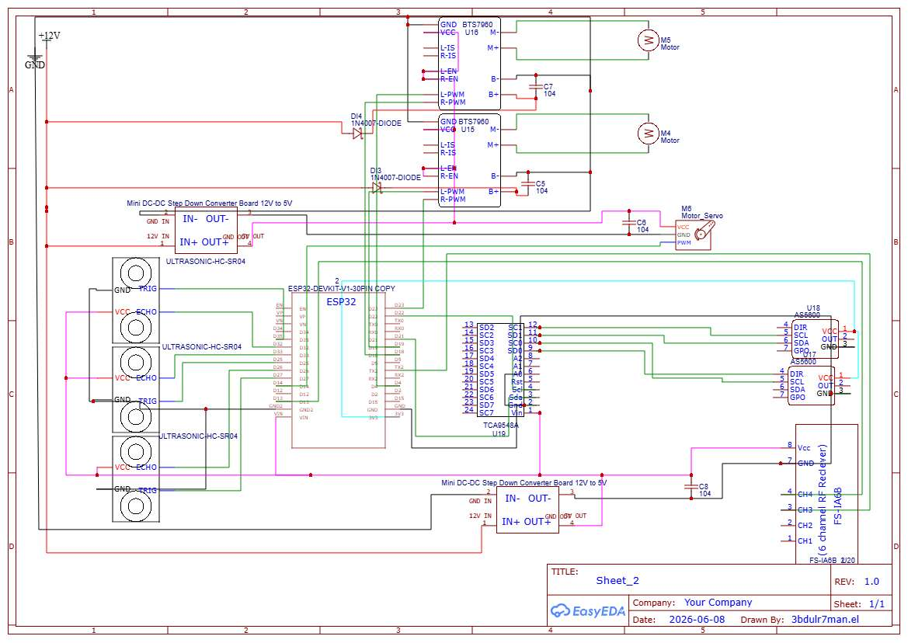
Circuit Design
The system is powered by a 12 V, 6 A power supply.
To reduce noise and voltage fluctuations, the power is divided into three isolated domains:
Actuator domain (5 V): TB6612FNG motor drivers and servo motor.
Logic 5 V domain: ESP32, TCA9548A, ultrasonic sensors, and receiver.
Sensor 3.3 V domain: AS5600 encoder.
www.aybu.edu.tr

Slide 21
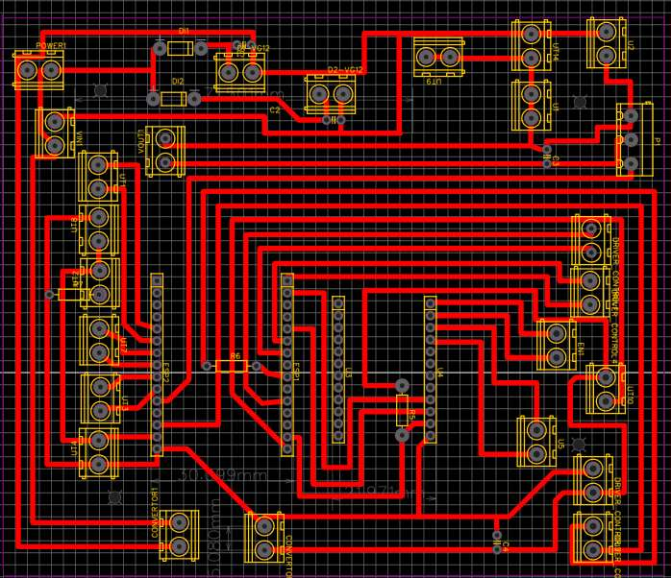
PCB Design and Current Capacity
The PCB was designed for fast lab prototyping using a single-layer layout to simplify CNC manufacturing.
crossovers were solved using bottom-side wire routing
Trace width design: 1 mm width to safely carry up to 2 A
CNC 3018 isolation milling machine ,probing for height mapping ,Soldering, testing
www.aybu.edu.tr

Slide 22
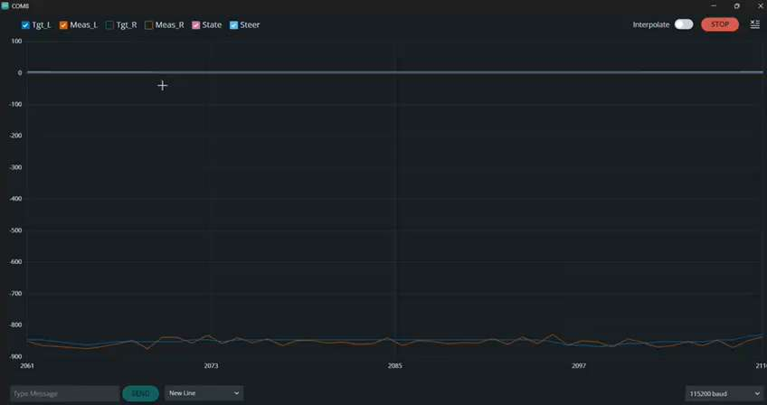
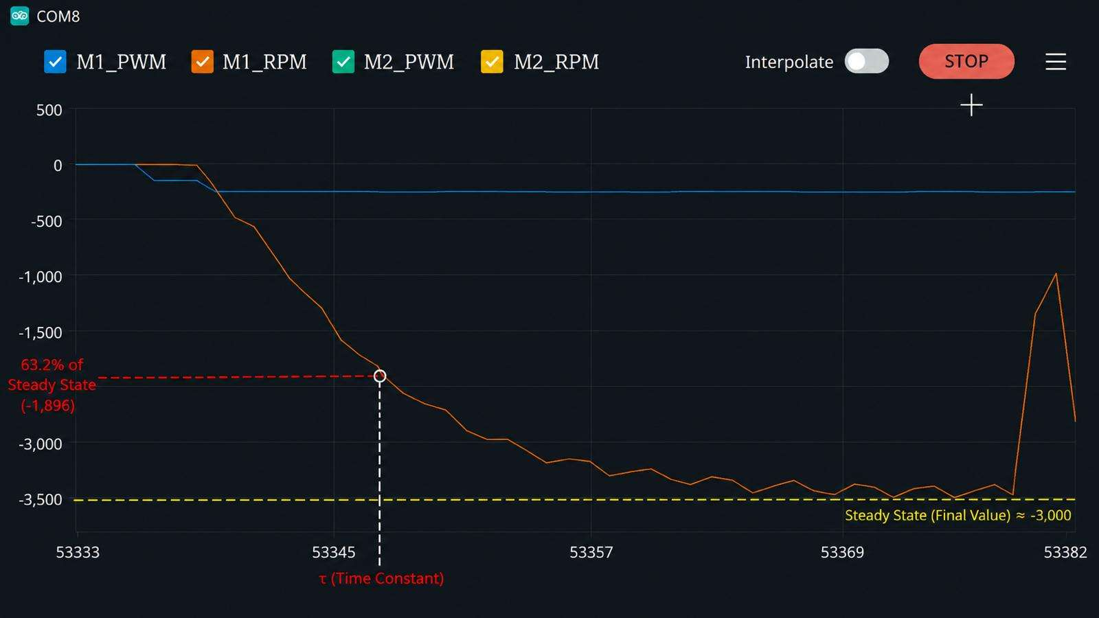
Control system
PI Controller[7]:
Due to variations between manufacturers and incomplete datasheet data, the DC motor is approximated as a first-order system.
For speed tracking, a PI controller is sufficient to ensure stable performance.
www.aybu.edu.tr

Slide 23
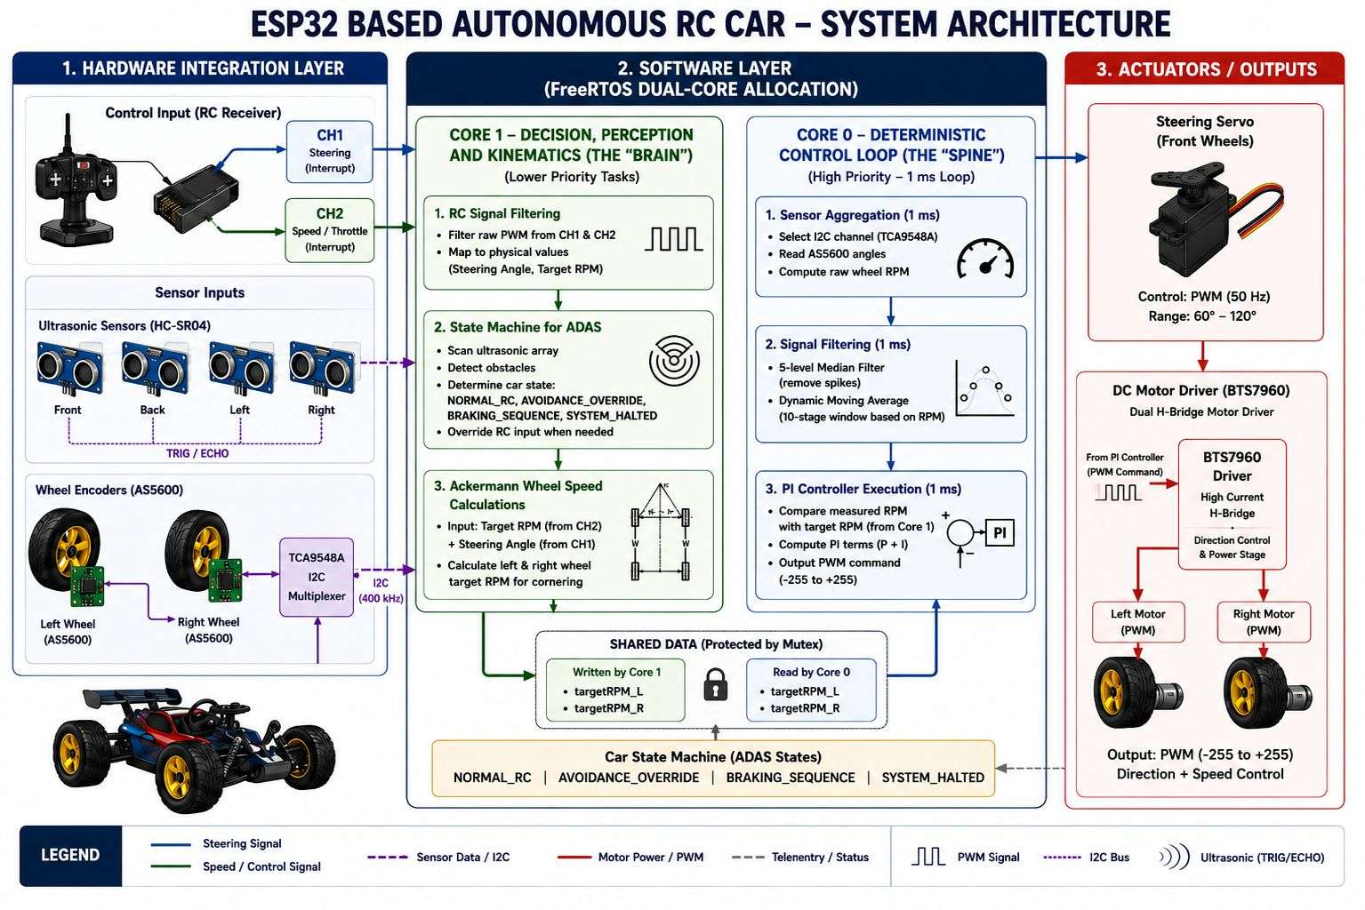
Embedded system
www.aybu.edu.tr

Slide 24
Conclusion
www.aybu.edu.tr

Slide 25
References
[1] J. Nocedal and S. J. Wright, Numerical optimization. Springer, 2006.
[2] T. Chai, R. R. Draxler, et al., “Root mean square error (rmse) or mean
[3] J. Bergstra and Y. Bengio, “Random search for hyper-parameter optimization.,” Journal of machine learning research, vol. 13, no. 2, 2012.
[4] A. P. Stoicescu, “On the optimization of an ackermann steering linkage,” UPB Scientific Bulletin, Series D: Mech Engi, vol. 75, no. 4, pp. 5–9, 2013.
[5] D. Bastow, “Steering mechanisms,” Proceedings of the Institution of Mechanical Engineers: Automobile Division, vol. 184, no. 1, pp. 137–156, 1969
[6] NXP, I²C Bus Specification UM10204, 2021.
[7] K. Ogata, Modern Control Engineering, 2010.
www.aybu.edu.tr

