Slide 1
Redis Design part 3
Shiwei Terry Zhou

Slide 2
Benchmark between hash-list schema and string schema
Measurements:
Data insertion (data initialization)
Data allocation (memory occupation)
Operations (sort, search, etc…)

Slide 3
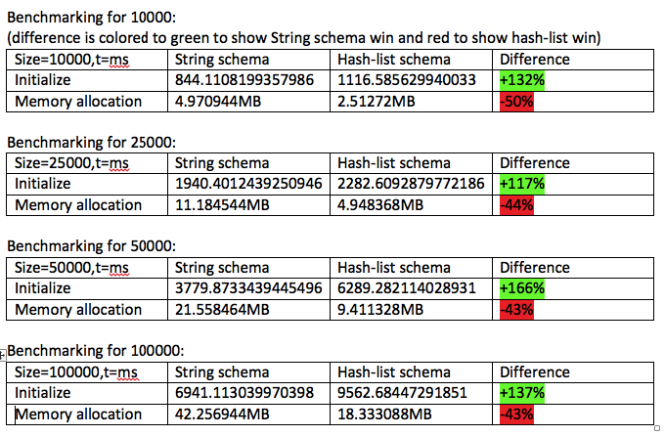
Data insertion and memory allocation
String schema: ~30% after data insertion
Hash-list schema: ~45% smaller memory occupation

Slide 4
Operations
Highly dependent on environment
Internet speed
Data structure
Server quality
Etc…
Highly dependent on implementation
Front end or back end operation
Frequent small package I/O or big data operation
Algorithm? (binary search? Linear search?)

Slide 5
Redis backup plan
Redis sentinels
Backup server from total failing by using slaves
Pros: self-respond & stable
Cons: High delay (20s+)
Redis clusters:
Partitioning data to many DBs
Pros: lower workload on servers
Cons: can lose data on server failure
Redis selective backup:
Use .rdb file to backup data we want
Pros: high persistency (a file is created that can be copied and backup)
Cons: require manual operation

Slide 6
Redis selective backup
How it works:
Temp Server can also be a backup server
Multiple rdb files can be created based on need or time stamp
DEMO TIME!
Main Server
Selective Data
Temp Server
dump
Backup.rdb

Slide 7
Search implementation & its practice in user log-in
We mentioned different operation implementation in previous slides, now we explore one of the implementation I find to be the best.
Challenge: search password by user name from Redis DB:
Schema:
User:idList = set of all user id
User:info:*->id,usn,pw = hash of id, user name and password
Solution:
SORT user:idList BY user:info:*->usn GET user:info:*->id GET user:info:*->usn
Binary search/linear search on user:info:*->usn to find id.
HGET user:info:[id] pw

Slide 8
Authentication implementation
Step1: user log-in and verify password
Step2: feedback a token to the user if log-in successful
Token should generated with payload of user name at least, preferably with client address
Step3: user browser saves the token to the cookie and always add it to the header
Step4: middleware verify the header and give permission to protected route

Slide 9
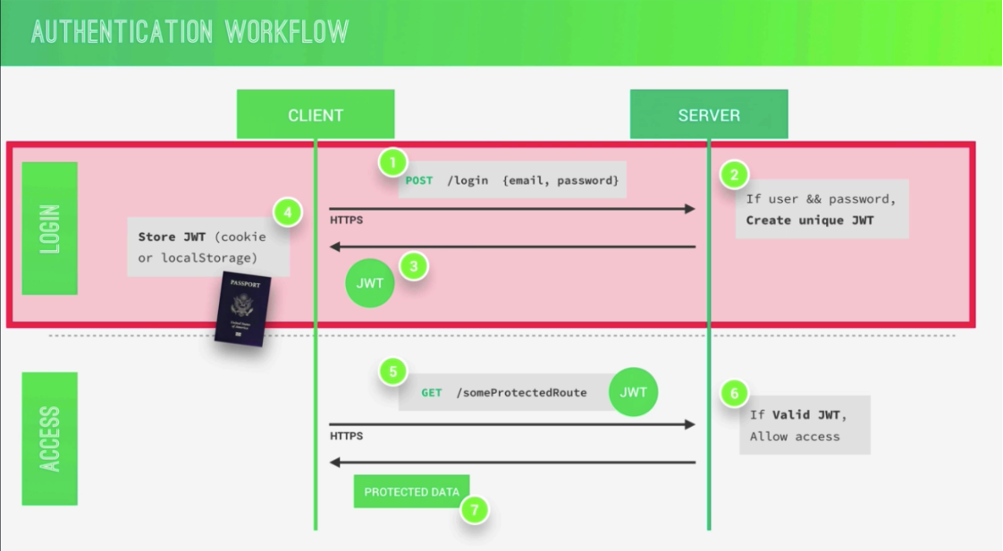
DEMO TIME!

