Slide 1
An Information-Theoretic Perspective of tf-idf Measures
Notes:
1

Slide 2

Introduction to key terms
Kullback–Leibler divergence:
KL Divergence 𝐷_{KL}(𝑃∥𝑄) measures how one probability distribution 𝑃 differs from another distribution 𝑄.
A larger value indicates that more information is lost when using 𝑄 to approximate 𝑃, meaning the two distributions are more different. (KL Divergence = 0 means the two distributions are identical)
P(𝑖) is the probability of event 𝑖 under distribution 𝑃
𝑄(𝑖) is the probability of the same event 𝑖 under distribution 𝑄
Notes:
2

Slide 3

Introduction to key terms
Term Frequency (tf):
Measures how frequently a term appears in a document.
Higher term frequency indicates higher importance within the document.
Notes:
3

Slide 4

Introduction to key terms
Inverse Document Frequency (idf):
Measures how rare a term is across all documents.
Rarer terms get higher weights because they are more informative.
N is the total number of documents
𝑛_{𝑡} is the number of documents that contain the term 𝑡
Notes:
4

Slide 5
Introduction to key terms
Term Frequency-Inverse Document Frequency (TF-IDF):
High TF-IDF: The term is frequent in a document but rare in the entire corpus, indicating its importance and relevance to that document.
Low TF-IDF: The term is frequent in the document and also common across the entire corpus, suggesting it is less informative for distinguishing that document.
Notes:
5

Slide 6

Introduction to key terms
Entropy:
In information theory, entropy is a measure of uncertainty or unpredictability for a random variable 𝑋.
Higher entropy means more uncertainty about the outcome, and lower entropy means less uncertainty.
P(x_{i}​) is the probability of event x_{i}​.
log P(x_{i}) represents the "amount of information" we get when the event x_{i}​ occurs. If P(x_{i}) is small (event is rare), then it gives more information when it happens.
Notes:
6

Slide 7
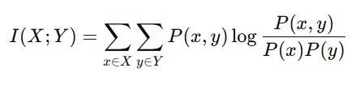
Introduction to key terms
Mutual Information:
It quantifies how much information one random variable provides about another. In the context of documents and terms, mutual information would tell us how much a term 𝑡 tells us about the document 𝑑.
P(x,y) is the joint probability of x and y
P(x) and P(y) are the marginal probabilities
Notes:
7

Slide 8
Problem
Although tf-idf has proven effective in practice, it lacks a robust theoretical foundation. Its empirical nature raises questions about the mathematical principles that justify its effectiveness, especially in comparison to probabilistic models and information-theoretic approaches
Notes:
8

Slide 9
Objective of the Paper
This paper aims to address the question: "What is the theoretical basis of tf-idf?" by reinterpreting it through an information-theoretic framework. The paper proposes a new metric called Probability-Weighted Information (PWI), which builds upon tf-idf, incorporating a more formal probabilistic and information-theoretic perspective.
Notes:
9

Slide 10
Key Issues in Selecting Probabilistic Models
1. Assumptions in tf-idf:
Homogeneity Assumption: Classic tf-idf assumes uniform document sizes and term distributions.
Limitations: Works well with homogeneous datasets but struggles with documents of varying length or uneven term distribution.
Notes:
10

Slide 11
Key Issues in Selecting Probabilistic Models
2. Simplicity vs. Precision:
P-tfidf (Simple Model):
Assumes equal probability across documents.
Fast and efficient but lacks precision in heterogeneous datasets.
P-exact (Accurate Model):
Uses actual term frequencies and document distributions.
More precise but computationally expensive, especially for large and diverse corpora.
Notes:
11

Slide 12
Key Issues in Selecting Probabilistic Models
3. Non-Linear Scaling of Term Frequency:
Overemphasis on High-Frequency Terms: Standard tf-idf may over-represent terms that appear frequently in longer documents.
Solution: Applying non-linear scaling (e.g., log or square root) to term frequency helps balance term importance.
Notes:
12

Slide 13

What is PWI (Probability-Weighted Information)?
1. Definition:
PWI measures the amount of information a word or document contributes, accounting for both its occurrence probability and its impact on the distribution of the other set (documents or words).
P(w_{i}​): Probability of the word w_{i}​ occurring in the document set.
K(P(D∣w_{i}),P(D)): KL divergence between:
P(D∣w_{i}): Distribution of document when w_{i} ​ occurs.
P(D): Overall document distribution.
2. Interpretation:
High PWI: Occurs when a rare word shifts the document distribution significantly.
Low PWI: Happens when a common word does not add much new information about the document set.
Notes:
13

Slide 14
Results - Term Selection
Datasets:
Dataset (D1): 2106 abstracts from the Japanese Society of Artificial Intelligence (JSAI).
Dataset (D2): 24 groups of academic conference abstracts from various societies.
Correlation between tf-idf and PWI:
High correlation for homogeneous datasets (D1): PWI closely matched tf-idf results.
Low correlation for heterogeneous datasets (D2): PWI outperformed tf-idf.
Notes:
14

Slide 15
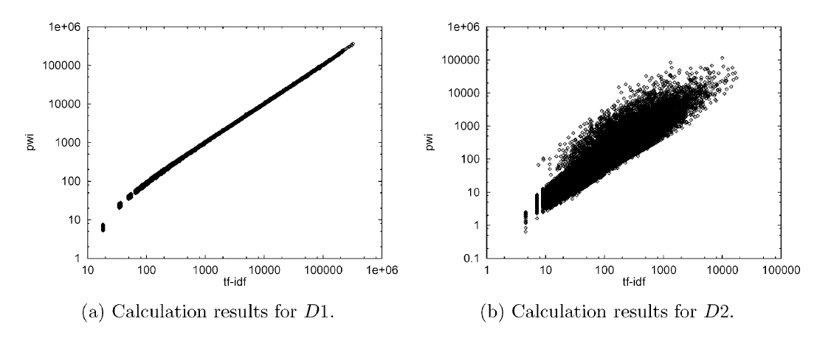
Results - Term Selection
Notes:
15

Slide 16
Results - Text Categorization
Datasets:
Dataset (D2) used for training (309,999 abstracts).
Categories: 24 academic societies.
Notes:
16

Slide 17

Conclusion
The paper provides insight into probabilistic models for text retrieval and categorization, helping us understand when and why traditional methods like tf-idf may fall short.
PWI-based models offer better performance for tasks such as automatic term selection and text categorization.
Notes:
17

Slide 18
Thank you
Presented by:
Nadiia Duiunova
Mariia Halchynska
Abdullah Abdelrazek
Notes:
18

