Slide 1

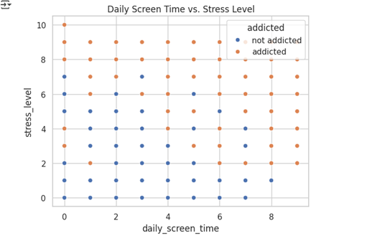
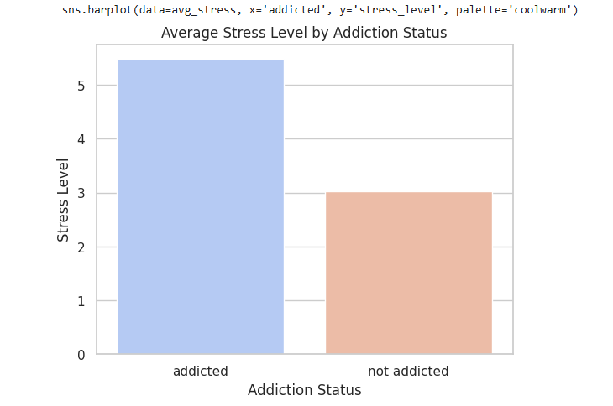
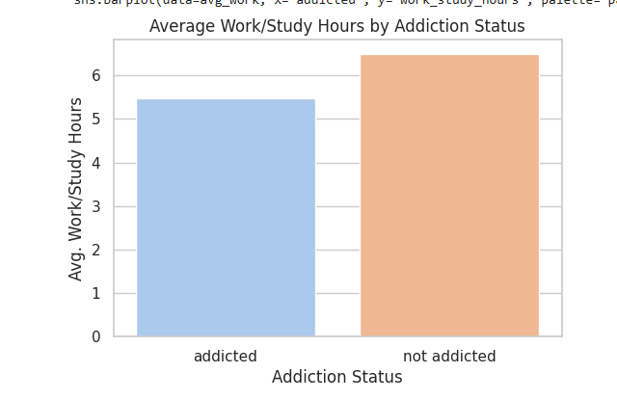


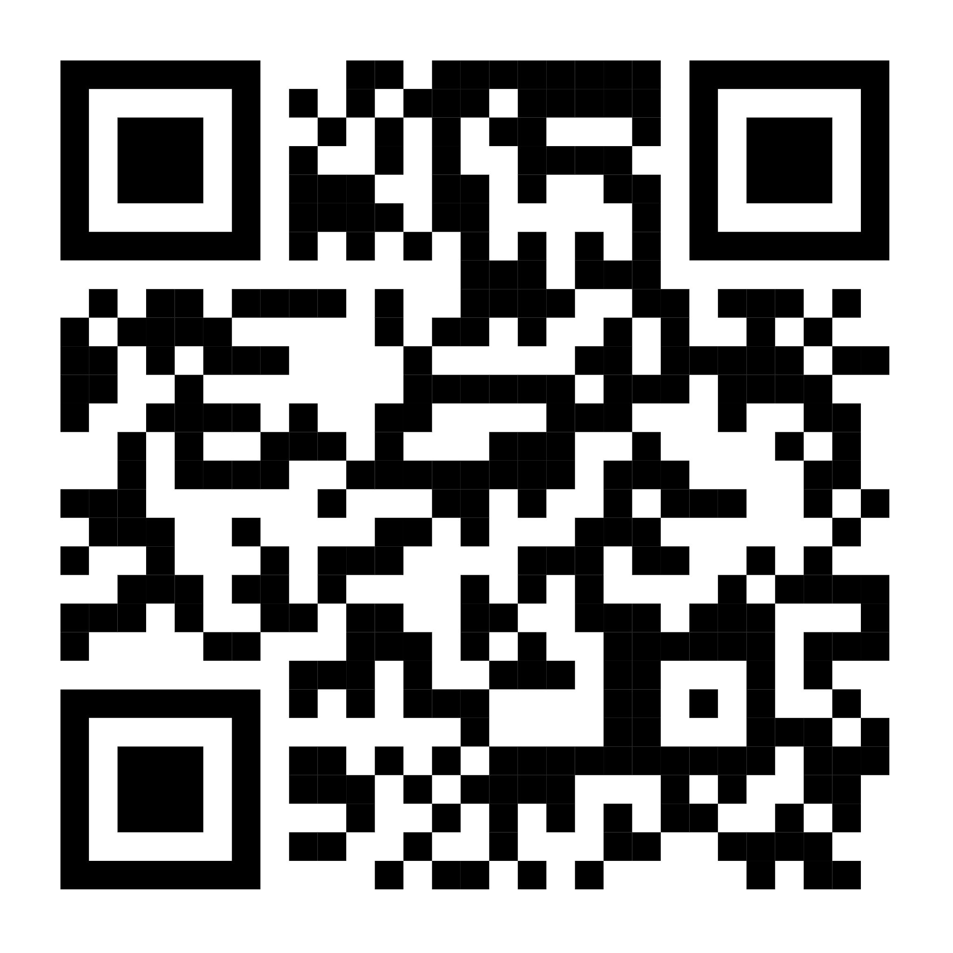
Mobile Addiction and Stress Level
Objective:
Is there a correlation between phone addiction and stress level among students ?
Used Datasets:
User_behavior (700 participants)
Mobile_addiction (13.6K participants)
Both from Kaggle
No missing or duplicate data
Removed outliers and performed statistical analysis
Fig 1.1 Daily Screen Time vs Stress Level
Visualization Results:
Addicted Users suffer from higher stress levels
More notifications indicate higher stress levels
Addicted Users are less productive than non-addicted users
Regression Models:
Fig 1.2 Average Stress Level by Addiction
Predict daily screentime
Best: Random Forest, XGBoost
Worst: Decision Tree
Classification Models:
Fig 1.3 Average Work/Study Hours by Addiction
Predict if user is addicted or not
Best: Random Forest, Gaussian Naïve Bayes
Worst: Decision Tree
Findings:
Clear link between mobile addiction and stress levels
Stress is higher with: more phone usage, more notifications, less study/work time.
Member Contributions:
References:
Ethar Mostafa 22-101121
Contribution: KNN and Decision Tree Classifier
Arwa Mostafa 22-101120
Contribution: Naïve Bayes and Random Forest Classifier
Rana Wael 22-101219
Contribution: Lasso, Random Forest, XGBoost, Elastic Net Regression Models
Noureen Ibrahim 22-101056
Contribution: Data Visualization
Kareem ElKenany 22-101031
Contribution: Linear, Ridge, Decision Tree Regression Models
Abdelrahman Mahdi 22-101173
Contribution: Data Wrangling

