Slide 1
Learning Mealy Machines

Slide 2
Revisit Language of DFAs

Slide 3
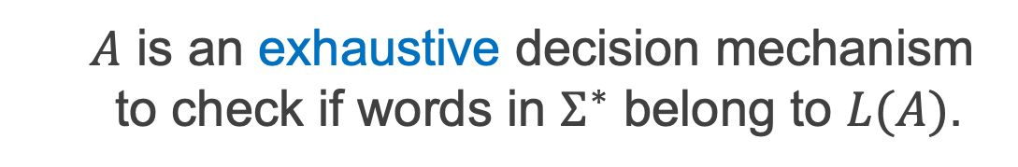
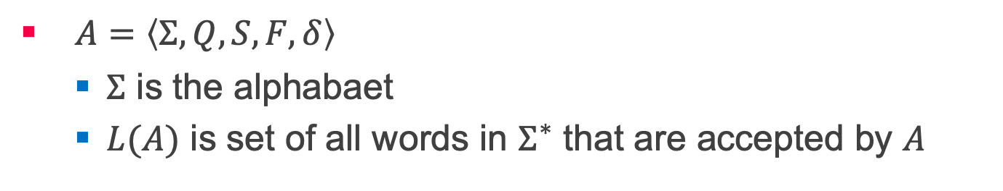
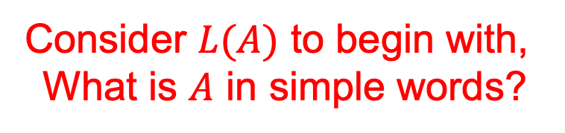
DFAs and Regular Languages
$A=〈Σ,Q,S,F,δ〉$
$Σ$ is the alphabaet
$L(A)$ is set of all words in $Σ^{∗}$ that are accepted by $A$
Consider $L(A)$ to begin with,
What is $A$ in simple words?
$A$ is an exhaustive decision mechanism to check if words in $Σ^{∗}$ belong to $L(A)$.

Slide 4
L* & Mealy Machine

Slide 5
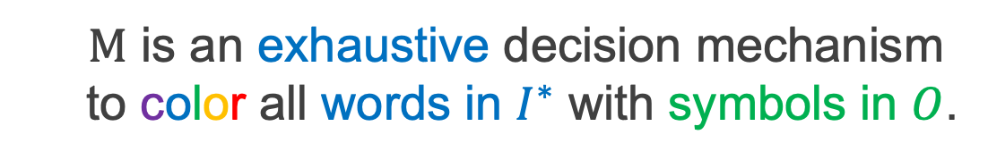
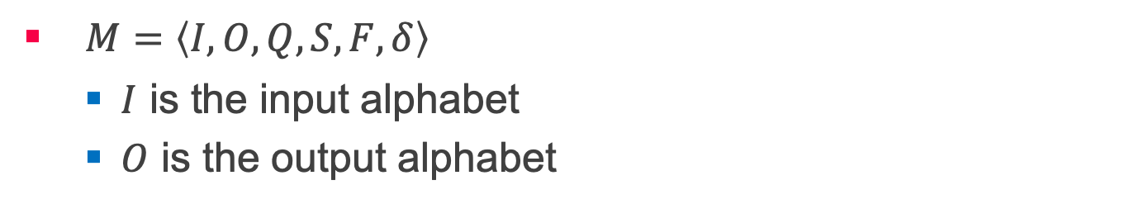

Mealy Machines and Regular bi-Languages
$M=〈I,O,Q,S,F,δ〉$
$I$ is the input alphabet
$O$ is the output alphabet
What is the language of $M$?
$M$ is an exhaustive decision mechanism to color all words in $I^{∗}$ with symbols in $O$.

Slide 6
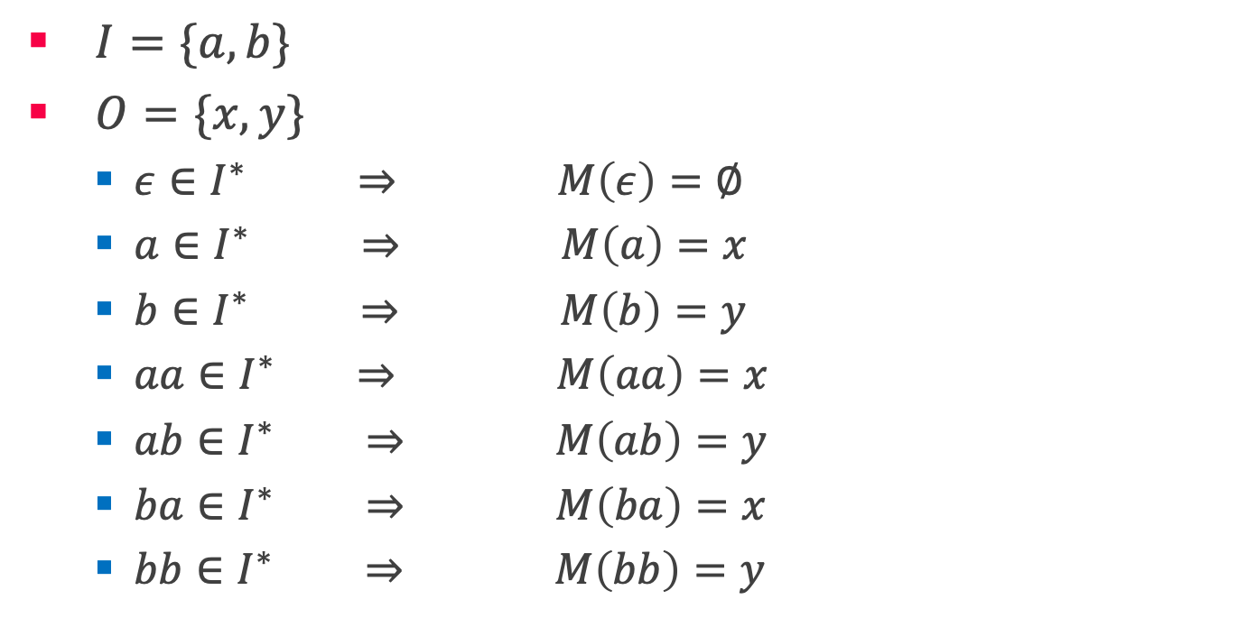
What is the language of $M$?
$I=\{a,b\}$
$O=\{x,y\}$
$ε∈I^{∗} ⇒ M\left(ε\right)=∅$
$a∈I^{∗} ⇒ M\left(a\right)=x$
$b∈I^{∗} ⇒ M\left(b\right)=y$
$aa∈I^{∗} ⇒ M\left(aa\right)=x$
$ab∈I^{∗} ⇒ M\left(ab\right)=y$
$ba∈I^{∗} ⇒ M\left(ba\right)=x$
$bb∈I^{∗} ⇒ M\left(bb\right)=y$

Slide 7
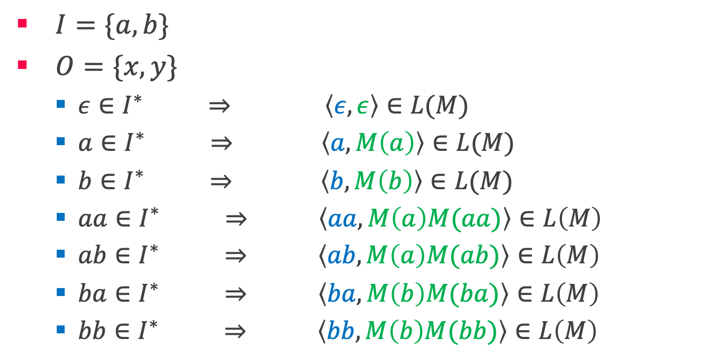
What is the language of $M$? ^{contd.}
$I=\{a,b\}$
$O=\{x,y\}$
$ε∈I^{∗} ⇒ \left\langle ε,ε\right\rangle ∈L(M)$
$a∈I^{∗} ⇒ \left\langle a,M\left(a\right)\right\rangle ∈L(M)$
$b∈I^{∗} ⇒ \left\langle b,M\left(b\right)\right\rangle ∈L(M)$
$aa∈I^{∗} ⇒ \left\langle aa,M\left(a\right)M(aa)\right\rangle ∈L\left(M\right)$
$ab∈I^{∗} ⇒ \left\langle ab,M\left(a\right)M(ab)\right\rangle ∈L\left(M\right)$
$ba∈I^{∗} ⇒ \left\langle ba,M\left(b\right)M(ba)\right\rangle ∈L\left(M\right)$
$bb∈I^{∗} ⇒ \left\langle bb,M\left(b\right)M(bb)\right\rangle ∈L\left(M\right)$

Slide 8
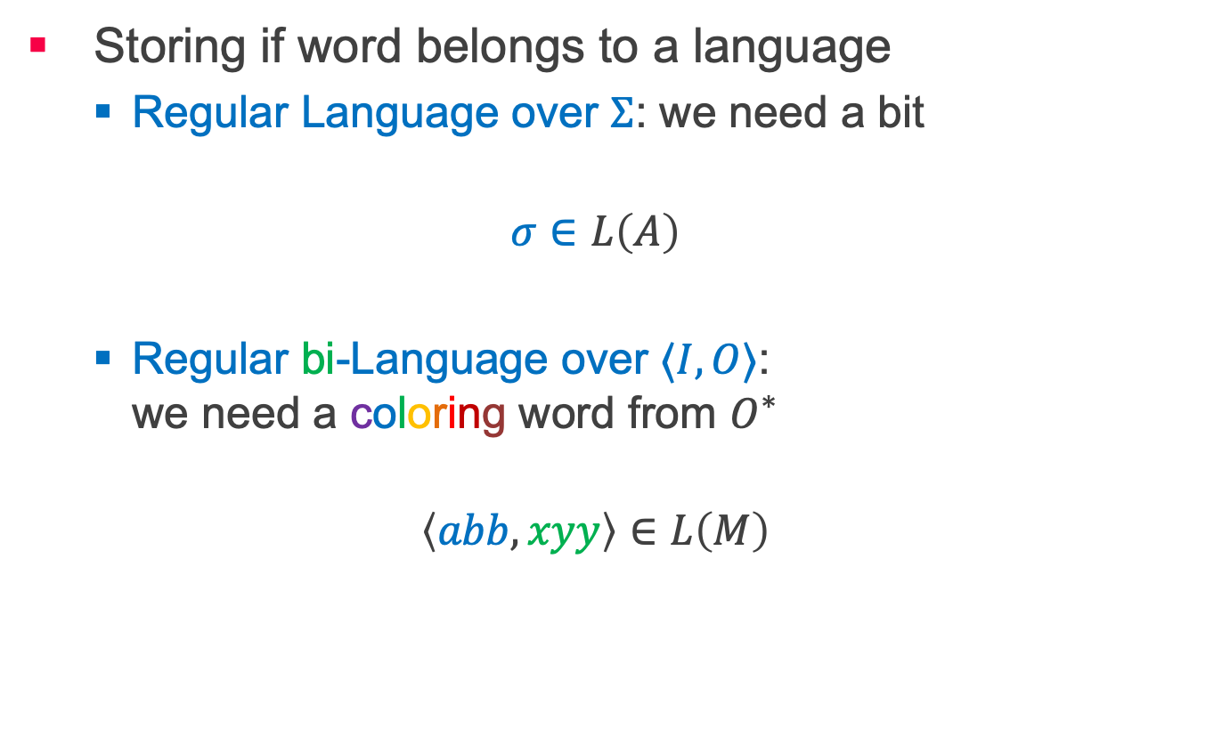
Regular Languages vs Regular bi-Languages
Storing if word belongs to a language
Regular Language over $Σ$: we need a bit
$$σ∈L\left(A\right)$$
Regular bi-Language over $⟨I, O⟩$: we need a coloring word from $O^{∗}$
$$\left\langle abb,xyy\right\rangle ∈L\left(M\right)$$

Slide 9

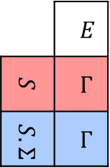
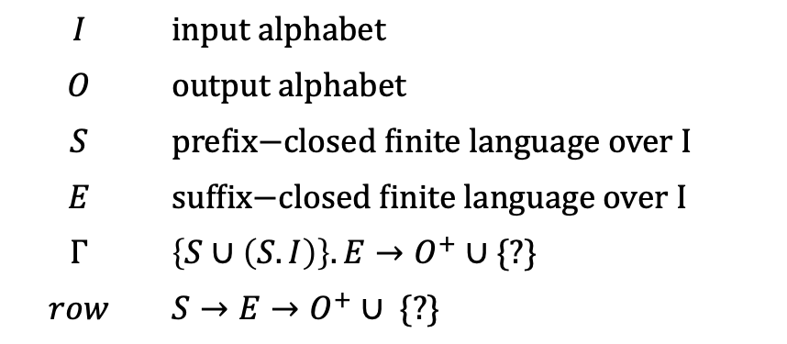
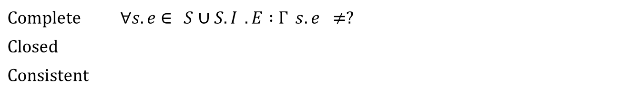

Observation Table
Mealy Machines
$$OT=〈I,O,S,E,Γ〉$$
$$I$$ | $$\text{input} \text{alphabet}$$
$$O$$ | output alphabet
$$S$$ | $\text{prefix}\text{−}\text{closed} \text{finite} \text{language} \text{over}$I
$$E$$ | $$\text{suffix}\text{−}\text{closed} \text{finite} \text{language} \text{over} I$$
$$Γ$$ | $\left\{S∪\left(S.I\right)\right\}.E→O^{+}∪$ {?}
$$row$$ | $$S→E→O^{+}∪\text{ \{?\}}$$
 | $$E$$
$$S$$ | $$Γ$$
$$S.Σ$$ | $$Γ$$
$$row→$$
Complete | $$∀s.e∈\left\{S∪S.I\right\}.E :Γ\left(s.e\right)≠?$$
Closed | $$∀s.i∈S.I ∃s∈S :row\left(s.i\right)=row(s)$$
Consistent | $$∀s,s^{′}∈S ∀i∈I:row\left(s\right)=row\left(s^{′}\right)→row\left(s.i\right)=row\left(s^{′}.i\right)$$

Slide 10
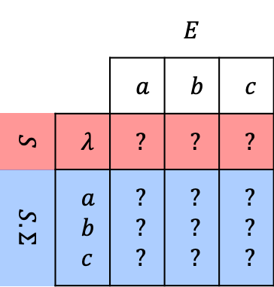
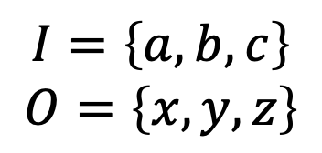
Observation Table contd.
Mealy Machines
$$I=\left\{a,b,c\right\}$$
$$O=\left\{x,y,z\right\}$$
 |  | $$E$$
 |  | $$a$$ | $$b$$ | $$c$$
$$S$$ | $$λ$$ | $$?$$ | ? | ?
$$S.Σ$$ | $$a$$ $$b$$ $$c$$ | ? ? ? | ? ? ? | ? ? ?
Initial Table

Slide 11
Counterexamples
A hypothesis includes behavior observed so far.
Now, what do counterexamples tell us?
An behavior that is not observed so far.
So far?
Explored states.
What do counterexamples tell us?
There is a new state to discover!

Slide 12
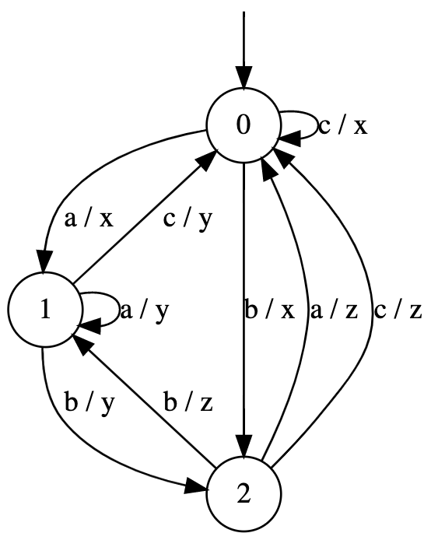
Discovering new states!
Counterexample: b c a a / x z x x

Slide 13
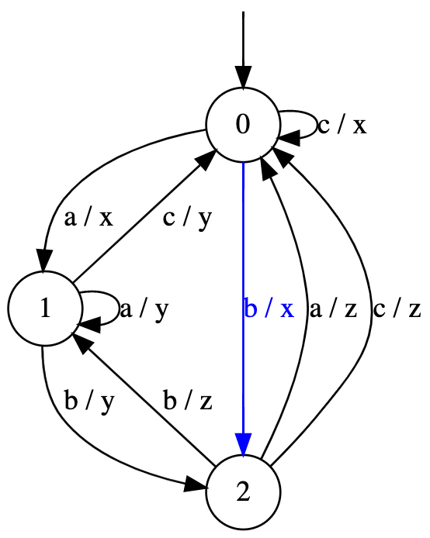
Discovering new states!
Counterexample: b c a a / x z x x

Slide 14
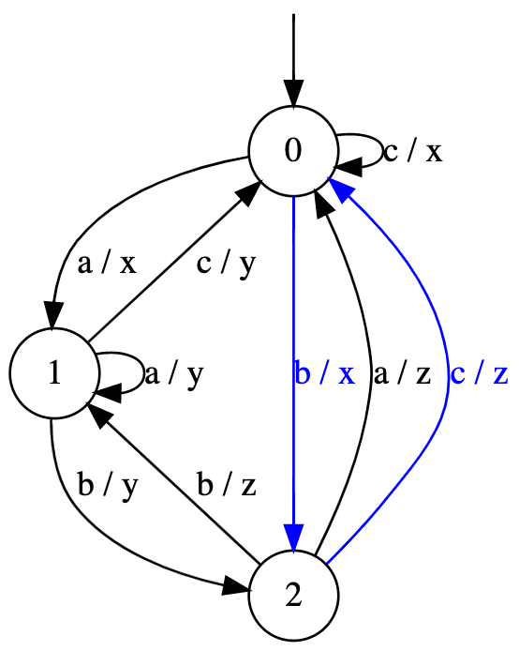
Discovering new states!
Counterexample: b c a a / x z x x

Slide 15
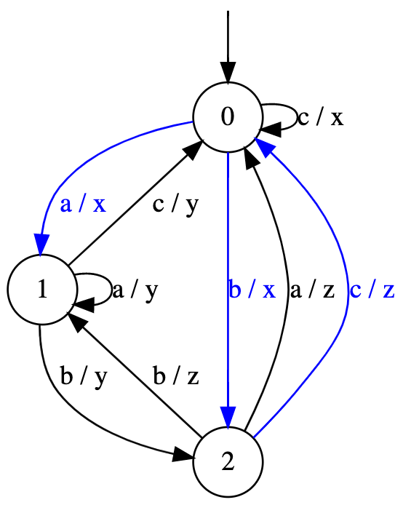
Discovering new states!
Counterexample: b c a a / x z x x

Slide 16
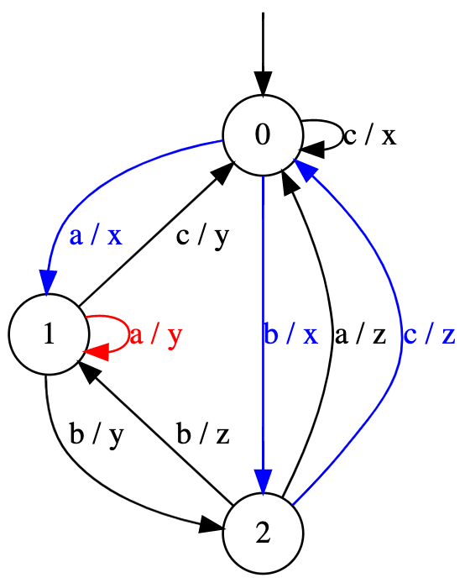
Discovering new states!
Counterexample: b c a a / x z x x

Slide 17

Discovering new states!
Counterexample: b c a a / x z x x
How to discover this state?
$bcaa↦ x$

Slide 18

Discovering new states!
Counterexample: b c a a / x z x x
How to discover this state?
$bcaa↦ x$
$label\left(q_{2}\right)⋅caa↦ x$

Slide 19
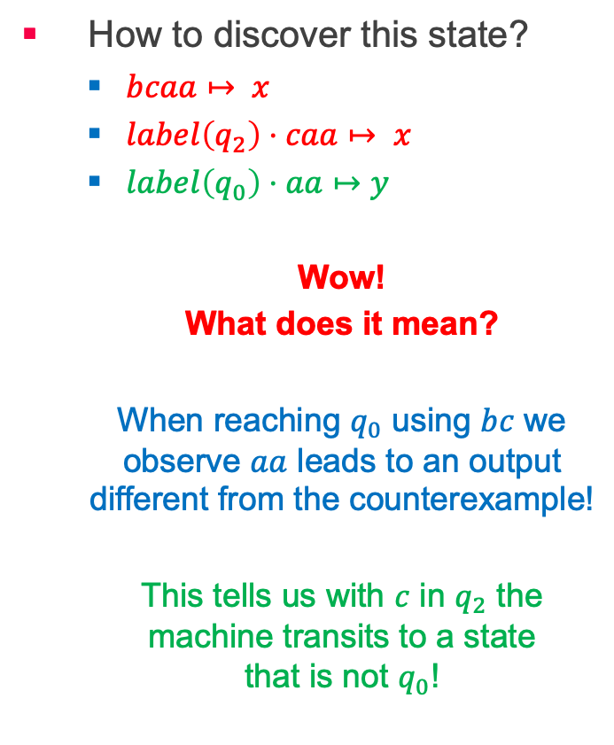
Discovering new states!
Counterexample: b c a a / x z x x
How to discover this state?
$bcaa↦ x$
$label\left(q_{2}\right)⋅caa↦ x$
$label\left(q_{0}\right)⋅aa↦y$
Wow!
What does it mean?
When reaching $q_{0}$ using $bc$ we observe $aa$ leads to an output different from the counterexample!
This tells us with $c$ in $q_{2}$ the machine transits to a state that is not $q_{0}$!

Slide 20
Suffix based counterexample refinement
We add the found suffix to the table instead.
This results in a smaller table.
Such table will always remain consistent.
Works for both DFAs and Mealy machines.
Inference of finite automata using homing sequences
by Ronald Linn Rivest & Robert Elias Schapire

