Slide 1
Learning DFAs

Slide 2
Agenda
Active Learning DFAs
Observation Tables
L* Learning Algorithm
Hands-on implementation
Active Learning Mealy Machines
Active Learning Moore Machines

Slide 3
L* & DFAs

Slide 4

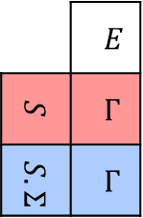
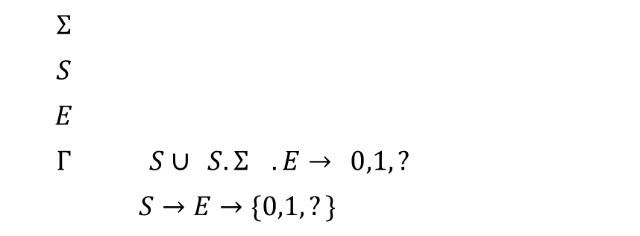
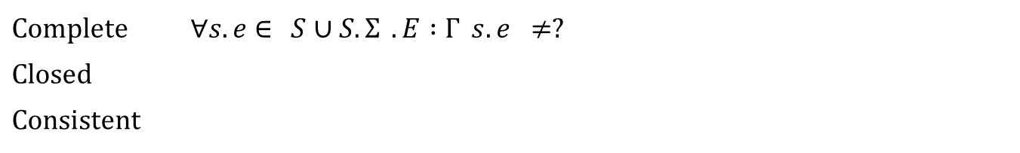

Observation Table
Deterministic Finite Automata
$$OT=〈Σ,S,E,Γ〉$$
$$Σ$$ | $$\text{alphabet}$$
$$S$$ | $$\text{prefix}\text{−}\text{closed} \text{finite} \text{language} \text{over} Σ$$
$$E$$ | $$\text{suffix}\text{−}\text{closed} \text{finite} \text{language} \text{over} Σ$$
$$Γ$$ | $$\left\{S∪\left(S.Σ\right)\right\}.E→\left\{0,1,?\right\}$$
$$row$$ | $$S→E→\{0,1,?\}$$
 | $$E$$
$$S$$ | $$Γ$$
$$S.Σ$$ | $$Γ$$
$$row→$$
Complete | $$∀s.e∈\left\{S∪S.Σ\right\}.E :Γ\left(s.e\right)≠?$$
Closed | $$∀s.σ∈S.Σ ∃s∈S :row\left(s.σ\right)=row(s)$$
Consistent | $$∀s,s^{′}∈S ∀σ∈Σ :row\left(s\right)=row\left(s^{′}\right)→row\left(s.σ\right)=row\left(s^{′}.σ\right)$$

Slide 5

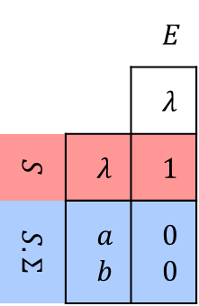
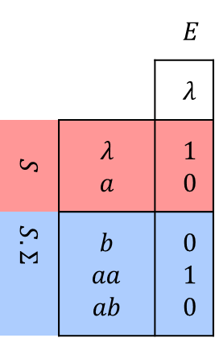
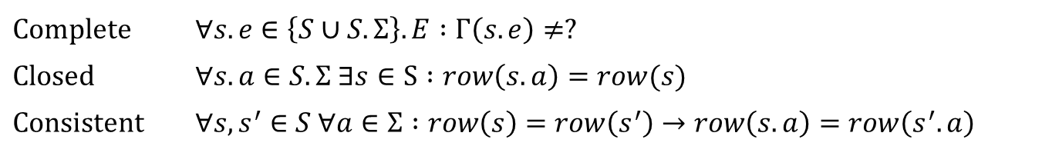
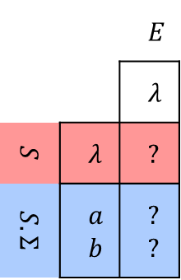
Examples
Deterministic Finite Automata
$$Σ=\{a,b\}$$
 |  | $$E$$
 |  | $$λ$$
$$S$$ | $$λ$$ | $$?$$
$$S.Σ$$ | $$a$$ $$b$$ | ? ?
 |  | $$E$$
 |  | $$λ$$
$$S$$ | $$λ$$ | 1
$$S.Σ$$ | $$a$$ $$b$$ | 0 0
 |  | $$E$$
 |  | $$λ$$
$$S$$ | $$λ$$ $$a$$ | 1 0
$$S.Σ$$ | $$b$$ $$aa$$ $$ab$$ | 0 1 0
Initial
Complete | $$∀s.e∈\left\{S∪S.Σ\right\}.E :Γ\left(s.e\right)≠?$$
Closed | $$∀s.a∈S.Σ ∃s∈S :row\left(s.a\right)=row(s)$$
Consistent | $$∀s,s^{′}∈S ∀a∈Σ :row\left(s\right)=row\left(s^{′}\right)→row\left(s.a\right)=row\left(s^{′}.a\right)$$

Slide 6



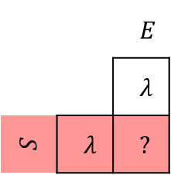





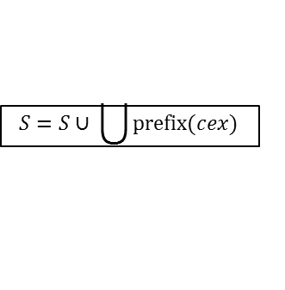
Flow Chart
Deterministic Finite Automata
Start
Read $Σ$
Update OT
 |  | $$E$$
 |  | $$λ$$
$$S$$ | $$λ$$ | $$?$$
Complete?
Y
N
$$S=S∪s_{i}.σ$$
Closed?
N
Y
Member ($w$)?
Y
Consistent?
N
$$E=E∪σ.e$$
N
Y
$$Γ\left(w\right)=0$$
A = DFA(OT)
$$Γ\left(w\right)=1$$
Equival ($A$)?
N
$$S=S∪ \bigcup{prefix(cex)}$$
Y
Return $L(A)$

Slide 7

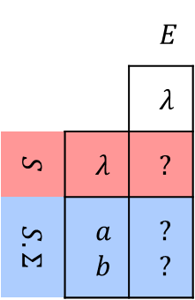
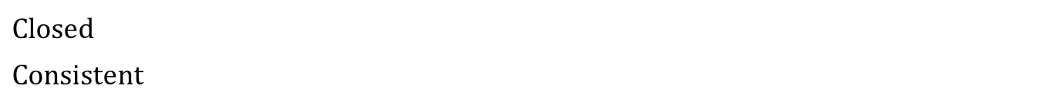
Deterministic Finite Automata
Start
number of a’s is even and number of b’s is even
$$Σ=\{a,b\}$$
Read $Σ$
Update OT
Complete?
Y
N
$$S=S∪s_{i}.σ$$
Closed?
 |  | $$E$$
 |  | $$λ$$
$$S$$ | $$λ$$ | $$?$$
$$S.Σ$$ | $$a$$ $$b$$ | ? ?
N
 |  | $$E$$
 |  | $$λ$$
$$S$$ | $$λ$$ | $$?$$
Y
Member ($w$)?
Y
Consistent?
N
$$E=E∪σ.e$$
N
Y
$$Γ\left(w\right)=0$$
A = DFA(OT)
$$Γ\left(w\right)=1$$
Equival ($A$)?
N
$$S=S∪ \bigcup{prefix(cex)}$$
Y
Return $L(A)$
Closed | $$∀s.σ∈S.Σ ∃s∈S :row\left(s.σ\right)=row(s)$$
Consistent | $$∀s,s^{′}∈S ∀σ∈Σ :row\left(s\right)=row\left(s^{′}\right)→row\left(s.σ\right)=row\left(s^{′}.σ\right)$$

Slide 8
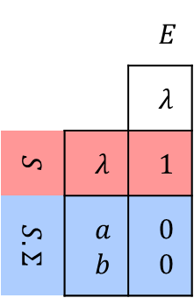
Deterministic Finite Automata
Start
number of a’s is even and number of b’s is even
$$Σ=\{a,b\}$$
Read $Σ$
Update OT
Complete?
Y
N
$$S=S∪s_{i}.σ$$
Closed?
N
 |  | $$E$$
 |  | $$λ$$
$$S$$ | $$λ$$ | 1
$$S.Σ$$ | $$a$$ $$b$$ | 0 0
Y
Member ($w$)?
Y
Consistent?
N
$$E=E∪σ.e$$
N
Y
$$Γ\left(w\right)=0$$
A = DFA(OT)
$$Γ\left(w\right)=1$$
Equival ($A$)?
N
$$S=S∪ \bigcup{prefix(cex)}$$
Y
Return $L(A)$
Closed | $$∀s.σ∈S.Σ ∃s∈S :row\left(s.σ\right)=row(s)$$
Consistent | $$∀s,s^{′}∈S ∀σ∈Σ :row\left(s\right)=row\left(s^{′}\right)→row\left(s.σ\right)=row\left(s^{′}.σ\right)$$

Slide 9
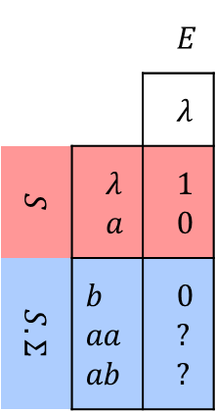
Deterministic Finite Automata
Start
number of a’s is even and number of b’s is even
$$Σ=\{a,b\}$$
Read $Σ$
Update OT
Y
N
 |  | $$E$$
 |  | $$λ$$
$$S$$ | $$λ$$ $$a$$ | 1 0
$$S.Σ$$ | $$b$$ $$aa$$ $$ab$$ | 0 ? ?
Complete?
Closed?
$$S=S∪s_{i}.σ$$
N
Y
Member ($w$)?
Y
Consistent?
N
$$E=E∪σ.e$$
N
Y
$$Γ\left(w\right)=0$$
A = DFA(OT)
$$Γ\left(w\right)=1$$
Equival ($A$)?
N
$$S=S∪ \bigcup{prefix(cex)}$$
Y
Return $L(A)$
Closed | $$∀s.σ∈S.Σ ∃s∈S :row\left(s.σ\right)=row(s)$$
Consistent | $$∀s,s^{′}∈S ∀σ∈Σ :row\left(s\right)=row\left(s^{′}\right)→row\left(s.σ\right)=row\left(s^{′}.σ\right)$$

Slide 10
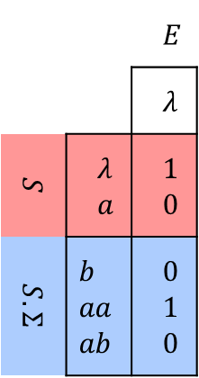
Deterministic Finite Automata
Start
number of a’s is even and number of b’s is even
$$Σ=\{a,b\}$$
Read $Σ$
Update OT
Y
N
 |  | $$E$$
 |  | $$λ$$
$$S$$ | $$λ$$ $$a$$ | 1 0
$$S.Σ$$ | $$b$$ $$aa$$ $$ab$$ | 0 1 0
Complete?
Closed?
$$S=S∪s_{i}.σ$$
N
Y
Member ($w$)?
Y
Consistent?
N
$$E=E∪σ.e$$
N
Y
$$Γ\left(w\right)=0$$
A = DFA(OT)
$$Γ\left(w\right)=1$$
Equival ($A$)?
N
$$S=S∪ \bigcup{prefix(cex)}$$
Y
Return $L(A)$
Closed | $$∀s.σ∈S.Σ ∃s∈S :row\left(s.σ\right)=row(s)$$
Consistent | $$∀s,s^{′}∈S ∀σ∈Σ :row\left(s\right)=row\left(s^{′}\right)→row\left(s.σ\right)=row\left(s^{′}.σ\right)$$

Slide 11
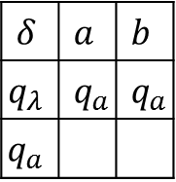


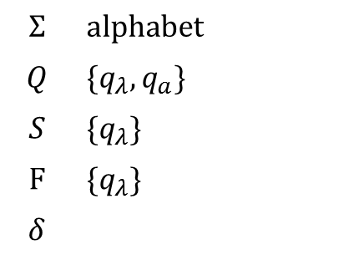
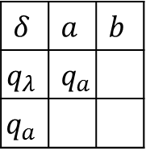


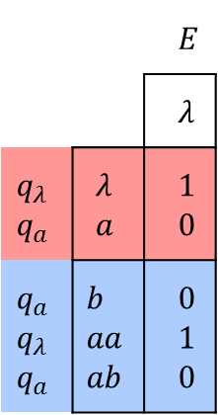

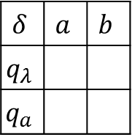





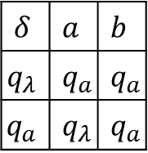

Extract DFA
Deterministic Finite Automata
$$A=〈Σ,Q,S,F,δ〉$$
$$Σ$$ | $$\text{alphabet}$$
$$Q$$ | $$\{q_{λ},q_{a}\}$$
$$S$$ | $$\{q_{λ}\}$$
$$F$$ | $$\{q_{λ}\}$$
$$δ$$
 |  | $$E$$
 |  | $$λ$$
$$q_{λ}$$ $$q_{a}$$ | $$λ$$ $$a$$ | 1 0
$$q_{a}$$ $$q_{λ}$$ $$q_{a}$$ | $$b$$ $$aa$$ $$ab$$ | 0 1 0
distinct rows in S
$${∀q}_{σ}:Γ\left(σ. λ\right)=1$$
$$δ$$ | $$a$$ | $$b$$
$$q_{λ}$$
$$q_{a}$$
$$δ$$ | $$a$$ | $$b$$
$$q_{λ}$$ | $$q_{a}$$
$$q_{a}$$
$$δ$$ | $$a$$ | $$b$$
$$q_{λ}$$ | $$q_{a}$$ | $$q_{a}$$
$$q_{a}$$
$$δ$$ | $$a$$ | $$b$$
$$q_{λ}$$ | $$q_{a}$$ | $$q_{a}$$
$$q_{a}$$ | $$q_{λ}$$ | $$q_{a}$$
$$→$$
$$→$$
$$…$$
$$a,b$$
$$b$$
$$q_{λ}$$
$$q_{a}$$
$$cex=bb$$
$$a$$

Slide 12
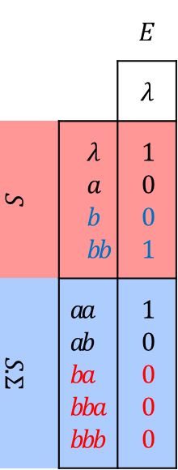

Deterministic Finite Automata
Start
number of a’s is even and number of b’s is even
$$cex=bb$$
Read $Σ$
 |  | $$E$$
 |  | $$λ$$
$$S$$ | $$λ$$ $$a$$ $$b$$ $$bb$$ | 1 0 0 1
$$S.Σ$$ | $$aa$$ $$ab$$ $$ba$$ $$bba$$ $$bbb$$ | 1 0 0 0 0
Update OT
Complete?
Y
N
$$S=S∪s_{i}.σ$$
Closed?
N
Y
Member ($w$)?
Y
Consistent?
N
$$E=E∪σ.e$$
N
Y
$$Γ\left(w\right)=0$$
A = DFA(OT)
$$Γ\left(w\right)=1$$
Equival ($A$)?
N
$$S=S∪ \bigcup{prefix(cex)}$$
Y
Return $L(A)$
Closed | $$∀s.σ∈S.Σ ∃s∈S :row\left(s.σ\right)=row(s)$$
Consistent | $$∀s,s^{′}∈S ∀σ∈Σ :row\left(s\right)=row\left(s^{′}\right)→row\left(s.σ\right)=row\left(s^{′}.σ\right)$$

Slide 13

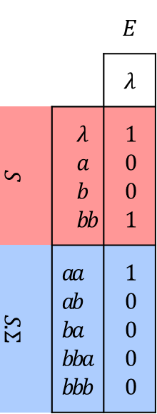
Deterministic Finite Automata
Start
number of a’s is even and number of b’s is even
$$E=E∪a.λ$$
Read $Σ$
 |  | $$E$$
 |  | $$λ$$
$$S$$ | $$λ$$ $$a$$ $$b$$ $$bb$$ | 1 0 0 1
$$S.Σ$$ | $$aa$$ $$ab$$ $$ba$$ $$bba$$ $$bbb$$ | 1 0 0 0 0
Update OT
Complete?
Y
N
$$S=S∪s_{i}.σ$$
Closed?
N
Y
Member ($w$)?
Y
Consistent?
N
$$E=E∪σ.e$$
N
Y
$$Γ\left(w\right)=0$$
A = DFA(OT)
$$Γ\left(w\right)=1$$
Equival ($A$)?
N
$$S=S∪ \bigcup{prefix(cex)}$$
Y
Return $L(A)$
Closed | $$∀s.σ∈S.Σ ∃s∈S :row\left(s.σ\right)=row(s)$$
Consistent | $$∀s,s^{′}∈S ∀σ∈Σ :row\left(s\right)=row\left(s^{′}\right)→row\left(s.σ\right)=row\left(s^{′}.σ\right)$$

Slide 14
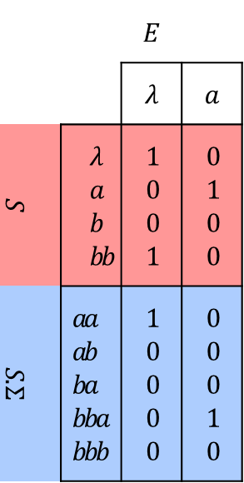
Deterministic Finite Automata
Start
number of a’s is even and number of b’s is even
Read $Σ$
 |  | $$E$$
 |  | $$λ$$ | $$a$$
$$S$$ | $$λ$$ $$a$$ $$b$$ $$bb$$ | 1 0 0 1 | 0 1 0 0
$$S.Σ$$ | $$aa$$ $$ab$$ $$ba$$ $$bba$$ $$bbb$$ | 1 0 0 0 0 | 0 0 0 1 0
Update OT
Complete?
Y
N
$$S=S∪s_{i}.σ$$
Closed?
N
Y
Member ($w$)?
Y
Consistent?
N
$$E=E∪σ.e$$
N
Y
$$Γ\left(w\right)=0$$
A = DFA(OT)
$$Γ\left(w\right)=1$$
Equival ($A$)?
N
$$S=S∪ \bigcup{prefix(cex)}$$
Y
Return $L(A)$
Closed | $$∀s.σ∈S.Σ ∃s∈S :row\left(s.σ\right)=row(s)$$
Consistent | $$∀s,s^{′}∈S ∀σ∈Σ :row\left(s\right)=row\left(s^{′}\right)→row\left(s.σ\right)=row\left(s^{′}.σ\right)$$

Slide 15




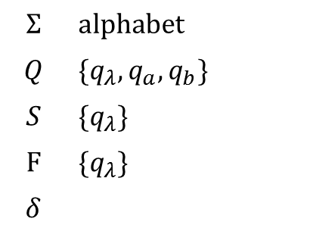

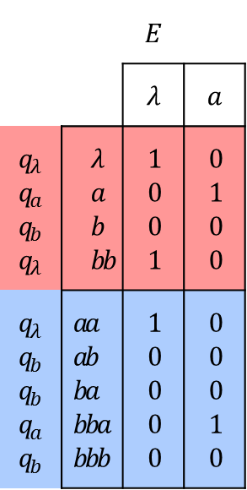

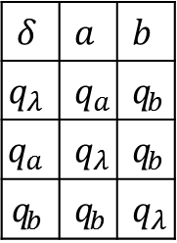




Extract DFA
Deterministic Finite Automata
$$A=〈Σ,Q,S,F,δ〉$$
 |  | $$E$$
 |  | $$λ$$ | $$a$$
$q_{λ}$ $$q_{a}$$ $$q_{b}$$ $$q_{λ}$$ | $$λ$$ $$a$$ $$b$$ $$bb$$ | 1 0 0 1 | 0 1 0 0
$$q_{λ}$$ $$q_{b}$$ $$q_{b}$$ $$q_{a}$$ $$q_{b}$$ | $$aa$$ $$ab$$ $$ba$$ $$bba$$ $$bbb$$ | 1 0 0 0 0 | 0 0 0 1 0
$$Σ$$ | $$\text{alphabet}$$
$$Q$$ | $$\{q_{λ},q_{a},q_{b}\}$$
$$S$$ | $$\{q_{λ}\}$$
$$F$$ | $$\{q_{λ}\}$$
$$δ$$
distinct rows in S
$${∀q}_{σ}:Γ\left(σ. λ\right)=1$$
$$a$$
$$δ$$ | $$a$$ | $$b$$
$$q_{λ}$$ | $$q_{a}$$ | $$q_{b}$$
$$q_{a}$$ | $$q_{λ}$$ | $$q_{b}$$
$$q_{b}$$ | $$q_{b}$$ | $$q_{λ}$$
$$b$$
$$q_{λ}$$
$$q_{b}$$
$$b$$
$$q_{a}$$
$$b$$
$$a$$
$$a$$
$$cex=abb$$

Slide 16
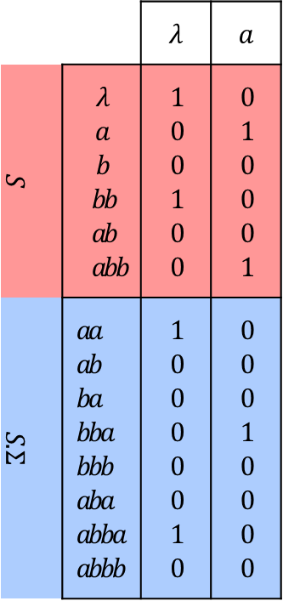

Deterministic Finite Automata
Start
number of a’s is even and number of b’s is even
$$cex=abb$$
Read $Σ$
 |  | $$λ$$ | $$a$$
$$S$$ | $$λ$$ $$a$$ $$b$$ $$bb$$ $$ab$$ $$abb$$ | 1 0 0 1 0 0 | 0 1 0 0 0 1
$$S.Σ$$ | $$aa$$ $$ab$$ $$ba$$ $$bba$$ $$bbb$$ $$aba$$ $$abba$$ $$abbb$$ | 1 0 0 0 0 0 1 0 | 0 0 0 1 0 0 0 0
Update OT
Complete?
Y
N
$$S=S∪s_{i}.σ$$
Closed?
N
Y
Member ($w$)?
Y
Consistent?
N
$$E=E∪σ.e$$
N
Y
$$Γ\left(w\right)=0$$
A = DFA(OT)
$$Γ\left(w\right)=1$$
Equival ($A$)?
N
$$S=S∪ \bigcup{prefix(cex)}$$
Y
Return $L(A)$
Closed | $$∀s.σ∈S.Σ ∃s∈S :row\left(s.σ\right)=row(s)$$
Consistent | $$∀s,s^{′}∈S ∀σ∈Σ :row\left(s\right)=row\left(s^{′}\right)→row\left(s.σ\right)=row\left(s^{′}.σ\right)$$

Slide 17
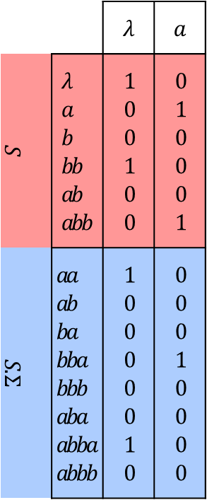


Deterministic Finite Automata
Start
number of a’s is even and number of b’s is even
$$E=E∪b.λ$$
$$E=E∪b.a$$
Read $Σ$
 |  | $$λ$$ | $$a$$
$$S$$ | $$λ$$ $$a$$ $$b$$ $$bb$$ $$ab$$ $$abb$$ | 1 0 0 1 0 0 | 0 1 0 0 0 1
$$S.Σ$$ | $$aa$$ $$ab$$ $$ba$$ $$bba$$ $$bbb$$ $$aba$$ $$abba$$ $$abbb$$ | 1 0 0 0 0 0 1 0 | 0 0 0 1 0 0 0 0
Update OT
Complete?
Y
N
$$S=S∪s_{i}.σ$$
Closed?
N
Y
Member ($w$)?
Y
Consistent?
N
$$E=E∪σ.e$$
N
Y
$$Γ\left(w\right)=0$$
A = DFA(OT)
$$Γ\left(w\right)=1$$
Equival ($A$)?
N
$$S=S∪ \bigcup{prefix(cex)}$$
Y
Return $L(A)$
Closed | $$∀s.σ∈S.Σ ∃s∈S :row\left(s.σ\right)=row(s)$$
Consistent | $$∀s,s^{′}∈S ∀σ∈Σ :row\left(s\right)=row\left(s^{′}\right)→row\left(s.σ\right)=row\left(s^{′}.σ\right)$$

Slide 18
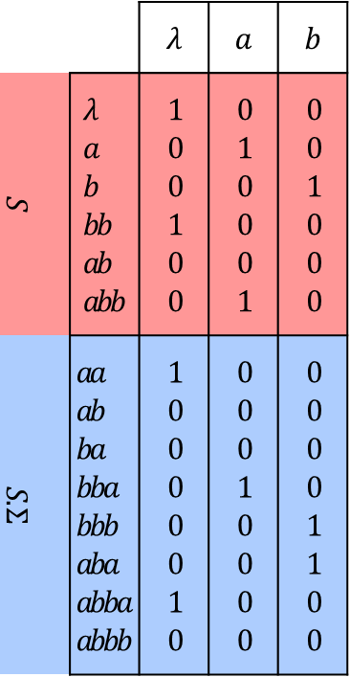
Deterministic Finite Automata
Start
number of a’s is even and number of b’s is even
$$E=E∪b.a$$
Read $Σ$
 |  | $$λ$$ | $$a$$ | $$b$$
$$S$$ | $$λ$$ $$a$$ $$b$$ $$bb$$ $$ab$$ $$abb$$ | 1 0 0 1 0 0 | 0 1 0 0 0 1 | 0 0 100 0
$$S.Σ$$ | $$aa$$ $$ab$$ $$ba$$ $$bba$$ $$bbb$$ $$aba$$ $$abba$$ $$abbb$$ | 1 0 0 0 0 0 1 0 | 0 0 0 1 0 0 0 0 | 0 0 0 0 1 1 0 0
Update OT
Complete?
Y
N
$$S=S∪s_{i}.σ$$
Closed?
N
Y
Member ($w$)?
Y
Consistent?
N
$$E=E∪σ.e$$
N
Y
$$Γ\left(w\right)=0$$
A = DFA(OT)
$$Γ\left(w\right)=1$$
Equival ($A$)?
N
$$S=S∪ \bigcup{prefix(cex)}$$
Y
Return $L(A)$
Closed | $$∀s.σ∈S.Σ ∃s∈S :row\left(s.σ\right)=row(s)$$
Consistent | $$∀s,s^{′}∈S ∀σ∈Σ :row\left(s\right)=row\left(s^{′}\right)→row\left(s.σ\right)=row\left(s^{′}.σ\right)$$

Slide 19






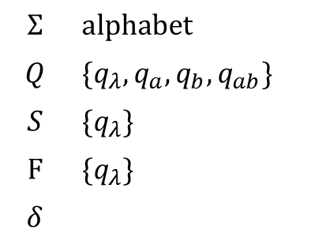

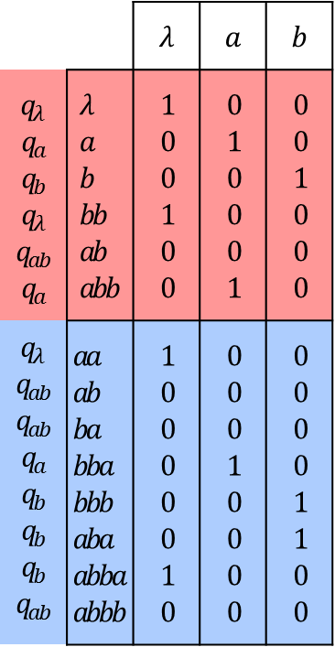

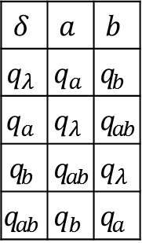




Extract DFA
Deterministic Finite Automata
$$A=〈Σ,Q,S,F,δ〉$$
 |  | $$λ$$ | $$a$$ | $$b$$
$$q_{λ}$$ $$q_{a}$$ $$q_{b}$$ $q_{λ}$ $$q_{ab}$$ $$q_{a}$$ | $$λ$$ $$a$$ $$b$$ $$bb$$ $$ab$$ $$abb$$ | 1 0 0 1 0 0 | 0 1 0 0 0 1 | 0 0 100 0
$$q_{λ}$$ $$q_{ab}$$ $$q_{ab}$$ $q_{a}$ $$q_{b}$$ $$q_{b}$$ $$q_{b}$$ $$q_{ab}$$ | $$aa$$ $$ab$$ $$ba$$ $$bba$$ $$bbb$$ $$aba$$ $$abba$$ $$abbb$$ | 1 0 0 0 0 0 1 0 | 0 0 0 1 0 0 0 0 | 0 0 0 0 1 1 0 0
$$Σ$$ | $$\text{alphabet}$$
$$Q$$ | $$\{q_{λ},q_{a},q_{b},q_{ab}\}$$
$$S$$ | $$\{q_{λ}\}$$
$$F$$ | $$\{q_{λ}\}$$
$$δ$$
distinct rows in S
$${∀q}_{σ}:Γ\left(σ. λ\right)=1$$
$$b$$
$$q_{λ}$$
$$b$$
$$q_{b}$$
$$δ$$ | $$a$$ | $$b$$
$$q_{λ}$$ | $$q_{a}$$ | $$q_{b}$$
$$q_{a}$$ | $$q_{λ}$$ | $$q_{ab}$$
$$q_{b}$$ | $$q_{ab}$$ | $$q_{λ}$$
$$q_{ab}$$ | $$q_{b}$$ | $$q_{a}$$
$$a$$
$$a$$
$$a$$
$$a$$
$$q_{a}$$
$$b$$
$$q_{ab}$$
$$b$$

Slide 20
L* & Mealy Machine

Slide 21
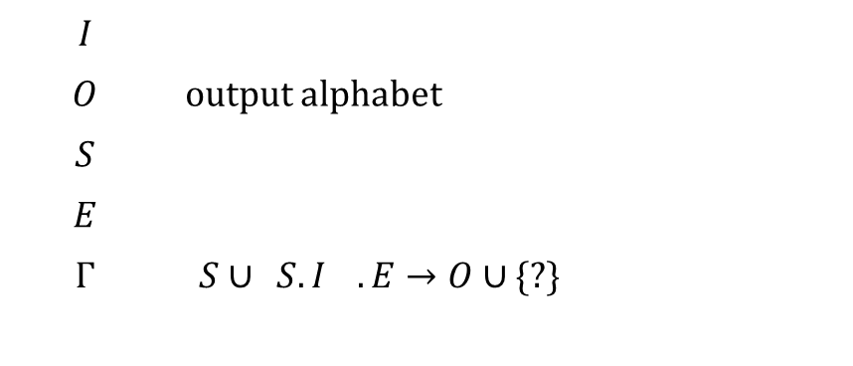
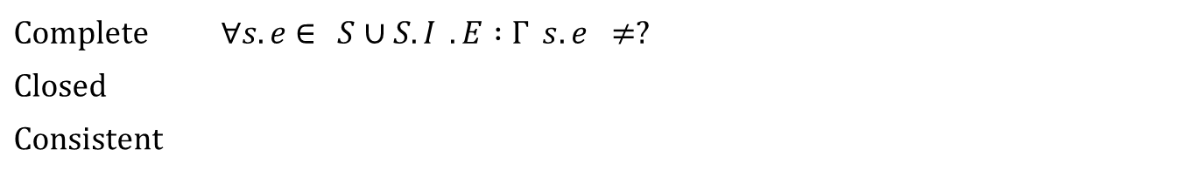

Observation Table
Mealy Machines
$$OT=〈I,O,S,E,Γ〉$$
$$I$$ | $$\text{input} \text{alphabet}$$
$$O$$ | output alphabet
$$S$$ | $\text{prefix}\text{−}\text{closed} \text{finite} \text{language} \text{over}$I
$$E$$ | $$\text{suffix}\text{−}\text{closed} \text{finite} \text{language} \text{over} I$$
$$Γ$$ | $\left\{S∪\left(S.I\right)\right\}.E→O∪$ {?}
$$row$$ | $$S→E→O∪\text{ \{?\}}$$
 | $$E$$
$$S$$ | $$Γ$$
$$S.Σ$$ | $$Γ$$
$$row→$$
Complete | $$∀s.e∈\left\{S∪S.I\right\}.E :Γ\left(s.e\right)≠?$$
Closed | $$∀s.i∈S.I ∃s∈S :row\left(s.i\right)=row(s)$$
Consistent | $$∀s,s^{′}∈S ∀i∈I:row\left(s\right)=row\left(s^{′}\right)→row\left(s.i\right)=row\left(s^{′}.i\right)$$

Slide 22
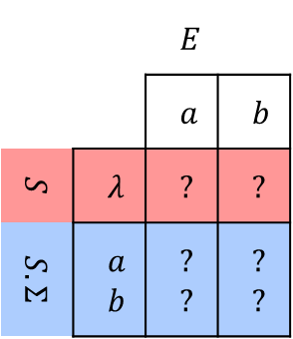
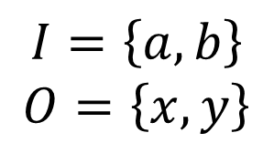
Observation Table contd.
Mealy Machines
$$I=\left\{a,b\right\}$$
$$O=\left\{x,y\right\}$$
 |  | $$E$$
 |  | $$a$$ | $$b$$
$$S$$ | $$λ$$ | $$?$$ | ?
$$S.Σ$$ | $$a$$ $$b$$ | ? ? | ? ?
Initial

