Slide 1
Learning Mealy Machines

Slide 2
Revisit Language of DFAs

Slide 3
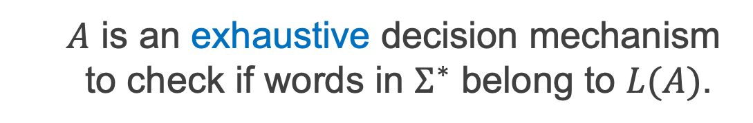
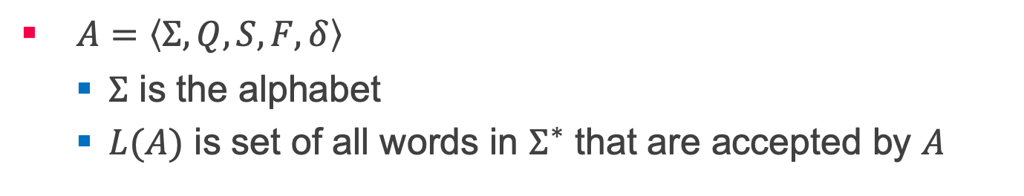
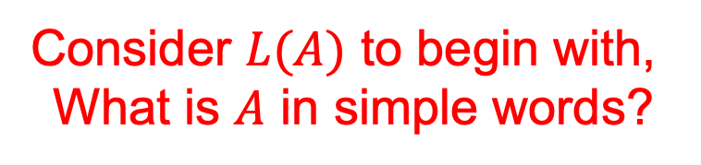
DFAs and Regular Languages
$A=〈Σ,Q,S,F,δ〉$
$Σ$ is the alphabet
$L(A)$ is set of all words in $Σ^{∗}$ that are accepted by $A$
Consider $L(A)$ to begin with,
What is $A$ in simple words?
$A$ is an exhaustive decision mechanism to check if words in $Σ^{∗}$ belong to $L(A)$.

Slide 4
L* & Mealy Machine

Slide 5
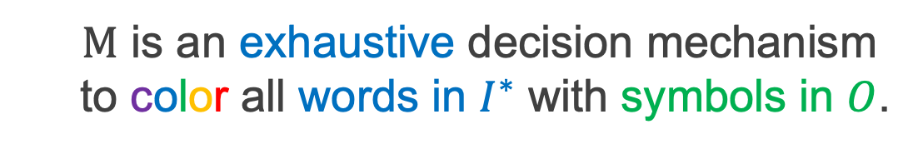
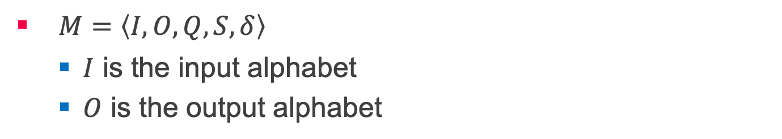

Mealy Machines and Regular bi-Languages
$M=〈I,O,Q,S,δ〉$
$I$ is the input alphabet
$O$ is the output alphabet
What is the language of $M$?
$M$ is an exhaustive decision mechanism to color all words in $I^{∗}$ with symbols in $O$.

Slide 6
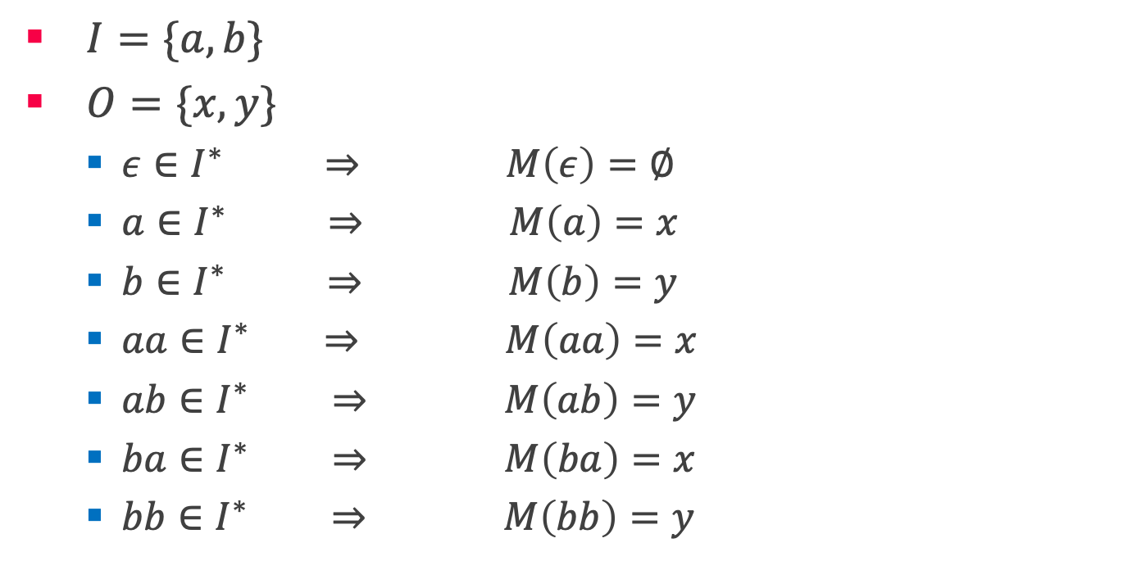
What is the language of $M$?
$I=\{a,b\}$
$O=\{x,y\}$
$ε∈I^{∗} ⇒ M\left(ε\right)=∅$
$a∈I^{∗} ⇒ M\left(a\right)=x$
$b∈I^{∗} ⇒ M\left(b\right)=y$
$aa∈I^{∗} ⇒ M\left(aa\right)=x$
$ab∈I^{∗} ⇒ M\left(ab\right)=y$
$ba∈I^{∗} ⇒ M\left(ba\right)=x$
$bb∈I^{∗} ⇒ M\left(bb\right)=y$

Slide 7
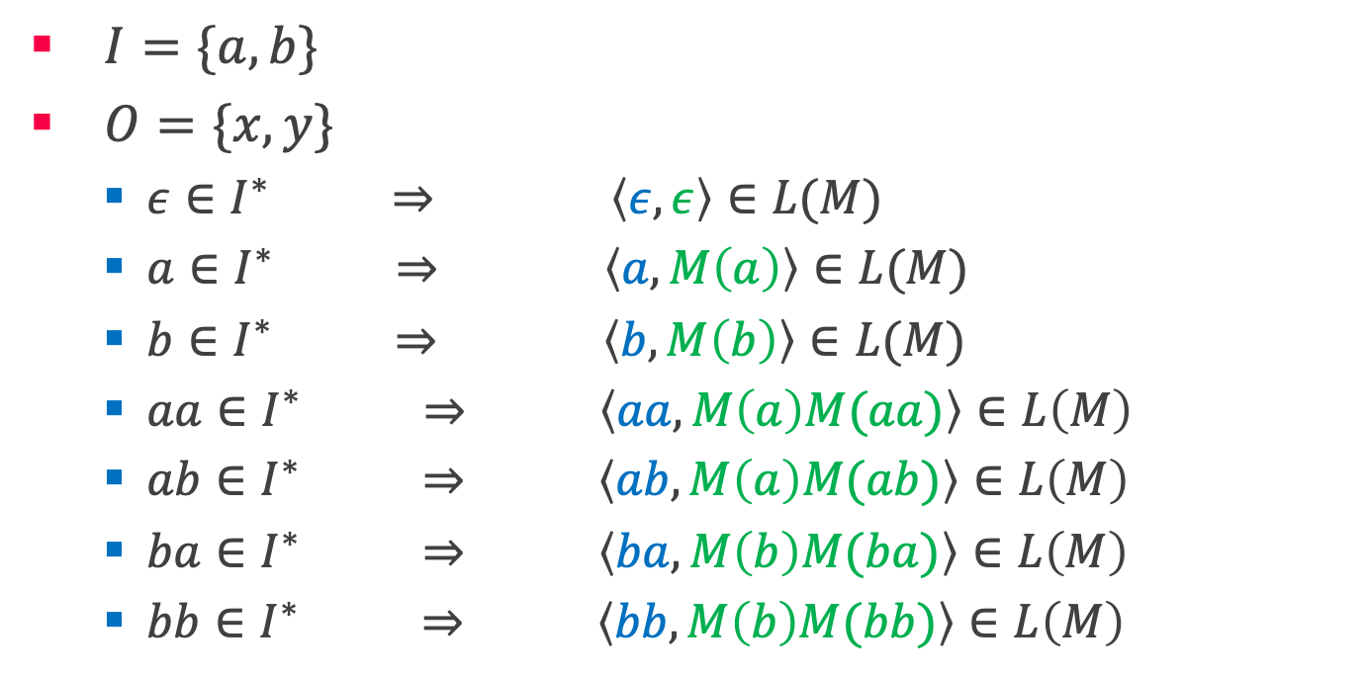
What is the language of $M$? ^{contd.}
$I=\{a,b\}$
$O=\{x,y\}$
$ε∈I^{∗} ⇒ \left\langle ε,ε\right\rangle ∈L(M)$
$a∈I^{∗} ⇒ \left\langle a,M\left(a\right)\right\rangle ∈L(M)$
$b∈I^{∗} ⇒ \left\langle b,M\left(b\right)\right\rangle ∈L(M)$
$aa∈I^{∗} ⇒ \left\langle aa,M\left(a\right)M(aa)\right\rangle ∈L\left(M\right)$
$ab∈I^{∗} ⇒ \left\langle ab,M\left(a\right)M(ab)\right\rangle ∈L\left(M\right)$
$ba∈I^{∗} ⇒ \left\langle ba,M\left(b\right)M(ba)\right\rangle ∈L\left(M\right)$
$bb∈I^{∗} ⇒ \left\langle bb,M\left(b\right)M(bb)\right\rangle ∈L\left(M\right)$

Slide 8
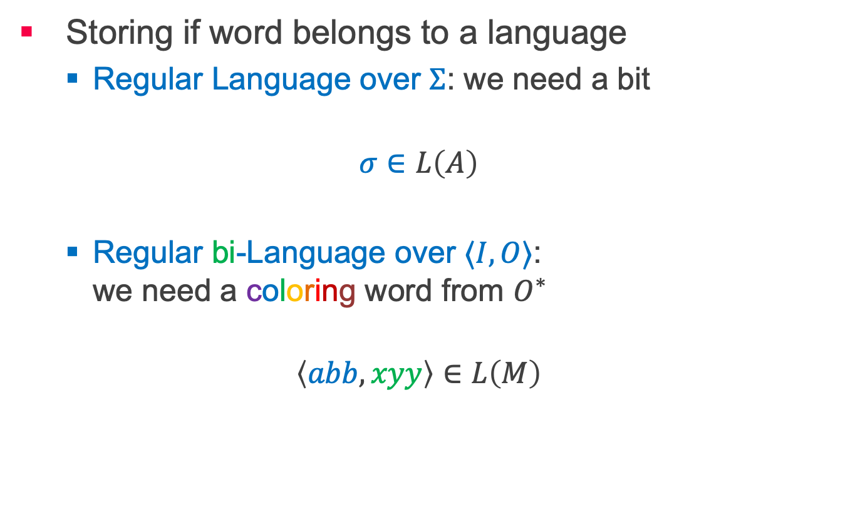
Regular Languages vs Regular bi-Languages
Storing if word belongs to a language
Regular Language over $Σ$: we need a bit
$$σ∈L\left(A\right)$$
Regular bi-Language over $⟨I, O⟩$: we need a coloring word from $O^{∗}$
$$\left\langle abb,xyy\right\rangle ∈L\left(M\right)$$

Slide 9

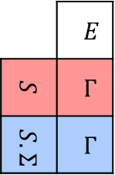
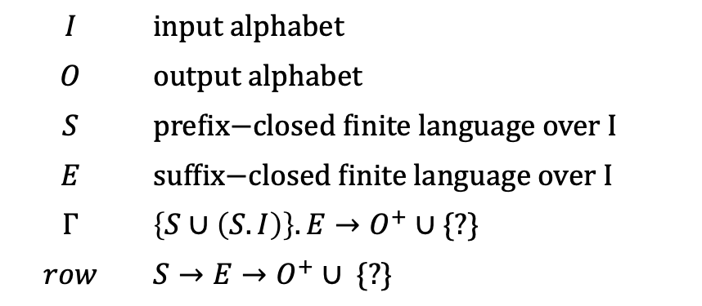
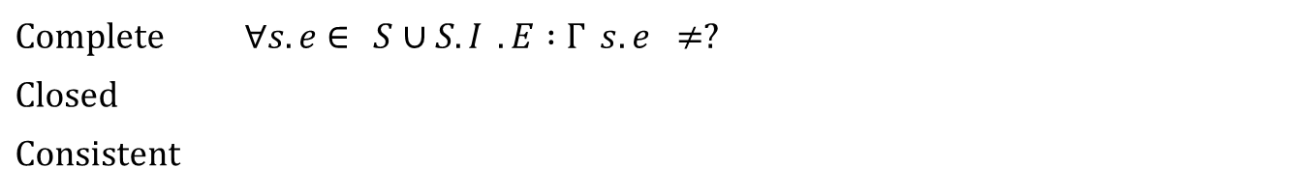

Observation Table
Mealy Machines
$$OT=〈I,O,S,E,Γ〉$$
$$I$$ | $$\text{input} \text{alphabet}$$
$$O$$ | output alphabet
$$S$$ | $\text{prefix}\text{−}\text{closed} \text{finite} \text{language} \text{over}$I
$$E$$ | $$\text{suffix}\text{−}\text{closed} \text{finite} \text{language} \text{over} I$$
$$Γ$$ | $\left\{S∪\left(S.I\right)\right\}.E→O^{+}∪$ {?}
$$row$$ | $$S→E→O^{+}∪\text{ \{?\}}$$
 | $$E$$
$$S$$ | $$Γ$$
$$S.Σ$$ | $$Γ$$
$$row→$$
Complete | $$∀s.e∈\left\{S∪S.I\right\}.E :Γ\left(s.e\right)≠?$$
Closed | $$∀s.i∈S.I ∃s∈S :row\left(s.i\right)=row(s)$$
Consistent | $$∀s,s^{′}∈S ∀i∈I:row\left(s\right)=row\left(s^{′}\right)→row\left(s.i\right)=row\left(s^{′}.i\right)$$

Slide 10
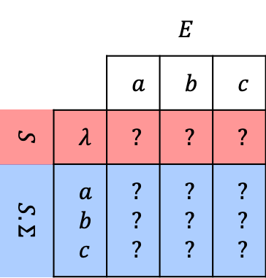
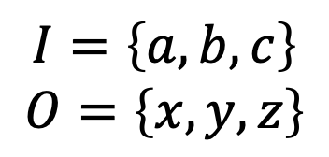
Observation Table contd.
Mealy Machines
$$I=\left\{a,b,c\right\}$$
$$O=\left\{x,y,z\right\}$$
 |  | $$E$$
 |  | $$a$$ | $$b$$ | $$c$$
$$S$$ | $$λ$$ | $$?$$ | ? | ?
$$S.Σ$$ | $$a$$ $$b$$ $$c$$ | ? ? ? | ? ? ? | ? ? ?
Initial Table

Slide 11
Counterexamples
A hypothesis includes behavior observed so far.
Now, what do counterexamples tell us?
A behavior that is not observed so far.
So far?
Explored states.
What do counterexamples tell us?
There is a new state to discover!

Slide 12
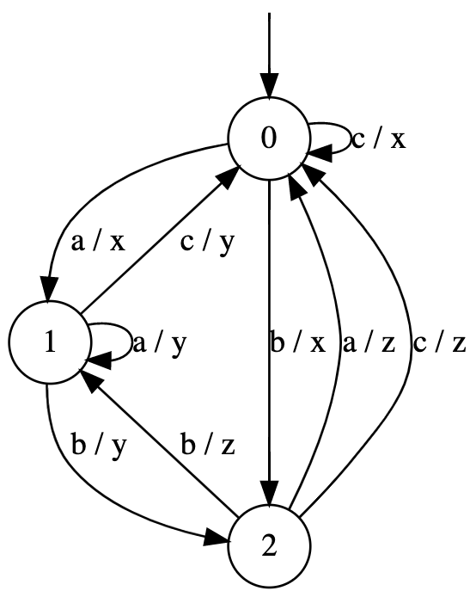
Discovering new states!
Counterexample: b c a a / x z x x

Slide 13
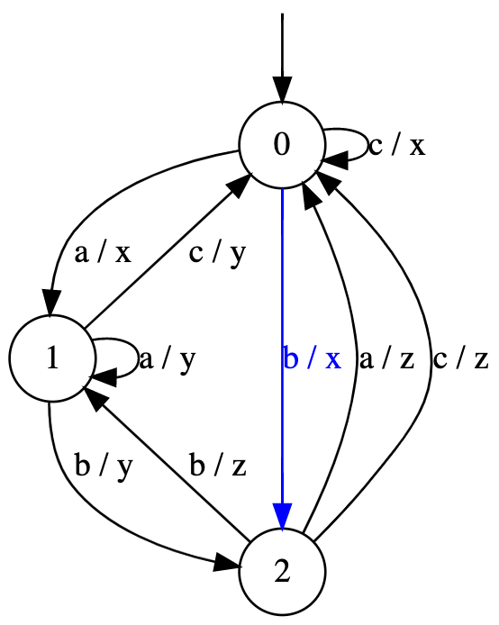
Discovering new states!
Counterexample: b c a a / x z x x

Slide 14
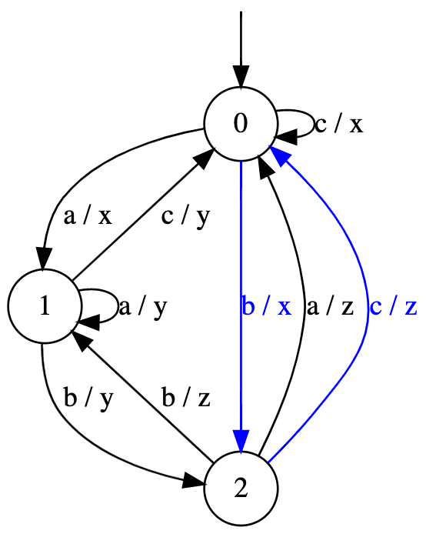
Discovering new states!
Counterexample: b c a a / x z x x

Slide 15
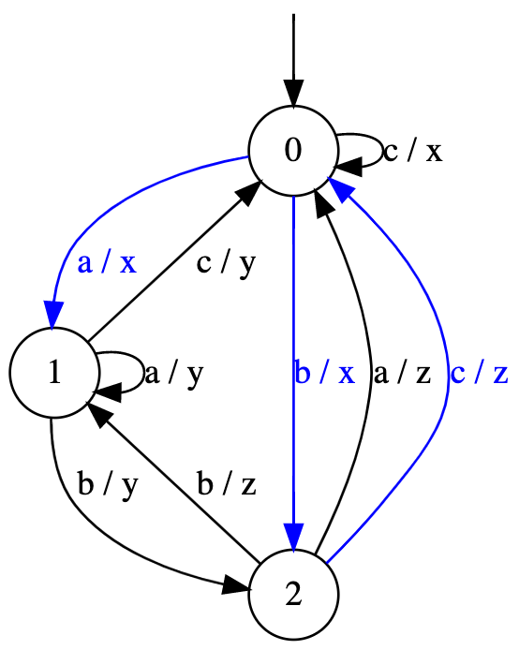
Discovering new states!
Counterexample: b c a a / x z x x

Slide 16
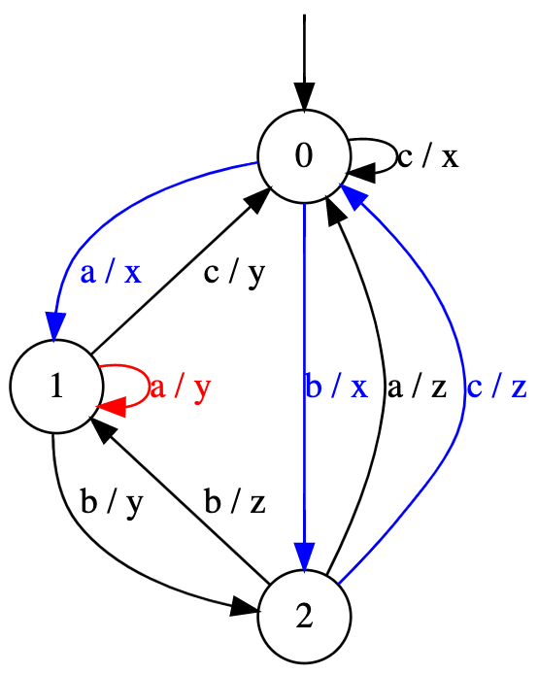
Discovering new states!
Counterexample: b c a a / x z x x

Slide 17

Discovering new states!
Counterexample: b c a a / x z x x
How to discover this state?
$bcaa↦ x$

Slide 18

Discovering new states!
Counterexample: b c a a / x z x x
How to discover this state?
$bcaa↦ x$
$label\left(q_{2}\right)⋅caa↦ x$

Slide 19
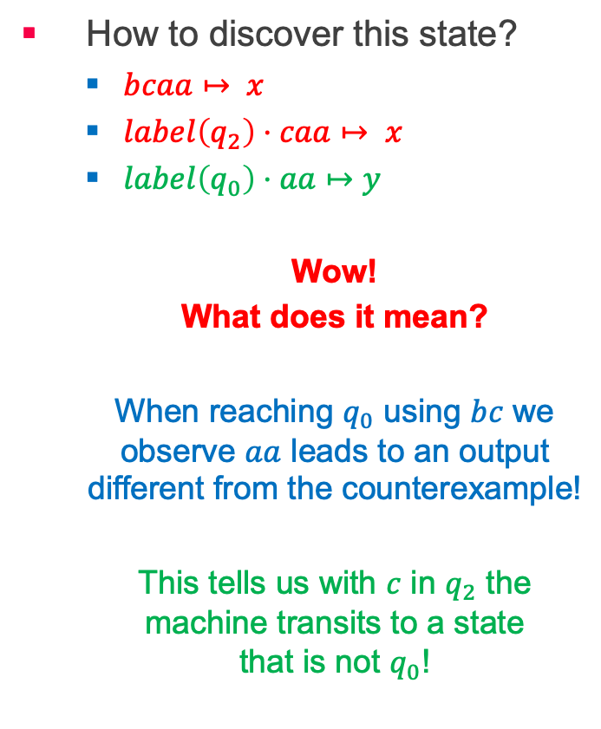
Discovering new states!
Counterexample: b c a a / x z x x
How to discover this state?
$bcaa↦ x$
$label\left(q_{2}\right)⋅caa↦ x$
$label\left(q_{0}\right)⋅aa↦y$
Wow!
What does it mean?
When reaching $q_{0}$ using $bc$ we observe $aa$ leads to an output different from the counterexample!
This tells us with $c$ in $q_{2}$ the machine transits to a state that is not $q_{0}$!

Slide 20
Suffix based counterexample refinement
We add the found suffix to the table instead.
This results in a smaller table.
Such table will always remain consistent.
Works for both DFAs and Mealy machines.
Inference of finite automata using homing sequences
by Ronald Linn Rivest & Robert Elias Schapire

