Slide 1
Learning Moore Machines

Slide 2
L* & Moore Machines

Slide 3
Reactive Systems
A pair of Moore and Mealy machines form a reactive system!

Slide 4
Moore Machines
They act first then think later!

Slide 5

Moore Machine’s Configuration
Given an input trace of length n
Output trace of length n + 1
Given an $ε$ trace
Output trace of 1

Slide 6

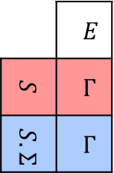
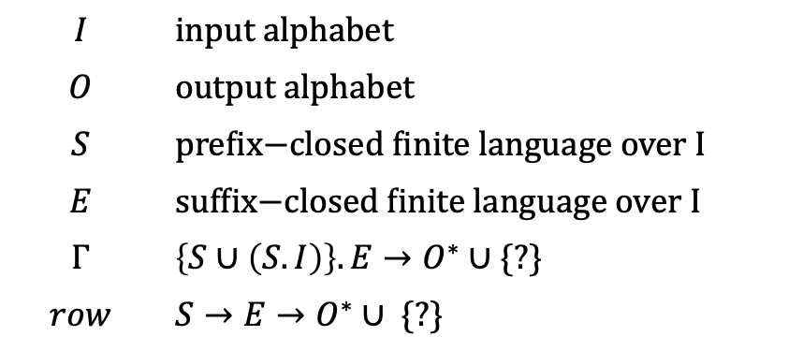


Observation Table
Mealy Machines
$$OT=〈I,O,S,E,Γ〉$$
$$I$$ | $$\text{input} \text{alphabet}$$
$$O$$ | output alphabet
$$S$$ | $\text{prefix}\text{−}\text{closed} \text{finite} \text{language} \text{over}$I
$$E$$ | $$\text{suffix}\text{−}\text{closed} \text{finite} \text{language} \text{over} I$$
$$Γ$$ | $\left\{S∪\left(S.I\right)\right\}.E→O^{∗}∪$ {?}
$$row$$ | $$S→E→O^{∗}∪\text{ \{?\}}$$
 | $$E$$
$$S$$ | $$Γ$$
$$S.Σ$$ | $$Γ$$
$$row→$$
Complete | $$∀s.e∈\left\{S∪S.I\right\}.E :Γ\left(s.e\right)≠?$$
Closed | $$∀s.i∈S.I ∃s∈S :row\left(s.i\right)=row(s)$$
Consistent | $$∀s,s^{′}∈S ∀i∈I:row\left(s\right)=row\left(s^{′}\right)→row\left(s.i\right)=row\left(s^{′}.i\right)$$

Slide 7
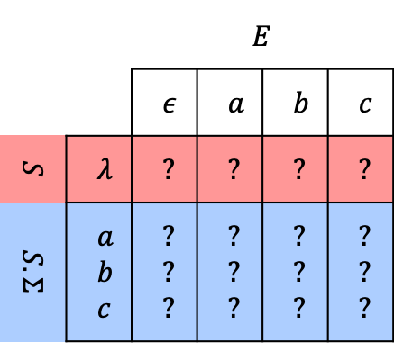
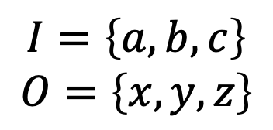
Observation Table contd.
Mealy Machines
$$I=\left\{a,b,c\right\}$$
$$O=\left\{x,y,z\right\}$$
State’s output
 |  | $$E$$
 |  | $$ε$$ | $$a$$ | $$b$$ | $$c$$
$$S$$ | $$λ$$ | $$?$$ | ? | ? | ?
$$S.Σ$$ | $$a$$ $$b$$ $$c$$ | ? ? ? | ? ? ? | ? ? ? | ? ? ?
Initial Table

Slide 8
Current LearnLib is incapable of learning Moore Machines!

Slide 9
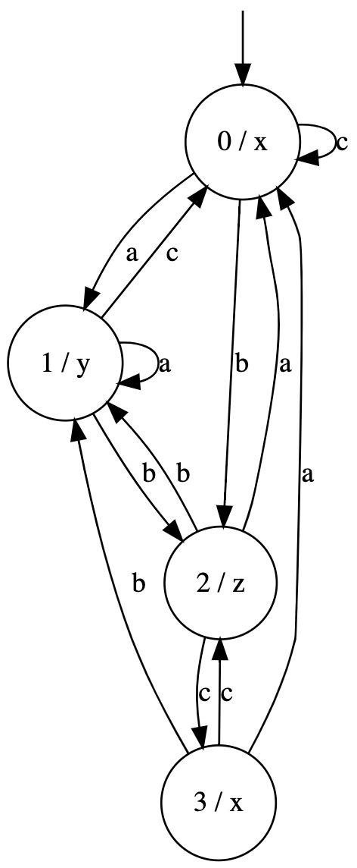
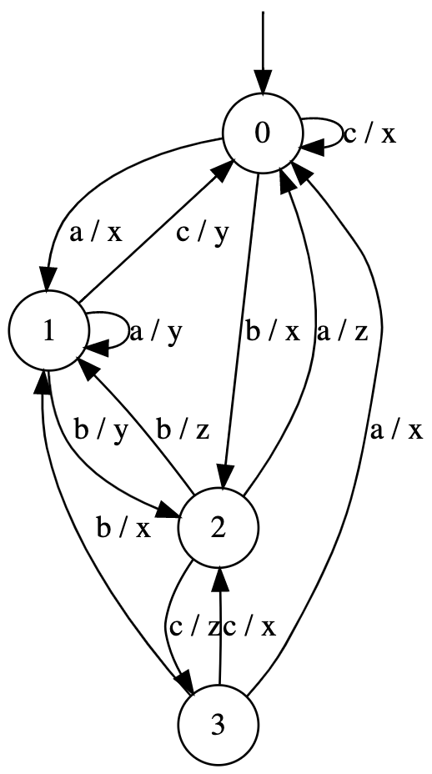
From Moore Machines to Mealy Machines!

Slide 10
From Mealy Machines to Moore Machines
This is beyond our scope; and more involved. Please see the text books in automata theory, and digital circuit design.

