Slide 1


Vuetrospective
Lessons Learned & Mistakes Made
Žiga Miklič
StoryChief

Slide 2
Overvue
Introduce the project
Examine if Vue was right choice for our project
Mistakes I made on the project
The most important lesson learned

Slide 3
About the project
Enterprise application built Vue
Improve the workflow of the client company’s internal developers
200+ Vue components

Slide 4

Project screenshot

Slide 5
Was Vue the right choice?
*
YES.
*
But with small imperfections.

Slide 6
Why was Vue the right choice
Simple and straightforward API
Gentle learning curve & amazing documentation
Best practices
Vue's templating system
Tools (Vue CLI, browser developer tools)
Performance

Slide 7



Vue’s growth
2.3x repositories on GitHub
4.8x weekly downloads on NPM
3.6x questions on Stack Overflow
28k repositories
12k repositories
416k downloads
2mil downloads
2 major releases
18k questions
66k questions
Start project
Join project
Vue 2.6 release
Vue 3 release
Leave project
May 2018
July 2018
February 2019
September 2020
October 2020

Slide 8
Issues with Vue
Ecosystem
Missing core features:
Alternative to mixins
Fragments
Multiple v-model
Portals
=> Composition API
=> Teleport

Slide 9
Problems with Mixins
Name collision
Implicit dependency
Snowballing complexity

Slide 10
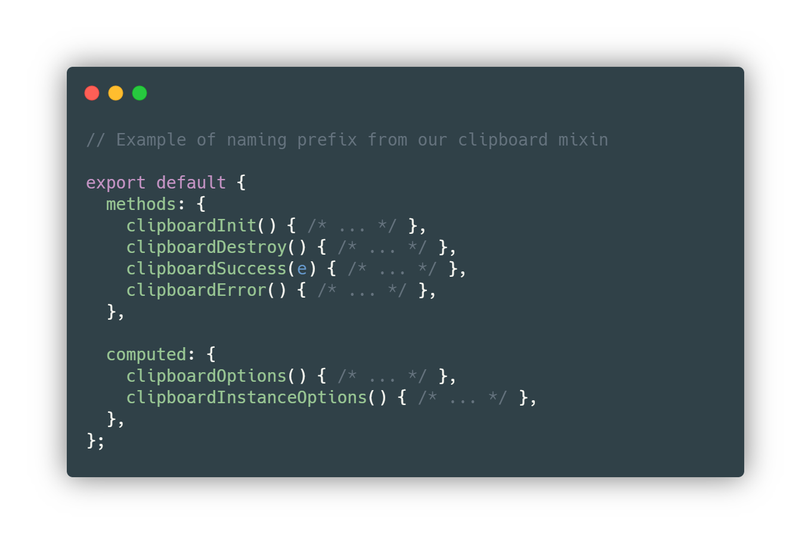
Name collision

Slide 11
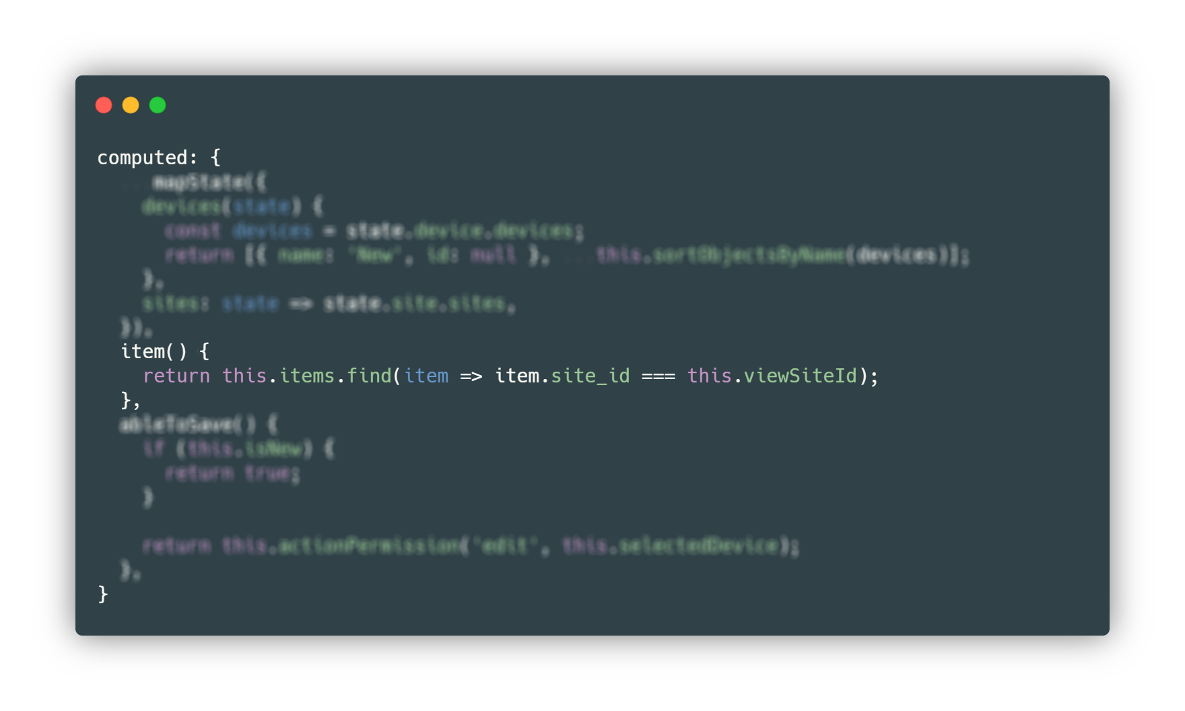
Implicit dependency

Slide 12
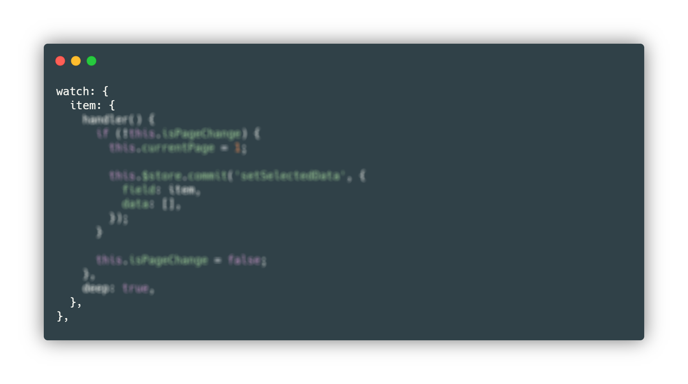
Implicit dependency

Slide 13

Mistakes Made

Slide 14
Temporary solutions
“There's nothing more permanent than a temporary hack.”
Kyle Simpson

Slide 15
Temporary solutions
Task: update the data inside the data tables
Periodic polling using setTimeout
“shortly in the future”
WebSocket API

Slide 16
Temporary solutions
Make it reusable outside of data tables
Changing the interval time depending on if the user is active
Allowing the user to do a manual refresh
Solve edge cases
…
Is it still worth investing the time?

Slide 17
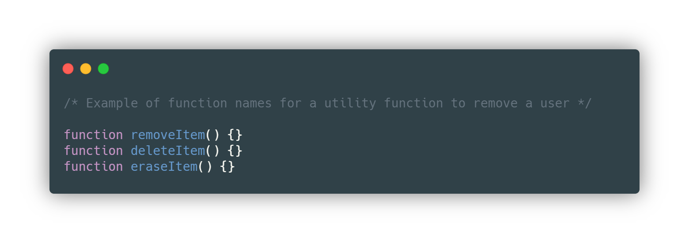
Code duplication between developers

Slide 18
Code duplication between developers
Check if a similar utility function exists to the one being submitted
Set up project naming conventions
Project librarian
More communication regarding our code

Slide 19

The most important lesson in Vue I’ve learned
Slots > Props

Slide 20



Prefer slots over props
Add to cart
Composition instead of config
Flexibility
Readability
Delete item
Go back

Slide 21
Thank you!

Slide 22
Sources
Vue statistics
https://web.archive.org/web/20180615000000*/https://github.com/topics/vue
https://www.npmtrends.com/vue
https://web.archive.org/web/20180601000000*/https://stackoverflow.com/questions/tagged/vue.js
Assets
https://undraw.co/
https://www.flaticon.com/free-icon/reward_4168977

