Slide 1
Predicting Gentrification
Presented by:
Jassmine Rabii, Jeff Simonson, Brian Valerio
September 30, 2019
Notes:
Jassmine

Slide 2
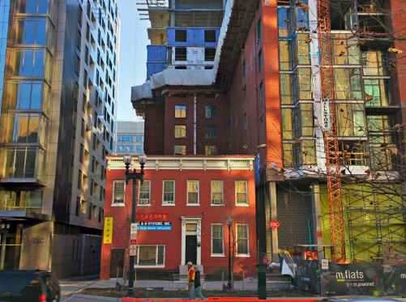
Gentrification: What is it?
Gentrification is "a complex process involving physical improvement of the housing stock, housing tenure change from renting to owning, price rises and the displacement or replacement of the working-class population by the new middle class."
- Wikipedia
Notes:
Jassmine

Slide 3
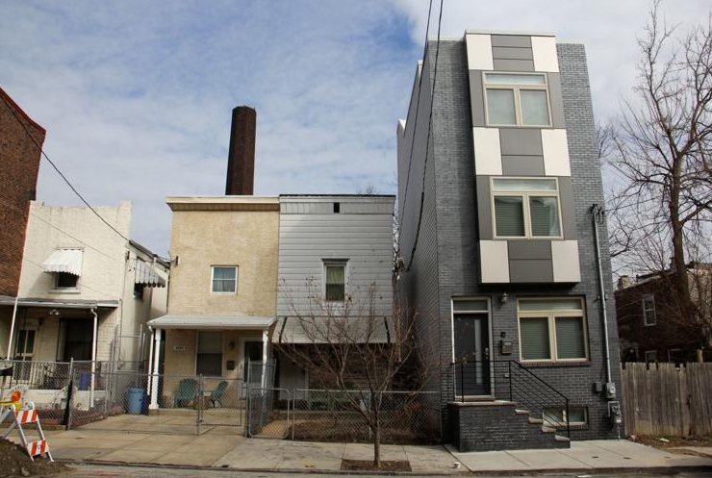
Gentrification: Why study it?
Proponents argue:
Investment returns to neglected areas
New jobs to struggling neighborhoods
Risk taking, entrepreneurship
Walkability up, Reliance on Automobile down
Skeptics argue:
Economic/social strain on long-time residents
Jobs created don’t always go to native residents
Rents displace people, family businesses
Loss of history = diminished ‘identity of place’
Old challenges not solved, just moved elsewhere
Notes:
Jassmine

Slide 4
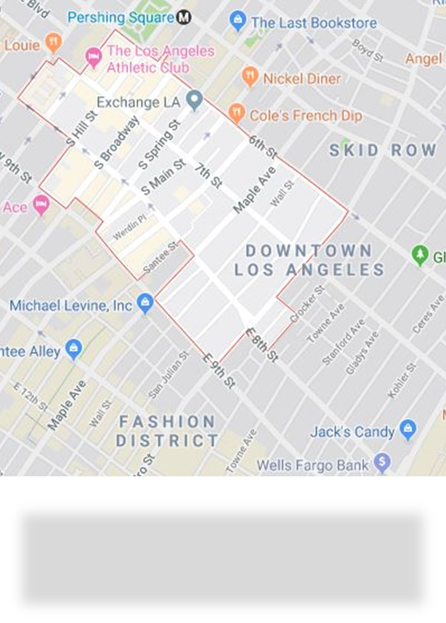
Our Study…
… takes place in our backyard: Los Angeles & 90014
4 Big Questions:
What census data differentiates a highly gentrified zip code from a less gentrified zip code?
What role does commercial real estate (CRE) development play in gentrification?
Can we better understand the census variables and build a model that predicts/classifies gentrification?
Can we identify meaningful CRE variables that will enhance our ‘census’ model?
90014
Notes:
Brian

Slide 5
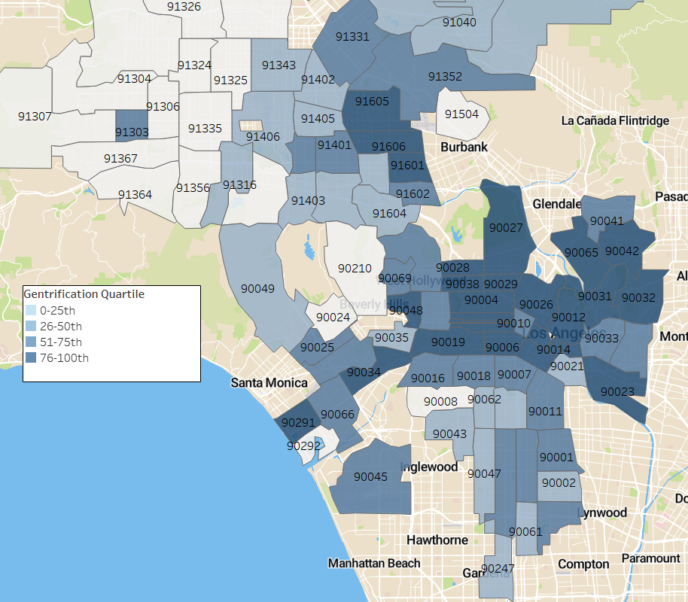
Phase I: the ‘Census’ model
The Census Model:
The City of LA developed a City Change Index in 2016
Uses primarily census data
Change measured over 20+ variables from 2000-14
110 zip codes were studied
Each zip code was assigned an index value from 0 to 1 based on degree of zip code/’city’ change.
We used this index as our ‘degree of gentrified’ dependent variable
Los Angeles zip codes by degree of gentrification quartile.
Darker shades indicate higher gentrification.
Notes:
Brian

Slide 6
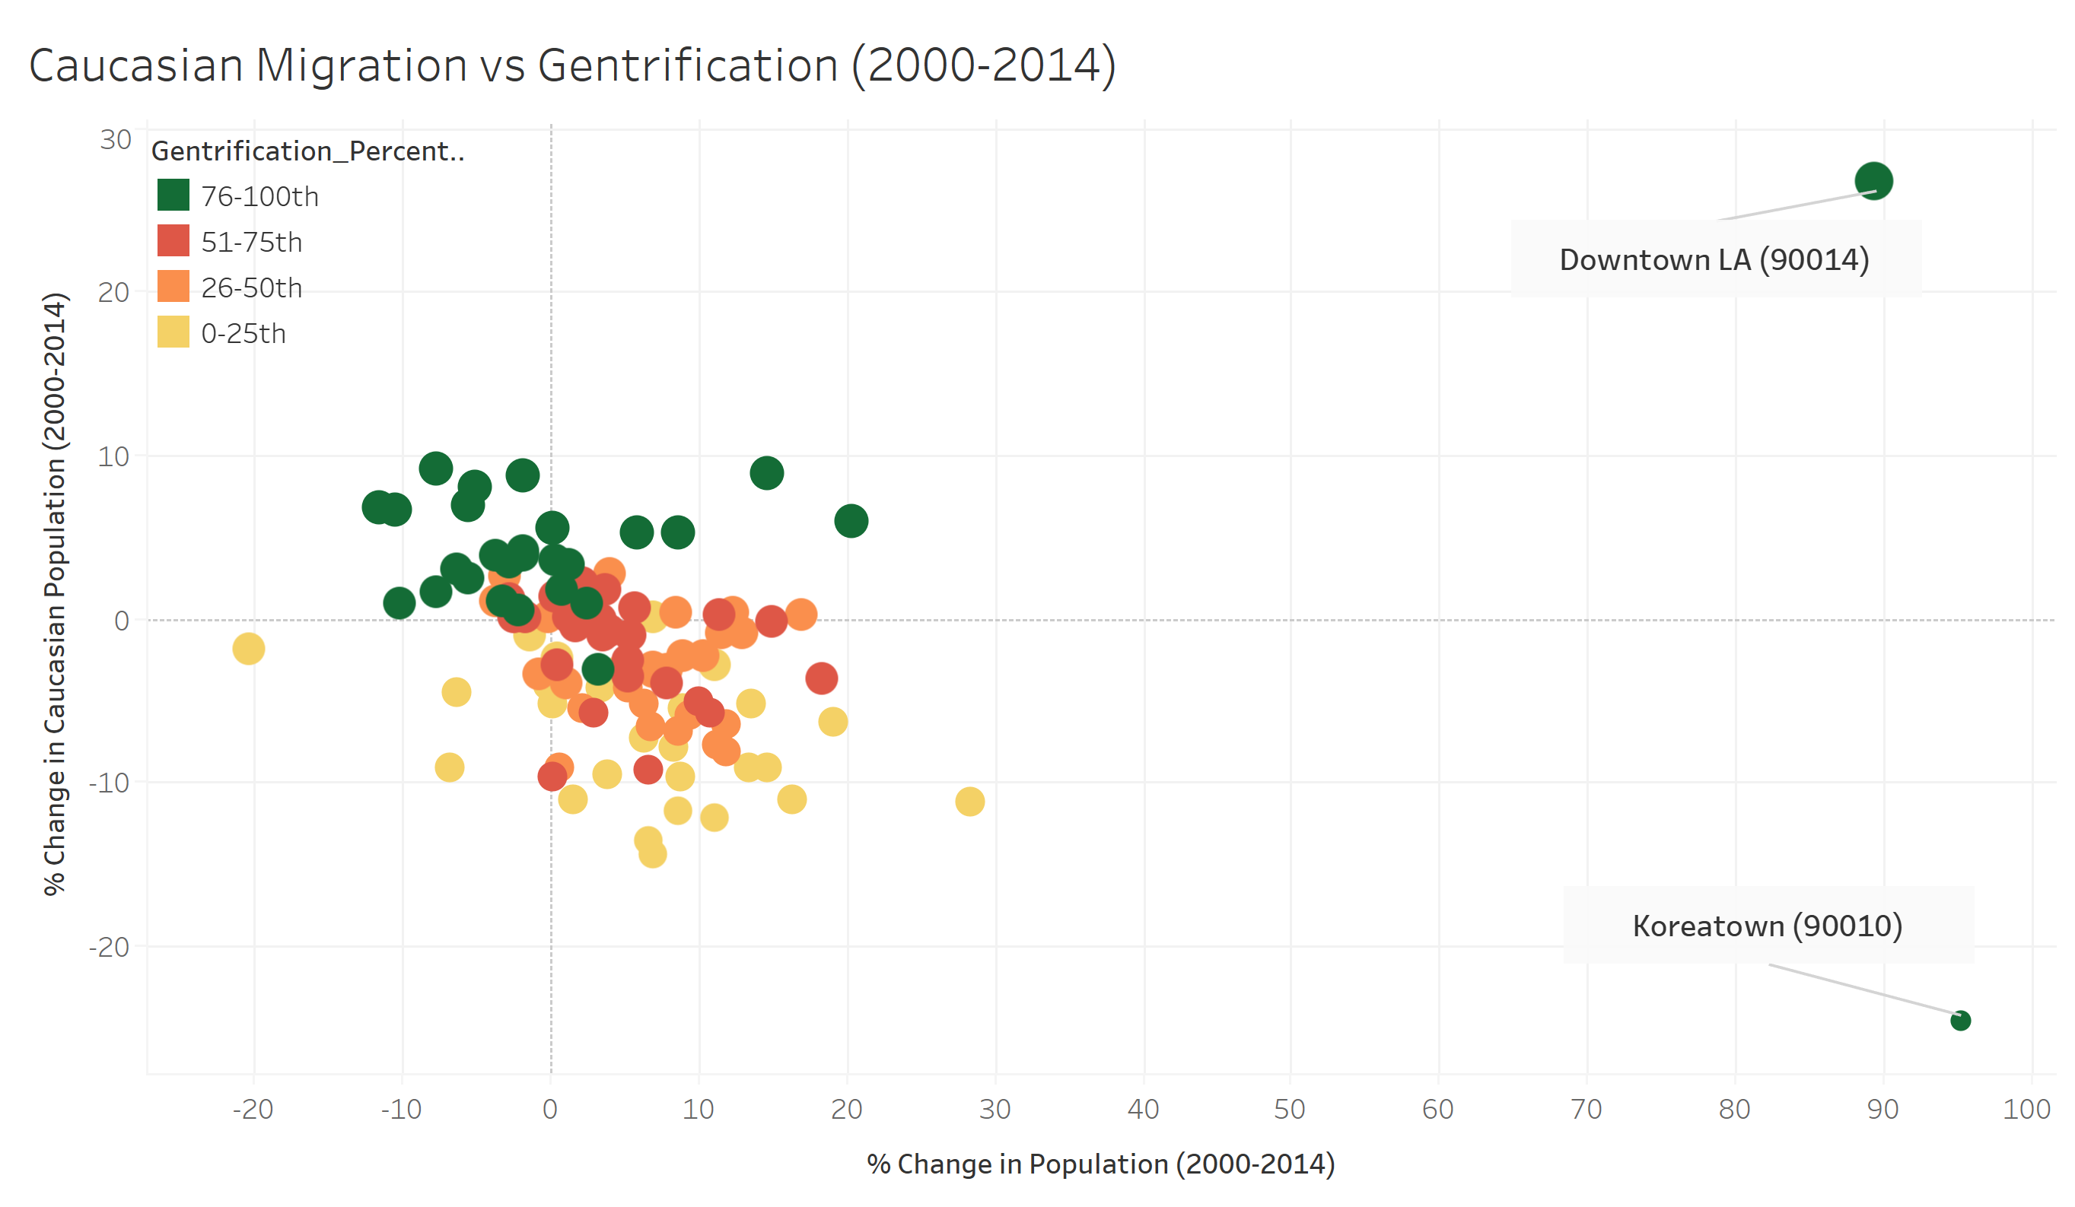
Gentrification Data Spotlight
Notes:
Jassmine

Slide 7
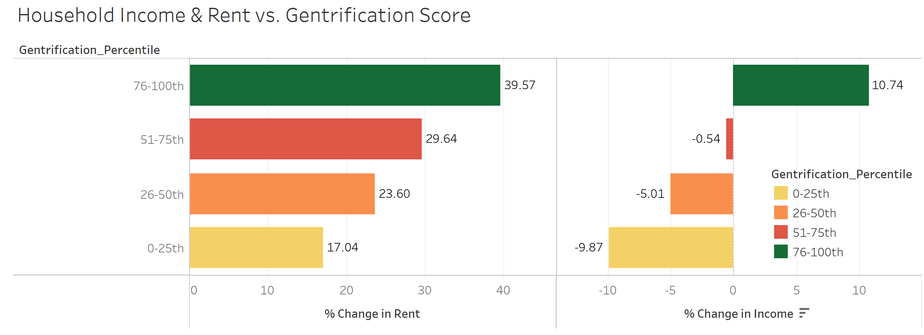
Gentrification Data Spotlight
Notes:
Jassmine

Slide 8
Phase I: Using the ‘Census’ model to Understand Drivers of Gentrification
We split our ‘gentrified’ index variable (our dependent variable) into quartiles
We then one-hot coded the gentrification by quartile
Next, we ran the data through the following supervised machine-learning algorithms:
Logistic regression
Random forest
K-nearest neighbors
Support Vector Machine (SVM)
Upon first pass… the variables in the census model were quite strong
Prediction rates across the algorithms ranged from 74% to 92% accuracy in prediction
Notes:
To build our model we initially split the gentrified index variable into quartiles
This allowed us to one-hot code each quartile
Next, we ran the data through the following supervised ML algorithms:
Logistic regression, random forest, K Nearest Neighbors, SVM
Even at first pass we knew we had good data. Prediction rates ranged from mid 70% to low 90%

Slide 9
Phase I: Our final ‘Census’ model
For our final Census model we used a logistic regression
Challenges with first model:
High prediction for training data (91%), horrible prediction for test data (60%).
How our final model evolved:
Model | Y Variable Coding | X Variables (Feature Set) | Data Set | N | Features | Train Size (%) | Test Size (%) | Training Data Score | Testing Data Score
1 | One-hot encoded by Gentrification Quartiles, (4) outcomes | non-scaled | Census Data Only | 110 | 22 | 75% | 25% | 0.914 | 0.607
 |  |  |  |  |  | 50% | 50% | 0.945 | 0.600
 |  |  |  |  |  | 55% | 45% | 0.950 | 0.640
 |  |  |  |  |  | 60% | 40% | 0.924 | 0.659
 |  |  |  |  |  | 65% | 35% | 0.929 | 0.666
2 | Top gentrified quartile = 1, rest = 0 | non-scaled | Census Data Only | 110 | 22 | 65% | 35% | 0.985 | 0.923
 |  |  |  |  |  | 60% | 40% | 0.984 | 0.840
 |  |  |  |  |  | 55% | 45% | 0.983 | 0.860
3 | Top gentrified quartile = 1, rest = 0 | scaled | Census Data Only | 110 | 22 | 65% | 35% | 0.957 | 0.974
Notes:
The model we chose to refine was the logistic regression model.
What was intriguing about it was that we had high training data results (91% prediction) but poor Testing Data results (60%).
In this table you can see how our model evolved.
The first adjustment we made was the Training-Test split.
With our sample size just 110 zips and the fact that we had one-hot encoded for each quartile we increased the Test size.
We found a test-train split sweet spot of 65/35 and this resulted in a testing prediction improvement from 60% to 66%.
The large jump occurred by changing the way we coded our gentrification variable. The goal isn’t so much to predict which quartile zips fall in, but rather whether it is gentrified or not.
So we changed the coding to 1 for just the most gentrified zips and zero for the rest.
This resulted in our Training predict score improving to 98% and testing to 84-92%.
But of course, there is always room for improvement. So in line 3, we took all our X variables and scaled them to z scores.
While training prediction fell 3%. Testing prediction jumped to 97%

Slide 10
Phase II: Finding significant CRE variables
Next step: Can we make the model more robust with CRE data?
Steps in our analysis:
Missing data:
CRE data is about tracking deals, not ensuring representation
To minimize loss to N and preserve our most highly gentrified quartile we reduced our feature set from 34 to 25
N decreased from 110 to 97, but we only lost 1 zip code from the top percentile of gentrified zips
Interestingly, of the 13 lost records, 9 were from the least gentrified quartile (NIMBY?)
Notes:
Jeff
The census data provides us with an excellent model … we could walk away and feel good about it
But our hypothesis was: can we bring CRE data into the model and make it more robust?
We know certain change are taking place in these areas, let’s see what we can find.
Unlike census data, CRE is about tracking deals not necessarily ensuring representation for citizens
To reduce the impact of missing data on our sample size we reduced our CRE data set from 34 to 25 potential variables
N decreased from 110 to 97 but of those 13 zips we lost only 1 zip code was lost from the top quartile used as our dependent variable.
Interestingly of those 13 lost records 9 were from the least gentrified quartile.

Slide 11
Phase II: Finding significant CRE variables
We ran a correlation of the index value against the CRE features
Correlations are weak, but some possibles emerge:
Total Retail Bldgs 2014 (+.43)
New Multi-family Projects 2000-14 (+.32)
% Studio Apartments (+.32)
% 2 Bedroom Apartments (-.30)
% Change in Retail Bldgs 2000-14 (-.25)
Notes:
Jeff
To pare down features further we ran a correlation of the variables against the raw index percentile.
The correlations aren’t very strong, but this resulted in us reducing the features from 25 to 5.
The variables that made the cut were a combination of retail and multifamily inventory levels and characteristics.
And these kind of make sense too. If single professionals are moving in areas with high levels of studio apartment this would positively correlate with areas that were highly gentrified.

Slide 12
Our Final Model:
Model | Y Variable Coding | X Variables (Feature Set) | Data Set | N | Features | Train Size (%) | Test Size (%) | Training Data Score | Testing Data Score
1 | One-hot encoded by Gentrification Quartiles, (4) outcomes | non-scaled | Census Data Only | 110 | 22 | 75% | 25% | .914 | .607
 |  |  |  |  |  | 50% | 50% | .945 | .600
 |  |  |  |  |  | 55% | 45% | .950 | .640
 |  |  |  |  |  | 60% | 40% | .924 | .659
 |  |  |  |  |  | 65% | 35% | .929 | .666
2 | Top gentrified quartile = 1, rest = 0 | non-scaled | Census Data Only | 110 | 22 | 65% | 35% | .985 | .923
 |  |  |  |  |  | 60% | 40% | .984 | .840
 |  |  |  |  |  | 55% | 45% | .983 | .860
3 | Top gentrified quartile = 1, rest = 0 | scaled | Census Data Only | 110 | 22 | 65% | 35% | .957 | .974
4 | Top gentrified quartile = 1, rest = 0 | scaled | Census + CRE Data | 97 | 27 | 65% | 35% | .984 | .971
The CRE data enhanced an already strong model!
Training data score improved to 98.4% without a significant drop off in our Testing data score (97.1%)
Notes:
And here on the last line is our final model with the CRE and Census features included.
Our training data score bumped up from 95% to 98% and our Testing Data score remained at 97%.

Slide 13
Our Final Model: What Features Predict Gentrification?
Conclusions:
We have a very strong model (97% prediction)
4 of the 5 CRE features improved the model!
Next steps (if we were so inclined):
Run the same data set using different algorithms (Random Forest).
Reduce the feature set by paring out weaker variables, variables with narrow distributions.
Notes:
So, in review we were able to build a very strong model and incorporate CRE features in an attempt to make the model more robust.
There really is no where to go after this.
But if we did want to do that it would be interesting to see the same data set run with a random forest algorithm.

Slide 14
Thank You!
Notes:
Group

