Slide 1
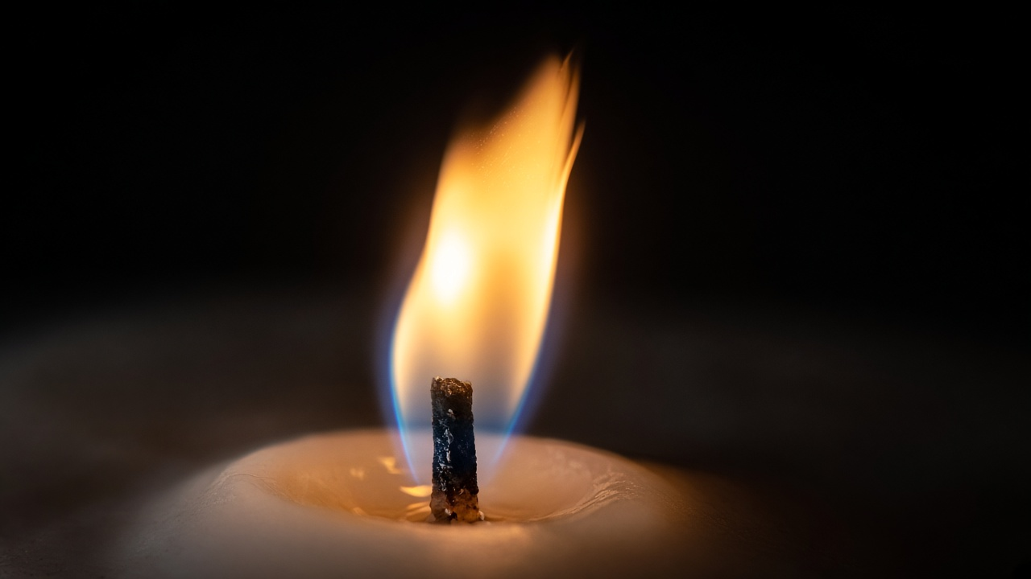
THE MYSTERY OF FIRE
What does a flame need to keep burning?
Notes:
TEACHER EXPLANATION
Open in silence. Let the flame hold attention.
SCIENTIFIC POINT
Central investigation question.
STUDENT QUESTION
What might a flame need?
EXPECTED ANSWER
Fuel, heat, air — gather ideas.
TIP
Do not answer yet.

Slide 2
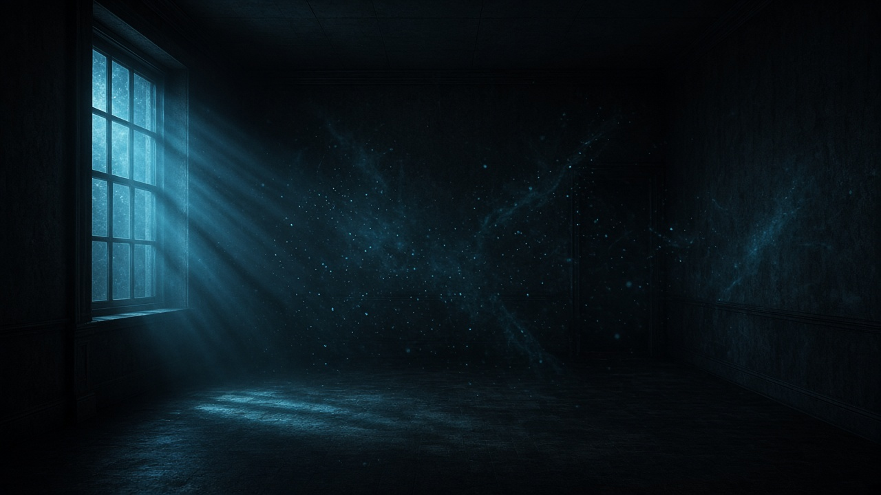
AIR IS EVERYWHERE
You cannot see it — but it can affect fire.
Notes:
TEACHER EXPLANATION
Point out the space around us is filled with air.
SCIENTIFIC POINT
Air occupies space even when invisible.
STUDENT QUESTION
Can invisible things affect fire?
EXPECTED ANSWER
Yes.
TIP
Particles are a visualization aid.

Slide 3
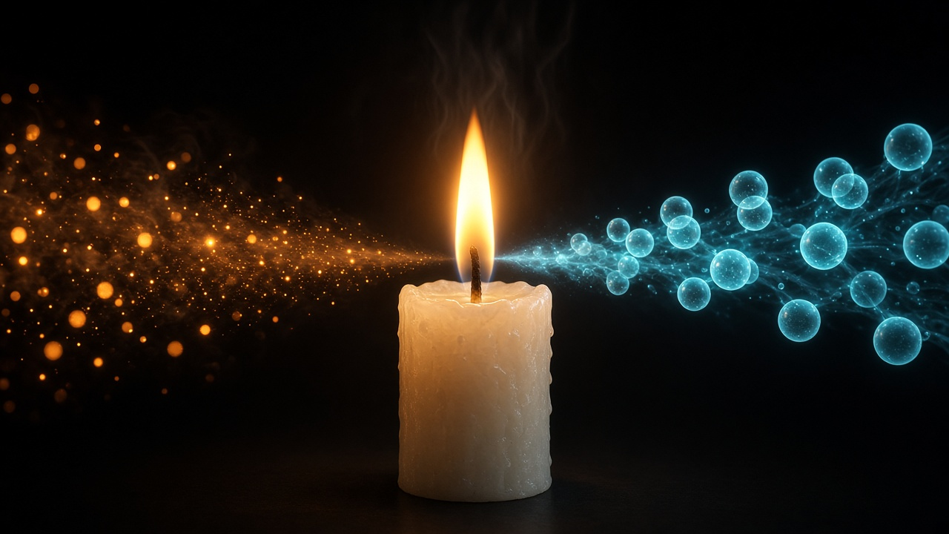
WHAT IS BURNING?
Heat + Fuel + Oxygen → Combustion → Heat + Light
Notes:
TEACHER EXPLANATION
Walk the mechanism: inputs → reaction → products.
SCIENTIFIC POINT
Combustion: oxygen + substance → heat and light.
STUDENT QUESTION
What three things meet?
EXPECTED ANSWER
Heat, fuel, oxygen.
TIP
Keep Grade 6 language.

Slide 4
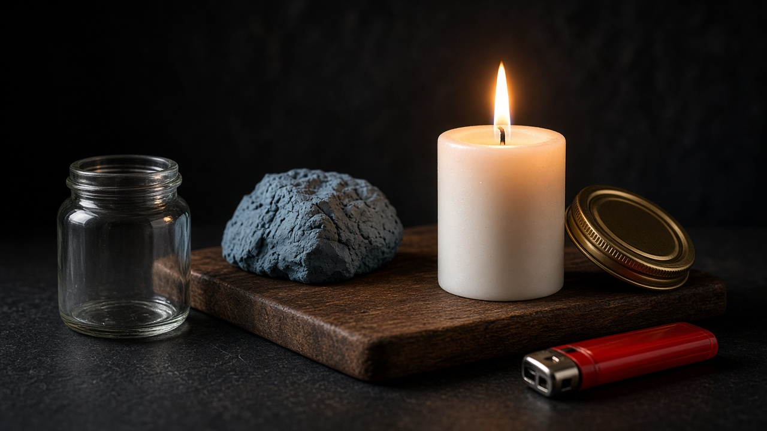
LET'S TEST IT
Candle · Glass jar · Lid · Clay · Board · Lighter (teacher only)
Notes:
TEACHER EXPLANATION
Name each object. Teacher-only lighter.
SCIENTIFIC POINT
Controlled experiment tools.
STUDENT QUESTION
Why a glass jar?
EXPECTED ANSWER
To trap or allow air around the flame.
TIP
Safety first.

Slide 5
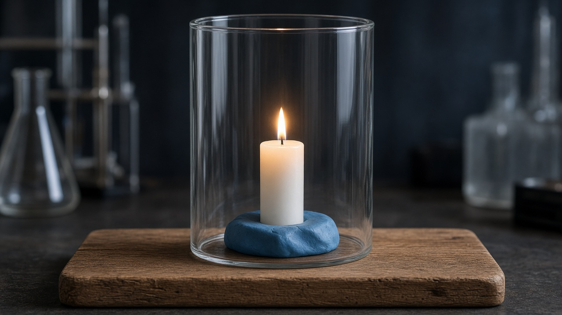
THE EXPERIMENT
A candle. A transparent jar. Controlled openings.
Notes:
TEACHER EXPLANATION
Describe the physical setup.
SCIENTIFIC POINT
Bottomless jar lets us control top and bottom.
STUDENT QUESTION
What can we change?
EXPECTED ANSWER
Lid on/off, gaps in clay.
TIP
Keep apparatus large on screen.

Slide 6
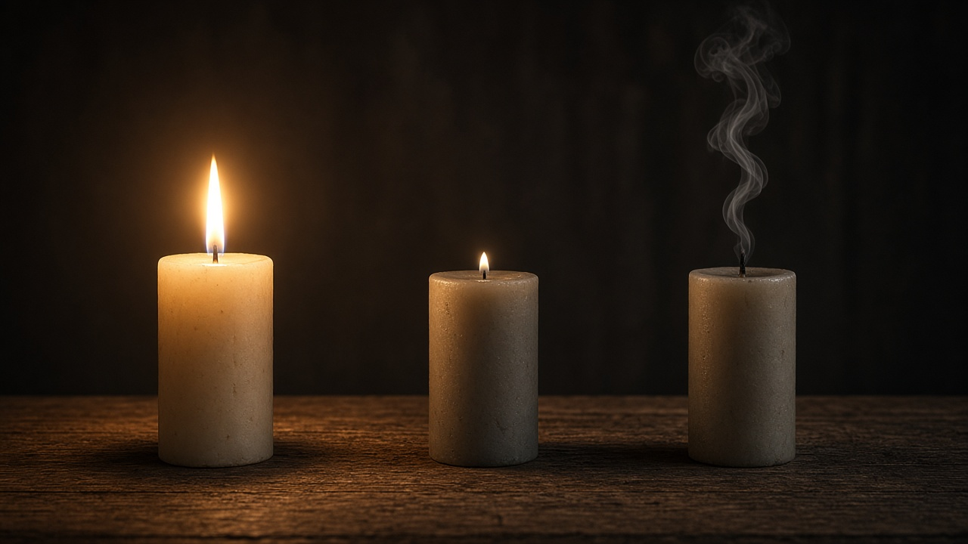
WHAT WILL HAPPEN?
A strong · B weaker · C out
A — KEEPS BURNING
B — BECOMES WEAKER
C — GOES OUT
Notes:
TEACHER EXPLANATION
Class vote before sealing.
SCIENTIFIC POINT
Prediction before observation.
STUDENT QUESTION
Which shows gradual change?
EXPECTED ANSWER
B.
TIP
Do not confirm yet.

Slide 7
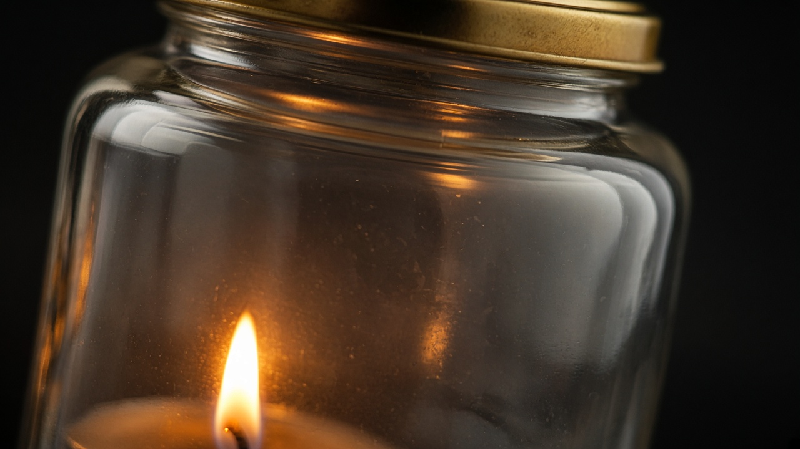
THE AIR CAN'T BE REPLACED
Notes:
TEACHER EXPLANATION
Emphasize enclosure and trapped volume.
SCIENTIFIC POINT
Closed system: air cannot renew.
STUDENT QUESTION
What is trapped with the flame?
EXPECTED ANSWER
A limited amount of air.
TIP
Almost no other text — let the image speak.

Slide 8

WATCH CAREFULLY
Strong → Weaker → Out
Notes:
TEACHER EXPLANATION
Trace the sequence left to right.
SCIENTIFIC POINT
Flame weakens as available air runs low.
STUDENT QUESTION
Instant or gradual?
EXPECTED ANSWER
Gradual, then out.
TIP
Match to prediction B.

Slide 9
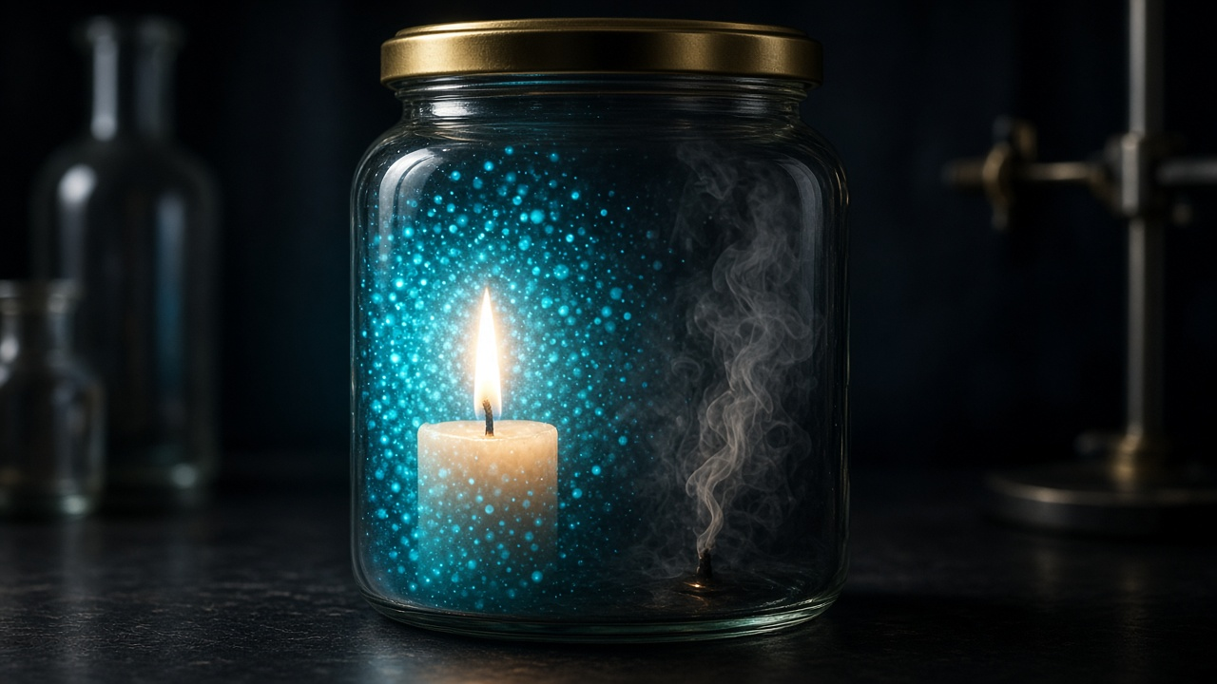
WHY DID IT GO OUT?
More air → stronger flame · Less air → weaker flame · Air used up → out
Notes:
TEACHER EXPLANATION
Connect particle density to flame strength.
SCIENTIFIC POINT
In a closed jar, air is used up.
STUDENT QUESTION
Why can't it burn forever sealed?
EXPECTED ANSWER
No fresh air enters.
TIP
Avoid exact oxygen percentages.

Slide 10

WHAT IF FRESH AIR CAN ENTER?
A path for new air — but renewal still matters.
Notes:
TEACHER EXPLANATION
Show the gap as a doorway for air.
SCIENTIFIC POINT
Opening allows possible inflow.
STUDENT QUESTION
Does any hole guarantee burning forever?
EXPECTED ANSWER
No — continuous replacement matters.
TIP
Preview bottom-only nuance verbally.

Slide 11
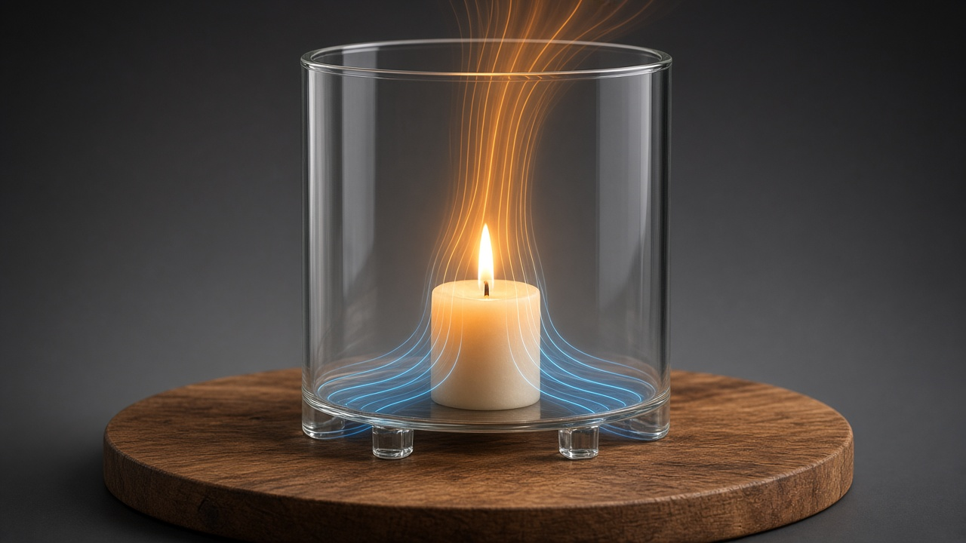
FRESH AIR ENTERS
WARM AIR ↑
OXYGEN → FLAME
FRESH AIR ↓
Notes:
TEACHER EXPLANATION
Trace bottom in → flame → top out.
SCIENTIFIC POINT
Air constantly renewed with both openings.
STUDENT QUESTION
Which way does warm air move?
EXPECTED ANSWER
Up and out.
TIP
Key teaching slide.

Slide 12
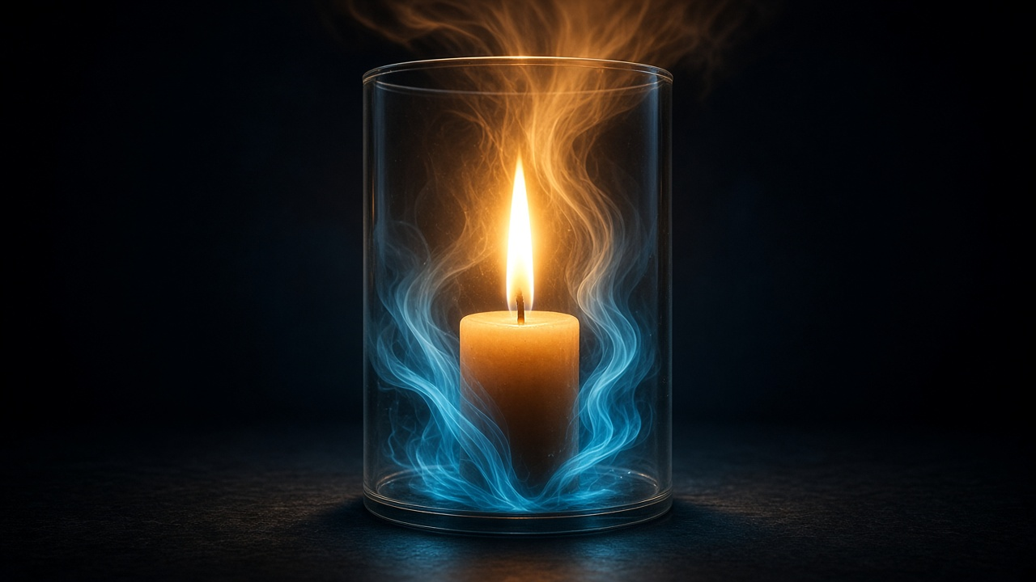
IT KEEPS BURNING
Fresh air keeps supplying what the flame needs.
Notes:
TEACHER EXPLANATION
Contrast with sealed outcome.
SCIENTIFIC POINT
Continuous supply allows continued burning.
STUDENT QUESTION
What changed from the sealed jar?
EXPECTED ANSWER
Air can be renewed.
TIP
Hold on the strong flame.

Slide 13
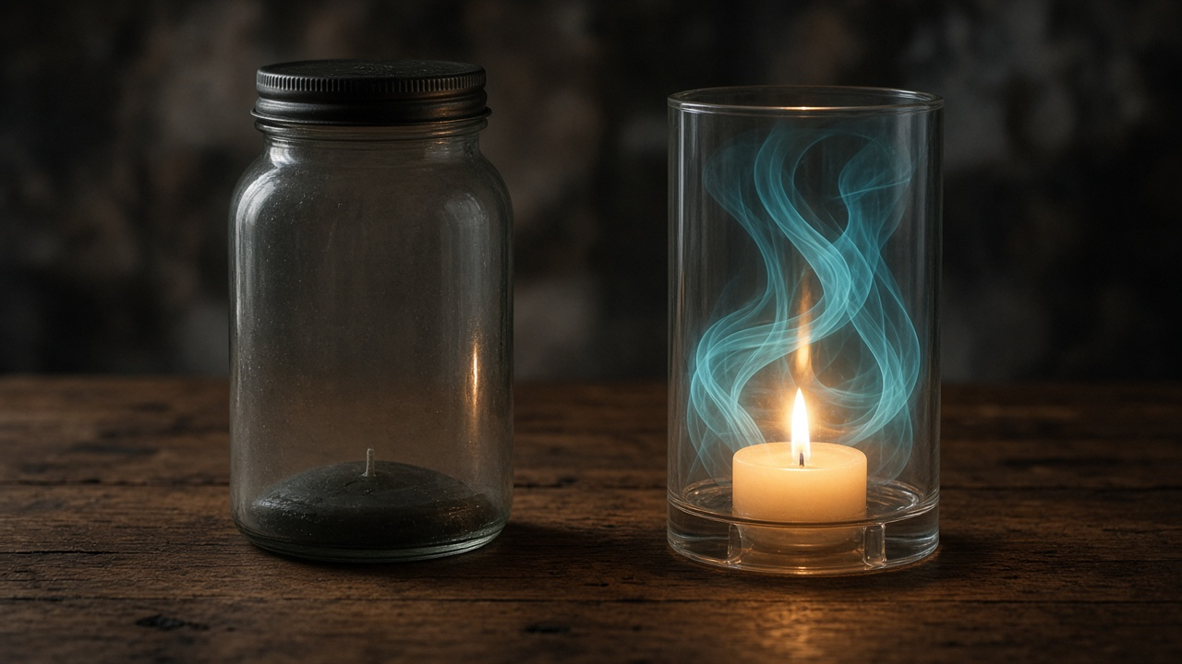
CLOSED vs OPEN
AIR RUNS OUT
AIR RENEWED
Notes:
TEACHER EXPLANATION
Partner explain left vs right.
SCIENTIFIC POINT
Both openings support renewal in this experiment.
STUDENT QUESTION
Which keeps burning?
EXPECTED ANSWER
Open / airflow side.
TIP
Aha moment.

Slide 14
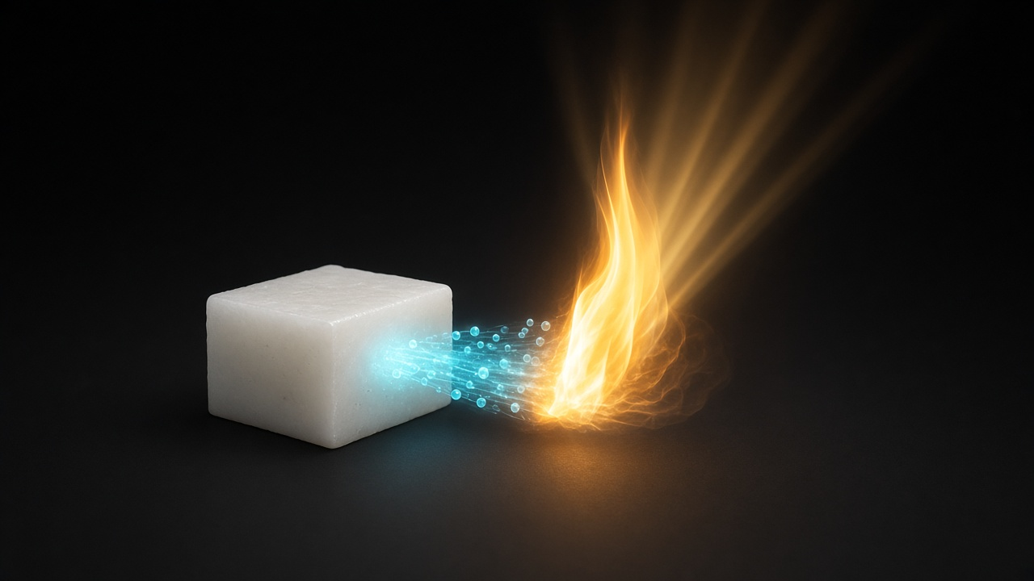
WHY DOES THIS HAPPEN?
FUEL + OXYGEN + HEAT → COMBUSTION → HEAT + LIGHT
Notes:
TEACHER EXPLANATION
Return to the definition as culmination.
SCIENTIFIC POINT
Official combustion meaning.
STUDENT QUESTION
What products appear?
EXPECTED ANSWER
Heat and light.
TIP
Keep wording source-aligned.

Slide 15
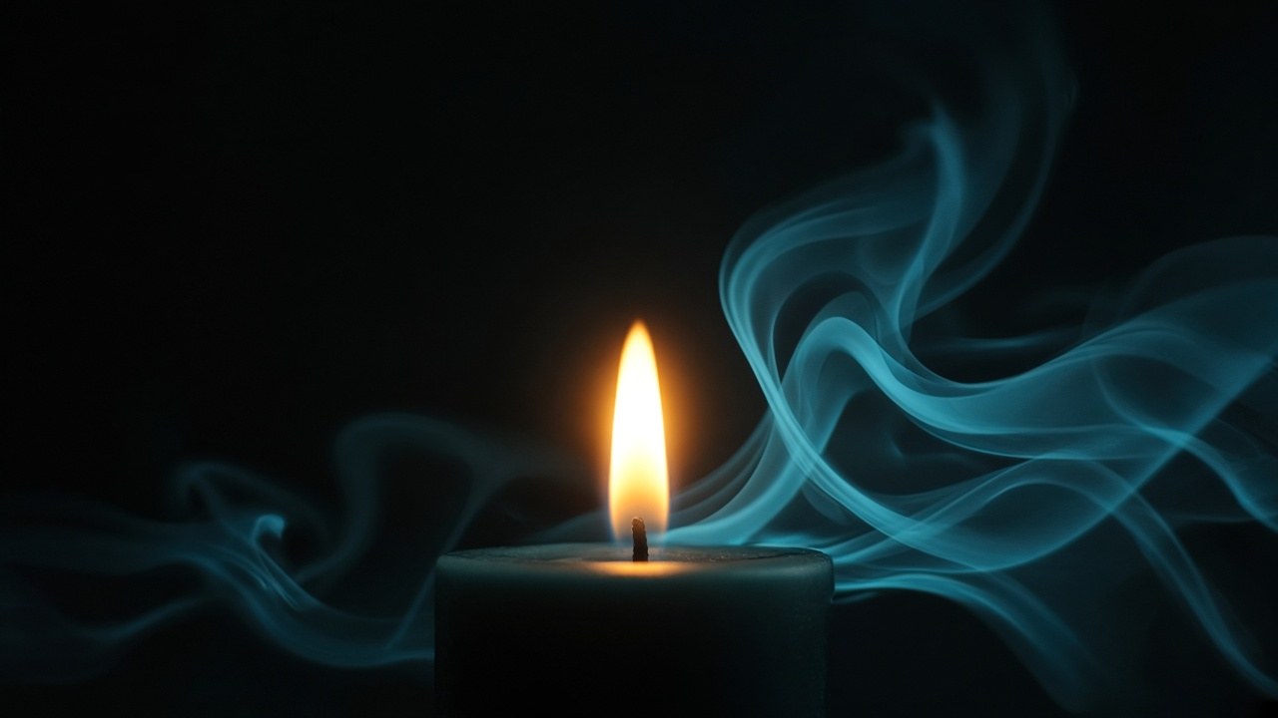
AIR PLAYS A KEY ROLE IN BURNING
Notes:
TEACHER EXPLANATION
Pause. Let the line land.
SCIENTIFIC POINT
Air is essential for continued burning.
STUDENT QUESTION
One-sentence takeaway?
EXPECTED ANSWER
Burning needs renewed fresh air.
TIP
Calm, memorable close of concept.

Slide 16
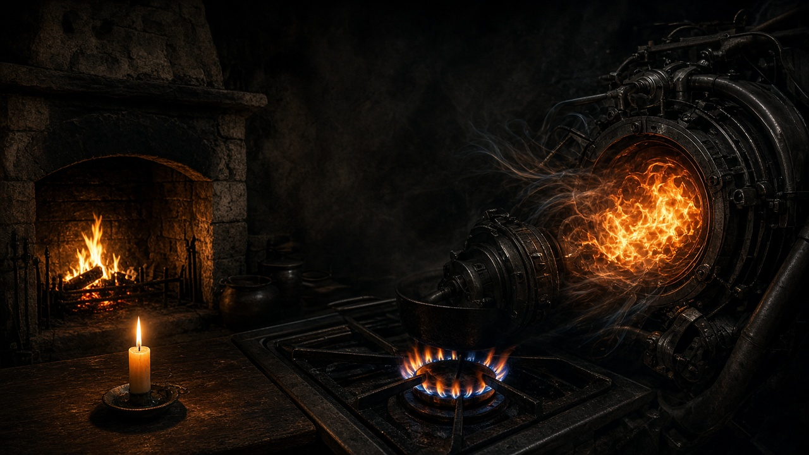
REAL LIFE
Fireplace · Candle · Stove · Engine — each needs air.
Notes:
TEACHER EXPLANATION
Connect to student homes.
SCIENTIFIC POINT
Designed airflow in real systems.
STUDENT QUESTION
Why chimneys?
EXPECTED ANSWER
Warm air out, fresh air in.
TIP
Concrete examples.

Slide 17
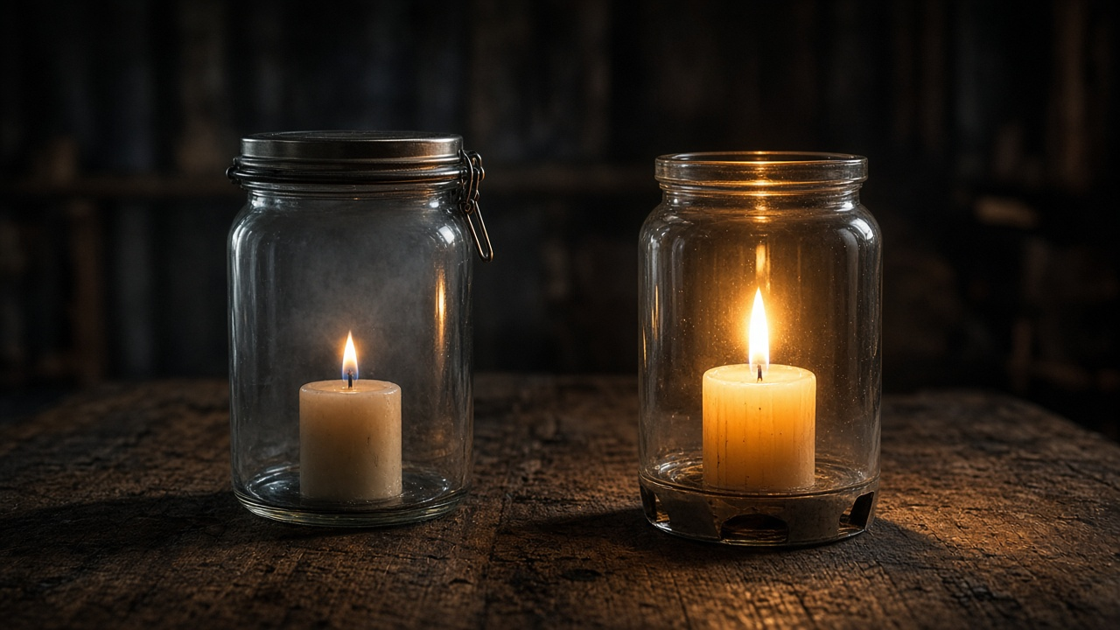
WHICH ONE WILL KEEP BURNING?
Enclosed · vs · Airflow
Notes:
TEACHER EXPLANATION
Students choose before reveal.
SCIENTIFIC POINT
Airflow side continues; sealed goes out.
STUDENT QUESTION
Why?
EXPECTED ANSWER
Fresh air can be renewed.
TIP
Formative check.

Slide 18
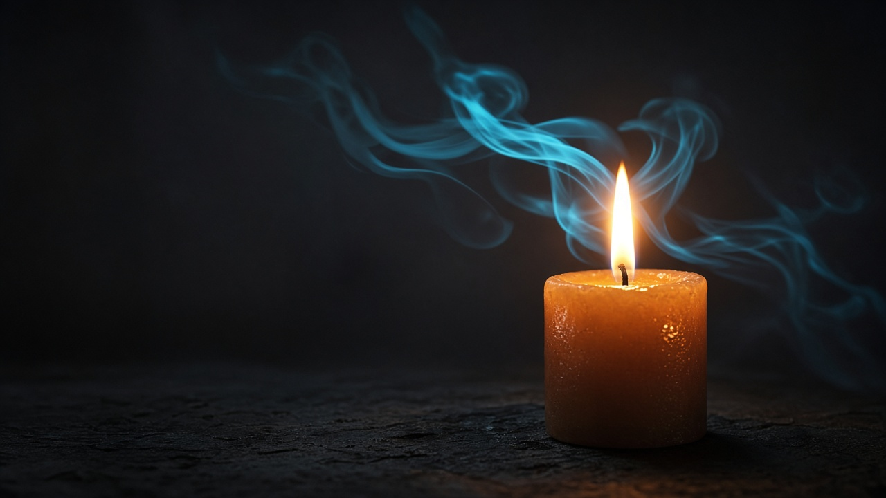
REMEMBER
BURNING NEEDS OXYGEN
FRESH AIR MUST BE SUPPLIED
WITHOUT RENEWAL, THE FLAME GOES OUT
Notes:
TEACHER EXPLANATION
Read the three lines slowly.
SCIENTIFIC POINT
Authoritative conclusions.
STUDENT QUESTION
What does a flame need to keep burning?
EXPECTED ANSWER
Fuel, heat, continuous fresh air.
TIP
End on the image.

