Slide 1
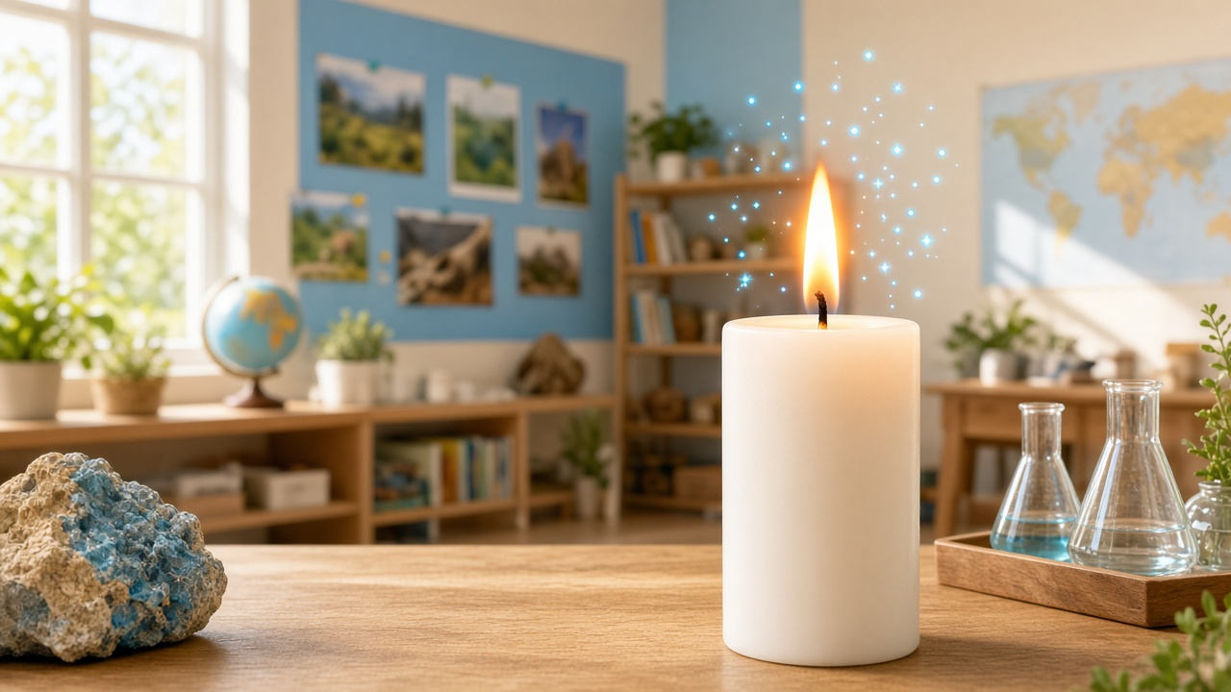
THE MYSTERY OF FIRE
What does a flame need to keep burning?
Notes:
TEACHER
Build excitement. Pause before the question.
SCIENCE
Central inquiry.
QUESTION
What might fire need?
ANSWER
Fuel, heat, air.
TIP
Keep energy high.

Slide 2
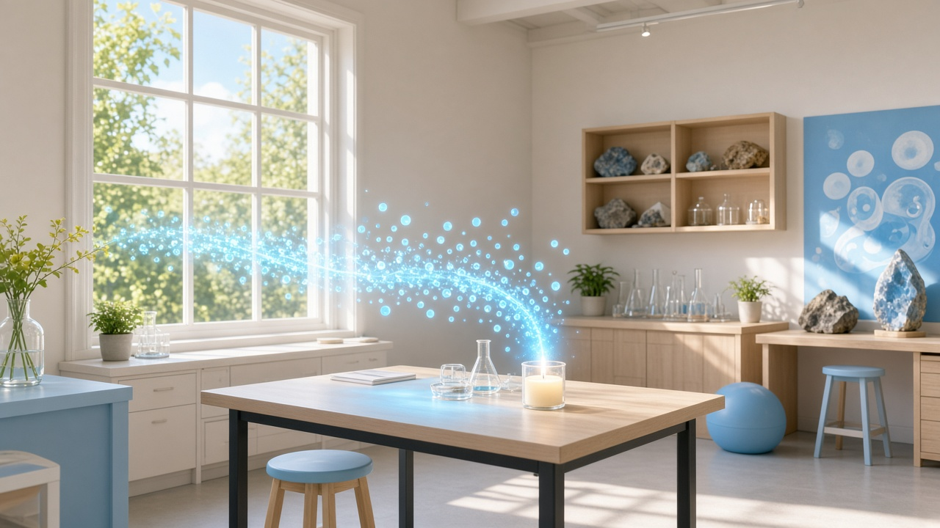
AIR IS EVERYWHERE!
You can't see it — but it's there.
WHOOSH →
Notes:
TEACHER
Reveal airflow as a surprise.
SCIENCE
Air fills the space around us.
QUESTION
Can invisible air affect fire?
ANSWER
Yes!
TIP
Playful whoosh moment.

Slide 3
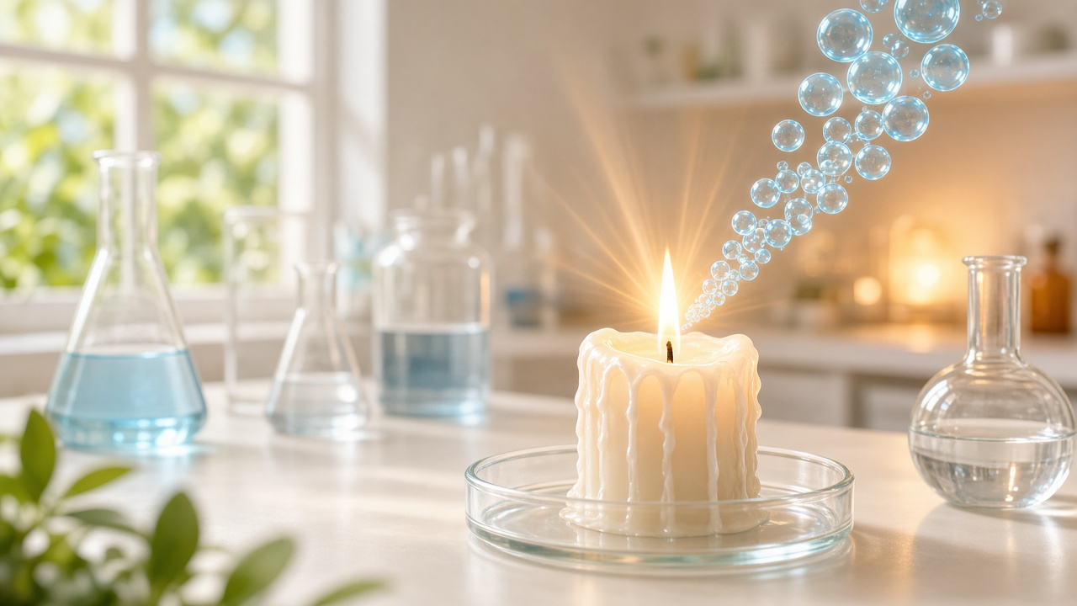
WHAT IS BURNING?
HEAT
FUEL
OXYGEN
↓
COMBUSTION!
↓
HEAT + LIGHT
Notes:
TEACHER
Click through each step slowly.
SCIENCE
Combustion needs heat, fuel, oxygen.
QUESTION
What appears after combustion?
ANSWER
Heat and light.
TIP
Make it feel like building a recipe.

Slide 4
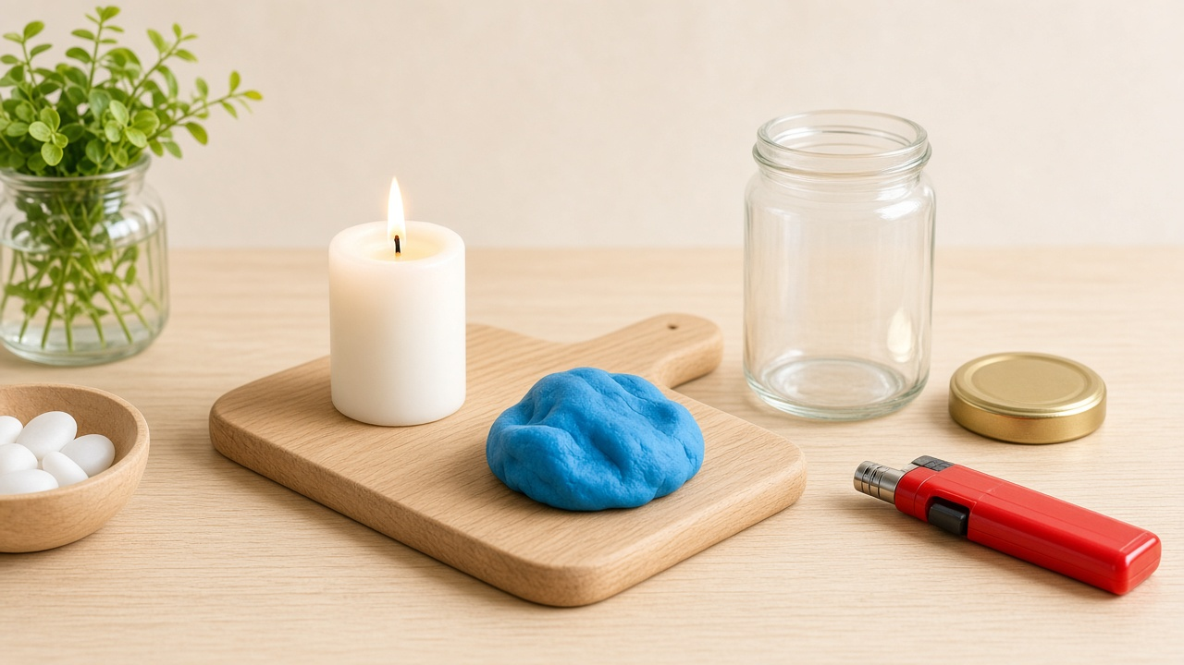
LET'S TEST IT!
SCIENCE LAB TIME!
Candle · Jar · Lid · Clay · Board · Lighter (teacher only)
Notes:
TEACHER
Cheerful lab energy.
SCIENCE
Teacher-only lighter.
QUESTION
Name each tool.
ANSWER
Jar controls air around flame.
TIP
Safety first.

Slide 5
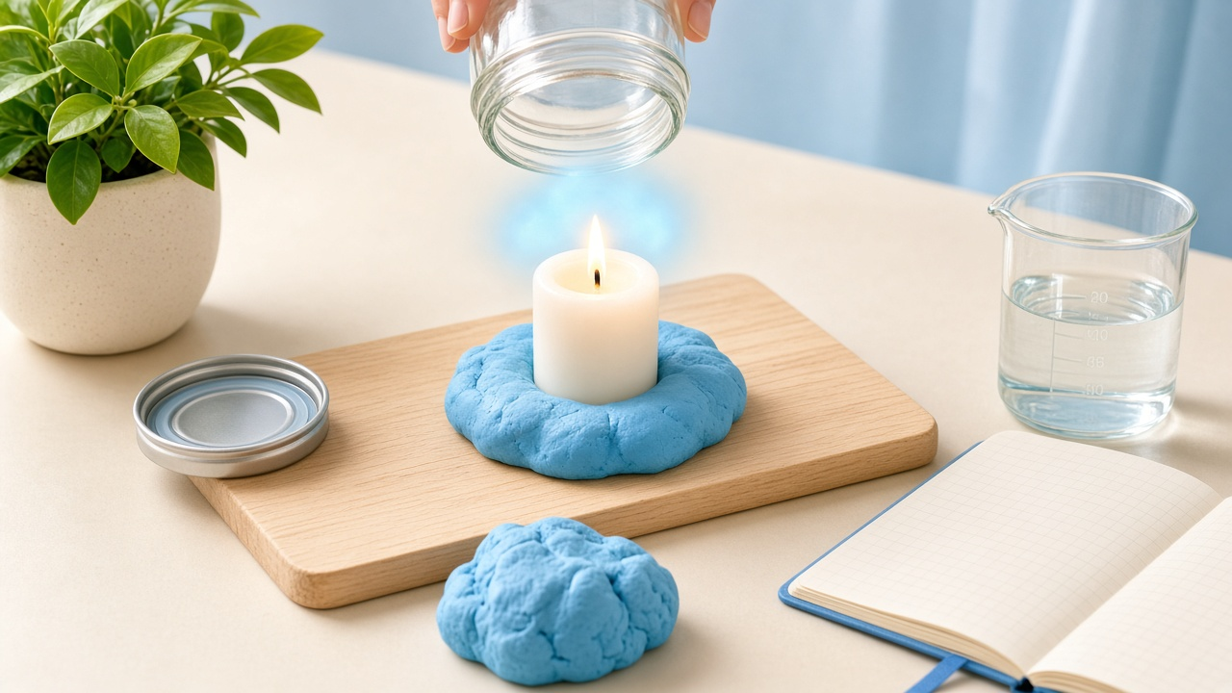
EXPERIMENT SETUP
1. Candle ready
2. Jar moves over
3. Air around flame
Watch how the jar traps the air around the flame!
Notes:
TEACHER
Show jar placement.
SCIENCE
Openings control airflow.
QUESTION
What's around the flame?
ANSWER
Air.
TIP
Clear physical setup.

Slide 6
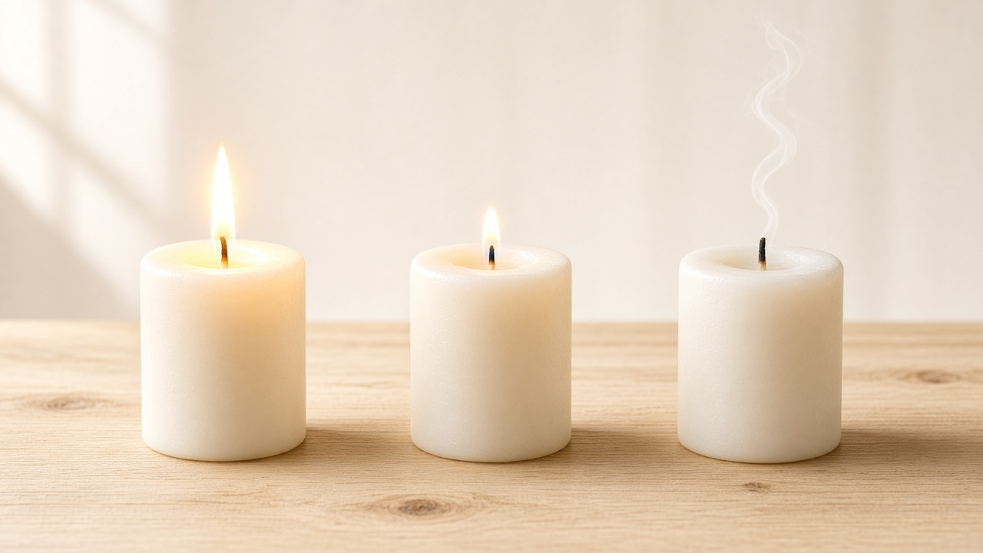
WHAT DO YOU THINK
WILL HAPPEN?
A STRONG FLAME
B SMALLER FLAME
C FLAME OUT
Notes:
TEACHER
Class vote — suspense!
SCIENCE
Predict before sealing.
QUESTION
Which is gradual?
ANSWER
B.
TIP
Don't confirm yet.

Slide 7
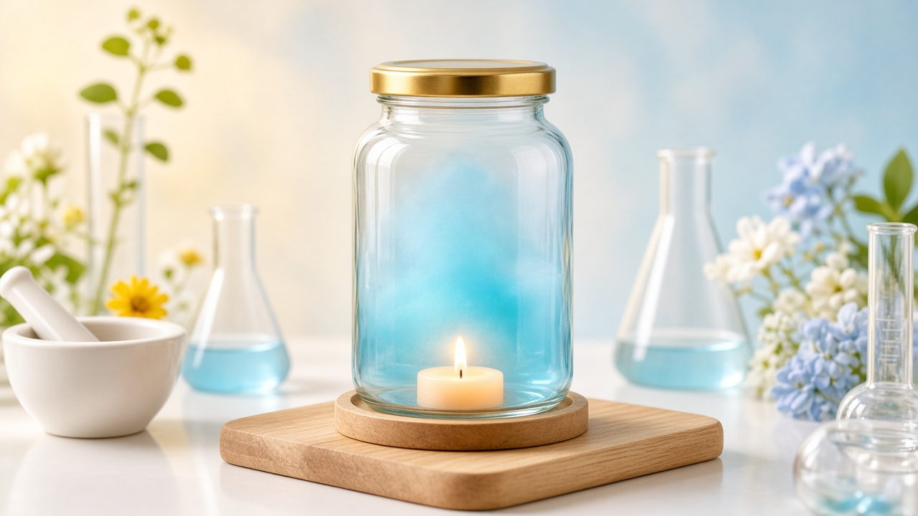
THE CLOSED JAR
THE AIR
IS TRAPPED
INSIDE
Notes:
TEACHER
Emphasize trapped air.
SCIENCE
Closed = no renewal.
QUESTION
What's trapped?
ANSWER
Limited air.
TIP
Bright lab feel.

Slide 8
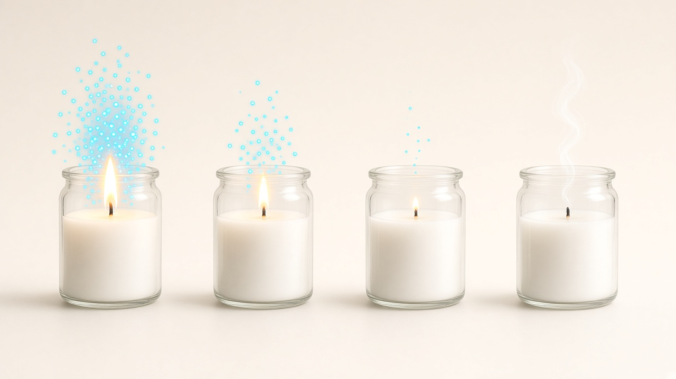
WATCH CAREFULLY!
BIG FLAME → smaller → tiny → OUT
Oxygen particles decrease at the same time!
Notes:
TEACHER
Narrate the shrink.
SCIENCE
Cause and effect.
QUESTION
Instant or gradual?
ANSWER
Gradual then out.
TIP
Key observation.

Slide 9
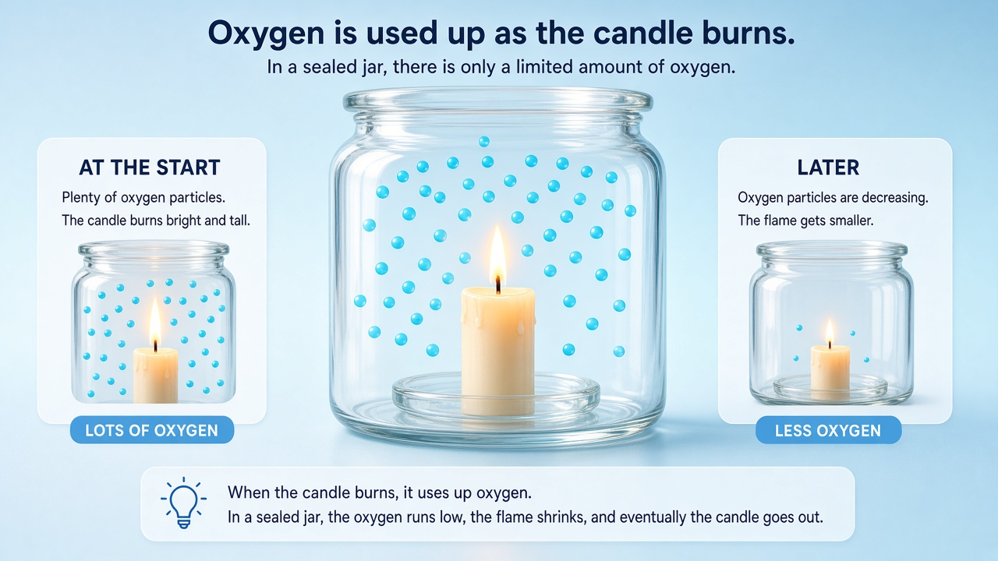
WHY DID THE FLAME GO OUT?
1. Oxygen near the flame
2. Oxygen gets used up
3. Flame gets weaker
4. Flame goes out
Notes:
TEACHER
Sync clicks with story.
SCIENCE
Air used up → burning stops.
QUESTION
Why sealed fails?
ANSWER
No fresh air.
TIP
Teaching climax.

Slide 10
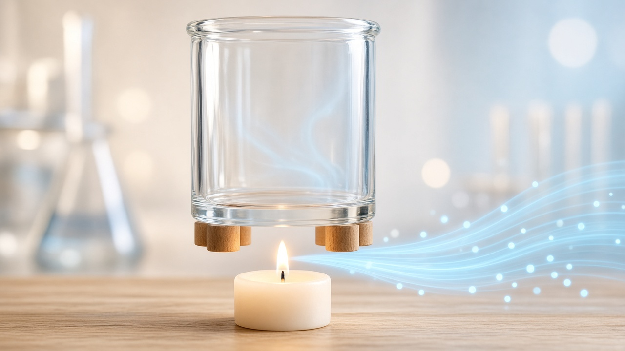
WHAT IF FRESH AIR CAN ENTER?
Gap at the bottom
Fresh air can flow in
WHOOSH!
An opening lets new air reach the flame.
Notes:
TEACHER
Discovery energy!
SCIENCE
Opening allows inflow.
QUESTION
Does any hole guarantee forever?
ANSWER
No — renewal matters.
TIP
Exciting turn.

Slide 11
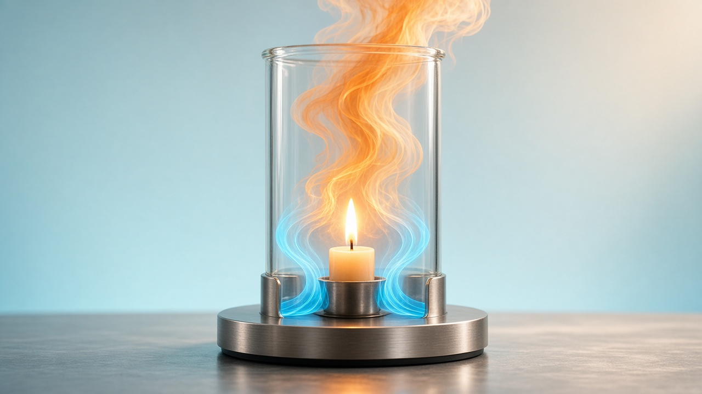
FRESH AIR ENTERS!
FRESH AIR ↓
OXYGEN →
WARM AIR ↑
Notes:
TEACHER
Trace the loop.
SCIENCE
Bottom in, top out.
QUESTION
Warm air direction?
ANSWER
Up!
TIP
Most exciting visual.

Slide 12
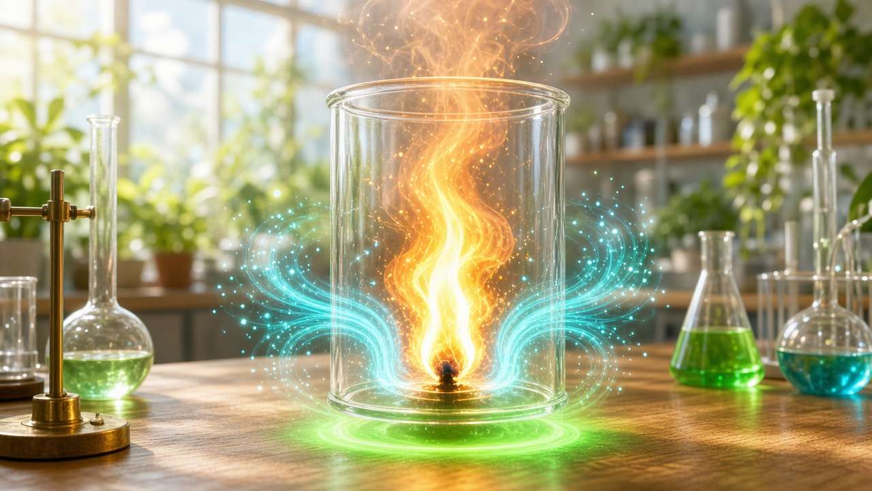
IT KEEPS BURNING!
Fresh air enters
Oxygen reaches flame
Flame grows strong!
AHA! Fresh air keeps supplying oxygen.
Notes:
TEACHER
Celebrate discovery!
SCIENCE
Continuous supply → continues burning.
QUESTION
What changed?
ANSWER
Air can renew.
TIP
Payoff moment.

Slide 13
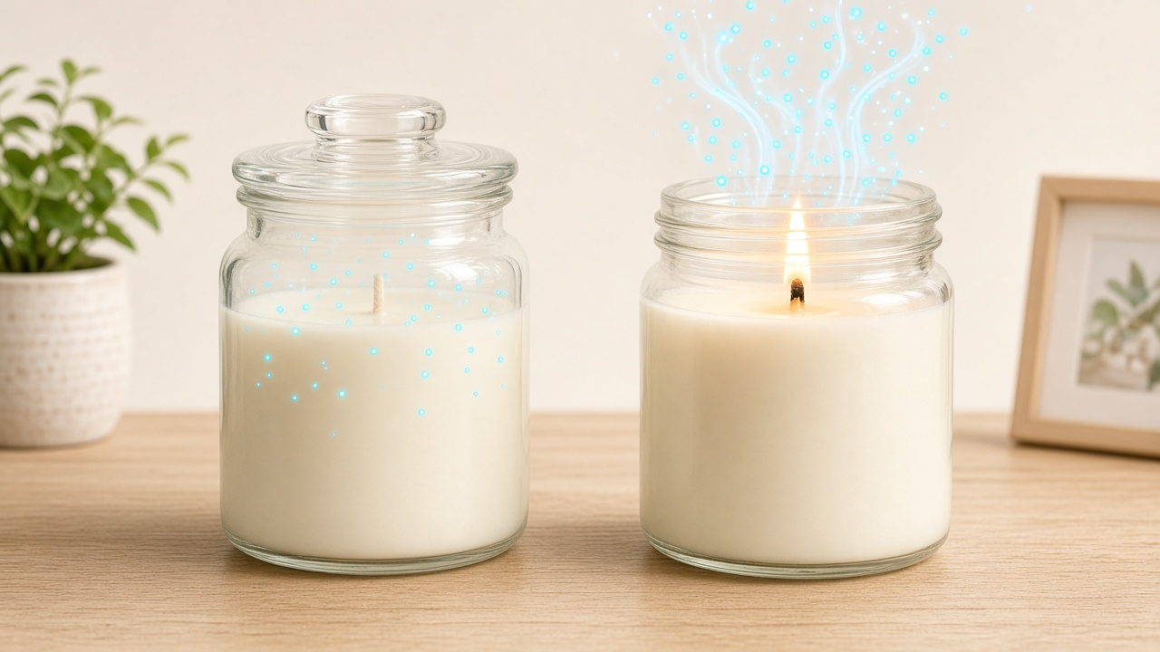
CLOSED vs OPEN
Air runs out → OUT
Air renewed → BURNS
Notes:
TEACHER
Partner compare.
SCIENCE
Both openings help renewal.
QUESTION
Which lasts?
ANSWER
Open side.
TIP
Aha comparison.

Slide 14
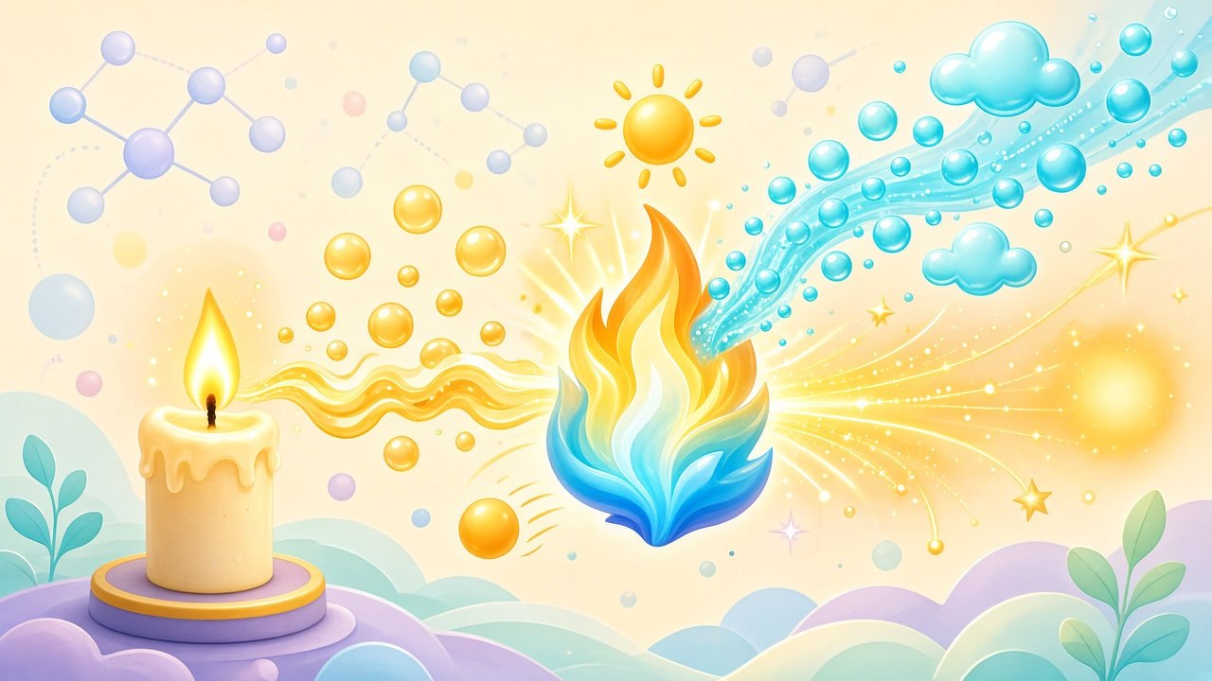
WHY DOES THIS HAPPEN?
HEAT
FUEL
OXYGEN
+
+
↓ COMBUSTION ↓
HEAT + LIGHT
Notes:
TEACHER
Build the chain.
SCIENCE
Source-aligned definition.
QUESTION
Products?
ANSWER
Heat + light.
TIP
Culmination.

Slide 15
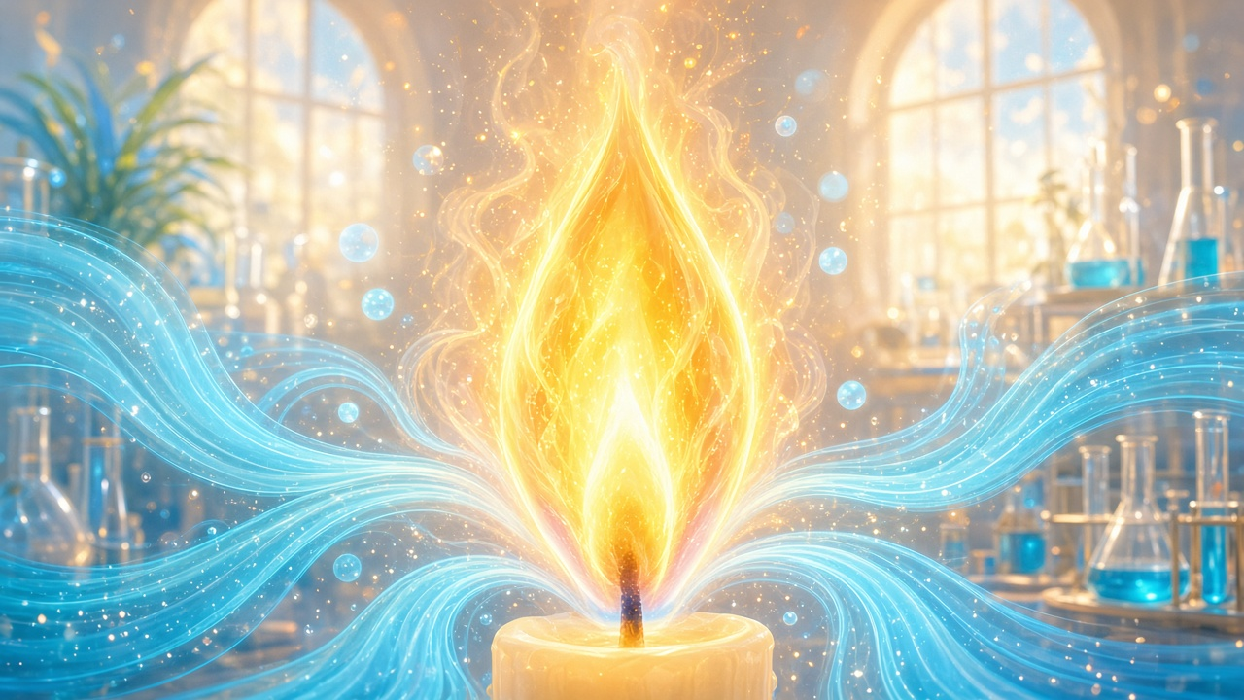
AIR HELPS FIRE KEEP BURNING
FRESH AIR
KEEPS THE
FLAME
ALIVE
Fresh air surrounds the flame — and keeps it burning.
Notes:
TEACHER
Let it land.
SCIENCE
Air is essential for continued burning.
QUESTION
One sentence?
ANSWER
Fire needs renewed fresh air.
TIP
Memorable.

Slide 16
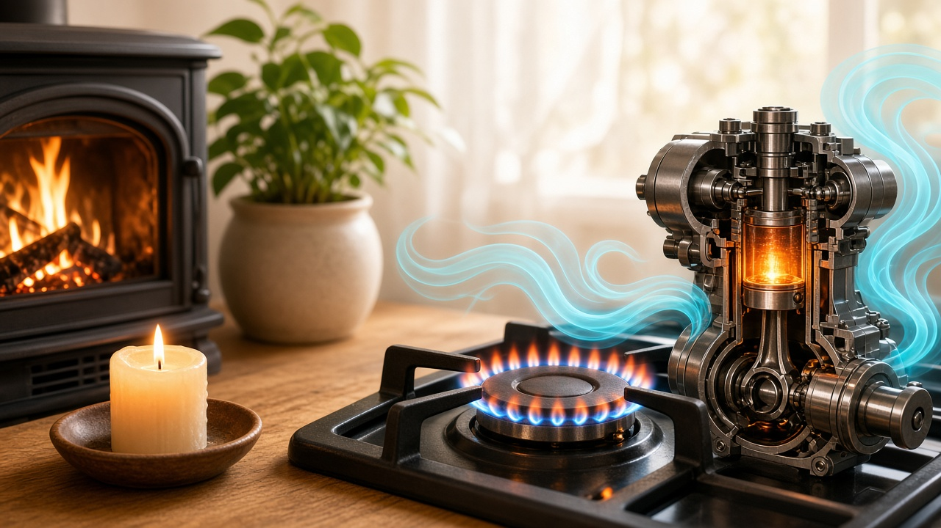
REAL LIFE!
Candle · Fireplace · Stove · Engine — each needs air!
Notes:
TEACHER
Connect to home.
SCIENCE
Designed airflow.
QUESTION
Why chimneys?
ANSWER
Warm out, fresh in.
TIP
Exciting transfer.

Slide 17

SCIENCE CHALLENGE!
WHICH ONE WILL KEEP BURNING?
A Closed jar
B Open air
Answer: B — fresh air keeps coming in!
Notes:
TEACHER
Suspense then reveal.
SCIENCE
Airflow continues; sealed goes out.
QUESTION
Why?
ANSWER
Renewal.
TIP
Interactive feel.

Slide 18
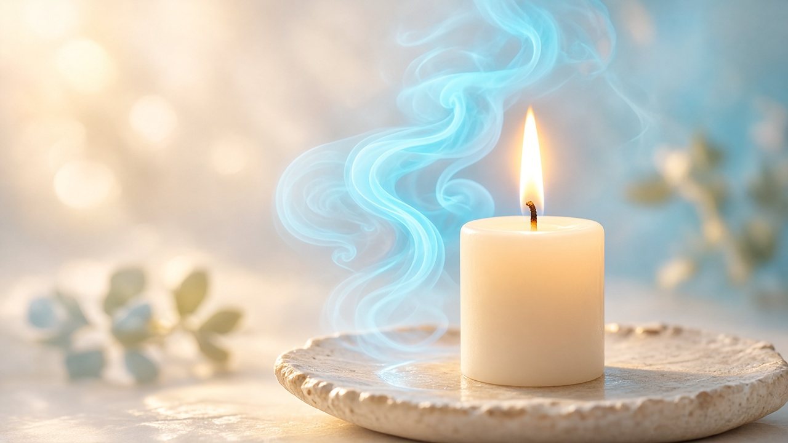
REMEMBER!
1. BURNING NEEDS OXYGEN
2. FRESH AIR MUST BE SUPPLIED
3. WITHOUT FRESH AIR, THE FLAME GOES OUT
Notes:
TEACHER
Read slowly together.
SCIENCE
Three takeaways.
QUESTION
What does a flame need?
ANSWER
Fuel, heat, continuous fresh air.
TIP
Strong ending.

