Slide 1

INTERACTIVE SCIENCE EXPERIENCE · GRADE 6
The Mystery of Fire
What does a flame need to keep burning?
The Role of Air in Burning Things
Notes:
TEACHER EXPLANATION
Welcome students. Dim lights if possible. Show the title without answering yet.
SCIENTIFIC POINT
Tonight we investigate the role of air in burning.
SUGGESTED STUDENT QUESTION
What do you already think a flame needs to keep burning?
EXPECTED ANSWER
Fuel, heat, air/oxygen — accept all ideas for now.
TEACHING TIP
Protect the mystery; do not reveal conclusions yet.

Slide 2
CHAPTER 01 · THE MYSTERY
What does a flame need to keep burning?
Air is all around us — invisible, but powerful.
Notes:
TEACHER EXPLANATION
Let students watch the flame image quietly.
SCIENTIFIC POINT
Air is invisible but may still matter for fire.
SUGGESTED STUDENT QUESTION
Can something we cannot see still affect fire?
EXPECTED ANSWER
Yes — air can affect fire even though we cannot see it.
TEACHING TIP
Invite predictions without judging correctness.

Slide 3


CHAPTER 02 · INVISIBLE AIR
Air is everywhere.
You cannot see it. But can something invisible affect a flame?
Before
Revealed
Notes:
TEACHER EXPLANATION
Reveal the right image after discussion.
SCIENTIFIC POINT
Cyan particles visualize air — not literal colored air.
SUGGESTED STUDENT QUESTION
If air is invisible, how can we study it?
EXPECTED ANSWER
By observing effects when air is trapped or renewed.
TEACHING TIP
Emphasize visualization vs. literal colored air.

Slide 4
FOCUS QUESTION
Can air affect fire?
Let's test it with a careful classroom experiment.
Notes:
TEACHER EXPLANATION
Transition from wonder to investigation.
SCIENTIFIC POINT
Experiments help us test ideas about invisible air.
SUGGESTED STUDENT QUESTION
What equipment might help us trap or release air around a flame?
EXPECTED ANSWER
Jar, lid, clay, candle — ways to control openings.
TEACHING TIP
Preview safety: teacher lights the candle.

Slide 5

CHAPTER 03 · EXPERIMENT
Build the investigation.
Board · Clay · Candle · Bottomless glass jar · Metal lid · Lighter (teacher only)
Caution: Only the teacher should use the lighter to light the candle.
Notes:
TEACHER EXPLANATION
Assemble materials visibly. Assign observation roles.
SCIENTIFIC POINT
The jar is bottomless so we can control top and bottom openings.
SUGGESTED STUDENT QUESTION
Why must only the teacher use the lighter?
EXPECTED ANSWER
Fire safety — adults handle ignition.
TEACHING TIP
Keep clay ready for making bottom gaps later.

Slide 6
CHAPTER 04 · PREDICT
What do you think will happen?
If we seal the jar with a metal lid…
A
The flame keeps burning the same.
B
The flame becomes weaker, then may go out.
C
The flame goes out right away.
Vote as a class — then continue to test.
Notes:
TEACHER EXPLANATION
Poll the room. Record votes without revealing the answer.
SCIENTIFIC POINT
We are about to trap air with the candle.
SUGGESTED STUDENT QUESTION
Which choice matches a gradual change?
EXPECTED ANSWER
B suggests gradual weakening.
TEACHING TIP
Do not confirm yet — discovery comes after observation.

Slide 7

CHAPTER 05 · THE CLOSED JAR
Trap the air.
Place the metal lid. Watch the air inside — and the flame.
Notes:
TEACHER EXPLANATION
Demonstrate sealing carefully.
SCIENTIFIC POINT
In a closed jar, air cannot be renewed from outside.
SUGGESTED STUDENT QUESTION
What do you notice first — the flame or the air?
EXPECTED ANSWER
Flame may look normal at first, then weaken.
TEACHING TIP
Ask students to time how long until change is visible.

Slide 8
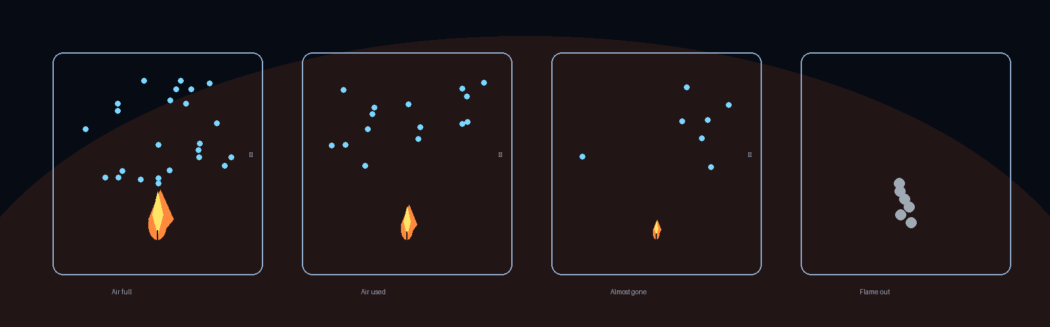
CHAPTER 06 · OBSERVATION
The flame goes out.
The flame gradually weakens… then the candle goes out after a short time.
Prediction check: B matches the observation best.
Notes:
TEACHER EXPLANATION
Walk the strip: full → used → almost gone → out.
SCIENTIFIC POINT
Available air decreases; flame strength falls with it.
SUGGESTED STUDENT QUESTION
Did the flame die instantly or gradually?
EXPECTED ANSWER
Gradually — then it went out.
TEACHING TIP
Connect back to student predictions kindly.

Slide 9



CHAPTER 07 · WHY?
The air inside was used up.
In a closed jar, the air is used up. Once it runs out, the candle goes out.
Notes:
TEACHER EXPLANATION
Walk left to right through the four frames.
SCIENTIFIC POINT
Closed system → air used up → burning stops.
SUGGESTED STUDENT QUESTION
Why can't the candle keep burning forever under the lid?
EXPECTED ANSWER
Fresh air cannot enter to replace used air.
TEACHING TIP
Avoid claiming exact oxygen percentages for Grade 6.

Slide 10
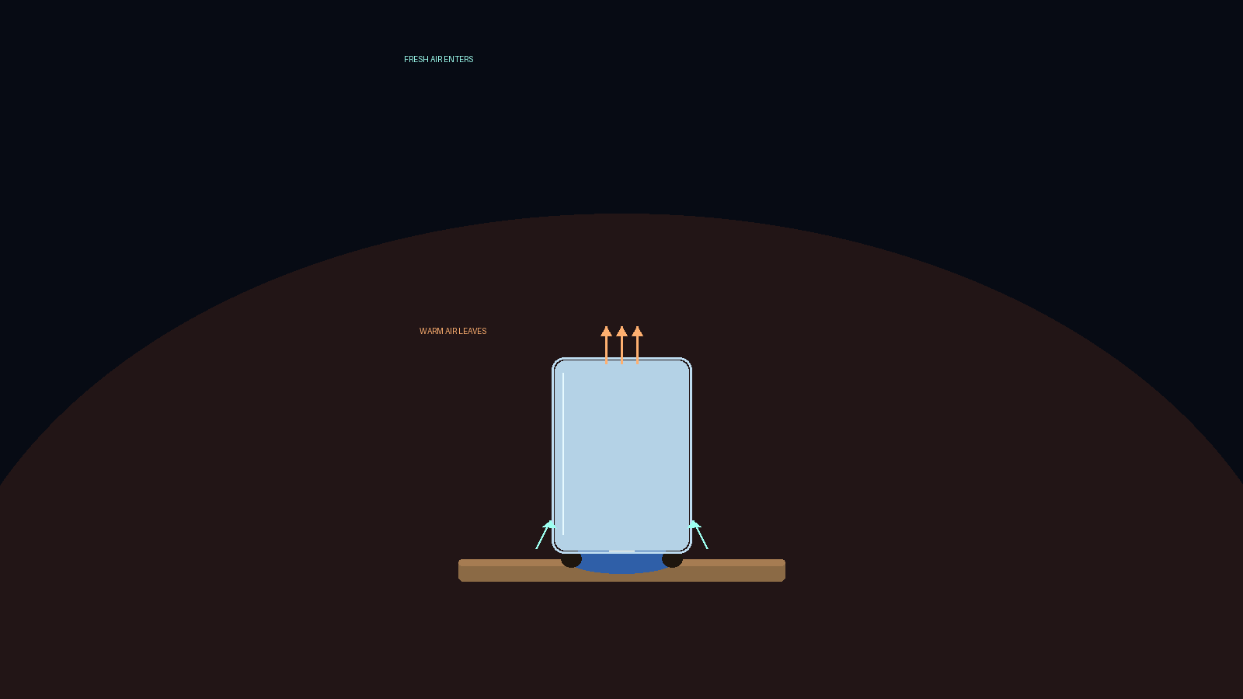
CHAPTER 08 · FRESH AIR
Fresh air in. Warm air out.
Gap at the bottom + opening at the top → air is constantly renewed.
Notes:
TEACHER EXPLANATION
Trace cyan arrows in, warm arrows out.
SCIENTIFIC POINT
Continuous renewal of air allows burning to continue.
SUGGESTED STUDENT QUESTION
Which way does warm air tend to move?
EXPECTED ANSWER
Upward — out the top opening.
TEACHING TIP
Introduce renew / replace gently.

Slide 11
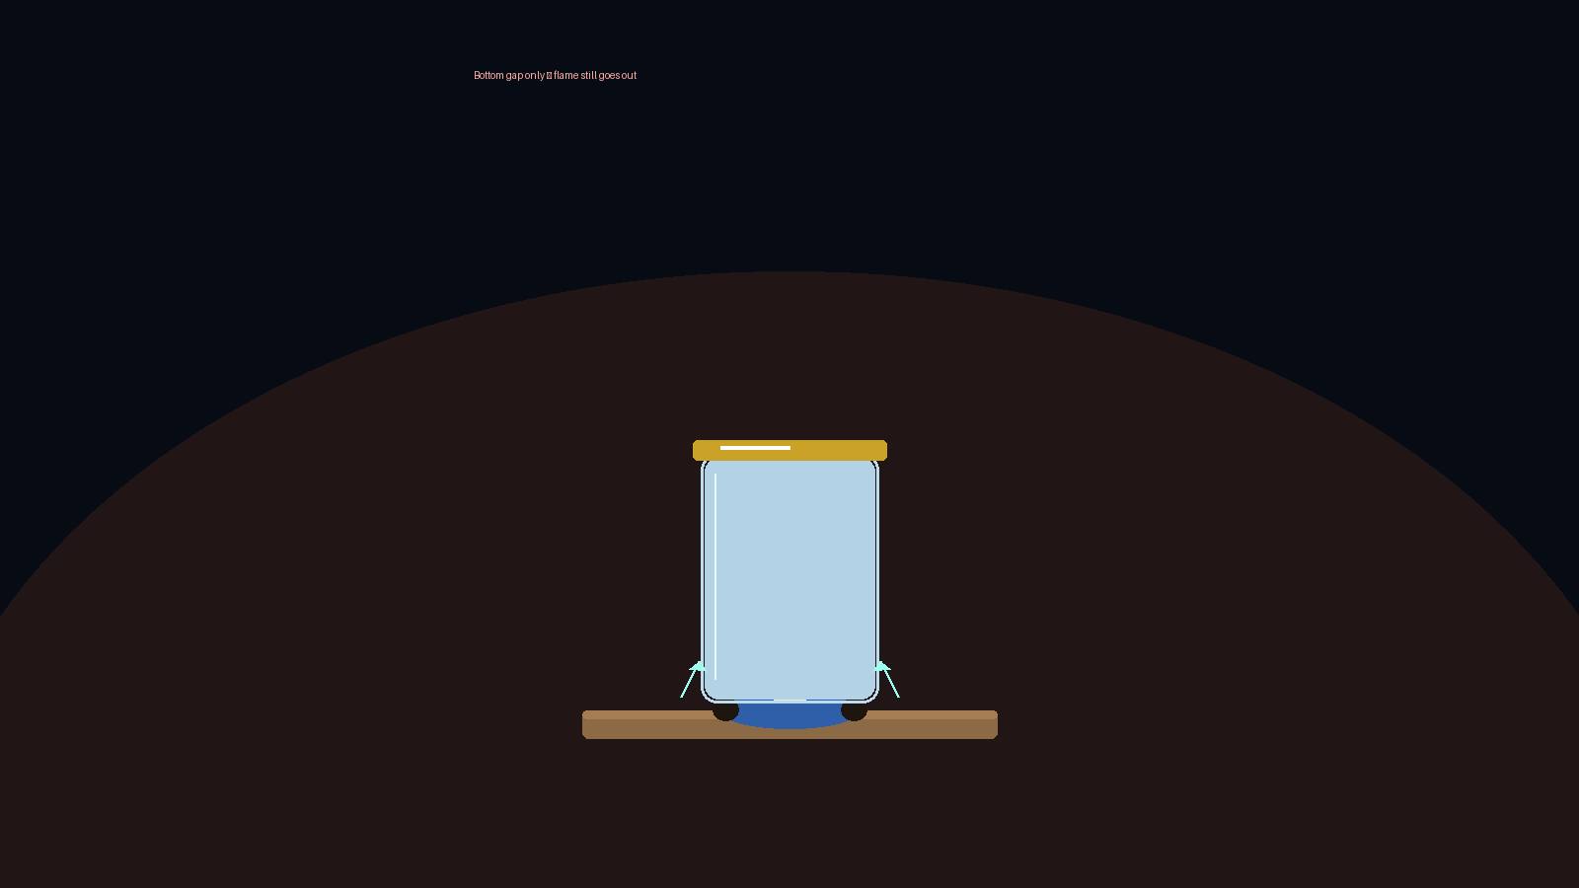
EXPERIMENT NUANCE
Bottom gap alone is not enough.
Lid on + small bottom gap → flame goes out after a slightly longer time.
Notes:
TEACHER EXPLANATION
Prevent the misconception that one opening is enough.
SCIENTIFIC POINT
Without a top exit, air cannot circulate well enough.
SUGGESTED STUDENT QUESTION
Why might it last a little longer than fully sealed?
EXPECTED ANSWER
A little air can enter — but not enough continuous renewal.
TEACHING TIP
Keep language Grade 6: renew, openings, continue burning.

Slide 12
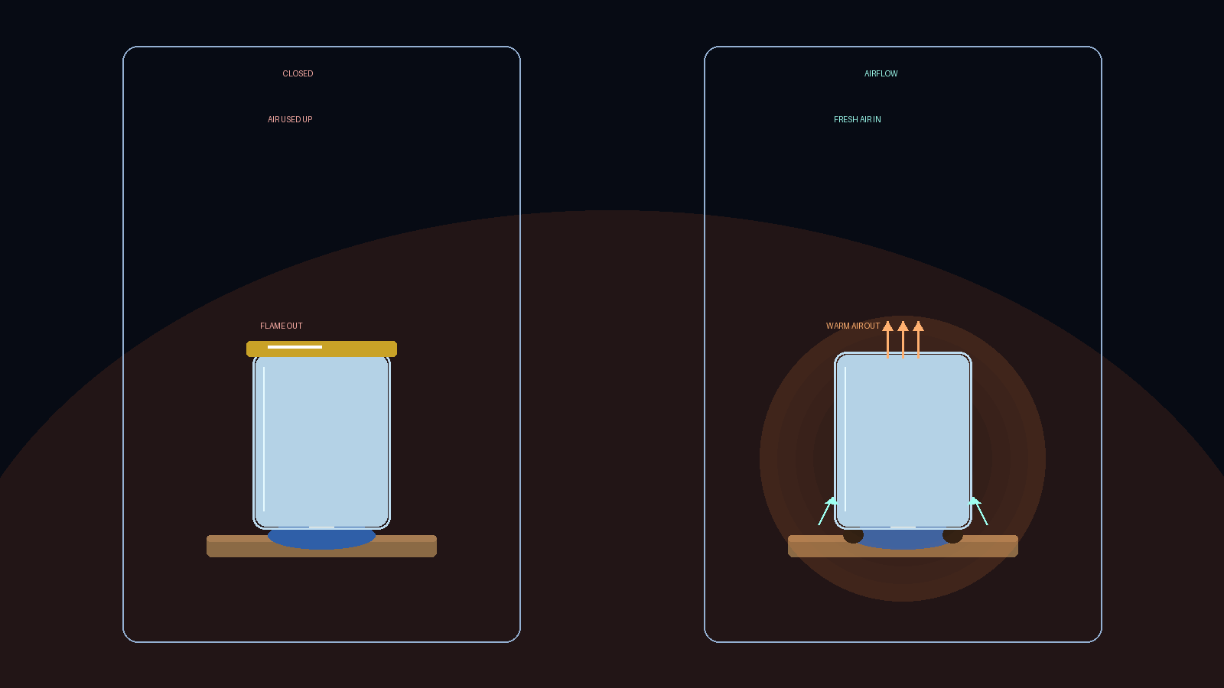
CHAPTER 09 · THE AHA MOMENT
Closed vs. airflow.
Sealed air runs out. Continuous fresh air keeps burning going.
Notes:
TEACHER EXPLANATION
Have students explain the difference to a partner.
SCIENTIFIC POINT
Both top and bottom openings matter for renewal in this setup.
SUGGESTED STUDENT QUESTION
Which side would you use to keep a flame alive longer?
EXPECTED ANSWER
The airflow side.
TEACHING TIP
Celebrate the aha — this is the core discovery.

Slide 13
DIAGRAM · EDITABLE SHAPES
Build the science with shapes.
Closed (left) vs airflow (right) — PowerPoint objects you can edit.
CLOSED
AIRFLOW
Notes:
TEACHER EXPLANATION
Ungroup/edit these shapes live with students if useful.
SCIENTIFIC POINT
Visual model of chimney-style airflow.
SUGGESTED STUDENT QUESTION
What do the cyan arrows mean? The warm arrow?
EXPECTED ANSWER
Fresh air entering; warm air leaving.
TEACHING TIP
Keep editable — do not flatten this slide to a picture.

Slide 14

CHAPTER 10 · THE SCIENCE
What is meant by burning?
A reaction between oxygen and a substance that produces heat and light.
Fuel
+
Oxygen
+
Heat
→
Heat + Light
Notes:
TEACHER EXPLANATION
Read the definition aloud together.
SCIENTIFIC POINT
Combustion: oxygen + substance → heat + light.
SUGGESTED STUDENT QUESTION
Is oxygen the only thing needed?
EXPECTED ANSWER
No — also a substance (fuel) and conditions for the reaction (heat).
TEACHING TIP
Keep the official definition wording close to the source lesson.

Slide 15
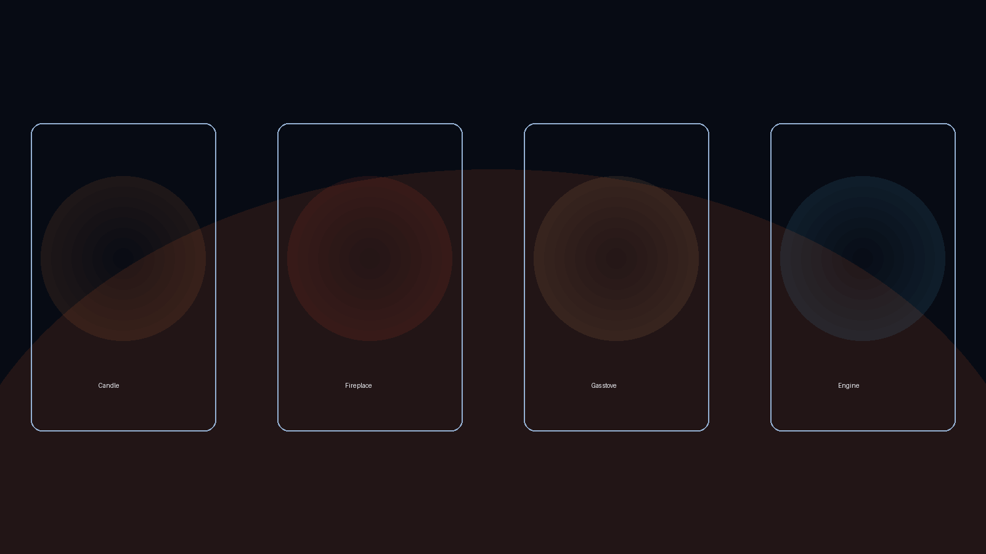
CHAPTER 11 · REAL WORLD
Where do we see this?
Burning needs a continuous supply of fresh air.
Candle · Fireplace · Gas stove · Engine
Notes:
TEACHER EXPLANATION
Ask for local examples (campfire, kitchen, heater).
SCIENTIFIC POINT
Real systems are designed so air can renew.
SUGGESTED STUDENT QUESTION
Why do fireplaces have chimneys?
EXPECTED ANSWER
To let warm air out so fresh air can enter.
TEACHING TIP
Keep connections concrete for Grade 6.

Slide 16
CHAPTER 12 · SCIENCE CHALLENGE
Which candle burns longer?
Choose carefully — then reveal.
A
Candle A — jar sealed with a lid, no gaps.
B
Candle B — lid on, but a small gap only at the bottom.
C
Candle C — gap at the bottom and open at the top.
Answer: C — both openings renew air so burning can continue.
B lasts a bit longer than A, but still goes out.
Notes:
TEACHER EXPLANATION
Hide/reveal the answer when presenting live.
SCIENTIFIC POINT
Correct: both openings (bottom + top).
SUGGESTED STUDENT QUESTION
Why isn't B good enough?
EXPECTED ANSWER
Bottom-only gap still cannot fully renew air with the lid on.
TEACHING TIP
Use as formative check before conclusions.

Slide 17
FINAL DISCOVERY
Air plays an important role in burning.
Fresh air must continuously be supplied for burning to continue.
1. Air has a role in burning.
2. Fresh air must constantly flow in and out for burning to continue.
3. Where air is not renewed, things cannot continue burning.
Notes:
TEACHER EXPLANATION
Read each conclusion slowly. Ask students to restate in their own words.
SCIENTIFIC POINT
These three statements are the authoritative lesson takeaways.
SUGGESTED STUDENT QUESTION
Can you give one sentence that captures all three?
EXPECTED ANSWER
Burning needs fresh air renewed; without renewal, fire stops.
TEACHING TIP
Post these on the board for the rest of the week.

Slide 18
REMEMBER
Investigation complete.
Air is invisible — but essential for a flame to keep burning.
Fuel + Oxygen + Heat → Heat + Light
Notes:
TEACHER EXPLANATION
Close by returning to the opening question — now students can answer it.
SCIENTIFIC POINT
Air (with oxygen) is required for continued burning; renewal matters.
SUGGESTED STUDENT QUESTION
What does a flame need to keep burning?
EXPECTED ANSWER
Fuel, heat, and a continuous supply of fresh air (oxygen).
TEACHING TIP
Optional: replay the HTML experience as a station rotation.

