Slide 1
Vertex 2
I₀
I₁
Scan Line
p
Vertex 0
Vertex 1

Slide 2
y
Vertex 2
I₀
I₁
Scan Line
p
Vertex 0
Vertex 1
x
p = ((y₃-y₁)/(y₀-y₁))*I₀ + ((y₀-y₃)/(y₀-y₁))*I₁

Slide 3
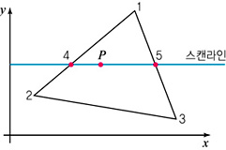
I₃ = ((y₃-y₁)/(y₀-y₁))*I₀ + ((y₀-y₃)/(y₀-y₁))*I₁
2
N₁
0
N₄
N₅
N_{p}
1
N₂
N₃
I_{p} = ((x₄-x_{p})/(x₄-x₃))*I₃ + ((x_{p}-x₃)/(x₄-x₃))*I₄
x: 각 점의 x 좌표, y: 각 점의 y 좌표

