Slide 1
Splines
Jehee Lee
Seoul National University

Slide 2
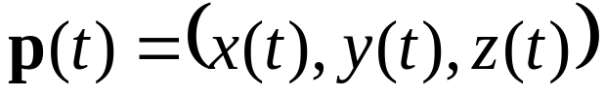
Particle Motion
A curve in 3-dimensional space
World coordinates

Slide 3

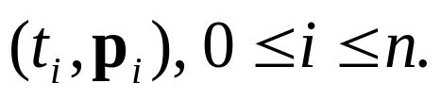
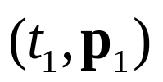
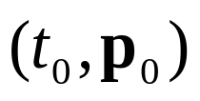
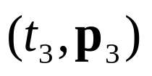
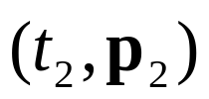
Keyframing Particle Motion
Find a smooth function that passes through given keyframes
World coordinates

Slide 4
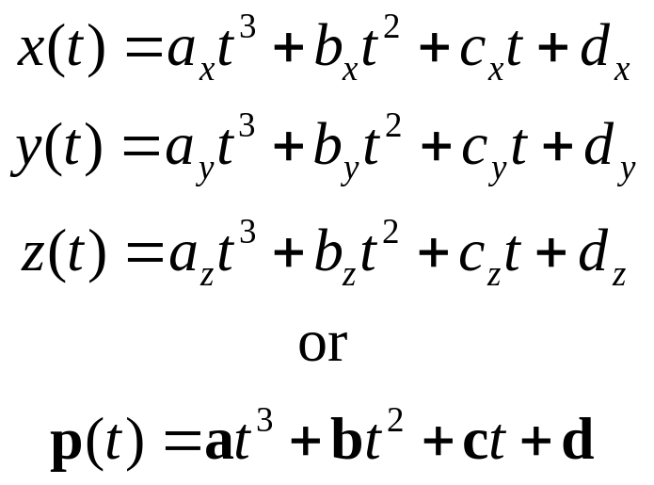
Polynomial Curve
Mathematical function vs. discrete samples
  Compact
  Resolution independence
Why polynomials ?
  Simple
  Efficient
  Easy to manipulate
  Historical reasons

Slide 5
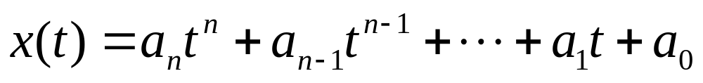
Degree and Order
Polynomial
  Order n+1 (= number of coefficients)
  Degree n

Slide 6
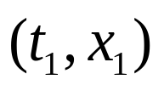
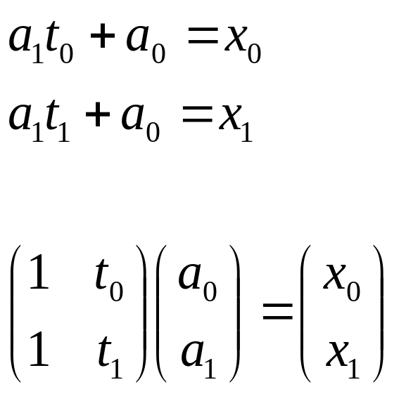
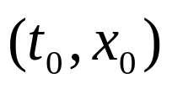
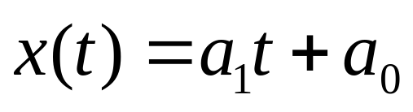
Polynomial Interpolation
Linear interpolation with a polynomial of degree one
  Input: two nodes
  Output: Linear polynomial

Slide 7
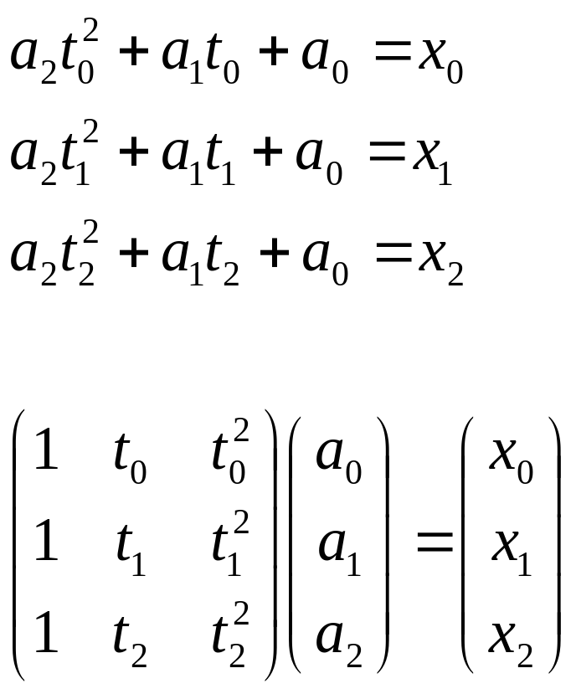
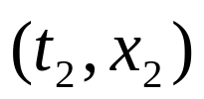
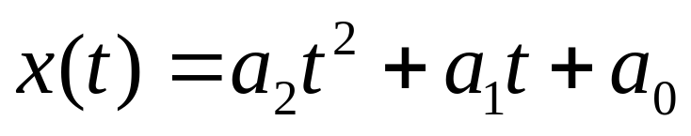
Polynomial Interpolation
Quadratic interpolation with a polynomial of degree two

Slide 8
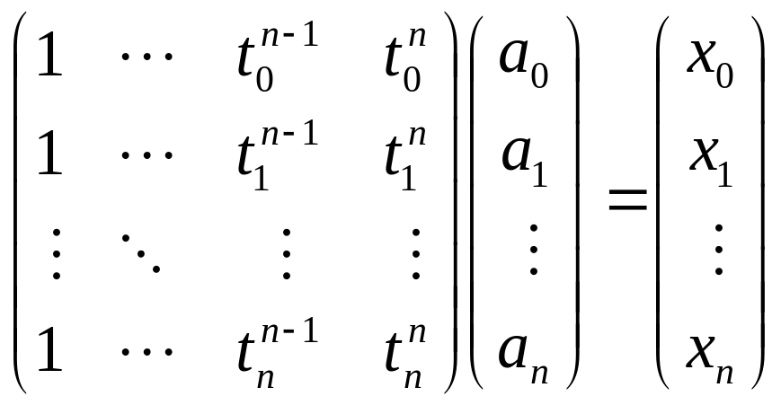
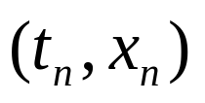
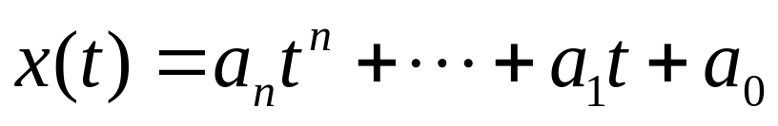
Polynomial Interpolation
Polynomial interpolation of degree n
Do we really need to solve the linear system ?

Slide 9
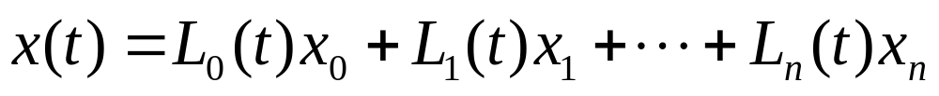
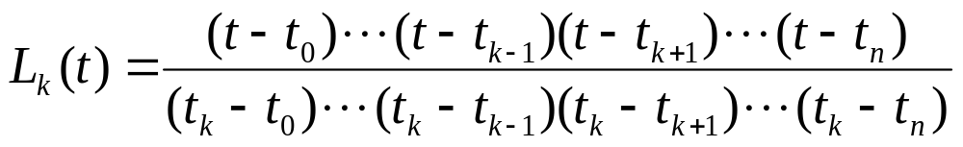
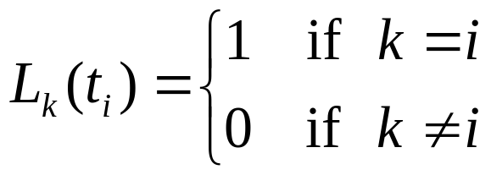
Lagrange Polynomial
Weighted sum of data points and cardinal functions
Cardinal polynomial functions

Slide 10
Limitation of Polynomial Interpolation
Oscillations at the ends
  Nobody uses higher-order polynomial interpolation now
Demo
  Lagrange.htm

Slide 11










Spline Interpolation
Piecewise smooth curves
  Low-degree (cubic for example) polynomials
  Uniform vs. non-uniform knot sequences
Time

Slide 12
Why cubic polynomials ?
Cubic (degree of 3) polynomial is a lowest-degree polynomial representing a space curve
Quadratic (degree of 2) is a planar curve
  Eg). Font design
Higher-degree polynomials can introduce unwanted wiggles

Slide 13
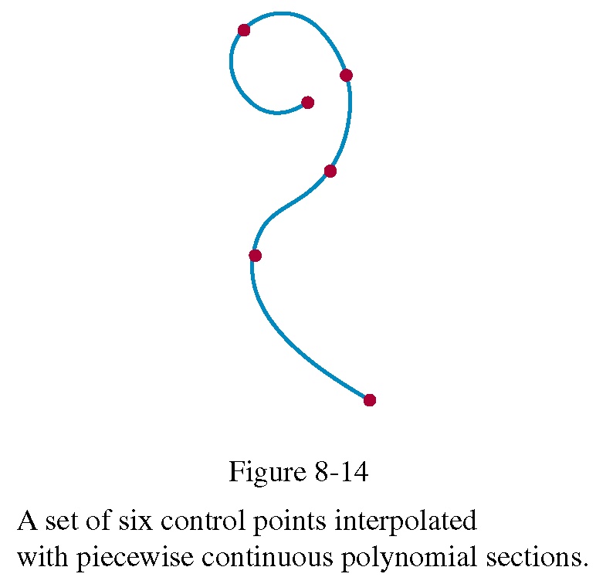
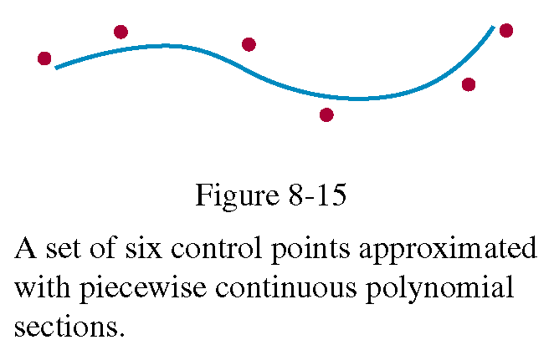
Interpolation and Approximation

Slide 14
Continuity Conditions
To ensure a smooth transition from one section of a piecewise parametric spline to the next, we can impose various continuity conditions at the connection points
Parametric continuity
  Matching the parametric derivatives of adjoining curve sections at their common boundary
Geometric continuity
  Geometric smoothness independent of parametrization
  parametric continuity is sufficient, but not necessary, for geometric smoothness

Slide 15
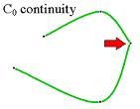


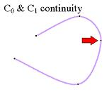
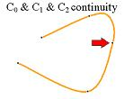

Parametric Continuity
Zero-order parametric continuity
  -continuity
  Means simply that the curves meet
First-order parametric continuity
  -continuity
  The first derivatives of two adjoining curve functions are equal
Second-order parametric continuity
  -continuity
  Both the first and the second derivatives of two adjoining curve functions are equal

Slide 16


Geometric Continuity
Zero-order geometric continuity
  Equivalent to -continuity
First-order geometric continuity
  -continuity
  The tangent directions at the ends of two adjoining curves are equal, but their magnitudes can be different
Second-order geometric continuity
  -continuity
  Both the tangent directions and curvatures at the ends of two adjoining curves are equal

Slide 17
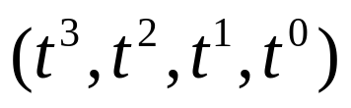
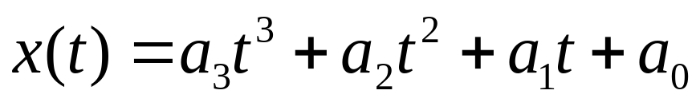

Basis Functions
A linear space of cubic polynomials
  Monomial basis
  The coefficients do not give tangible geometric meaning

Slide 18
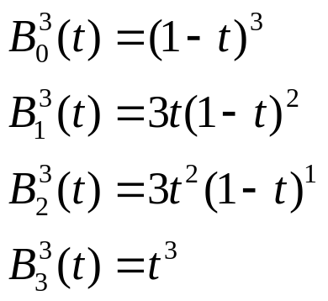
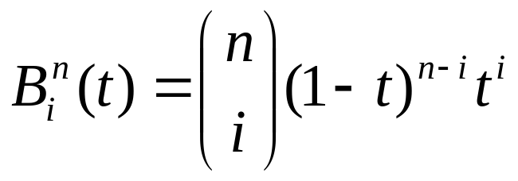
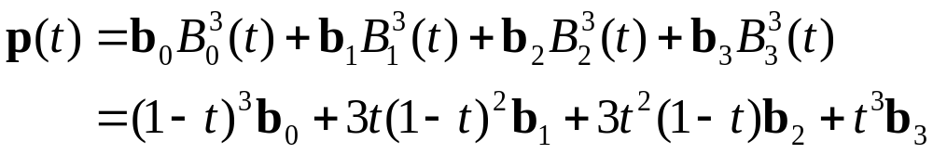
Bezier Curve
Bernstein basis functions
Cubic polynomial in Bernstein bases

Slide 19
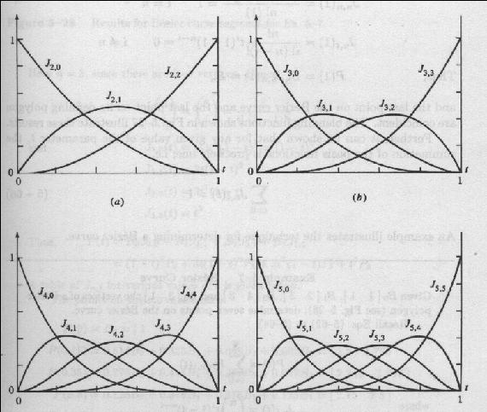
Bernstein Basis Functions

Slide 20
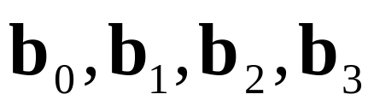
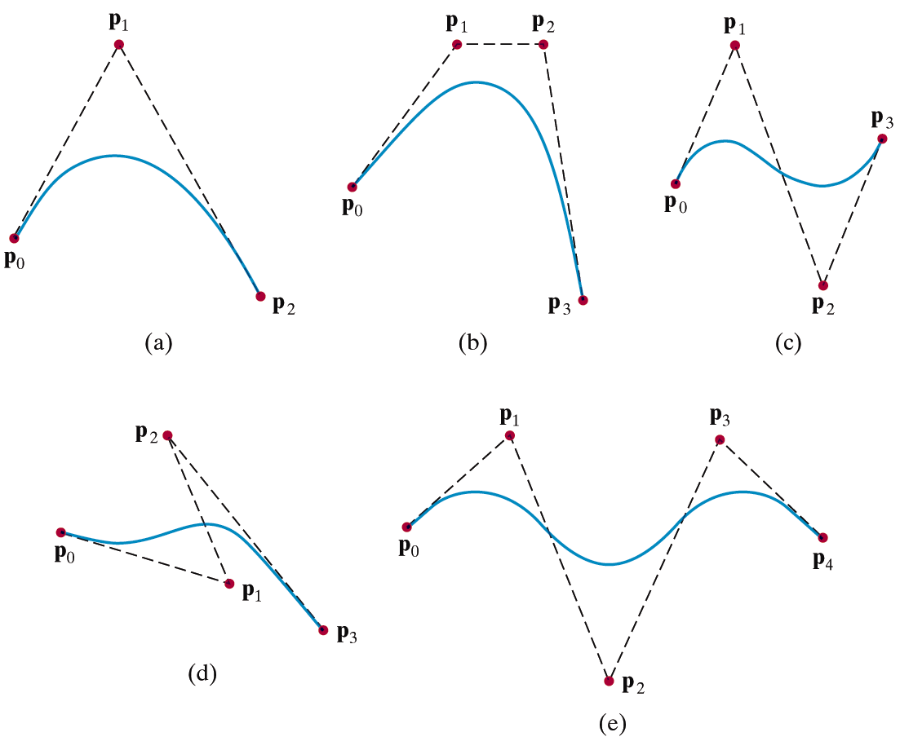
Bezier Control Points
Control points (control polygon)
Demo
  Bezier.htm

Slide 21
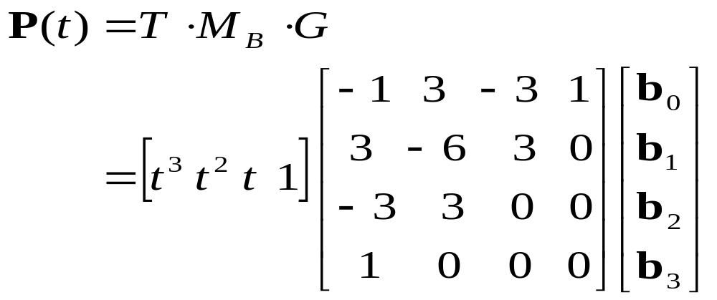
Bezier Curves in Matrix Form

Slide 22
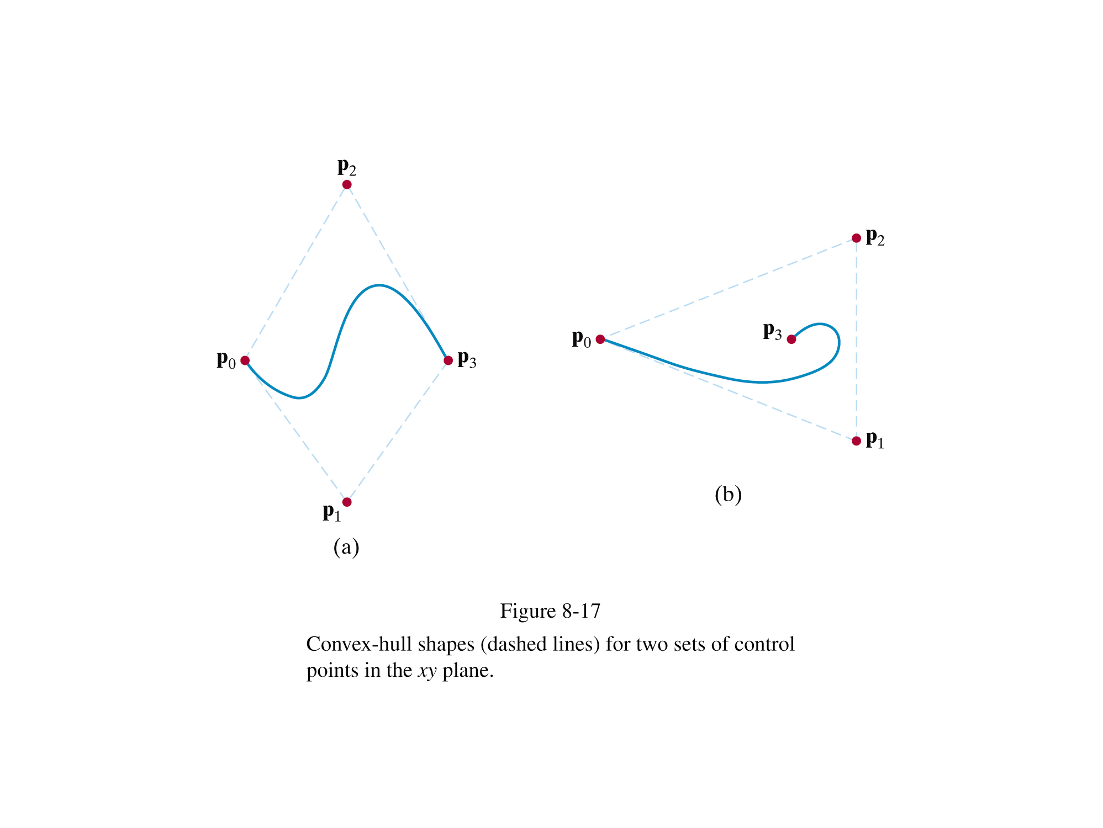
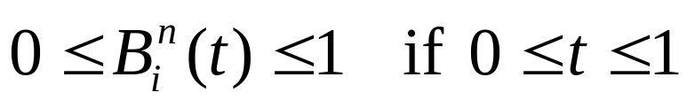
Properties of Bezier Curves
Invariance under affine transformation
  Partition of unity of Bernstein basis functions
The curve is contained in the convex hull of the control polygon
Variation diminishing
  the curve in 2D space does not oscillate about any straight line more often than the control point polygon

Slide 23
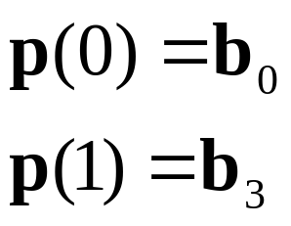

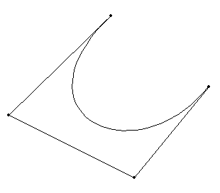
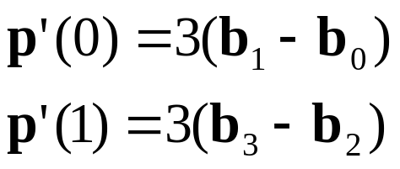



Properties of Cubic Bezier Curves
End point interpolation
The tangent vectors to the curve at the end points are coincident with the first and last edges of the control point polygon

Slide 24
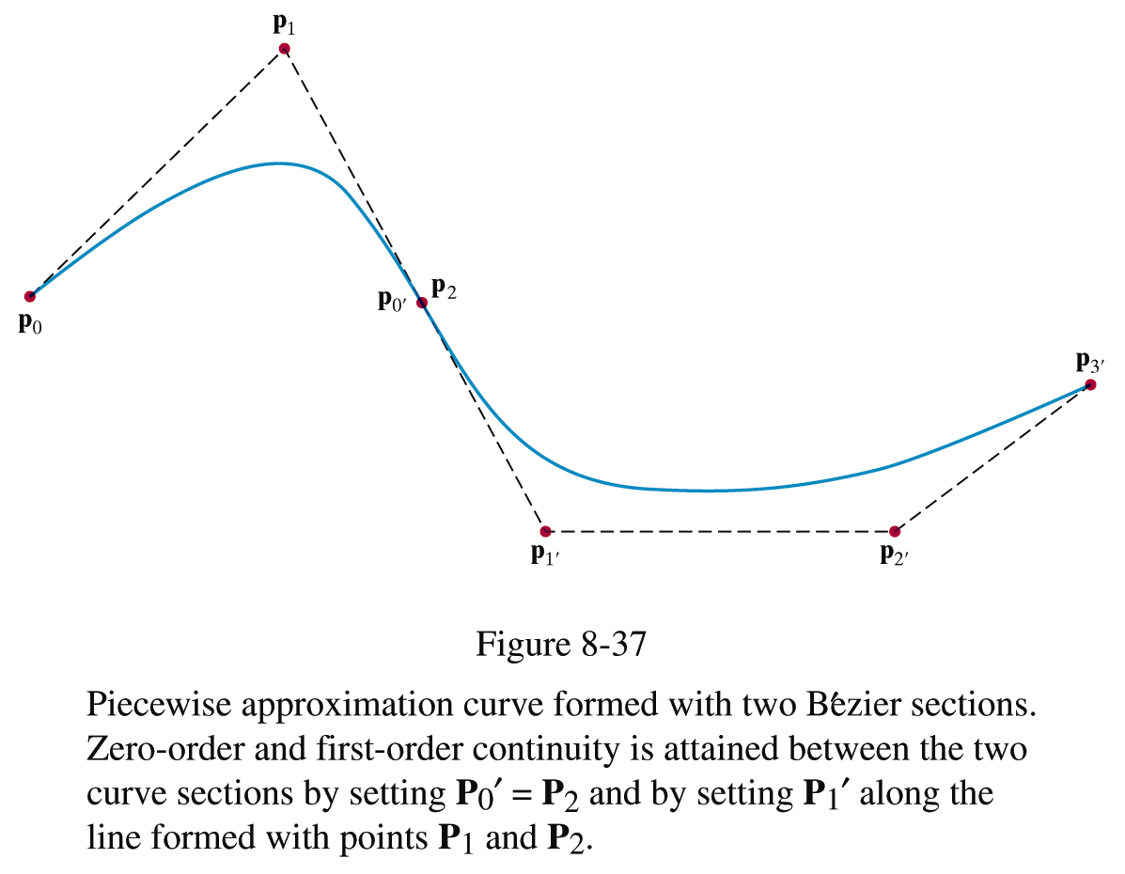
Properties of Cubic Bezier Curves

Slide 25
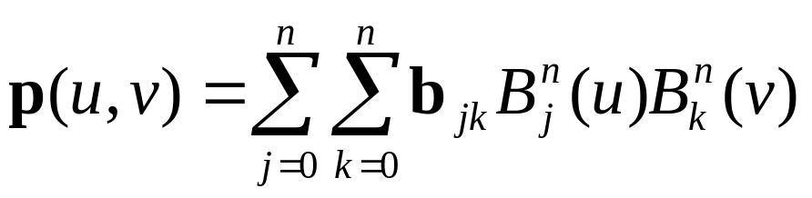
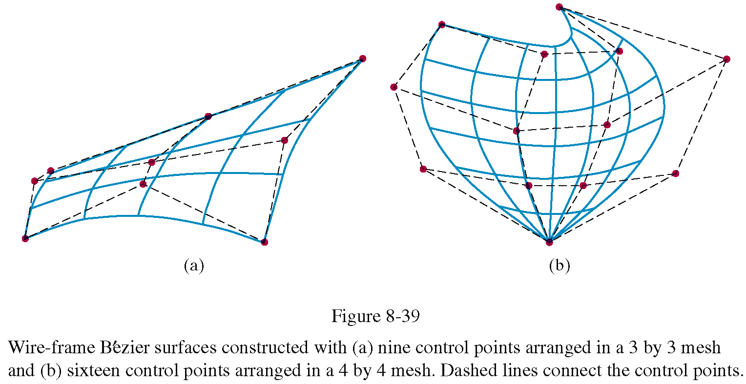
Bezier Surfaces
The Cartesian (tensor) product of Bernstein basis functions

Slide 26
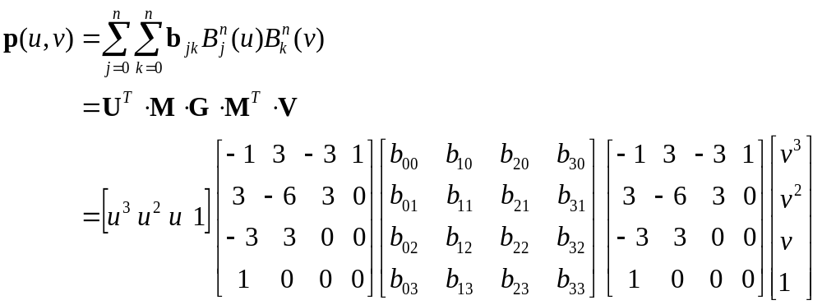
Bezier Surface in Matrix Form

Slide 27
Bezier Splines with Tangent Conditions
Find a piecewise Bezier curve that passes through given keyframes and tangent vectors
Adobe Illustrator provides a typical example of user interfaces for cubic Bezier splines

Slide 29
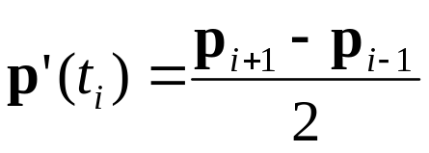

Catmull-Rom Splines
Polynomial interpolation without tangent conditions
  -continuity
  Local controllability
Demo
  CatmullRom.html

Slide 30

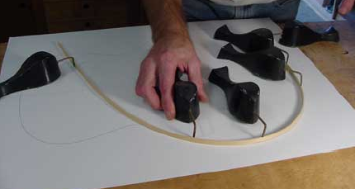
Natural Cubic Splines
Is it possible to achieve higher continuity ?
  -continuity can be achieved from splines of degree n
Motivated by loftman’s spline
  Long narrow strip of wood or plastic
  Shaped by lead weights (called ducks)

Slide 31
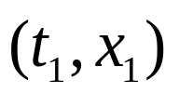
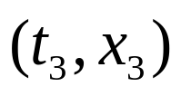
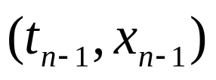
Natural Cubic Splines
We have 4n unknowns
  n Bezier curve segments (4 control points per each segment)
We have (4n-2) equations
  2n equations for end point interpolation
  (n-1) equations for tangential continuity
  (n-1) equations for second derivative continuity
Two more equations are required !

Slide 32
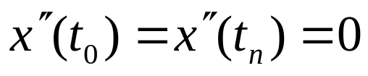

Natural Cubic Splines
Natural spline boundary condition
Closed boundary condition
High-continuity, but no local controllability
Demo
  natcubic.html
  natcubicclosed.html

Slide 33



B-splines
Is it possible to achieve both -continuity and local controllability ?
  B-splines can do !
  But, B-splines do not interpolate any of control points
Uniform cubic B-spline basis functions

Slide 34

B-Splines in Matrix Form

Slide 35
Uniform B-spline basis functions
Bell-shaped basis function for each control points
Overlapping basis functions
  Control points correspond to knot points

Slide 36
B-spline Properties
Convex hull
Affine invariance
Variation diminishing
-continuity
Local controllability
Demo
  Bspline.html

Slide 37

NURBS
Non-uniform Rational B-splines
  Non-uniform knot spacing
  Rational polynomial
    A polynomial divided by a polynomial
    Can represent conics (circles, ellipses, and hyperbolics)
    Invariant under projective transformation
Note
  Uniform B-spline is a special case of non-uniform B-spline
  Non-rational B-spline is a special case of rational B-spline

Slide 38


Cubic Spline Interpolation in a B-Spline Form

Slide 39


Conversion Between
Spline Representations
Sometimes it is desirable to be able to switch from one spline representation to another
For example, both B-spline and Bezier curves represent polynomials, so either can be used to go from one to the other
The conversion matrix is

Slide 40


Displaying Spline Curves
Forward-difference calculation
  Generate successive values recursively by incrementing previously calculated values
  For example, consider a cubic polynomial
  We want to calculate x(t) at tk for k=0,1,2,…

Slide 41


Displaying Spline Curves
Forward-difference calculation
  Two successive values of a cubic polynomial
  The forward difference is a quadratic polynomial with respect to t

Slide 42


Displaying Spline Curves
Forward-difference calculation
  The second- and third-order forward difference
  Incremental evaluation of polynomial

Slide 43
Procedurally Defined Curves
De Casteljau Algorithm
B-spline subdivision
Corner Cutting
Subdivision surfaces

Slide 44


De Casteljau Algorithm
Subdivision of a Bezier Curve into two curve segments

Slide 45



Curve Refinement
Subdivide a curve into two segments
Figures and equations were taken from http://graphics.idav.ucdavis.edu/education/CAGDNotes/homepage.html

Slide 46


Review: Matrix Equations for B-splines
Cubic B-spline curves
Monomial Bases
Geometric Matrix
Control Points

Slide 47

Binary Subdivision
The left segment

Slide 48


Binary Subdivision

Slide 49

Binary Subdivision

Slide 50


The Subdivision Rule for Cubic B-Splines
The new control polygon consists of
  Edge points: the midpoints of the line segments
  Vertex points: the weighted average of the corresponding vertex and its two neighbors

Slide 51

Recursive Subdivision
Recursive subdivision brings the control polygon to converge to a cubic B-spline curve
Control polygon + subdivision rule
  Yet another way of defining a smooth curve

Slide 52



Chaikin’s Algorithm
Corner cutting (non-stationary subdivision)
Converges to a quadratic B-spline curve
Demo: subdivision.htm

Slide 53


Interpolating Subdivision
The original control points are interpolated
  Vertex points: The original control points
  Edge points: The weighed average of the original points
Stationary subdivision
Demo: subdivision.htm

Slide 54

Subdivision Surfaces
bi-cubic uniform B-spline patch can be subdivided into four subpatches

Slide 55




Catmull-Clark Surfaces
Generalization of the bi-cubic B-spline subdivision rule for arbitrary topological meshes

Slide 56




Catmull-Clark Surfaces

Slide 57

Subdivision in Action
A Bug’s Life

Slide 58

Subdivision in Action
Geri’s Game

Slide 59
Summary
Polynomial interpolation
  Lagrange polynomial
Spline interpolation
  Piecewise polynomial
  Knot sequence
  Continuity across knots
    Natural spline ( -continuity)
    Catmull-Rom spline ( -continuity)
  Basis function
    Bezier
    B-spline
Procedurally defined curves

Slide 60
Programming Assignment #3:
Swept Surface
A swepted surface has a sequence of cross sections
Each cross section is specified by using either closed B-splines or Catmull-Rom splines
Then, a sequence of transformations (scaling + rotation + translation) is defined to bring cross sections at desired 3D locations.
A smooth sweep surface can be constructed to interpolate those cross sections using three Catmull-Rom splines that interpolate scaling factors, orientations, positions, and shape (control points) of the cross sections.

Slide 61
Programming Assignment #3:
Reruirement
(extra) You may implement a simple user interface for designing interpolating/approximating spline curves
(extra) The interface may allow for the user to add, move, and delete control points
Your system should allow for the user to rotate the scene so that we can inspect your surfaces at arbitrary view points
You will describe the control points of the cross section and transformations in the data file.
Your system should be able to parse the standard format so that we can compare your results side-by-side.
(extra) You may implement cubic natural splines, cubic b-spline subdivision, or interpolatory subdivision

Slide 62
Programming Assignment #3:
Requirement
You should construct a closed curve using either B-splines or Catmull-Rom splines depending on what the data file demands.
You will describe a sequence of transformations in the data file. Each transformation represents scaling, followed by rotation, followed by translation.
Submit at least three data files of your own
You are required to write and submit a report of less than five A4 pages. This report should describe
  how you implemented
  what you have done, and
  what you haven’t done.

Slide 63
Programming Assignment #3:
File Format
BSPLINE # Curve type (BSPLINE or INTERPOLATION)
8 # The number of keyframes
7 # The number of control points of the cross section.
########### The first frame
10 10 # The 2D position of the first control point within X-Z plane
15 25 # The second control point
… #
1 # Scaling factor
1.2 1 0 0 # The orientation as a rotation about (1,0,0) by angle 1.2
10 50 30 # Position
########### The second frame
5 10 # the first control point
10 15 # the second control point
… #
0.8 # The scaling factor at the second frame
0.5 0 1 2 # The orientation of the second keyframe
20 10 40 # The position of the second keyframe
########### The third frame
…

Slide 64


Affine Combination of Unit Quaternions
Multi-linear method
  Evaluate n-point weighted sum as a series of slerps
Slerp
Slerp

Slide 65

Multi-Linear Method
Evaluate n-point weighted sum as a series of slerps
Slerp
Slerp

Slide 66

De Casteljau Algorithm
A procedure for evaluating a point on a Bezier curve
t : 1-t
P(t)
t : 1-t
t : 1-t

Slide 67





Quaternion Bezier Curve
Multi-linear construction
  Replace linear interpolation by slerp

Slide 68





Quaternion Bezier Spline
Find a smooth quaternion Bezier spline that interpolates given unit quaternions
  Catmull-Rom’s derivative estimation

Slide 69


Quaternion Bezier Spline
Find a smooth quaternion Bezier spline that interpolates given unit quaternions
  Catmull-Rom’s derivative estimation

Slide 70

Quaternion Bezier Spline
Find a smooth quaternion Bezier spline that interpolates given unit quaternions
  Catmull-Rom’s derivative estimation
  Bezier control points (qi, ai, bi, qi+1) of i-th curve segment

