Slide 1

3D Game Programming 63
- OpenGL ES afewhee@gmail.com

Slide 2
0. 목차
OpenGL ES - 기초

Slide 3
OpenGL ES 1.X Programmable Pipeline
API
Triangles/Lines/Points
Primitive
Processing
Vertices
Transform
and
Lighting
Primitive
Assembly
Rasterizer
Vertex
Buffer
Objects
Texture
Environment
Colour
Sum
Fog
Alpha
Test
Depth
Stencil
Colour
Buffer
Blend
Dither
Frame Buffer

Slide 4
OpenGL ES 2.0 Programmable Pipeline
API
Triangles/Lines/Points
Primitive
Processing
Vertices
Vertex
Shader
Primitive
Assembly
Rasterizer
Vertex
Buffer
Objects
Fragment
Shader
Depth
Stencil
Color
Buffer
Blend
Dither
Frame Buffer

Slide 5



OpenGL ES – Khronos Group 관계
Feedback and Ratification
OpenGL ARB
Embedded System
Workstation

Slide 6




Khronos Group에서 관리하는 API
2005
2D Vector Graphics
2002
3D Graphics
2000
Streaming Media and Video
2005
Media

Slide 7
OpenGL ES Primitive
GL_POINTS
GL_LINES
GL_LINE_LOOP
GL_LINE_STRIP
GL_TRIANGLES
GL_TRIANGLE_STRIP
GL_TRIANGLE_FAN

Slide 8
Vertex Processing
Vertex
Shader
Primitive
Assembly
Rasterizer
Fragment
Shader

Slide 9
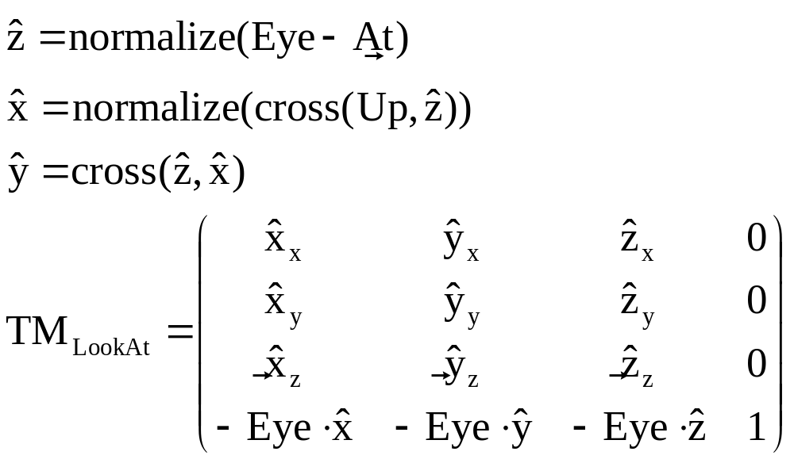






1. 카메라 클래스
Camera

Slide 10
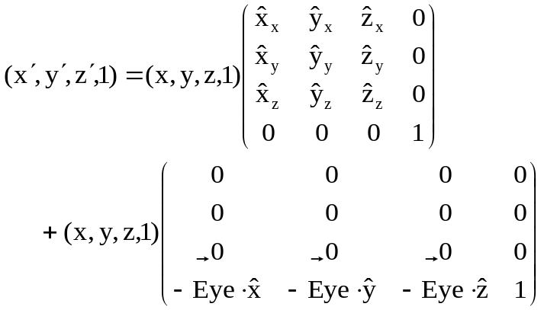




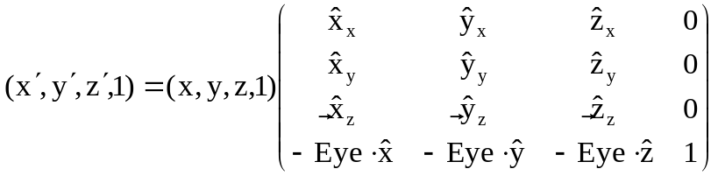


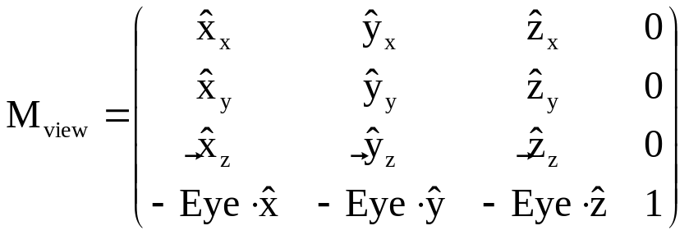
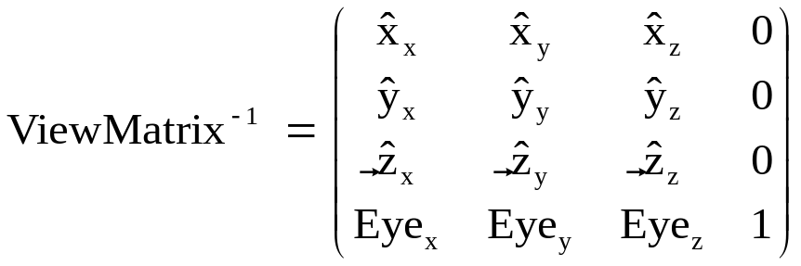
1. 카메라 클래스
뷰 행렬 계산
Camera
Object

