Slide 1
Virtual Classroom Assistant
Deiva Raja B 2022115118
Varun M 2022115120
Praveen Kumar P 2022115115
Introduction:
The Virtual Classroom Assistant is a web-based platform designed to enhance education by providing interactive features for both students and teachers.
It simplifies classroom management by having group chats, attendance tracking, and even includes a chatbot for students to assist with their queries

Slide 2
Problem Definition
Managing classrooms, interactions, and attendance is often challenging for both students and teachers.
This platform addresses these issues with secure logins, personalized dashboards, and tools for teachers to manage classes and assignments.
Students benefit from joining groups, viewing messages, participating in discussions, and using a chatbot for additional support.

Slide 3
Objectives:
Make Learning Fun:
Create an engaging platform that makes managing classrooms, group chats, and attendance easier for everyone.
Better Communication:
Help students and teachers communicate and interact easily.
Accessible for All:
Ensure the platform works well on the web, so it's accessible to all students and teachers, even those with limited digital access.
Reduce Teacher Workload:
Provide tools for simple class creation, assignment posting, and group management.
Personalized Dashboards:
Give students and teachers personalized dashboards to quickly access the information and resources they need.
Instant Support with Chatbot:
Include a chatbot that provides students with immediate support and answers to their questions, enhancing their learning experience.

Slide 4
Ideas:
Enhanced Analytics:
Provide teachers with advanced analytics on student performance and engagement.
Language Support:
Expand the number of languages supported by the chatbot and the platform.
Mobile App Development:
Create a dedicated mobile app to improve accessibility and user experience on smartphones and tablets.
Parent-Teacher Communication Tools:
Develop dedicated features to enhance communication between parents and teachers, like virtual parent-teacher conferences.

Slide 5
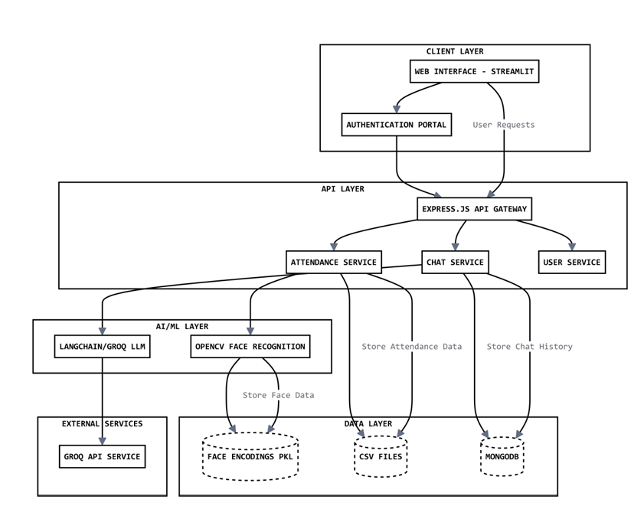
System Architecture:

Slide 6
Detailed design:
Front-End – User Interface using (HTML, CSS)
Login portal
2.Backend – Using MongoDB cloud(MongoDB Atlas)
3.Server side-Node.js, Express.js API gateway
core services:
Attendance tracking
Chat system
User management
Assignment posting & submission
4.Smart Features
OpenCV face recognition
LangChain/GROQ for chat
5.Data Storage
Face data → PKL files
Attendance → CSV
User chats → MongoDB3.

Slide 7
Tools and technologies used:
Tech Stack
Frontend:
HTML, CSS, JavaScript: For building and styling the user interface.
Backend:
Node.js, Express.js: For server-side logic and handling API requests.
Database:
MongoDB: For storing and managing data.
ML Modules:
OpenCV: For image processing tasks.
LangChain:
For natural language processing.
Generative AI: ollama

Slide 8
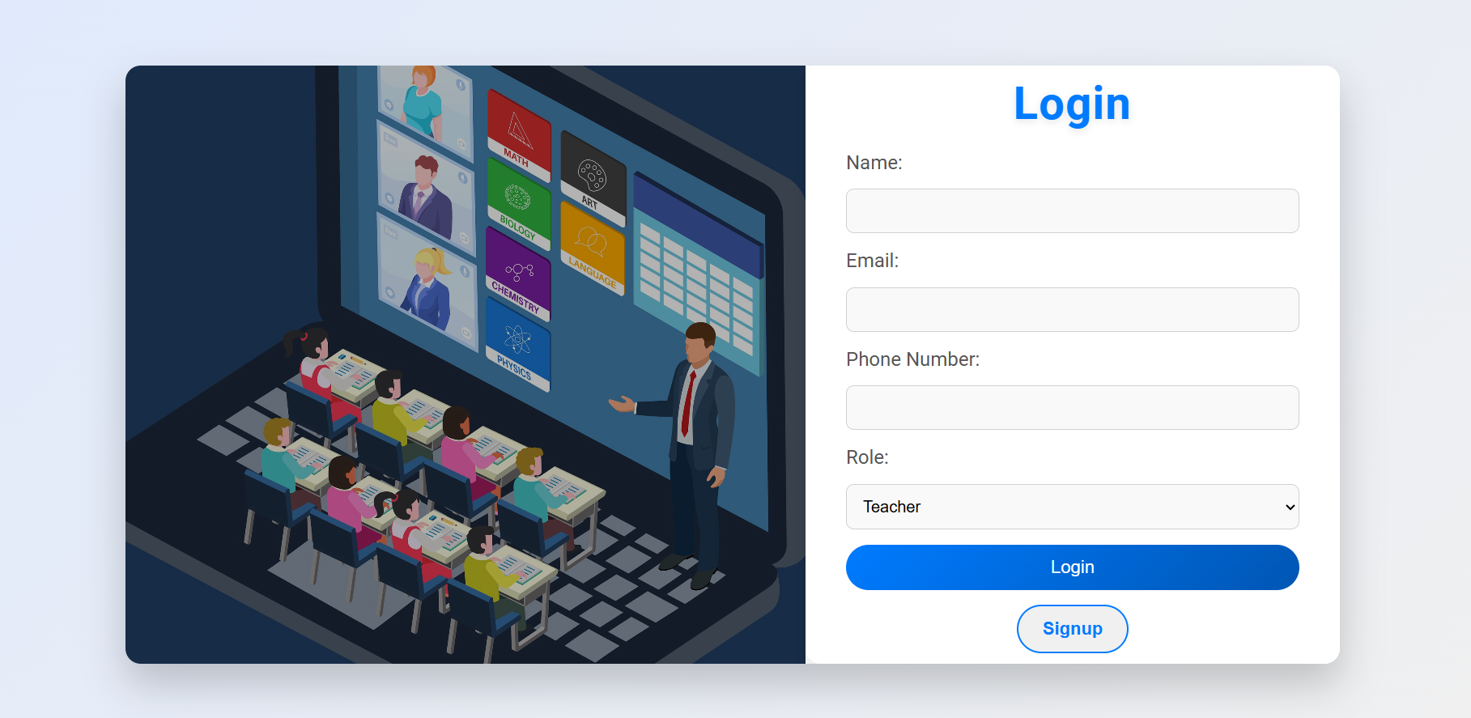
Screenshots of output

Slide 9
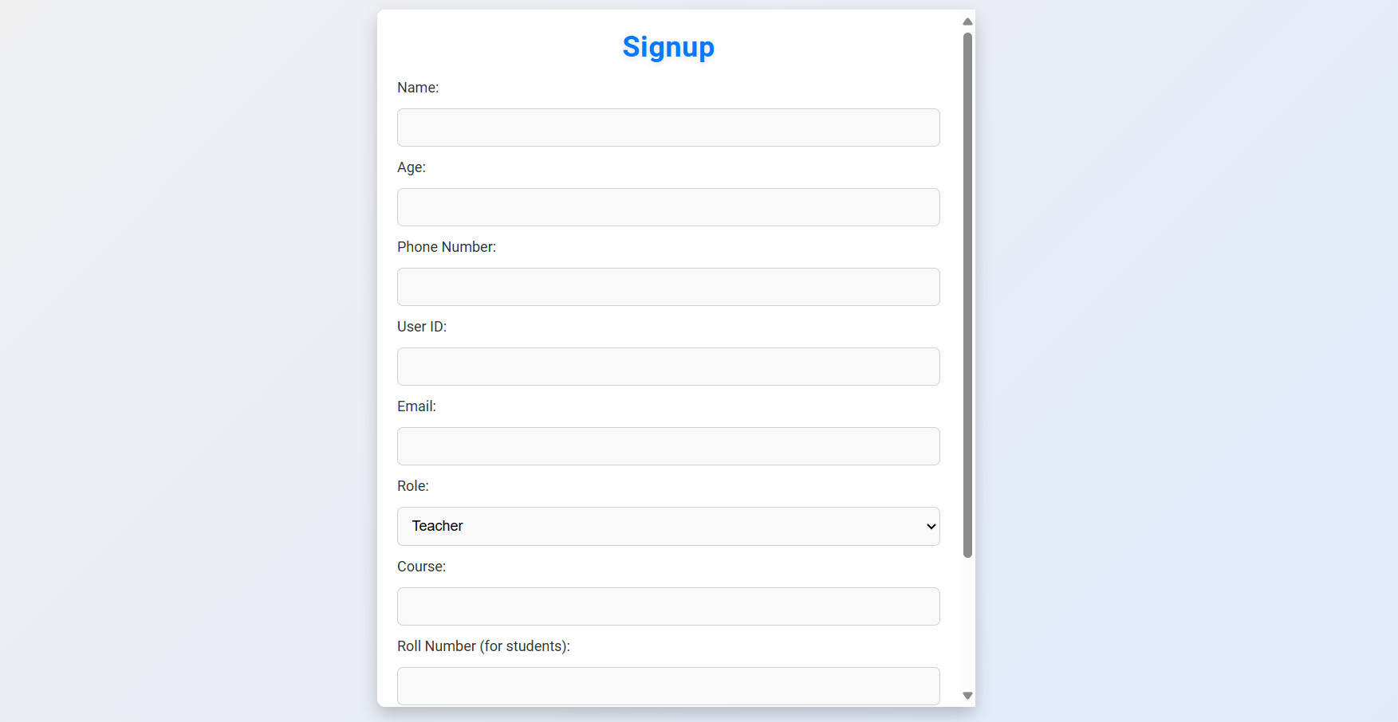

Slide 10
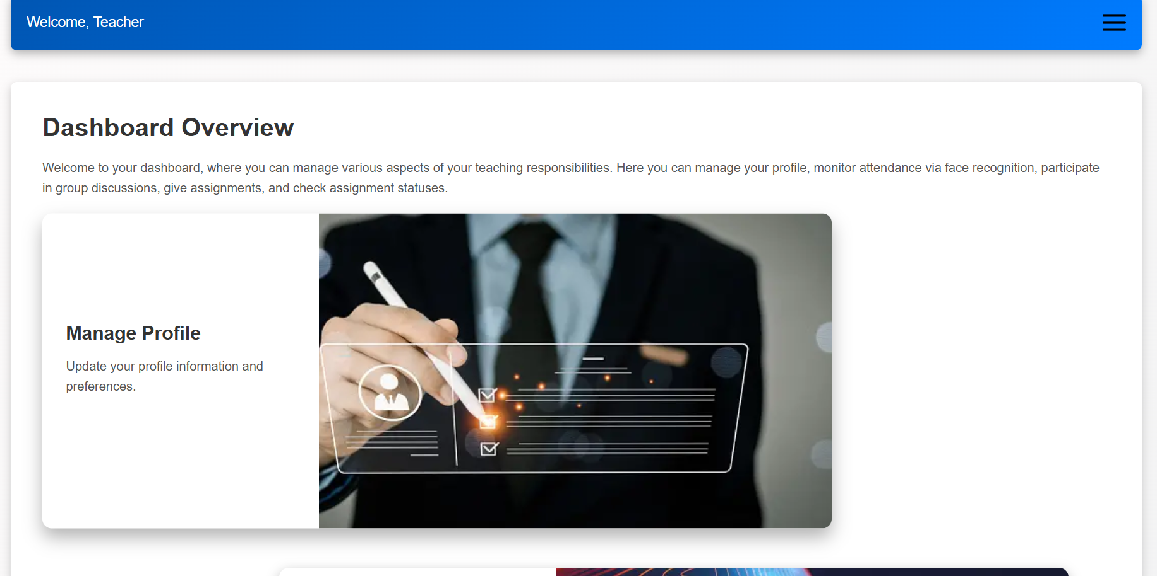

Slide 11
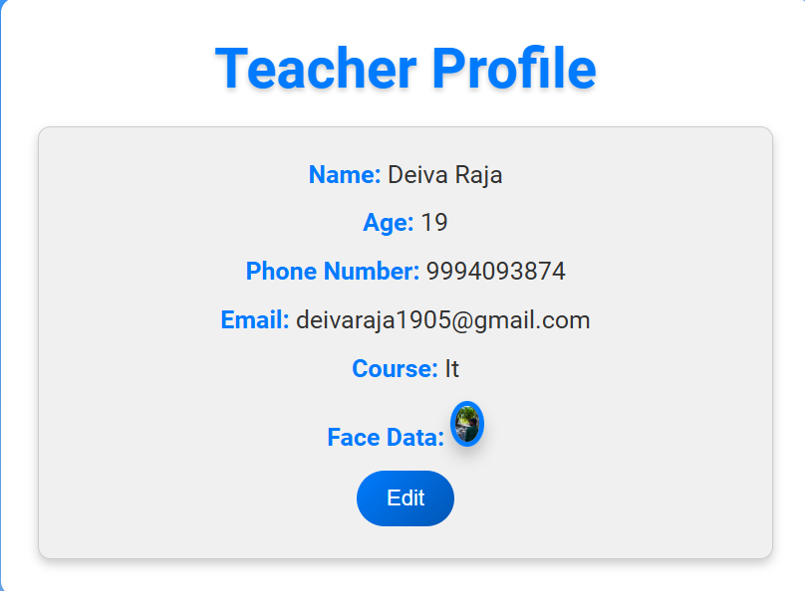

Slide 12
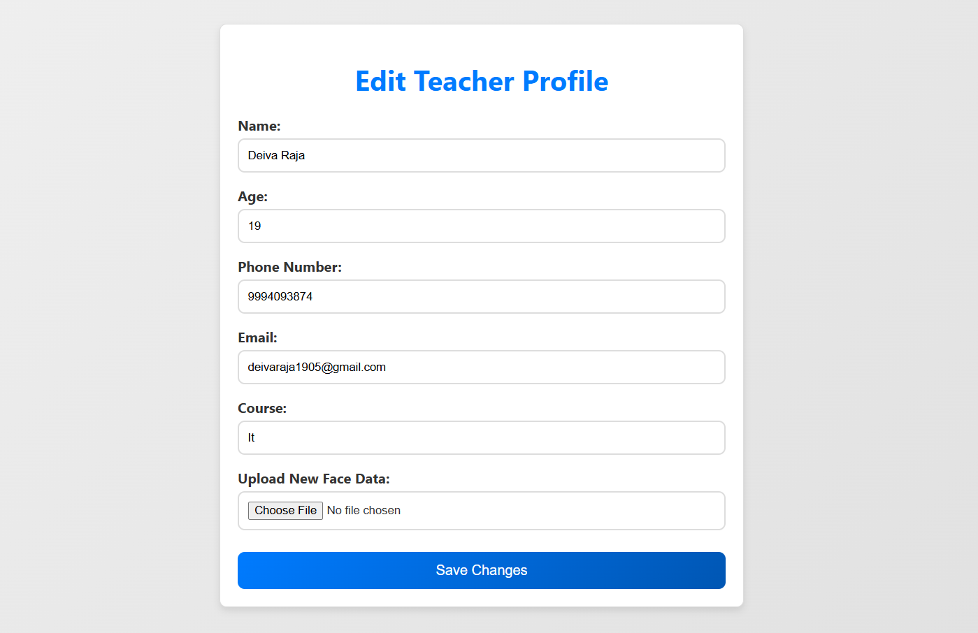

Slide 13
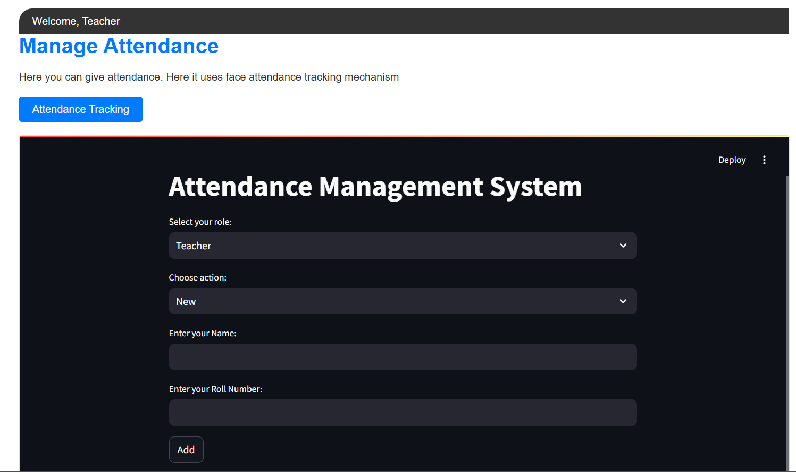

Slide 14
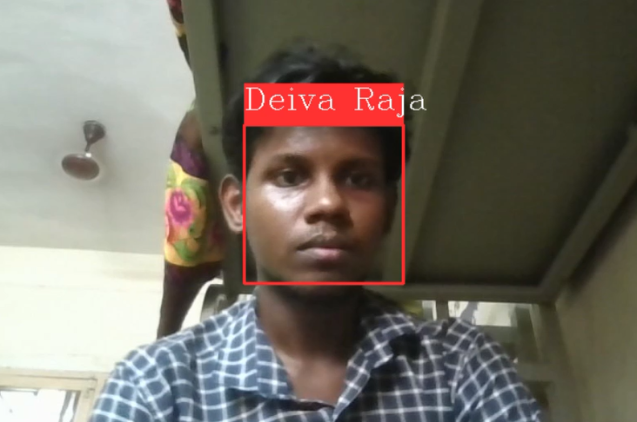

Slide 15
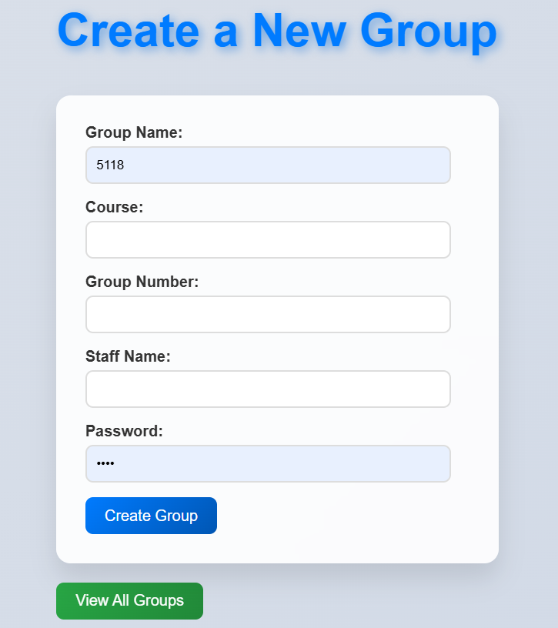

Slide 16
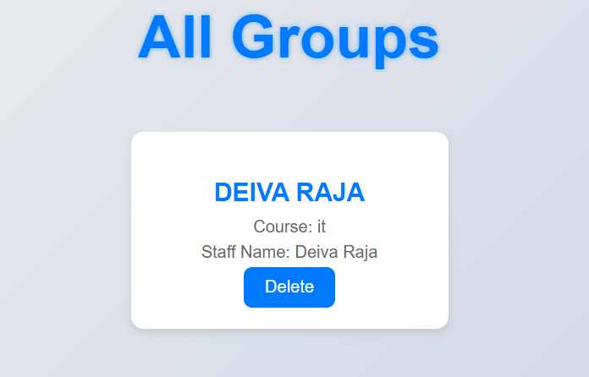

Slide 17
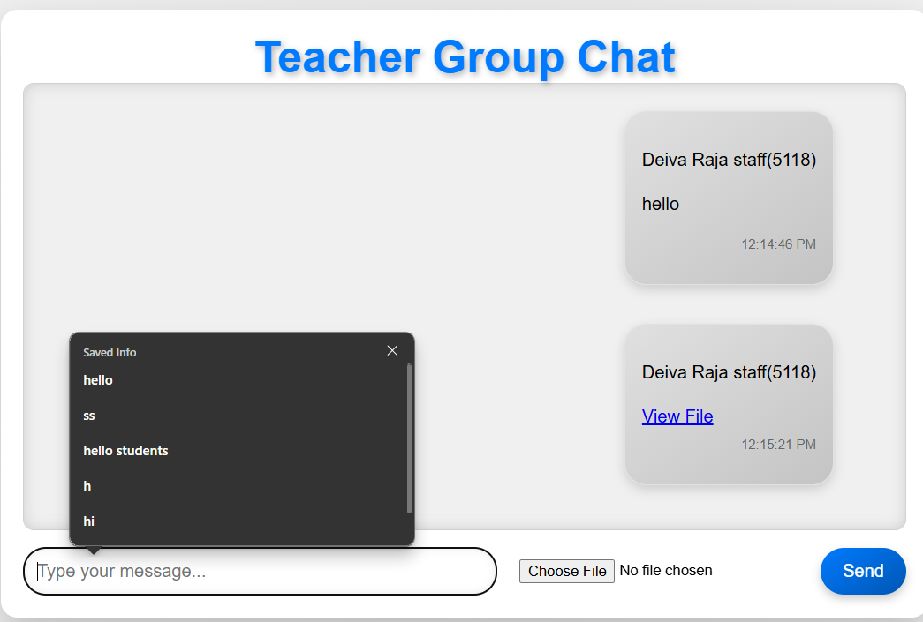

Slide 18
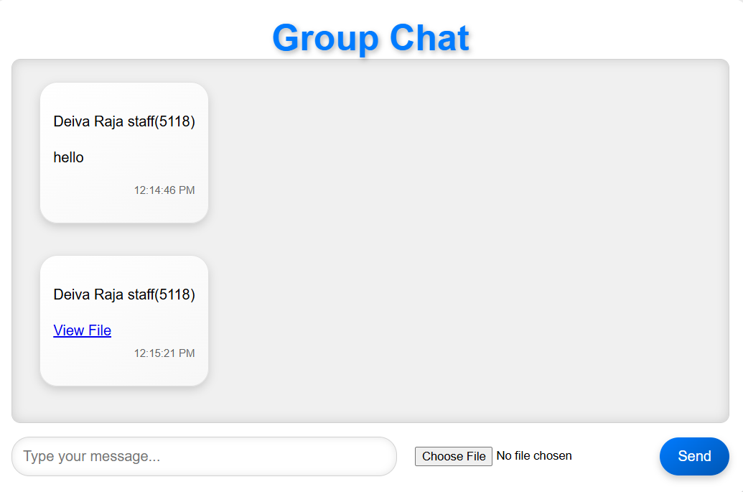

Slide 19
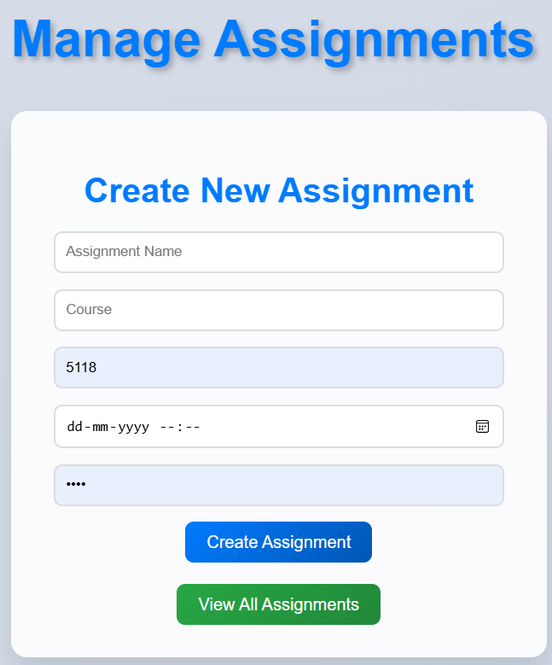

Slide 20
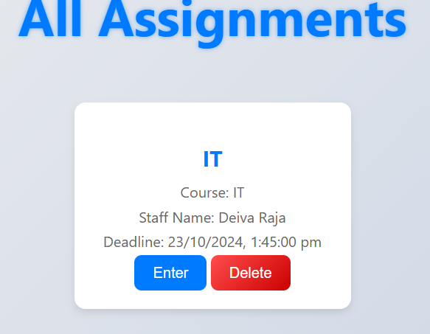

Slide 21
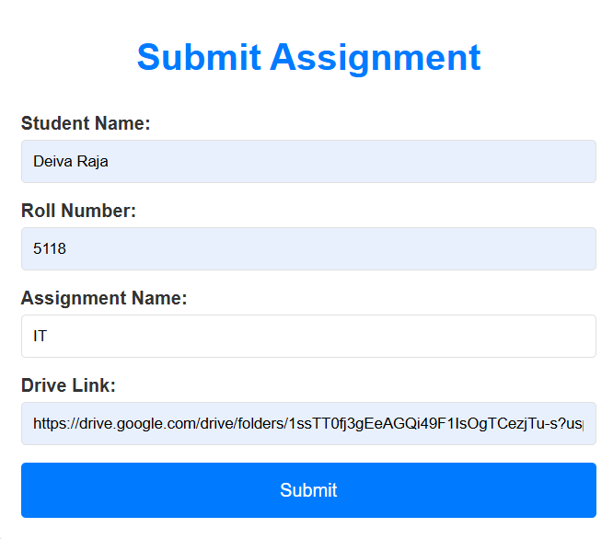

Slide 22
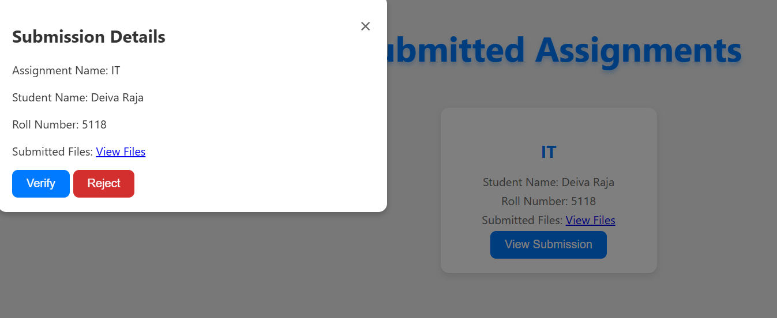

Slide 23
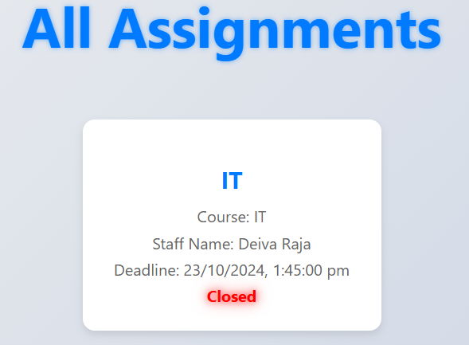

Slide 24
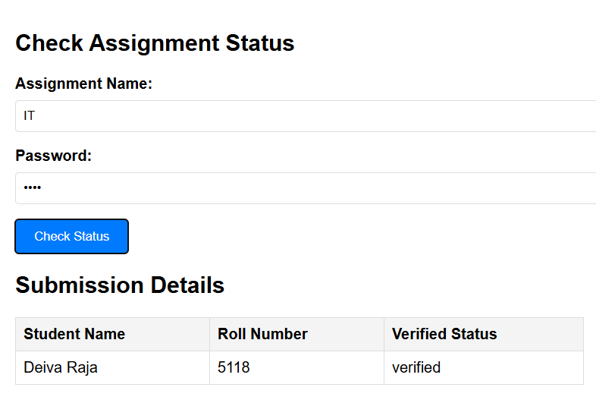

Slide 25
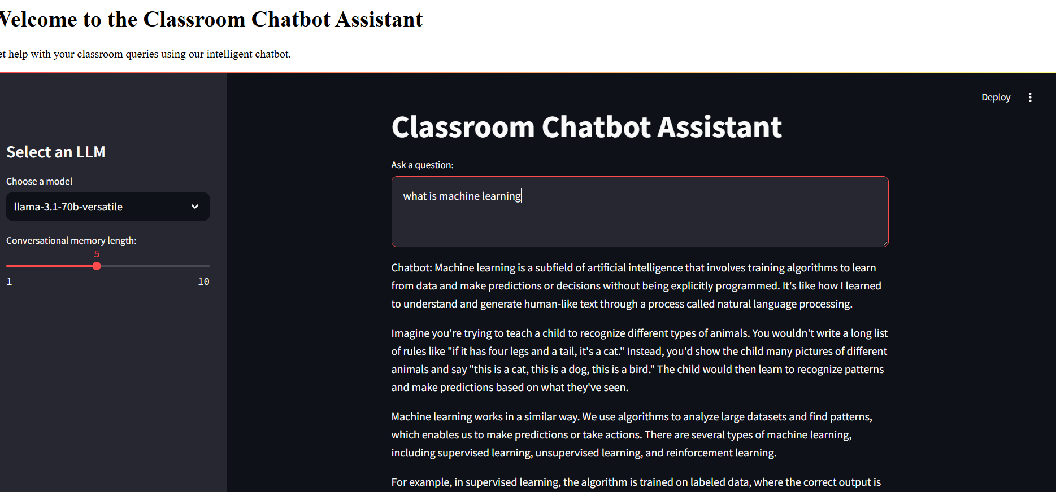

Slide 26
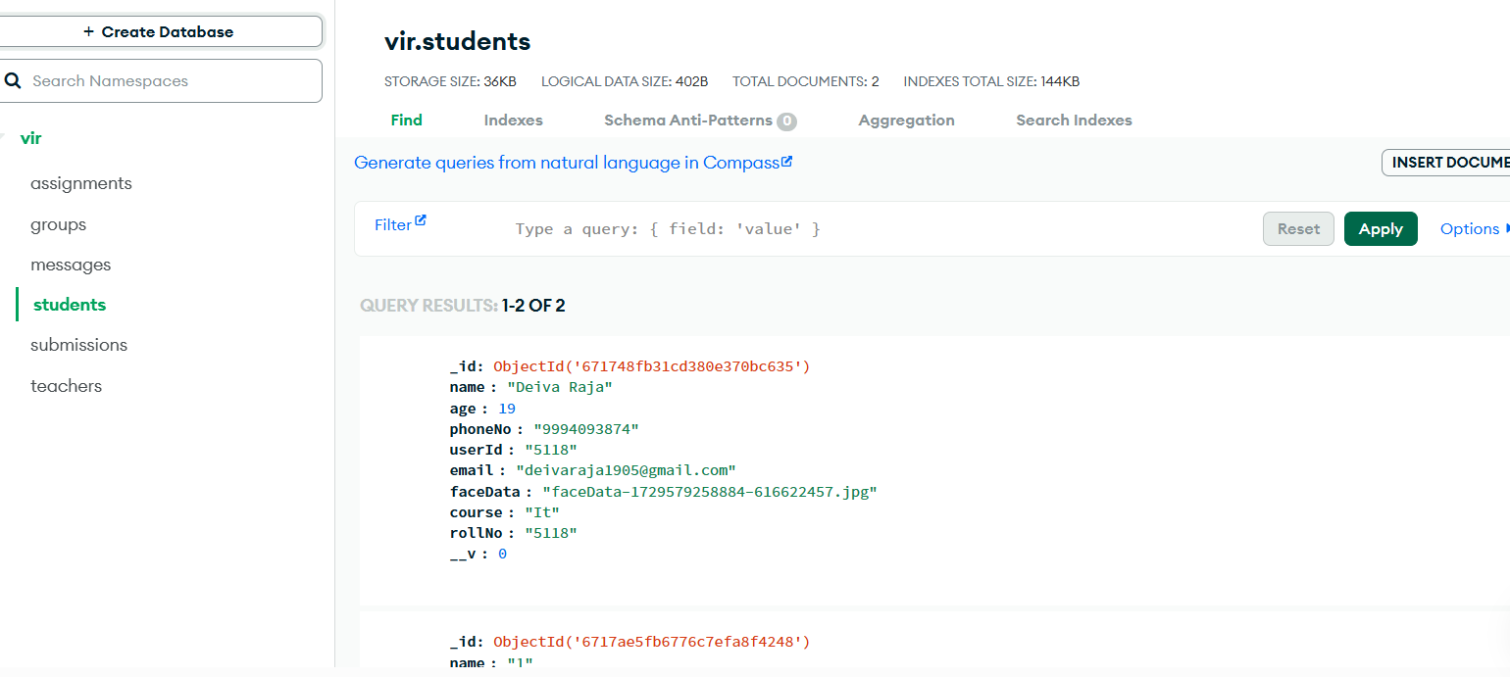

Slide 27
Results:
Increased Engagement:
Both students and teachers became more engaged due to the interactive features and personalized dashboards.
Simplified Management:
Teachers found it much easier to manage classrooms and post assignments with the provided tools.
Effective Communication:
Group chats and discussions made communication and collaboration smoother.
Immediate Support:
The chatbot provided quick help, answering students' questions and offering guidance.

Slide 28
Discussions:
User Feedback:
Users loved the multilingual support and found the interface easy to use. Some suggested adding more advanced analytics for teachers.
Technical Performance:
MongoDB Cloud ensured smooth backend operations.
Challenges:
Initial setup and configuration took some time, especially making sure all parts worked together seamlessly.
Future Improvements:
Possible future updates include expanding the chatbot's abilities, adding more languages, and offering advanced analytics features for teachers.

Slide 29
References:
Research papers:
1.
2. Creating Large Language Model Applications Utilizing LangChain: A Primer on Developing LLM Apps Fast
July 2023
· International Conference on Applied Engineering and Natural Sciences·
Link: Creating Large Language Model Applications Utilizing LangChain: A Primer on Developing LLM Apps Fast
A brief introduction to OpenCV
Publisher: IEEE
Ivan Culjak; David Abram; Tomislav Pribanic; Hrvoje Dzapo; Mario Cifrek
Link:
A brief introduction to OpenCV | IEEE Conference Publication | IEEE Xplore

Slide 30
3. LLaMA: Open and Efficient Foundation Language Models
Hugo Touvron, Thibaut Lavril, Gautier Izacard
Link: LLaMA: Open and Efficient Foundation Language Models
4. Node.js Challenges in Implementation
May 2017·
Global Journal of Computer Science and Technology
Link:Node.js Challenges in Implementation

