Slide 1
Task Manager Project
Simple backend-based application to manage daily tasks easily.

Slide 2
Introduction
Task Manager helps users add, view, and delete tasks.
Improves productivity and organization.

Slide 3
Problem Statement
People forget daily tasks.
Need simple system to track tasks.
Manual tracking is inefficient.

Slide 4
Objective
Create simple task management system.
Easy to use.
Efficient task tracking.

Slide 5
Modules
1. Add Task
2. View Task
3. Delete Task
4. Task Storage

Slide 6
Tech Stack
Python
Basic Data Structures
Optional File Storage

Slide 7
Working
User enters task.
Task stored in list/file.
User can view or delete anytime.

Slide 8
Architecture
User interacts with Python backend.
Backend stores tasks.
Data retrieved when needed.

Slide 9
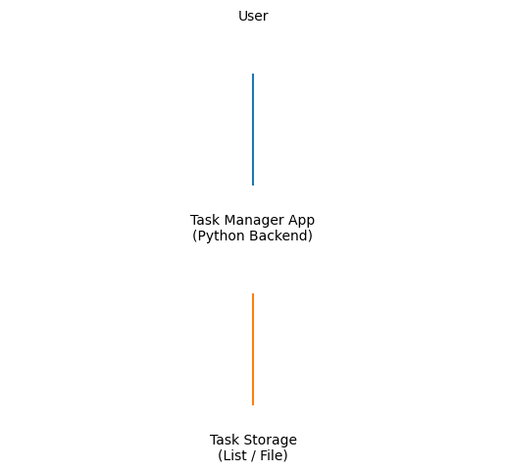
System Architecture Diagram

Slide 10
Advantages
Simple
Easy to implement
Extendable
Useful for beginners

Slide 11
Future Scope
Add database
Add UI
Add login system
Cloud storage

Slide 12
Conclusion
Simple and useful project.
Can be expanded into full application.

