Slide 1
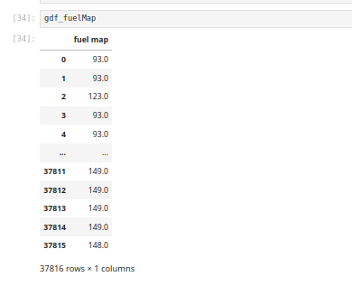
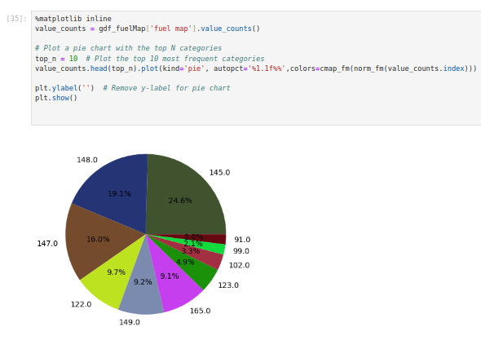
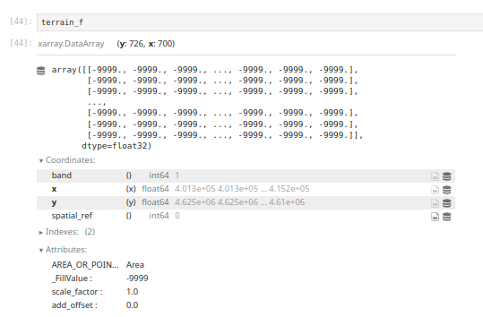
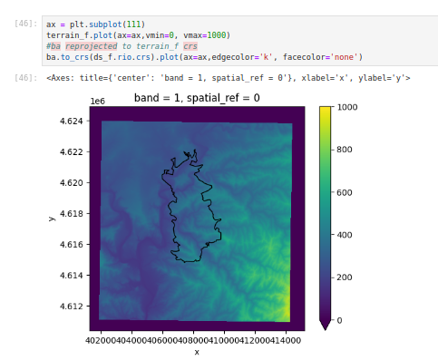
Pandas, GeoPandas
Xarray
Series: 1D single variable (time series of temperature)
Data Frame: 1D multi variable (excel)
DataArray for multidimension variable (Image)
Data set for multidimension multi variable (Model Ouput)
Both are coming with GIS capabilities, statistical analysis tools, and connection with matplotlib for plotting

