Slide 1


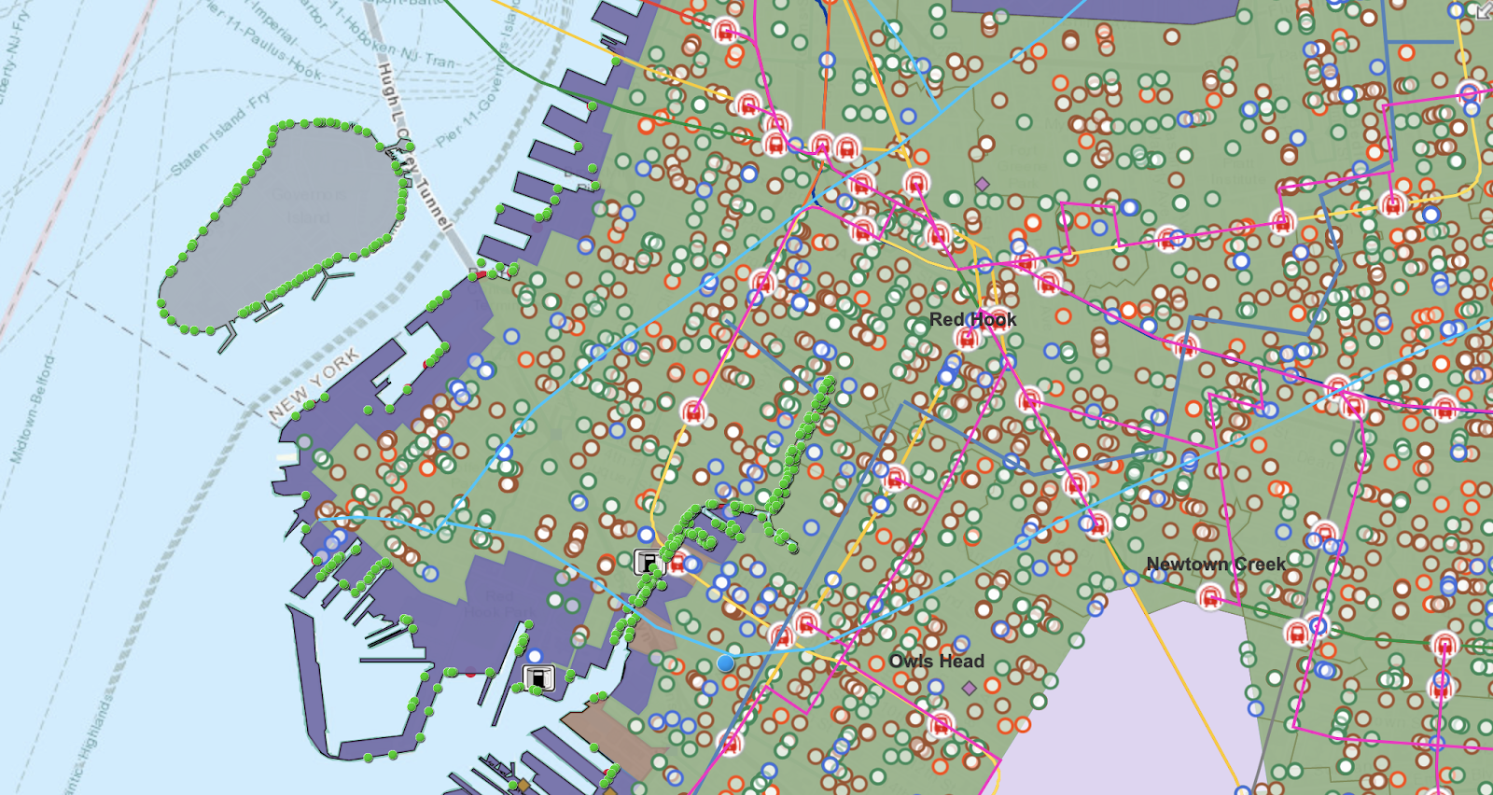
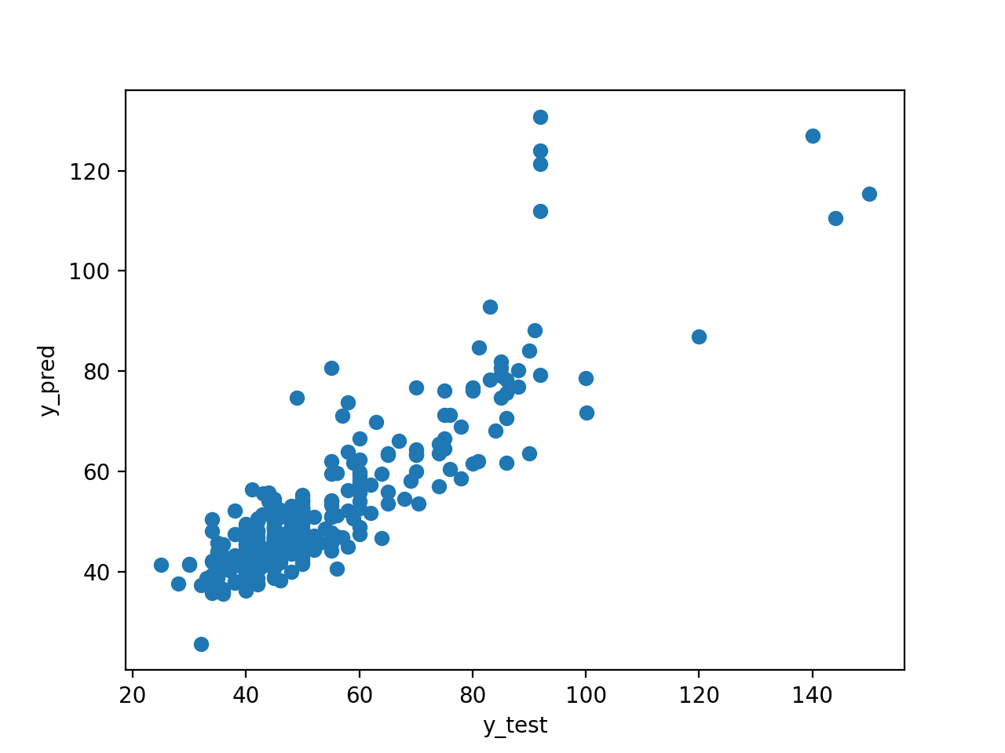
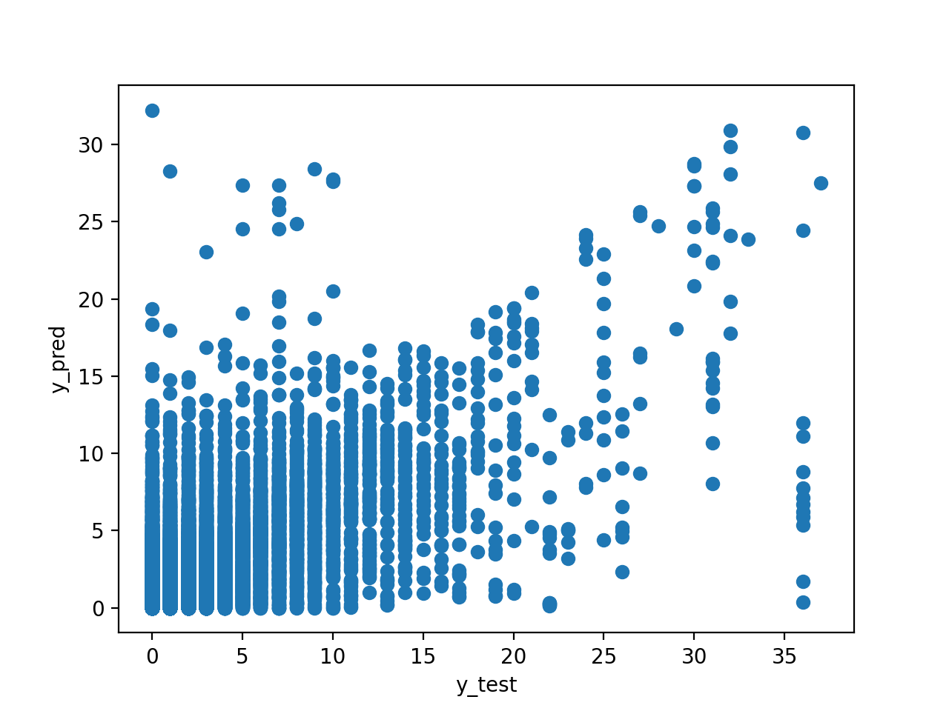
Subsurface Testbed
University Logo
Xinru Li,¹ Silvia Wei,¹ Michael Stanley,² Debra F. Laefer, PhD³
New York University Tandon School of Engineering
Supervisor, New York University Tandon School of Engineering
Professor, Center for Urban Science and Progress
Abstract
This project aims to harvest and integrate existing data about subsurface data related to existing construction, utility failures, and storm information (both historical and predicted) and to use this information as the basis for future, neighborhood-level, performance, as well as infrastructure investment planning. This is done in a Geographic Information System for a 1km² area in the Sunset Park neighborhood of Brooklyn. The immediate goal is to show the horizontal and vertical relationship between underground structures. Self-reporting from 311 calls [2010-present] were then overlaid, along with FEMA flooding predictions. A machine learning approach is used to predict foundation information and flooding.
Project Background
New York City has a long, rich history filled with aging infrastructure and previous generations of construction. While the information for and problems of aboveground constructions are common and relatively well understood, collecting and integrating subsurface elements and the in-situ natural materials pose major challenges due to the complexity, incompleteness, and inconsistency of the available data. These are in addition to technical difficulties in processing, storing, and integrating the data and uncertainties as to what historical information is still relevant. Having such information can be a critical advantage in a wide range of planning, construction, and disaster mitigation efforts.
Collect above- below ground construction data
Layer ArcGIS map with collected data
Create 3D map as reference for city planning
Analyze and estimate under- ground structures
Analyze 311 complaints data
ArcGIS
(Fig. 2)
Figure 3: Foundation Depth Predict
Overlay pipes, subways, & other infrastructures
Extract water problems
(2010-2019)
Combine historical maps and current data
ID catch basin clogged, sewer backup, & flooding
Figure 2: ArcGIS Map of Sunset Park
Figure 4: Plumbing Complaint Predict
Conclusions & Future Plan
The overall data collection and cleaning process is shown in Fig. 1. This involved harvesting information from historic fire insurance maps and open access information from State, City and national GIS layers. Building machine learning models from Sklearn were applied. For inferring building foundation, R² = 0.7614 (Fig. 3). For future complaints prediction, R² = 0.5631(Fig. 4).To increase reliability, future work will focus on introducing geological and hydrological data.
Predict building foundations
Predict future complaint occurrence
Known Data
Unknown Data
Methods
75%- training
25%- confirming
Estimate with trained model
75%- training
25%- confirming
Works Cited
[1] “PLUTO and MapPLUTO.” Nyc.Gov, www1.nyc.gov/site/planning/data-maps/open-data/dwn-pluto-mappluto.page. Accessed 2 Aug. 2020.
‌[2] “Google Map View of 311 Reports.” NYC Open Data, https://data.cityofnewyork.us/Social-Services/Google-map-view-of-311-reports/dtiu-hq3j
[3] “Building Footprints.” NYC Open Data, https://data.cityofnewyork.us/Housing-Development/Building-Footprints/nqwf-w8eh
[4] “Brooklyn Historical Map”, Greatest Grid, https://thegreatestgrid.mcny.org
Acknowledgements
The authors thank NYU Tandon School of Engineering’s Office of Undergraduate Academics for generous funding of the project.
Above and below ground construction data of Sunset park area is collected through NYC Open data and NYC Department of Planning and converged by. A machine learning model for estimating foundation is constructed to enrich the datasets. 311 complaints data is analyzed by Python and predicted by machine learning models.
*Machine learning involved
Figure 1: Methodology
Results
For result, the subsurface map of Sunset park area is constructed on ArcGIS which includes layers of wires, pipes, subways, and other underground urban structures. Based on the machine learning model, the accuracy of predicting future plumbing complaints is 56.31%.
Contact: corresponding author’s email

