Slide 1


Slide 2
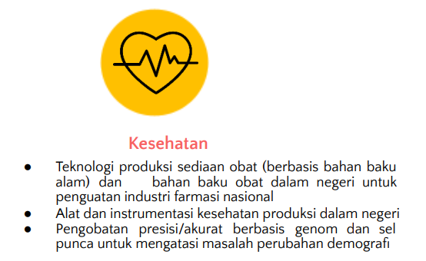

Slide 3
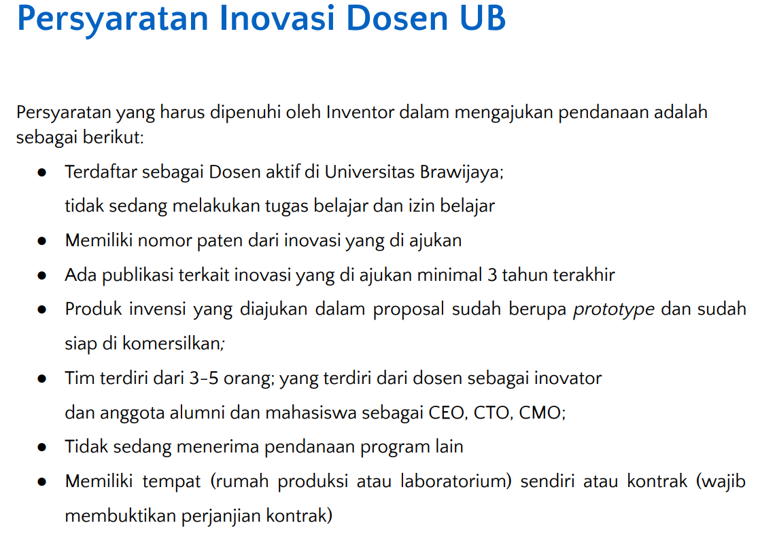

Slide 4
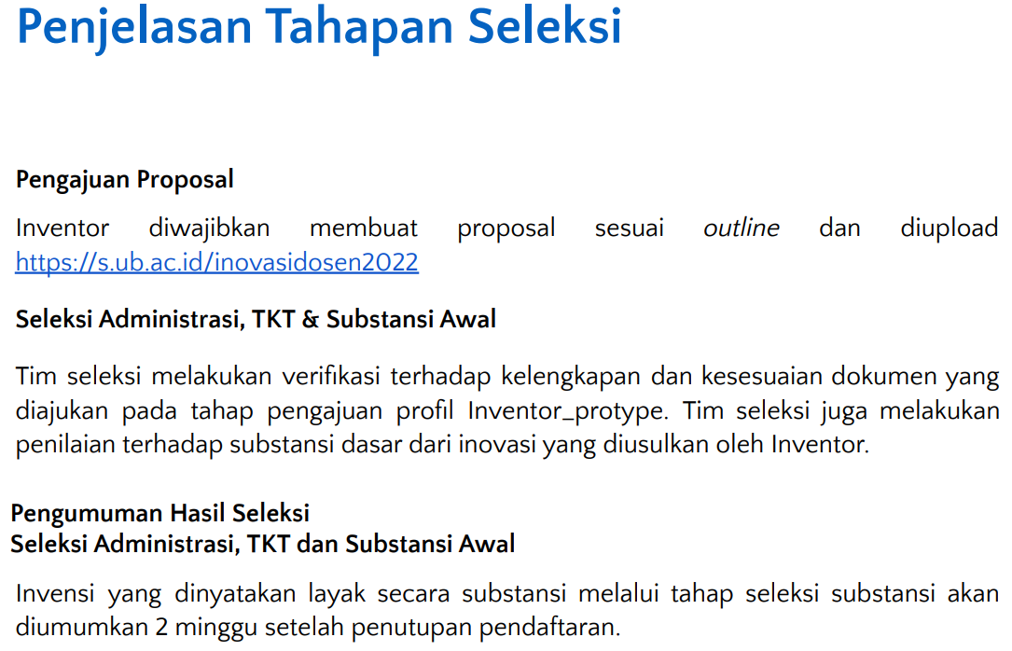

Slide 5
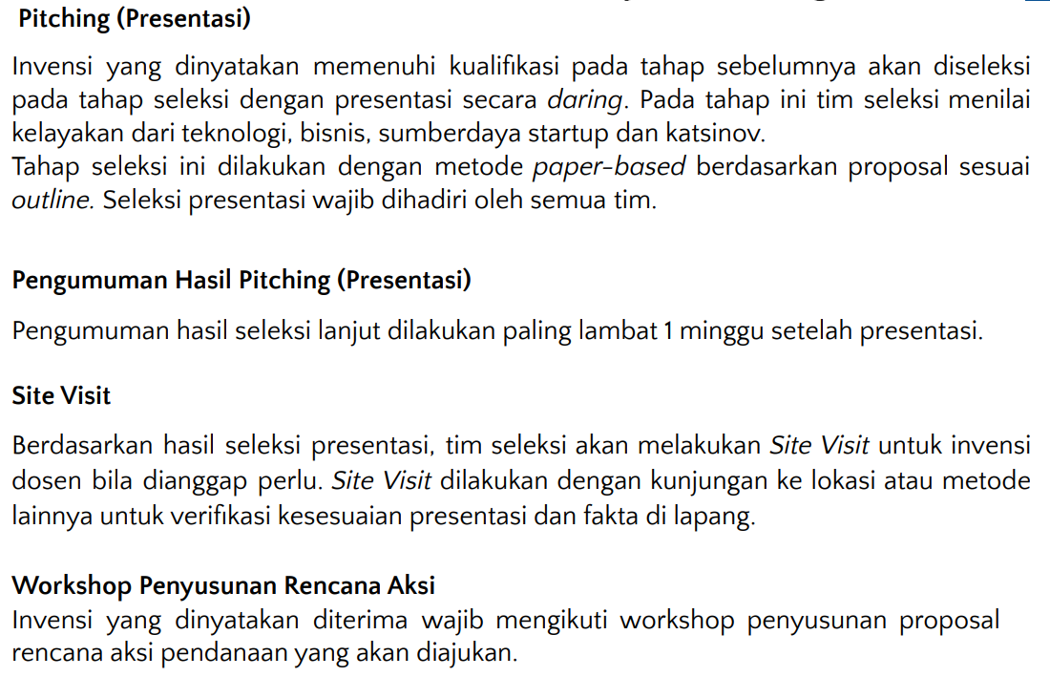

Slide 6
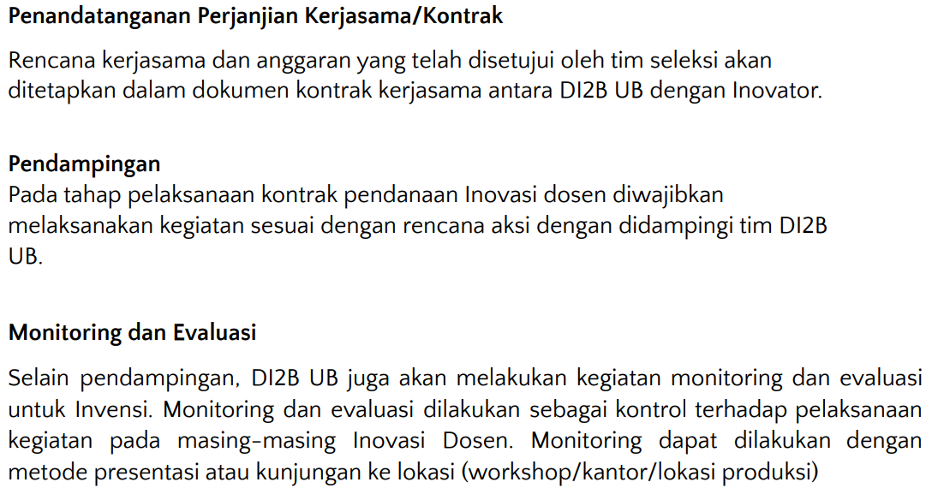

Slide 7
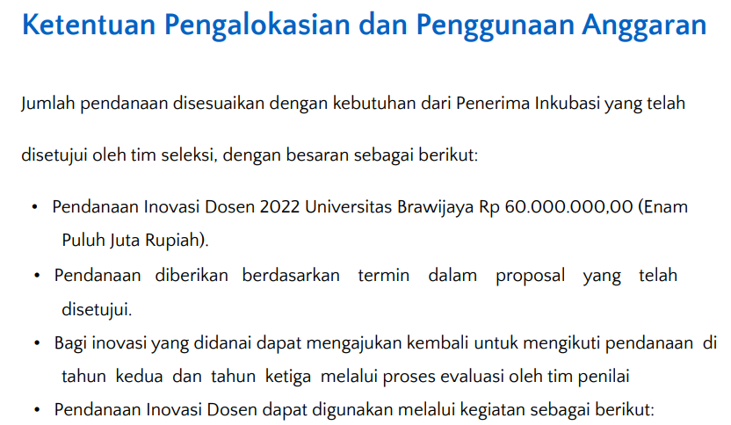

Slide 8
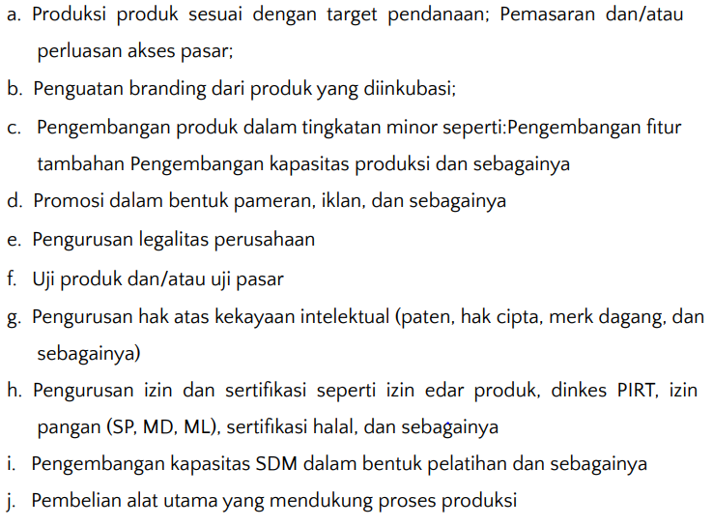
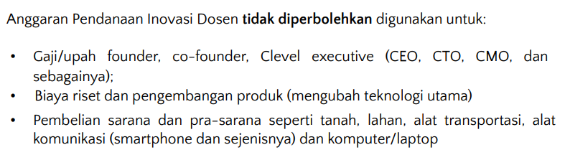

Slide 9
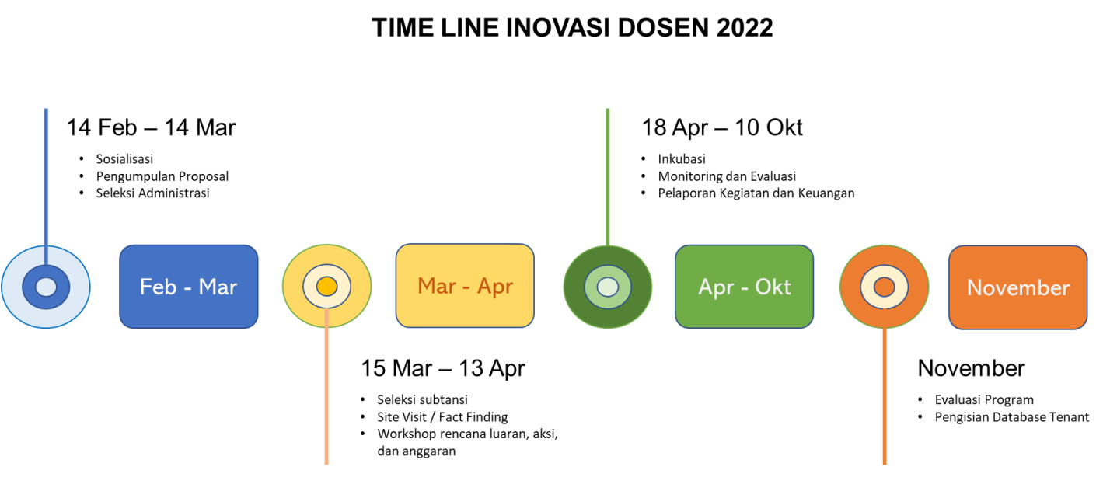

Slide 10
Cover – Agil
Ringkasan Eksekutif – Agil
Lempeng – Agil
Profil Tim dan desain proposal – Agil
Bab 1 - Anita
Bab 2 – Chandra
Bab 3 - Chandra, Adrian, Rosa
Bab 4 - Rosa
Bab 5 - Chandra, Adrian, Rosa
Bab 6 - Chandra, Adrian, Rosa
Bab 7 - Chandra, Adrian, Rosa
Deadline 10 Maret + meeting lagi (jam menyusul)
13 Maret Dikumpul

Slide 11
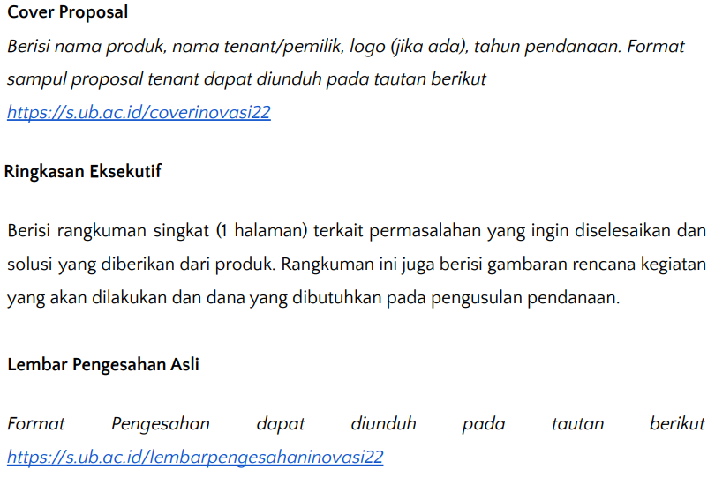
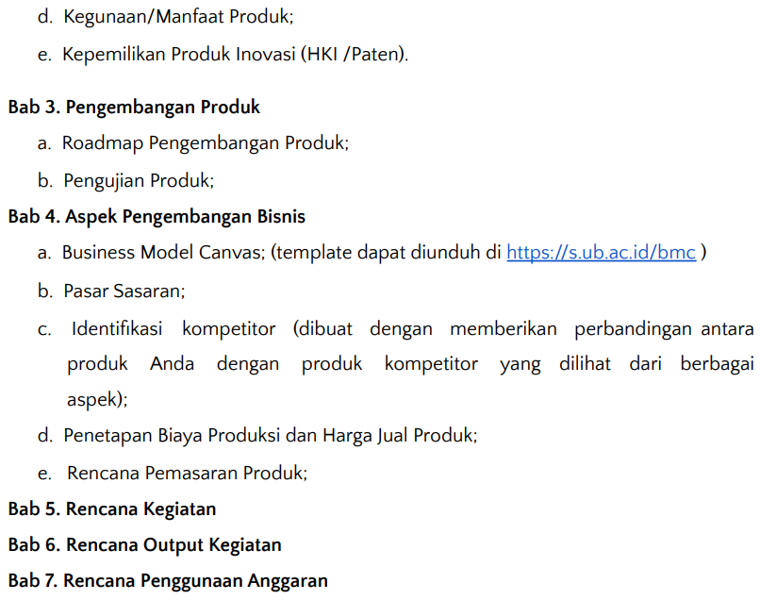
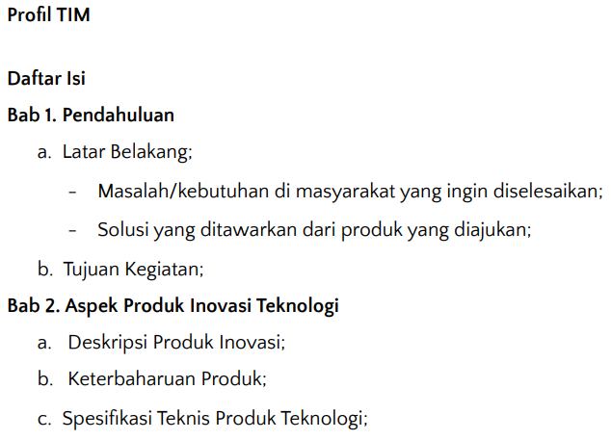

Slide 12
Smart Wearable ECG EKG Monitor - QardioCore
HEALTHCARE PROFESSIONALS - Preventice Solutions
EKG Anywhere, Anytime | AliveCor (kardia.com)
WISH for Health on Instagram: “Halo teman-teman Imersif Mari kita sambut awal bulan dengan quiz menarik dari WISH Buat kalian followers kita pasti tau apa saja fitur yang…”
Spire Health | Remote Patient Monitoring
Aktiia - Your Home Blood Pressure Monitoring Solution

Slide 13

2.0 ?

