Slide 1
juice_up
Cycle powered charging
Team:
Anthony Thomas – Developer,
Amish Ralhan – Hardware,
Annafee Azad - Electronics

Slide 2
What, Why?
Battery life
Cycling
Energy Source
Security and portability
Ease of use, protection

Slide 3
Design and How?
Cycle powered USB level charger
Fits inside most existing bicycles
Low risk of theft
Easy retrofit

Slide 4
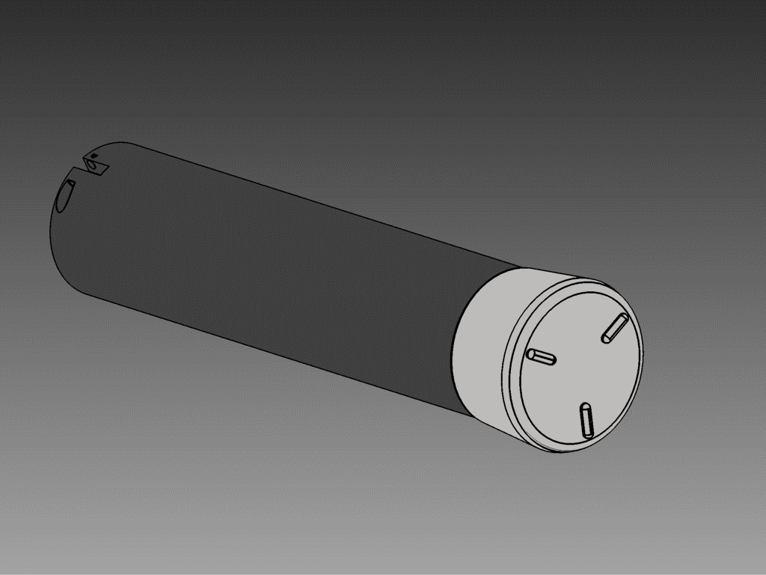

Slide 5
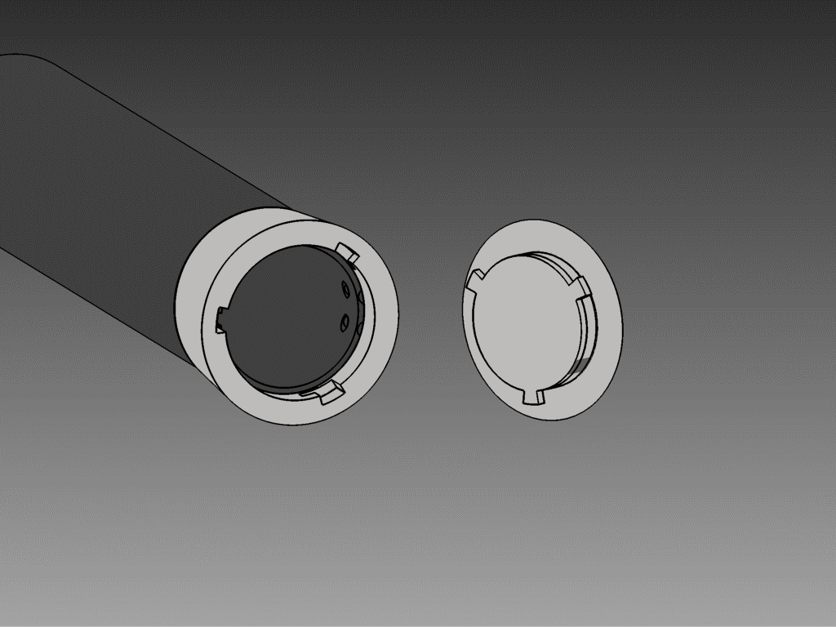

Slide 6
What next?
Crowdfunding
Pre-orders open now
From £20

Slide 7


