Slide 1
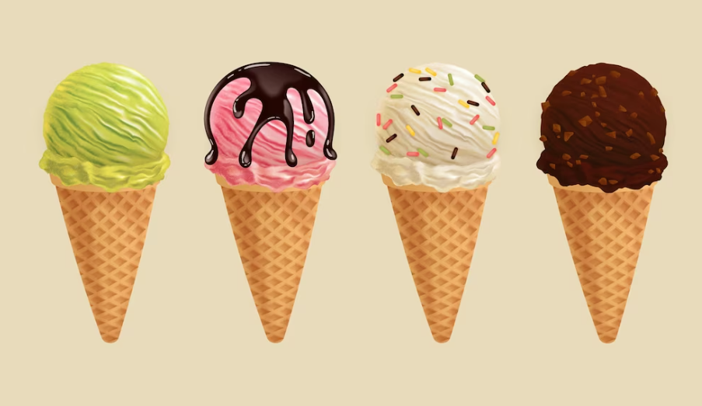

Slide 2
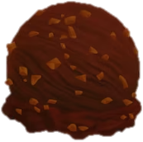
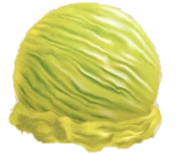

Slide 3


Slide 4


Slide 5



Slide 6


Slide 7
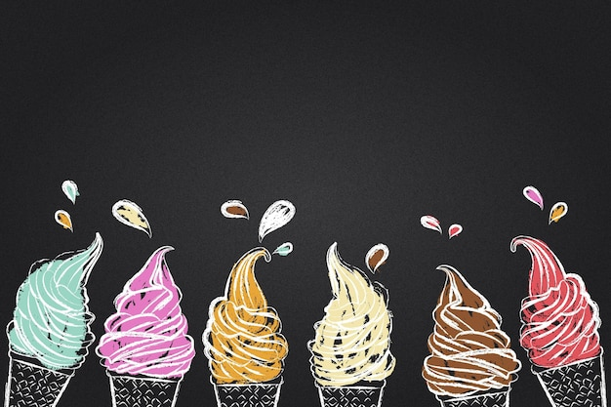


Slide 9
Hello world
Icecream orders
NEXT
RETRY
1 2 3 36

