Slide 1
3dxws.dotnet.samples.docs
Attach Documents Sample in C#

Slide 2
Example
This sample shows how to use the 3DEXPERIENCE web service to attach documents (both attachment and specification) to either Engineering or Manufacturing Items
This is done in 3 steps:
User logs in to a given 3DEXPERIENCE tenant (either Cloud or OnPrem)
User searches for an Engineering (or Manufacturing) item using a Search Criteria
User attaches one more documents as either Specification or Attachment

Slide 3
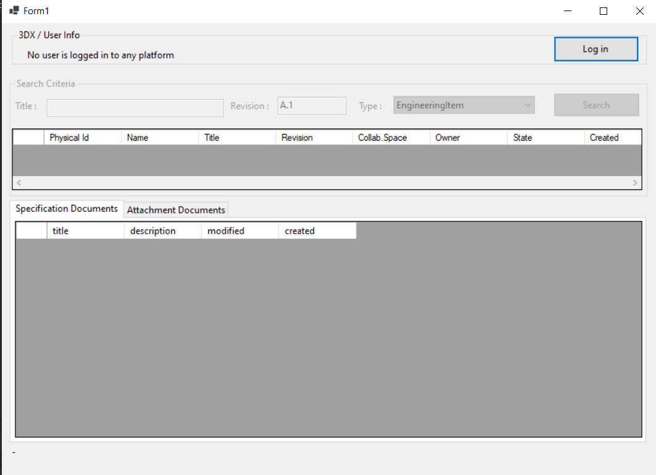
Build and start Example
Clone the source code in the repository
Open the 3dxws.dotnet.samples.docs solution using Microsoft Visual Studio Professional 2019
Build the solution
Run or Debug

Slide 4
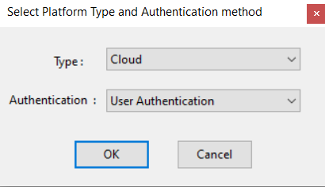
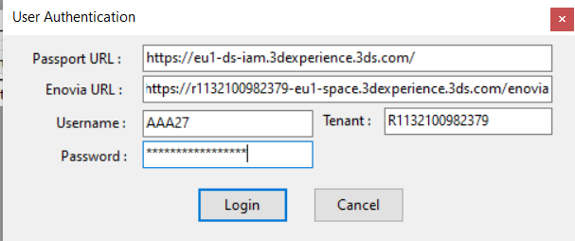
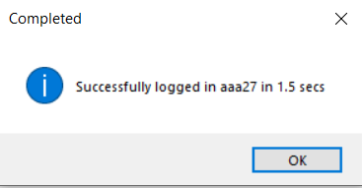
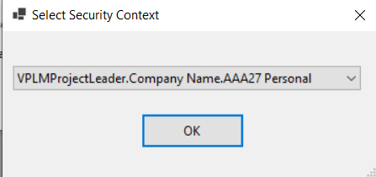
Step 1 – Log in
Select Login and type of Authentication (see notes next slide)
Fill Server Settings and User credentials
Select Security Context

Slide 5
Step 1 – authentication notes
Some examples of server settings for User authentication (CAS)
 | Cloud | On Premise
Passport Url | https://eu1-ds-iam.3dexperience.3ds.com | e.g. https://vdemopro1185dsy.extranet.3ds.com:443/iam
Enovia Url | e.g. https://r1132100982379-eu1-space.3dexperience.3ds.com/enovia | e.g. https://vdemopro1185dsy.extranet.3ds.com/3DSpace
Tenant | e.g. R1132100982379 | (can be empty)

Slide 6
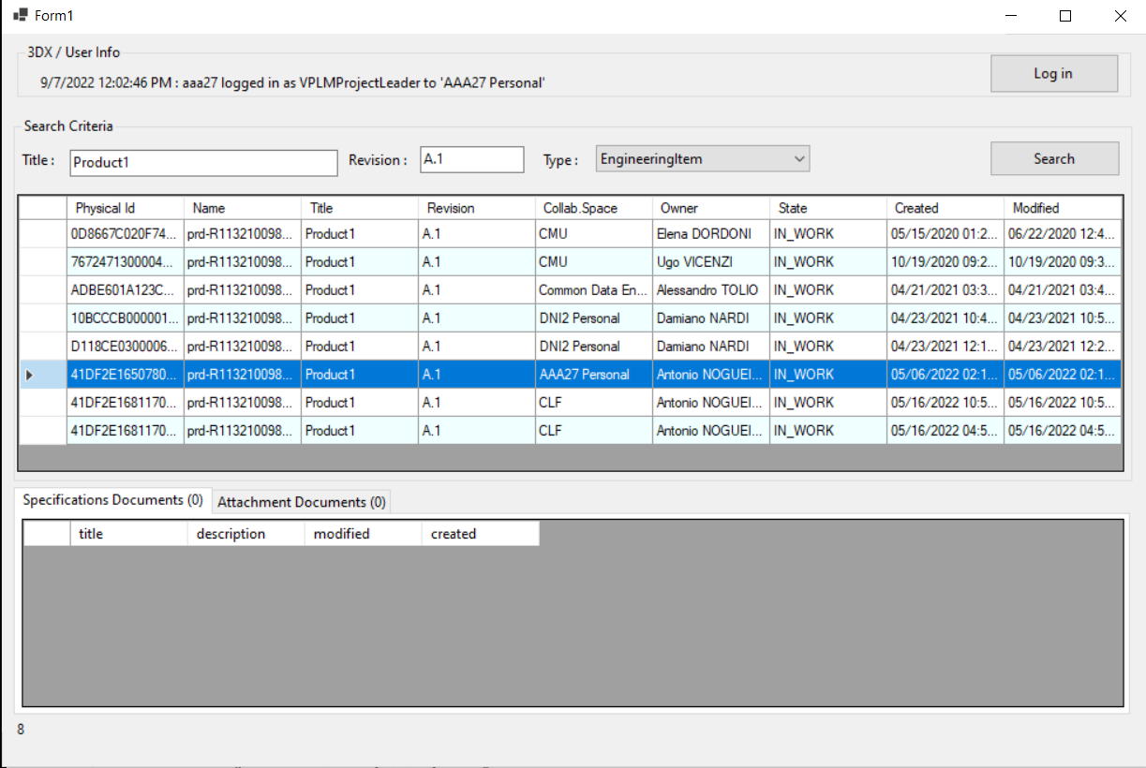
Step 2 – SEARCH for aN ITEM by title and revision
Upon successful login the Search Criteria area becomes available
Fill the Title box for the search criteria
Click on Search
A number of Eng. Items are displayed
Select one from the table
The Specification and Attachment Documents area shows if any document is associated.
Note: You can also search and attach documents to manufacturing items

Slide 7
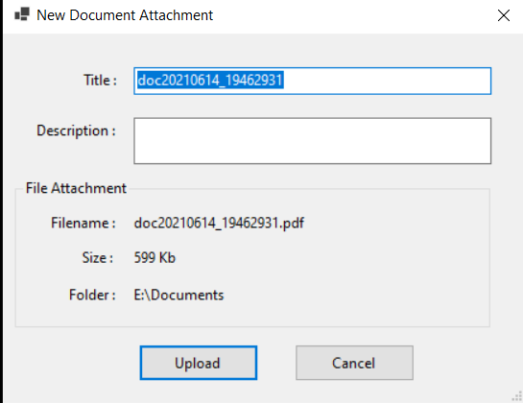
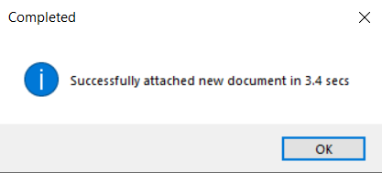
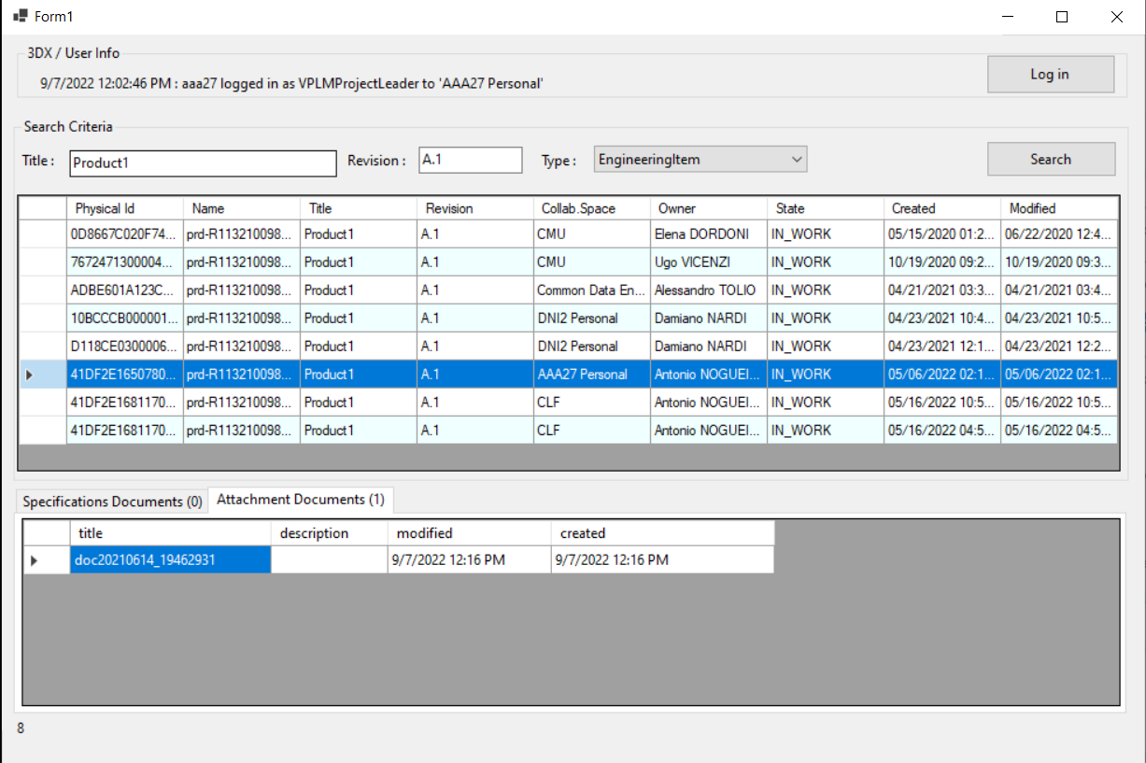
Step 3 – Attach document
Select the Attachment Documents tab in our sample
Drag a file from Windows Explorer into the Attachments area
Fill the New Document Attachment form
Wait for the upload to complete

