Slide 1
Sentiment Analysis
With the Sentiment140 Dataset
CSML1010 Fall 2019
Pete Gray, YorkU #217653247

Slide 2
Sentiment140
Created in 2009 by Alec Go, Richa Bhayani, and Lei Huang, who were Computer Science graduate students at Stanford University.
“Distant Supervision”
Use emoticons as “noisy labels”
1,600,000 Tweets
Perfectly Balanced

Slide 3
Problem Definition
Develop a Sentiment Classifier for Tweets
Design and train a model to predict, as skillfully as possible, positive or negative sentiment of a Tweet.

Slide 4
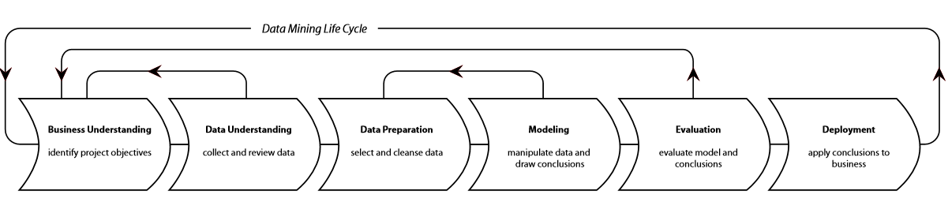
Methodology
CRoss-Industry Standard Process for Data Mining
(CRISP-DM)

Slide 5
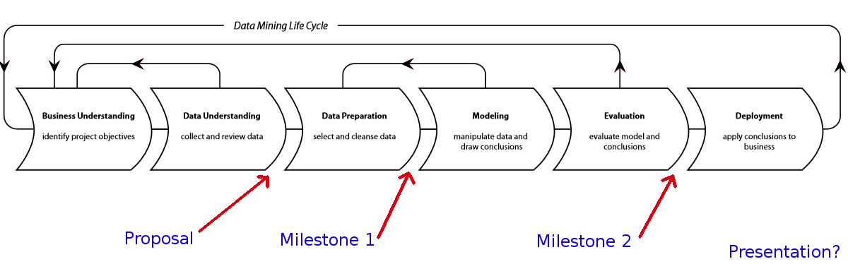
CRISP-DM & ML Life-Cycle
Proposal, Milestones, and Presentation

Slide 6
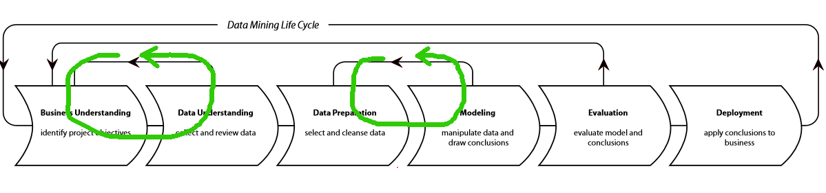
Iterative Development
Data Cleaning
Feature Selection
Data Sampling

Slide 7
Results
Most useful vectorization of documents:
TF-IDF
Best performing models:
Logistic Regression
LinearSVC (Support Vector Classifier)

Slide 8
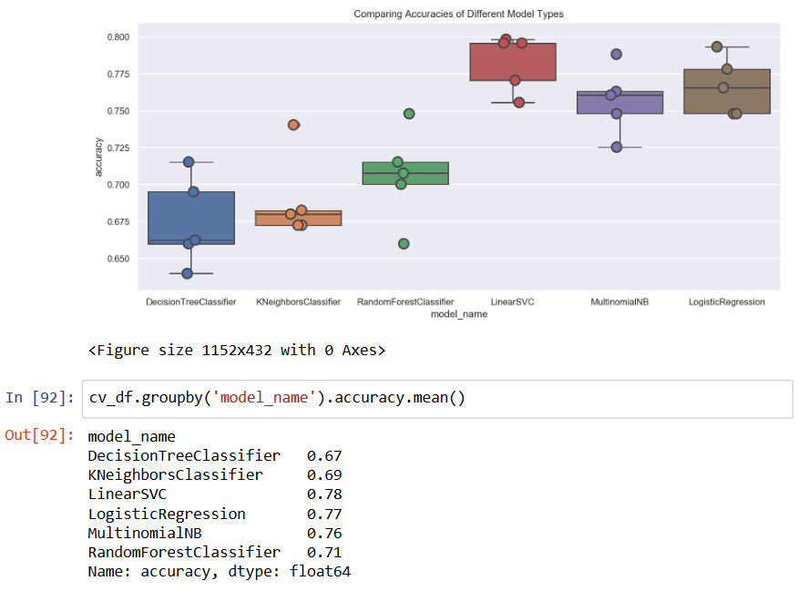
Simple Comparison: Accuracy

Slide 9
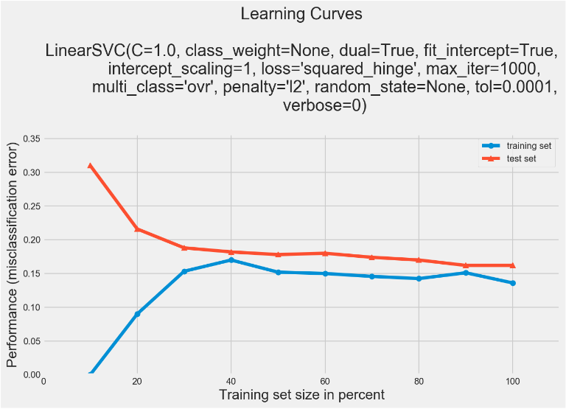
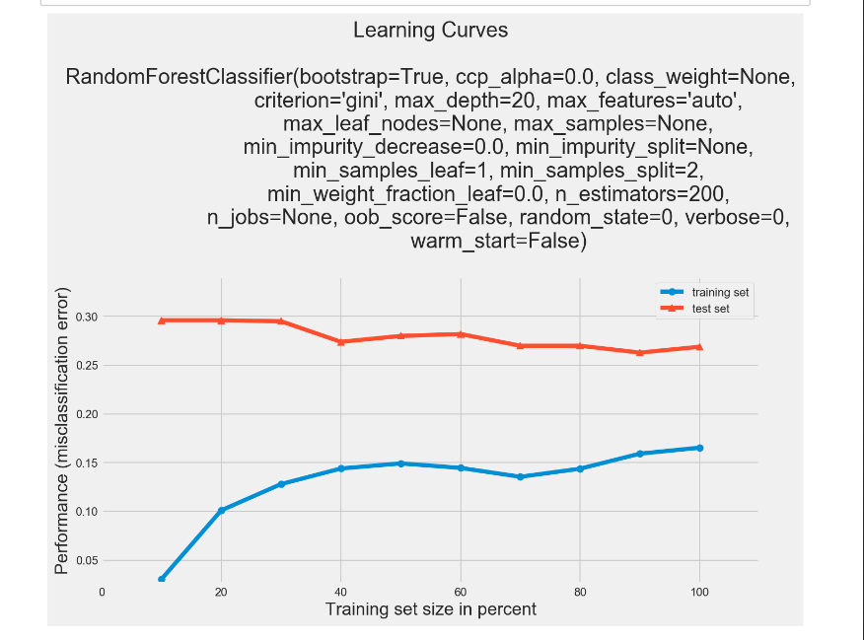
Comparing Learning Curves
LinearSVC – Looks good.
Random Forest – Looks dubious.

Slide 10
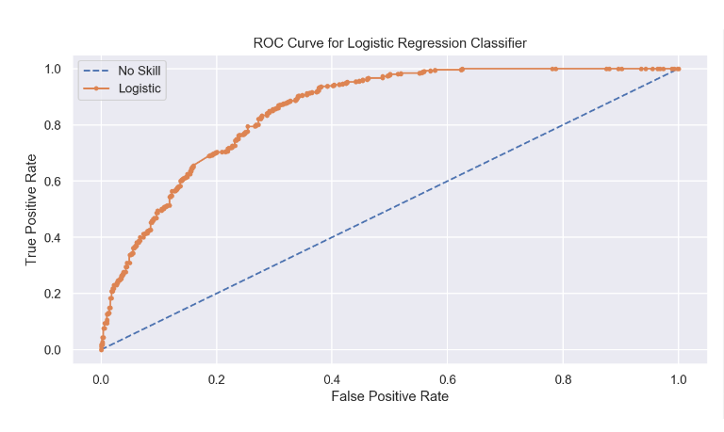
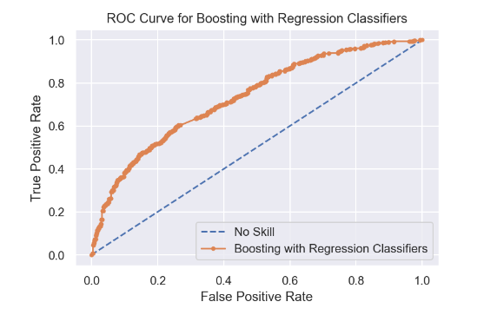
Comparing AUROC
Logistic Regression AUC=~0.86
Boosting LR AUC=~0.73

Slide 11
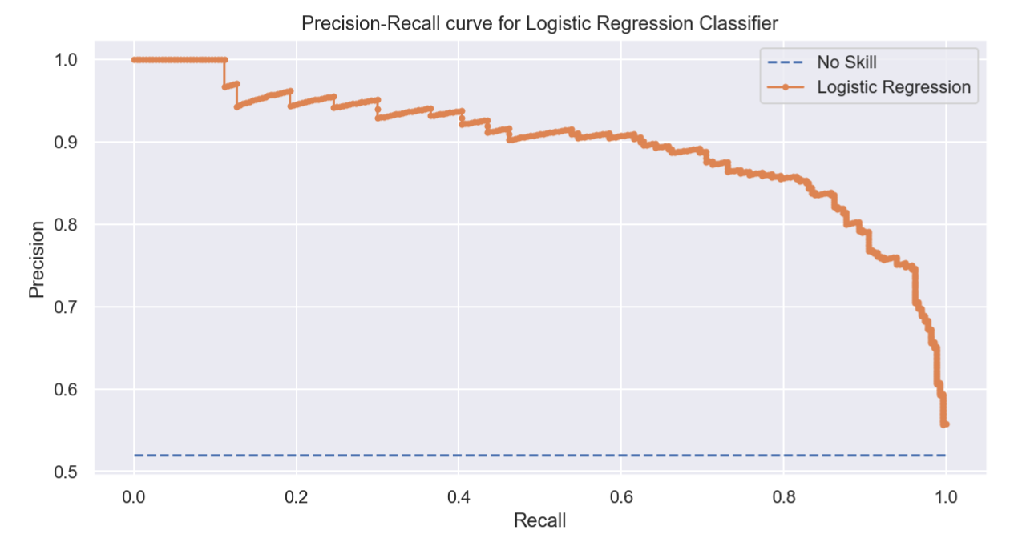
Precision-Recall Curves
Better than ROC for unbalanced data.

Slide 12
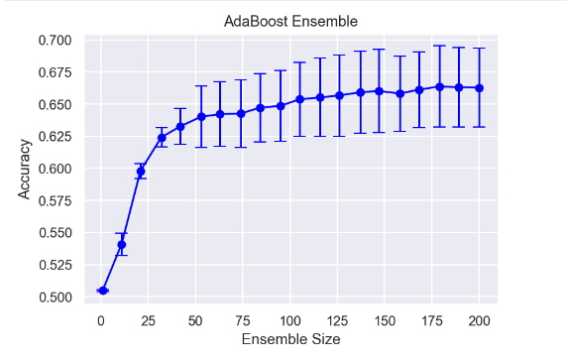
Ensemble Size: Boosting
AdaBoost was the one method that brought results comparable to standalones – but only with huge ensemble size.

Slide 13
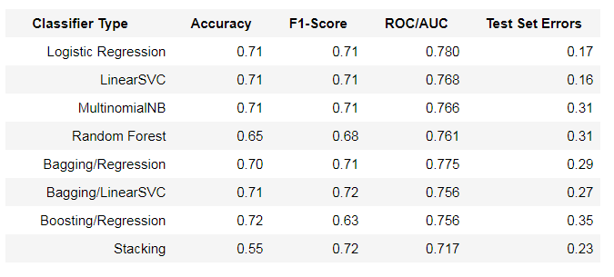
Comparing Evaluation Metrics

Slide 14
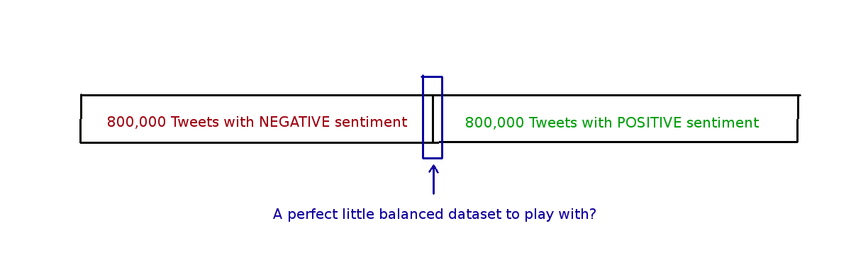
Discussion – Dataset Sampling
Sentiment140 is 800,000 negative Tweets, then 800,000 positive Tweets.

Slide 15
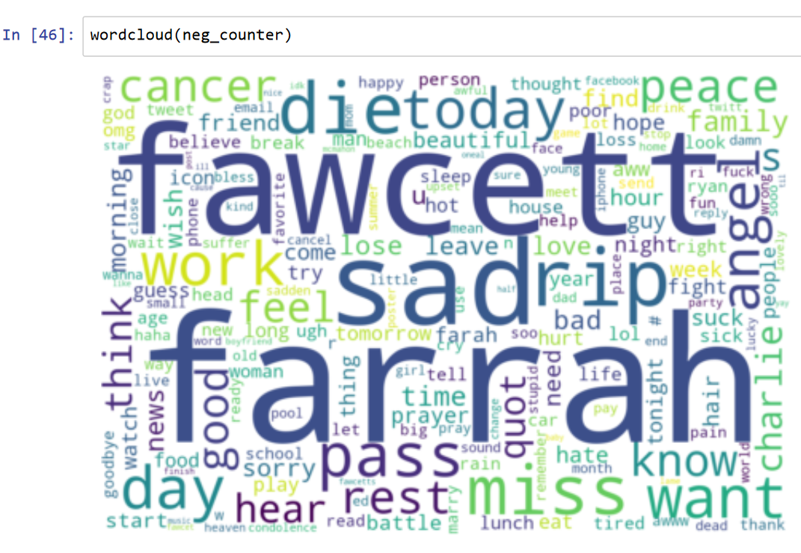
First Sign of Trouble – Word Cloud

Slide 16
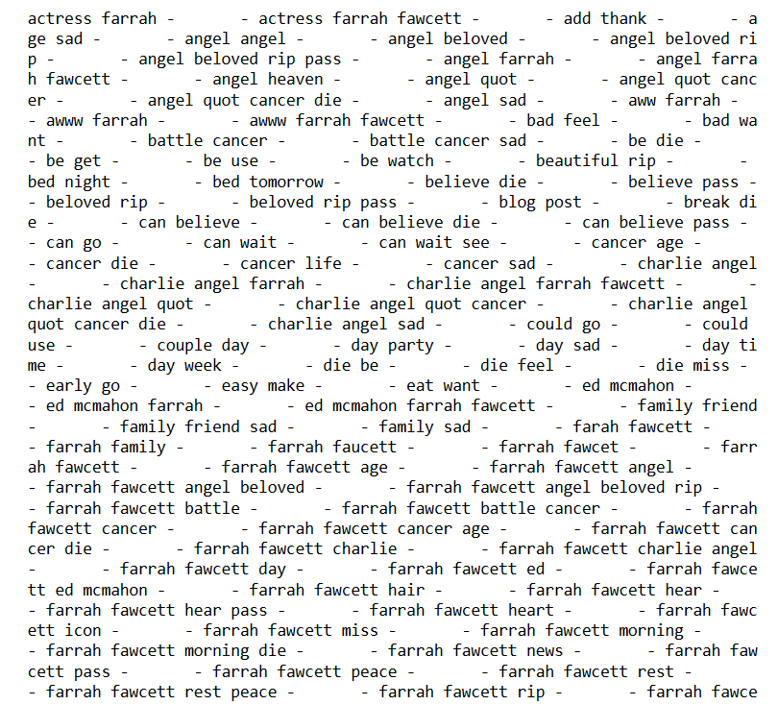
More Trouble – Selected N-Grams

Slide 17

Farrah Fawcett – 1947 - 2009

Slide 18
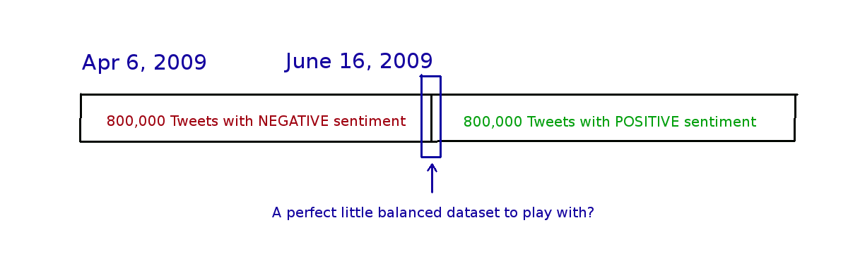
So What Happened There?
Why does actress Farrah Fawcett have such a powerful negative correlation?

Slide 19
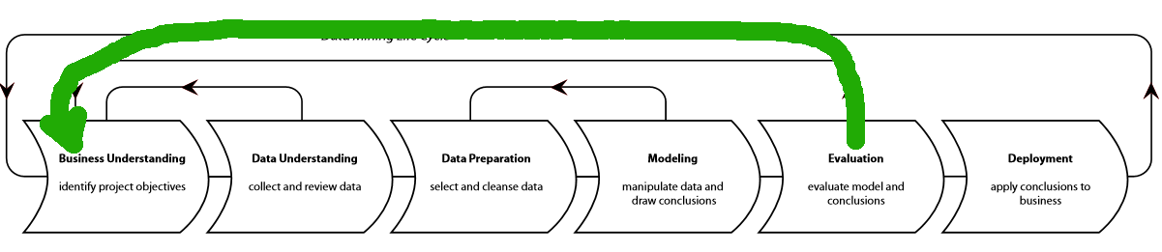
Random Sampling is the Fix.
But before we double back and fix that, let’s evaluate models trained on this mistake to compare and contrast!

Slide 20
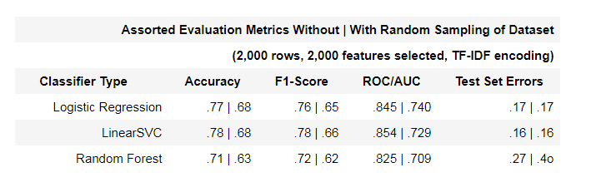
Bad Data Sampling, Better Results
Some evaluation metrics come out 10+% higher on poorly sampled data

Slide 21
Conclusions
Logistic Regression and LinearSVC consistently scored the best on multiple evaluation metrics
SVC sometimes scores trivially higher, but Regression is inherently more Interpretable (parametric vs. non-parametric)
Random Sampling is critical!
Ensemble Methods not advanced enough yet to beat standalone models

Slide 22
Recommendations
Run bigger datasets for algorithms that performed poorly, but suggested potential for improvement
Improve Ensemble Methods by mixing more model types in ensemble
Feature Engineering with Word Embeddings and Language Models
Lots of other model types to try – Sentiment140 team used Maximum Entropy Classifier

Slide 23
Future Work
In the spirit of “Distant Supervision” and noisy labels, use a Sentiment Classifier to label a conversational dataset.
Engineers Features based on Improvements in Sentiment during a conversation
Train a chatbot for everything it’s supposed to do, plus account for optimizing a user’s sentiment during the conversation.

Slide 24
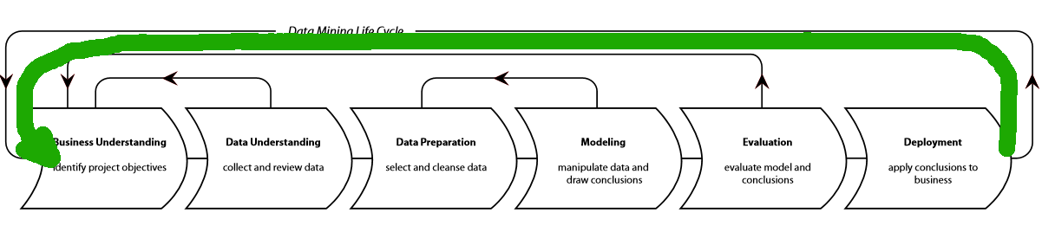
Future Work
Bigger ideas
Bigger data
More powerful algorithms
More computing power

Slide 25
Example 1 – Customer Support
E.g. call if washing machine doesn’t work
Chatbot can tell if user is upset, is trained in what things to say might help calm user
Increase user engagement and optimism, and therefore success rate of support service
Chatbot must still be able to perform its primary task, even if it is enabled to help the user’s state of mind when needed.

Slide 26
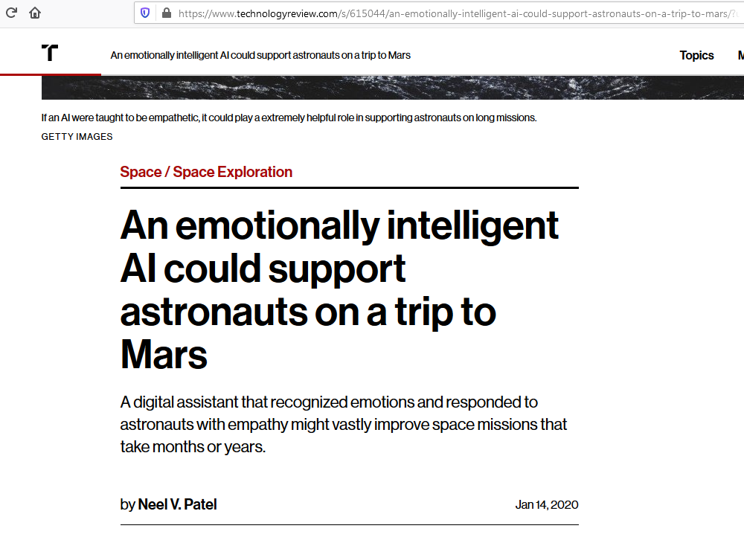
Example 2 – Astronaut Support

Slide 27
Bibliography
Sentiment140 for Academics
http://help.sentiment140.com/for-students
Twitter Sentiment Classification using Distant Supervision - Alec Go, Richa Bhayani, Lei Huang, 2009
https://cs.stanford.edu/people/alecmgo/papers/TwitterDistantSupervision09.pdf

Slide 28
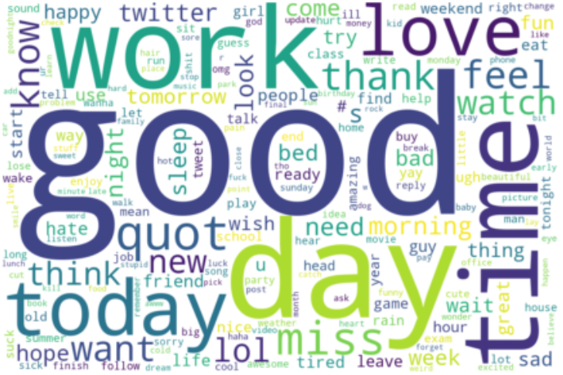
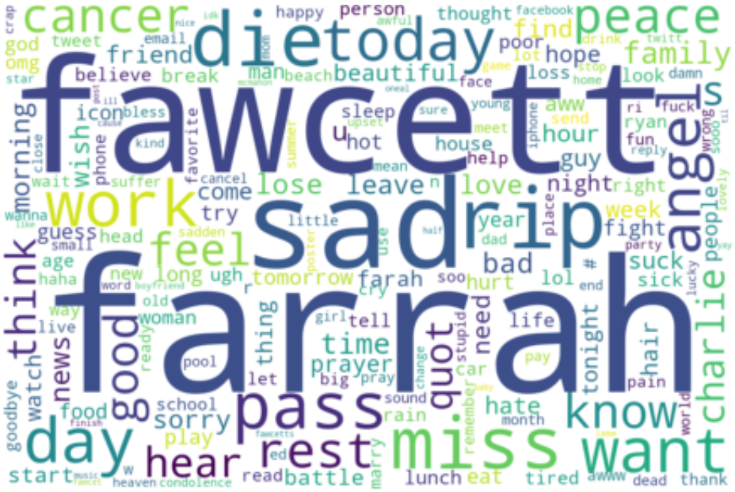
Questions?

Slide 29
Thank You!
This has been Pete Gray’s final presentation for CSML1010, Machine Learning Life-Cycle, Jan 2020

