Slide 1
Training Bird Song Classifiers
CSML1020
Machine Learning at Scale
Pete Gray YorkU #217653247

Slide 2
Objectives
Use deep learning to classify bird songs
Play with models in the cloud
Identify bird species in the real world

Slide 3
Previous Work
Data comes from a 2013 Kaggle competition
Many successful commercial apps
Merlin Bird ID by Cornell Lab
Bird Song Id Canada
Song Sleuth
BirdNET
ChirpOMatic

Slide 4
Contributes to Human Learning
You and app hear bird song
App performs inference, displays output
You have “label” for your “training data”
You learn
App allows you to perform supervised learning on live environmental data by labeling it for you.

Slide 5
Approaches
Feature extraction with Librosa spectrograms, train a keras Convolutional Network from scratch
Feature extraction with a pre-trained VGG-19, training and inference with an SVC (support vector classifier)

Slide 6
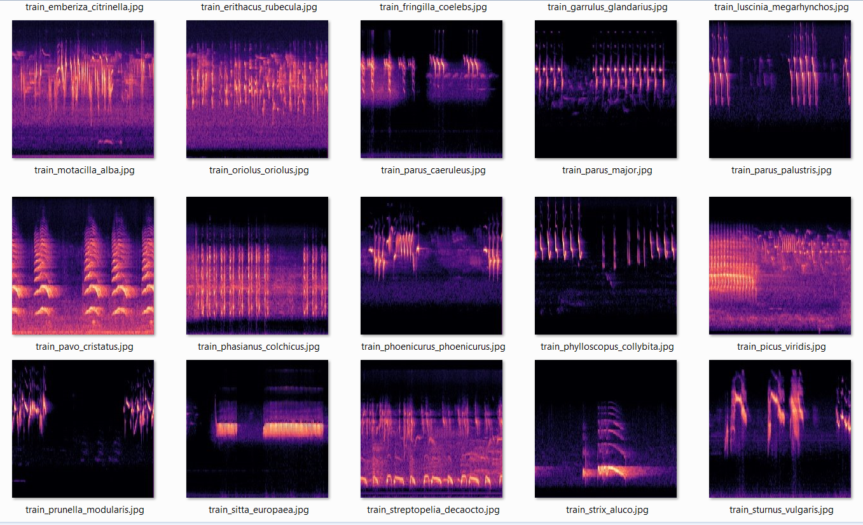
Feature Extraction with Librosa

Slide 7
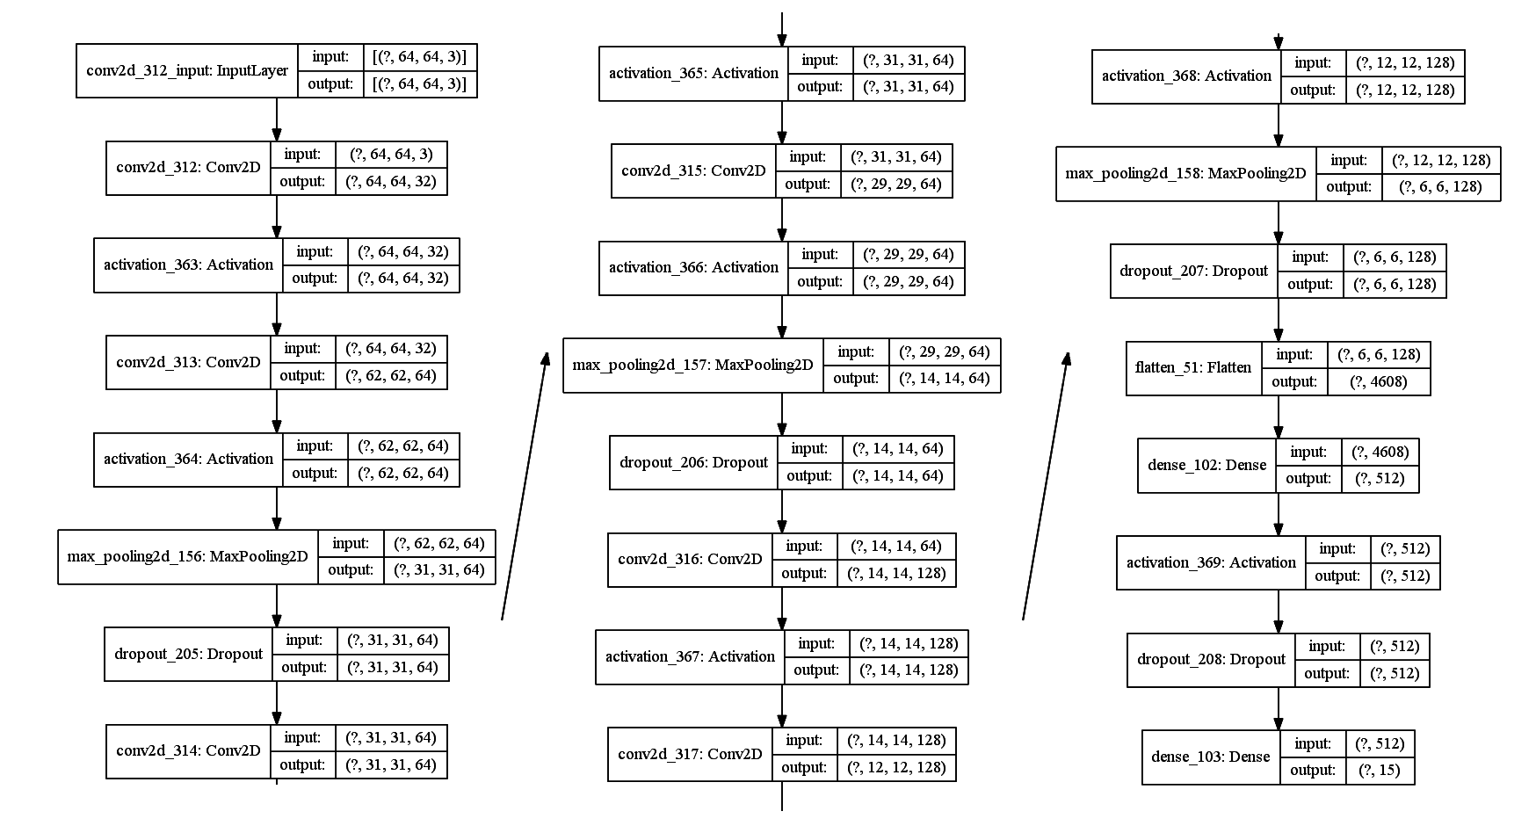
A Convolutional Network
Conv2d, activation, pooling, dropout, and dense layers!

Slide 8
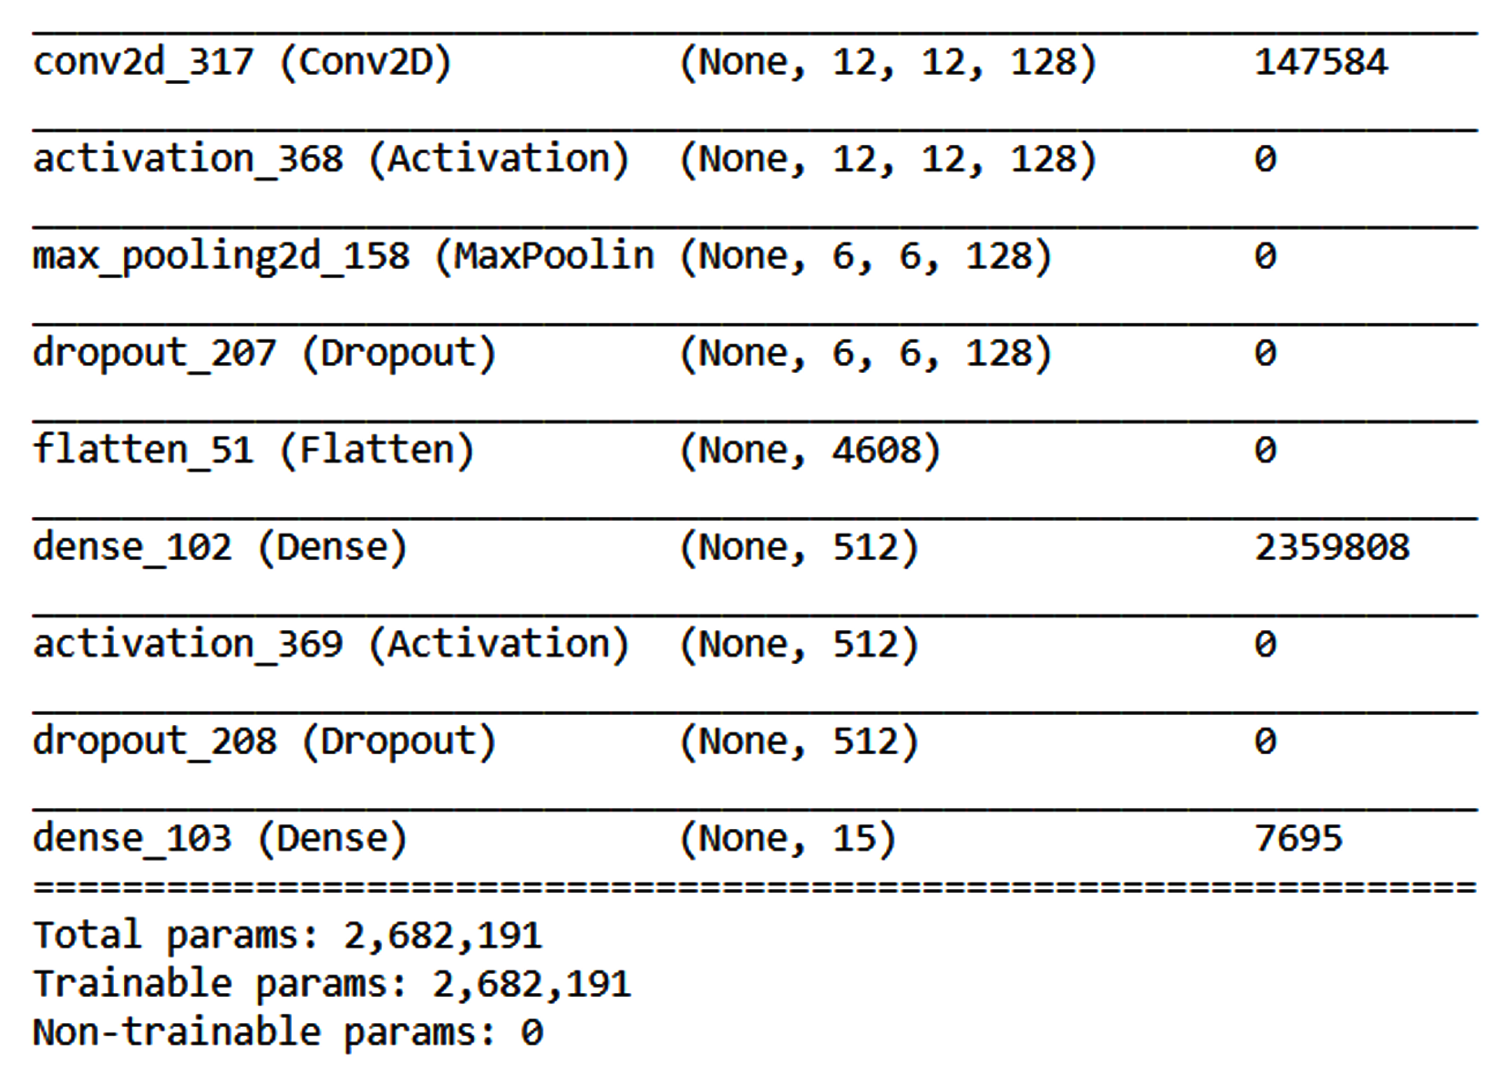
A closer look: 2.7M weights

Slide 9
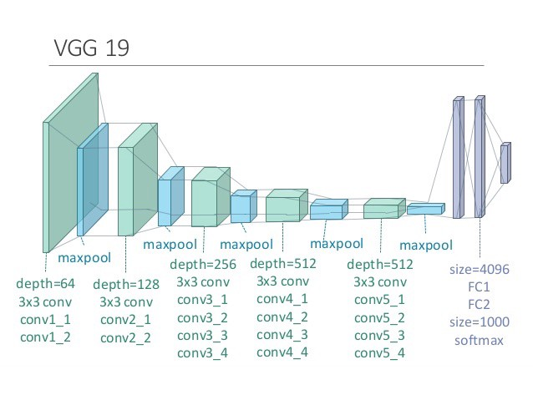
Explainability: Voodoo & Robot Dreams
Image: https://sites.google.com/site/aidysft/objectdetection/more-gadgets

Slide 10
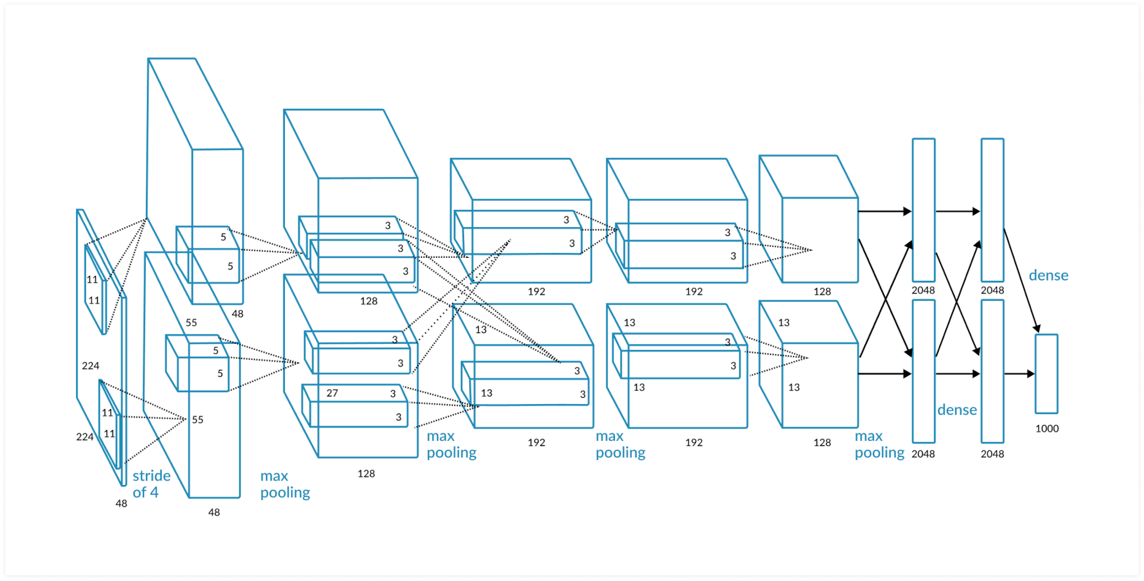
Explainability: Voodoo and Robot Dreams
Image: https://missinglink.ai/guides/convolutional-neural-networks/convolutional-neural-networks-image-classification/

Slide 11
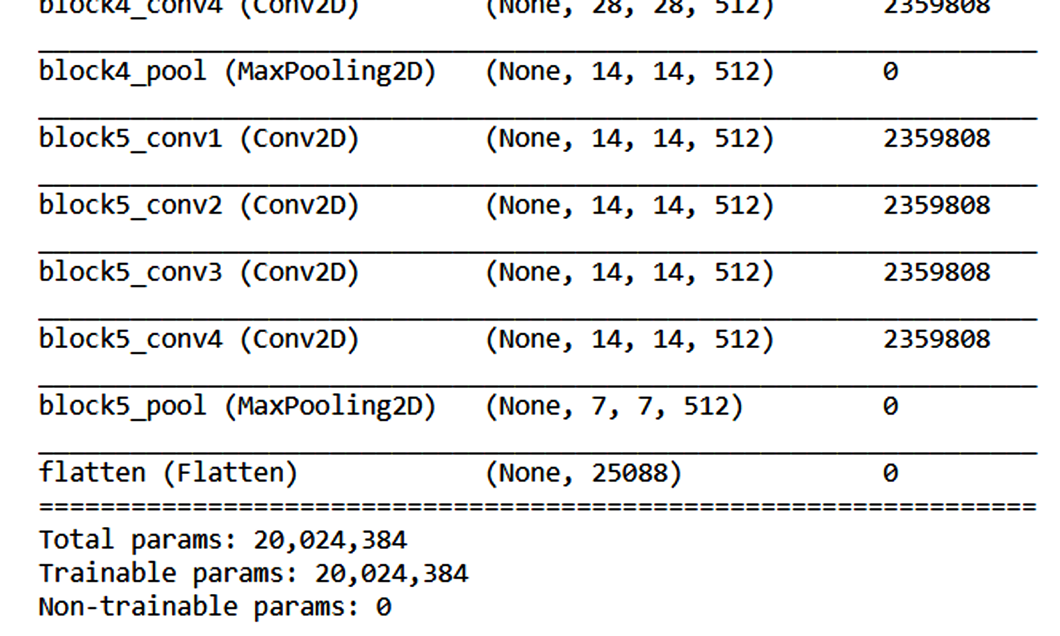
20M Weights, Voodoo Output

Slide 12
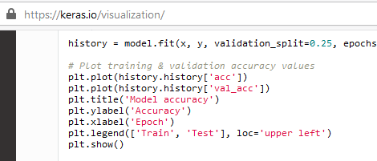
My Favourite Chunk of Code

Slide 13
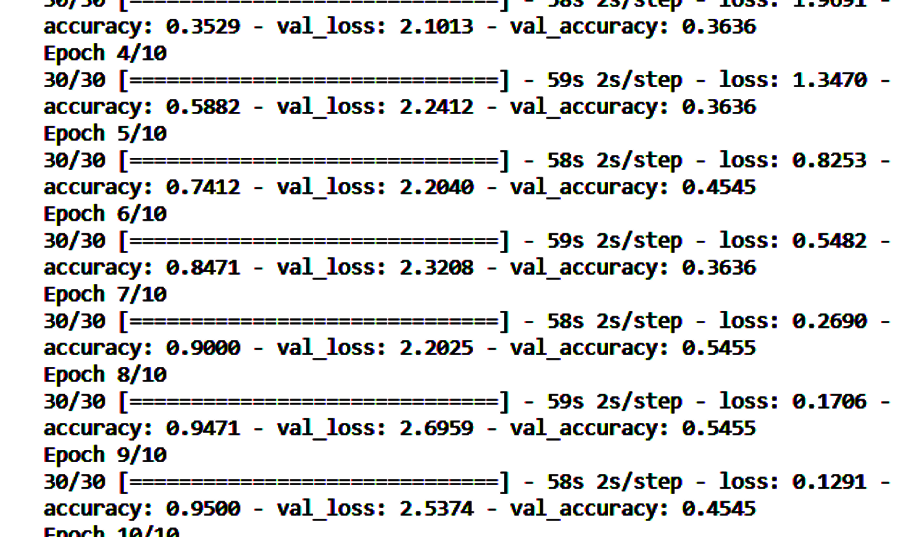
Training Without Plot

Slide 14
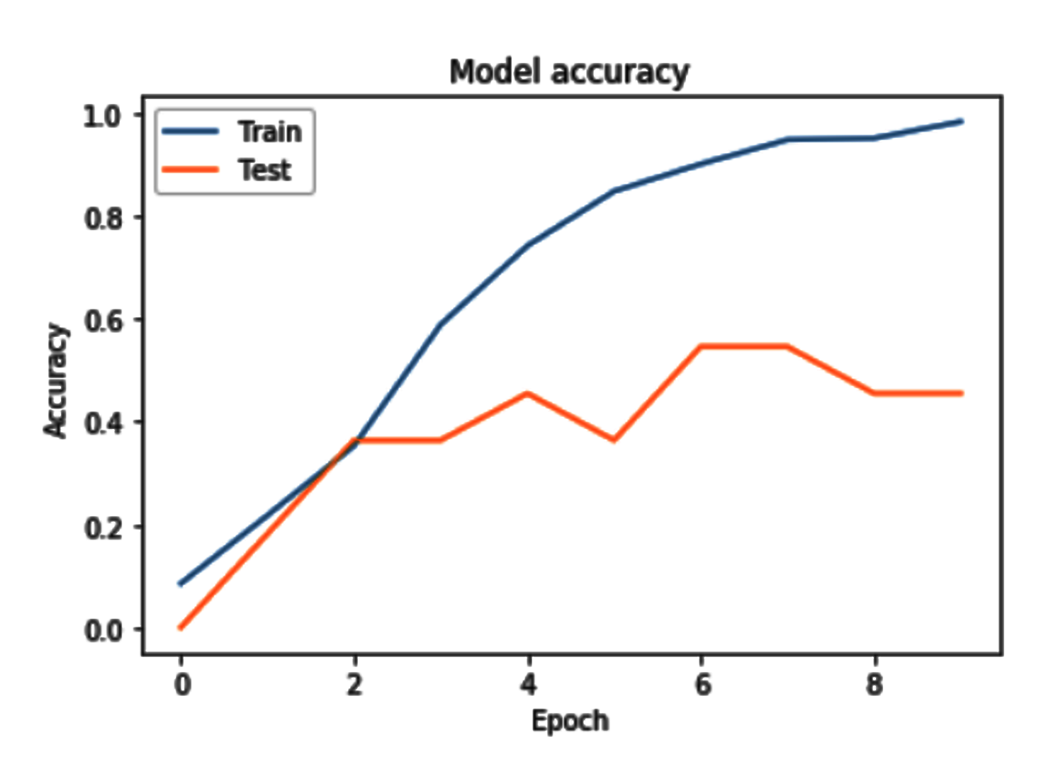
Training With Plot

Slide 15
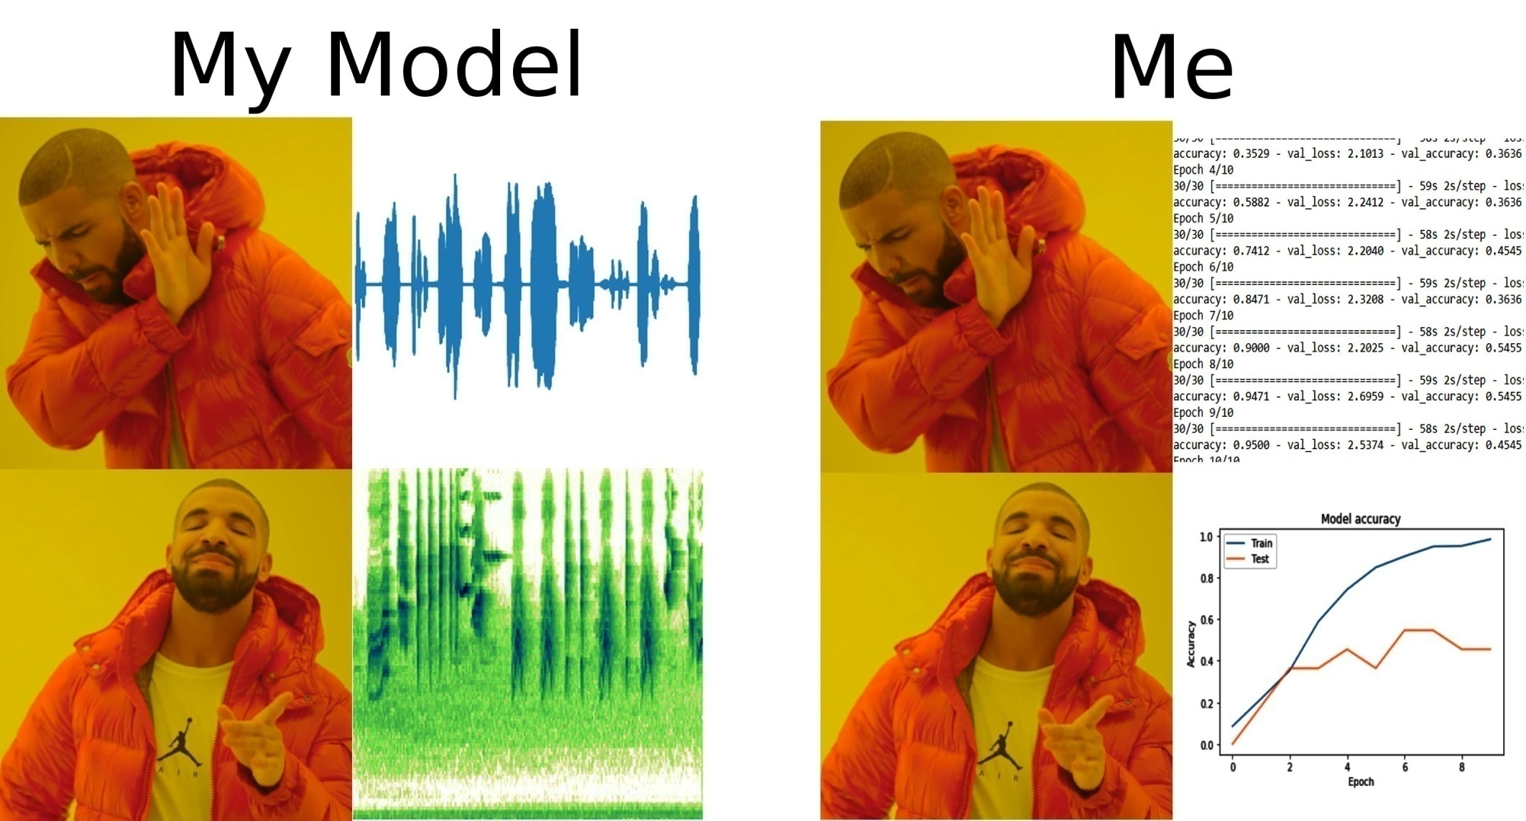
Empathizing with ML Models on Raw Data & Feature Extraction

Slide 16
Scaling Up
Use all the species in the dataset
More samples from sliding windows
More steps per Epoch
More Epochs

Slide 17
Playing with the Model
Decrease learning rate
Adjust learning rate decay
Adam, RMSProp optimizers
Momentum
Add and remove layers
Increase size of model’s input layer

Slide 18
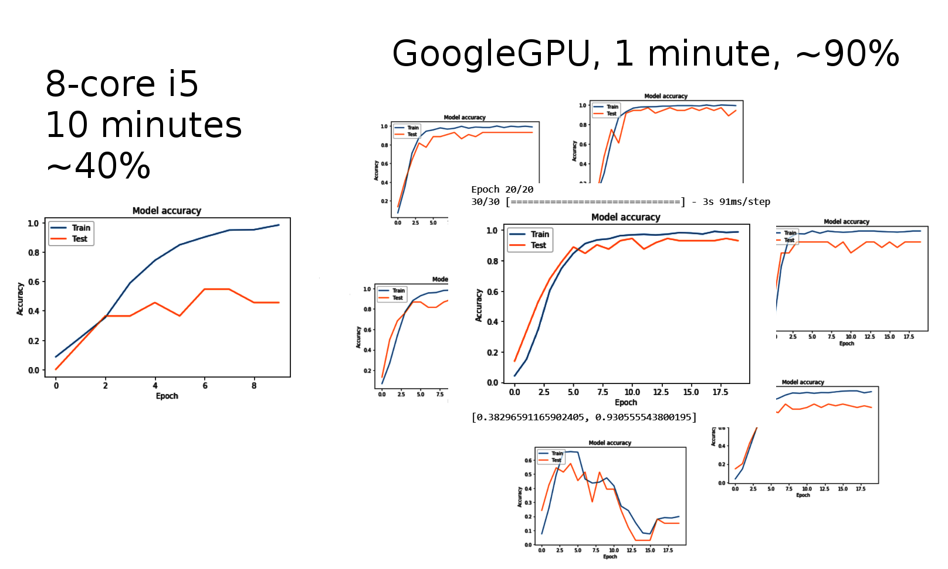
Laptop vs GPU in the Cloud

Slide 19
Conclusions
Spectrograms with a ConvNet are the simplest most common approach
Using a flattened VGG-19 to extract audio features is powerful but mysterious
A simple cloud environment can run 10 times as fast, using 10 times as much data

Slide 20
Future Work
More data, more birds
More advanced models
Deploy in the field

Slide 21
Bibliography
Beginner's Guide to Audio Data
https://www.kaggle.com/fizzbuzz/beginner-s-guide-to-audio-data
How to apply machine learning and deep learning methods to audio analysis
https://towardsdatascience.com/how-to-apply-machine-learning-and-deep-learning-methods-to-audio-analysis-615e286fcbbc
Urban Sound Classification using Convolutional Neural Networks with Keras: Theory and Implementation
https://medium.com/gradientcrescent/urban-sound-classification-using-convolutional-neural-networks-with-keras-theory-and-486e92785df4
Audio Classification with Pre-trained VGG-19 (Keras)
https://towardsdatascience.com/audio-classification-with-pre-trained-vgg-19-keras-bca55c2a0efe
Sound Event Classification: A to Z
https://towardsdatascience.com/sound-event-classification-using-machine-learning-8768092beafc

