Slide 1
Training Bird Song Classifiers
CSML1020
Machine Learning at Scale
Pete Gray YorkU #217653247

Slide 2
Objectives
Use deep learning to classify bird songs
Play with models in the cloud
Identify bird species in the real world

Slide 3
Previous Work
Data comes from a 2013 Kaggle competition
Many successful commercial apps
Merlin Bird ID by Cornell Lab
Bird Song Id Canada
Song Sleuth
BirdNET
ChirpOMatic

Slide 4
Contributes to Human Learning
You and app hear bird song
App performs inference, displays output
You have “label” for your “training data”
You learn
App allows you to perform supervised learning on live environmental data by labeling it for you.

Slide 5
Approaches
Feature extraction with spectrograms, train a Convolutional Network from scratch
Feature extraction with a flattened, pre-trained VGG-19, training and inference with an SVC (support vector classifier)
A search for an approach to features that would work for an LSTM or other sequential neural network

Slide 6
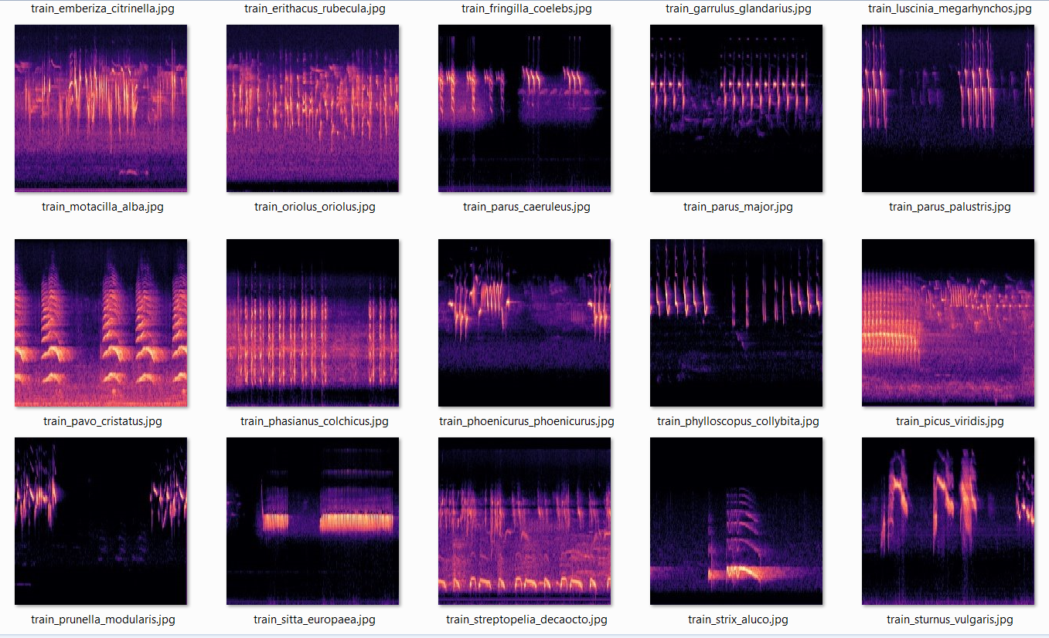
Feature Extraction with Librosa

Slide 7
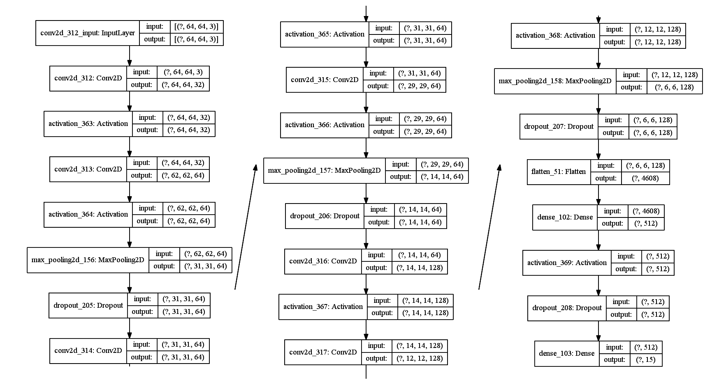
A Convolutional Network
Conv2d, activation, pooling, dropout, and dense layers!

Slide 8
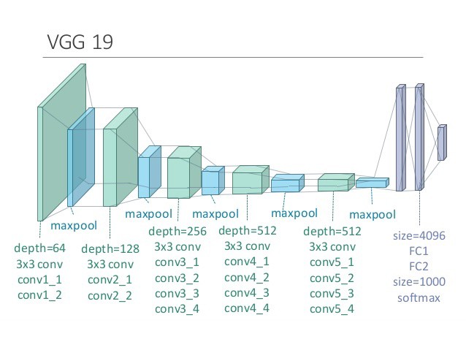
Explainability: Voodoo & Robot Dreams
Image: https://sites.google.com/site/aidysft/objectdetection/more-gadgets

Slide 9
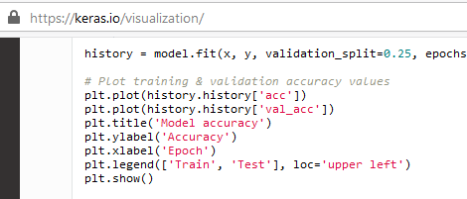
My Favourite Chunk of Code

Slide 10
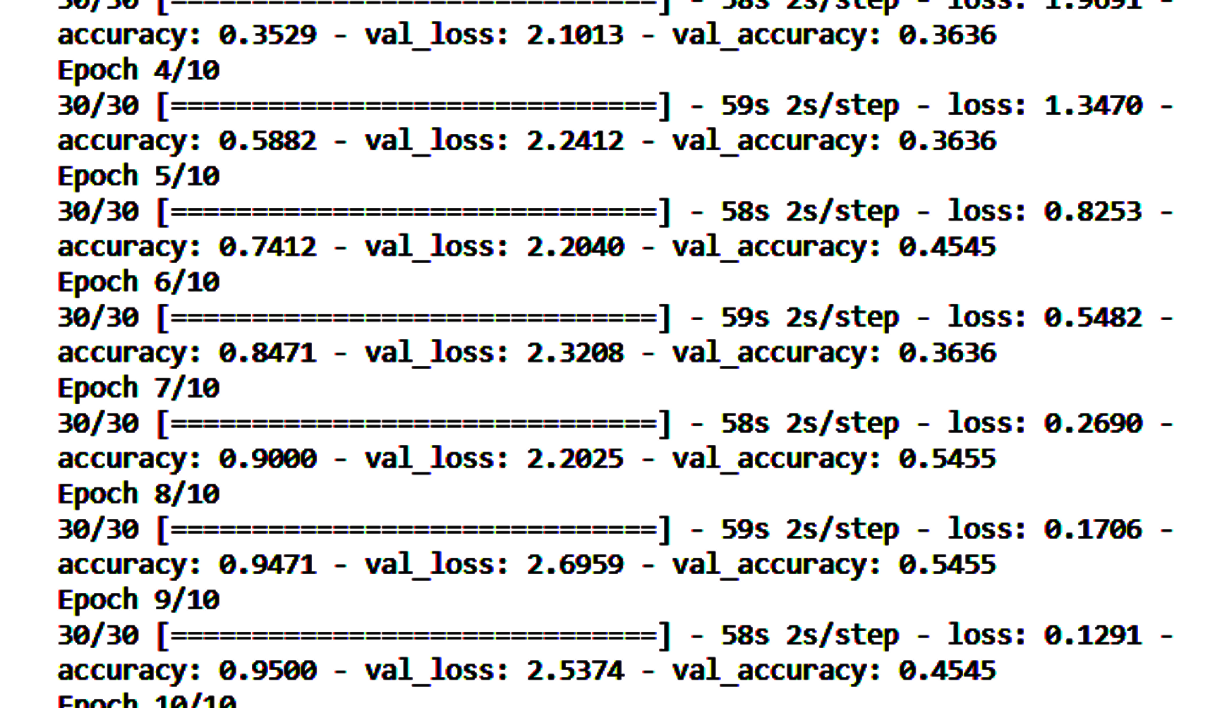
Training Without Plot

Slide 11
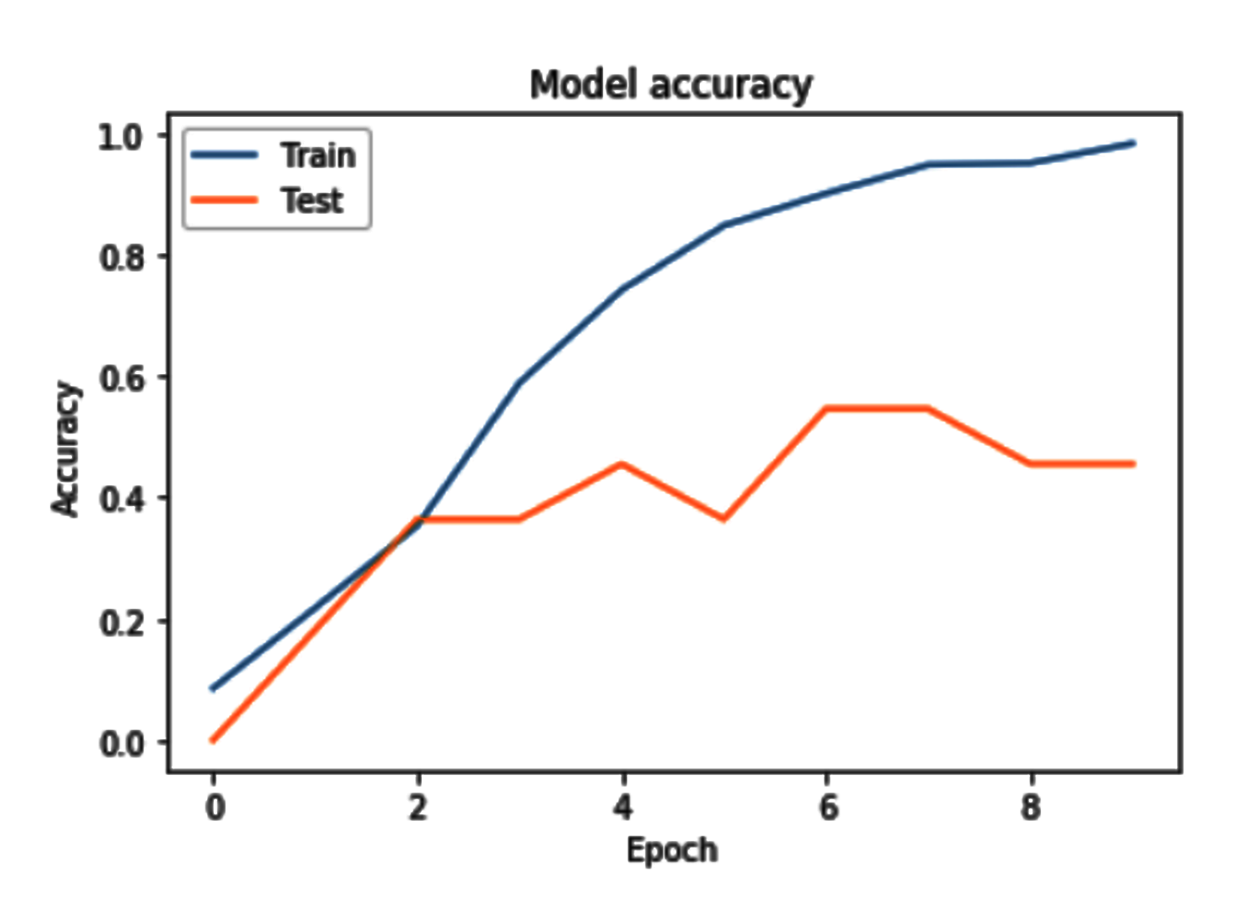
Training With Plot

Slide 12
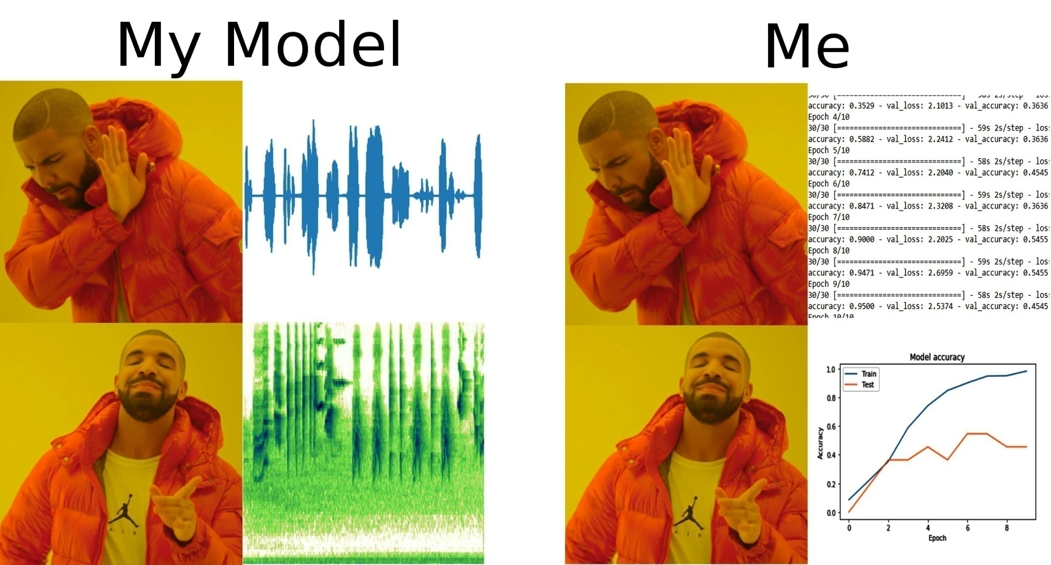
Empathizing with ML Models on Raw Signal Data

Slide 13
Scaling Up
Use all the species in the dataset
More samples from sliding windows
More steps per Epoch
More Epochs

Slide 14
Tuning the model
Decrease learning rate
Adjust learning rate decay
Adam, RMSProp optimizers
Momentum
Add and remove layers
Increase size of model’s input layer

Slide 15
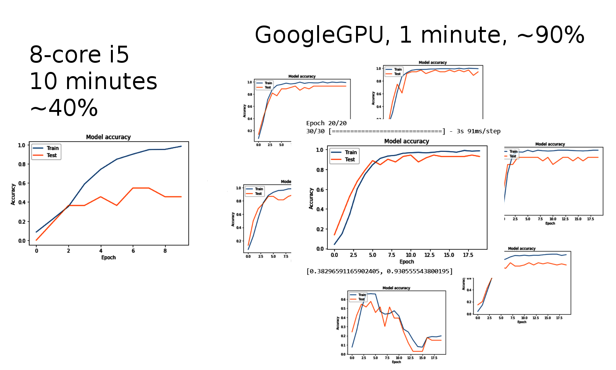
Laptop vs Cloud GPUs

Slide 16
Conclusions
Spectrograms with a ConvNet are the simplest most common approach
Using a flattened VGG-19 to extract audio features is powerful but mysterious
A simple cloud environment can run 10 times as fast using 10 times as much data

Slide 17
Future Work
More data, more birds
More advanced models
Deploy in the field

Slide 18
Bibliography
Beginner's Guide to Audio Data
https://www.kaggle.com/fizzbuzz/beginner-s-guide-to-audio-data
How to apply machine learning and deep learning methods to audio analysis
https://towardsdatascience.com/how-to-apply-machine-learning-and-deep-learning-methods-to-audio-analysis-615e286fcbbc
Urban Sound Classification using Convolutional Neural Networks with Keras: Theory and Implementation
https://medium.com/gradientcrescent/urban-sound-classification-using-convolutional-neural-networks-with-keras-theory-and-486e92785df4
Audio Classification with Pre-trained VGG-19 (Keras)
https://towardsdatascience.com/audio-classification-with-pre-trained-vgg-19-keras-bca55c2a0efe
Sound Event Classification: A to Z
https://towardsdatascience.com/sound-event-classification-using-machine-learning-8768092beafc

