Slide 1
Training Bird Song Classifiers
CSML1020
Machine Learning at Scale
Pete Gray YorkU #217653247

Slide 2
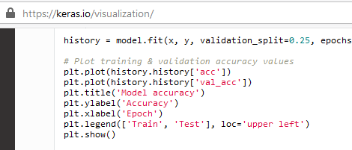
My Favourite Chunk of Code

Slide 3
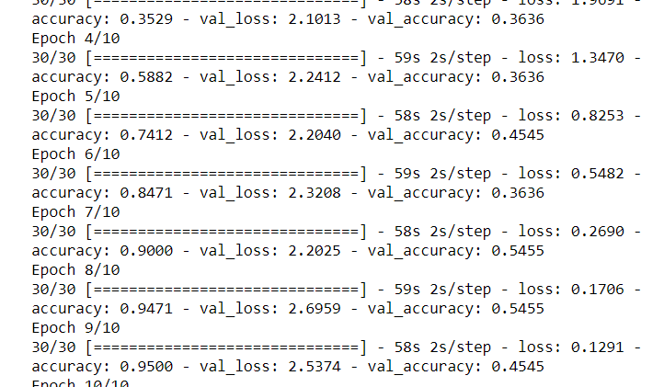
Training Without Plot

Slide 4
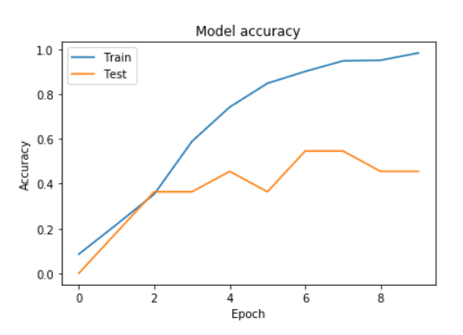
Training With Plot

Slide 5
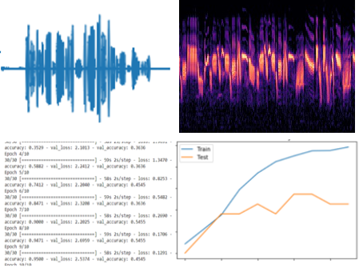
Feature Extraction for Humans?

Slide 6
Future Work
More data, more birds
More advanced models
Deploy in the field

