Slide 1
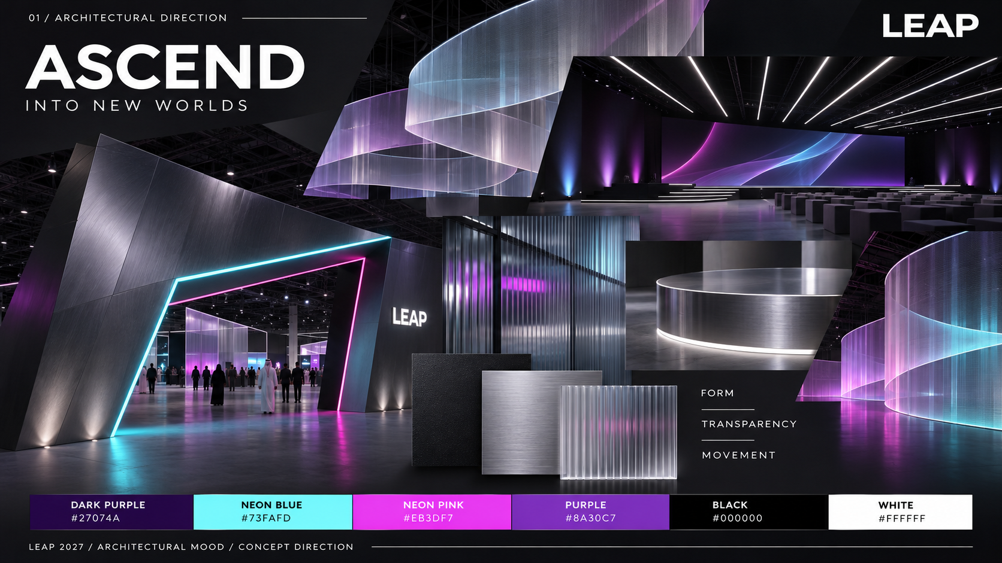
LEAP 2027 / FAIR PLATZ
AREA DESIGN + MATERIAL MOOD
Location. Scale. Reference. Material.
22 AREA SHEETS
Each sheet puts the client-plan location, stand code, footprint, concept reference and material palette together.
HOW TO READ
Pink pins identify the listed locations.
Images show the proposed design family.
Material samples are proposed finishes, with their intended use beside each one.
Regional supplier references appear beside each material. Public catalogues and local supply routes were checked on 11 Nov 2026. Exact grade, colour, stock and delivery need an RFQ. Text and layouts can be edited in the accompanying PowerPoint.
ASCEND / INTO NEW WORLDS
Dark architectural structure, translucent layers, brushed metal, controlled neon accents and human-scale hospitality.
DARK PURPLE
NEON BLUE
NEON PINK
PURPLE
BLACK
WHITE
#27074A
#73FAFD
#EB3DF7
#8A30C7
#000000
#FFFFFF
Sources: client master plan dated 09 Nov 2026; LEAP Brand Playbook 2027; 22 supplier briefs. Spatial concepts and material samples are AI-generated design references.
EDITABLE TEXT + SEPARATE IMAGE ASSETS / UAE + SAUDI SOURCING / PLAN EXCERPTS NOT TO SCALE
01 / 27
Notes:
Client source: LEAP master plan dated 09 Nov 2026 and the supplied 22 creative briefs. Material samples and spatial concepts are illustrative. Regional supplier catalogues checked 11 Nov 2026. Exact grade, stock and certifications require supplier RFQ. Official sources:
S01 Gulf Extrusions UAE https://gulfex.com/
S02 ALUPCO Saudi Arabia https://alupco.com/region/gcc/
S03 Sabin Plastic UAE https://www.sabinplastic.com/wp-content/uploads/2025/10/SABIN-PLASTI_GROUP.pdf
S04 Sabin Plastic KSA https://www.sabinplastic.com/ksa/trading/
S05 Guardian Glass supplier network https://www.guardianglass.com/me/en/our-glass/find-a-guardian-glass-supplier
S06 Al Samiah Furniture UAE https://alsamiah.com/
S07 Sedar UAE https://www.sedarglobal.com/uae-en/tools-and-guides
S08 Sedar KSA https://sedarglobal.com/ksa-en
S09 Gerflor Middle East https://www.gerflorme.com/node/87221
S10 Protect Middle East UAE https://www.protectmiddleeast.com/flooring
S11 Danube Building Materials UAE https://danubebuildingmaterials.com/
S12 Danube Building Materials Riyadh https://danubeholding.com/places/2933/
S13 Sioen / Sioline regional team https://sioline.com/en/contact
S14 Obeikan Technical Fabrics KSA https://obeikanfabrics.com/the-company/
S15 Adams Furniture UAE https://www.adamsinternational.ae/post/outdoor-fabrics-dubai
S16 Aljuraid Group KSA https://aljuraidgroup.com/products/lounge-and-sofa/reva/
S17 RAK Ceramics UAE https://www.rakceramics.com/uae/en/tiles-floors-coverings/outdoor-porcelain-tiles/
S18 RAK Ceramics Saudi store https://onlineshop.rakceramics.com/sa/ara/outdoor.html
S19 LEDFlex Dubai https://ledflexgroup.com/press-media/news/v/?url=enhancing_our_support_within_the_gcc_region
S20 LEDFlex lighting ranges https://ledflexgroup.com/product/neon-flex/
S21 LEDFlex Saudi project supply https://ledflexgroup.com/projects/v/?url=bain-and-company
S22 CSiX UAE https://csixgt.com/
S23 Desert Sign KSA https://desertsign.com.sa/
S24 Desert Group UAE https://desertgroup.ae/
S25 Desert Views KSA https://desertviews.sa/nursery/

Slide 2
LEAP 2027 / AREA FINDER
Find an area
Select a row to open its location, reference image and material mood sheet.
01
Main Stage
03
12
Private Dining
14
H1.A90
H2.T30 / Upper Level 1
02
The Full Stack Stage
04
13
Coworking Stations
15
H2.S40
H1A.A60 / H4.A70 / H2.H50
03
Investor & Founder Stage
05
14
Media Hub
16
H3.H200
H2.A11 / Media Lounge / H2.A12-A25 / 14 stands
04
LEAP Forward Stage
06
15
LEAP Connect
17
H3.A30
H4.H10
05
Rocket Fuel Stage
07
16
Merch Store
18
H3.A150
RA12
06
Announcement Stages
08
17
Indoor F&B Kiosks
19
H4.A40 / H1A.A10
13 locations - see full schedule on area sheet
07
Premium Lounges
09
18
Food Festival + Outdoor F&B
20
H2.P30 / H3.A80 / H1A.I10
5 locations - see full schedule on area sheet
08
LEAP Lounge
10
19
Future Mobility Zone
21
H2.T20
H3.A10
09
Speakers Lounge
11
20
Open Vista
22
H1.A80
H1.C10
10
Green Rooms
12
21
Hall 3 Seating + Photo Areas
23
H1.A100 / H4.C10
H3.D150 / H3.G150
11
Investors Lounge + Matchmaking
13
22
Tunnels
24
H3.A200 / Investors / H3.A180 / Matchmaking
5 locations - see full schedule on area sheet
A single sheet may cover several locations that share one brief and design family.
All stand codes follow the supplied client briefs; master-plan labels are used to identify the locations.
EDITABLE TEXT + SEPARATE IMAGE ASSETS / UAE + SAUDI SOURCING / PLAN EXCERPTS NOT TO SCALE
02 / 27
Notes:
Client source: LEAP master plan dated 09 Nov 2026 and the supplied 22 creative briefs. Material samples and spatial concepts are illustrative. Regional supplier catalogues checked 11 Nov 2026. Exact grade, stock and certifications require supplier RFQ. Official sources:
S01 Gulf Extrusions UAE https://gulfex.com/
S02 ALUPCO Saudi Arabia https://alupco.com/region/gcc/
S03 Sabin Plastic UAE https://www.sabinplastic.com/wp-content/uploads/2025/10/SABIN-PLASTI_GROUP.pdf
S04 Sabin Plastic KSA https://www.sabinplastic.com/ksa/trading/
S05 Guardian Glass supplier network https://www.guardianglass.com/me/en/our-glass/find-a-guardian-glass-supplier
S06 Al Samiah Furniture UAE https://alsamiah.com/
S07 Sedar UAE https://www.sedarglobal.com/uae-en/tools-and-guides
S08 Sedar KSA https://sedarglobal.com/ksa-en
S09 Gerflor Middle East https://www.gerflorme.com/node/87221
S10 Protect Middle East UAE https://www.protectmiddleeast.com/flooring
S11 Danube Building Materials UAE https://danubebuildingmaterials.com/
S12 Danube Building Materials Riyadh https://danubeholding.com/places/2933/
S13 Sioen / Sioline regional team https://sioline.com/en/contact
S14 Obeikan Technical Fabrics KSA https://obeikanfabrics.com/the-company/
S15 Adams Furniture UAE https://www.adamsinternational.ae/post/outdoor-fabrics-dubai
S16 Aljuraid Group KSA https://aljuraidgroup.com/products/lounge-and-sofa/reva/
S17 RAK Ceramics UAE https://www.rakceramics.com/uae/en/tiles-floors-coverings/outdoor-porcelain-tiles/
S18 RAK Ceramics Saudi store https://onlineshop.rakceramics.com/sa/ara/outdoor.html
S19 LEDFlex Dubai https://ledflexgroup.com/press-media/news/v/?url=enhancing_our_support_within_the_gcc_region
S20 LEDFlex lighting ranges https://ledflexgroup.com/product/neon-flex/
S21 LEDFlex Saudi project supply https://ledflexgroup.com/projects/v/?url=bain-and-company
S22 CSiX UAE https://csixgt.com/
S23 Desert Sign KSA https://desertsign.com.sa/
S24 Desert Group UAE https://desertgroup.ae/
S25 Desert Views KSA https://desertviews.sa/nursery/

Slide 3
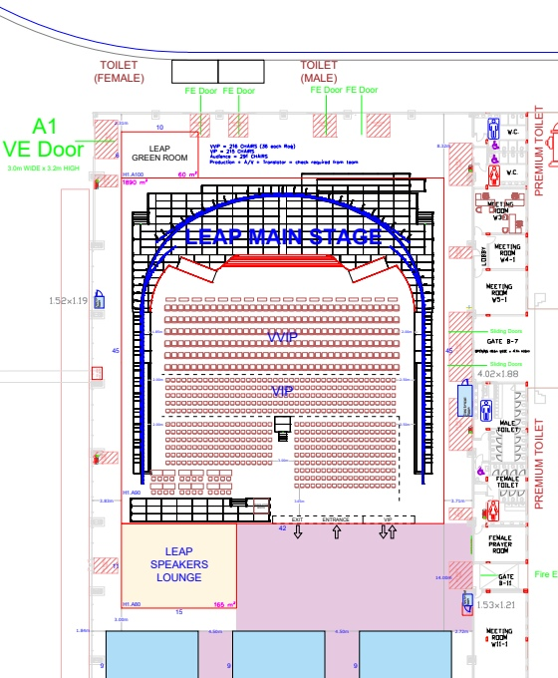
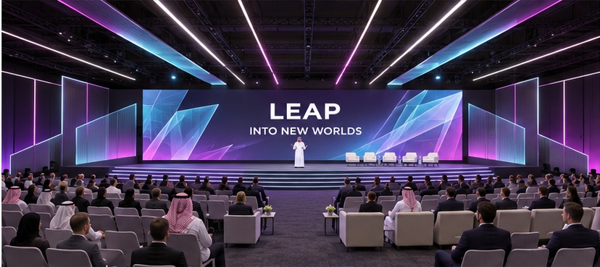
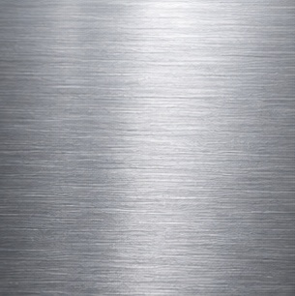


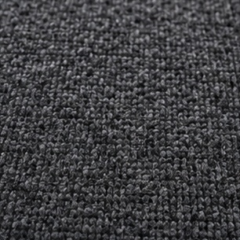
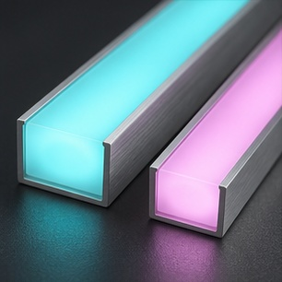
LEAP 2027 / STAGES
01
Main Stage
IMMERSIVE / DIRECTIONAL / MONUMENTAL
01 / LOCATION ON CLIENT PLAN
02 / DESIGN REFERENCE + ARCHITECTURAL MOOD
MAIN STAGE CLUSTER / H1.* ON PLAN
1
STAND / AREA SCHEDULE
1
H1.A90
1,890 m²
LIGHT + ATMOSPHERE Moving light sequences along static ceiling strips; clean white speaker light.
WHAT TO DESIGN
Panoramic LED, signature strips, ceiling and side-wall scenery, VIP/audience seating and accessible stage routes.
03 / UAE + SAUDI MATERIAL OPTIONS
AREA NOTE
The brief calls the hall Hall 1A; the master plan uses stand H1.A90. Coordinate using the stand code.
BRUSHED / ANODIZED ALUMINIUM
PRINTABLE FABRIC / MEDIA
TRANSLUCENT POLYCARBONATE
GRAPHITE EVENT CARPET
DIFFUSED LINEAR LED
Lightweight scenic frames
Graphic walls / scenic faces
Translucent ceiling diffusers
Auditorium floor finish
Directional ceiling light lines
UAE GulfEx / KSA ALUPCO [S01-02]
UAE CSiX / KSA Desert Sign [S22-23]
UAE + KSA Sabin Plastic [S03-04]
UAE stockist / KSA supply Al Samiah [S06]
UAE + KSA LEDFlex supply [S19-21]
DARK PURPLE
NEON BLUE
NEON PINK
PURPLE
BLACK
WHITE
#27074A
#73FAFD
#EB3DF7
#8A30C7
#000000
#FFFFFF
Location source: client master plan p.1; Main Stage brief pp.3,14-19. Material photographs are visual proposals; confirm product, finish and construction specifications.
EDITABLE TEXT + SEPARATE IMAGE ASSETS / UAE + SAUDI SOURCING / PLAN EXCERPTS NOT TO SCALE
03 / 27
Notes:
Client source: LEAP master plan dated 09 Nov 2026 and the supplied 22 creative briefs. Material samples and spatial concepts are illustrative. Regional supplier catalogues checked 11 Nov 2026. Exact grade, stock and certifications require supplier RFQ. Official sources:
S01 Gulf Extrusions UAE https://gulfex.com/
S02 ALUPCO Saudi Arabia https://alupco.com/region/gcc/
S03 Sabin Plastic UAE https://www.sabinplastic.com/wp-content/uploads/2025/10/SABIN-PLASTI_GROUP.pdf
S04 Sabin Plastic KSA https://www.sabinplastic.com/ksa/trading/
S05 Guardian Glass supplier network https://www.guardianglass.com/me/en/our-glass/find-a-guardian-glass-supplier
S06 Al Samiah Furniture UAE https://alsamiah.com/
S07 Sedar UAE https://www.sedarglobal.com/uae-en/tools-and-guides
S08 Sedar KSA https://sedarglobal.com/ksa-en
S09 Gerflor Middle East https://www.gerflorme.com/node/87221
S10 Protect Middle East UAE https://www.protectmiddleeast.com/flooring
S11 Danube Building Materials UAE https://danubebuildingmaterials.com/
S12 Danube Building Materials Riyadh https://danubeholding.com/places/2933/
S13 Sioen / Sioline regional team https://sioline.com/en/contact
S14 Obeikan Technical Fabrics KSA https://obeikanfabrics.com/the-company/
S15 Adams Furniture UAE https://www.adamsinternational.ae/post/outdoor-fabrics-dubai
S16 Aljuraid Group KSA https://aljuraidgroup.com/products/lounge-and-sofa/reva/
S17 RAK Ceramics UAE https://www.rakceramics.com/uae/en/tiles-floors-coverings/outdoor-porcelain-tiles/
S18 RAK Ceramics Saudi store https://onlineshop.rakceramics.com/sa/ara/outdoor.html
S19 LEDFlex Dubai https://ledflexgroup.com/press-media/news/v/?url=enhancing_our_support_within_the_gcc_region
S20 LEDFlex lighting ranges https://ledflexgroup.com/product/neon-flex/
S21 LEDFlex Saudi project supply https://ledflexgroup.com/projects/v/?url=bain-and-company
S22 CSiX UAE https://csixgt.com/
S23 Desert Sign KSA https://desertsign.com.sa/
S24 Desert Group UAE https://desertgroup.ae/
S25 Desert Views KSA https://desertviews.sa/nursery/

Slide 4
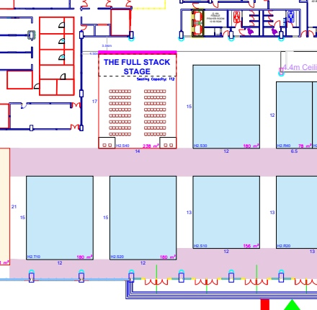
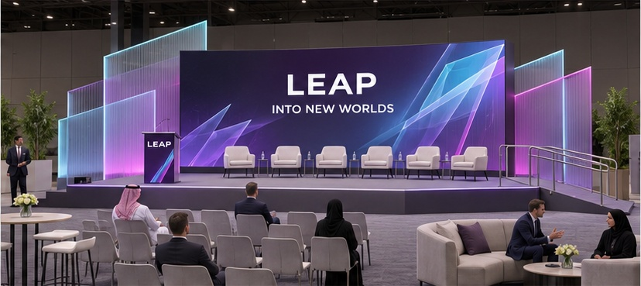
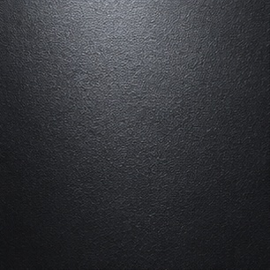
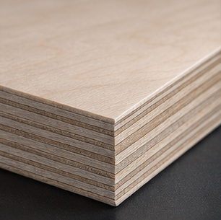
LEAP 2027 / STAGES
02
The Full Stack Stage
LAYERED / PRECISE / OPEN
01 / LOCATION ON CLIENT PLAN
02 / DESIGN REFERENCE + ARCHITECTURAL MOOD
WEST HALL 2 / LABELLED HALL 2A ON PLAN
1
STAND / AREA SCHEDULE
1
H2.S40
238 m²
LIGHT + ATMOSPHERE Soft cyan/pink edges with even screen and speaker lighting.
WHAT TO DESIGN
14 x 17 m; one main LED, accessible ramp, podium, six speaker chairs, mixed audience seating and production desks.
03 / UAE + SAUDI MATERIAL OPTIONS
BLACK POWDER-COATED ALUMINIUM
TRANSLUCENT POLYCARBONATE
FSC PLYWOOD / SCENIC BOARD
GRAPHITE EVENT CARPET
DIFFUSED LINEAR LED
Portal and scenic framework
Layered translucent fins
FSC timber scenic substrate
Stage and seating floor
Integrated accent lighting
UAE GulfEx / KSA ALUPCO [S01-02]
UAE + KSA Sabin Plastic [S03-04]
UAE + KSA Danube RFQ [S11-12]
UAE stockist / KSA supply Al Samiah [S06]
UAE + KSA LEDFlex supply [S19-21]
DARK PURPLE
NEON BLUE
NEON PINK
PURPLE
BLACK
WHITE
#27074A
#73FAFD
#EB3DF7
#8A30C7
#000000
#FFFFFF
Location source: client master plan p.1; Full Stack Stage brief pp.3,14-18. Material photographs are visual proposals; confirm product, finish and construction specifications.
EDITABLE TEXT + SEPARATE IMAGE ASSETS / UAE + SAUDI SOURCING / PLAN EXCERPTS NOT TO SCALE
04 / 27
Notes:
Client source: LEAP master plan dated 09 Nov 2026 and the supplied 22 creative briefs. Material samples and spatial concepts are illustrative. Regional supplier catalogues checked 11 Nov 2026. Exact grade, stock and certifications require supplier RFQ. Official sources:
S01 Gulf Extrusions UAE https://gulfex.com/
S02 ALUPCO Saudi Arabia https://alupco.com/region/gcc/
S03 Sabin Plastic UAE https://www.sabinplastic.com/wp-content/uploads/2025/10/SABIN-PLASTI_GROUP.pdf
S04 Sabin Plastic KSA https://www.sabinplastic.com/ksa/trading/
S05 Guardian Glass supplier network https://www.guardianglass.com/me/en/our-glass/find-a-guardian-glass-supplier
S06 Al Samiah Furniture UAE https://alsamiah.com/
S07 Sedar UAE https://www.sedarglobal.com/uae-en/tools-and-guides
S08 Sedar KSA https://sedarglobal.com/ksa-en
S09 Gerflor Middle East https://www.gerflorme.com/node/87221
S10 Protect Middle East UAE https://www.protectmiddleeast.com/flooring
S11 Danube Building Materials UAE https://danubebuildingmaterials.com/
S12 Danube Building Materials Riyadh https://danubeholding.com/places/2933/
S13 Sioen / Sioline regional team https://sioline.com/en/contact
S14 Obeikan Technical Fabrics KSA https://obeikanfabrics.com/the-company/
S15 Adams Furniture UAE https://www.adamsinternational.ae/post/outdoor-fabrics-dubai
S16 Aljuraid Group KSA https://aljuraidgroup.com/products/lounge-and-sofa/reva/
S17 RAK Ceramics UAE https://www.rakceramics.com/uae/en/tiles-floors-coverings/outdoor-porcelain-tiles/
S18 RAK Ceramics Saudi store https://onlineshop.rakceramics.com/sa/ara/outdoor.html
S19 LEDFlex Dubai https://ledflexgroup.com/press-media/news/v/?url=enhancing_our_support_within_the_gcc_region
S20 LEDFlex lighting ranges https://ledflexgroup.com/product/neon-flex/
S21 LEDFlex Saudi project supply https://ledflexgroup.com/projects/v/?url=bain-and-company
S22 CSiX UAE https://csixgt.com/
S23 Desert Sign KSA https://desertsign.com.sa/
S24 Desert Group UAE https://desertgroup.ae/
S25 Desert Views KSA https://desertviews.sa/nursery/

Slide 5
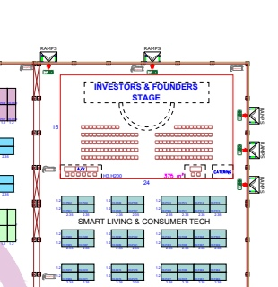
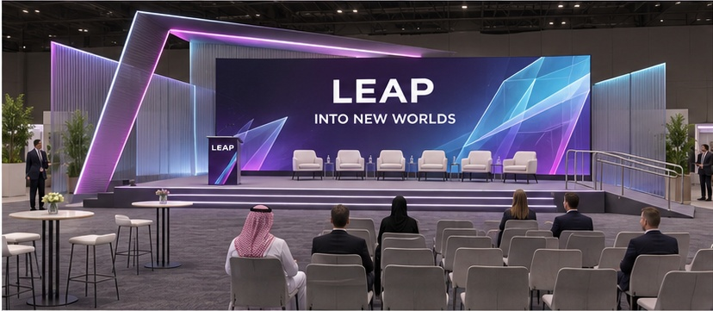
LEAP 2027 / STAGES
03
Investor & Founder Stage
FOCUSED / PREMIUM / CONNECTED
01 / LOCATION ON CLIENT PLAN
02 / DESIGN REFERENCE + ARCHITECTURAL MOOD
HALL 3 / NORTH-EAST STAGE
1
STAND / AREA SCHEDULE
1
H3.H200
375 m²
LIGHT + ATMOSPHERE Clear faces and presentation content; restrained perimeter accents.
WHAT TO DESIGN
24 x 15 m; one main LED, raised stage, ramp, lectern, six speaker chairs and mixed seating.
03 / UAE + SAUDI MATERIAL OPTIONS
BLACK POWDER-COATED ALUMINIUM
BRUSHED / ANODIZED ALUMINIUM
TRANSLUCENT POLYCARBONATE
GRAPHITE EVENT CARPET
DIFFUSED LINEAR LED
Ground-supported framework
Fine metallic scenic trim
Slim translucent side fins
Stage / audience flooring
Directional portal accents
UAE GulfEx / KSA ALUPCO [S01-02]
UAE GulfEx / KSA ALUPCO [S01-02]
UAE + KSA Sabin Plastic [S03-04]
UAE stockist / KSA supply Al Samiah [S06]
UAE + KSA LEDFlex supply [S19-21]
DARK PURPLE
NEON BLUE
NEON PINK
PURPLE
BLACK
WHITE
#27074A
#73FAFD
#EB3DF7
#8A30C7
#000000
#FFFFFF
Location source: client master plan p.1; Investor & Founder Stage brief pp.3,13-17. Material photographs are visual proposals; confirm product, finish and construction specifications.
EDITABLE TEXT + SEPARATE IMAGE ASSETS / UAE + SAUDI SOURCING / PLAN EXCERPTS NOT TO SCALE
05 / 27
Notes:
Client source: LEAP master plan dated 09 Nov 2026 and the supplied 22 creative briefs. Material samples and spatial concepts are illustrative. Regional supplier catalogues checked 11 Nov 2026. Exact grade, stock and certifications require supplier RFQ. Official sources:
S01 Gulf Extrusions UAE https://gulfex.com/
S02 ALUPCO Saudi Arabia https://alupco.com/region/gcc/
S03 Sabin Plastic UAE https://www.sabinplastic.com/wp-content/uploads/2025/10/SABIN-PLASTI_GROUP.pdf
S04 Sabin Plastic KSA https://www.sabinplastic.com/ksa/trading/
S05 Guardian Glass supplier network https://www.guardianglass.com/me/en/our-glass/find-a-guardian-glass-supplier
S06 Al Samiah Furniture UAE https://alsamiah.com/
S07 Sedar UAE https://www.sedarglobal.com/uae-en/tools-and-guides
S08 Sedar KSA https://sedarglobal.com/ksa-en
S09 Gerflor Middle East https://www.gerflorme.com/node/87221
S10 Protect Middle East UAE https://www.protectmiddleeast.com/flooring
S11 Danube Building Materials UAE https://danubebuildingmaterials.com/
S12 Danube Building Materials Riyadh https://danubeholding.com/places/2933/
S13 Sioen / Sioline regional team https://sioline.com/en/contact
S14 Obeikan Technical Fabrics KSA https://obeikanfabrics.com/the-company/
S15 Adams Furniture UAE https://www.adamsinternational.ae/post/outdoor-fabrics-dubai
S16 Aljuraid Group KSA https://aljuraidgroup.com/products/lounge-and-sofa/reva/
S17 RAK Ceramics UAE https://www.rakceramics.com/uae/en/tiles-floors-coverings/outdoor-porcelain-tiles/
S18 RAK Ceramics Saudi store https://onlineshop.rakceramics.com/sa/ara/outdoor.html
S19 LEDFlex Dubai https://ledflexgroup.com/press-media/news/v/?url=enhancing_our_support_within_the_gcc_region
S20 LEDFlex lighting ranges https://ledflexgroup.com/product/neon-flex/
S21 LEDFlex Saudi project supply https://ledflexgroup.com/projects/v/?url=bain-and-company
S22 CSiX UAE https://csixgt.com/
S23 Desert Sign KSA https://desertsign.com.sa/
S24 Desert Group UAE https://desertgroup.ae/
S25 Desert Views KSA https://desertviews.sa/nursery/

Slide 6
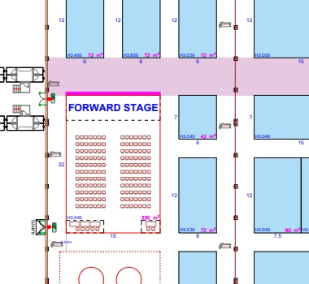
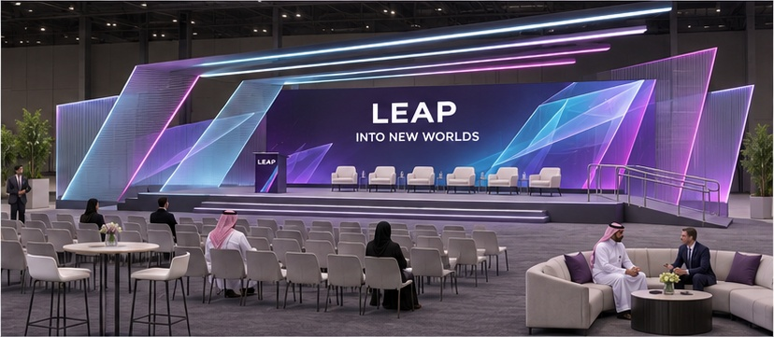
LEAP 2027 / STAGES
04
LEAP Forward Stage
PROGRESSIVE / LINEAR / INVITING
01 / LOCATION ON CLIENT PLAN
02 / DESIGN REFERENCE + ARCHITECTURAL MOOD
HALL 3 / WEST SIDE
1
STAND / AREA SCHEDULE
1
H3.A30
330 m²
LIGHT + ATMOSPHERE Ground-supported light profiles; direct speaker wash, subtle cyan/pink.
WHAT TO DESIGN
15 x 22 m; one main LED, podium, accessible ramp, mixed audience furniture and production area.
03 / UAE + SAUDI MATERIAL OPTIONS
BLACK POWDER-COATED ALUMINIUM
BRUSHED / ANODIZED ALUMINIUM
TRANSLUCENT POLYCARBONATE
GRAPHITE EVENT CARPET
DIFFUSED LINEAR LED
Ground-supported scenic frames
Linear metallic fascia
Translucent layered planes
Stage and audience flooring
Forward-travel light accents
UAE GulfEx / KSA ALUPCO [S01-02]
UAE GulfEx / KSA ALUPCO [S01-02]
UAE + KSA Sabin Plastic [S03-04]
UAE stockist / KSA supply Al Samiah [S06]
UAE + KSA LEDFlex supply [S19-21]
DARK PURPLE
NEON BLUE
NEON PINK
PURPLE
BLACK
WHITE
#27074A
#73FAFD
#EB3DF7
#8A30C7
#000000
#FFFFFF
Location source: client master plan p.1; LEAP Forward Stage brief pp.3,14-18. Material photographs are visual proposals; confirm product, finish and construction specifications.
EDITABLE TEXT + SEPARATE IMAGE ASSETS / UAE + SAUDI SOURCING / PLAN EXCERPTS NOT TO SCALE
06 / 27
Notes:
Client source: LEAP master plan dated 09 Nov 2026 and the supplied 22 creative briefs. Material samples and spatial concepts are illustrative. Regional supplier catalogues checked 11 Nov 2026. Exact grade, stock and certifications require supplier RFQ. Official sources:
S01 Gulf Extrusions UAE https://gulfex.com/
S02 ALUPCO Saudi Arabia https://alupco.com/region/gcc/
S03 Sabin Plastic UAE https://www.sabinplastic.com/wp-content/uploads/2025/10/SABIN-PLASTI_GROUP.pdf
S04 Sabin Plastic KSA https://www.sabinplastic.com/ksa/trading/
S05 Guardian Glass supplier network https://www.guardianglass.com/me/en/our-glass/find-a-guardian-glass-supplier
S06 Al Samiah Furniture UAE https://alsamiah.com/
S07 Sedar UAE https://www.sedarglobal.com/uae-en/tools-and-guides
S08 Sedar KSA https://sedarglobal.com/ksa-en
S09 Gerflor Middle East https://www.gerflorme.com/node/87221
S10 Protect Middle East UAE https://www.protectmiddleeast.com/flooring
S11 Danube Building Materials UAE https://danubebuildingmaterials.com/
S12 Danube Building Materials Riyadh https://danubeholding.com/places/2933/
S13 Sioen / Sioline regional team https://sioline.com/en/contact
S14 Obeikan Technical Fabrics KSA https://obeikanfabrics.com/the-company/
S15 Adams Furniture UAE https://www.adamsinternational.ae/post/outdoor-fabrics-dubai
S16 Aljuraid Group KSA https://aljuraidgroup.com/products/lounge-and-sofa/reva/
S17 RAK Ceramics UAE https://www.rakceramics.com/uae/en/tiles-floors-coverings/outdoor-porcelain-tiles/
S18 RAK Ceramics Saudi store https://onlineshop.rakceramics.com/sa/ara/outdoor.html
S19 LEDFlex Dubai https://ledflexgroup.com/press-media/news/v/?url=enhancing_our_support_within_the_gcc_region
S20 LEDFlex lighting ranges https://ledflexgroup.com/product/neon-flex/
S21 LEDFlex Saudi project supply https://ledflexgroup.com/projects/v/?url=bain-and-company
S22 CSiX UAE https://csixgt.com/
S23 Desert Sign KSA https://desertsign.com.sa/
S24 Desert Group UAE https://desertgroup.ae/
S25 Desert Views KSA https://desertviews.sa/nursery/

Slide 7
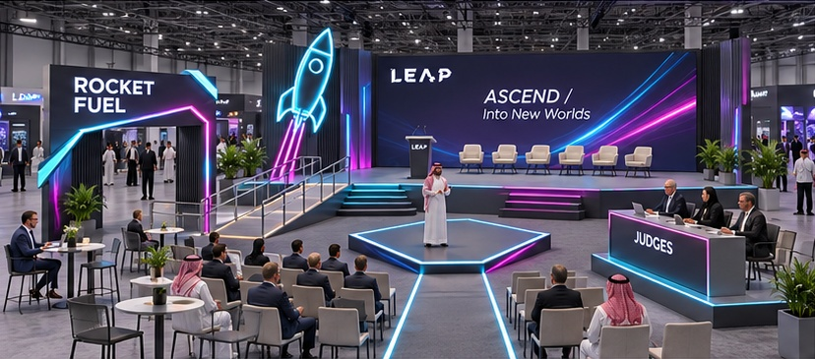
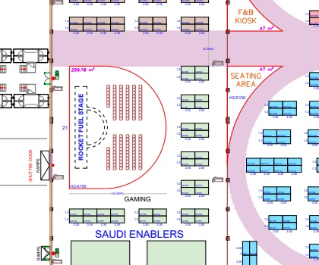
LEAP 2027 / STAGES
05
Rocket Fuel Stage
ENERGETIC / BOLD / FOUNDER-LED
01 / LOCATION ON CLIENT PLAN
02 / DESIGN REFERENCE + ARCHITECTURAL MOOD
HALL 3 / STARTUP + VC ECOSYSTEM
1
STAND / AREA SCHEDULE
1
H3.A150
299.18 m²
LIGHT + ATMOSPHERE Founder spotlight, programmable launch-energy lines, no real flame effect.
WHAT TO DESIGN
Panel stage and diamond pitch platform, judges desk, hero entrance, check-in, accessible ramp, one main LED and mixed seating.
03 / UAE + SAUDI MATERIAL OPTIONS
BLACK POWDER-COATED ALUMINIUM
PRINTABLE FABRIC / MEDIA
FSC PLYWOOD / SCENIC BOARD
GRAPHITE EVENT CARPET
DIFFUSED LINEAR LED
Rocket motif / low framework
Competition graphic faces
FSC scenic platform substrate
Panel / pitch stage flooring
Launch-energy perimeter light
UAE GulfEx / KSA ALUPCO [S01-02]
UAE CSiX / KSA Desert Sign [S22-23]
UAE + KSA Danube RFQ [S11-12]
UAE stockist / KSA supply Al Samiah [S06]
UAE + KSA LEDFlex supply [S19-21]
DARK PURPLE
NEON BLUE
NEON PINK
PURPLE
BLACK
WHITE
#27074A
#73FAFD
#EB3DF7
#8A30C7
#000000
#FFFFFF
Location source: client master plan p.1; Rocket Fuel Stage brief pp.3,12-18. Material photographs are visual proposals; confirm product, finish and construction specifications.
EDITABLE TEXT + SEPARATE IMAGE ASSETS / UAE + SAUDI SOURCING / PLAN EXCERPTS NOT TO SCALE
07 / 27
Notes:
Client source: LEAP master plan dated 09 Nov 2026 and the supplied 22 creative briefs. Material samples and spatial concepts are illustrative. Regional supplier catalogues checked 11 Nov 2026. Exact grade, stock and certifications require supplier RFQ. Official sources:
S01 Gulf Extrusions UAE https://gulfex.com/
S02 ALUPCO Saudi Arabia https://alupco.com/region/gcc/
S03 Sabin Plastic UAE https://www.sabinplastic.com/wp-content/uploads/2025/10/SABIN-PLASTI_GROUP.pdf
S04 Sabin Plastic KSA https://www.sabinplastic.com/ksa/trading/
S05 Guardian Glass supplier network https://www.guardianglass.com/me/en/our-glass/find-a-guardian-glass-supplier
S06 Al Samiah Furniture UAE https://alsamiah.com/
S07 Sedar UAE https://www.sedarglobal.com/uae-en/tools-and-guides
S08 Sedar KSA https://sedarglobal.com/ksa-en
S09 Gerflor Middle East https://www.gerflorme.com/node/87221
S10 Protect Middle East UAE https://www.protectmiddleeast.com/flooring
S11 Danube Building Materials UAE https://danubebuildingmaterials.com/
S12 Danube Building Materials Riyadh https://danubeholding.com/places/2933/
S13 Sioen / Sioline regional team https://sioline.com/en/contact
S14 Obeikan Technical Fabrics KSA https://obeikanfabrics.com/the-company/
S15 Adams Furniture UAE https://www.adamsinternational.ae/post/outdoor-fabrics-dubai
S16 Aljuraid Group KSA https://aljuraidgroup.com/products/lounge-and-sofa/reva/
S17 RAK Ceramics UAE https://www.rakceramics.com/uae/en/tiles-floors-coverings/outdoor-porcelain-tiles/
S18 RAK Ceramics Saudi store https://onlineshop.rakceramics.com/sa/ara/outdoor.html
S19 LEDFlex Dubai https://ledflexgroup.com/press-media/news/v/?url=enhancing_our_support_within_the_gcc_region
S20 LEDFlex lighting ranges https://ledflexgroup.com/product/neon-flex/
S21 LEDFlex Saudi project supply https://ledflexgroup.com/projects/v/?url=bain-and-company
S22 CSiX UAE https://csixgt.com/
S23 Desert Sign KSA https://desertsign.com.sa/
S24 Desert Group UAE https://desertgroup.ae/
S25 Desert Views KSA https://desertviews.sa/nursery/

Slide 8
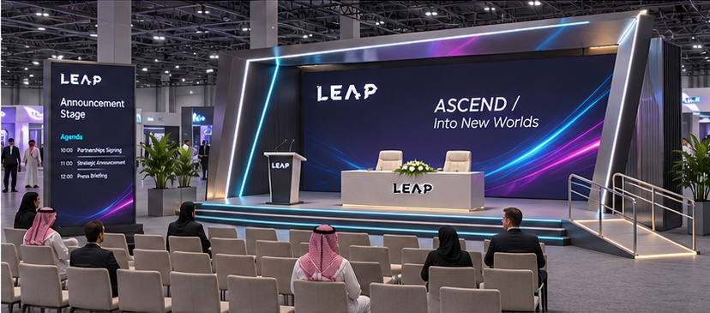
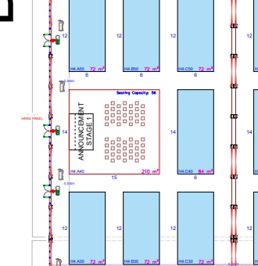
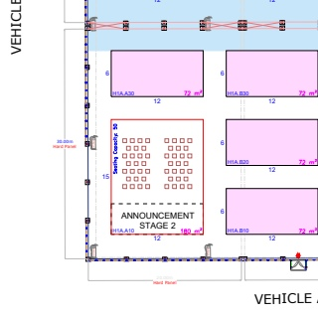
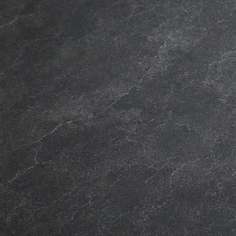
LEAP 2027 / STAGES
06
Announcement Stages
CEREMONIAL / CLEAN / CAMERA-READY
01 / LOCATION ON CLIENT PLAN
02 / DESIGN REFERENCE + ARCHITECTURAL MOOD
STAGE 1 / HALL 4
STAGE 2 / HALL 1A
1
2
STAND / AREA SCHEDULE
1
H4.A40
210 m²
LIGHT + ATMOSPHERE Even signing-table and speaker lighting, controlled scenic glow.
2
H1A.A10
180 m²
WHAT TO DESIGN
03 / UAE + SAUDI MATERIAL OPTIONS
One modular family for two sizes: 15 x 14 m and 15 x 12 m. Signing table, main screen, podium, ramp and audience seating.
AREA NOTE
Same concept reference applies to both locations; resize to each footprint.
BLACK POWDER-COATED ALUMINIUM
PRINTABLE FABRIC / MEDIA
CHARCOAL LVT / VINYL
GRAPHITE EVENT CARPET
DIFFUSED LINEAR LED
Modular stage / portal frames
Branded photo backdrop faces
Signing platform surface
Audience flooring
Photogenic scenic accents
UAE GulfEx / KSA ALUPCO [S01-02]
UAE CSiX / KSA Desert Sign [S22-23]
UAE + KSA Gerflor network [S09-10]
UAE stockist / KSA supply Al Samiah [S06]
UAE + KSA LEDFlex supply [S19-21]
DARK PURPLE
NEON BLUE
NEON PINK
PURPLE
BLACK
WHITE
#27074A
#73FAFD
#EB3DF7
#8A30C7
#000000
#FFFFFF
Location source: client master plan p.1; Announcement Stages brief pp.3,12-17. Material photographs are visual proposals; confirm product, finish and construction specifications.
EDITABLE TEXT + SEPARATE IMAGE ASSETS / UAE + SAUDI SOURCING / PLAN EXCERPTS NOT TO SCALE
08 / 27
Notes:
Client source: LEAP master plan dated 09 Nov 2026 and the supplied 22 creative briefs. Material samples and spatial concepts are illustrative. Regional supplier catalogues checked 11 Nov 2026. Exact grade, stock and certifications require supplier RFQ. Official sources:
S01 Gulf Extrusions UAE https://gulfex.com/
S02 ALUPCO Saudi Arabia https://alupco.com/region/gcc/
S03 Sabin Plastic UAE https://www.sabinplastic.com/wp-content/uploads/2025/10/SABIN-PLASTI_GROUP.pdf
S04 Sabin Plastic KSA https://www.sabinplastic.com/ksa/trading/
S05 Guardian Glass supplier network https://www.guardianglass.com/me/en/our-glass/find-a-guardian-glass-supplier
S06 Al Samiah Furniture UAE https://alsamiah.com/
S07 Sedar UAE https://www.sedarglobal.com/uae-en/tools-and-guides
S08 Sedar KSA https://sedarglobal.com/ksa-en
S09 Gerflor Middle East https://www.gerflorme.com/node/87221
S10 Protect Middle East UAE https://www.protectmiddleeast.com/flooring
S11 Danube Building Materials UAE https://danubebuildingmaterials.com/
S12 Danube Building Materials Riyadh https://danubeholding.com/places/2933/
S13 Sioen / Sioline regional team https://sioline.com/en/contact
S14 Obeikan Technical Fabrics KSA https://obeikanfabrics.com/the-company/
S15 Adams Furniture UAE https://www.adamsinternational.ae/post/outdoor-fabrics-dubai
S16 Aljuraid Group KSA https://aljuraidgroup.com/products/lounge-and-sofa/reva/
S17 RAK Ceramics UAE https://www.rakceramics.com/uae/en/tiles-floors-coverings/outdoor-porcelain-tiles/
S18 RAK Ceramics Saudi store https://onlineshop.rakceramics.com/sa/ara/outdoor.html
S19 LEDFlex Dubai https://ledflexgroup.com/press-media/news/v/?url=enhancing_our_support_within_the_gcc_region
S20 LEDFlex lighting ranges https://ledflexgroup.com/product/neon-flex/
S21 LEDFlex Saudi project supply https://ledflexgroup.com/projects/v/?url=bain-and-company
S22 CSiX UAE https://csixgt.com/
S23 Desert Sign KSA https://desertsign.com.sa/
S24 Desert Group UAE https://desertgroup.ae/
S25 Desert Views KSA https://desertviews.sa/nursery/

Slide 9
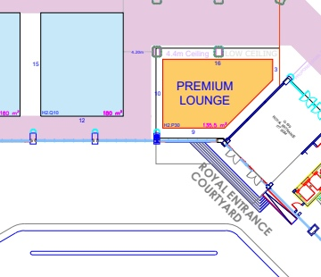
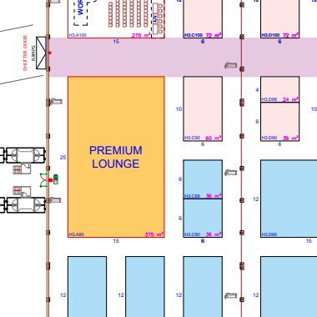
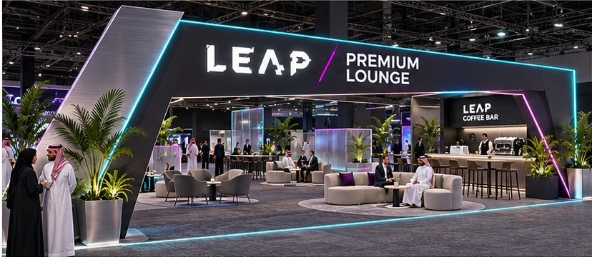
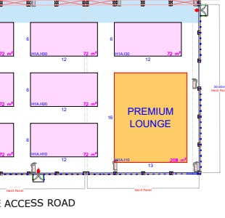
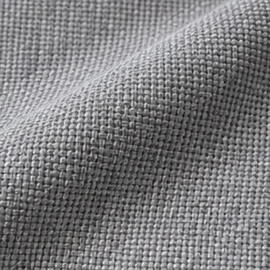
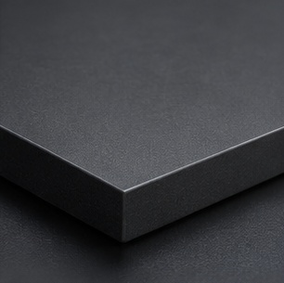
LEAP 2027 / LOUNGES
07
Premium Lounges
REFINED / OPEN / COMFORTABLE
01 / LOCATION ON CLIENT PLAN
02 / DESIGN REFERENCE + ARCHITECTURAL MOOD
LOUNGE 1 / HALL 2
LOUNGE 2 / HALL 3
1
2
LOUNGE 3 / HALL 1A
3
STAND / AREA SCHEDULE
1
H2.P30
135.5 m²
LIGHT + ATMOSPHERE Warm-white seating light with fine cyan/pink edges; avoid many glowing columns.
2
H3.A80
375 m²
3
H1A.I10
208 m²
03 / UAE + SAUDI MATERIAL OPTIONS
WHAT TO DESIGN
One premium family across three footprints: illuminated portal, mixed seating, networking clusters, lettering, coffee bar and low dividers.
AREA NOTE
Graphite carpet remains the main lounge flooring; LVT is a selected premium inlay.
BLACK POWDER-COATED ALUMINIUM
TRANSLUCENT POLYCARBONATE
CONTRACT UPHOLSTERY FABRIC
CHARCOAL LVT / VINYL
HPL-FACED JOINERY
Signature entrance portal
Low translucent dividers
Premium sofas and chairs
Selected floor inlays
Coffee bar / service surfaces
UAE GulfEx / KSA ALUPCO [S01-02]
UAE + KSA Sabin Plastic [S03-04]
UAE + KSA Sedar [S07-08]
UAE + KSA Gerflor network [S09-10]
UAE + KSA Danube [S11-12]
DARK PURPLE
NEON BLUE
NEON PINK
PURPLE
BLACK
WHITE
#27074A
#73FAFD
#EB3DF7
#8A30C7
#000000
#FFFFFF
Location source: client master plan p.1; Premium Lounges brief pp.3,12-16. Material photographs are visual proposals; confirm product, finish and construction specifications.
EDITABLE TEXT + SEPARATE IMAGE ASSETS / UAE + SAUDI SOURCING / PLAN EXCERPTS NOT TO SCALE
09 / 27
Notes:
Client source: LEAP master plan dated 09 Nov 2026 and the supplied 22 creative briefs. Material samples and spatial concepts are illustrative. Regional supplier catalogues checked 11 Nov 2026. Exact grade, stock and certifications require supplier RFQ. Official sources:
S01 Gulf Extrusions UAE https://gulfex.com/
S02 ALUPCO Saudi Arabia https://alupco.com/region/gcc/
S03 Sabin Plastic UAE https://www.sabinplastic.com/wp-content/uploads/2025/10/SABIN-PLASTI_GROUP.pdf
S04 Sabin Plastic KSA https://www.sabinplastic.com/ksa/trading/
S05 Guardian Glass supplier network https://www.guardianglass.com/me/en/our-glass/find-a-guardian-glass-supplier
S06 Al Samiah Furniture UAE https://alsamiah.com/
S07 Sedar UAE https://www.sedarglobal.com/uae-en/tools-and-guides
S08 Sedar KSA https://sedarglobal.com/ksa-en
S09 Gerflor Middle East https://www.gerflorme.com/node/87221
S10 Protect Middle East UAE https://www.protectmiddleeast.com/flooring
S11 Danube Building Materials UAE https://danubebuildingmaterials.com/
S12 Danube Building Materials Riyadh https://danubeholding.com/places/2933/
S13 Sioen / Sioline regional team https://sioline.com/en/contact
S14 Obeikan Technical Fabrics KSA https://obeikanfabrics.com/the-company/
S15 Adams Furniture UAE https://www.adamsinternational.ae/post/outdoor-fabrics-dubai
S16 Aljuraid Group KSA https://aljuraidgroup.com/products/lounge-and-sofa/reva/
S17 RAK Ceramics UAE https://www.rakceramics.com/uae/en/tiles-floors-coverings/outdoor-porcelain-tiles/
S18 RAK Ceramics Saudi store https://onlineshop.rakceramics.com/sa/ara/outdoor.html
S19 LEDFlex Dubai https://ledflexgroup.com/press-media/news/v/?url=enhancing_our_support_within_the_gcc_region
S20 LEDFlex lighting ranges https://ledflexgroup.com/product/neon-flex/
S21 LEDFlex Saudi project supply https://ledflexgroup.com/projects/v/?url=bain-and-company
S22 CSiX UAE https://csixgt.com/
S23 Desert Sign KSA https://desertsign.com.sa/
S24 Desert Group UAE https://desertgroup.ae/
S25 Desert Views KSA https://desertviews.sa/nursery/

Slide 10
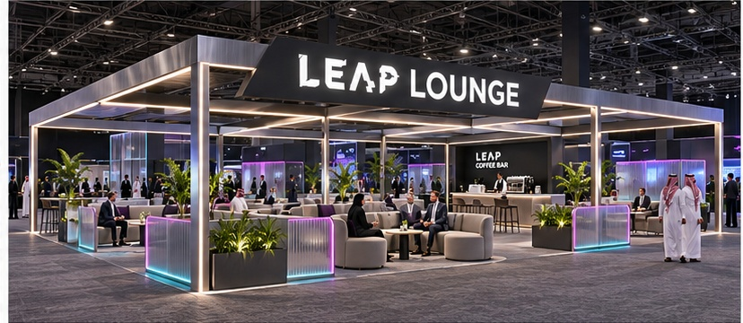
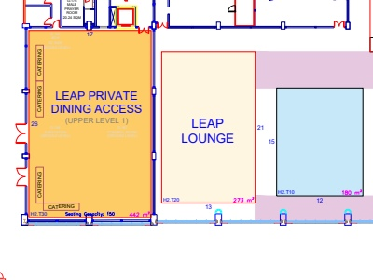
LEAP 2027 / LOUNGES
08
LEAP Lounge
SOCIAL / CALM / ACCESSIBLE
01 / LOCATION ON CLIENT PLAN
02 / DESIGN REFERENCE + ARCHITECTURAL MOOD
HALL 2 / WEST WING
1
STAND / AREA SCHEDULE
1
H2.T20
273 m²
LIGHT + ATMOSPHERE Comfortable warm-white light, small cyan/pink perimeter highlights.
WHAT TO DESIGN
13 x 21 m open lounge with mixed seating, meeting clusters, LEAP lettering, coffee bar and low acoustic/translucent dividers.
03 / UAE + SAUDI MATERIAL OPTIONS
BLACK POWDER-COATED ALUMINIUM
TRANSLUCENT POLYCARBONATE
CONTRACT UPHOLSTERY FABRIC
GRAPHITE EVENT CARPET
HPL-FACED JOINERY
Illuminated entry frame
Low semi-private dividers
Mixed lounge seating
Dark graphite carpet
Branded coffee bar
UAE GulfEx / KSA ALUPCO [S01-02]
UAE + KSA Sabin Plastic [S03-04]
UAE + KSA Sedar [S07-08]
UAE stockist / KSA supply Al Samiah [S06]
UAE + KSA Danube [S11-12]
DARK PURPLE
NEON BLUE
NEON PINK
PURPLE
BLACK
WHITE
#27074A
#73FAFD
#EB3DF7
#8A30C7
#000000
#FFFFFF
Location source: client master plan p.1; LEAP Lounge brief pp.3,12-13. Material photographs are visual proposals; confirm product, finish and construction specifications.
EDITABLE TEXT + SEPARATE IMAGE ASSETS / UAE + SAUDI SOURCING / PLAN EXCERPTS NOT TO SCALE
10 / 27
Notes:
Client source: LEAP master plan dated 09 Nov 2026 and the supplied 22 creative briefs. Material samples and spatial concepts are illustrative. Regional supplier catalogues checked 11 Nov 2026. Exact grade, stock and certifications require supplier RFQ. Official sources:
S01 Gulf Extrusions UAE https://gulfex.com/
S02 ALUPCO Saudi Arabia https://alupco.com/region/gcc/
S03 Sabin Plastic UAE https://www.sabinplastic.com/wp-content/uploads/2025/10/SABIN-PLASTI_GROUP.pdf
S04 Sabin Plastic KSA https://www.sabinplastic.com/ksa/trading/
S05 Guardian Glass supplier network https://www.guardianglass.com/me/en/our-glass/find-a-guardian-glass-supplier
S06 Al Samiah Furniture UAE https://alsamiah.com/
S07 Sedar UAE https://www.sedarglobal.com/uae-en/tools-and-guides
S08 Sedar KSA https://sedarglobal.com/ksa-en
S09 Gerflor Middle East https://www.gerflorme.com/node/87221
S10 Protect Middle East UAE https://www.protectmiddleeast.com/flooring
S11 Danube Building Materials UAE https://danubebuildingmaterials.com/
S12 Danube Building Materials Riyadh https://danubeholding.com/places/2933/
S13 Sioen / Sioline regional team https://sioline.com/en/contact
S14 Obeikan Technical Fabrics KSA https://obeikanfabrics.com/the-company/
S15 Adams Furniture UAE https://www.adamsinternational.ae/post/outdoor-fabrics-dubai
S16 Aljuraid Group KSA https://aljuraidgroup.com/products/lounge-and-sofa/reva/
S17 RAK Ceramics UAE https://www.rakceramics.com/uae/en/tiles-floors-coverings/outdoor-porcelain-tiles/
S18 RAK Ceramics Saudi store https://onlineshop.rakceramics.com/sa/ara/outdoor.html
S19 LEDFlex Dubai https://ledflexgroup.com/press-media/news/v/?url=enhancing_our_support_within_the_gcc_region
S20 LEDFlex lighting ranges https://ledflexgroup.com/product/neon-flex/
S21 LEDFlex Saudi project supply https://ledflexgroup.com/projects/v/?url=bain-and-company
S22 CSiX UAE https://csixgt.com/
S23 Desert Sign KSA https://desertsign.com.sa/
S24 Desert Group UAE https://desertgroup.ae/
S25 Desert Views KSA https://desertviews.sa/nursery/

Slide 11
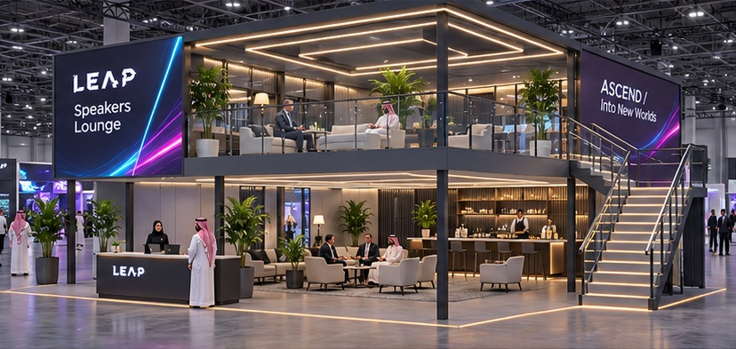
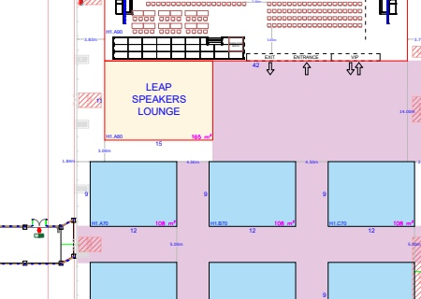
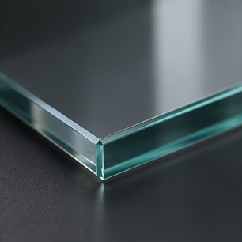
LEAP 2027 / LOUNGES
09
Speakers Lounge
ELEVATED / EXCLUSIVE / WARM
01 / LOCATION ON CLIENT PLAN
02 / DESIGN REFERENCE + ARCHITECTURAL MOOD
HALL 1 MAIN-STAGE CLUSTER
1
STAND / AREA SCHEDULE
1
H1.A80
165 m² / two levels
LIGHT + ATMOSPHERE Warm-white hospitality lighting with selective facade LED and LEAP accents.
WHAT TO DESIGN
15 x 11 m double-deck lounge; stairs, glass balustrade, registration, LED facade, catering counter, photo wall, screens and planting.
03 / UAE + SAUDI MATERIAL OPTIONS
AREA NOTE
Concept shows the design language; the double-deck structure needs its own detailed development.
BLACK POWDER-COATED ALUMINIUM
PROCESSED SAFETY GLASS
CONTRACT UPHOLSTERY FABRIC
CHARCOAL LVT / VINYL
HPL-FACED JOINERY
Engineered deck / portal frame
Upper-level glass balustrade
Lounge seating on both levels
Luxury vinyl floor finishes
Reception and catering counters
UAE GulfEx / KSA ALUPCO [S01-02]
UAE + KSA local glass fabricators [S05]
UAE + KSA Sedar [S07-08]
UAE + KSA Gerflor network [S09-10]
UAE + KSA Danube [S11-12]
DARK PURPLE
NEON BLUE
NEON PINK
PURPLE
BLACK
WHITE
#27074A
#73FAFD
#EB3DF7
#8A30C7
#000000
#FFFFFF
Location source: client master plan p.1; Speakers Lounge brief pp.3,15-18. Material photographs are visual proposals; confirm product, finish and construction specifications.
EDITABLE TEXT + SEPARATE IMAGE ASSETS / UAE + SAUDI SOURCING / PLAN EXCERPTS NOT TO SCALE
11 / 27
Notes:
Client source: LEAP master plan dated 09 Nov 2026 and the supplied 22 creative briefs. Material samples and spatial concepts are illustrative. Regional supplier catalogues checked 11 Nov 2026. Exact grade, stock and certifications require supplier RFQ. Official sources:
S01 Gulf Extrusions UAE https://gulfex.com/
S02 ALUPCO Saudi Arabia https://alupco.com/region/gcc/
S03 Sabin Plastic UAE https://www.sabinplastic.com/wp-content/uploads/2025/10/SABIN-PLASTI_GROUP.pdf
S04 Sabin Plastic KSA https://www.sabinplastic.com/ksa/trading/
S05 Guardian Glass supplier network https://www.guardianglass.com/me/en/our-glass/find-a-guardian-glass-supplier
S06 Al Samiah Furniture UAE https://alsamiah.com/
S07 Sedar UAE https://www.sedarglobal.com/uae-en/tools-and-guides
S08 Sedar KSA https://sedarglobal.com/ksa-en
S09 Gerflor Middle East https://www.gerflorme.com/node/87221
S10 Protect Middle East UAE https://www.protectmiddleeast.com/flooring
S11 Danube Building Materials UAE https://danubebuildingmaterials.com/
S12 Danube Building Materials Riyadh https://danubeholding.com/places/2933/
S13 Sioen / Sioline regional team https://sioline.com/en/contact
S14 Obeikan Technical Fabrics KSA https://obeikanfabrics.com/the-company/
S15 Adams Furniture UAE https://www.adamsinternational.ae/post/outdoor-fabrics-dubai
S16 Aljuraid Group KSA https://aljuraidgroup.com/products/lounge-and-sofa/reva/
S17 RAK Ceramics UAE https://www.rakceramics.com/uae/en/tiles-floors-coverings/outdoor-porcelain-tiles/
S18 RAK Ceramics Saudi store https://onlineshop.rakceramics.com/sa/ara/outdoor.html
S19 LEDFlex Dubai https://ledflexgroup.com/press-media/news/v/?url=enhancing_our_support_within_the_gcc_region
S20 LEDFlex lighting ranges https://ledflexgroup.com/product/neon-flex/
S21 LEDFlex Saudi project supply https://ledflexgroup.com/projects/v/?url=bain-and-company
S22 CSiX UAE https://csixgt.com/
S23 Desert Sign KSA https://desertsign.com.sa/
S24 Desert Group UAE https://desertgroup.ae/
S25 Desert Views KSA https://desertviews.sa/nursery/

Slide 12
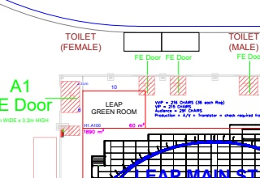
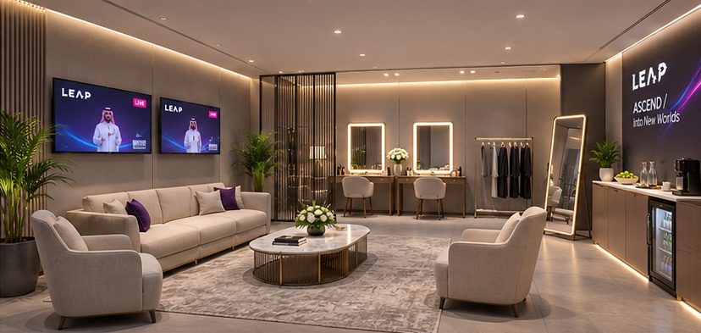
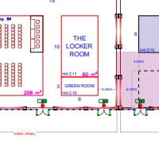
LEAP 2027 / LOUNGES
10
Green Rooms
PRIVATE / SOFT / COMPOSED
01 / LOCATION ON CLIENT PLAN
02 / DESIGN REFERENCE + ARCHITECTURAL MOOD
MAIN STAGE GREEN ROOM
1
SPORTS TECH GREEN ROOM
2
STAND / AREA SCHEDULE
1
H1.A100
60 m²
LIGHT + ATMOSPHERE Flattering mirror and task light, calm warm-white ambient light; hidden cables.
2
H4.C10
18 m²
WHAT TO DESIGN
03 / UAE + SAUDI MATERIAL OPTIONS
Enclosed speaker preparation rooms: seating, screened make-up area, mirrors, garment storage, catering counter and stage-feed TVs.
AREA NOTE
Image illustrates the 60 m² room. Adapt furniture and quantities to the 18 m² room.
GRAPHITE EVENT CARPET
CONTRACT UPHOLSTERY FABRIC
HPL-FACED JOINERY
TRANSLUCENT POLYCARBONATE
DIFFUSED LINEAR LED
Full-room carpet
Comfortable soft seating
Make-up / catering cabinetry
Screened preparation zone
Diffused mirrors / ambient light
UAE stockist / KSA supply Al Samiah [S06]
UAE + KSA Sedar [S07-08]
UAE + KSA Danube [S11-12]
UAE + KSA Sabin Plastic [S03-04]
UAE + KSA LEDFlex supply [S19-21]
DARK PURPLE
NEON BLUE
NEON PINK
PURPLE
BLACK
WHITE
#27074A
#73FAFD
#EB3DF7
#8A30C7
#000000
#FFFFFF
Location source: client master plan p.1; Green Rooms brief pp.3,15-16. Material photographs are visual proposals; confirm product, finish and construction specifications.
EDITABLE TEXT + SEPARATE IMAGE ASSETS / UAE + SAUDI SOURCING / PLAN EXCERPTS NOT TO SCALE
12 / 27
Notes:
Client source: LEAP master plan dated 09 Nov 2026 and the supplied 22 creative briefs. Material samples and spatial concepts are illustrative. Regional supplier catalogues checked 11 Nov 2026. Exact grade, stock and certifications require supplier RFQ. Official sources:
S01 Gulf Extrusions UAE https://gulfex.com/
S02 ALUPCO Saudi Arabia https://alupco.com/region/gcc/
S03 Sabin Plastic UAE https://www.sabinplastic.com/wp-content/uploads/2025/10/SABIN-PLASTI_GROUP.pdf
S04 Sabin Plastic KSA https://www.sabinplastic.com/ksa/trading/
S05 Guardian Glass supplier network https://www.guardianglass.com/me/en/our-glass/find-a-guardian-glass-supplier
S06 Al Samiah Furniture UAE https://alsamiah.com/
S07 Sedar UAE https://www.sedarglobal.com/uae-en/tools-and-guides
S08 Sedar KSA https://sedarglobal.com/ksa-en
S09 Gerflor Middle East https://www.gerflorme.com/node/87221
S10 Protect Middle East UAE https://www.protectmiddleeast.com/flooring
S11 Danube Building Materials UAE https://danubebuildingmaterials.com/
S12 Danube Building Materials Riyadh https://danubeholding.com/places/2933/
S13 Sioen / Sioline regional team https://sioline.com/en/contact
S14 Obeikan Technical Fabrics KSA https://obeikanfabrics.com/the-company/
S15 Adams Furniture UAE https://www.adamsinternational.ae/post/outdoor-fabrics-dubai
S16 Aljuraid Group KSA https://aljuraidgroup.com/products/lounge-and-sofa/reva/
S17 RAK Ceramics UAE https://www.rakceramics.com/uae/en/tiles-floors-coverings/outdoor-porcelain-tiles/
S18 RAK Ceramics Saudi store https://onlineshop.rakceramics.com/sa/ara/outdoor.html
S19 LEDFlex Dubai https://ledflexgroup.com/press-media/news/v/?url=enhancing_our_support_within_the_gcc_region
S20 LEDFlex lighting ranges https://ledflexgroup.com/product/neon-flex/
S21 LEDFlex Saudi project supply https://ledflexgroup.com/projects/v/?url=bain-and-company
S22 CSiX UAE https://csixgt.com/
S23 Desert Sign KSA https://desertsign.com.sa/
S24 Desert Group UAE https://desertgroup.ae/
S25 Desert Views KSA https://desertviews.sa/nursery/

Slide 13
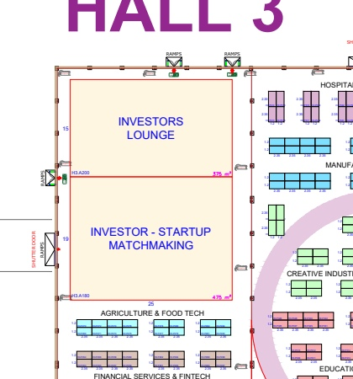
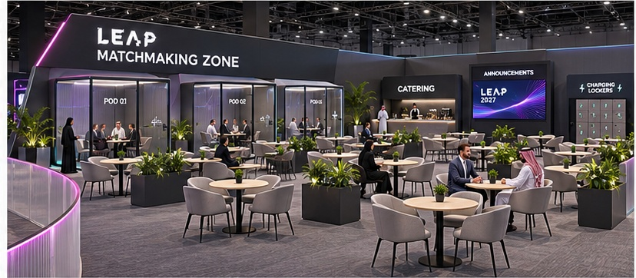
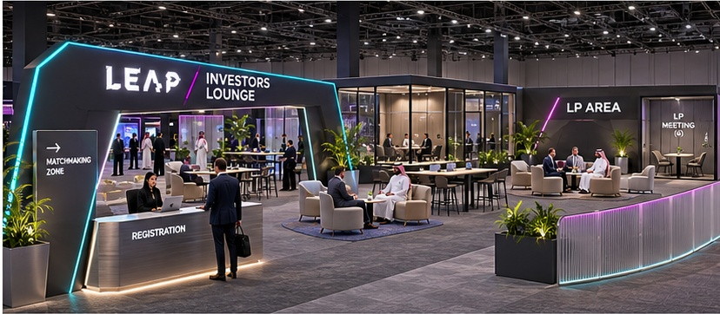
LEAP 2027 / LOUNGES
11
Investors Lounge + Matchmaking
CONFIDENT / CONNECTED / SEMI-PRIVATE
01 / LOCATION ON CLIENT PLAN
02 / DESIGN REFERENCE + ARCHITECTURAL MOOD
HALL 3 / TWO CONNECTED FEATURES
1
2
STAND / AREA SCHEDULE
1
H3.A200 / Investors
375 m²
LIGHT + ATMOSPHERE Good face-to-face meeting light, subtle brand accents, quiet LP lounge mood.
2
H3.A180 / Matchmaking
475 m²
WHAT TO DESIGN
03 / UAE + SAUDI MATERIAL OPTIONS
Shared entry and registration; removable divide, meeting rooms/pods, catering, tables and charging. LP area of about 45 m² is inside Investors Lounge.
AREA NOTE
The two footprints total 850 m²; brief header says 580 m². Use the individual labelled areas for review.
BLACK POWDER-COATED ALUMINIUM
TRANSLUCENT POLYCARBONATE
CONTRACT UPHOLSTERY FABRIC
GRAPHITE EVENT CARPET
HPL-FACED JOINERY
Shared digital entry / framing
Movable low curved dividers
Investor / LP soft seating
Lounge and meeting flooring
Meeting / catering worktops
UAE GulfEx / KSA ALUPCO [S01-02]
UAE + KSA Sabin Plastic [S03-04]
UAE + KSA Sedar [S07-08]
UAE stockist / KSA supply Al Samiah [S06]
UAE + KSA Danube [S11-12]
DARK PURPLE
NEON BLUE
NEON PINK
PURPLE
BLACK
WHITE
#27074A
#73FAFD
#EB3DF7
#8A30C7
#000000
#FFFFFF
Location source: client master plan p.1; Investors Lounge + Matchmaking brief pp.3,12,15,17,19. Material photographs are visual proposals; confirm product, finish and construction specifications.
EDITABLE TEXT + SEPARATE IMAGE ASSETS / UAE + SAUDI SOURCING / PLAN EXCERPTS NOT TO SCALE
13 / 27
Notes:
Client source: LEAP master plan dated 09 Nov 2026 and the supplied 22 creative briefs. Material samples and spatial concepts are illustrative. Regional supplier catalogues checked 11 Nov 2026. Exact grade, stock and certifications require supplier RFQ. Official sources:
S01 Gulf Extrusions UAE https://gulfex.com/
S02 ALUPCO Saudi Arabia https://alupco.com/region/gcc/
S03 Sabin Plastic UAE https://www.sabinplastic.com/wp-content/uploads/2025/10/SABIN-PLASTI_GROUP.pdf
S04 Sabin Plastic KSA https://www.sabinplastic.com/ksa/trading/
S05 Guardian Glass supplier network https://www.guardianglass.com/me/en/our-glass/find-a-guardian-glass-supplier
S06 Al Samiah Furniture UAE https://alsamiah.com/
S07 Sedar UAE https://www.sedarglobal.com/uae-en/tools-and-guides
S08 Sedar KSA https://sedarglobal.com/ksa-en
S09 Gerflor Middle East https://www.gerflorme.com/node/87221
S10 Protect Middle East UAE https://www.protectmiddleeast.com/flooring
S11 Danube Building Materials UAE https://danubebuildingmaterials.com/
S12 Danube Building Materials Riyadh https://danubeholding.com/places/2933/
S13 Sioen / Sioline regional team https://sioline.com/en/contact
S14 Obeikan Technical Fabrics KSA https://obeikanfabrics.com/the-company/
S15 Adams Furniture UAE https://www.adamsinternational.ae/post/outdoor-fabrics-dubai
S16 Aljuraid Group KSA https://aljuraidgroup.com/products/lounge-and-sofa/reva/
S17 RAK Ceramics UAE https://www.rakceramics.com/uae/en/tiles-floors-coverings/outdoor-porcelain-tiles/
S18 RAK Ceramics Saudi store https://onlineshop.rakceramics.com/sa/ara/outdoor.html
S19 LEDFlex Dubai https://ledflexgroup.com/press-media/news/v/?url=enhancing_our_support_within_the_gcc_region
S20 LEDFlex lighting ranges https://ledflexgroup.com/product/neon-flex/
S21 LEDFlex Saudi project supply https://ledflexgroup.com/projects/v/?url=bain-and-company
S22 CSiX UAE https://csixgt.com/
S23 Desert Sign KSA https://desertsign.com.sa/
S24 Desert Group UAE https://desertgroup.ae/
S25 Desert Views KSA https://desertviews.sa/nursery/

Slide 14
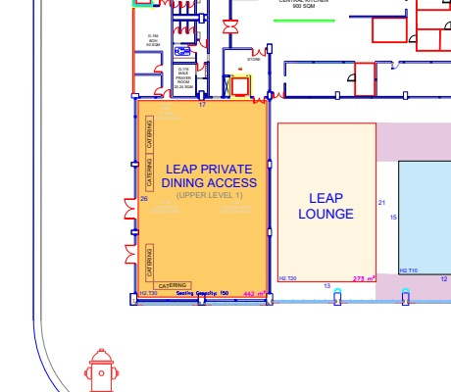
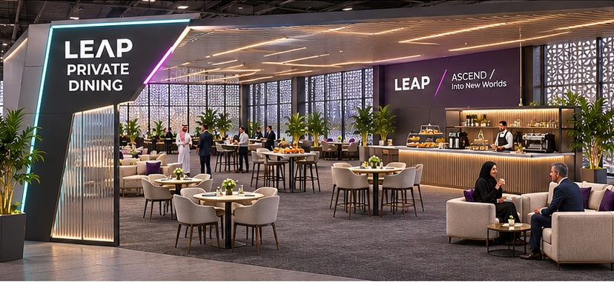
LEAP 2027 / LOUNGES
12
Private Dining
HOSPITABLE / SHELTERED / ELEGANT
01 / LOCATION ON CLIENT PLAN
02 / DESIGN REFERENCE + ARCHITECTURAL MOOD
ACCESS LOCATION ONLY / ROOM ABOVE
1
STAND / AREA SCHEDULE
1
H2.T30 / Upper Level 1
442 m²
LIGHT + ATMOSPHERE Warm-white dining and buffet light; discreet cyan/pink detailing.
WHAT TO DESIGN
26 x 17 m, 150 seats; brandable sun walls on two sides, portal, mixed furniture, coffee bar and catering counters.
03 / UAE + SAUDI MATERIAL OPTIONS
AREA NOTE
Plan shows the access position. The upper-level room is not drawn in the supplied master plan; graphite carpet is the main floor finish.
BLACK POWDER-COATED ALUMINIUM
TRANSLUCENT POLYCARBONATE
CONTRACT UPHOLSTERY FABRIC
CHARCOAL LVT / VINYL
HPL-FACED JOINERY
Entrance and screening frames
Translucent privacy elements
Premium dining / lounge seats
Selected floor inlays
Coffee and catering counters
UAE GulfEx / KSA ALUPCO [S01-02]
UAE + KSA Sabin Plastic [S03-04]
UAE + KSA Sedar [S07-08]
UAE + KSA Gerflor network [S09-10]
UAE + KSA Danube [S11-12]
DARK PURPLE
NEON BLUE
NEON PINK
PURPLE
BLACK
WHITE
#27074A
#73FAFD
#EB3DF7
#8A30C7
#000000
#FFFFFF
Location source: client master plan p.1; Private Dining brief pp.3,12-13. Material photographs are visual proposals; confirm product, finish and construction specifications.
EDITABLE TEXT + SEPARATE IMAGE ASSETS / UAE + SAUDI SOURCING / PLAN EXCERPTS NOT TO SCALE
14 / 27
Notes:
Client source: LEAP master plan dated 09 Nov 2026 and the supplied 22 creative briefs. Material samples and spatial concepts are illustrative. Regional supplier catalogues checked 11 Nov 2026. Exact grade, stock and certifications require supplier RFQ. Official sources:
S01 Gulf Extrusions UAE https://gulfex.com/
S02 ALUPCO Saudi Arabia https://alupco.com/region/gcc/
S03 Sabin Plastic UAE https://www.sabinplastic.com/wp-content/uploads/2025/10/SABIN-PLASTI_GROUP.pdf
S04 Sabin Plastic KSA https://www.sabinplastic.com/ksa/trading/
S05 Guardian Glass supplier network https://www.guardianglass.com/me/en/our-glass/find-a-guardian-glass-supplier
S06 Al Samiah Furniture UAE https://alsamiah.com/
S07 Sedar UAE https://www.sedarglobal.com/uae-en/tools-and-guides
S08 Sedar KSA https://sedarglobal.com/ksa-en
S09 Gerflor Middle East https://www.gerflorme.com/node/87221
S10 Protect Middle East UAE https://www.protectmiddleeast.com/flooring
S11 Danube Building Materials UAE https://danubebuildingmaterials.com/
S12 Danube Building Materials Riyadh https://danubeholding.com/places/2933/
S13 Sioen / Sioline regional team https://sioline.com/en/contact
S14 Obeikan Technical Fabrics KSA https://obeikanfabrics.com/the-company/
S15 Adams Furniture UAE https://www.adamsinternational.ae/post/outdoor-fabrics-dubai
S16 Aljuraid Group KSA https://aljuraidgroup.com/products/lounge-and-sofa/reva/
S17 RAK Ceramics UAE https://www.rakceramics.com/uae/en/tiles-floors-coverings/outdoor-porcelain-tiles/
S18 RAK Ceramics Saudi store https://onlineshop.rakceramics.com/sa/ara/outdoor.html
S19 LEDFlex Dubai https://ledflexgroup.com/press-media/news/v/?url=enhancing_our_support_within_the_gcc_region
S20 LEDFlex lighting ranges https://ledflexgroup.com/product/neon-flex/
S21 LEDFlex Saudi project supply https://ledflexgroup.com/projects/v/?url=bain-and-company
S22 CSiX UAE https://csixgt.com/
S23 Desert Sign KSA https://desertsign.com.sa/
S24 Desert Group UAE https://desertgroup.ae/
S25 Desert Views KSA https://desertviews.sa/nursery/

Slide 15
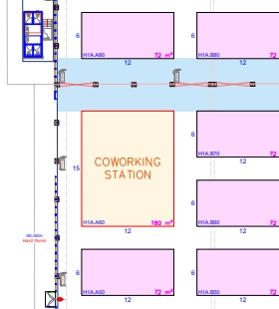
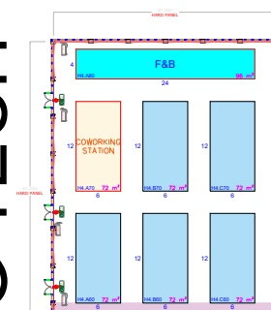
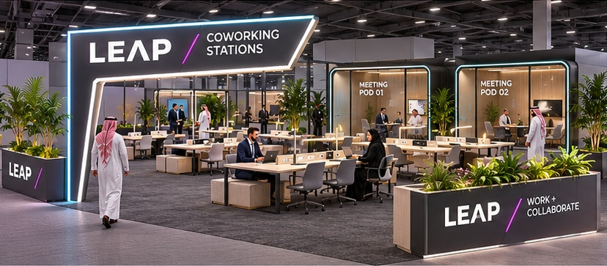
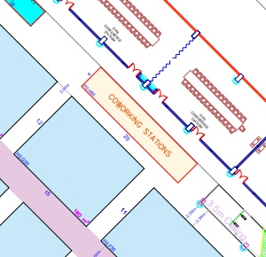
LEAP 2027 / WORK + MEDIA
13
Coworking Stations
PRODUCTIVE / OPEN / PLUGGED-IN
01 / LOCATION ON CLIENT PLAN
02 / DESIGN REFERENCE + ARCHITECTURAL MOOD
HALL 1A
HALL 4
1
2
HALL 2
3
STAND / AREA SCHEDULE
1
H1A.A60
180 m²
LIGHT + ATMOSPHERE Good warm-white task light at every work position; subtle LEAP edge detail.
2
H4.A70
72 m²
3
H2.H50
4 x 20 m / confirm
03 / UAE + SAUDI MATERIAL OPTIONS
WHAT TO DESIGN
Work tables, benches, chairs/stools, sockets/USB, lockers, plants and space/power for organiser-provided meeting pods.
AREA NOTE
Three locations are listed. H2.H50 dimensions give 80 m² but the brief says 40 m²; confirm before layout.
BLACK POWDER-COATED ALUMINIUM
HPL-FACED JOINERY
CONTRACT UPHOLSTERY FABRIC
GRAPHITE EVENT CARPET
TRANSLUCENT POLYCARBONATE
Entrance / table frameworks
Durable shared worktops
Task seating upholstery
Work-lounge flooring
Pod framing / low partitions
UAE GulfEx / KSA ALUPCO [S01-02]
UAE + KSA Danube [S11-12]
UAE + KSA Sedar [S07-08]
UAE stockist / KSA supply Al Samiah [S06]
UAE + KSA Sabin Plastic [S03-04]
DARK PURPLE
NEON BLUE
NEON PINK
PURPLE
BLACK
WHITE
#27074A
#73FAFD
#EB3DF7
#8A30C7
#000000
#FFFFFF
Location source: client master plan p.1; Coworking Stations brief pp.3,13-16. Material photographs are visual proposals; confirm product, finish and construction specifications.
EDITABLE TEXT + SEPARATE IMAGE ASSETS / UAE + SAUDI SOURCING / PLAN EXCERPTS NOT TO SCALE
15 / 27
Notes:
Client source: LEAP master plan dated 09 Nov 2026 and the supplied 22 creative briefs. Material samples and spatial concepts are illustrative. Regional supplier catalogues checked 11 Nov 2026. Exact grade, stock and certifications require supplier RFQ. Official sources:
S01 Gulf Extrusions UAE https://gulfex.com/
S02 ALUPCO Saudi Arabia https://alupco.com/region/gcc/
S03 Sabin Plastic UAE https://www.sabinplastic.com/wp-content/uploads/2025/10/SABIN-PLASTI_GROUP.pdf
S04 Sabin Plastic KSA https://www.sabinplastic.com/ksa/trading/
S05 Guardian Glass supplier network https://www.guardianglass.com/me/en/our-glass/find-a-guardian-glass-supplier
S06 Al Samiah Furniture UAE https://alsamiah.com/
S07 Sedar UAE https://www.sedarglobal.com/uae-en/tools-and-guides
S08 Sedar KSA https://sedarglobal.com/ksa-en
S09 Gerflor Middle East https://www.gerflorme.com/node/87221
S10 Protect Middle East UAE https://www.protectmiddleeast.com/flooring
S11 Danube Building Materials UAE https://danubebuildingmaterials.com/
S12 Danube Building Materials Riyadh https://danubeholding.com/places/2933/
S13 Sioen / Sioline regional team https://sioline.com/en/contact
S14 Obeikan Technical Fabrics KSA https://obeikanfabrics.com/the-company/
S15 Adams Furniture UAE https://www.adamsinternational.ae/post/outdoor-fabrics-dubai
S16 Aljuraid Group KSA https://aljuraidgroup.com/products/lounge-and-sofa/reva/
S17 RAK Ceramics UAE https://www.rakceramics.com/uae/en/tiles-floors-coverings/outdoor-porcelain-tiles/
S18 RAK Ceramics Saudi store https://onlineshop.rakceramics.com/sa/ara/outdoor.html
S19 LEDFlex Dubai https://ledflexgroup.com/press-media/news/v/?url=enhancing_our_support_within_the_gcc_region
S20 LEDFlex lighting ranges https://ledflexgroup.com/product/neon-flex/
S21 LEDFlex Saudi project supply https://ledflexgroup.com/projects/v/?url=bain-and-company
S22 CSiX UAE https://csixgt.com/
S23 Desert Sign KSA https://desertsign.com.sa/
S24 Desert Group UAE https://desertgroup.ae/
S25 Desert Views KSA https://desertviews.sa/nursery/

Slide 16
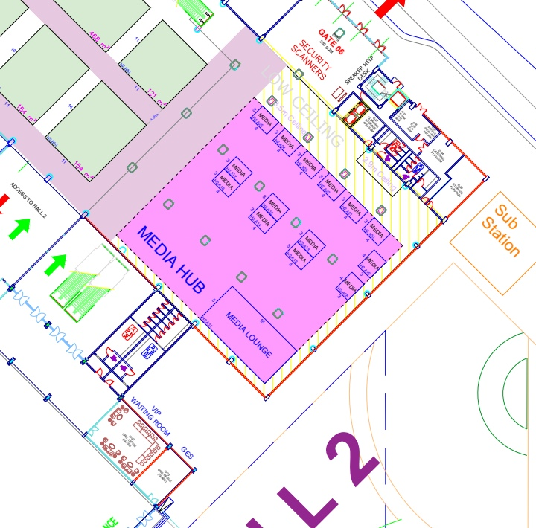
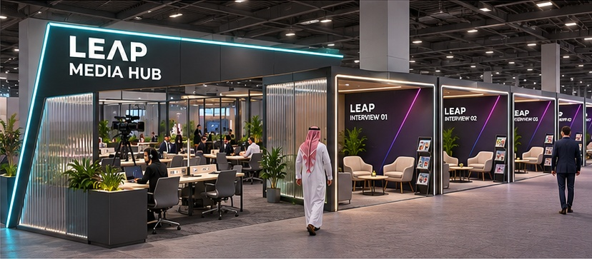
LEAP 2027 / WORK + MEDIA
14
Media Hub
CLEAR / PROFESSIONAL / CAMERA-READY
01 / LOCATION ON CLIENT PLAN
02 / DESIGN REFERENCE + ARCHITECTURAL MOOD
HALL 2 / MEDIA LOUNGE + INTERVIEW STANDS
2
1
STAND / AREA SCHEDULE
1
H2.A11 / Media Lounge
128 m²
LIGHT + ATMOSPHERE Even neutral interview lighting and practical desk light; minimal coloured spill.
2
H2.A12-A25 / 14 stands
about 12 m² each
WHAT TO DESIGN
03 / UAE + SAUDI MATERIAL OPTIONS
Working journalist lounge with desks, power and lighting; 14 interview stands with two chairs, coffee table, magazine rack and backdrop each.
AREA NOTE
Respect the 3.5 m ceiling and nearby 2.9 m low zone. Booth area excludes circulation.
BLACK POWDER-COATED ALUMINIUM
PRINTABLE FABRIC / MEDIA
GRAPHITE EVENT CARPET
CONTRACT UPHOLSTERY FABRIC
TRANSLUCENT POLYCARBONATE
Low stand / portal framework
Clean branded interview faces
Lounge and booth floor
Interview and work chairs
Subtle booth side treatments
UAE GulfEx / KSA ALUPCO [S01-02]
UAE CSiX / KSA Desert Sign [S22-23]
UAE stockist / KSA supply Al Samiah [S06]
UAE + KSA Sedar [S07-08]
UAE + KSA Sabin Plastic [S03-04]
DARK PURPLE
NEON BLUE
NEON PINK
PURPLE
BLACK
WHITE
#27074A
#73FAFD
#EB3DF7
#8A30C7
#000000
#FFFFFF
Location source: client master plan p.1; Media Hub brief pp.3,12-14. Material photographs are visual proposals; confirm product, finish and construction specifications.
EDITABLE TEXT + SEPARATE IMAGE ASSETS / UAE + SAUDI SOURCING / PLAN EXCERPTS NOT TO SCALE
16 / 27
Notes:
Client source: LEAP master plan dated 09 Nov 2026 and the supplied 22 creative briefs. Material samples and spatial concepts are illustrative. Regional supplier catalogues checked 11 Nov 2026. Exact grade, stock and certifications require supplier RFQ. Official sources:
S01 Gulf Extrusions UAE https://gulfex.com/
S02 ALUPCO Saudi Arabia https://alupco.com/region/gcc/
S03 Sabin Plastic UAE https://www.sabinplastic.com/wp-content/uploads/2025/10/SABIN-PLASTI_GROUP.pdf
S04 Sabin Plastic KSA https://www.sabinplastic.com/ksa/trading/
S05 Guardian Glass supplier network https://www.guardianglass.com/me/en/our-glass/find-a-guardian-glass-supplier
S06 Al Samiah Furniture UAE https://alsamiah.com/
S07 Sedar UAE https://www.sedarglobal.com/uae-en/tools-and-guides
S08 Sedar KSA https://sedarglobal.com/ksa-en
S09 Gerflor Middle East https://www.gerflorme.com/node/87221
S10 Protect Middle East UAE https://www.protectmiddleeast.com/flooring
S11 Danube Building Materials UAE https://danubebuildingmaterials.com/
S12 Danube Building Materials Riyadh https://danubeholding.com/places/2933/
S13 Sioen / Sioline regional team https://sioline.com/en/contact
S14 Obeikan Technical Fabrics KSA https://obeikanfabrics.com/the-company/
S15 Adams Furniture UAE https://www.adamsinternational.ae/post/outdoor-fabrics-dubai
S16 Aljuraid Group KSA https://aljuraidgroup.com/products/lounge-and-sofa/reva/
S17 RAK Ceramics UAE https://www.rakceramics.com/uae/en/tiles-floors-coverings/outdoor-porcelain-tiles/
S18 RAK Ceramics Saudi store https://onlineshop.rakceramics.com/sa/ara/outdoor.html
S19 LEDFlex Dubai https://ledflexgroup.com/press-media/news/v/?url=enhancing_our_support_within_the_gcc_region
S20 LEDFlex lighting ranges https://ledflexgroup.com/product/neon-flex/
S21 LEDFlex Saudi project supply https://ledflexgroup.com/projects/v/?url=bain-and-company
S22 CSiX UAE https://csixgt.com/
S23 Desert Sign KSA https://desertsign.com.sa/
S24 Desert Group UAE https://desertgroup.ae/
S25 Desert Views KSA https://desertviews.sa/nursery/

Slide 17
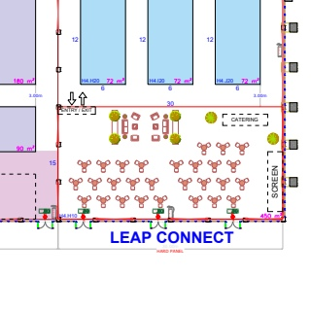
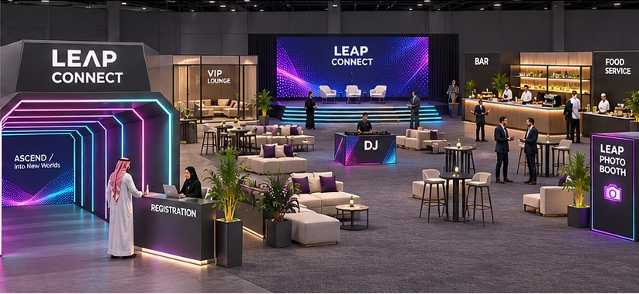
LEAP 2027 / HOSPITALITY
15
LEAP Connect
ATMOSPHERIC / SOCIAL / IMMERSIVE
01 / LOCATION ON CLIENT PLAN
02 / DESIGN REFERENCE + ARCHITECTURAL MOOD
HALL 4 / SOUTH-EAST CORNER
1
STAND / AREA SCHEDULE
1
H4.H10
450 m²
LIGHT + ATMOSPHERE Layered warm-white hospitality lighting with a short digital arrival tunnel and LED accents.
WHAT TO DESIGN
30 x 15 m; stage with 8 x 3 m LED, digital tunnel, registration, bar, food counters, VIP lounge, DJ/photo booths and back-of-house.
03 / UAE + SAUDI MATERIAL OPTIONS
BLACK POWDER-COATED ALUMINIUM
TRANSLUCENT POLYCARBONATE
CONTRACT UPHOLSTERY FABRIC
GRAPHITE EVENT CARPET
HPL-FACED JOINERY
Ground-supported scenic frame
Digital-entry / divider detailing
VIP and social lounge furniture
Lounge carpet
Bar / food service counters
UAE GulfEx / KSA ALUPCO [S01-02]
UAE + KSA Sabin Plastic [S03-04]
UAE + KSA Sedar [S07-08]
UAE stockist / KSA supply Al Samiah [S06]
UAE + KSA Danube [S11-12]
DARK PURPLE
NEON BLUE
NEON PINK
PURPLE
BLACK
WHITE
#27074A
#73FAFD
#EB3DF7
#8A30C7
#000000
#FFFFFF
Location source: client master plan p.1; LEAP Connect brief pp.3,6,9-10,13. Material photographs are visual proposals; confirm product, finish and construction specifications.
EDITABLE TEXT + SEPARATE IMAGE ASSETS / UAE + SAUDI SOURCING / PLAN EXCERPTS NOT TO SCALE
17 / 27
Notes:
Client source: LEAP master plan dated 09 Nov 2026 and the supplied 22 creative briefs. Material samples and spatial concepts are illustrative. Regional supplier catalogues checked 11 Nov 2026. Exact grade, stock and certifications require supplier RFQ. Official sources:
S01 Gulf Extrusions UAE https://gulfex.com/
S02 ALUPCO Saudi Arabia https://alupco.com/region/gcc/
S03 Sabin Plastic UAE https://www.sabinplastic.com/wp-content/uploads/2025/10/SABIN-PLASTI_GROUP.pdf
S04 Sabin Plastic KSA https://www.sabinplastic.com/ksa/trading/
S05 Guardian Glass supplier network https://www.guardianglass.com/me/en/our-glass/find-a-guardian-glass-supplier
S06 Al Samiah Furniture UAE https://alsamiah.com/
S07 Sedar UAE https://www.sedarglobal.com/uae-en/tools-and-guides
S08 Sedar KSA https://sedarglobal.com/ksa-en
S09 Gerflor Middle East https://www.gerflorme.com/node/87221
S10 Protect Middle East UAE https://www.protectmiddleeast.com/flooring
S11 Danube Building Materials UAE https://danubebuildingmaterials.com/
S12 Danube Building Materials Riyadh https://danubeholding.com/places/2933/
S13 Sioen / Sioline regional team https://sioline.com/en/contact
S14 Obeikan Technical Fabrics KSA https://obeikanfabrics.com/the-company/
S15 Adams Furniture UAE https://www.adamsinternational.ae/post/outdoor-fabrics-dubai
S16 Aljuraid Group KSA https://aljuraidgroup.com/products/lounge-and-sofa/reva/
S17 RAK Ceramics UAE https://www.rakceramics.com/uae/en/tiles-floors-coverings/outdoor-porcelain-tiles/
S18 RAK Ceramics Saudi store https://onlineshop.rakceramics.com/sa/ara/outdoor.html
S19 LEDFlex Dubai https://ledflexgroup.com/press-media/news/v/?url=enhancing_our_support_within_the_gcc_region
S20 LEDFlex lighting ranges https://ledflexgroup.com/product/neon-flex/
S21 LEDFlex Saudi project supply https://ledflexgroup.com/projects/v/?url=bain-and-company
S22 CSiX UAE https://csixgt.com/
S23 Desert Sign KSA https://desertsign.com.sa/
S24 Desert Group UAE https://desertgroup.ae/
S25 Desert Views KSA https://desertviews.sa/nursery/

Slide 18
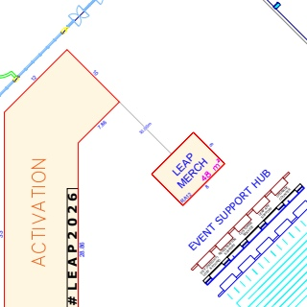
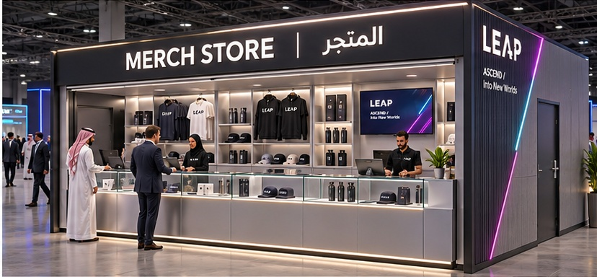
LEAP 2027 / RETAIL
16
Merch Store
PRECISE / SECURE / INVITING
01 / LOCATION ON CLIENT PLAN
02 / DESIGN REFERENCE + ARCHITECTURAL MOOD
EAST SIDE / EVENT SUPPORT HUB
1
STAND / AREA SCHEDULE
1
RA12
48 m²
LIGHT + ATMOSPHERE Track display lighting and discreet counter/header LEDs.
WHAT TO DESIGN
8 x 6 m; four closed sides, front serving counters, merchandise display, bilingual lit header, TV and lockable stock storage.
03 / UAE + SAUDI MATERIAL OPTIONS
BLACK POWDER-COATED ALUMINIUM
PROCESSED SAFETY GLASS
HPL-FACED JOINERY
CHARCOAL LVT / VINYL
DIFFUSED LINEAR LED
Enclosed store / header frame
Glass-top display counters
Lockable cabinetry / shelving
Durable retail floor
Display and header accents
UAE GulfEx / KSA ALUPCO [S01-02]
UAE + KSA local glass fabricators [S05]
UAE + KSA Danube [S11-12]
UAE + KSA Gerflor network [S09-10]
UAE + KSA LEDFlex supply [S19-21]
DARK PURPLE
NEON BLUE
NEON PINK
PURPLE
BLACK
WHITE
#27074A
#73FAFD
#EB3DF7
#8A30C7
#000000
#FFFFFF
Location source: client master plan p.1; Merch Store brief pp.3,12-14. Material photographs are visual proposals; confirm product, finish and construction specifications.
EDITABLE TEXT + SEPARATE IMAGE ASSETS / UAE + SAUDI SOURCING / PLAN EXCERPTS NOT TO SCALE
18 / 27
Notes:
Client source: LEAP master plan dated 09 Nov 2026 and the supplied 22 creative briefs. Material samples and spatial concepts are illustrative. Regional supplier catalogues checked 11 Nov 2026. Exact grade, stock and certifications require supplier RFQ. Official sources:
S01 Gulf Extrusions UAE https://gulfex.com/
S02 ALUPCO Saudi Arabia https://alupco.com/region/gcc/
S03 Sabin Plastic UAE https://www.sabinplastic.com/wp-content/uploads/2025/10/SABIN-PLASTI_GROUP.pdf
S04 Sabin Plastic KSA https://www.sabinplastic.com/ksa/trading/
S05 Guardian Glass supplier network https://www.guardianglass.com/me/en/our-glass/find-a-guardian-glass-supplier
S06 Al Samiah Furniture UAE https://alsamiah.com/
S07 Sedar UAE https://www.sedarglobal.com/uae-en/tools-and-guides
S08 Sedar KSA https://sedarglobal.com/ksa-en
S09 Gerflor Middle East https://www.gerflorme.com/node/87221
S10 Protect Middle East UAE https://www.protectmiddleeast.com/flooring
S11 Danube Building Materials UAE https://danubebuildingmaterials.com/
S12 Danube Building Materials Riyadh https://danubeholding.com/places/2933/
S13 Sioen / Sioline regional team https://sioline.com/en/contact
S14 Obeikan Technical Fabrics KSA https://obeikanfabrics.com/the-company/
S15 Adams Furniture UAE https://www.adamsinternational.ae/post/outdoor-fabrics-dubai
S16 Aljuraid Group KSA https://aljuraidgroup.com/products/lounge-and-sofa/reva/
S17 RAK Ceramics UAE https://www.rakceramics.com/uae/en/tiles-floors-coverings/outdoor-porcelain-tiles/
S18 RAK Ceramics Saudi store https://onlineshop.rakceramics.com/sa/ara/outdoor.html
S19 LEDFlex Dubai https://ledflexgroup.com/press-media/news/v/?url=enhancing_our_support_within_the_gcc_region
S20 LEDFlex lighting ranges https://ledflexgroup.com/product/neon-flex/
S21 LEDFlex Saudi project supply https://ledflexgroup.com/projects/v/?url=bain-and-company
S22 CSiX UAE https://csixgt.com/
S23 Desert Sign KSA https://desertsign.com.sa/
S24 Desert Group UAE https://desertgroup.ae/
S25 Desert Views KSA https://desertviews.sa/nursery/

Slide 19
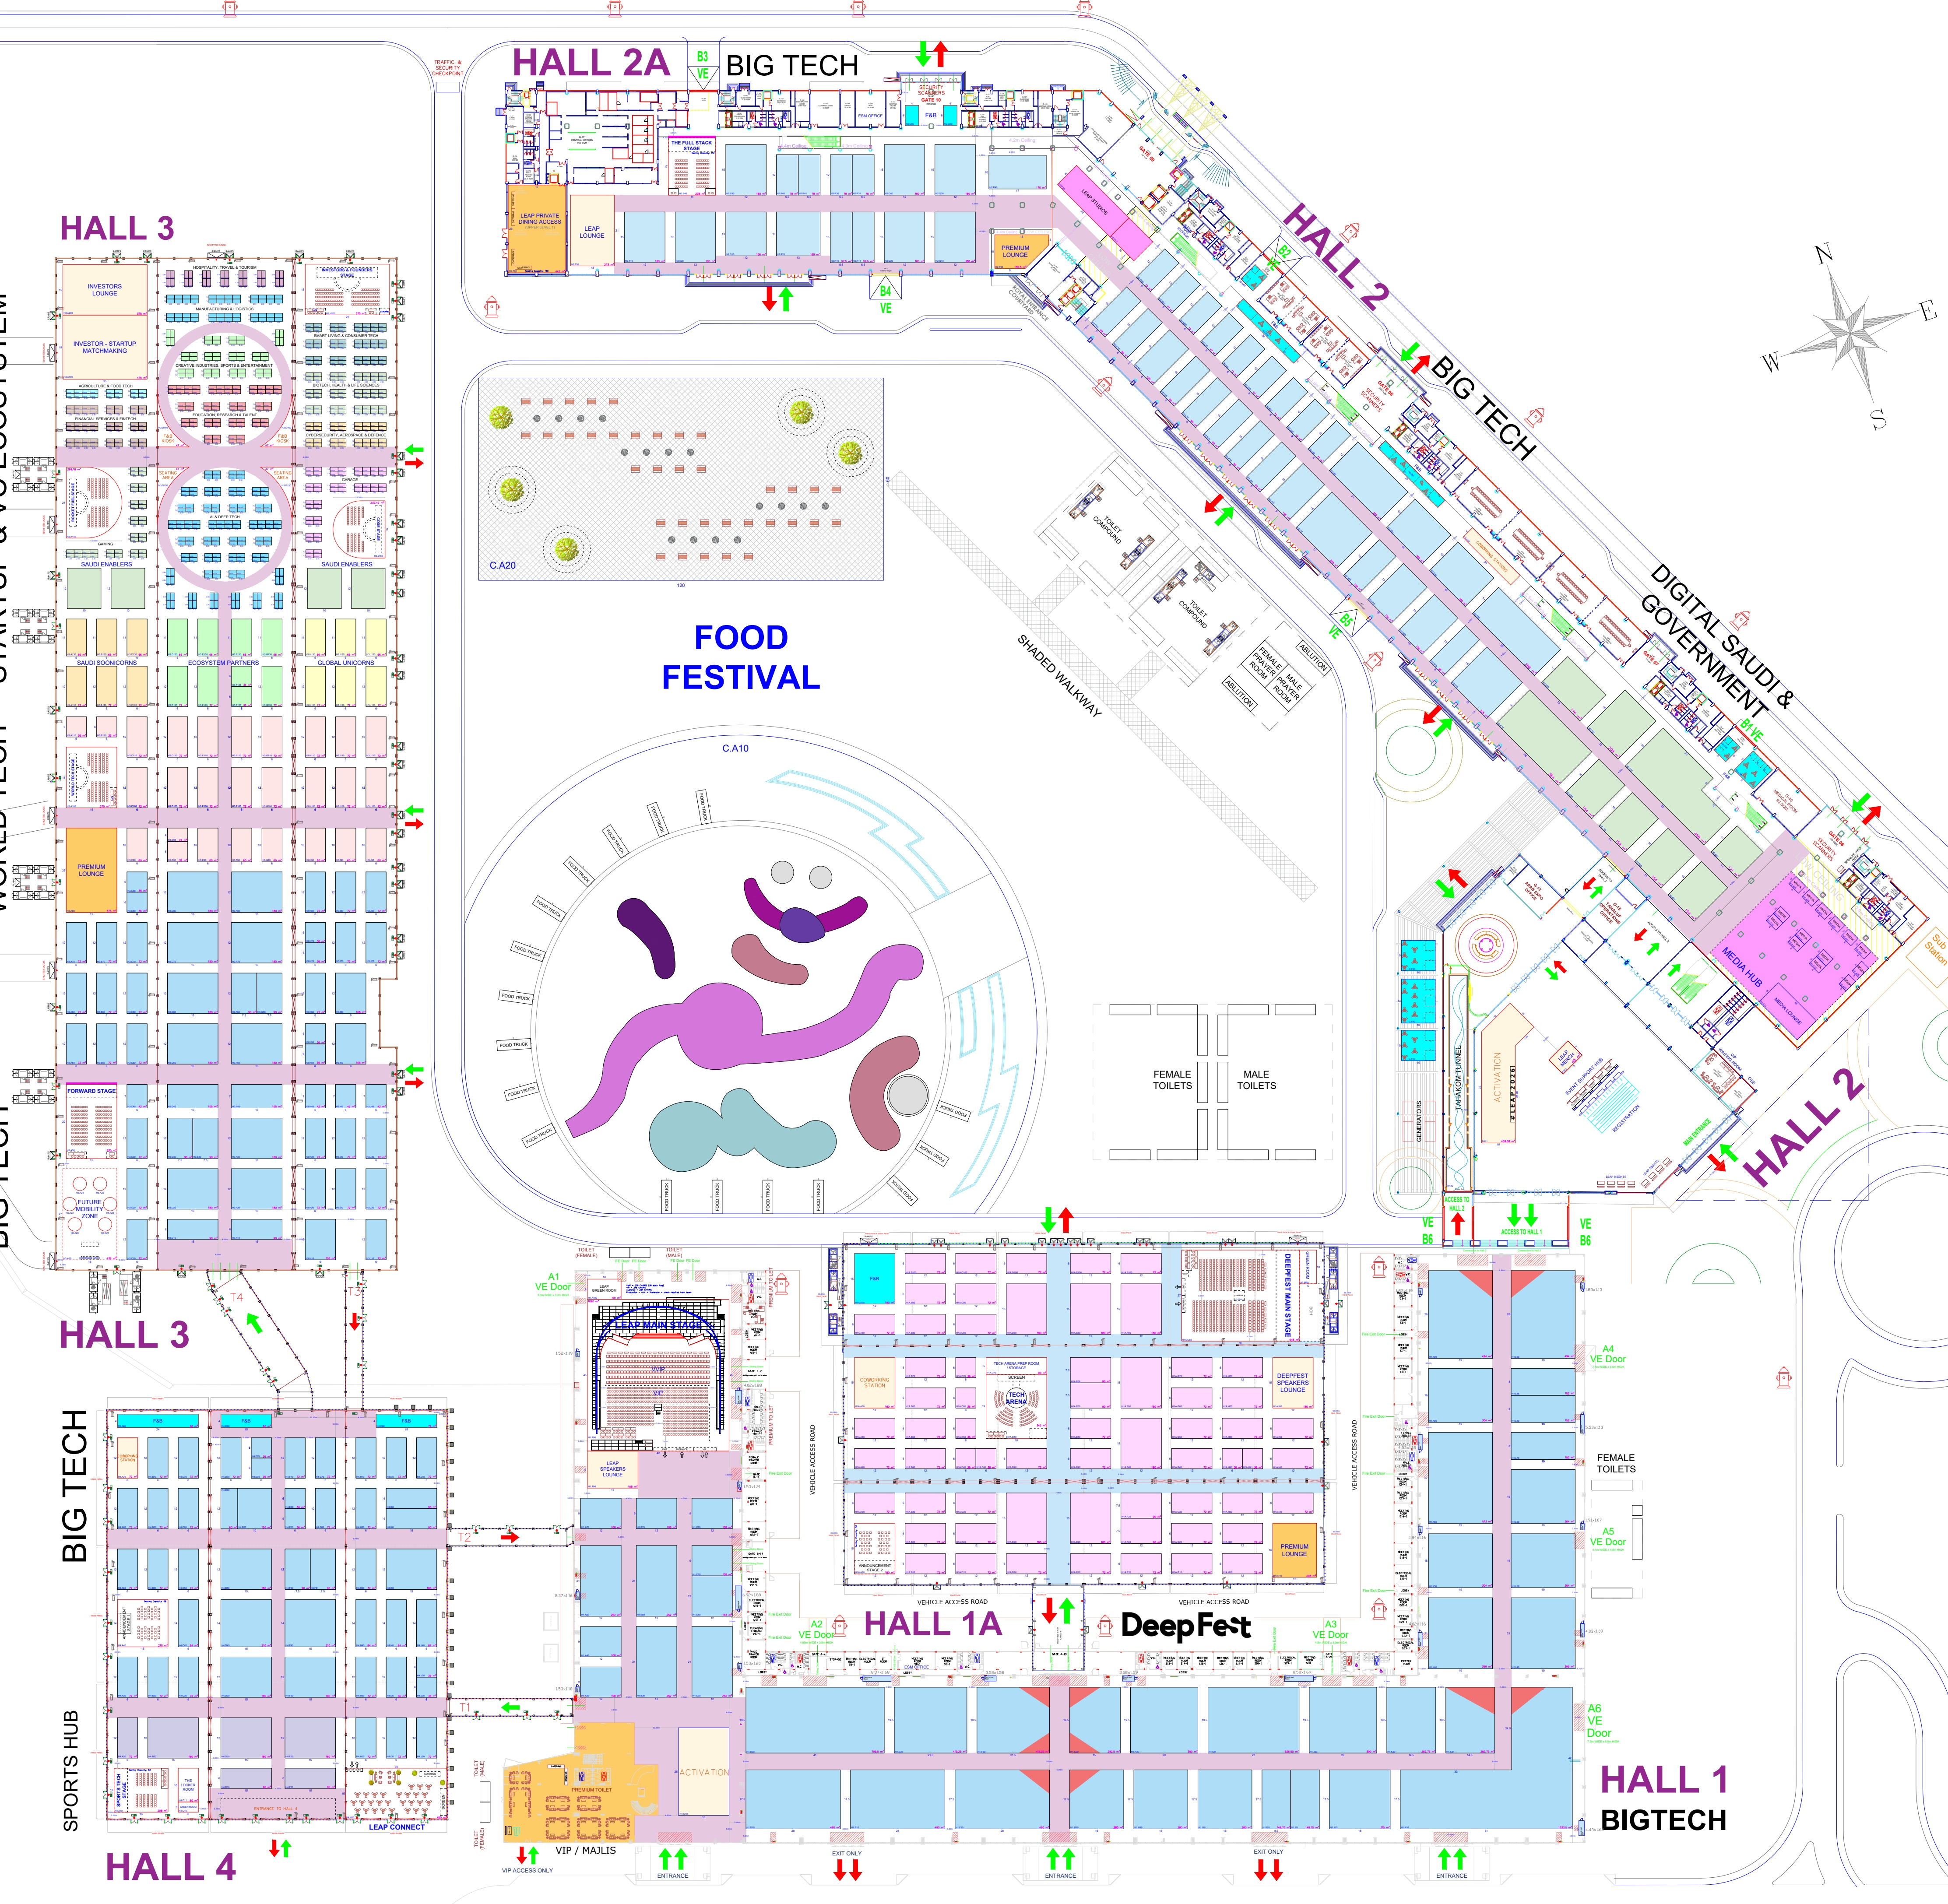

LEAP 2027 / FOOD + BEVERAGE
17
Indoor F&B Kiosks
MODULAR / VISIBLE / SOCIAL
01 / LOCATION ON CLIENT PLAN
02 / DESIGN REFERENCE + ARCHITECTURAL MOOD
VENUE-WIDE / NEARBY KIOSKS GROUPED AS PINS
2/3
4/5
9/10
6
7/8
1
11-13
STAND / AREA SCHEDULE
1
H1A.A90
180 m²
LIGHT + ATMOSPHERE Clear menu/food lighting, illuminated counter fronts and vertical light lines.
2
H2.Q60
24 m²
3
H2.Q50
24 m²
4
H2.N50
72 m²
03 / UAE + SAUDI MATERIAL OPTIONS
5
H2.N60
24 m²
6
H2.I50
75 m²
7
H2.C40
30 m²
8
H2.C50
64 m²
9
H3.D160
47 m²
10
H3.G160
47 m²
11
H4.A80
96 m²
12
H4.D80
60 m²
BLACK POWDER-COATED ALUMINIUM
HPL-FACED JOINERY
CHARCOAL LVT / VINYL
DIFFUSED LINEAR LED
PRINTABLE FABRIC / MEDIA
13
H4.H80
72 m²
WHAT TO DESIGN
Modular counter / backwall frame
Service and storage surfaces
Durable kiosk flooring
Illuminated counter / fascia
LEAP backwall graphics
One kiosk family scaled to 13 locations, with branded service counters, storage, backwalls, digital menus, clear queues and seating.
UAE GulfEx / KSA ALUPCO [S01-02]
UAE + KSA Danube [S11-12]
UAE + KSA Gerflor network [S09-10]
UAE + KSA LEDFlex supply [S19-21]
UAE CSiX / KSA Desert Sign [S22-23]
AREA NOTE
Listed footprints total 915 m²; the brief header says 815 m². Food operations/equipment are by others.
DARK PURPLE
NEON BLUE
NEON PINK
PURPLE
BLACK
WHITE
#27074A
#73FAFD
#EB3DF7
#8A30C7
#000000
#FFFFFF
Location source: client master plan p.1; Shared F&B brief pp.3-5,15. Material photographs are visual proposals; confirm product, finish and construction specifications.
EDITABLE TEXT + SEPARATE IMAGE ASSETS / UAE + SAUDI SOURCING / PLAN EXCERPTS NOT TO SCALE
19 / 27
Notes:
Client source: LEAP master plan dated 09 Nov 2026 and the supplied 22 creative briefs. Material samples and spatial concepts are illustrative. Regional supplier catalogues checked 11 Nov 2026. Exact grade, stock and certifications require supplier RFQ. Official sources:
S01 Gulf Extrusions UAE https://gulfex.com/
S02 ALUPCO Saudi Arabia https://alupco.com/region/gcc/
S03 Sabin Plastic UAE https://www.sabinplastic.com/wp-content/uploads/2025/10/SABIN-PLASTI_GROUP.pdf
S04 Sabin Plastic KSA https://www.sabinplastic.com/ksa/trading/
S05 Guardian Glass supplier network https://www.guardianglass.com/me/en/our-glass/find-a-guardian-glass-supplier
S06 Al Samiah Furniture UAE https://alsamiah.com/
S07 Sedar UAE https://www.sedarglobal.com/uae-en/tools-and-guides
S08 Sedar KSA https://sedarglobal.com/ksa-en
S09 Gerflor Middle East https://www.gerflorme.com/node/87221
S10 Protect Middle East UAE https://www.protectmiddleeast.com/flooring
S11 Danube Building Materials UAE https://danubebuildingmaterials.com/
S12 Danube Building Materials Riyadh https://danubeholding.com/places/2933/
S13 Sioen / Sioline regional team https://sioline.com/en/contact
S14 Obeikan Technical Fabrics KSA https://obeikanfabrics.com/the-company/
S15 Adams Furniture UAE https://www.adamsinternational.ae/post/outdoor-fabrics-dubai
S16 Aljuraid Group KSA https://aljuraidgroup.com/products/lounge-and-sofa/reva/
S17 RAK Ceramics UAE https://www.rakceramics.com/uae/en/tiles-floors-coverings/outdoor-porcelain-tiles/
S18 RAK Ceramics Saudi store https://onlineshop.rakceramics.com/sa/ara/outdoor.html
S19 LEDFlex Dubai https://ledflexgroup.com/press-media/news/v/?url=enhancing_our_support_within_the_gcc_region
S20 LEDFlex lighting ranges https://ledflexgroup.com/product/neon-flex/
S21 LEDFlex Saudi project supply https://ledflexgroup.com/projects/v/?url=bain-and-company
S22 CSiX UAE https://csixgt.com/
S23 Desert Sign KSA https://desertsign.com.sa/
S24 Desert Group UAE https://desertgroup.ae/
S25 Desert Views KSA https://desertviews.sa/nursery/

Slide 20








LEAP 2027 / FOOD + BEVERAGE
18
Food Festival + Outdoor F&B
SHADED / SOCIABLE / WEATHER-READY
01 / LOCATION ON CLIENT PLAN
02 / DESIGN REFERENCE + ARCHITECTURAL MOOD
CENTRAL FOOD FESTIVAL PLAZAS
OUTDOOR KIOSKS / TAHAKOM TUNNEL
2
3
1
4
5
STAND / AREA SCHEDULE
1
C.A10 / Truck Plaza
~12,000 m² in brief
LIGHT + ATMOSPHERE Warm evening light, subtle brand details; shade and misting over queues, seating and kiosks.
2
C.A20 / Seating Plaza
7,200 m² from plan*
3
C.F30 / 2 kiosks
90 m²
03 / UAE + SAUDI MATERIAL OPTIONS
4
C.F40 / 3 kiosks
130 m²
5
C.F50 / 2 kiosks
90 m²
WHAT TO DESIGN
17 food-truck bays, 7 outdoor kiosks, dining/chill/game zones, entrance arches, photo landmark, planting and wayfinding.
AREA NOTE
*C.A20 measures 120 x 60 m on plan (= 7,200 m²); the brief says 17,000 m². Confirm both plaza extents before detailed design.
ARCHITECTURAL SHADE MEMBRANE
OUTDOOR FABRIC + CUSHIONS
OUTDOOR PORCELAIN PAVING
BLACK POWDER-COATED ALUMINIUM
LOCAL PLANTING + PLANTERS
Shade canopies with misting
Weather-resistant seating
Slip-resistant modular floor
Kiosk / furniture framing
Planting and zone edges
UAE Sioen / KSA Obeikan [S13-14]
UAE Adams / KSA Aljuraid [S15-16]
UAE + KSA RAK Ceramics [S17-18]
UAE GulfEx / KSA ALUPCO [S01-02]
UAE Desert Group / KSA Desert Views [S24-25]
DARK PURPLE
NEON BLUE
NEON PINK
PURPLE
BLACK
WHITE
#27074A
#73FAFD
#EB3DF7
#8A30C7
#000000
#FFFFFF
Location source: client master plan p.1; Food Festival + Outdoor F&B brief pp.3,13-16. Material photographs are visual proposals; confirm product, finish and construction specifications.
EDITABLE TEXT + SEPARATE IMAGE ASSETS / UAE + SAUDI SOURCING / PLAN EXCERPTS NOT TO SCALE
20 / 27
Notes:
Client source: LEAP master plan dated 09 Nov 2026 and the supplied 22 creative briefs. Material samples and spatial concepts are illustrative. Regional supplier catalogues checked 11 Nov 2026. Exact grade, stock and certifications require supplier RFQ. Official sources:
S01 Gulf Extrusions UAE https://gulfex.com/
S02 ALUPCO Saudi Arabia https://alupco.com/region/gcc/
S03 Sabin Plastic UAE https://www.sabinplastic.com/wp-content/uploads/2025/10/SABIN-PLASTI_GROUP.pdf
S04 Sabin Plastic KSA https://www.sabinplastic.com/ksa/trading/
S05 Guardian Glass supplier network https://www.guardianglass.com/me/en/our-glass/find-a-guardian-glass-supplier
S06 Al Samiah Furniture UAE https://alsamiah.com/
S07 Sedar UAE https://www.sedarglobal.com/uae-en/tools-and-guides
S08 Sedar KSA https://sedarglobal.com/ksa-en
S09 Gerflor Middle East https://www.gerflorme.com/node/87221
S10 Protect Middle East UAE https://www.protectmiddleeast.com/flooring
S11 Danube Building Materials UAE https://danubebuildingmaterials.com/
S12 Danube Building Materials Riyadh https://danubeholding.com/places/2933/
S13 Sioen / Sioline regional team https://sioline.com/en/contact
S14 Obeikan Technical Fabrics KSA https://obeikanfabrics.com/the-company/
S15 Adams Furniture UAE https://www.adamsinternational.ae/post/outdoor-fabrics-dubai
S16 Aljuraid Group KSA https://aljuraidgroup.com/products/lounge-and-sofa/reva/
S17 RAK Ceramics UAE https://www.rakceramics.com/uae/en/tiles-floors-coverings/outdoor-porcelain-tiles/
S18 RAK Ceramics Saudi store https://onlineshop.rakceramics.com/sa/ara/outdoor.html
S19 LEDFlex Dubai https://ledflexgroup.com/press-media/news/v/?url=enhancing_our_support_within_the_gcc_region
S20 LEDFlex lighting ranges https://ledflexgroup.com/product/neon-flex/
S21 LEDFlex Saudi project supply https://ledflexgroup.com/projects/v/?url=bain-and-company
S22 CSiX UAE https://csixgt.com/
S23 Desert Sign KSA https://desertsign.com.sa/
S24 Desert Group UAE https://desertgroup.ae/
S25 Desert Views KSA https://desertviews.sa/nursery/

Slide 21


LEAP 2027 / ACTIVATIONS
19
Future Mobility Zone
FUTURE-FOCUSED / MODULAR / PRECISE
01 / LOCATION ON CLIENT PLAN
02 / DESIGN REFERENCE + ARCHITECTURAL MOOD
HALL 3 / SOUTH-WEST END
1
STAND / AREA SCHEDULE
1
H3.A10
432 m²
LIGHT + ATMOSPHERE Vehicle feature lighting, luminous ring canopies and low-glare platform edges.
WHAT TO DESIGN
16 x 27 m; six circular pods in three pairs, light-ring canopies, curved LED/lightbox backdrops, entrance arch, desk and vehicle access.
03 / UAE + SAUDI MATERIAL OPTIONS
AREA NOTE
Pod IDs H5.A20-A25 are used inside zone H3.A10 in the client brief.
BLACK POWDER-COATED ALUMINIUM
BRUSHED / ANODIZED ALUMINIUM
CHARCOAL LVT / VINYL
TRANSLUCENT POLYCARBONATE
DIFFUSED LINEAR LED
Ring-canopy / pod framework
Metallic platform / fascia trim
Pod and circulation floor
Curved lightbox diffuser option
Ring and plinth edge light
UAE GulfEx / KSA ALUPCO [S01-02]
UAE GulfEx / KSA ALUPCO [S01-02]
UAE + KSA Gerflor network [S09-10]
UAE + KSA Sabin Plastic [S03-04]
UAE + KSA LEDFlex supply [S19-21]
DARK PURPLE
NEON BLUE
NEON PINK
PURPLE
BLACK
WHITE
#27074A
#73FAFD
#EB3DF7
#8A30C7
#000000
#FFFFFF
Location source: client master plan p.1; Future Mobility Zone brief pp.3,13-16. Material photographs are visual proposals; confirm product, finish and construction specifications.
EDITABLE TEXT + SEPARATE IMAGE ASSETS / UAE + SAUDI SOURCING / PLAN EXCERPTS NOT TO SCALE
21 / 27
Notes:
Client source: LEAP master plan dated 09 Nov 2026 and the supplied 22 creative briefs. Material samples and spatial concepts are illustrative. Regional supplier catalogues checked 11 Nov 2026. Exact grade, stock and certifications require supplier RFQ. Official sources:
S01 Gulf Extrusions UAE https://gulfex.com/
S02 ALUPCO Saudi Arabia https://alupco.com/region/gcc/
S03 Sabin Plastic UAE https://www.sabinplastic.com/wp-content/uploads/2025/10/SABIN-PLASTI_GROUP.pdf
S04 Sabin Plastic KSA https://www.sabinplastic.com/ksa/trading/
S05 Guardian Glass supplier network https://www.guardianglass.com/me/en/our-glass/find-a-guardian-glass-supplier
S06 Al Samiah Furniture UAE https://alsamiah.com/
S07 Sedar UAE https://www.sedarglobal.com/uae-en/tools-and-guides
S08 Sedar KSA https://sedarglobal.com/ksa-en
S09 Gerflor Middle East https://www.gerflorme.com/node/87221
S10 Protect Middle East UAE https://www.protectmiddleeast.com/flooring
S11 Danube Building Materials UAE https://danubebuildingmaterials.com/
S12 Danube Building Materials Riyadh https://danubeholding.com/places/2933/
S13 Sioen / Sioline regional team https://sioline.com/en/contact
S14 Obeikan Technical Fabrics KSA https://obeikanfabrics.com/the-company/
S15 Adams Furniture UAE https://www.adamsinternational.ae/post/outdoor-fabrics-dubai
S16 Aljuraid Group KSA https://aljuraidgroup.com/products/lounge-and-sofa/reva/
S17 RAK Ceramics UAE https://www.rakceramics.com/uae/en/tiles-floors-coverings/outdoor-porcelain-tiles/
S18 RAK Ceramics Saudi store https://onlineshop.rakceramics.com/sa/ara/outdoor.html
S19 LEDFlex Dubai https://ledflexgroup.com/press-media/news/v/?url=enhancing_our_support_within_the_gcc_region
S20 LEDFlex lighting ranges https://ledflexgroup.com/product/neon-flex/
S21 LEDFlex Saudi project supply https://ledflexgroup.com/projects/v/?url=bain-and-company
S22 CSiX UAE https://csixgt.com/
S23 Desert Sign KSA https://desertsign.com.sa/
S24 Desert Group UAE https://desertgroup.ae/
S25 Desert Views KSA https://desertviews.sa/nursery/

Slide 22


LEAP 2027 / ACTIVATIONS
20
Open Vista
SCULPTURAL / OPEN / MEMORABLE
01 / LOCATION ON CLIENT PLAN
02 / DESIGN REFERENCE + ARCHITECTURAL MOOD
HALL 1 / NEXT TO VIP-MAJLIS
1
STAND / AREA SCHEDULE
1
H1.C10
390 m²
LIGHT + ATMOSPHERE Soft internal sculpture light with cyan/pink gradients and calm seating light.
WHAT TO DESIGN
15 x 26 m; original central landmark, open seating clusters, planting, charging, photo space and LEAP floor graphics.
03 / UAE + SAUDI MATERIAL OPTIONS
AREA NOTE
An original 2027 concept: do not reproduce the 2025 tree or the 2026 numeral 5. Carpet remains the principal area finish.
BLACK POWDER-COATED ALUMINIUM
BRUSHED / ANODIZED ALUMINIUM
TRANSLUCENT POLYCARBONATE
CHARCOAL LVT / VINYL
DIFFUSED LINEAR LED
Concealed sculpture support
Sculptural metallic detailing
Ascending translucent ribbons
Selected feature-floor inlay
Integrated landmark lighting
UAE GulfEx / KSA ALUPCO [S01-02]
UAE GulfEx / KSA ALUPCO [S01-02]
UAE + KSA Sabin Plastic [S03-04]
UAE + KSA Gerflor network [S09-10]
UAE + KSA LEDFlex supply [S19-21]
DARK PURPLE
NEON BLUE
NEON PINK
PURPLE
BLACK
WHITE
#27074A
#73FAFD
#EB3DF7
#8A30C7
#000000
#FFFFFF
Location source: client master plan p.1; Open Vista brief pp.3,7,14. Material photographs are visual proposals; confirm product, finish and construction specifications.
EDITABLE TEXT + SEPARATE IMAGE ASSETS / UAE + SAUDI SOURCING / PLAN EXCERPTS NOT TO SCALE
22 / 27
Notes:
Client source: LEAP master plan dated 09 Nov 2026 and the supplied 22 creative briefs. Material samples and spatial concepts are illustrative. Regional supplier catalogues checked 11 Nov 2026. Exact grade, stock and certifications require supplier RFQ. Official sources:
S01 Gulf Extrusions UAE https://gulfex.com/
S02 ALUPCO Saudi Arabia https://alupco.com/region/gcc/
S03 Sabin Plastic UAE https://www.sabinplastic.com/wp-content/uploads/2025/10/SABIN-PLASTI_GROUP.pdf
S04 Sabin Plastic KSA https://www.sabinplastic.com/ksa/trading/
S05 Guardian Glass supplier network https://www.guardianglass.com/me/en/our-glass/find-a-guardian-glass-supplier
S06 Al Samiah Furniture UAE https://alsamiah.com/
S07 Sedar UAE https://www.sedarglobal.com/uae-en/tools-and-guides
S08 Sedar KSA https://sedarglobal.com/ksa-en
S09 Gerflor Middle East https://www.gerflorme.com/node/87221
S10 Protect Middle East UAE https://www.protectmiddleeast.com/flooring
S11 Danube Building Materials UAE https://danubebuildingmaterials.com/
S12 Danube Building Materials Riyadh https://danubeholding.com/places/2933/
S13 Sioen / Sioline regional team https://sioline.com/en/contact
S14 Obeikan Technical Fabrics KSA https://obeikanfabrics.com/the-company/
S15 Adams Furniture UAE https://www.adamsinternational.ae/post/outdoor-fabrics-dubai
S16 Aljuraid Group KSA https://aljuraidgroup.com/products/lounge-and-sofa/reva/
S17 RAK Ceramics UAE https://www.rakceramics.com/uae/en/tiles-floors-coverings/outdoor-porcelain-tiles/
S18 RAK Ceramics Saudi store https://onlineshop.rakceramics.com/sa/ara/outdoor.html
S19 LEDFlex Dubai https://ledflexgroup.com/press-media/news/v/?url=enhancing_our_support_within_the_gcc_region
S20 LEDFlex lighting ranges https://ledflexgroup.com/product/neon-flex/
S21 LEDFlex Saudi project supply https://ledflexgroup.com/projects/v/?url=bain-and-company
S22 CSiX UAE https://csixgt.com/
S23 Desert Sign KSA https://desertsign.com.sa/
S24 Desert Group UAE https://desertgroup.ae/
S25 Desert Views KSA https://desertviews.sa/nursery/

Slide 23


LEAP 2027 / ACTIVATIONS
21
Hall 3 Seating + Photo Areas
RESTFUL / PHOTOGENIC / OPEN
01 / LOCATION ON CLIENT PLAN
02 / DESIGN REFERENCE + ARCHITECTURAL MOOD
HALL 3 / MATCHING CORNERS ACROSS THE AISLE
1
2
STAND / AREA SCHEDULE
1
H3.D150
47 m²
LIGHT + ATMOSPHERE Lit LEAP letters, restrained furniture accents and comfortable ambient light.
2
H3.G150
47 m²
WHAT TO DESIGN
03 / UAE + SAUDI MATERIAL OPTIONS
Two triangular/curved-edge seating corners; soft seating, one lit 3D LEAP logo each, photo markers, removable floor graphics, charging and planting.
BLACK POWDER-COATED ALUMINIUM
CONTRACT UPHOLSTERY FABRIC
GRAPHITE EVENT CARPET
DIFFUSED LINEAR LED
LOCAL PLANTING + PLANTERS
Stable 3D letter construction
Soft lounge furniture
Carpet and photo-marker base
Logo and furniture accents
Planters / soft edges
UAE GulfEx / KSA ALUPCO [S01-02]
UAE + KSA Sedar [S07-08]
UAE stockist / KSA supply Al Samiah [S06]
UAE + KSA LEDFlex supply [S19-21]
UAE Desert Group / KSA Desert Views [S24-25]
DARK PURPLE
NEON BLUE
NEON PINK
PURPLE
BLACK
WHITE
#27074A
#73FAFD
#EB3DF7
#8A30C7
#000000
#FFFFFF
Location source: client master plan p.1; Hall 3 Seating Areas brief pp.3,11-14. Material photographs are visual proposals; confirm product, finish and construction specifications.
EDITABLE TEXT + SEPARATE IMAGE ASSETS / UAE + SAUDI SOURCING / PLAN EXCERPTS NOT TO SCALE
23 / 27
Notes:
Client source: LEAP master plan dated 09 Nov 2026 and the supplied 22 creative briefs. Material samples and spatial concepts are illustrative. Regional supplier catalogues checked 11 Nov 2026. Exact grade, stock and certifications require supplier RFQ. Official sources:
S01 Gulf Extrusions UAE https://gulfex.com/
S02 ALUPCO Saudi Arabia https://alupco.com/region/gcc/
S03 Sabin Plastic UAE https://www.sabinplastic.com/wp-content/uploads/2025/10/SABIN-PLASTI_GROUP.pdf
S04 Sabin Plastic KSA https://www.sabinplastic.com/ksa/trading/
S05 Guardian Glass supplier network https://www.guardianglass.com/me/en/our-glass/find-a-guardian-glass-supplier
S06 Al Samiah Furniture UAE https://alsamiah.com/
S07 Sedar UAE https://www.sedarglobal.com/uae-en/tools-and-guides
S08 Sedar KSA https://sedarglobal.com/ksa-en
S09 Gerflor Middle East https://www.gerflorme.com/node/87221
S10 Protect Middle East UAE https://www.protectmiddleeast.com/flooring
S11 Danube Building Materials UAE https://danubebuildingmaterials.com/
S12 Danube Building Materials Riyadh https://danubeholding.com/places/2933/
S13 Sioen / Sioline regional team https://sioline.com/en/contact
S14 Obeikan Technical Fabrics KSA https://obeikanfabrics.com/the-company/
S15 Adams Furniture UAE https://www.adamsinternational.ae/post/outdoor-fabrics-dubai
S16 Aljuraid Group KSA https://aljuraidgroup.com/products/lounge-and-sofa/reva/
S17 RAK Ceramics UAE https://www.rakceramics.com/uae/en/tiles-floors-coverings/outdoor-porcelain-tiles/
S18 RAK Ceramics Saudi store https://onlineshop.rakceramics.com/sa/ara/outdoor.html
S19 LEDFlex Dubai https://ledflexgroup.com/press-media/news/v/?url=enhancing_our_support_within_the_gcc_region
S20 LEDFlex lighting ranges https://ledflexgroup.com/product/neon-flex/
S21 LEDFlex Saudi project supply https://ledflexgroup.com/projects/v/?url=bain-and-company
S22 CSiX UAE https://csixgt.com/
S23 Desert Sign KSA https://desertsign.com.sa/
S24 Desert Group UAE https://desertgroup.ae/
S25 Desert Views KSA https://desertviews.sa/nursery/

Slide 24



LEAP 2027 / ACTIVATIONS
22
Tunnels
IMMERSIVE / DIRECTIONAL / CALM
01 / LOCATION ON CLIENT PLAN
02 / DESIGN REFERENCE + ARCHITECTURAL MOOD
FOUR HALL LINKS / FOLLOW FLOW ARROWS
T4
T3
T2
T1
GATE A-13 / TWO-WAY ENTRANCE
A13
STAND / AREA SCHEDULE
T1
Hall 1A to Hall 4
~185 m²
LIGHT + ATMOSPHERE Diffused dimmable portals, smooth transitions from hall light levels, no eye-level glare.
T2
Hall 4 to Hall 1A
~175 m²
T3
Hall 3 to Hall 4
~200 m²
03 / UAE + SAUDI MATERIAL OPTIONS
T4
Hall 4 to Hall 3
~328 m²
A13
Gate A-13 / 15 x 25 m
375 m²
WHAT TO DESIGN
Five treatments: four hall links plus Gate A-13. Brand walls/headers, floors, ceiling elements and directional signs; doors/exits remain clear.
AREA NOTE
Hall-link sizes are approximate from the brief: T1 5 x 37 m; T2 5 x 35 m; T3 5 x 40 m; T4 8 x 41 m.
BLACK POWDER-COATED ALUMINIUM
PRINTABLE FABRIC / MEDIA
GRAPHITE EVENT CARPET
TRANSLUCENT POLYCARBONATE
DIFFUSED LINEAR LED
Portal / light-frame system
Official key-visual wall fabric
Corridor flooring
Diffusers / translucent layers
Soft flicker-free light portals
UAE GulfEx / KSA ALUPCO [S01-02]
UAE CSiX / KSA Desert Sign [S22-23]
UAE stockist / KSA supply Al Samiah [S06]
UAE + KSA Sabin Plastic [S03-04]
UAE + KSA LEDFlex supply [S19-21]
DARK PURPLE
NEON BLUE
NEON PINK
PURPLE
BLACK
WHITE
#27074A
#73FAFD
#EB3DF7
#8A30C7
#000000
#FFFFFF
Location source: client master plan p.1; Tunnels brief pp.3,13-18. Material photographs are visual proposals; confirm product, finish and construction specifications.
EDITABLE TEXT + SEPARATE IMAGE ASSETS / UAE + SAUDI SOURCING / PLAN EXCERPTS NOT TO SCALE
24 / 27
Notes:
Client source: LEAP master plan dated 09 Nov 2026 and the supplied 22 creative briefs. Material samples and spatial concepts are illustrative. Regional supplier catalogues checked 11 Nov 2026. Exact grade, stock and certifications require supplier RFQ. Official sources:
S01 Gulf Extrusions UAE https://gulfex.com/
S02 ALUPCO Saudi Arabia https://alupco.com/region/gcc/
S03 Sabin Plastic UAE https://www.sabinplastic.com/wp-content/uploads/2025/10/SABIN-PLASTI_GROUP.pdf
S04 Sabin Plastic KSA https://www.sabinplastic.com/ksa/trading/
S05 Guardian Glass supplier network https://www.guardianglass.com/me/en/our-glass/find-a-guardian-glass-supplier
S06 Al Samiah Furniture UAE https://alsamiah.com/
S07 Sedar UAE https://www.sedarglobal.com/uae-en/tools-and-guides
S08 Sedar KSA https://sedarglobal.com/ksa-en
S09 Gerflor Middle East https://www.gerflorme.com/node/87221
S10 Protect Middle East UAE https://www.protectmiddleeast.com/flooring
S11 Danube Building Materials UAE https://danubebuildingmaterials.com/
S12 Danube Building Materials Riyadh https://danubeholding.com/places/2933/
S13 Sioen / Sioline regional team https://sioline.com/en/contact
S14 Obeikan Technical Fabrics KSA https://obeikanfabrics.com/the-company/
S15 Adams Furniture UAE https://www.adamsinternational.ae/post/outdoor-fabrics-dubai
S16 Aljuraid Group KSA https://aljuraidgroup.com/products/lounge-and-sofa/reva/
S17 RAK Ceramics UAE https://www.rakceramics.com/uae/en/tiles-floors-coverings/outdoor-porcelain-tiles/
S18 RAK Ceramics Saudi store https://onlineshop.rakceramics.com/sa/ara/outdoor.html
S19 LEDFlex Dubai https://ledflexgroup.com/press-media/news/v/?url=enhancing_our_support_within_the_gcc_region
S20 LEDFlex lighting ranges https://ledflexgroup.com/product/neon-flex/
S21 LEDFlex Saudi project supply https://ledflexgroup.com/projects/v/?url=bain-and-company
S22 CSiX UAE https://csixgt.com/
S23 Desert Sign KSA https://desertsign.com.sa/
S24 Desert Group UAE https://desertgroup.ae/
S25 Desert Views KSA https://desertviews.sa/nursery/

Slide 25
LEAP 2027 / REGIONAL MATERIAL SOURCING
Material schedule 1 / 2
Supplier ranges and regional presence verified from official websites. Exact product stock and project quantities are not reserved.
MATERIAL | SPECIFICATION / SELECTION | UAE SUPPLY ROUTE | SAUDI SUPPLY ROUTE
M01 BLACK POWDER-COATED ALUMINIUM | Reusable aluminium profiles / fabricated faces in matte charcoal. Match the LEAP black finish sample. | Gulf Extrusions + local fabricator [S01] | ALUPCO + local fabricator [S02]
M02 BRUSHED / ANODIZED ALUMINIUM | Silver brushed-look or anodized trim and scenic profiles. Confirm the finish sample and forming method. | Gulf Extrusions / fabricator [S01] | ALUPCO / fabricator [S02]
M03 TRANSLUCENT POLYCARBONATE | Opal, frosted or textured sheet. Use a stocked flat-sheet grade if the ribbed look needs a custom lead time. | Sabin Plastic UAE [S03] | Sabin Plastic KSA [S04]
M04 PROCESSED SAFETY GLASS | Local tempered / laminated fabrication. Balustrade grade, thickness and fixings are application-specific. | Guardian-listed fabricators [S05] | Guardian-listed fabricators [S05]
M05 GRAPHITE EVENT CARPET | Charcoal exhibition roll carpet or reusable contract carpet. Request the organiser-required fire documentation. | Al Samiah stockist [S06] | Al Samiah regional supply [S06]
M06 CONTRACT UPHOLSTERY FABRIC | Grey woven upholstery from the local range. Confirm wear performance and the required fire specification. | Sedar UAE [S07] | Sedar KSA [S08]
M07 CHARCOAL LVT / VINYL | Commercial interior LVT or sheet vinyl in a charcoal stone-look finish. Select the exact stocked range locally. | Protect Middle East / Gerflor [S09-10] | Gerflor Middle East [S09]
M08 HPL-FACED JOINERY | Charcoal HPL on an appropriate joinery substrate. Replaces a generic compact-laminate assumption with a locally supplied laminate finish. | Danube Building Materials [S11] | Danube Riyadh [S12]
Sourcing basis
Samples show the intended look, not a supplier SKU. Use the linked source list for an RFQ. Confirm FSC documentation, fire performance and outdoor grade for the chosen assembly where the brief requires them.
Regional sources S01-S25 are listed on the following page. Catalogue coverage confirms a supply route, not live stock of every finish.
EDITABLE TEXT + SEPARATE IMAGE ASSETS / UAE + SAUDI SOURCING / PLAN EXCERPTS NOT TO SCALE
25 / 27
Notes:
Client source: LEAP master plan dated 09 Nov 2026 and the supplied 22 creative briefs. Material samples and spatial concepts are illustrative. Regional supplier catalogues checked 11 Nov 2026. Exact grade, stock and certifications require supplier RFQ. Official sources:
S01 Gulf Extrusions UAE https://gulfex.com/
S02 ALUPCO Saudi Arabia https://alupco.com/region/gcc/
S03 Sabin Plastic UAE https://www.sabinplastic.com/wp-content/uploads/2025/10/SABIN-PLASTI_GROUP.pdf
S04 Sabin Plastic KSA https://www.sabinplastic.com/ksa/trading/
S05 Guardian Glass supplier network https://www.guardianglass.com/me/en/our-glass/find-a-guardian-glass-supplier
S06 Al Samiah Furniture UAE https://alsamiah.com/
S07 Sedar UAE https://www.sedarglobal.com/uae-en/tools-and-guides
S08 Sedar KSA https://sedarglobal.com/ksa-en
S09 Gerflor Middle East https://www.gerflorme.com/node/87221
S10 Protect Middle East UAE https://www.protectmiddleeast.com/flooring
S11 Danube Building Materials UAE https://danubebuildingmaterials.com/
S12 Danube Building Materials Riyadh https://danubeholding.com/places/2933/
S13 Sioen / Sioline regional team https://sioline.com/en/contact
S14 Obeikan Technical Fabrics KSA https://obeikanfabrics.com/the-company/
S15 Adams Furniture UAE https://www.adamsinternational.ae/post/outdoor-fabrics-dubai
S16 Aljuraid Group KSA https://aljuraidgroup.com/products/lounge-and-sofa/reva/
S17 RAK Ceramics UAE https://www.rakceramics.com/uae/en/tiles-floors-coverings/outdoor-porcelain-tiles/
S18 RAK Ceramics Saudi store https://onlineshop.rakceramics.com/sa/ara/outdoor.html
S19 LEDFlex Dubai https://ledflexgroup.com/press-media/news/v/?url=enhancing_our_support_within_the_gcc_region
S20 LEDFlex lighting ranges https://ledflexgroup.com/product/neon-flex/
S21 LEDFlex Saudi project supply https://ledflexgroup.com/projects/v/?url=bain-and-company
S22 CSiX UAE https://csixgt.com/
S23 Desert Sign KSA https://desertsign.com.sa/
S24 Desert Group UAE https://desertgroup.ae/
S25 Desert Views KSA https://desertviews.sa/nursery/

Slide 26
LEAP 2027 / REGIONAL MATERIAL SOURCING
Material schedule 2 / 2
Supplier ranges and regional presence verified from official websites. Exact product stock and project quantities are not reserved.
MATERIAL | SPECIFICATION / SELECTION | UAE SUPPLY ROUTE | SAUDI SUPPLY ROUTE
M09 FSC PLYWOOD / SCENIC BOARD | Request FSC-certified timber/plywood and the required fire-rated or treated assembly. Specific certified batches remain an RFQ item. | Danube timber / board enquiry [S11] | Danube Riyadh enquiry [S12]
M10 ARCHITECTURAL SHADE MEMBRANE | Locally supplied coated technical shade fabric. Confirm canopy grade, colour and structural fabrication with the fabric supplier. | Sioen / Sioline regional team [S13] | Obeikan Technical Fabrics [S14]
M11 OUTDOOR FABRIC + CUSHIONS | Weather-resistant contract upholstery or complete outdoor cushions. Saudi source verifies a furniture/cushion route, not bulk fabric meterage. | Adams outdoor fabric / cushions [S15] | Aljuraid outdoor cushion route [S16]
M12 OUTDOOR PORCELAIN PAVING | Dark textured exterior porcelain or pavers. Check slip grade and temporary-installation build-up before selection. | RAK Ceramics UAE [S17] | RAK Ceramics Saudi [S18]
M13 DIFFUSED LINEAR LED | Opal diffused linear profiles / neon flex. Select RGBW or pixel systems where programmed LEAP accents are needed. | LEDFlex Dubai [S19-20] | LEDFlex regional project supply [S20-21]
M14 PRINTABLE FABRIC / MEDIA | Local polyester print media with official LEAP artwork. The exact fabric fire certificate and print finish need confirmation. | CSiX fabric media [S22] | Desert Sign textile media [S23]
M16 LOCAL PLANTING + PLANTERS | Locally sourced planting with fabricated powder-coated planters. Choose species for indoor light or outdoor exposure as appropriate. | Desert Group nursery network [S24] | Desert Views nursery [S25]
Sourcing basis
Samples show the intended look, not a supplier SKU. Use the linked source list for an RFQ. Confirm FSC documentation, fire performance and outdoor grade for the chosen assembly where the brief requires them.
Regional sources S01-S25 are listed on the following page. Catalogue coverage confirms a supply route, not live stock of every finish.
EDITABLE TEXT + SEPARATE IMAGE ASSETS / UAE + SAUDI SOURCING / PLAN EXCERPTS NOT TO SCALE
26 / 27
Notes:
Client source: LEAP master plan dated 09 Nov 2026 and the supplied 22 creative briefs. Material samples and spatial concepts are illustrative. Regional supplier catalogues checked 11 Nov 2026. Exact grade, stock and certifications require supplier RFQ. Official sources:
S01 Gulf Extrusions UAE https://gulfex.com/
S02 ALUPCO Saudi Arabia https://alupco.com/region/gcc/
S03 Sabin Plastic UAE https://www.sabinplastic.com/wp-content/uploads/2025/10/SABIN-PLASTI_GROUP.pdf
S04 Sabin Plastic KSA https://www.sabinplastic.com/ksa/trading/
S05 Guardian Glass supplier network https://www.guardianglass.com/me/en/our-glass/find-a-guardian-glass-supplier
S06 Al Samiah Furniture UAE https://alsamiah.com/
S07 Sedar UAE https://www.sedarglobal.com/uae-en/tools-and-guides
S08 Sedar KSA https://sedarglobal.com/ksa-en
S09 Gerflor Middle East https://www.gerflorme.com/node/87221
S10 Protect Middle East UAE https://www.protectmiddleeast.com/flooring
S11 Danube Building Materials UAE https://danubebuildingmaterials.com/
S12 Danube Building Materials Riyadh https://danubeholding.com/places/2933/
S13 Sioen / Sioline regional team https://sioline.com/en/contact
S14 Obeikan Technical Fabrics KSA https://obeikanfabrics.com/the-company/
S15 Adams Furniture UAE https://www.adamsinternational.ae/post/outdoor-fabrics-dubai
S16 Aljuraid Group KSA https://aljuraidgroup.com/products/lounge-and-sofa/reva/
S17 RAK Ceramics UAE https://www.rakceramics.com/uae/en/tiles-floors-coverings/outdoor-porcelain-tiles/
S18 RAK Ceramics Saudi store https://onlineshop.rakceramics.com/sa/ara/outdoor.html
S19 LEDFlex Dubai https://ledflexgroup.com/press-media/news/v/?url=enhancing_our_support_within_the_gcc_region
S20 LEDFlex lighting ranges https://ledflexgroup.com/product/neon-flex/
S21 LEDFlex Saudi project supply https://ledflexgroup.com/projects/v/?url=bain-and-company
S22 CSiX UAE https://csixgt.com/
S23 Desert Sign KSA https://desertsign.com.sa/
S24 Desert Group UAE https://desertgroup.ae/
S25 Desert Views KSA https://desertviews.sa/nursery/

Slide 27
LEAP 2027 / OFFICIAL SOURCE LINKS
UAE + Saudi supplier references
Checked 11 Nov 2026. Select a source name to open its official page.
S01 Gulf Extrusions UAE
S14 Obeikan Technical Fabrics KSA
Extrusion, anodizing and powder coating in Dubai
Technical-fabric manufacture in Riyadh
S02 ALUPCO Saudi Arabia
S15 Adams Furniture UAE
Aluminium profile supply and GCC operations
Outdoor performance fabric and cushion manufacture
S03 Sabin Plastic UAE
S16 Aljuraid Group KSA
Acrylic, polycarbonate and display-sheet catalogue
Outdoor furniture with waterproof fabric cushions
S04 Sabin Plastic KSA
S17 RAK Ceramics UAE
Sheets and rolls supplied across Saudi Arabia
Outdoor porcelain tile and paving ranges
S05 Guardian Glass supplier network
S18 RAK Ceramics Saudi store
UAE and Saudi fabricators with tempering and lamination capabilities
Saudi outdoor ceramic and porcelain range
S06 Al Samiah Furniture UAE
S19 LEDFlex Dubai
Carpets and flooring for events, serving UAE and Saudi clients
Regional facility and GCC supply support
S07 Sedar UAE
S20 LEDFlex lighting ranges
Upholstery fabrics and upholstery services
Diffused linear, RGB/RGBW and pixel-light options
S08 Sedar KSA
S21 LEDFlex Saudi project supply
Saudi upholstery-fabric collection
Published Riyadh installation evidence
S09 Gerflor Middle East
S22 CSiX UAE
Saudi manufacturing and UAE/Saudi sales coverage
Fabric media and large-format print substrates
S10 Protect Middle East UAE
S23 Desert Sign KSA
Gerflor LVT and vinyl-flooring supply
Textile printing materials and signage media
S11 Danube Building Materials UAE
S24 Desert Group UAE
Plywood, MDF, laminates, acrylic and flooring ranges
Local nursery and planting divisions
S12 Danube Building Materials Riyadh
S25 Desert Views KSA
Saudi branch of the building-material supplier
Nursery and planting supply in Saudi Arabia
S13 Sioen / Sioline regional team
UAE and Saudi contacts for architectural technical fabrics
Editing
The PDF contains live text and individual images without editing restrictions. Use a PDF editor for text changes. The PowerPoint source provides separate text, pins, photos and material samples for layout changes. Concept renderings remain image assets.
Client scope and locations are unchanged. All 22 supplied briefs remain included with their listed locations.
EDITABLE TEXT + SEPARATE IMAGE ASSETS / UAE + SAUDI SOURCING / PLAN EXCERPTS NOT TO SCALE
27 / 27
Notes:
Client source: LEAP master plan dated 09 Nov 2026 and the supplied 22 creative briefs. Material samples and spatial concepts are illustrative. Regional supplier catalogues checked 11 Nov 2026. Exact grade, stock and certifications require supplier RFQ. Official sources:
S01 Gulf Extrusions UAE https://gulfex.com/
S02 ALUPCO Saudi Arabia https://alupco.com/region/gcc/
S03 Sabin Plastic UAE https://www.sabinplastic.com/wp-content/uploads/2025/10/SABIN-PLASTI_GROUP.pdf
S04 Sabin Plastic KSA https://www.sabinplastic.com/ksa/trading/
S05 Guardian Glass supplier network https://www.guardianglass.com/me/en/our-glass/find-a-guardian-glass-supplier
S06 Al Samiah Furniture UAE https://alsamiah.com/
S07 Sedar UAE https://www.sedarglobal.com/uae-en/tools-and-guides
S08 Sedar KSA https://sedarglobal.com/ksa-en
S09 Gerflor Middle East https://www.gerflorme.com/node/87221
S10 Protect Middle East UAE https://www.protectmiddleeast.com/flooring
S11 Danube Building Materials UAE https://danubebuildingmaterials.com/
S12 Danube Building Materials Riyadh https://danubeholding.com/places/2933/
S13 Sioen / Sioline regional team https://sioline.com/en/contact
S14 Obeikan Technical Fabrics KSA https://obeikanfabrics.com/the-company/
S15 Adams Furniture UAE https://www.adamsinternational.ae/post/outdoor-fabrics-dubai
S16 Aljuraid Group KSA https://aljuraidgroup.com/products/lounge-and-sofa/reva/
S17 RAK Ceramics UAE https://www.rakceramics.com/uae/en/tiles-floors-coverings/outdoor-porcelain-tiles/
S18 RAK Ceramics Saudi store https://onlineshop.rakceramics.com/sa/ara/outdoor.html
S19 LEDFlex Dubai https://ledflexgroup.com/press-media/news/v/?url=enhancing_our_support_within_the_gcc_region
S20 LEDFlex lighting ranges https://ledflexgroup.com/product/neon-flex/
S21 LEDFlex Saudi project supply https://ledflexgroup.com/projects/v/?url=bain-and-company
S22 CSiX UAE https://csixgt.com/
S23 Desert Sign KSA https://desertsign.com.sa/
S24 Desert Group UAE https://desertgroup.ae/
S25 Desert Views KSA https://desertviews.sa/nursery/

