Slide 1
COMP7035
Python for Data Analytics and Artificial Intelligence
Scikit-learn
Renjie Wan, Wei Xue

Slide 2
What we will learn?
Topic |  |  | Hours
I. | Python Fundamentals |  | 12
 | Program control and logic Data types and structures Function File I/O
II. | Numerical Computing and Data Visualization |  | 9
 | Tools and libraries such as NumPy Matplotlib Seaborn
III. | Exploratory Data Analysis (EDA) with Python |  | 9
 | Tools and libraries such as Pandas Sweetviz
IV. | Artificial Intelligence and Machine Learning with Python |  | 9
 | Tools and libraries such as Keras Scikit-learn

Slide 3
Outline
About Scikit-learn
Data and Feature Processing
Unsupervised Learning
Supervised Learning

Slide 4

What is Scikit-learn?
Open source data mining and analysis library in Python
Classification, regression, and clustering algorithms
First released in 2007
Mostly written in Python:
Built using NumPy and SciPy
Integrates with matplotlib and plotly for plotting

Slide 5
What is Scikit-learn?
Popular
Ranked as one of top machine learning projects on GitHub
Simple
Fewer dependencies, makes for easier distribution

Slide 6
Using Scikit-learn
!pip install scikit-learn
import sklearn

Slide 7
Outline
About Scikit-learn
Data and Feature Processing
Unsupervised Learning
Supervised Learning

Slide 8
Dataset Splitting
As we have introduced in the Keras part, we need to split the dataset into training, validation and testing datasets.
Scikit-learn provides a simple API to achieve this goal.
sklearn.model_selection.train_test_split(*arrays, test_size=None, train_size=None, random_state=None, shuffle=True, stratify=None)
test_size should be between 0.0 and 1.0 and represent the proportion of the dataset to include in the test split.

Slide 9
Dataset Splitting
As we have introduced in the Keras part, we need to split the dataset into training, validation and testing datasets.
Scikit-learn provides a simple API to achieve this goal.
from sklearn.model_selection import train_test_split
import numpy as np
N = 1000
X = np.random.randn(N,128)
y = np.random.randn(N,1)
X_train, X_test, y_train, y_test = train_test_split(X,y,test_size=0.3)
for i in [X_train, X_test, y_train, y_test]:
print(i.shape)

Slide 10
Standardization
Standardization of datasets is a common requirement for many machine learning estimators
Make each feature dimension of the dataset to be zero mean and unit variance.
The preprocessing module provides the StandardScaler utility class
from sklearn import preprocessing
import numpy as np
X_train = np.array([[ 1., -1., 2.],[ 2., 0., 0.],[ 0., 1., -1.]])
print(X_train.mean(axis=0))
print(X_train.std(axis=0))
scaler = preprocessing.StandardScaler().fit(X_train)
X_scaled = scaler.transform(X_train)
print(X_scaled.mean(axis=0))
print(X_scaled.std(axis=0))

Slide 11
Normalization
Normalization is the process of scaling individual samples to have unit norm.
from sklearn import preprocessing
import numpy as np
X_train = np.array([[ 1., -1., 2.],[ 2., 0., 0.],[ 0., 1., -1.]])
print(X_train.mean(axis=0))
print(X_train.std(axis=0))
X_normalized = preprocessing.normalize(X_train, norm='l2')
print(X_normalized)
print(np.sum(X_normalized*X_normalized,axis=1))

Slide 12
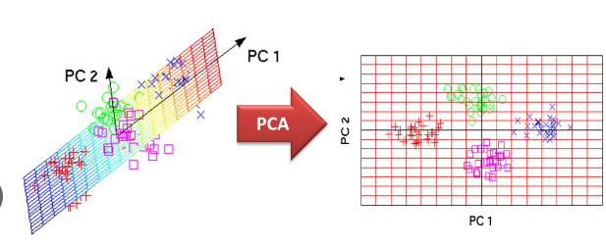
Principle Component Analysis (PCA)
Linear dimensionality reduction using Singular Value Decomposition of the data to project it to a lower dimensional space.

Slide 13
Principle Component Analysis (PCA)
Linear dimensionality reduction using Singular Value Decomposition of the data to project it to a lower dimensional space.
import numpy as np
from sklearn.decomposition import PCA
X = np.random.randn(5,20)
pca = PCA(n_components=2)
pca.fit(X)
Y = pca.transform(X)
print(Y)
Define operator, fit, transform

Slide 14
Outline
About Scikit-learn
Data and Feature Processing
Unsupervised Learning
Supervised Learning

Slide 15
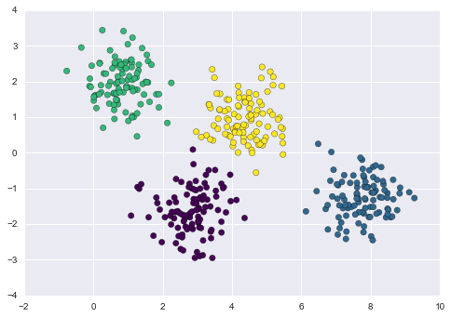
K-means Clustering
The K-Means algorithm clusters data by trying to separate samples in n groups

Slide 16
K-means Clustering
The K-Means algorithm clusters data by trying to separate samples in n groups
# Generate some data
from sklearn.datasets import make_blobs
import matplotlib.pyplot as plt
from sklearn.cluster import KMeans
X, y_true = make_blobs(n_samples=400, centers=4, cluster_std=0.60, random_state=0)
print(X.shape)
X = X[:, ::-1] # flip axes for better plotting
# Plot the data with K Means Labels
kmeans = KMeans(4) # 4 is the number of clusters
kmeans.fit(X)
labels = kmeans.predict(X)
plt.scatter(X[:, 0], X[:, 1], c=labels, s=40, cmap='viridis')
Define algorithm, fit, predict

Slide 17
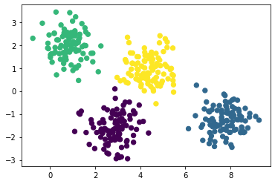
K-means Clustering
The K-Means algorithm clusters data by trying to separate samples in n groups

Slide 18
K-means Clustering
The K-Means algorithm clusters data by trying to separate samples in n groups
# Generate some data
from sklearn.datasets import make_blobs
import matplotlib.pyplot as plt
from sklearn.cluster import KMeans
X, y_true = make_blobs(n_samples=400, centers=4, cluster_std=0.60, random_state=0)
print(X.shape)
X = X[:, ::-1] # flip axes for better plotting
plt.scatter(X[:, 0], X[:, 1], c=y_true, s=40, cmap='viridis')
Now we compare the prediction with the ground truth

Slide 19
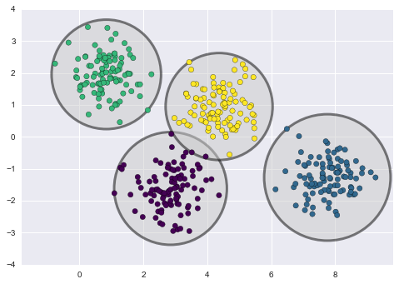
Gaussian Mixture Model (GMM)
An important observation for k-means is that these cluster models must be circular

Slide 20
Gaussian Mixture Model (GMM)
Now we generate some "stretched" data by applying a linear transformation
from sklearn.datasets import make_blobs
import matplotlib.pyplot as plt
from sklearn.cluster import KMeans
X, y_true = make_blobs(n_samples=400, centers=4, cluster_std=0.60, random_state=0)
X = X[:, ::-1]
rng = np.random.RandomState(13)
X_stretched = np.dot(X, rng.randn(2, 2))
plt.scatter(X_stretched[:, 0], X_stretched[:, 1], c=y_true, s=40, cmap='viridis')

Slide 21
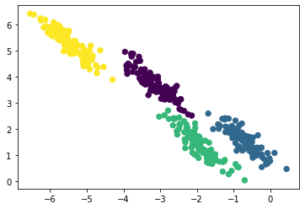
Gaussian Mixture Model (GMM)
Now we generate some "stretched" data by applying a linear transformation

Slide 22
Gaussian Mixture Model (GMM)
Let us predict the labels using K-Means
from sklearn.datasets import make_blobs
import matplotlib.pyplot as plt
from sklearn.cluster import KMeans
import numpy as np
X, y_true = make_blobs(n_samples=400, centers=4, cluster_std=0.60, random_state=0)
X = X[:, ::-1]
rng = np.random.RandomState(13)
X_stretched = np.dot(X, rng.randn(2, 2))
print(X_stretched.shape)
kmeans = KMeans(4)
kmeans.fit(X_stretched)
labels = kmeans.predict(X_stretched)
plt.scatter(X_stretched[:, 0], X_stretched[:, 1], c=labels, s=40, cmap='viridis')

Slide 23
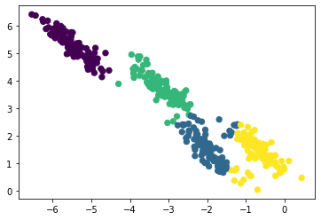
Gaussian Mixture Model (GMM)
Let us predict the labels using K-Means

Slide 24
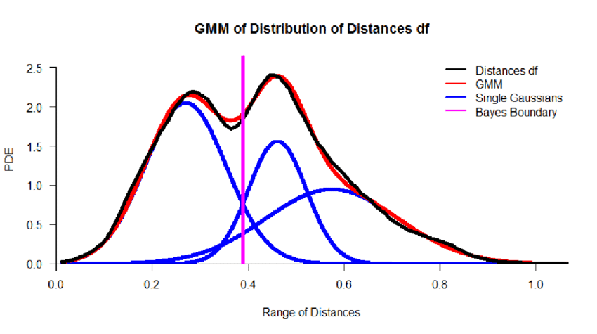
Gaussian Mixture Model (GMM)
A GMM attempts to find a mixture of multi-dimensional Gaussian probability distributions that best model any input dataset.

Slide 25
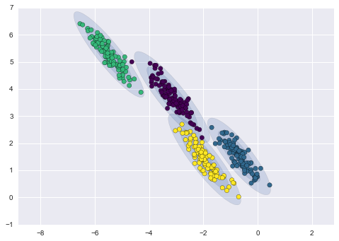
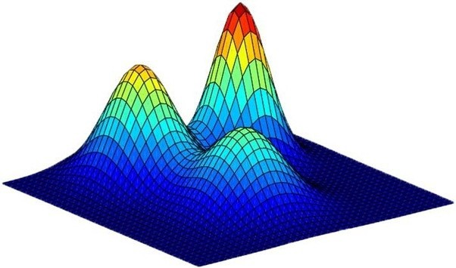
Gaussian Mixture Model (GMM)
A GMM attempts to find a mixture of multi-dimensional Gaussian probability distributions that best model any input dataset.
We aim to express the whole data with 4 Gaussian distributions

Slide 26
Gaussian Mixture Model (GMM)
Let us predict the labels using GMM
from sklearn.datasets import make_blobs
import matplotlib.pyplot as plt
import numpy as np
from sklearn.mixture import GaussianMixture
X, y_true = make_blobs(n_samples=400, centers=4, cluster_std=0.60, random_state=0)
X = X[:, ::-1]
rng = np.random.RandomState(13)
X_stretched = np.dot(X, rng.randn(2, 2))
gmm = GaussianMixture(n_components=4).fit(X_stretched)
labels = gmm.predict(X_stretched)
plt.scatter(X_stretched[:, 0], X_stretched[:, 1], c=labels, s=40, cmap='viridis')
Define algorithm, fit, predict

Slide 27
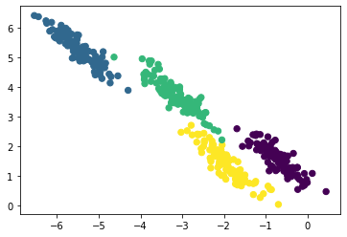
Gaussian Mixture Model (GMM)
Let us predict the labels using GMM

Slide 28
Outline
About Scikit-learn
Data and Feature Processing
Unsupervised Learning
Supervised Learning

Slide 29
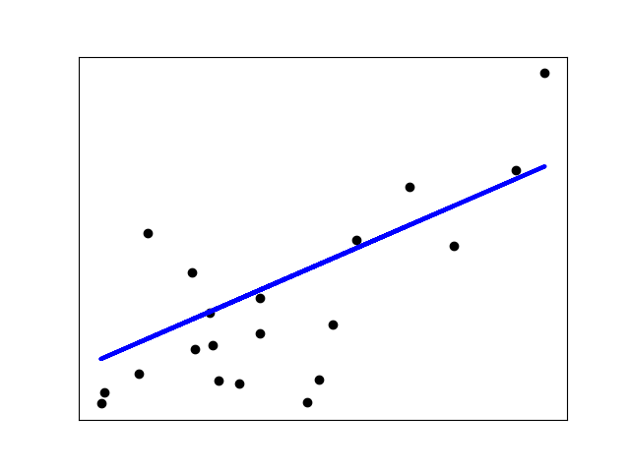

Linear Models
Ordinary Least Squares
from sklearn import linear_model
reg = linear_model.LinearRegression()
x= [[0, 0], [1, 1], [2, 2]]
y = [0, 1, 2]
reg.fit(x,y)
y_pred = reg.predict(x)
print(y_pred)

Slide 30
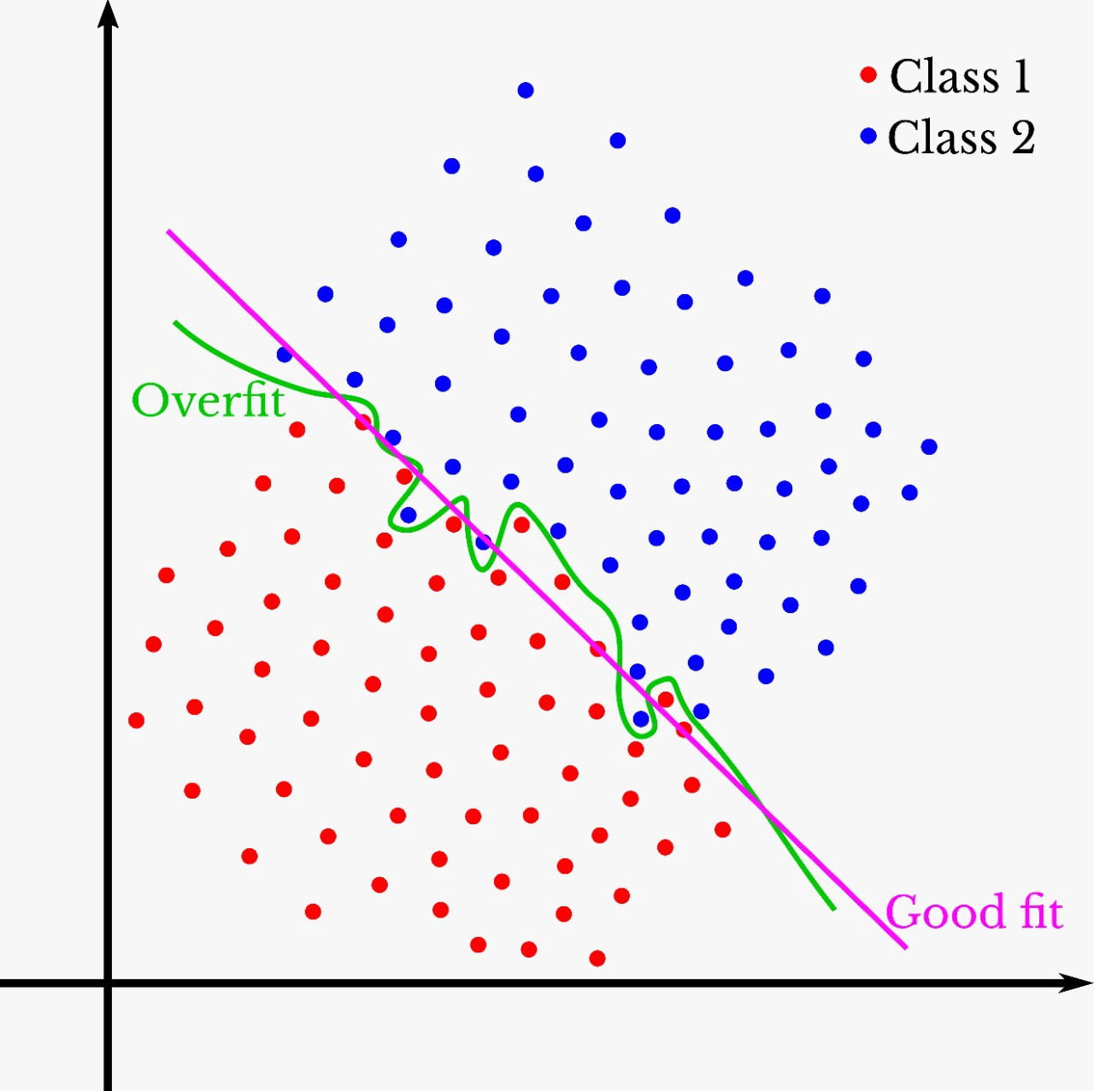
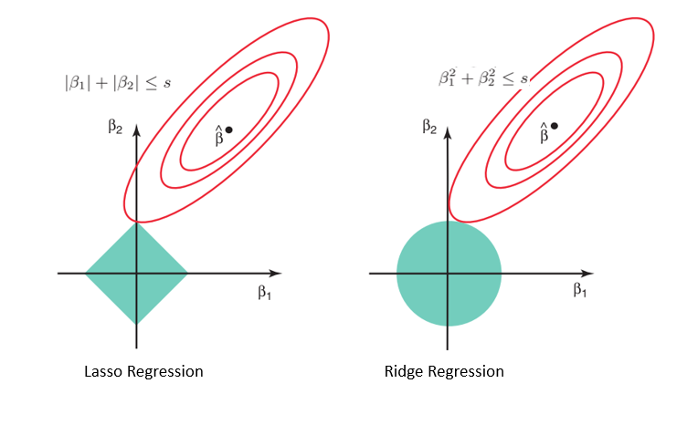
Linear Models
To avoid overfitting, regularization is used.
The overfitting happens when too much model parameters are used to fit simple data

Slide 31
Linear Models
To avoid overfitting, regularization is used.
The regularization is used to constrain the number of active parameters

Slide 32

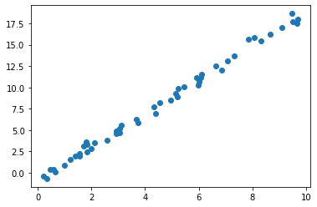
Linear Models
Ridge regression
Now let us first try using LinearRegression to fit the noisy data using the over-complicated model (20 parameters)
import numpy as np
from sklearn import linear_model
import matplotlib.pyplot as plt
reg = linear_model.LinearRegression()
rng = np.random.RandomState(42)
x = 10 * rng.rand(50,1)
y = 2 * x - 1 + rng.randn(50,1)
x_train = x
for ii in range(19):# add unnecessary dimensions
z = rng.rand(50,1)
x_train = np.concatenate((x_train,z),axis=1)
reg.fit(x_train,y) #using 20 parameters
y_pred = reg.predict(x_train)
plt.scatter(x, y_pred);
print(reg.coef_.shape)

Slide 33
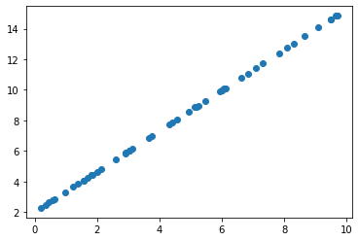
Linear Models
Ridge regression
Now let us try using Ridge to fit the noisy data using the over-complicated model (20 parameters), but with regularizations
import numpy as np
from sklearn import linear_model
import matplotlib.pyplot as plt
reg = linear_model.Ridge(alpha=200)
rng = np.random.RandomState(42)
x = 10 * rng.rand(50,1)
y = 2 * x - 1 + rng.randn(50,1)
x_train = x
for ii in range(19):# add unnecessary dimensions
z = rng.rand(50,1)
x_train = np.concatenate((x_train,z),axis=1)
reg.fit(x_train,y) #using 20 parameters
y_pred = reg.predict(x_train)
plt.scatter(x, y_pred);
print(reg.coef_.shape)

Slide 34

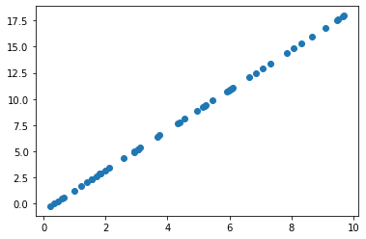
Linear Models
Lasso regression
Now let us try using Lasso to fit the noisy data using the over-complicated model (20 parameters), but with regularizations
import numpy as np
from sklearn import linear_model
import matplotlib.pyplot as plt
reg = linear_model.Lasso(alpha=0.5)
rng = np.random.RandomState(42)
x = 10 * rng.rand(50,1)
y = 2 * x - 1 + rng.randn(50,1)
x_train = x
for ii in range(19):# add unnecessary dimensions
z = rng.rand(50,1)
x_train = np.concatenate((x_train,z),axis=1)
reg.fit(x_train,y) #using 20 parameters
y_pred = reg.predict(x_train)
plt.scatter(x, y_pred);
print(reg.coef_.shape)

Slide 35
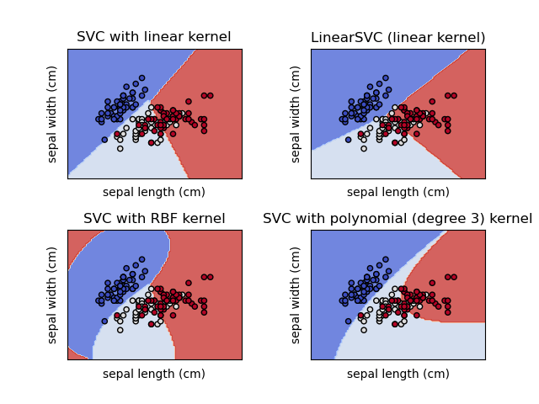
Support Vector Machine (SVM)
Support vector machine (SVM) is one of the most popular classifiers besides DNN.
It maps the data into high dimensions using kernels, and designs classifiers in the high-dimension space

Slide 36
Support Vector Machine (SVM)
Support vector machine (SVM) is one of the most popular classifiers besides DNN.
from sklearn import svm, datasets
from sklearn.model_selection import train_test_split
from sklearn.metrics import accuracy_score
# import some data to play with
iris = datasets.load_iris()
X_iris = iris.data
y_iris = iris.target
Xtrain, Xtest, ytrain, ytest = train_test_split(X_iris, y_iris,test_size=0.1)
model = svm.SVC(kernel="rbf")
model.fit(Xtrain, ytrain)
y_pred = model.predict(Xtest)
print(y_pred[:10])
print(ytest[:10])
print(accuracy_score(y_pred,ytest))

Slide 37
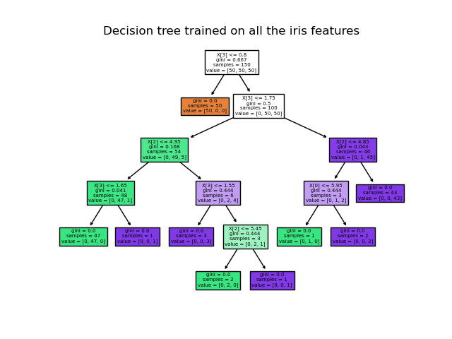
Decision Tree
The decision tree predicts the value of a target variable by learning simple decision rules inferred from the data features.

Slide 38
Decision Tree
The decision tree predicts the value of a target variable by learning simple decision rules inferred from the data features.
from sklearn import datasets
from sklearn.tree import DecisionTreeClassifier
from sklearn.model_selection import train_test_split
from sklearn.metrics import accuracy_score
# import some data to play with
iris = datasets.load_iris()
X_iris = iris.data
y_iris = iris.target
Xtrain, Xtest, ytrain, ytest = train_test_split(X_iris, y_iris,test_size=0.1)
model = DecisionTreeClassifier()
model.fit(Xtrain, ytrain)
y_pred = model.predict(Xtest)
print(y_pred[:10])
print(ytest[:10])
print(accuracy_score(y_pred,ytest))

Slide 39
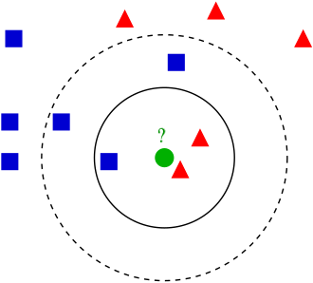
KNeighborsClassifier
Majority voting based on the nearest K neighbors

Slide 40
KNeighborsClassifier
Majority voting based on the nearest K neighbors
from sklearn import datasets
from sklearn.model_selection import train_test_split
from sklearn.metrics import accuracy_score
from sklearn.neighbors import KNeighborsClassifier
# import some data to play with
iris = datasets.load_iris()
X_iris = iris.data
y_iris = iris.target
Xtrain, Xtest, ytrain, ytest = train_test_split(X_iris, y_iris,test_size=0.1)
model = KNeighborsClassifier()
model.fit(Xtrain, ytrain)
y_pred = model.predict(Xtest)
print(y_pred[:10])
print(ytest[:10])
print(accuracy_score(y_pred,ytest))

Slide 41
Exercise
Split the Digits Dataset (load_digits) into training and testing sets with ratio 9:1
Standardize the data for each dimension
Reduce the dimension to 32 using PCA
Train a SVM classifier

