Slide 1
COMP7035
Python for Data Analytics and Artificial Intelligence
Keras
Renjie Wan, Wei Xue

Slide 2
What we will learn?
Topic |  |  | Hours
I. | Python Fundamentals |  | 12
 | Program control and logic Data types and structures Function File I/O
II. | Numerical Computing and Data Visualization |  | 9
 | Tools and libraries such as NumPy Matplotlib Seaborn
III. | Exploratory Data Analysis (EDA) with Python |  | 9
 | Tools and libraries such as Pandas Sweetviz
IV. | Artificial Intelligence and Machine Learning with Python |  | 9
 | Tools and libraries such as Keras Scikit-learn

Slide 3

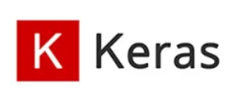

What is Keras?
Keras is a powerful and easy-to-use free open source Python library for developing and evaluating deep learning (DL) models.
It is part of the TensorFlow library and allows you to define and train neural network models easily.
While many DL frameworks are available, the pipelines are very similar. Here we take Keras as an example.
Top 3 Deep Learning Frameworks

Slide 4
Install and Import Keras
In Colab, run
! pip install keras
import keras

Slide 5
Key Components of Keras Pipeline
Dataset?
Load Data
Define Keras Model
Fit Keras Model
Evaluate Keras Model
Tie It All Together
Make Predictions
Learning Target?
Model Structure?
Loss function?
Optimizer?
Training Loop?

Slide 6
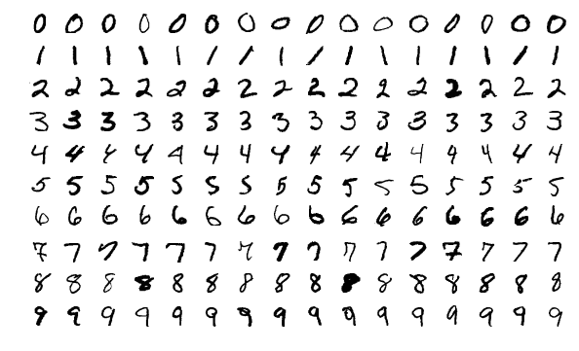
Key Components of Keras Pipeline
We will learn each step based on a famous task:
MNIST handwritten digits recognition

Slide 7
Key Components of Keras Pipeline
Dataset?
Load Data
Define Keras Model
Fit Keras Model
Evaluate Keras Model
Tie It All Together
Make Predictions
Learning Target?
Model Structure?
Loss function?
Optimizer?
Training Loop?

Slide 8
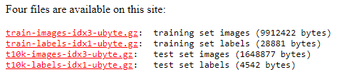
Loading Datasets
Let us first download the data from the web:
http://yann.lecun.com/exdb/mnist/
These files contains the pixel values and labels for each digit image. The pixel values range from 0 to 255.

Slide 9
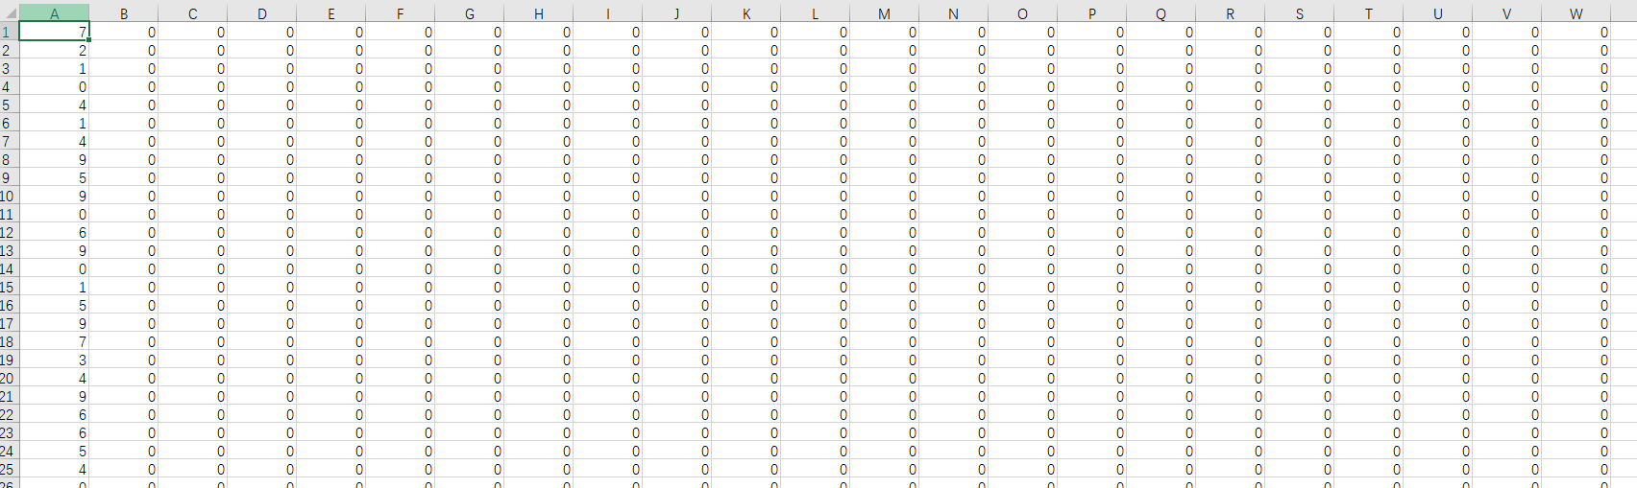
Loading Datasets
Using the codes in convert.py to convert the raw dataset to the csv files, we can check the details of the dataset:
mnist_test.csv
label
Pixel values (features)
Try converting the dataset by yourself and check the csv files.

Slide 10
Loading Datasets
Although there are some wrapped API to load the MNIST dataset, we will introduce the general ways of loading a dataset.
Loading the entire dataset when there is enough memory
Define a customized data generator to load the data sample one by one.

Slide 11
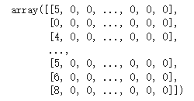
Loading Datasets
Loading the entire dataset
Because the MNIST dataset is small, we can load all the data into the memory
We have created two csv files: mnist_train.csv and mnist_test.csv.
Now we use Pandas to load the csv files and extract the values.
import pandas as pd
df_orig_train = pd.read_csv('mnist_train.csv',header=None)
df_orig_test = pd.read_csv('mnist_test.csv',header=None)
df_train_values = df_orig_train.values
df_test_values = df_orig_test.values

Slide 12

Loading Datasets
Loading the entire dataset
Then we extract the features and labels for the training and test set. Since the pixel values are in the range of [0,255], we normalize them to be within the range of [0,1]
train_feat_ori,train_label_ori = df_train_values[:,1:]/255.0,df_train_values[:,0]
test_feat,test_label = df_test_values[:,1:]/255.0,df_test_values[:,0]
# show the shape of each variable
for i_variable in [train_feat_ori,train_label_ori,test_feat,test_label]:
print(i_variable.shape)

Slide 13
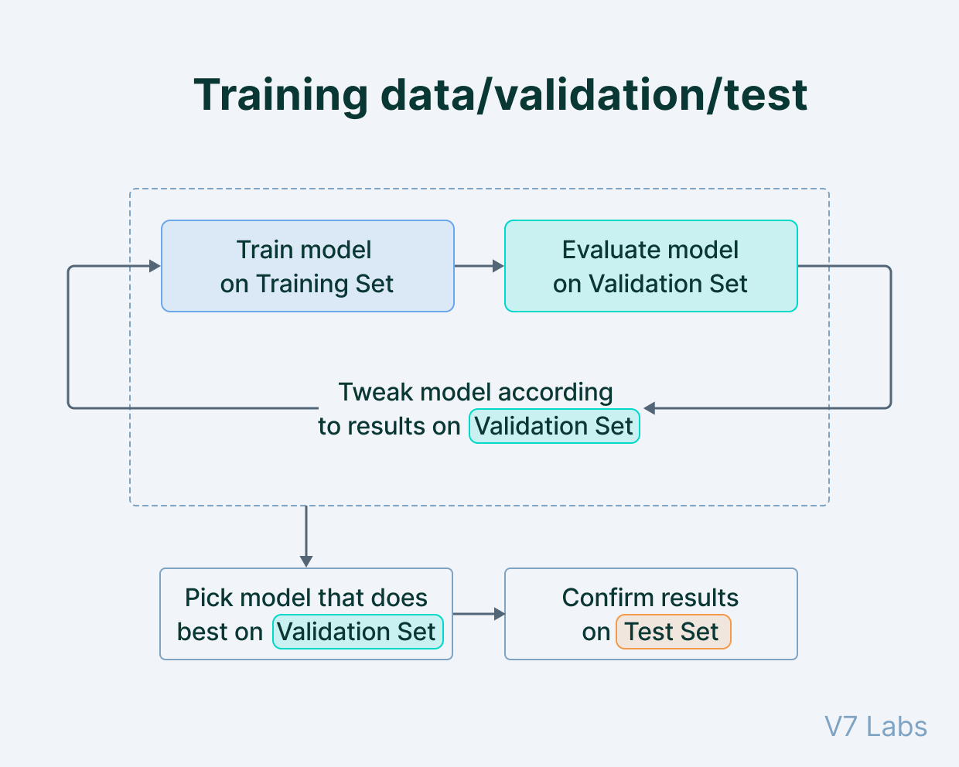
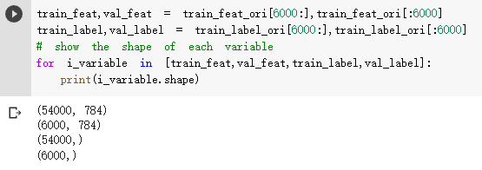
Loading Datasets
Loading the entire dataset
We also want to create a “validation” dataset, in order to verify whether the model has a good generalization ability during training.
Here we take 6000 samples out of the original training set as the validation set.

Slide 14
Loading Datasets
Defining a data generator
In many cases the dataset is huge such that it is impossible to load the entire dataset into the memory before training.
Speech Recognition: 20,000 hours of data
We can define a customized “data generator” to specify the rules of creating one sample.

Slide 15
Loading Datasets
Defining a data generator
The data generator is implemented as a class, which has three key methods:
__init__, __len__, and __getitem__.
class DataGenerator(keras.utils.Sequence):
'Generates data for Keras'
def __init__(self, para1, para2):
# initilizes some variables according to the input parameters.
# Any number of parameters are supported
# some codes
def __len__(self):
# return the total number of samples in the dataset
# some codes
def __getitem__(self,index):
# create one sample according to the index
# some codes

Slide 16
Loading Datasets
Defining a data generator
__init__
Instead of loading all the data, we use the directory of the csv file as the input, and let the generator to read only one line of the file when generating each sample (supported by linecache library).
import random
def __init__(self, csv_path, indexes):
# initilizes some variables
self.csv_path = csv_path
self.norm_facor = 255.0
self.indexes = indexes
random.shuffle(self.indexes)
We save the csv_path input as a class variable, in order to be used in other functions.
indexes indicate which lines of the csv file will be used in the dataset.
We also define two other variables which will be used later.
You can conduct all initialization processing before actually fetching the sample from dataset.

Slide 17
Loading Datasets
Defining a data generator
The data generator is implemented as a class, which has three key methods:
__init__, __len__, and __getitem__.
def __len__(self):
# return the total number of samples in the dataset
return len(self.indexes)
The function returns the total number of samples in the dataset
Given this value the data generator knows whether all the data has been traversed. The “index” parameter in __getitem__ ranges in [0, returned value-1].
In this example, since self.indexes stores the line indexes, we use the length of the list to indicate the number of samples.

Slide 18
Loading Datasets
Defining a data generator
The data generator is implemented as a class, which has three key methods:
__init__, __len__, and __getitem__.
def __getitem__(self,index):
# get one sample according to the index
line_index = self.indexes[index]
line_str = linecache.getline(self.csv_path,line_index)
line_val = [int(i) for i in line_str.split(',')]
label = line_val[0]
feat = np.array(line_val[1:])/self.norm_facor
return feat,label
The index value will iterate from 0 to L-1, where L is the value returned by __len__;
__getitem__ function defines the rules of creating the sample given the index
Here, the rules are
Determine which line should be read
Read the content of the chosen line to a string
Convert the string to a list containing integer elements
Get the feature and label
return the values

Slide 19
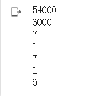
Loading Datasets
Using a data generator
Once the generator class is defined, the data generator instance can be further created
indexes = [i for i in range(60000)]
train_index = indexes[6000:]
val_index = indexes[:6000]
train_set = DataGenerator('mnist_train.csv',train_index)
val_set = DataGenerator('mnist_train.csv',val_index)
print(len(train_set))
print(len(val_set))
cnt = 0
for x, y in train_set:
print(y)
cnt = cnt+1
if cnt>=5:
break
The file directory and indexes are used as input parameters
Try run the codes for multiple times and check the outputs. Why each run gives a different output?

Slide 20
Loading Datasets
Defining the learning target
The learning target is defined as the label when creating a sample.
def __getitem__(self,index):
# get one sample according to the index
line_index = self.indexes[index]
line_str = linecache.getline(self.csv_path,line_index)
line_val = [int(i) for i in line_str.split(',')]
label = line_val[0]
feat = np.array(line_val[1:])/self.norm_facor
return feat,label
In our case, we want to classify the digits, therefore, the digit value itself, stored in the first element in each line, is taken as the learning target

Slide 21
Exercise
1. Rather than identifying the actual number, we want to classify whether the digit image contains an odd number. Modify the data generator to produce correct data samples from the MNIST dataset.
0
1
0
1
0
1
0
1
0
1

Slide 22
Exercise
Rather than identifying the actual number, we want to classify whether the digit image contains an odd number. Modify the data generator to produce correct data samples from the MNIST dataset.
We want to make the input feature normalized to [-1,1]. What shall we do?

Slide 23
Key Components of Keras Pipeline
Dataset?
Load Data
Define Keras Model
Fit Keras Model
Evaluate Keras Model
Tie It All Together
Make Predictions
Learning Target?
Model Structure?
Loss function?
Optimizer?
Training Loop?

Slide 24
Define Keras Model
A model is the core of deep learning, is composed of many building blocks and defines the computation logics from input to output.
Two different ways of defining a deep neural network:
Keras’ Sequential API
Keras’ Functional API
Input feature
DNN Model
Output

Slide 25
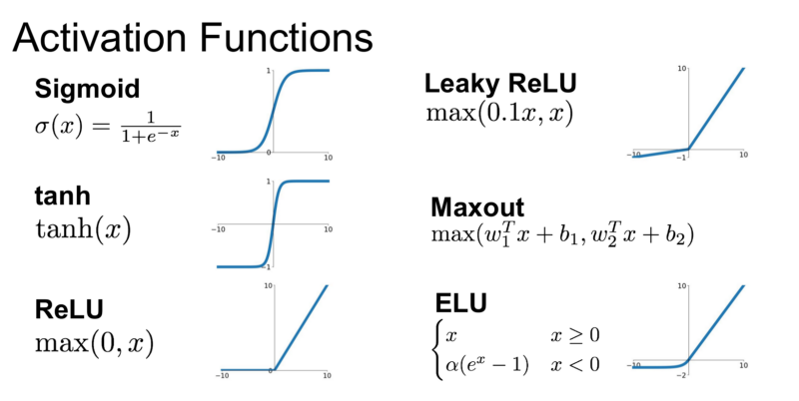
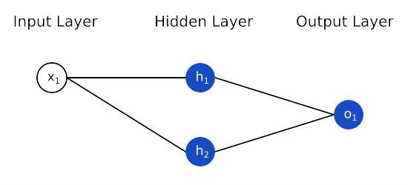
Define Keras Model
Keras’ Sequential API
Activation
Define a simple fully connected network with linear layers
DNN structure
# Define the model:
from keras.models import Sequential
from keras.layers import Dense
model = Sequential()
model.add(Dense(2, input_dim=1, activation='relu’))
model.add(Dense(1, activation='sigmoid'))
Input & hidden layer, 2 nodes in the hidden layer
Output layer, one node in the output layer

Slide 26
Define Keras Model
Keras’ Sequential API
Input(784) (28*28)
# Define the model:
from keras.models import Sequential
from keras.layers import Dense
model = Sequential()
model.add(Dense(512, input_shape=(784,), activation='relu'))
model.add(Dense(512, activation='relu'))
model.add(Dense(10, activation='softmax'))
model.summary()
linear(512)+relu
linear(512) +relu
linear(10) +softmax
Output
Now we define a fully connected network for MNIST inputs
The Dense layer can automatically figure out the input dimension when used as a hidden layer.

Slide 27
Define Keras Model
Keras’ Sequential API
Input(784) (28*28)
# Define the model:
from keras.models import Sequential
from keras.layers import Dense,Input
model = Sequential()
model.add(Input(shape=(784,)))
model.add(Dense(512, activation='relu'))
model.add(Dense(512, activation='relu'))
model.add(Dense(10, activation='softmax'))
model.summary()
linear(512)+relu
linear(512) +relu
linear(10) +softmax
Output
We can also use a separate “input layer” to specify the input dimension

Slide 28
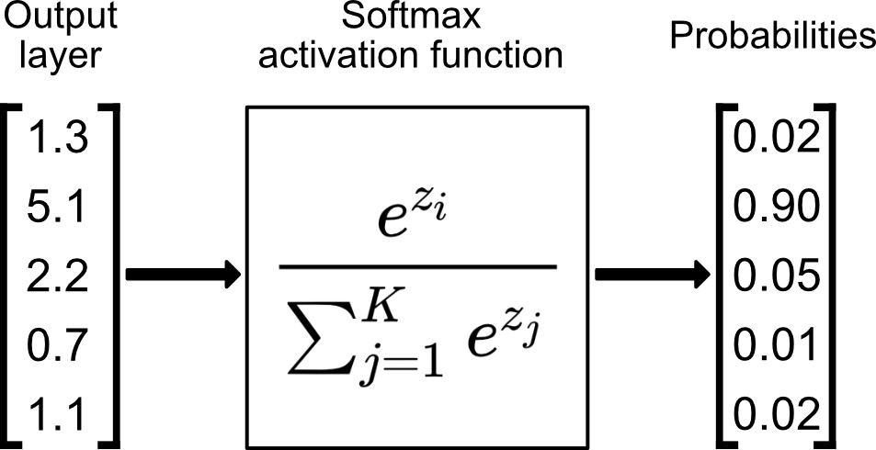
Define Keras Model
Keras’ Sequential API
Input(784) (28*28)
# Define the model:
from keras.models import Sequential
from keras.layers import Dense,Input
model = Sequential()
model.add(Input(shape=(784,)))
model.add(Dense(512, activation='relu'))
model.add(Dense(512, activation='relu'))
model.add(Dense(10, activation='softmax'))
model.summary()
linear(512)+relu
linear(512) +relu
linear(10) +softmax
Output
The activation gives nonlinearity to the model, popular activation functions include sigmoid, relu and softmax.
Softmax normalizes a vector to ensure the summation is one, which is suitable to indicate the probability of each class.

Slide 29
Define Keras Model
Keras’ Sequential API
Input(784) (28*28)
# Define the model:
from keras.models import Sequential
from keras.layers import Dense,Input
model = Sequential()
model.add(Input(shape=(784,)))
model.add(Dense(512, activation='relu'))
model.add(Dense(512, activation='relu'))
model.add(Dense(10, activation='softmax'))
model.summary()
linear(512)+relu
linear(512) +relu
linear(10) +softmax
Output
To understand sigmoid, relu and softmax activations, please see https://en.wikipedia.org/wiki/Activation_function

Slide 30
Define Keras Model
Keras’ Sequential API
Input(784) (28*28)
# Define the model:
from keras.models import Sequential
from keras.layers import Dense,Input
model = Sequential(
[Input(shape=(784,)),
Dense(512, activation='relu'),
Dense(512, activation='relu'),
Dense(10, activation='softmax')]
)
model.summary()
linear(512)+relu
linear(512) +relu
linear(10) +softmax
Output
The Sequential API can also take as input a list of layers.

Slide 31
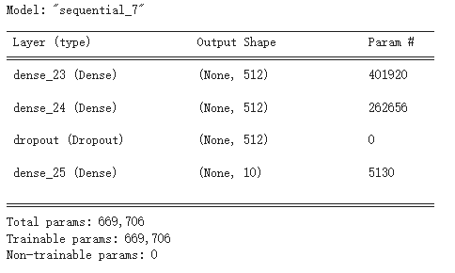
Define Keras Model
# Define the model using functional API:
from keras.models import Sequential
from keras.layers import Dense,Input,Dropout
x = Input(shape=(784,))
model = Sequential(
[Input(shape=(784,)),
Dense(512, activation='relu'),
Dense(512, activation='relu'),
Dropout(0.5),
Dense(10, activation='softmax')]
)
model.summary()
Keras’ Sequential API
Input(784) (28*28)
linear(512)+relu
linear(512) +relu
Dropout(0.5)
linear(10) +softmax
Output
A dropout layer is usually used to prevent overfitting.
It randomly drop neurons during training, the rate of dropout changes from 0 to 1.

Slide 32
Define Keras Model
A model is the core of deep learning, is composed of many building blocks and defines the computation logics from input to output.
Two different ways of defining a deep neural network:
Keras’ Sequential API
Keras’ Functional API
Input feature
DNN Model
Output

Slide 33
Define Keras Model
Keras’ Functional API
In many cases, the model structure is more complicated than forward connections.
Input(784) (28*28)
linear(512)+relu
512
linear(512) +relu
linear(256)+relu
concat
768
concatenate
linear(10) +softmax
256
Output

Slide 34
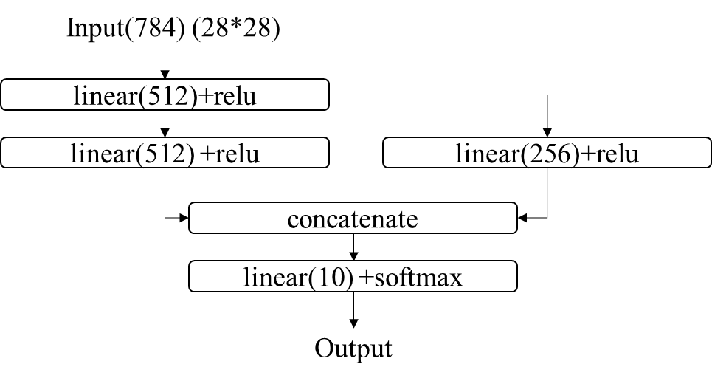
Define Keras Model
Keras’ Functional API
# Define the model using functional API:
from keras.models import Model
from keras.layers import Dense,Input,concatenate
input_tensor = Input(shape=(784,))
x = Dense(512, activation='relu')(input_tensor)
x1 = Dense(512, activation='relu')(x)
x2 = Dense(256, activation='relu')(x)
x3 = concatenate([x1,x2])
output_tensor = Dense(10, activation='softmax')(x3)
model = Model(inputs=input_tensor, outputs=output_tensor)
model.summary()
“concatenate” rather than “Concatenate”
Learn the syntax of forwarding the inputs

Slide 35
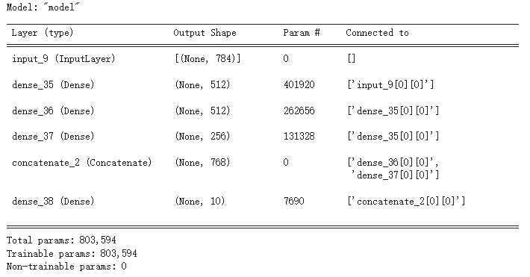
Define Keras Model
Keras’ Functional API
# Define the model using functional API:
from keras.models import Model
from keras.layers import Dense,Input,concatenate
input_tensor = Input(shape=(784,))
x = Dense(512, activation='relu')(input_tensor)
x1 = Dense(512, activation='relu')(x)
x2 = Dense(256, activation='relu')(x)
x3 = concatenate([x1,x2])
output_tensor = Dense(10, activation='softmax')(x3)
model = Model(inputs=input_tensor, outputs=output_tensor)
model.summary()
“concatenate” rather than “Concatenate”
Learn the syntax of forwarding the inputs

Slide 36
Define Keras Model
Keras’ Functional API
Functional API makes it possible to “package” a model as a function
# Define the model using functional API:
from keras.models import Model
from keras.layers import Dense,Input,concatenate
def MNIST_Model(in_shape,out_shape):
input_tensor = Input(shape=(in_shape,))
x = Dense(512, activation='relu')(input_tensor)
x1 = Dense(512, activation='relu')(x)
x2 = Dense(256, activation='relu')(x)
x3 = concatenate([x1,x2])
output_tensor = Dense(out_shape, activation='softmax')(x3)
model = Model(inputs=input_tensor, outputs=output_tensor)
return model
my_model = MNIST_Model(784,10)
my_model.summary()
We can easily change the hyperparameters!

Slide 37
Define Keras Model
# Define the model using functional API:
from keras.models import Model
from keras.layers import Dense,Input,concatenate
def MNIST_Model(in_shape,out_shape):
# define layers
input_tensor = Input(shape=(in_shape,))
linear_layer1 = Dense(512, activation='relu')
linear_layer2 = Dense(512, activation='relu')
linear_layer3 = Dense(512, activation='relu')
out_layer = Dense(out_shape, activation='softmax')
# define operations
x = linear_layer1(input_tensor)
x1 = linear_layer2(x)
x2 = linear_layer3(x)
x3 = concatenate([x1,x2])
output_tensor = out_layer(x3)
# define the model
model = Model(inputs=input_tensor, outputs=output_tensor)
return model
my_model = MNIST_Model(784,10)
my_model.summary()
Keras’ Functional API
We suggest a clearer way of defining the model:
Define layers, operations, models.
The operations are easier to read when giving layer names in the codes.
Linear 1
Linear 2
Linear 3
Output

Slide 38
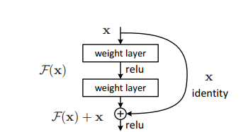
Exercise
Rather than identifying the actual number, we want to classify whether the digit image contains an odd number. Modify the data generator to produce correct data samples from the MNIST dataset.
We want to make the input feature normalized to [-1,1]. What shall we do?
Define the resnet structure with all weight layers as 256-node dense layers.

Slide 39
Exercise
Rather than identifying the actual number, we want to classify whether the digit image contains an odd number. Modify the data generator to produce correct data samples from the MNIST dataset.
We want to make the input feature normalized to [-1,1]. What shall we do?
Define a resnet block with all weight layers as 256-node dense layers.
Define a large resnet consisting of 80 resnet blocks.

