Slide 1
Sql server libpcap

Slide 2
OpenLive
handle, err := pcap.OpenLive(deviceName, snapLen, true, pcap.BlockForever)

Slide 3
Package parse
PayLoad

Slide 4
gopackge osi
tcp/ip application layout
应用层
表示层
gopackge
会话层
传输层
网络层
数据链路层
物理层
https://baike.baidu.com/item/OSI%E6%A8%A1%E5%9E%8B/10119902?fr=aladdin

Slide 5
gopackge

Slide 6
Sql server parse
TDS Protocol Message Fetch
https://github.com/google/gopacket
TDS protocol parse

Slide 7
Steps
Which layout of message (Application/ Transport)
Sql servere tds protocol parser for golang (ref ms docs)
Do some metrics merature (latency,counts,sql,requet time)
Prometheus metrics provide
Log storage provide (es,syslog…)
Notes: Method canbe apply to mysql&&postgres

Slide 8
Mysql protocol
https://dev.mysql.com/doc/internals/en/client-server-protocol.html

Slide 9
How go-mssqldb works
Client Message
Pre-login/login
Sql-batch
Rpc
Attension (for cancel)
Transaction manager request
Bulk load
Federated authentication token

Slide 10
How go-mssqldb works
Server Message
Pre-login/login
Row data
Return status
Return parameters
Response completion
Error and info
Attention ack
Federated authentication info

Slide 11
Packet format
8
header
Packet datas
Type&&length

Slide 12
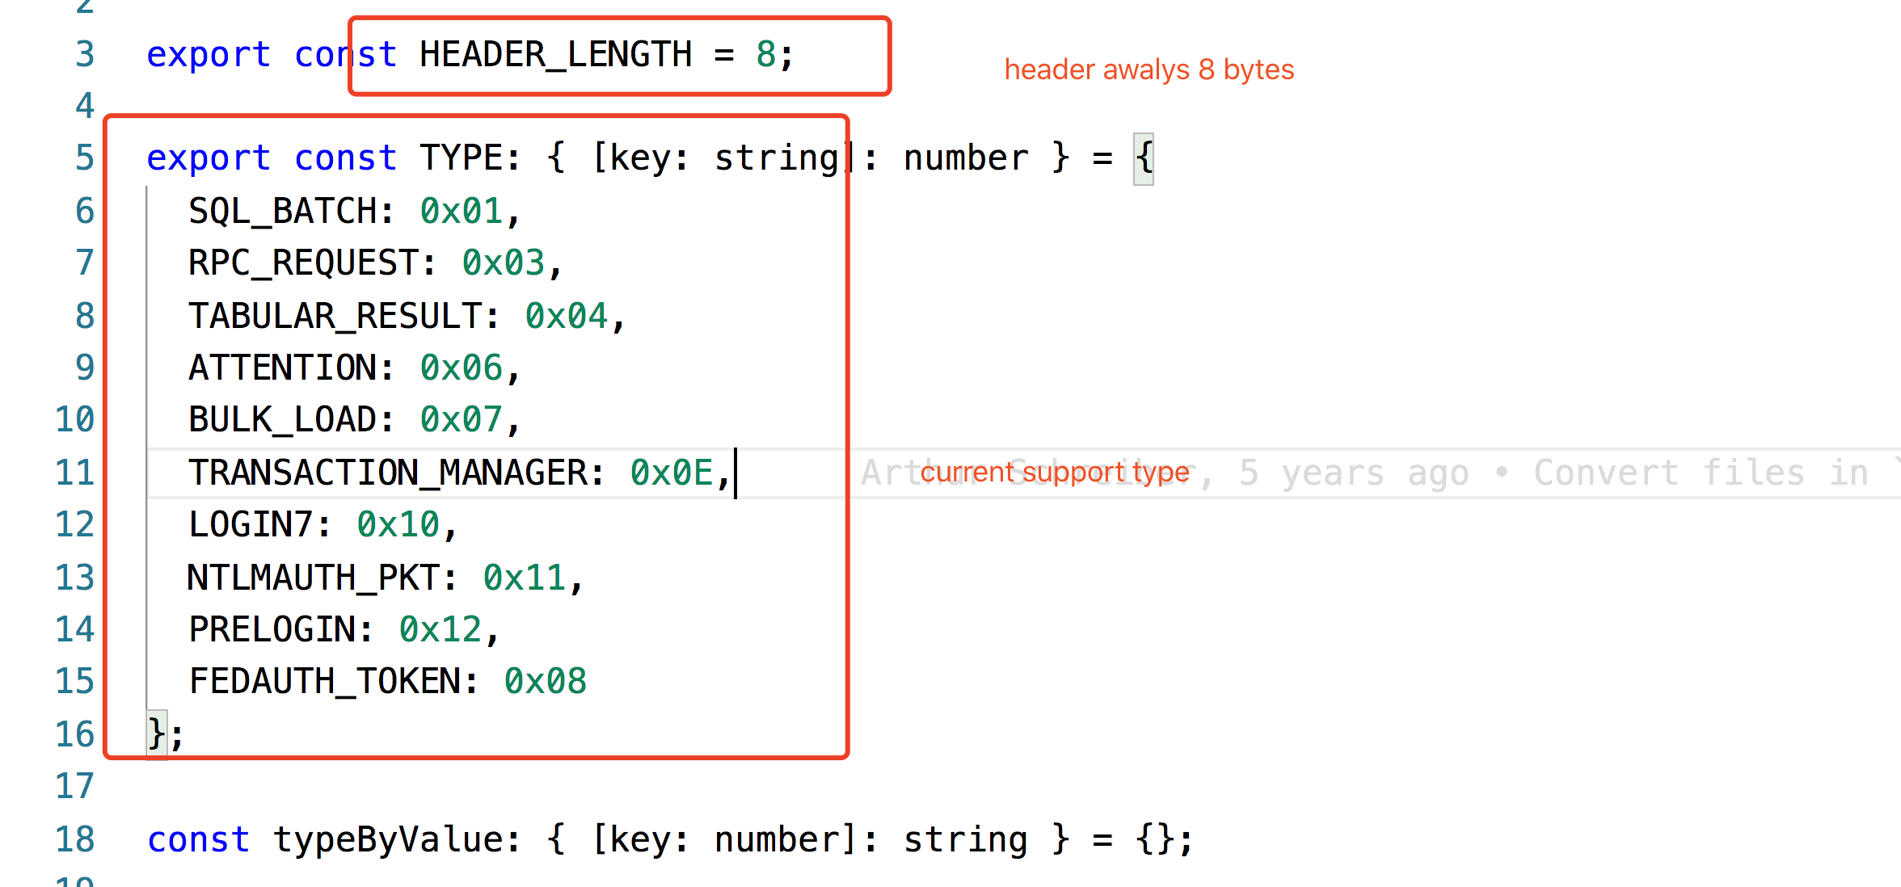
Nodejs implements-packet

Slide 13
Nodejs implements-pre-login

