Slide 1
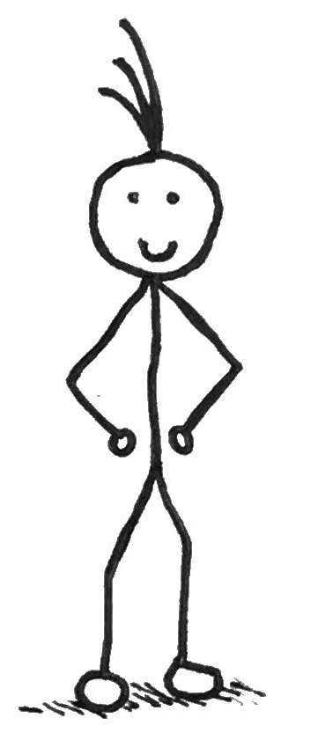
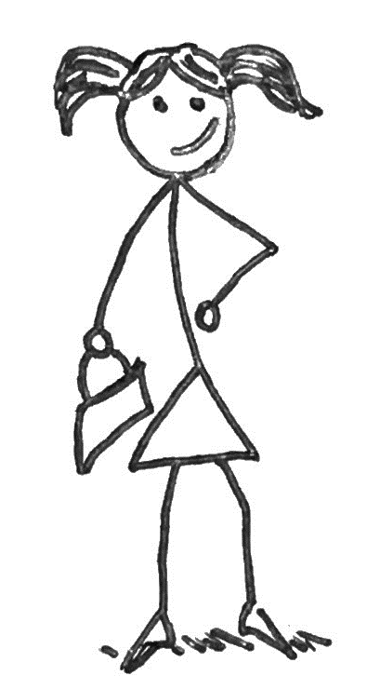
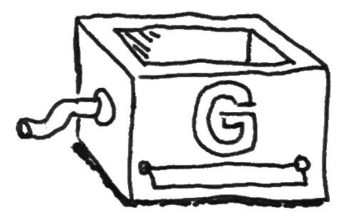
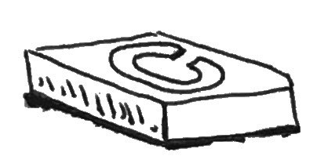
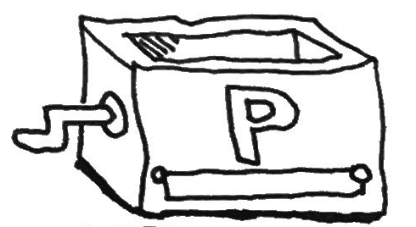
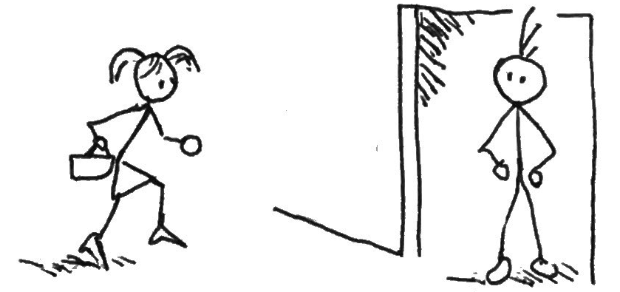
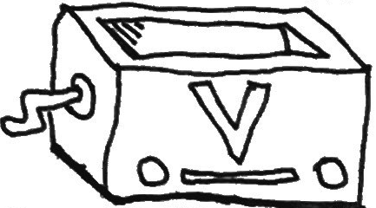

zk-SNARKs
Explainer for Developers
The Cast: Alice
The Cast: Bob
This is Alice.
Alice enjoys shopping at an exclusive fashion store. The store is so exclusive that customers must know a secret passphrase to get in.
Alice knows the secret phrase is "Hello World" (which we will call 'w'). Alice doesn't want to reveal the secret 'w', but is happy to publicly share the hash of this value, which we will call 'x'. So we can write: x = hash(w).
This is Bob.
Bob has been barred from the exclusive fashion store for reasons too shocking to document, but he still works there as a store guard.
He has to let people in who know the secret phrase, but can't know the phrase himself in case he tries to get into the store again. And we don’t want a repeat of last time.
Bob does know 'x'.
A zk-SNARK is a form of Zero-Knowledge Proof (ZKP), It allows someone with a secret to convince another person that they have the secret, without revleaing that secret*.
Here we will see a semi-technical example of using zk-SNARKs, treating all the difficult bits as black boxes.
The Scenario
The Setup
Alice would like to visit the store and Bob is on duty. In other scenarios Alice could simply say the passphrase, but here she cannot.
Let's do some setup. First we need to create a check program called 'C' that we can use to convince ourselves (and others) that a person knows the secret phrase 'w' if we are given the public value 'x'. In pseudo-code we can use:
p
Generator Algorithm
zk-SNARKs to the rescue! Instead of revealing the secret 'w', Alice will reveal a proof that she knows ‘w’.
p
public bool C(x, w) {
return (hash(w) == x);
}
p
Prover Algorithm
If the correct secret 'w' is given, then the above will return true. We also setup three algorithms which we will treat as black boxes.
We use the icon to identify public information, and to identify secret information.
p
Verifier Algorithm
p
Page 1/2
* Strictly speaking, the person with the secret convinces the other person that the secret conforms to some rule (the program C you see later).

Slide 2
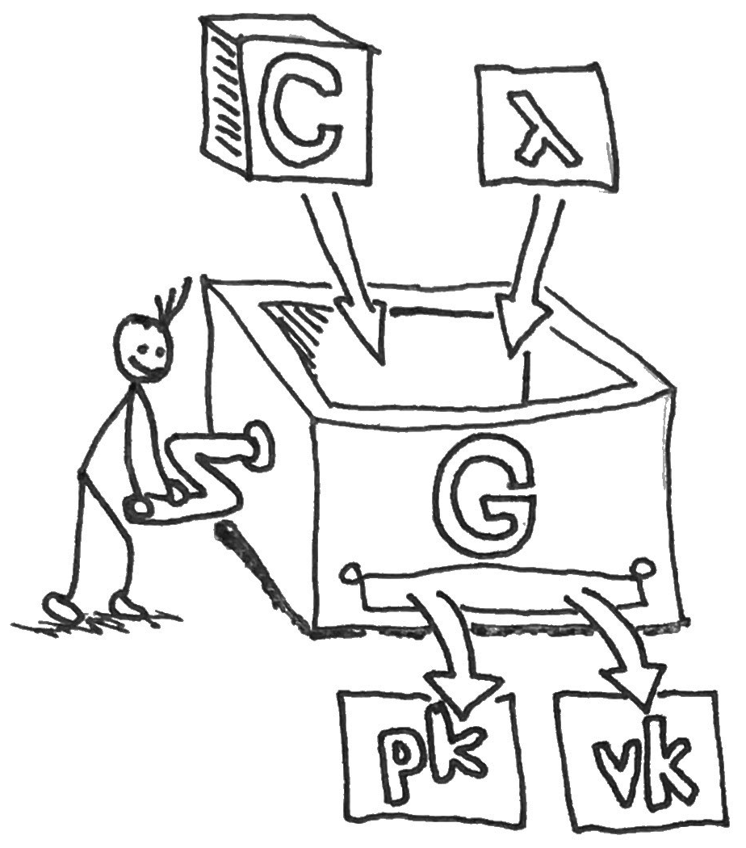
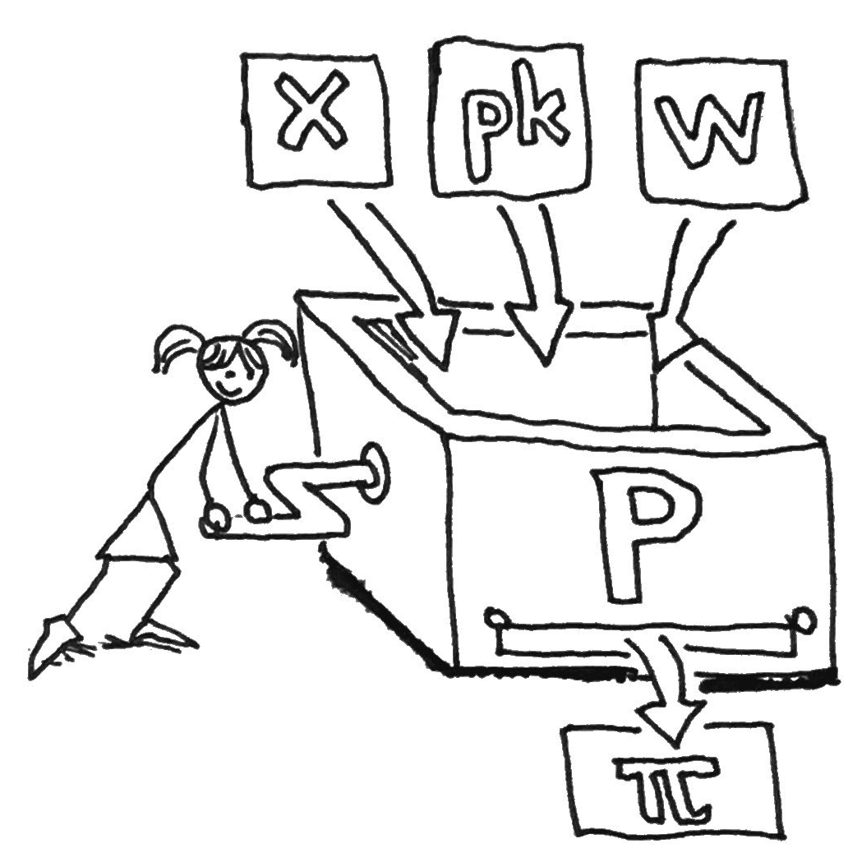
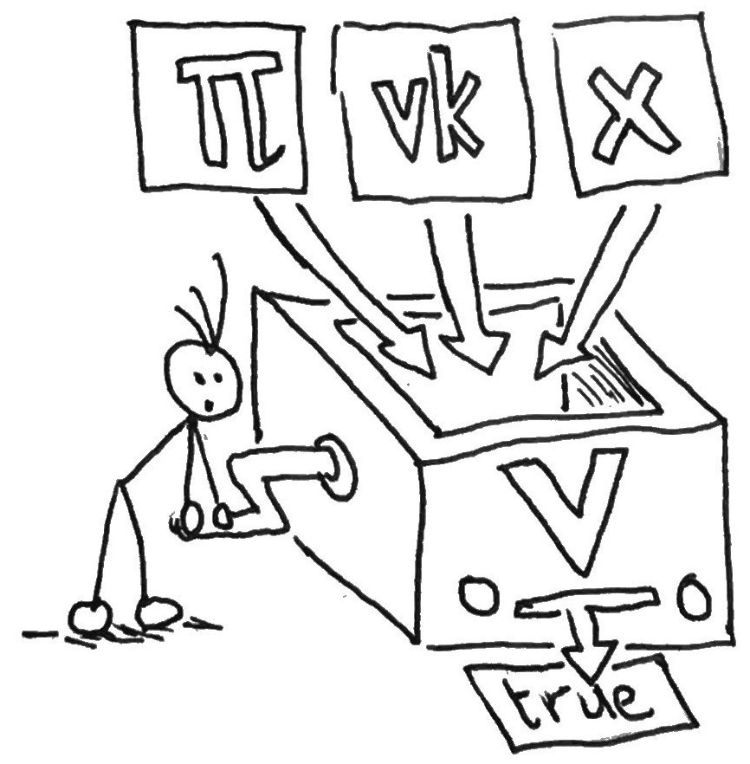
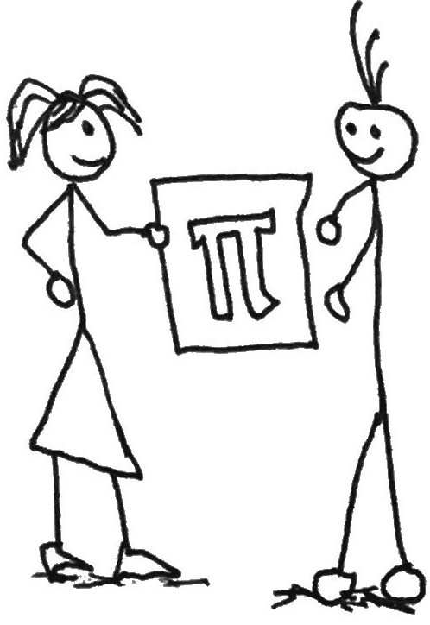
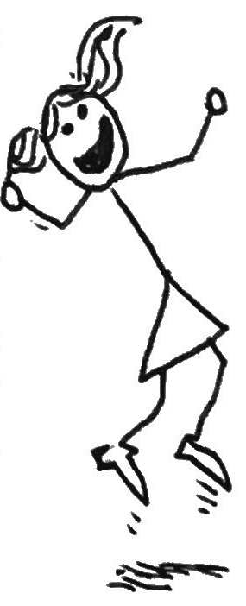

The Verifier
p
The Prover
Alice is the prover.
She passes 'pk', 'x’ (the hash of ‘w’) and her secret 'w' into the Prover algorithm, to produce a proof ‘Π’.
The proof ‘Π’ should not be public, Alice should reveal it only to Bob.
p
p
Bob is the verifier.
He passes the program ‘C’ and a value ‘λ’ lamba into the Generator algorithm, to produce a proving key (‘pk’) and verification key (‘vk’).
The value ‘λ’ lamba is a secret value known only to Bob**. The ‘pk’ and ‘vk’ are public.
p
p
The Verification
That’s a Wrap
Alice passes the proof to Bob.
Bob can now verify if Alice should be allowed to enter the store.
He passes the proof ‘Π’ he got from Alice, 'vk' and 'x' into the Verifier algorithm.
The verifier algorithm produces the value true meaning Alice can enter the store.
p
p
Store access granted!
Note that Bob cannot use the proof ‘Π’ to convince his fellow store guard Chloe that he knows the secret phrase.
This is because when Chloe acts as a verifier, she would generate her own ‘pk’, ‘vk’ pair using her own secret ‘λ’ lambda.
License: CC0-1.0 Source files: https://bit.ly/gitHuBk Inspiration: https://bit.ly/3z9aTeW
@kevnsmall
Page 2/2
** or others could create fake proofs that make it appear that they know secret 'w' when they don’t. Think of ‘λ’ lamba as ‘toxic waste’.

