Slide 1
Using Regular Expressions More, um, Regularly
A medium-deep dive for PowerShell Summit 2018 9-10:45 Tuesday 10/18
Copyright 2018 Mark Minasi
Presented by Mark Minasi
mark@minasi.com
www.minasi.com
Twitter mminasi
Notes:
Nondeterministic Finite Automaton NFA and DFA
Global Regex Print = grep

Slide 2
Welcome Welcome Welcome!
Housekeeping:
How many of you have seen me do a talk before?
How many of you have ever used a regex?
How many are total regex ninjas?
Thank you for attending. Really. I wanted to go to Mike's talk also. And Kirk's. And… Well, anyway, thanks in general
And thanks to Lisa at Brookstone
It is… unwise… in my opinion to ask people to sit for an hour and 45 minutes, so we're taking a ten minute break at 9:50. Feel free to remind me. :) Dunno if there will be coffee at the time, but at least we'll get a stretch.

Slide 3
Goals in this Talk
I assume that some will have only the barest knowledge of regexes
Understand what they are and why you'd use them
Basic patterns: literals and metacharacters
Engine internals: How regex thinks
If PowerShell is too greedy, we can instead make it lazy
Regex in PowerShell: controlling PoSH regex and meeting the "big" regex-y cmdlets
A quick tour of regex syntax: classes, groups, capture groups, quantifiers, lookarounds….

Slide 4

Why Regex? A few Examples and Reasons
"Does that new password meet our criteria?"
Find and update text, like web sites
"Is that a valid email address?"
Is supported everywhere. Yes, it's great for PowerShell, but it also runs on just about every platform around.
Find personally identifiable data in folders of text files
Old, well-understood tool
And I tell you, my friends, if I could search OneNote with regex, I might never have to leave the house again.

Slide 5
And No, It Can't Do Everything
It matches text patterns, it doesn't parse them
It's really weird looking… "line noise" often comes to mind
It's not as hard as it's made out to be, but it is not trivial
It's not a programming language – you can't write procedures/functions in it, alias oft-used patterns and the like
Hierarchical text like XML would be difficult to parse with it
Some patterns are difficult, like "is this a palindrome?" although "is this a palindrome?" is easy if you specify an exact length

Slide 6
The World's Simplest Regexes "Literals" and "Metacharacters"
The "regex pattern" to match be is just those two letters – "be"
be would first match
To be or not to be
Many consider Abe Lincoln to be the best President
The letters in "be" are called literals (rather than metacharacters)
Simplest metacharacter is . or "dot;" it matches any SINGLE character other than a line termination (although you can change that behavior)
be. would match bee, bet, abet, antebellum, bear, etc
be. would not match just "be"
BTW, to actually match "period," use \.
Example: to match will.i.am, use will\.i\.am

Slide 7
Reference: The Other Metacharacters
\ backslash, "escape"-ish
^ and $ are "anchors"
| acts like "or"
* means "repeat 0 or more times"
+ "repeat 1 or more times"
( and ) let you group chunks of your pattern
[] surround classes
{} specify how many matches to expect
We'll see more of them later

Slide 8
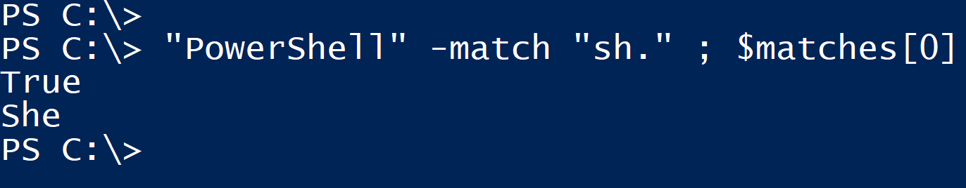
Basic Regex Pattern Testing: -Match
To try a regex in PoSH, -match
Doesn't show up everywhere, e.g. the Active Directory module
To see that "But Be or not to be" can match the pattern "be," type
"PowerShell" –match "sh"
Returns $True or $False
The matched text is stored in $matches[0]
-Match only returns one match, but we'll see better tools later
Note that PowerShell regex is by default case-insensitive, unlike most regexes

Slide 9
Powering Up "Dot" with + and *
In pattern b.e, . only matches one character (albeit any character), so it's a "wild card," sort of
So it'd match oboe or able, but not bone or be – there must be one and only one character of some kind where the "." is,
Suffix + to anything and it means "match this one or more times"
So .+ is like the familiar "*"
Suffix * to anything and it means "match this zero or more times"
Thus, b.+e matches "Bayer" but not "burn" and not "be"
(Why not "be?")
Similarly, b.*e does match "be" because "no characters" matches *

Slide 10
Understanding How Regex Works: regex's engine, under the hood

Slide 11
Meet the Regex Engine: Atoms and Direction "giddy-up, giddy-up, giddy-up four-oh-nine!"
Terminology: patterns are built of what I've been calling "chunks" but regex calls "atoms."
Literals are all atoms
The pattern be has two atoms – b and e
Metacharacters can have multiple-character atoms but not always
In the pattern b.e then as we've already seen, b and e are atoms. Here, the dot is also.
In a pattern like b.+e, the plus does not stand alone, as it modifies the dot. In this case, the dot and the plus stand as one atom.
Engine scans the target string left-to-right by default trying to match every atom of the pattern

Slide 12
How the Engine Matches
Start from the beginning of the pattern, in our case with literal "b"
We stop trying to match when we've used all of the regex pattern, so let's say that we've got a sort of "pattern cursor" that points to how far along in the pattern we've matched, pointing at the next chunk to try to match
Now look at the string to search in… imagine a "String cursor" pointing to the first character in the target string, moving that as a pattern matches more and more
If an attempted match can't complete, the engine
returns the pattern cursor to the beginning of the regex
Moves the string cursor back so that it points at the character after the previous try, which is sort of a third cursor
Here's a trivial example

Slide 13
Does pattern "be" find a match in "Abeam?"
pattern cursor
string cursor
abeam
be
Points to first atom to try to match
Points to next position in the string to try to match to

Slide 14
Does pattern "be" find a match in "Abeam?"
abeam
No match! Bump the green.
be
abeam
Match! Bump red & green.
be
abeam
Match! Bump red & green.
be
abeam
No more pattern… Success!
be

Slide 15
Regex Concept: The Left Shall Be First
Big concept: if there is more than one part of the input string that will match the pattern, regex always shows the leftmost match
If our string were "bebebe," which would it match? The leftmost "be"
Be aware, however, it doesn't always look like the leftmost match at first glance

Slide 16
A Second Example with a Little More Detail
In that example, we didn't see what happens when the engine only finds a partial match, which causes it to backtrack
I'll show that by blue underlining the third "cursor" that remembers where it should backtrack the pattern cursor (red) and the string cursor (green) to continue searching

Slide 17
Regex, is "be" in "imbibe?"
Imbibe
No match! Bump the green.
be
Imbibe
No match, bump green.
be
imbibe
Match! Bump red & green.
be
Now set the "where we started matching" cursor to the first "b" and again I'm underlining to show that.
imbibe
Match fails, bummer. But there's more string, so…
be

Slide 18
Time to backtract! So…
Reset red to leftmost position. Move green back to the position just after the start of the last partial match -- in this case, the l"I" right after "failed b."
Imbibe
No match, bump green.
be
imbibe
Match! Bump red & green.
be
imbibe
Match, no more pattern, done.
be

Slide 19
Now Add in a Power Tool
Ah, but that was simply a two-literal pattern
Now let's add a power tool and see what happens
Pattern: b.+e
Target string: "Beer House"
Remember:
Regex delivers the leftmost successful match found
. = any character but newline
+ = "quantifier" (more later) saying, "I'll match from 1 to a zillion of those dots -- as many as I can find"

Slide 20
Matching b.+e to Beer House
b.+e
Beer House
b matched "B"
Huh?
b.+e
Beer House
.+ matched "eer House"
b.+e
Beer House
No match for e, as .+ ate the rest of the target string

Slide 21
Now What? Backtrack.
Not surprisingly, this happens a lot in regex
So in this case, regex just starts walking the .+ back
The engine only lets .+ match "eer Hous" instead of "eer House"
Now
b matches "B"
.+ matches "eer Hous"
So now the e in the pattern can match "e" in the string and so we finally have a successful match to all of b.+e, "Beer House"
It is the first match, so it's the one returned
So the match was "Beer House," rather than "Be"
Regex calls the behavior of .+ in this case "greedy"

Slide 22
Dude. I Totally Don't Want That.
Change the behavior to make it "lazy" instead of "greedy"
In that case, the engine grabs just the first available match-able character instead of all of them
If that provides a match, great; if not, the engine takes the first two available to see if that creates a match, and so on.
Results:
B matches b, as before
Now .+ matches the first e in "Beer" rather than the whole string
And now the final e in the pattern can match the second e in "Beer"
Again regex succeeds, but this time it matched "Bee"

Slide 23
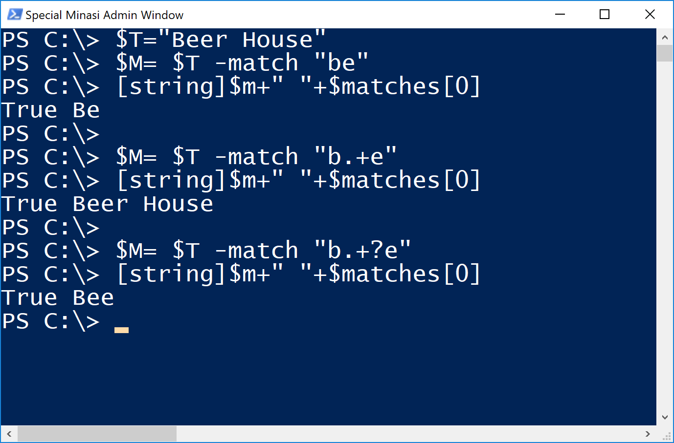
Leftmost, Greedy and Lazy Examples

Slide 24
PowerShell Regex Tools

Slide 25
The PowerShell Tools: String Operators
The –match, -replace and –split operators take regex
Of them, only -match populates $matches
Try "This is a sentence" –split "e. " for example
There is also –cmatch (it's case-insensitive by default), -notmatch, creplace etc and the usually unnecessary –imatch, which forces case insensitivity

Slide 26
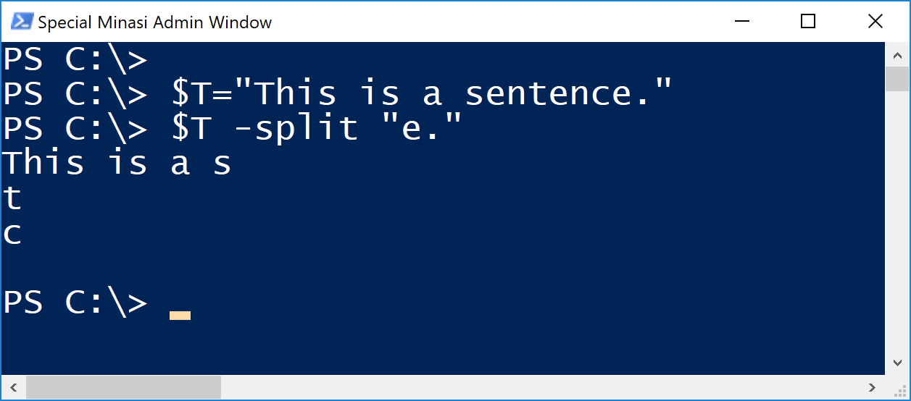
-Split and Regex Example

Slide 27

Case Matching Example

Slide 28
Back to the Source
Directly accessing .NET regex via the .NET classes
More matches
More control of timeouts
Another way to get sensitive

Slide 29
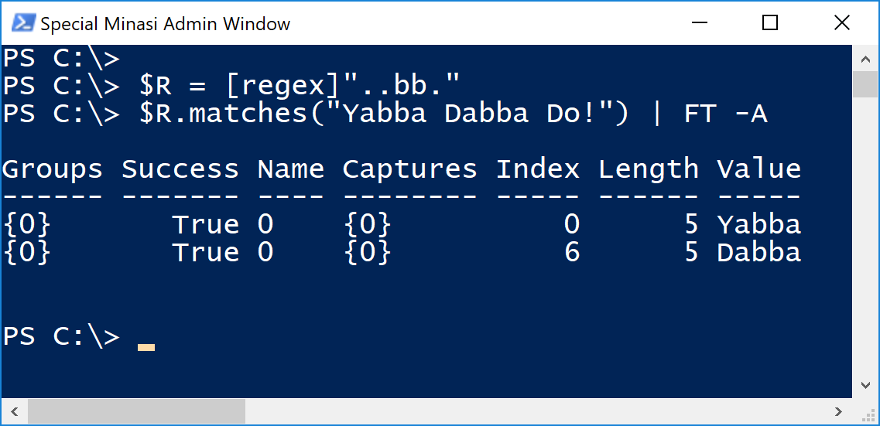
.NET Coverage: [regex] Class
PoSH's Regex is the .NET implementation
Basic layout: $VARIABLE = [regex]'pattern'
$VARIABLE.matches("Target") | FT- A

Slide 30
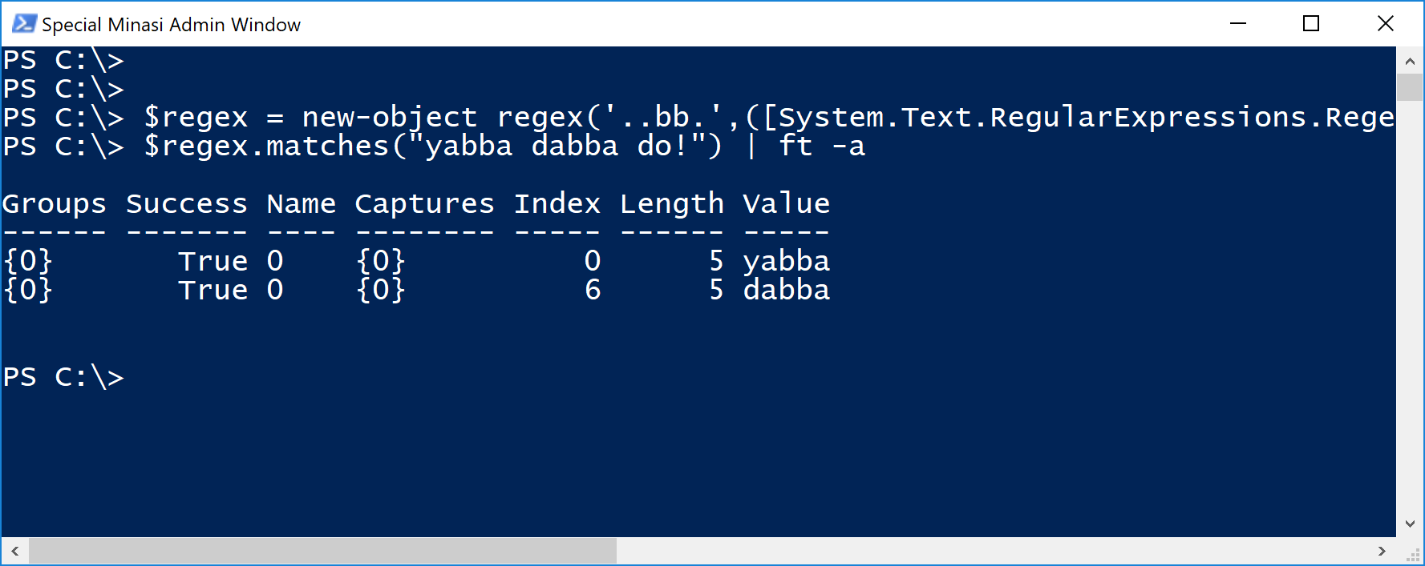
Maximum Control with New-Object
Invoking the engine with the [regex] cast is nice
But new-object extends that, although it's uglier:
$regex = new-object regex('..bb.', ([System.Text.RegularExpressions. RegexOptions]::MultiLine,[System.Text.RegularExpressions.RegexOptions]::IgnoreCase))

Slide 31
Sample Run in New-Object

Slide 32
Sidebar: Very Small Timespans
I'm going to talk next about forcing regex to time out after some period of time in a very complex or inefficiently-built regex
That requires timespans
They're normally easy, like "$span = new-timespan –seconds 1
But for anything smaller, you need a trick.
$tspan=[timespan]1 will create the smallest timespan I know -- 0.0001 ms
(And go ahead and ask, but I don't know. :) )
We won't need that, but a 1 ms timeout would be interesting because we can actually see the error. Build it like:
$tspan = [timespan]10000 will build a 1 ms timespan

Slide 33

Handling Timeouts: In Case You Meet …
It's easy to accidentally create regexes that go on forever or take minutes to run
In .NET 4.5 and later, you can create a regex object with a timeout
Again, first you'll need a timespan.NET needs the timeout built as a TimeSpan; example:
$tspan = [timespan]10000
$myreg = New-Object -TypeName regex -ArgumentList 'A.', ([System.Text.RegularExpressions.RegexOptions]::MultiLine,[System.Text.RegularExpressions.RegexOptions]::IgnoreCase),$maxtime
$matchups = $myreg.matches("Aces axis asking")

Slide 34
Getting Insensitive: Options and Mode Mods
Two more ways to regain case insensitivity is via .NET regex options or regex "mode modifiers"
$regex = new-object regex('hel.', ([System.Text.RegularExpressions. RegexOptions]::MultiLine,[System.Text.RegularExpressions.RegexOptions]::IgnoreCase))
Or prefix your pattern with "(?i)," a "mode modifier:"
$myreg = [regex]'hel.'
Becomes
$myreg = [regex]'(?i)hel.'
There are a handful of other mode modifiers, more later

Slide 35
The Star of the Show: Select-String
If you've been wondering, "Does PowerShell have a GREP?," it does
Select-String
Alias is "SLS"
Can do regex matches against multiple files (-path, -literalpath)
Alternatively, it'll consume strings from the pipeline
Can easily be told to be case sensitive, although it's not by default
By default, SLS reports every line in every file with a match, but once it finds a match on a line, it doesn't keep searching that line
If, however, you add –AllMatches, it still returns only one object on every line where it finds a match, but those objects each have a .matches member that contains multiple matches

Slide 36
Useful Parms
Main parms:
-Pattern regex which is also positional parm 1
-Path pathvalue points to the folder where you want it to scan a bunch of files. Also positional parameter number 2
-CaseSensitive
-AllMatches
-LiteralPath (like path but doesn't allow wild cards)
-Context integer stores a number of lines around each match, storing that in a .context member for the output. Default is not to do this, and so don't expect a .context member if you didn't do -context

Slide 37
Examples
("I just love love love SLS","You'll love it too" | sls "love" ) | ft –a
Add –AllMatches and then look at the .matches member
Add –Context 1 and look at .context
An example with files in a folder:
(SLS "saw" "c:\files\test*.txt –all)
(SLS "saw" "c:\files\test*.txt –all).matches
(SLS "saw" "c:\files\test*.txt –all –con 1).context

Slide 38
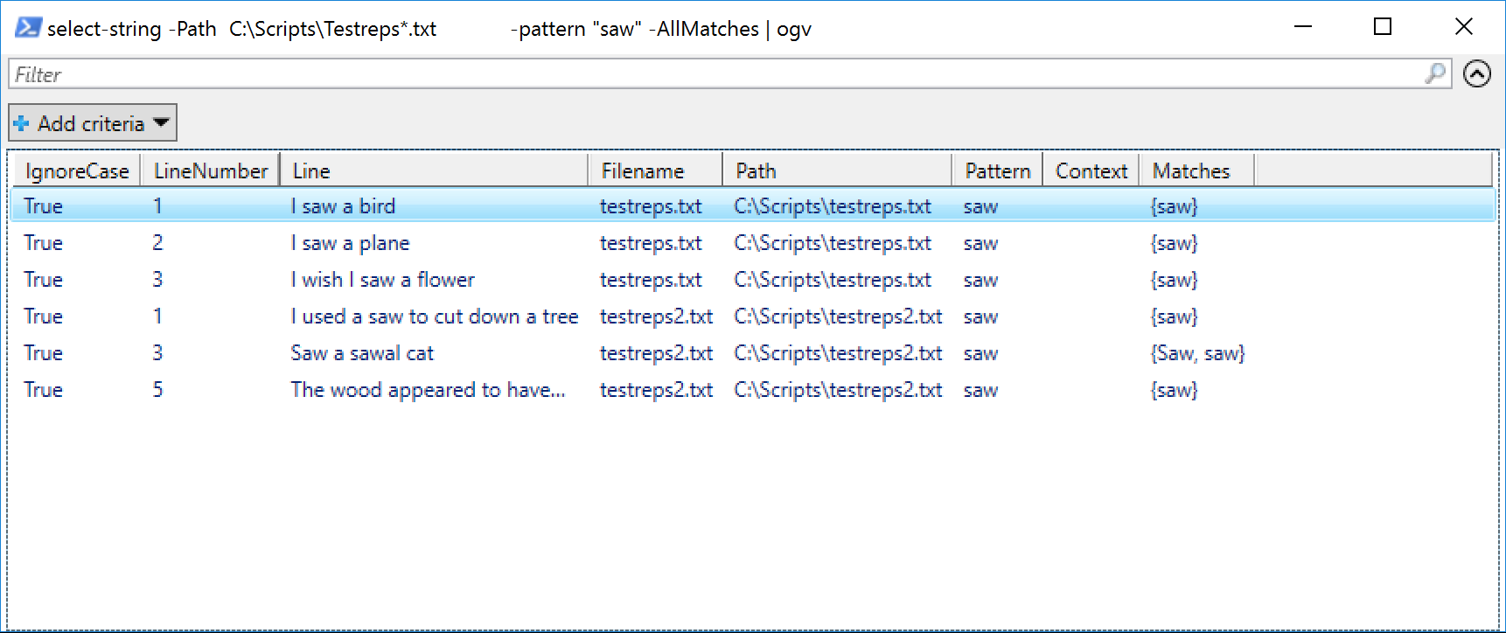
Files-in-Folder Example

Slide 39
Dot-Weakness: Multi/Single Line
The dot (.) matches everything but the line feed
(Ancient historical reason – don't ask)
You can turn on a mode to change that so all of the newline characters match a dot
"Single line mode" means "dot matches everything" and it's the .NET "RegexOptions.Singleline" option and the (?s) mode modifier
You'll want this when parsing things like an entire web page read into a variable
Select-String is great in that it's basically built to avoid the issue

Slide 40
Use Online Testers and Libraries
Is this sounding scary?
Save yourself time with some nice online testers
Regexr.com
Regex101.com
http://regexhero.net/tester/ is great because it's built atop .NET regex, but requires Silverlight, which a certain big company is killing for some reason
There are also no end of sites with solutions to "how do I write a regex that matches…" questions
One example: http://www.regexlib.com

Slide 41
Well, The Only Thing Left Is…
Regular Expression Syntax!

Slide 42
Character Classes

Slide 43
Character Classes for a Range of Values
Literals are easy matches – 1 matches just an actual "1"
But if we want to match any digit, we could create a "custom character class" with
a range, like [0-9] or [b-k]
a set, like [aeiou]
a combination, like [b-cfbn]
Note the square brackets around a custom class
No escape needed to have "-" in a range, just make it unambiguous
Examples:
"is th5ere a digit" –match "[0-9]"
"is th5ere a digit" –match "[a-f567h-j]"

Slide 44
Regex Includes Some Predefined Classes
[0-9] or [0123456789] works for digits, but there is a predefined class, "\d" that does that job
And \D, which means "everything but digits"
\w is "all 'word' characters," a-z, A-Z, 0-9, _ in ANSI ;\W is, again, everything but that
\s is "white space," which means tab, line feed, vertical tab, form feed, carriage return, space (ASCII 9-13, 20) but not "start of line"
\S is anything that isn't white space

Slide 45
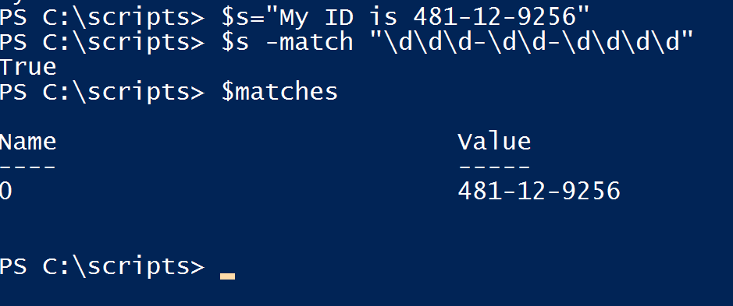
Mandatory Regex Example
We must search for any US social security numbers (or things that look like them) in a document or perhaps a folder full of files

Slide 46
Quantifiers: Beyond + and *
Writing \d\d\d was irritating, so \d{3} works also, requiring exactly three digits
x{2,7} matches from two to seven consecutive x's
x{5,} requires five or more consecutive x's
Again, they must be consecutive; x{2} would not match Xerox
Example: do any English words start with "X" that at some point are followed by two consecutive vowels?

Slide 47
The "Optional" Quantifier, ?
Suppose we wanted to match either "color" or "colour"
Could * help, as in colou*r ?
Yes, but it'd also match colouuuuuuuuur
So we have "?," the "optional" quantifier
"Groups" and "Alternation" could solve this also, we'll get to them later
? Means "0 or 1," as in colou?r
You can use parens to make groups of more than one letter optional
So this very simple example works: colo(u)?r

Slide 48
A "Negation" Character Class
What if we don't want something?
Again, there are the predefined "anything but" classes like \D, \W
Alternatively, to negate a custom character class, put ^ as its first token
[^0-9] is the same as \D
To match [^e], all a string must do is to have one or more characters in it that are not "e"

Slide 49
Or to Tweak a Class: Class Subtraction
Suppose we wanted to match a letter:
[a-zA-Z]
But didn't want r or w
Use this:
[a-z-[rw]]
PS C:\> "Row" -match "[a-z-[rw]]"
True
PS C:\> "wwr" -match "[a-z-[rw]]"
False
You can also subtract inside subtracted classes, etc.
If subtracting from a negated group, the negation happens first, then the subtraction

Slide 50
Quantifier Examples: Finding Weird Words
Example: find a word with five consecutive vowels, given a file crwords.txt with all English words:
select-string -Pattern "[aeiou]{5}" -Path .\words.txt
The character class is clearly vowels; the {5} says, "and exactly five of them." Six consonants would be
select-string -Pattern "[a-z-[aeiouy]]{6}" -Path .\words.txt

Slide 51
Regex Groups
Clarifying, Quantifying, Alternation, Capture

Slide 52
Groups
"Groups" has a special meaning in Regex
You "group" part of your regexes with parentheses
Groups have several functions
Sometimes they just clarify a regex visually
Like character classes, they take quantifiers
(a)(a)(a) is identical to (a){3}
They allow you to mark some of the matched pattern to "capture" for re-use later (for example, to find duplicate words or letters)
They define an "alternation," covered next

Slide 53
Alternation
[af] is a convenient way to say, "I'll accept a or f to match," but how to say, "match either 'black' or 'white?'"
With alternation, the pipeline symbol "|" as in
(black | white)
Note:
[af] and (af) are essentially identical, but you can't put ranges inside groups, just classes – "(a-z)" is a literal pattern a, -, z
Either way, groups and custom classes create a "fork in the road" for the regex engine
This offers us another answer to the color/colour problem:
(colour|color)
Be careful of the order of the options, though…

Slide 54
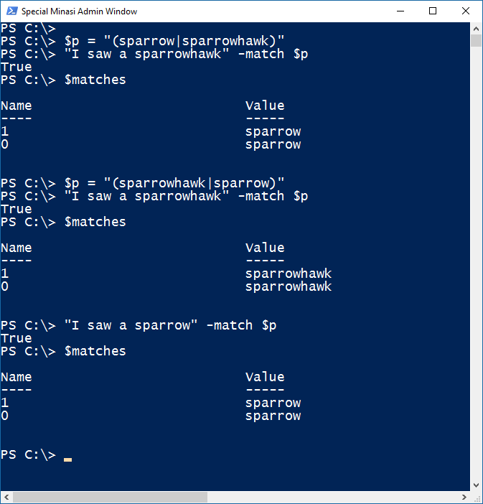
"More Specific to the Left" Example
Also, even if your options don't step on each other, you can make the regex faster by putting the most-likely options to the left

Slide 55
How Might We Create a "Word" Pattern?
Recall that \w is a character class that includes only characters that would appear in a word – no digits etc.
Words are composed of at least one thing from the \w character class
Thus, \w+ could do it

Slide 56
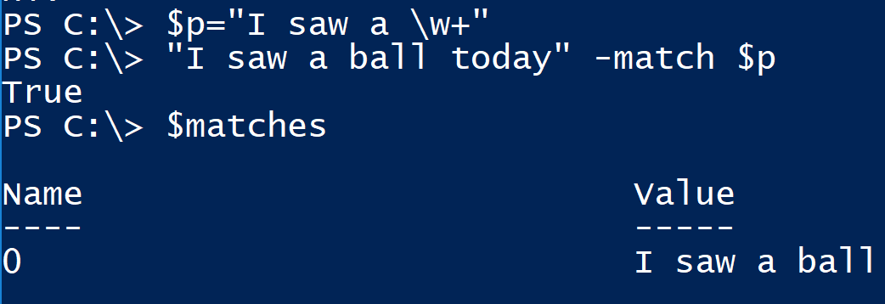
Capture Groups
Parentheses can also surround a subset of a group that you want not just to match but pull out into regex variables
They also show up in $matches or the Select-String variables
Here, we just match "I saw a [whatever]," no capture:

Slide 57
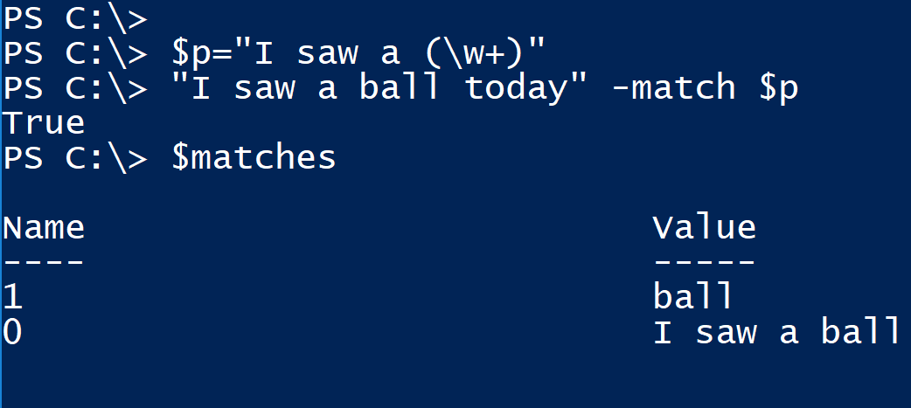
Now Refine It with a Capture
Now just put parentheses around the word, and it captures it into $matches[1]

Slide 58
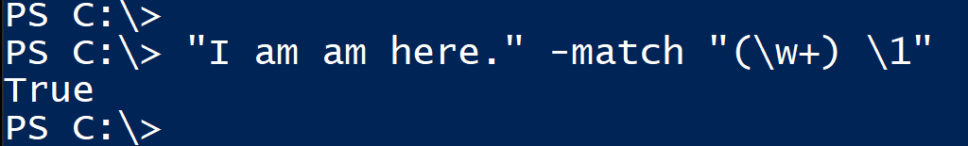
Naming Captured Groups
The first captured group is sometimes referred to as $1 or \1
The second is $2 or \2 and so on
Note that $1 and $2 are not PowerShell variables; regex has used those names for decades but PoSH gets confused, so surround them with single quotes, like '$1'
Let's see how to actually use this
The classic example is "find any doubled words, like this:

Slide 59
Example of Captured Text
Are there any words with the same letter three times in a row?
This tells us:
sls -path .\words.txt -Pattern "(\w)\1\1"

Slide 60
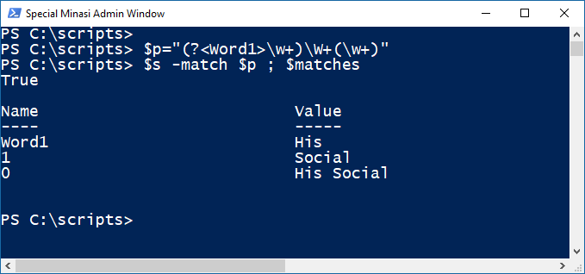
Named Capture Groups
If you want a name besides $1 or the like, you can specify any name by starting the capture with ?<name>
"(?<Word1>\w+)\W+(\w+)" has a named and then unnamed capture

Slide 61
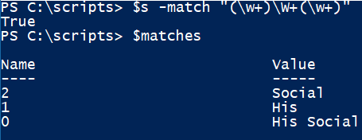
More on Captures
In that example, there was only one capture group, so only $1 appeared
If there were more captures, they'd be $2 etc; they're \1, \2 etc
To see some examples, look at my "Harvesting the Web" PPT from last Summit
Another simple example captures the first two words in a string:
(\w+)\W+(\w+)
Two capture groups

Slide 62
Anchors

Slide 63
Anchors Refine a Pattern
When part of the pattern is "... But only at the end of the line" or something like that, an anchor helps
^ matches "start of line, so ^hawk doesn't match "He was a deficit hawk" but would match "Hawkman is a pretty lame DC character"
(Yes, ^ means "set negation" also, but only in [ … ] constructs)
End of line anchor is $
\b = "must begin on a word boundary"
\B = "must not begin on a word boundary"
\A = like ^ but only the beginning of the first line
\Z = like $ but only at the end of the last line
\z = like \Z but ignores carriage returns \r
\G = must start immediately after the last match ended

Slide 64
Anchor Example
Suppose I take my words.txt file and wonder if there's a word starting with w and has two r's in it
So I fire up Select-String and give it the pattern w.*r.*r.*
Ooops… "Answerer" comes up
So the better pattern is ^w.*r.*r.*
Notes:
And isn't it odd that no English word has two x's in it

Slide 65
Multiline Mode
Suppose you feed regex a string with newline characters
Normally ^ means, "beginning of input string" and $ refers to the end of the input string
If you enable multiline mode, ^ also matches the beginning of each line, and $ also matches the newline characters
Turn it on as a regex option in a .NET new-object
Or use the "m" mode modifier in your pattern… prefix the pattern with "(?m)"

Slide 66
Lookarounds

Slide 67
Lookarounds
Allows you to say
Match x, but only if y doesn't follow it (negative lookahead)
written as x(?!y)
Match x, but only if a y follows it – and don't make y part of the match (positive lookahead)
written as x(?=y)
Match x, but only if y doesn't precede it (negative lookbehind)
written as (?<!y)x
Match x, but only if y precedes it and, again, don't make y part of the match (positive lookbehind)
written as (?<=y)x

Slide 68
Notes: Negative lookahead
Negative lookahead means "match such-and-such, but not if it's followed by some other pattern"
Like "q" without "u"
Do that with (?!<pattern you don't want>)
Like "q(?!u)" which matches Iraqi
Example: find all words with three consecutive vowels:
[aeiou]{5}
But we want no doubled vowels

Slide 69
Building it
We want just three vowels, so it'll be ( … something … ) {3}
We want vowels, so our class is [aeiou]
But no dups, so it'd start like
([aeiou])(?!\1)
And then do it twice more with a \2 group and a \3 group:
([aeiou])(?!\1)([aeiou])(?!\2)([aeiou])(?!\3)

Slide 70
Notes: Positive Lookahead
Like negative, but with ? replaced with =
This tests a line to see if it has between two and six characters:
'^(?=.{2,6}$)' as in "hello there" -match '^(?=.{2,6}$)'
But notice that it doesn't move the "cursor," so you can still check other things about the line, as in
"hello" -match '^(?=.{2,6}$)h' returns True
"hello" -match '^(?=.{2,6}$)x' returns False

Slide 71
Notes: Catch Two Identical Characters
Need first to understand capture groups
(.)\1 is a pattern describing two repeated characters, as (.) captures any character into \1 or, restated (character)(same character)
To catch three identicals, (.)\1\1\1 as in
sls -path .\words.txt -Pattern '(.)\1\1'
Or find
Notes:
if ("boom" -match '(.)\1') {"True; found two of "+ $matches[1]} else {"False"}
"
then \1 demands that the second character equal \1
\S
$p="\S*(.)\1\S*"
"Hanna" -match $p; $matches
How it works:
\S* means "don't care, ignore"
(.) = "match anything and store to \1"
\1 = contents of \1 so (.)\1 only matches when the . = \1, two consecutives
$p="\S*(.)\1\S*"
"Dooomsday bee" –match "\S*(.)\1\S*"; $matches
Test approach:
"Deeemsday bee" –match "\S*(.)\1\1\S*"; $matches; remove-variable matches -ErrorAction SilentlyContinue

Slide 72
Notes: Catching Repeated Characters
This example matches passphrases that are 8-20 letters and do not have an three-in-a-row matches:
^(?=.{8,20}$)(([a-z0-9])\2?(?!\2))+$
This just catches three in a row:
$p="^(([a-z0-9])\2?(?!\2))+$"

Slide 73
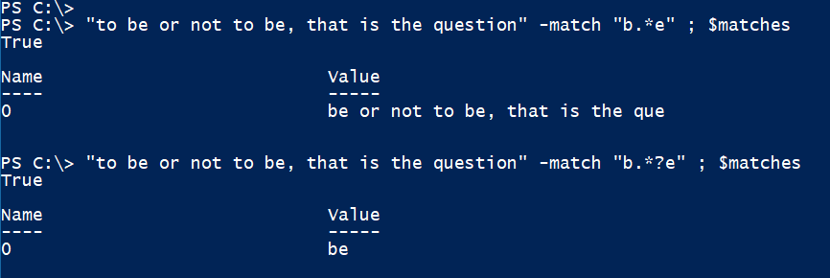

Slide 74

Mode Modifiers
Change options like multiline in mid-pattern, even enable and disable them within the pattern
Look like
"(?modifier)pattern)" or negate the modifier with "(?-modifier)pattern)"
For example, "i" makes the regex case-insensitive, so make PowerShell regex case-sensitive with ?-i a like this:
Notes:
$myreg = [regex]'hel.'
Becomes
$myreg = [regex]'(?i)hel.'

Slide 75
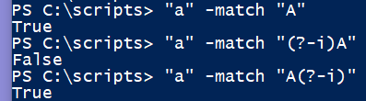
Mode Modifier Values in .NET
i = case sensitivity
m = multiline mode
s = singleline mode
n = do not capture unnamed groups
x = Ignore spaces in the pattern unless they are escaped and allow comments after #
Assemble these as
(?imsnx-imsnx) so if you wanted multiline but case sensitivity then you'd prefix your pattern with (?m-i); for example:

Slide 76
Thank You Very Much!
I hope I inspired you to learn enough about regexes to put them to work for you
Remember:
It's okay to cheat. There are lots of great examples on the web
Use an online regex tester
Select-String is the power tool for attacking folders full of files
Regex only LOOKS weird… it is useful
Thank you for attending, please don't forget to do an evaluation
I'm at mark@minasi.com and @mminasi

