Slide 1
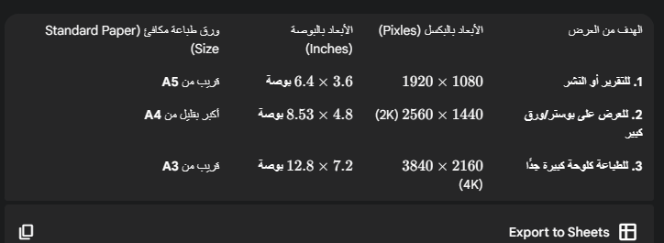

Slide 2

#FFFFFF | #F5F7FA | #1A202C | #121212 | #333333 | #6B7280 | #007AFF | #34C759
#FF9500 | #FF3B30 | #E5E7EB | #F9F9F9

Slide 3
