Slide 1
Chapter 3. Gate-Level Minimization

Slide 2
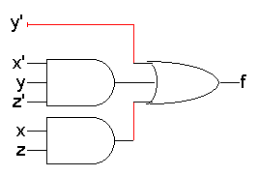
Review: Standard forms of expressions
We can write expressions in many ways, but some ways are more useful than others
A sum of products (SOP) expression contains:
Only OR (sum) operations at the “outermost” level
Each term that is summed must be a product of literals
The advantage is that any sum of products expression can be implemented using a two-level circuit
literals and their complements at the “0th” level
AND gates at the first level
a single OR gate at the second level
This diagram uses some shorthands…
NOT gates are implicit
literals are reused
A product of sums expressing → duality
f(x,y,z) = y’ + x’yz’ + xz

Slide 3
Terminology: Minterms
A minterm is a special product of literals, in which each input variable appears exactly once.
A function with n variables has 2^{n} minterms (since each variable can appear complemented or not)
A three-variable function, such as f(x,y,z), has 2³ = 8 minterms:
Each minterm is true for exactly one combination of inputs:
x’y’z’ x’y’z x’yz’ x’yz
xy’z’ xy’z xyz’ xyz
Minterm Is true when… Shorthand
x’y’z’ x=0, y=0, z=0 m₀
x’y’z x=0, y=0, z=1 m₁
x’yz’ x=0, y=1, z=0 m₂
x’yz x=0, y=1, z=1 m₃
xy’z’ x=1, y=0, z=0 m₄
xy’z x=1, y=0, z=1 m₅
xyz’ x=1, y=1, z=0 m₆
xyz x=1, y=1, z=1 m₇

Slide 4
Terminology: Sum of Minterms Form
Every function can be written as a sum of minterms, which is a special kind of sum of products form
The sum of minterms form for any function is unique
If you have a truth table for a function, you can write a sum of minterms expression just by picking out the rows of the table where the function output is 1.
f = x’y’z’ + x’y’z + x’yz’ + x’yz + xyz’
= m₀ + m₁ + m₂ + m₃ + m₆
= Σ(0,1,2,3,6)
f’ = xy’z’ + xy’z + xyz
= m₄ + m₅ + m₇
= Σ(4,5,7)
f’ contains all the minterms not in f

Slide 5
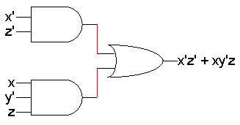
Karnaugh maps
Last time we saw applications of Boolean logic to circuit design.
The basic Boolean operations are AND, OR and NOT.
These operations can be combined to form complex expressions, which can also be directly translated into a hardware circuit.
Boolean algebra helps us simplify expressions and circuits.
Today we’ll look at a graphical technique for simplifying an expression into a minimal sum of products (MSP) form:
There are a minimal number of product terms in the expression.
Each term has a minimal number of literals.
Circuit-wise, this leads to a minimal two-level implementation.

Slide 6
Re-arranging the truth table
A two-variable function has four possible minterms. We can re-arrange these minterms into a Karnaugh map.
Now we can easily see which minterms contain common literals.
Minterms on the left and right sides contain y’ and y respectively.
Minterms in the top and bottom rows contain x’ and x respectively.

Slide 7
Karnaugh map simplifications
Imagine a two-variable sum of minterms:
x’y’ + x’y
Both of these minterms appear in the top row of a Karnaugh map, which means that they both contain the literal x’.
What happens if you simplify this expression using Boolean algebra?
x’y’ + x’y = x’(y’ + y) [ Distributive ]
= x’ • 1 [ y + y’ = 1 ]
= x’ [ x • 1 = x ]

Slide 8
More two-variable examples
Another example expression is x’y + xy.
Both minterms appear in the right side, where y is uncomplemented.
Thus, we can reduce x’y + xy to just y.
How about x’y’ + x’y + xy?
We have x’y’ + x’y in the top row, corresponding to x’.
There’s also x’y + xy in the right side, corresponding to y.
This whole expression can be reduced to x’ + y.

Slide 9
A three-variable Karnaugh map
For a three-variable expression with inputs x, y, z, the arrangement of minterms is more tricky:
Another way to label the K-map (use whichever you like):

Slide 10
Why the funny ordering?
With this ordering, any group of 2, 4 or 8 adjacent squares on the map contains common literals that can be factored out.
“Adjacency” includes wrapping around the left and right sides:
We’ll use this property of adjacent squares to do our simplifications.
x’y’z + x’yz
= x’z(y’ + y)
= x’z • 1
= x’z
x’y’z’ + xy’z’ + x’yz’ + xyz’
= z’(x’y’ + xy’ + x’y + xy)
= z’(y’(x’ + x) + y(x’ + x))
= z’(y’+y)
= z’

Slide 11
Example K-map simplification
Let’s consider simplifying f(x,y,z) = xy + y’z + xz.
First, you should convert the expression into a sum of minterms form, if it’s not already.
The easiest way to do this is to make a truth table for the function, and then read off the minterms.
You can either write out the literals or use the minterm shorthand.
Here is the truth table and sum of minterms for our example:
f(x,y,z) = x’y’z + xy’z + xyz’ + xyz
= m₁ + m₅ + m₆ + m₇

Slide 12
Unsimplifying expressions
You can also convert the expression to a sum of minterms with Boolean algebra.
Apply the distributive law in reverse to add in missing variables.
Very few people actually do this, but it’s occasionally useful.
In both cases, we’re actually “unsimplifying” our example expression.
The resulting expression is larger than the original one!
But having all the individual minterms makes it easy to combine them together with the K-map.
xy + y’z + xz = (xy • 1) + (y’z • 1) + (xz • 1)
= (xy • (z’ + z)) + (y’z • (x’ + x)) + (xz • (y’ + y))
= (xyz’ + xyz) + (x’y’z + xy’z) + (xy’z + xyz)
= xyz’ + xyz + x’y’z + xy’z

Slide 13
Making the example K-map
Next up is drawing and filling in the K-map.
Put 1s in the map for each minterm, and 0s in the other squares.
You can use either the minterm products or the shorthand to show you where the 1s and 0s belong.
In our example, we can write f(x,y,z) in two equivalent ways.
In either case, the resulting K-map is shown below.
f(x,y,z) = x’y’z + xy’z + xyz’ + xyz
f(x,y,z) = m₁ + m₅ + m₆ + m₇

Slide 14
K-maps from truth tables
You can also fill in the K-map directly from a truth table.
The output in row i of the table goes into square m_{i} of the K-map.
Remember that the rightmost columns of the K-map are “switched.”

Slide 15
Grouping the minterms together
The most difficult step is grouping together all the 1s in the K-map.
Make rectangles around groups of one, two, four or eight 1s.
All of the 1s in the map should be included in at least one rectangle.
Do not include any of the 0s.
Each group corresponds to one product term. For the simplest result:
Make as few rectangles as possible, to minimize the number of products in the final expression.
Make each rectangle as large as possible, to minimize the number of literals in each term.
It’s all right for rectangles to overlap, if that makes them larger.

Slide 16
Reading the MSP from the K-map
Finally, you can find the MSP.
Each rectangle corresponds to one product term.
The product is determined by finding the common literals in that rectangle.
For our example, we find that xy + y’z + xz = y’z + xy. (This is one of the additional algebraic laws from last time.)

Slide 17
Practice K-map 1
Simplify the sum of minterms m₁ + m₃ + m₅ + m₆.

Slide 18
Solutions for practice K-map 1
Here is the filled in K-map, with all groups shown.
The magenta and green groups overlap, which makes each of them as large as possible.
Minterm m₆ is in a group all by its lonesome.
The final MSP here is x’z + y’z + xyz’.

Slide 19
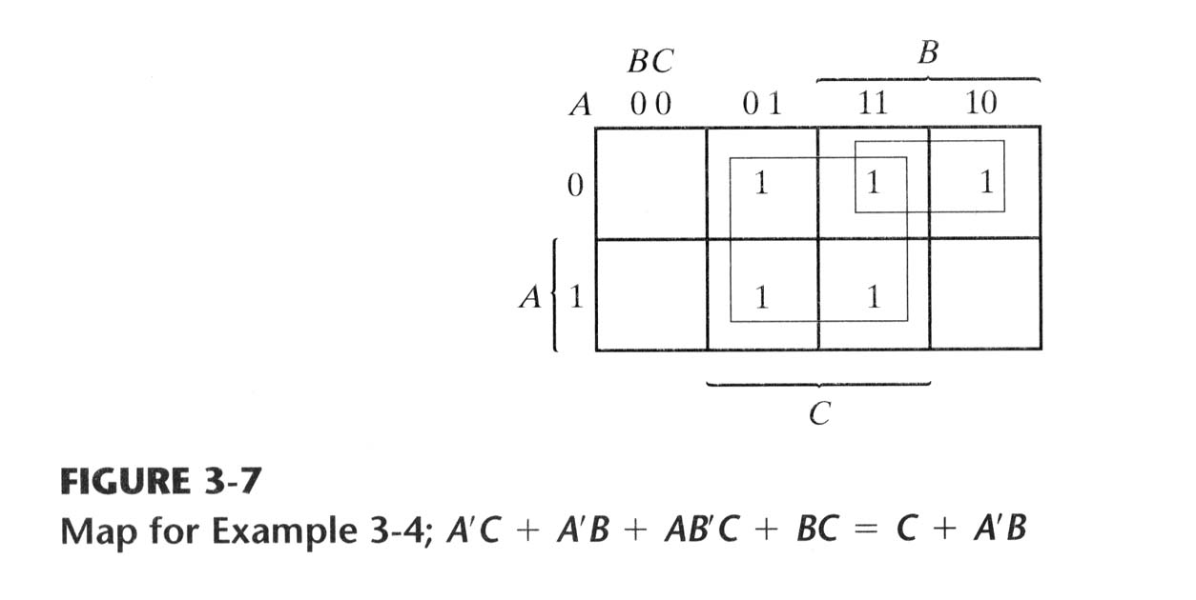
Example 3-4
F = A’C + A’B + AB’C + BC
Express it in sum of products
Find the minimal SOP

Slide 20
Four-variable K-maps
We can do four-variable expressions too!
The minterms in the third and fourth columns, and in the third and fourth rows, are switched around.
Again, this ensures that adjacent squares have common literals
Grouping minterms is similar to the three-variable case, but:
You can have rectangular groups of 1, 2, 4, 8 or 16 minterms.
You can wrap around all four sides.

Slide 21
Example: Simplify m₀+m₂+m₅+m₈+m₁₀+m₁₃
The expression is already a sum of minterms, so here’s the K-map:
We can make the following groups, resulting in the MSP x’z’ + xy’z.

Slide 22
Prime Implicants
Prime implicant: a product term obtained by combining the maximum possible number of adjacent squares
Essential prime implicant: a minterm in a square is covered by only one prime implicant
There may not necessarily be a unique MSP. The K-map below yields two valid and equivalent MSPs, because there are two possible ways to include minterm m₇.
Remember that overlapping groups is possible, as shown above.
Essential prime implicant
y’z + yz’ + xy
y’z + yz’ + xz

Slide 23
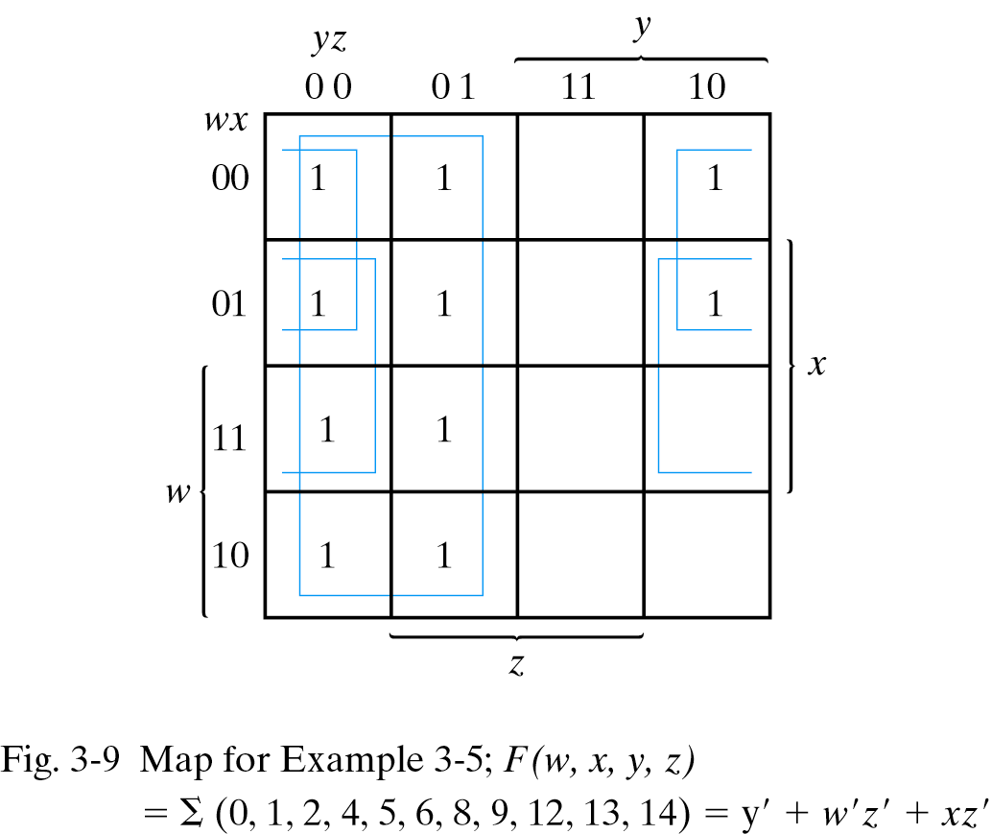
Example 3-5
F(w, x, y, z)
= Σ(0, 1, 2, 4, 5, 6, 8, 9, 12, 13, 14)
F = y'+ w'z' + xz'
1

Slide 24
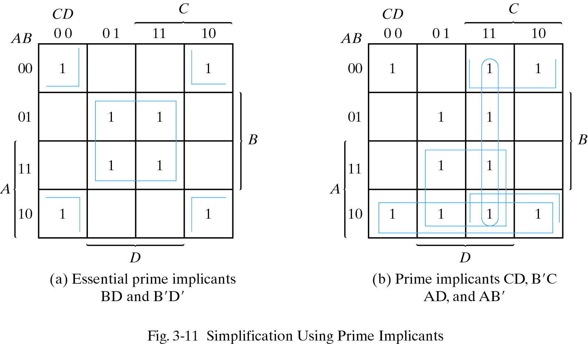
Example: Prime Implicants
F(A,B,C,D) = Σ(0,2,3,5,7,8,9,10,11,13,15)
F = BD+B'D'+CD+AD
= BD+B'D'+CD+AB'
= BD+B'D'+B'C+AD
= BD+B'D'+B’C+AB'

Slide 25
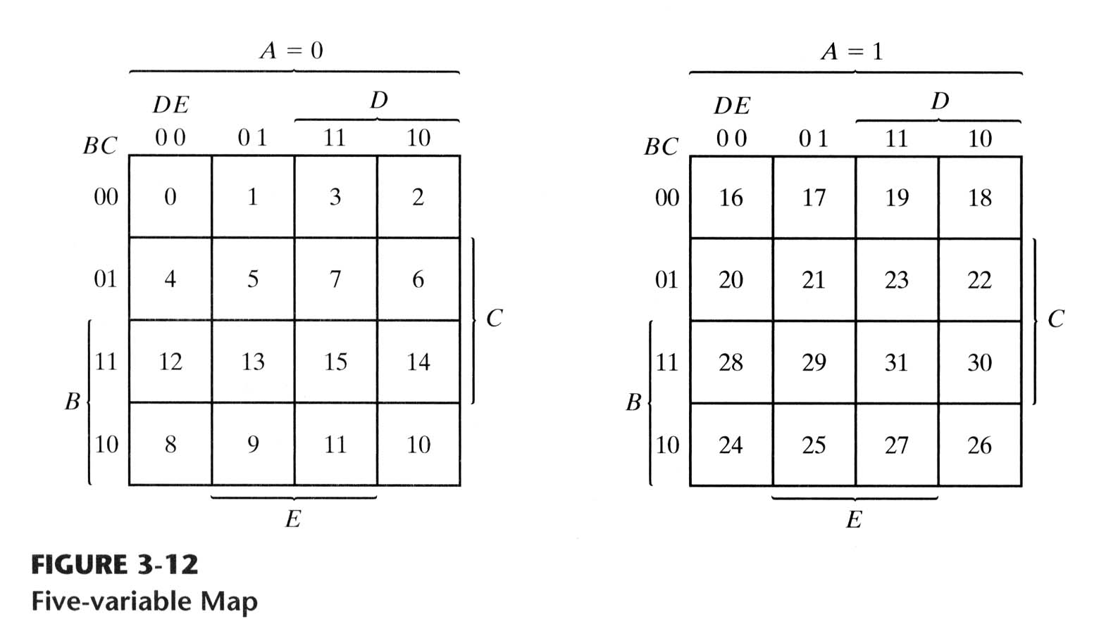
Five-variable Map
Maps with six or more variables → impractical to use

Slide 26
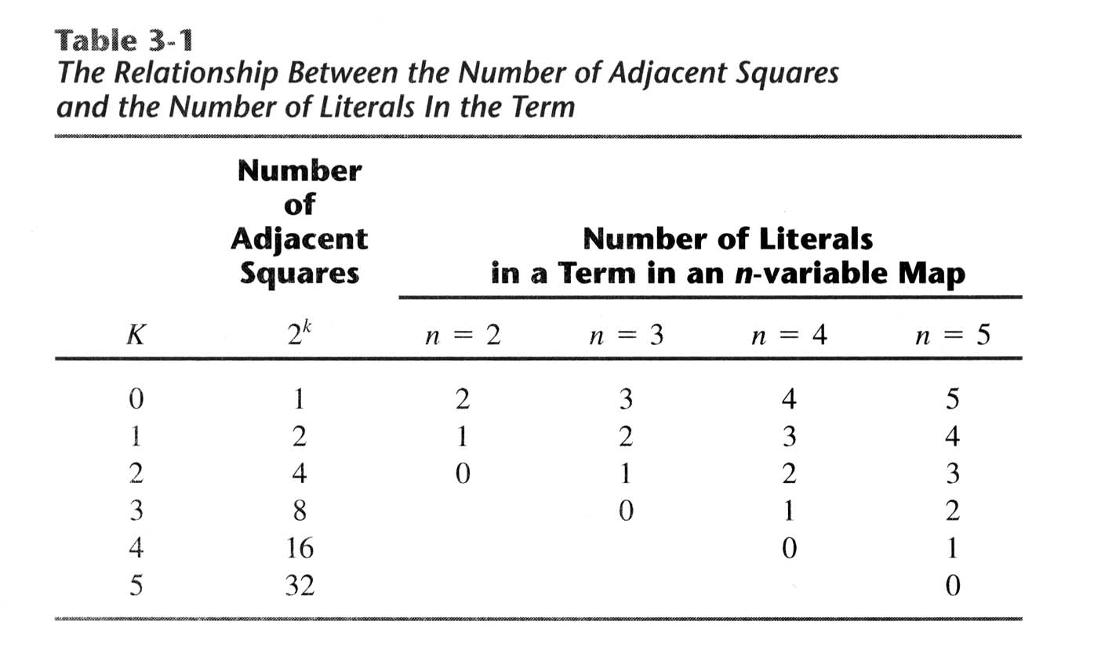
Adjacent Squares
Any 2^{k} adjacent squares for k = (0, 1, …, n) in an n-variable → n – k literals

Slide 27
Example: Five-variable Map
A = 0
A = 1
A’B’E’
ACE
BD’E
F = A’B’E’ + BD’E + ACE

Slide 28
Product of Sums Simplification
Considering the generalized DeMorgan’s Theorem
1 – 0
AND – OR
Minterms – Maxterms
Product of sums – sum of products

Slide 29
Example 3-8
F(A,B,C,D) = ∑(0,1,2,5,8,9,10)
= ∏(3,4,6,7,11,12,13,14,15)
A’C’D
B’D’
B’+D
C’+D’
B’C’
A’+B’
F = B’D’ + B’C’ + A’C’D
F = (A’+B’)(C’+D’)(B’+D)

Slide 30
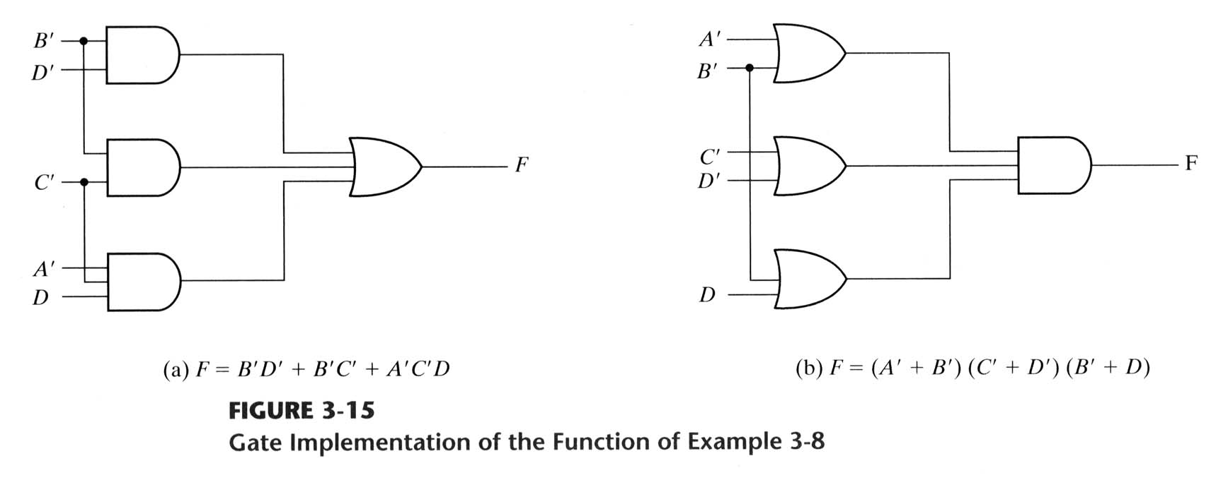
Gate Implementation

Slide 31
I don’t care!
Don’t always need all 2^{n} input combinations in an n-variable function.
If you can guarantee that certain input combinations never occur.
If some outputs aren’t used in the rest of the circuit.
Mark don’t-care outputs in truth tables and K-maps with Xs.
Within a K-map, each X can be considered as either 0 or 1. You should pick the interpretation that allows for the most simplification.

Slide 32
Example: Seven Segment Display
 | A | B | C | D | e
0 | 0 | 0 | 0 | 0 | 1
1 | 0 | 0 | 0 | 1 | 0
2 | 0 | 0 | 1 | 0 | 1
3 | 0 | 0 | 1 | 1 | 0
4 | 0 | 1 | 0 | 0 | 0
5 | 0 | 1 | 0 | 1 | 0
6 | 0 | 1 | 1 | 0 | 1
7 | 0 | 1 | 1 | 1 | 0
8 | 1 | 0 | 0 | 0 | 1
9 | 1 | 0 | 0 | 1 | 0
X |  |  |  |  | X
X |  |  |  |  | X
X |  |  |  |  | X
X |  |  |  |  | X
X |  |  |  |  | X
X |  |  |  |  | X
Input: digit encoded as 4 bits: ABCD
Table for e
a
f
b
Assumption: Input represents a legal digit (0-9)
g
e
c
d
CD AB | 00 | 01 | 11 | 10
00 | 1 | 0 | 0 | 1
01 | 0 | 0 | 0 | 1
11 | X | X | X | X
10 | 1 | 0 | X | X
CD’ + B’D’

Slide 33
Example: Seven Segment Display
a
 | A | B | C | D | a
0 | 0 | 0 | 0 | 0 | 1
1 | 0 | 0 | 0 | 1 | 0
2 | 0 | 0 | 1 | 0 | 1
3 | 0 | 0 | 1 | 1 | 1
4 | 0 | 1 | 0 | 0 | 0
5 | 0 | 1 | 0 | 1 | 1
6 | 0 | 1 | 1 | 0 | 1
7 | 0 | 1 | 1 | 1 | 1
8 | 1 | 0 | 0 | 0 | 1
9 | 1 | 0 | 0 | 1 | 1
X |  |  |  |  | X
X |  |  |  |  | X
X |  |  |  |  | X
X |  |  |  |  | X
X |  |  |  |  | X
X |  |  |  |  | X
f
b
Table for a
g
e
c
CD AB | 00 | 01 | 11 | 10
00 | 1 |  | 1 | 1
01 |  | 1 | 1 | 1
11 | X | X | X | X
10 | 1 | 1 | X | X
d
A + C + BD + B’D’

Slide 34
Practice K-map 3
Find a MSP for
f(w,x,y,z) = Σm(0,2,4,5,8,14,15), d(w,x,y,z) = Σm(7,10,13)
This notation means that input combinations wxyz = 0111, 1010 and 1101 (corresponding to minterms m₇, m₁₀ and m₁₃) are unused.

Slide 35
Solutions for practice K-map 3
Find a MSP for:
f(w,x,y,z) = Σm(0,2,4,5,8,14,15), d(w,x,y,z) = Σm(7,10,13)
All prime implicants are circled. We can treat X’s as 1s if we want, so the red group includes two X’s, and the light blue group includes one X.
The only essential prime implicant is x’z’. The red group is not essential because the minterms in it also appear in other groups.
The MSP is x’z’ + wxy + w’xy’. It turns out the red group is redundant; we can cover all of the minterms in the map without it.

Slide 36
K-map Summary
K-maps are an alternative to algebra for simplifying expressions.
The result is a minimal sum of products, which leads to a minimal two-level circuit.
It’s easy to handle don’t-care conditions.
K-maps are really only good for manual simplification of small expressions... but that’s good enough for this course.
Things to keep in mind:
Remember the correct order of minterms on the K-map.
When grouping, you can wrap around all sides of the K-map, and your groups can overlap.
Make as few rectangles as possible, but make each of them as large as possible. This leads to fewer, but simpler, product terms.
There may be more than one valid solution.

Slide 37
Why NAND and NOR Implementations ?
NAND and NOR gates are more frequently used than AND and OR gates in digital circuits.
Easier to fabricate with electronic components
Basic gates used in all IC digital logic ciruits

Slide 38
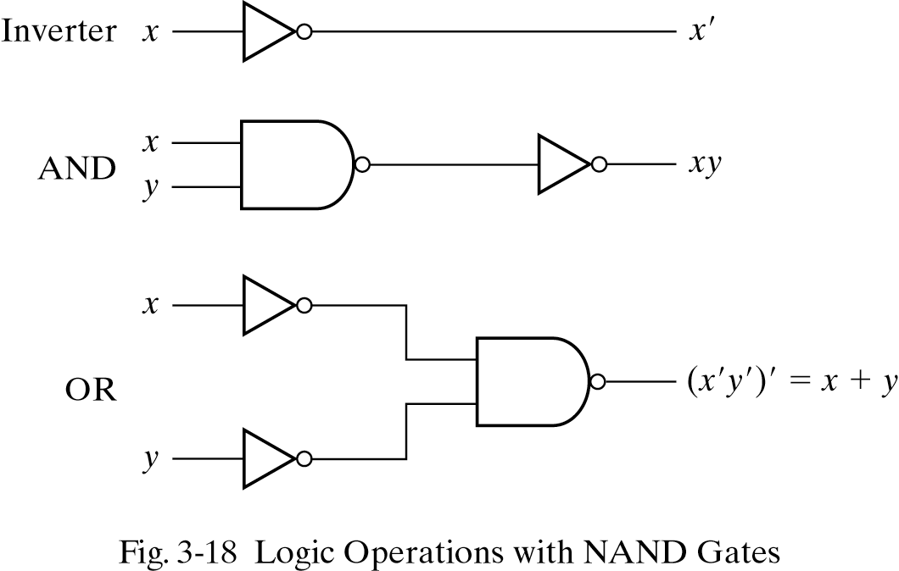
NAND Circuits
Any digital system can be implemented with NAND gates
→ “Universal gates”

Slide 39
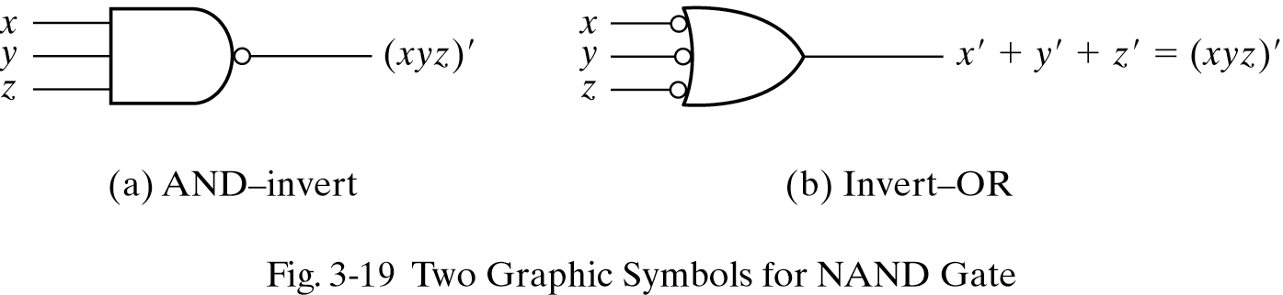
NAND Symbols
DeMorgan’s Theorem

Slide 40
Conversion into NAND
Convert all AND to NAND with AND-invert symbols
Convert all OR to NAND with invert-OR symbols
Check all the bubbles in the diagram.
If not compensated, insert an inverter.

Slide 41
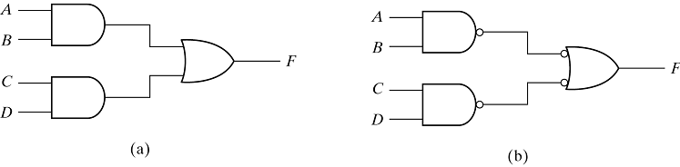
Example
F = AB + CD

Slide 42
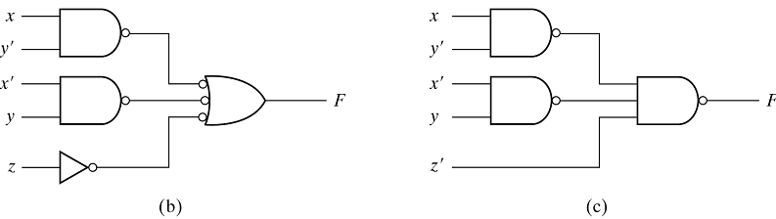
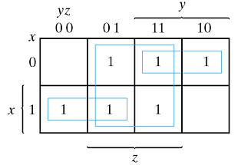
Practice: NAND Implementation
F(x, y, z) = Σ(1, 2, 3, 4, 5, 7)
= xy' + x'y + z

Slide 43
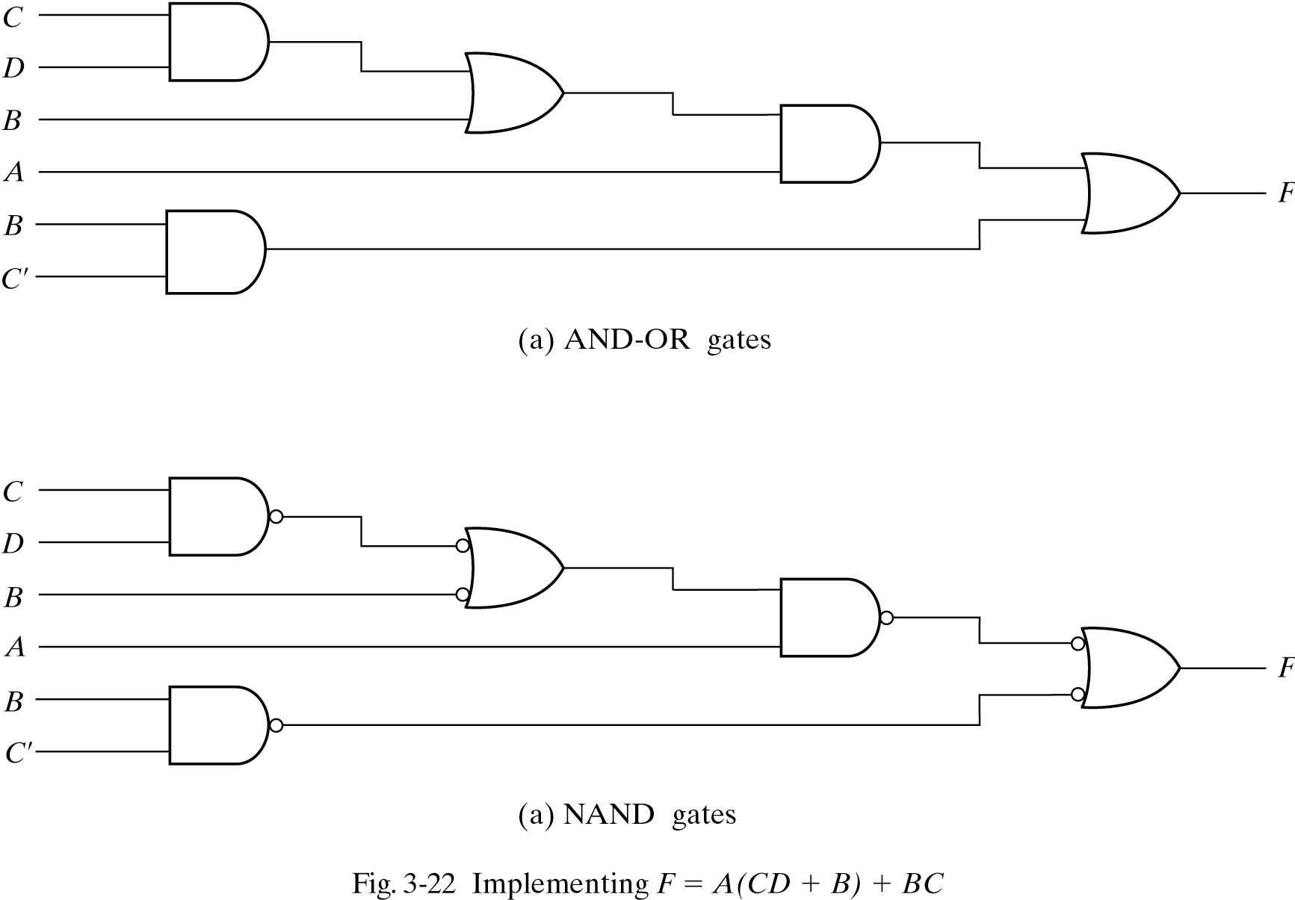
Multilevel NAND Circuits
F = A (CD + B) + BC’
’

Slide 44
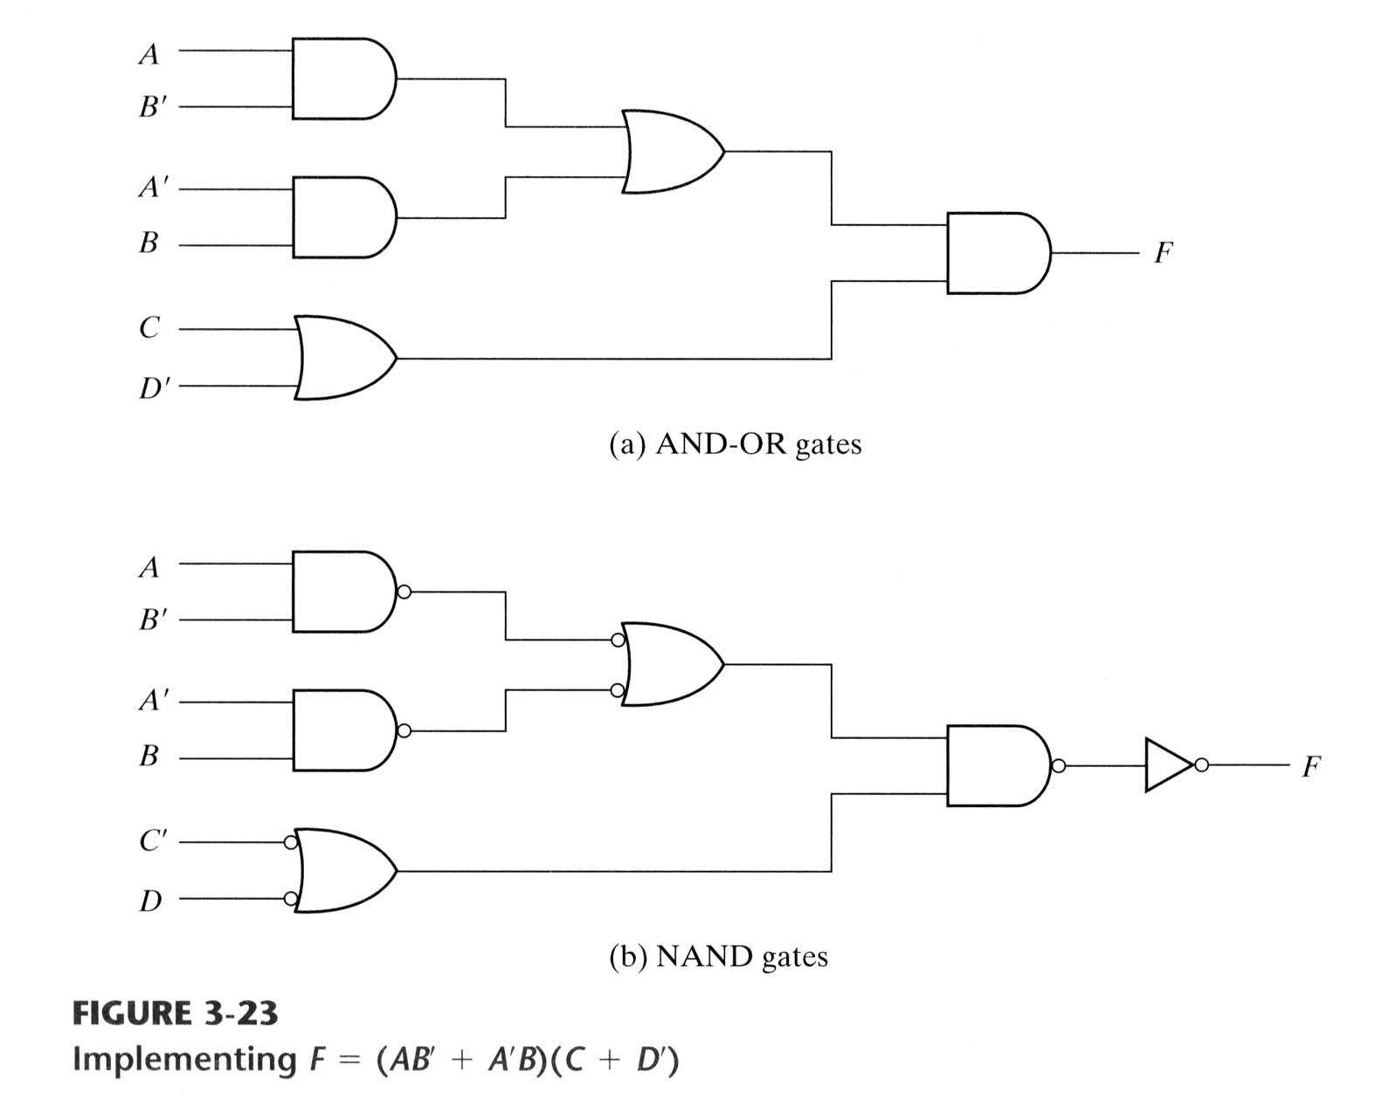
Multilevel NAND Circuits(2)
F = (AB’ + A’B)(C + D’)

Slide 45
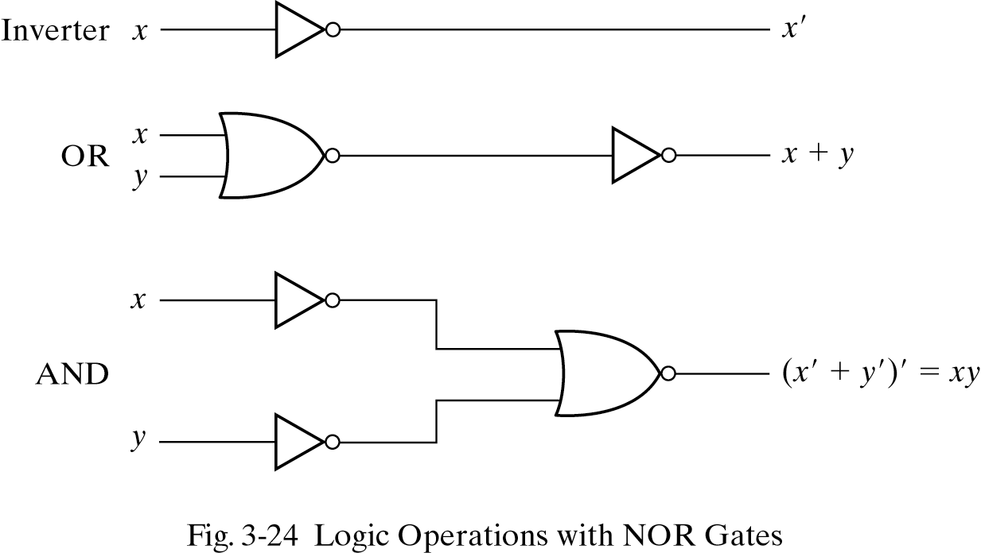
NOR Implementations
NOR → the dual of NAND
Another “universal gates”

Slide 46
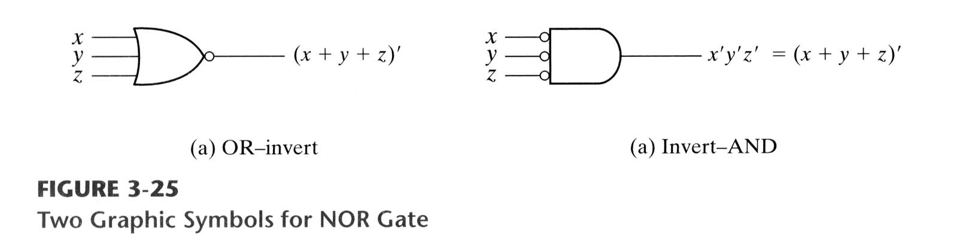
NOR Symbols
DeMorgan’s Theorem

Slide 47
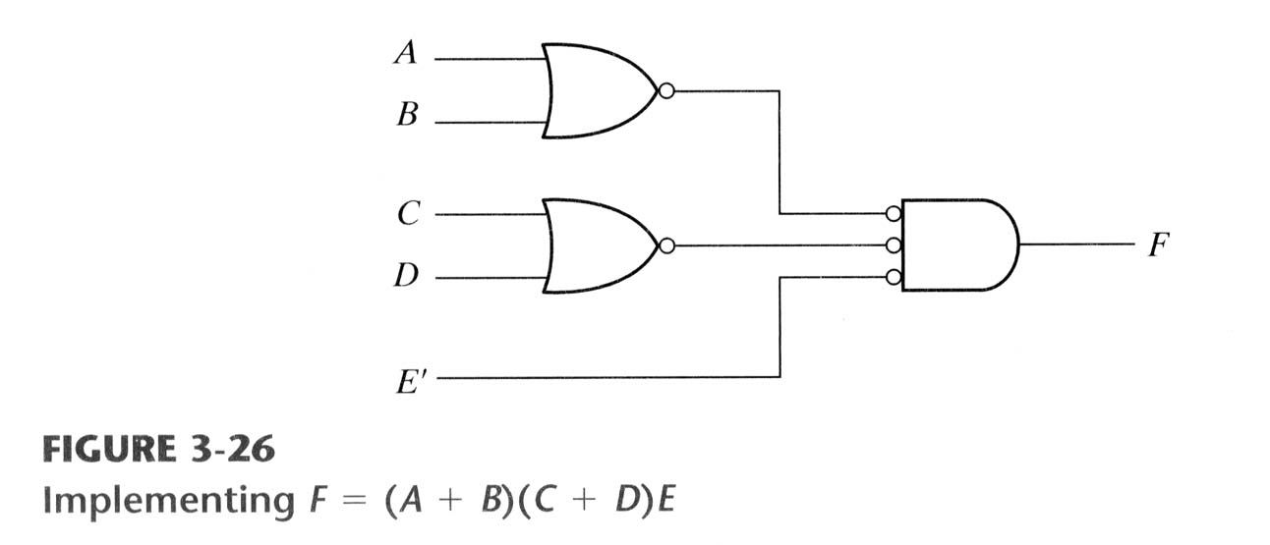
Example: NOR Implementing
F = (A + B)(C + D)E

Slide 48
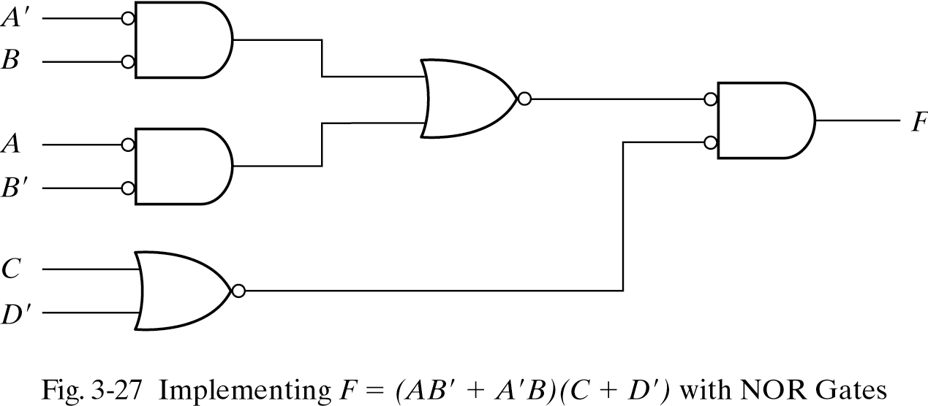
Example: NOR Implementing (2)
F = (AB' + A'B)(C + D')

Slide 49
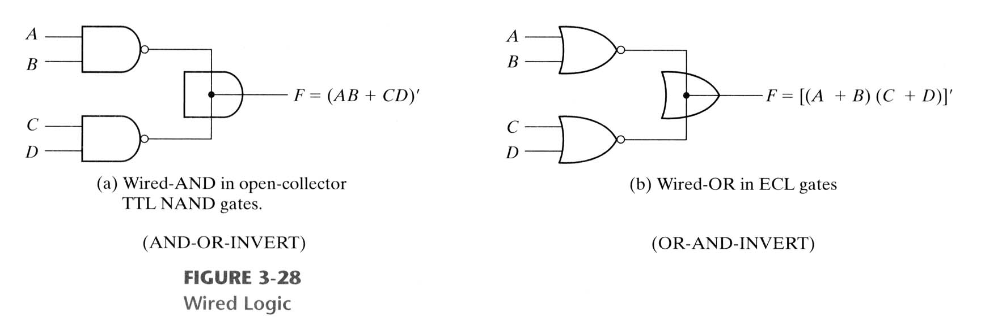
Wired Logic Gates
Some NAND and NOR gates (but not all)
Allow a wire connection between the outputs
Wire connection called as “wired logic”
not a physical logic
Consider as a logic symbol
이건 안한대
Two level implementations

Slide 50
Nondegenerate Forms
4 types of gates:
AND, OR, NAND, NOR
16 possible combinations of two-level forms
8 degenerate forms
They degenerate into a single operation.
8 nondegenerate forms
Nondegenerate Forms
AND-OR | OR-AND
NAND-NAND | NOR-NOR
NOR-OR | NAND-AND
OR-NAND | AND-NOR

Slide 51
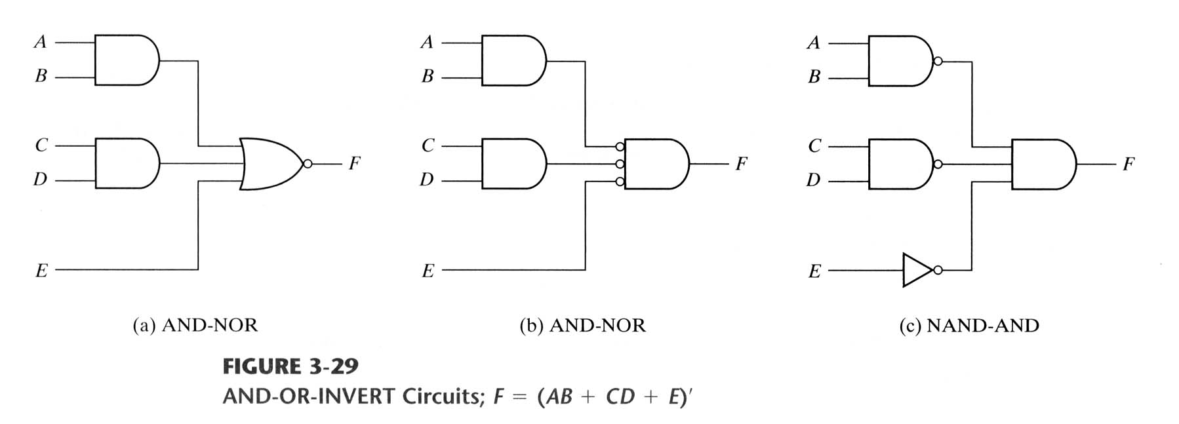
AND-OR-Invert
The complement of sum of products
AND-NOR = NAND-AND
F = (AB + CD + E)’

Slide 52
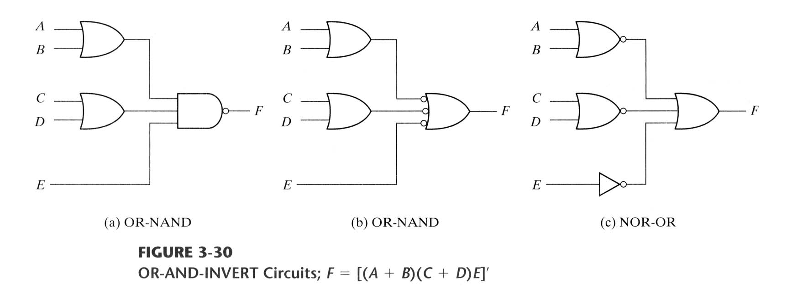
OR-AND-Invert
The complement of product of sums
OR-NAND = NOR-OR
F = [(A + B)(C + D)E]’

Slide 53
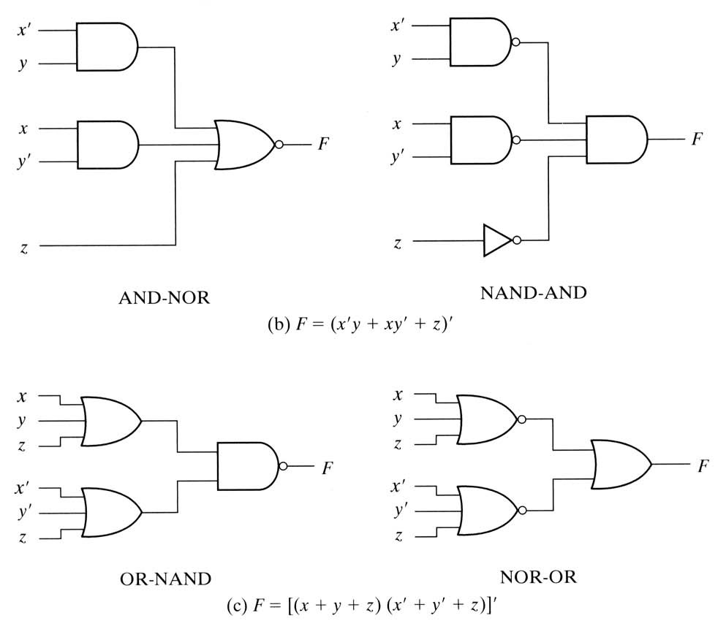
Example 3-11
F = x’y’z’ + xyz’
F’ = x’y + xy’ + z

Slide 54
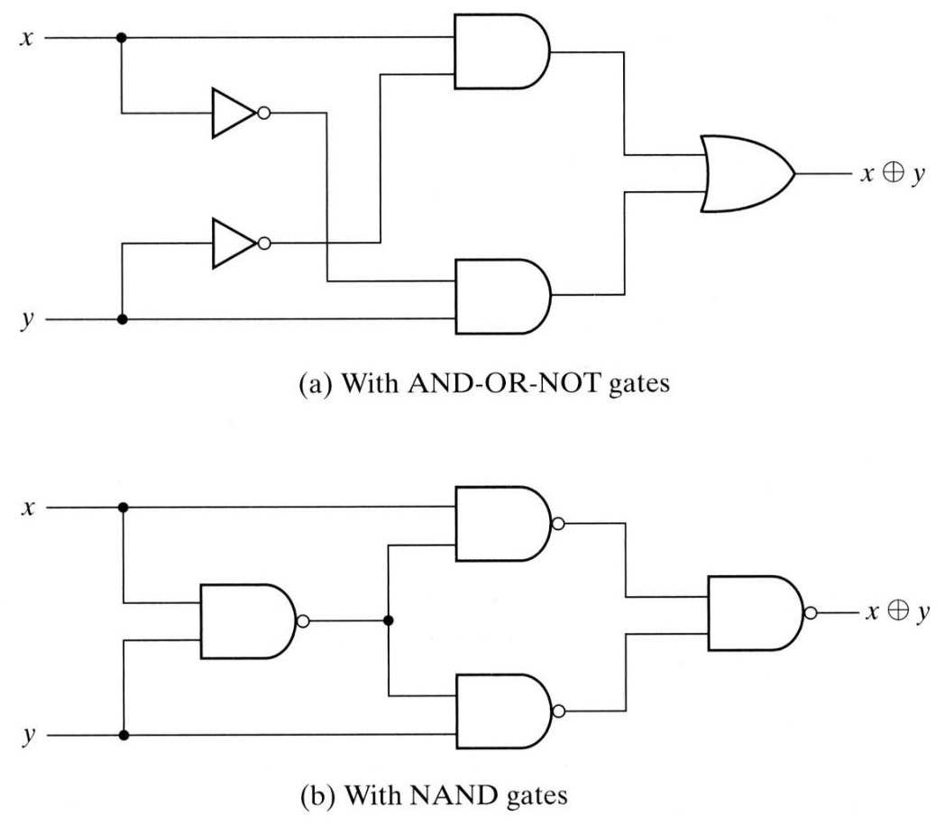
Exclusive-OR Function
Exclusive-OR
Exclusive-NOR
Properties
Multiple input XOR → difficult to fabricate with hardware
Useful in
Arithmetic operations: adder
Error-detection (correction) circuits

Slide 55
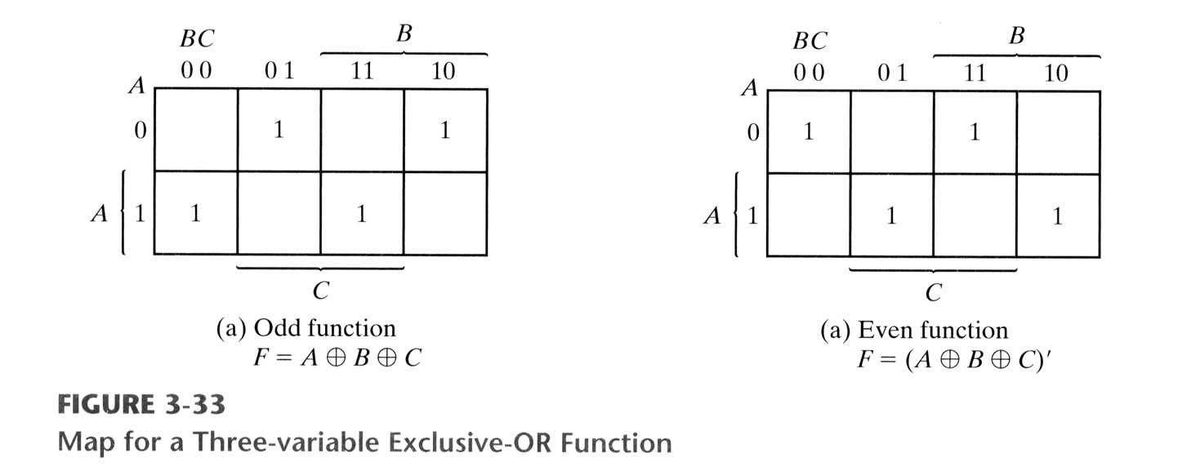
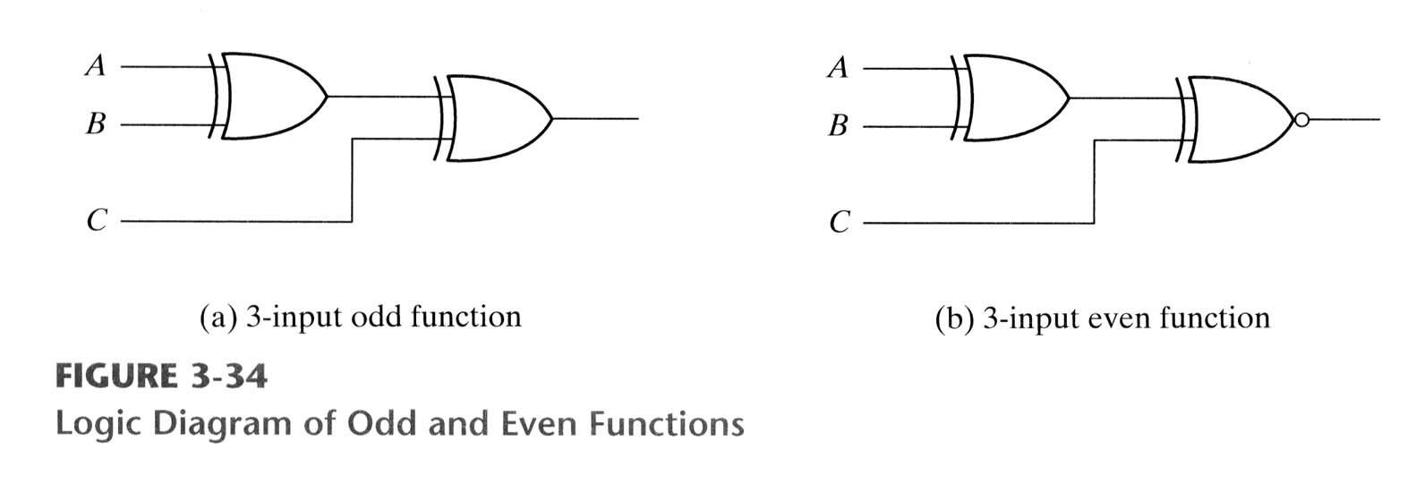
Odd Function

Slide 56
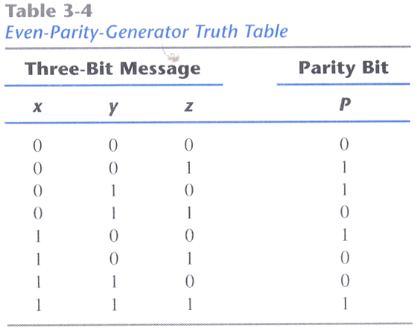
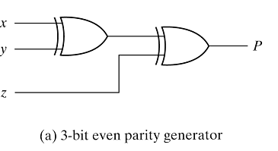
Parity Generation and Checking
Even-Parity Generator

Slide 57
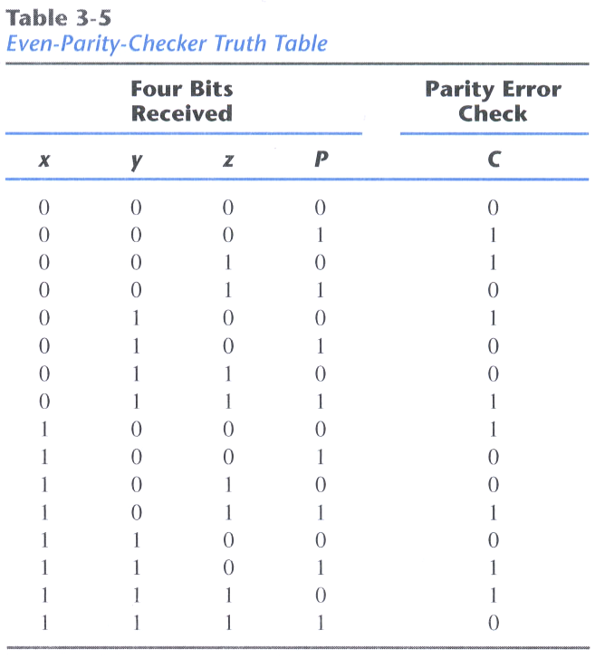
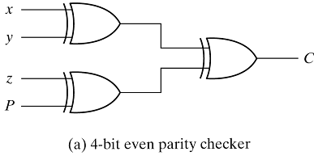
Parity Generation and Checking
Even-Parity Checker
Reuse the parity generator!

