Slide 1
Chapter 4. Combinational Logic Part C

Slide 2
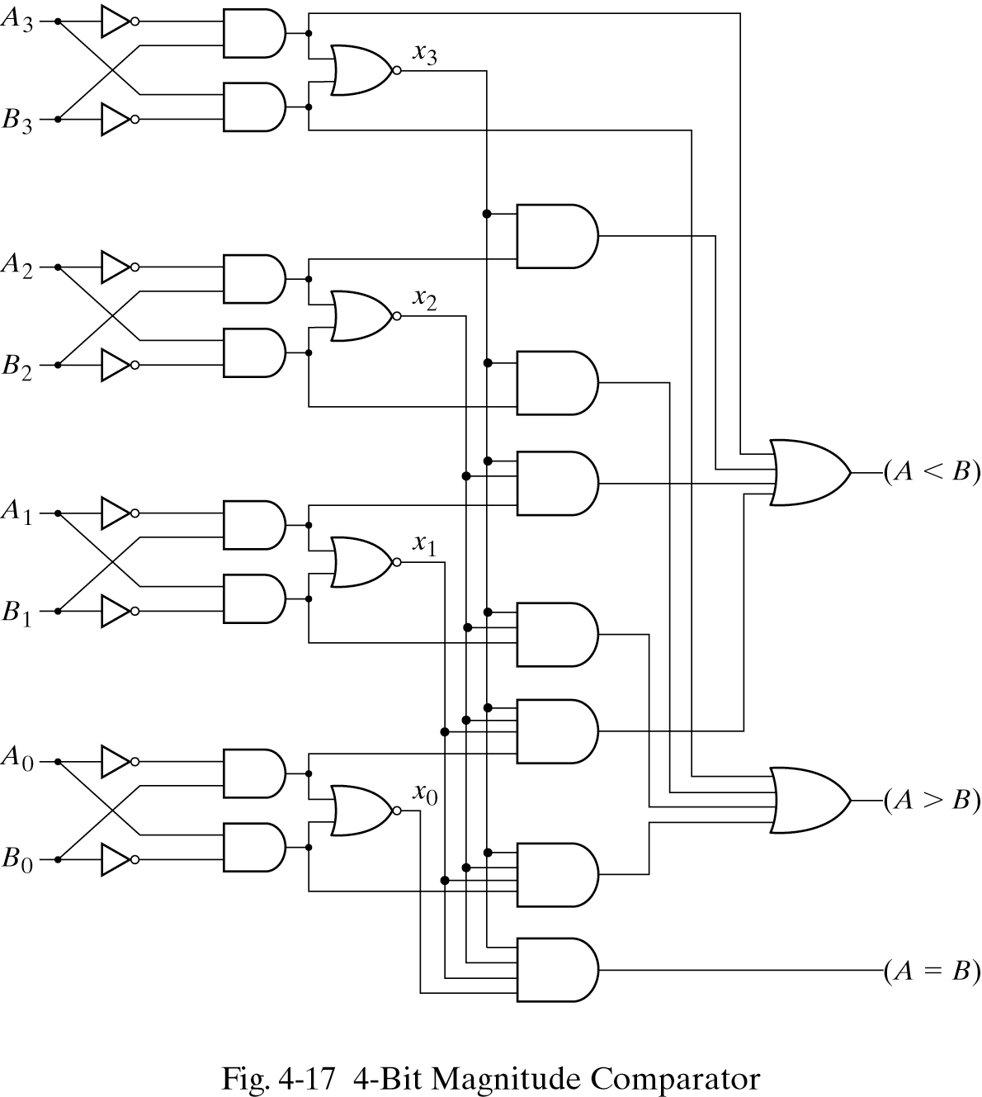
A = A₃A₂A₁A₀
B = B₃B₂B₁B₀
x_{i} =A_{i}B_{i} + A’_{i}B’_{I}
(A=B)=x₃x₂x₁x₀
(A>B)=A₃B₃′+x₃A₂B₂′+ x₃x₂A₁B₁′+x₃ x₂x₁A₀B₀′
(A<B)=A₃′B₃+x₃A₂′B₂+ x₃x₂A₁’B₁ + x₃ x₂x₁A₀’B₀

Slide 3
Decoders
We’ll look at some commonly used circuits: decoders and multiplexers.
These serve as examples of the circuit analysis and design techniques.
They can be used to implement arbitrary functions.
We are introduced to abstraction and modularity as hardware design principles.
Throughout the semester, we’ll often use decoders and multiplexers as building blocks in designing more complex hardware.

Slide 4
What is a decoder
In older days, the (good) printers used be like typewriters:
To print “A”, a wheel turned, brought the “A” key up, which then was struck on the paper.
Letters are encoded as 8 bit codes inside the computer.
When the particular combination of bits that encodes “A” is detected, we want to activate the output line corresponding to A
(Not actually how the wheels worked)
How to do this “detection” : decoder
General idea: given a k-bit input,
Detect which of the 2^{k} combinations is represented
Produce 2^{k} outputs, only one of which is “1”.

Slide 5
What a decoder does
A n-to-2^{n} decoder takes an n-bit input and produces 2^{n} outputs. The n inputs represent a binary number that determines which of the 2^{n} outputs is uniquely true.
A 2-to-4 decoder operates according to the following truth table.
The 2-bit input is called S1S0, and the four outputs are Q0-Q3.
If the input is the binary number i, then output Qi is uniquely true.
For instance, if the input S1 S0 = 10 (decimal 2), then output Q2 is true, and Q0, Q1, Q3 are all false.
This circuit “decodes” a binary number into a “one-of-four” code.

Slide 6
How can you build a 2-to-4 decoder?
Follow the design procedures from last time! We have a truth table, so we can write equations for each of the four outputs (Q0-Q3), based on the two inputs (S0-S1).
In this case there’s not much to be simplified. Here are the equations:
Q0 = S1’ S0’
Q1 = S1’ S0
Q2 = S1 S0’
Q3 = S1 S0

Slide 7
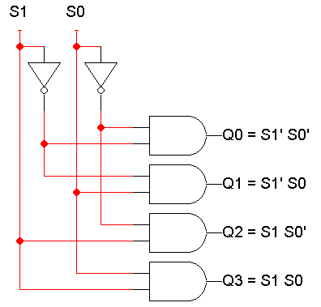
A picture of a 2-to-4 decoder

Slide 8
Enable inputs
Many devices have an additional enable input, which is used to “activate” or “deactivate” the device.
For a decoder,
EN=1 activates the decoder, so it behaves as specified earlier. Exactly one of the outputs will be 1.
EN=0 “deactivates” the decoder. By convention, that means all of the decoder’s outputs are 0.
We can include this additional input in the decoder’s truth table:

Slide 9
An aside: abbreviated truth tables
In this table, note that whenever EN=0, the outputs are always 0, regardless of inputs S1 and S0.
We can abbreviate the table by writing x’s in the input columns for S1 and S0.

Slide 10
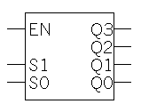
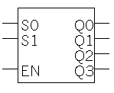
Blocks and abstraction
Decoders are common enough that we want to encapsulate them and treat them as an individual entity.
Block diagrams for 2-to-4 decoders are shown here. The names of the inputs and outputs, not their order, is what matters.
A decoder block provides abstraction:
You can use the decoder as long as you know its truth table or equations, without knowing exactly what’s inside.
It makes diagrams simpler by hiding the internal circuitry.
It simplifies hardware reuse. You don’t have to keep rebuilding the decoder from scratch every time you need it.
These blocks are like functions in programming!
Q0 = S1’ S0’
Q1 = S1’ S0
Q2 = S1 S0’
Q3 = S1 S0

Slide 11
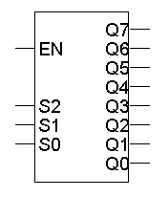
A 3-to-8 decoder
Larger decoders are similar. Here is a 3-to-8 decoder.
The block symbol is on the right.
A truth table (without EN) is below.
Output equations are at the bottom right.
Again, only one output is true for any input combination.
Q0 = S2’ S1’ S0’
Q1 = S2’ S1’ S0
Q2 = S2’ S1 S0’
Q3 = S2’ S1 S0
Q4 = S2 S1’ S0’
Q5 = S2 S1’ S0
Q6 = S2 S1 S0’
Q7 = S2 S1 S0

Slide 12
So what good is a decoder?
Do the truth table and equations look familiar?
Decoders are sometimes called minterm generators.
For each of the input combinations, exactly one output is true.
Each output equation contains all of the input variables.
These properties hold for all sizes of decoders.
This means that you can implement arbitrary functions with decoders. If you have a sum of minterms equation for a function, you can easily use a decoder (a minterm generator) to implement that function.
Q0 = S1’ S0’
Q1 = S1’ S0
Q2 = S1 S0’
Q3 = S1 S0

Slide 13
Design example: addition
Let’s make a circuit that adds three 1-bit inputs X, Y and Z.
We will need two bits to represent the total; let’s call them C and S, for “carry” and “sum.” Note that C and S are two separate functions of the same inputs X, Y and Z.
Here are a truth table and sum-of-minterms equations for C and S.
0 + 1 + 1 = 10
C(X,Y,Z) = Σm(3,5,6,7)
S(X,Y,Z) = Σm(1,2,4,7)
1 + 1 + 1 = 11

Slide 14
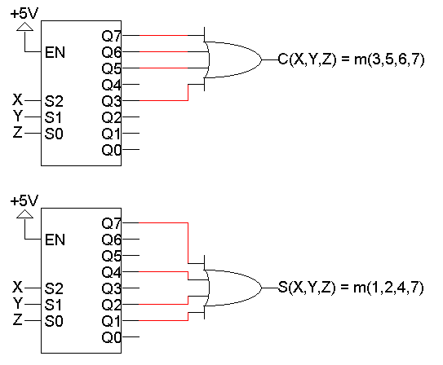
Decoder-based adder
Here, two 3-to-8 decoders implement C and S as sums of minterms.
The “+5V” symbol (“5 volts”) is how you represent a constant 1 or true. We use it here so the decoders are always active.
C(X,Y,Z) = Σm(3,5,6,7)
S(X,Y,Z) = Σm(1,2,4,7)

Slide 15
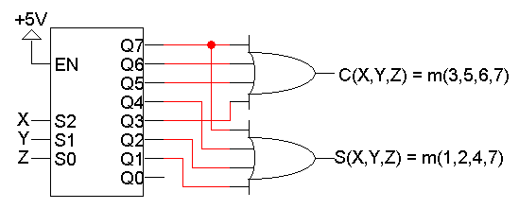
Using just one decoder
Since the two functions C and S both have the same inputs, we could use just one decoder instead of two.
C(X,Y,Z) = Σm(3,5,6,7)
S(X,Y,Z) = Σm(1,2,4,7)

Slide 16
Building a 3-to-8 decoder
You could build a 3-to-8 decoder directly from the truth table and equations below, just like how we built the 2-to-4 decoder.
Another way to design a decoder is to break it into smaller ones.
Notice some patterns in the table below:
When S2 = 0, outputs Q0-Q3 are generated as in a 2-to-4 decoder.
When S2 = 1, outputs Q4-Q7 are generated as in a 2-to-4 decoder.
Q0 = S2’ S1’ S0’ = m₀
Q1 = S2’ S1’ S0 = m₁
Q2 = S2’ S1 S0’ = m₂
Q3 = S2’ S1 S0 = m₃
Q4 = S2 S1’ S0’ = m₄
Q5 = S2 S1’ S0 = m₅
Q6 = S2 S1 S0’ = m₆
Q7 = S2 S1 S0 = m₇

Slide 17
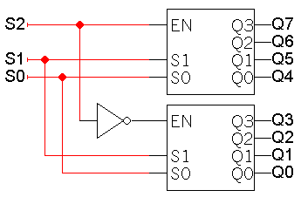
Decoder expansion
You can use enable inputs to string decoders together. Here’s a 3-to-8 decoder constructed from two 2-to-4 decoders:

Slide 18
Modularity
Be careful not to confuse the “inner” inputs and outputs of the 2-to-4 decoders with the “outer” inputs and outputs of the 3-to-8 decoder (which are in boldface).
This is similar to having several functions in a program which all use a formal parameter “x”.
You could verify that this circuit is a 3-to-8 decoder, by using equations for the 2-to-4 decoders to derive equations for the 3-to-8.

Slide 19
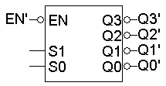
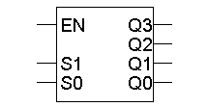
A variation of the standard decoder
The decoders we’ve seen so far are active-high decoders.
An active-low decoder is the same thing, but with an inverted EN input and inverted outputs.

Slide 20
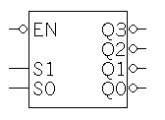
Separated at birth?
Active-high decoders generate minterms, as we’ve already seen.
The output equations for an active-low decoder are mysteriously similar, yet somehow different.
It turns out that active-low decoders generate maxterms.
Q3 = S1 S0
Q2 = S1 S0’
Q1 = S1’ S0
Q0 = S1’ S0’
Q3’ = (S1 S0)’ = S1’ + S0’
Q2’ = (S1 S0’)’ = S1’ + S0
Q1’ = (S1’ S0)’ = S1 + S0’
Q0’ = (S1’ S0’)’ = S1 + S0

Slide 21
Maxterms
A maxterm is a sum which contains each input variable exactly once.
A function with n variables has up to 2^{n} maxterms. The 8 maxterms possible for a three-variable function f(x,y,z) are:
Each maxterm is false for exactly one combination of inputs:
x’ + y’ + z’ x’ + y’ + z x’ + y + z’ x’+ y + z
x + y’ + z’ x + y’ + z x + y + z’ x + y + z
Maxterm Is false when… Shorthand
x + y + z xyz = 000 M₀
x + y + z’ xyz = 001 M₁
x + y’ + z xyz = 010 M₂
x + y’ + z’ xyz = 011 M₃
x’ + y + z xyz = 100 M₄
x’ + y + z’ xyz = 101 M₅
x’ + y’ + z xyz = 110 M₆
x’ + y’ + z’ xyz = 111 M₇

Slide 22
Product of maxterms form
Every function can be written as a unique product of maxterms:
Only AND (product) operations occur at the “outermost” level.
Each term must be maxterm.
If you have a truth table for a function, you can write a product of maxterms by picking out the rows of the table where the function output is 0.
f = M₄ M₅ M₇
= ∏M(4,5,7)
= (x’ + y + z)(x’ + y + z’)(x’ + y’ + z’)
f’ = M₀ M₁ M₂ M₃ M₆
= ∏M(0,1,2,3,6)
= (x + y + z)(x + y + z’)(x + y’ + z)
(x + y’ + z’)(x’ + y’ + z)
f’ contains all the maxterms not in f.

Slide 23
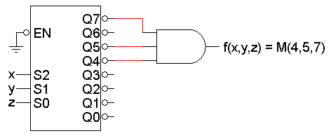
Active-low decoder example
So we can use active-low decoders to implement arbitrary functions too, but as a product of maxterms.
For example, here is an implementation of the function from the previous page, f(x,y,z) = ΠM(4,5,7), using an active-low decoder.
The “ground” symbol connected to EN represents logical 0, so this decoder is always enabled.
Remember that you need an AND gate for a product of sums.

Slide 24
Minterms and maxterms
Any minterm m_{i} is the complement of the corresponding maxterm M_{i}:
For example, m₄’ = M₄ because (xy’z’)’ = x’ + y + z.
Minterm Shorthand
x’y’z’ m₀
x’y’z m₁
x’yz’ m₂
x’yz m₃
xy’z’ m₄
xy’z m₅
xyz’ m₆
xyz m₇
Maxterm Shorthand
x + y + z M₀
x + y + z’ M₁
x + y’ + z M₂
x + y’ + z’ M₃
x’ + y + z M₄
x’ + y + z’ M₅
x’ + y’ + z M₆
x’ + y’ + z’ M₇

Slide 25
Converting between standard forms
We can easily convert a sum of minterms to a product of maxterms.
The easy way is to replace minterms with maxterms, using maxterm numbers that don’t appear in the sum of minterms:
The same thing works for converting in the opposite direction, from a product of maxterms to a sum of minterms.
f = Σm(0,1,2,3,6)
f’ = Σm(4,5,7) -- f’ contains all the minterms not in f
= m₄ + m₅ + m₇
(f’)’ = (m₄ + m₅ + m₇)’ -- complementing both sides
f = m₄’ m₅’ m₇’ -- DeMorgan’s law
= M₄ M₅ M₇ -- from the previous page
= ∏M(4,5,7)
f = Σm(0,1,2,3,6)
= ∏M(4,5,7)

Slide 26
Summary
A n-to-2^{n} decoder generates the minterms of an n-variable function.
As such, decoders can be used to implement arbitrary functions.
Later on we’ll see other uses for decoders too.
Some variations of the basic decoder include:
Adding an enable input.
Using active-low inputs and outputs to generate maxterms.
We also talked about:
Applying our circuit analysis and design techniques to understand and work with decoders.
Using block symbols to encapsulate common circuits like decoders.
Building larger decoders from smaller ones.
시험 여기까지

Slide 27
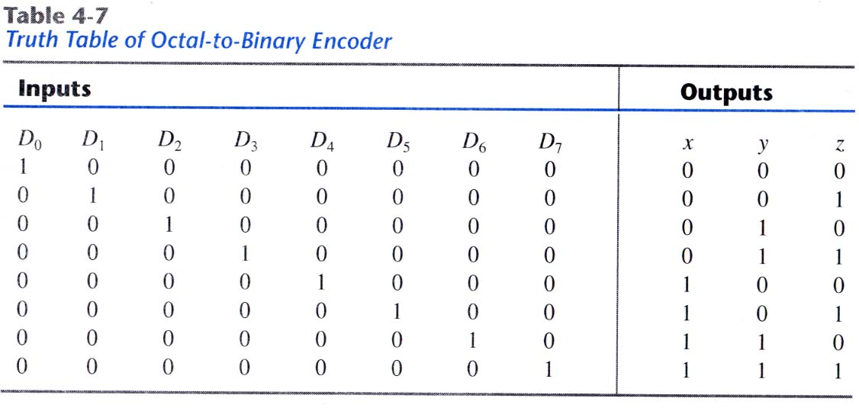
Encoder
A digital circuit that performs the “inverse” operation of decoder.
2^{n} input lines and n output lines
Example: octal-to-binary encoder → implemented with OR gates
z = D₁ + D₃ + D₅ + D₇
y = D₂ + D₃ + D₆ + D₇
x = D₄ + D₅ + D₆ + D₇

Slide 28
Ambiguity of Encoder
The limitation that only one input can be active at any given time
Two ambiguities
When two or more inputs are active simultaneously,
solution: establishing an input priority to ensure that only one input is encoded. → priority encoded
When all inputs are zero,
solution1: this output is the same as when D₀ is equal to 1.
solution2: add one more output to indicate that at least one input is equal to 1.

Slide 29
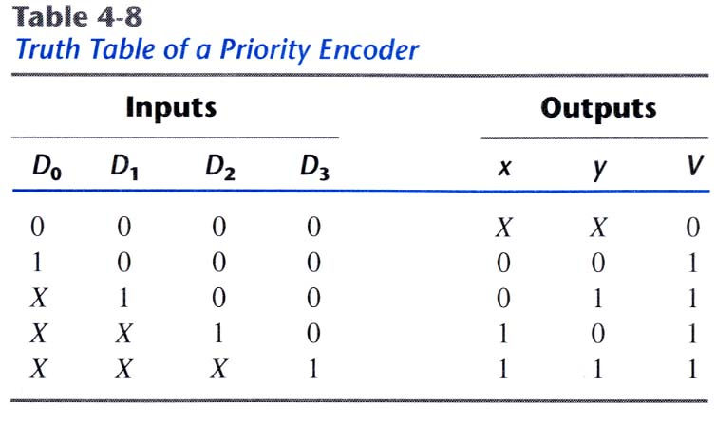
Priority Encoder
If two or more inputs are equal to 1 simultaneously, the input having the highest priority will take precedence.

Slide 30
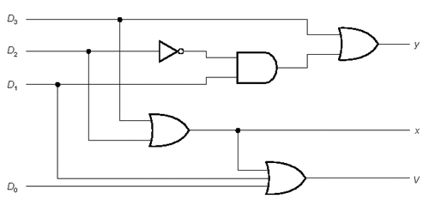
Priority encoder
x = D₂ + D₃
y = D₃ + D₁D’₂

Slide 31
Multiplexers
For the rest of the day, we’ll study multiplexers, which are just as commonly used as the decoders. Again,
These serve as examples for circuit analysis and modular design.
Multiplexers can implement arbitrary functions.
We will actually put these circuits to good use in later weeks, as building blocks for more complex designs.

Slide 32




Resource selection
Multiplexers, or muxes, are used to choose between resources.
A real-life example: in the old days before networking, several computers could share one printer through the use of a switch.

Slide 33
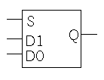
Multiplexers
A 2^{n}-to-1 multiplexer sends one of 2^{n} input lines to a single output line.
A multiplexer has two sets of inputs:
2^{n} data input lines
n select lines, to pick one of the 2^{n} data inputs
The mux output is a single bit, which is one of the 2^{n} data inputs.
The simplest example is a 2-to-1 mux:
The select bit S controls which of the data bits D0-D1 is chosen:
If S=0, then D0 is the output (Q=D0).
If S=1, then D1 is the output (Q=D1).
Q = S’ D0 + S D1

Slide 34
More truth table abbreviations
Here is a full truth table for this 2-to-1 mux, based on the equation:
Here is another kind of abbreviated truth table.
Input variables appear in the output column.
This table implies that when S=0, the output Q=D0, and when S=1 the output Q=D1.
This is a pretty close match to the equation.
Q = S’ D0 + S D1

Slide 35
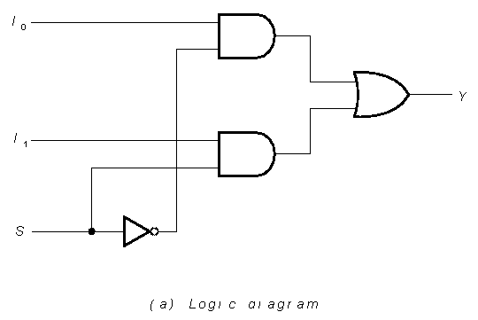
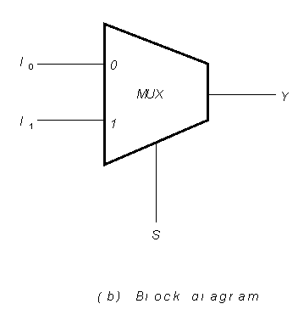
2-to-1 Multiplexer
D0
D0
Q
Q
D1
D1
S
S

Slide 36
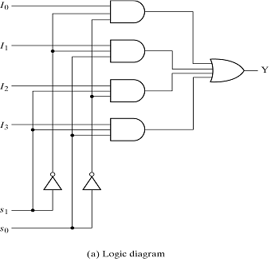
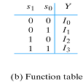
4-to-1 Multiplexer

Slide 37
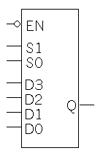
A 4-to-1 multiplexer
Here is a block diagram and abbreviated truth table for a 4-to-1 mux.
Q = S1’ S0’ D0 + S1’ S0 D1 + S1 S0’ D2 + S1 S0 D3

Slide 38
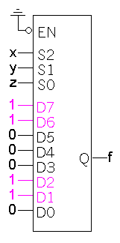
Implementing functions with multiplexers
Muxes can be used to implement arbitrary functions.
One way to implement a function of n variables is to use an n-to-1 mux:
For each minterm m_{i} of the function, connect 1 to mux data input Di. Each data input corresponds to one row of the truth table.
Connect the function’s input variables to the mux select inputs. These are used to indicate a particular input combination.
For example, let’s look at f(x,y,z) = Σm(1,2,6,7).

Slide 39
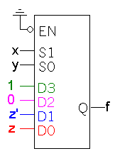
A more efficient way
We can actually implement f(x,y,z) = Σm(1,2,6,7) with just a 4-to-1 mux, instead of an 8-to-1.
Step 1: Find the truth table for the function, and group the rows into pairs. Within each pair of rows, x and y are the same, so f is a function of z only.
When xy=00, f=z
When xy=01, f=z’
When xy=10, f=0
When xy=11, f=1
Step 2: Connect the first two input variables of the truth table (here, x and y) to the select bits S1 S0 of the 4-to-1 mux.
Step 3: Connect the equations above for f(z) to the data inputs D0-D3.

Slide 40
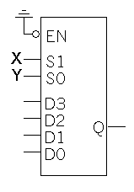
Example: multiplexer-based adder
Let’s implement the adder carry function, C(X,Y,Z), with muxes.
There are three inputs, so we’ll need a 4-to-1 mux.
The basic setup is to connect two of the input variables (usually the first two in the truth table) to the mux select inputs.
With S1=X and S0=Y, then
Q=X’Y’D0 + X’YD1 + XY’D2 + XYD3
Equation for the multiplexer

Slide 41
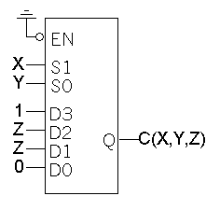
Multiplexer-based carry
We can set the multiplexer data inputs D0-D3, by fixing X and Y and finding equations for C in terms of just Z.
When XY=00, C=0
When XY=01, C=Z
When XY=10, C=Z
When XY=11, C=1
C = X’ Y’ D0 + X’ Y D1 + X Y’ D2 + X Y D3
= X’ Y’ 0 + X’ Y Z + X Y’ Z + X Y 1
= X’ Y Z + X Y’ Z + XY
= Σm(3,5,6,7)

Slide 42
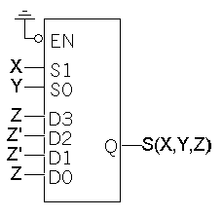
Multiplexer-based sum
Here’s the same thing, but for the sum function S(X,Y,Z).
When XY=00, S=Z
When XY=01, S=Z’
When XY=10, S=Z’
When XY=11, S=Z
S = X’ Y’ D0 + X’ Y D1 + X Y’ D2 + X Y D3
= X’ Y’ Z + X’ Y Z’ + X Y’ Z’ + X Y Z
= Σm(1,2,4,7)

Slide 43
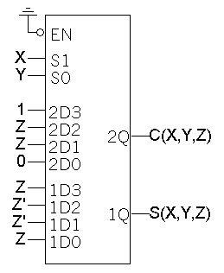
Dual multiplexer-based full adder
We need two separate 4-to-1 muxes: one for C and one for S.
But sometimes it’s convenient to think about the adder output as being a single 2-bit number, instead of as two separate functions.
A dual 4-to-1 mux gives the illusion of 2-bit data inputs and outputs.
It’s really just two 4-to-1 muxes connected together.

Slide 44
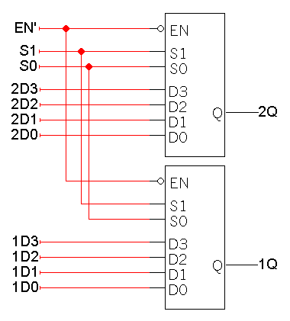
Dual muxes in more detail
You can make a dual 4-to-1 mux by connecting two 4-to-1 muxes. (“Dual” means “two-bit values.”)
In the diagram on the right, we’re using S1-S0 to choose one of the following pairs of inputs:
2D3 1D3, when S1 S0 = 11
2D2 1D2, when S1 S0 = 10
2D1 1D1, when S1 S0 = 01
2D0 1D0, when S1 S0 = 00
You can see how 8-way multiplexer (k-to-1) can be used to select from a set of (k) 8-bit numbers

Slide 45
Summary
A 2^{n}-to-1 multiplexer routes one of 2^{n} input lines to a single output line.
Just like decoders,
Muxes are common enough to be supplied as stand-alone devices for use in modular designs.
Muxes can implement arbitrary functions.
We saw some variations of the standard multiplexer:
Smaller muxes can be combined to produce larger ones.
We can add active-low or active-high enable inputs.
As always, we use truth tables and Boolean algebra to analyze things.

