Slide 1
Chapter 5. Synchronous Sequential Logic Part B

Slide 2
Flip-Flops
Last time, we saw how latches can be used as memory in a circuit.
Latches introduce new problems:
We need to know when to enable a latch.
We also need to quickly disable a latch.
In other words, it’s difficult to control the timing of latches in a large circuit.
We solve these problems with two new elements: clocks and flip-flops
Clocks tell us when to write to our memory.
Flip-flops allow us to quickly write the memory at clearly defined times.
Used together, we can create circuits without worrying about the memory timing.

Slide 3
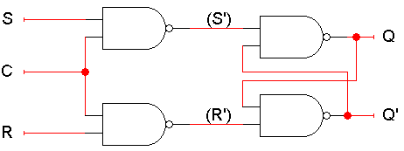
An SR latch with a control input
Here is an SR latch with a control input C.
Notice the hierarchical design!
The dotted blue box is the S’R’ latch.
The additional NAND gates are simply used to generate the correct inputs for the S’R’ latch.
The control input acts just like an enable.

Slide 4
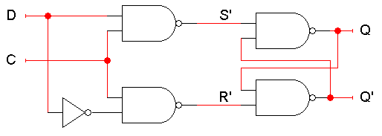
D latch
Finally, a D latch is based on an S’R’ latch. The additional gates generate the S’ and R’ signals, based on inputs D (“data”) and C (“control”).
When C = 0, S’ and R’ are both 1, so the state Q does not change.
When C = 1, the latch output Q will equal the input D.
No more messaging with one input for set and another input for reset!
Also, this latch has no “bad” input combinations to avoid. Any of the four possible assignments to C and D are valid.

Slide 5
Using latches in real life
We can connect some latches, acting as memory, to an ALU.
Let’s say these latches contain some value that we want to increment.
The ALU should read the current latch value.
It applies the “G = X + 1” operation.
The incremented value is stored back into the latches.
At this point, we have to stop the cycle, so the latch value doesn’t get incremented again by accident.
One convenient way to break the loop is to disable the latches.
+1
S
ALU
G
X
D
Q
Latches
C

Slide 6
The problem with latches
The problem is exactly when to disable the latches. You have to wait long enough for the ALU to produce its output, but no longer.
But different ALU operations have different delays. For instance, arithmetic operations might go through an adder, whereas logical operations don’t.
Changing the ALU implementation, such as using a carry-lookahead adder instead of a ripple-carry adder, also affects the delay.
In general, it’s very difficult to know how long operations take, and how long latches should be enabled for.
+1
S
ALU
G
X
D
Q
Latches
C

Slide 7
Making latches work right
Our example used latches as memory for an ALU.
Let’s say there are four latches initially storing 0000.
We want to use an ALU to increment that value to 0001.
Normally the latches should be disabled, to prevent unwanted data from being accidentally stored.
In our example, the ALU can read the current latch contents, 0000, and compute their increment, 0001.
But the new value cannot be stored back while the latch is disabled.
+1
S
ALU
G
X
0001
0000
D
Q
Latches
C
0

Slide 8
Writing to the latches
After the ALU has finished its increment operation, the latch can be enabled, and the updated value is stored.
The latch must be quickly disabled again, before the ALU has a chance to read the new value 0001 and produce a new result 0010.
+1
S
ALU
G
X
0001
0001
D
Q
Latches
C
1
+1
S
ALU
G
X
0010
0001
D
Q
Latches
C
0

Slide 9
Two main issues
So to use latches correctly within a circuit, we have to:
Keep the latches disabled until new values are ready to be stored.
Enable the latches just long enough for the update to occur.
There are two main issues we need to address:
How do we know exactly when the new values are ready?
We’ll add another signal to our circuit. When this new
signal becomes 1, the latches will know that the ALU
computation has completed and data is ready to be stored.
How can we enable and then quickly disable the latches?
This can be done by combining latches together in a
special way, to form what are called flip-flops.

Slide 10

Clocks and synchronization
A clock is a special device that whose output continuously alternates between 0 and 1.
The time it takes the clock to change from 1 to 0 and back to 1 is called the clock period, or clock cycle time.
The clock frequency is the inverse of the clock period. The unit of measurement for frequency is the hertz.
Clocks are often used to synchronize circuits.
They generate a repeating, predictable pattern of 0s and 1s that can trigger certain events in a circuit, such as writing to a latch.
If several circuits share a common clock signal, they can coordinate their actions with respect to one another.
This is similar to how humans use real clocks for synchronization.
clock period

Slide 11

Synchronizing our example
We can use a clock to synchronize our latches with the ALU.
The clock signal is connected to the latch control input C.
The clock controls the latches. When it becomes 1, the latches will be enabled for writing.
The clock period must be set appropriately for the ALU.
It should not be too short. Otherwise, the latches will start writing before the ALU operation has finished.
It should not be too long either. Otherwise, the ALU might produce a new result that will accidentally get stored, as we saw before.
The faster the ALU runs, the shorter the clock period can be.
+1
S
ALU
G
X
D
Q
Latches
C

Slide 12
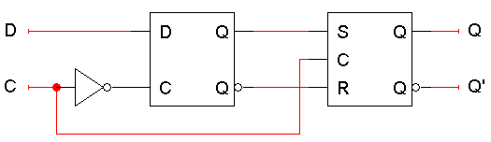
Flip-flops
The second issue was how to enable a latch for just an instant.
Here is the internal structure of a D flip-flop.
The flip-flop inputs are C and D, and the outputs are Q and Q’.
The D latch on the left is the master, while the SR latch on the right is called the slave.
Note the layout here.
The flip-flop input D is connected directly to the master latch.
The master latch output goes to the slave.
The flip-flop outputs come directly from the slave latch.

Slide 13
D flip-flops when C=0
The D flip-flop’s control input C enables either the D latch or the SR latch, but not both.
When C = 0:
The master latch is enabled, and it monitors the flip-flop input D. Whenever D changes, the master’s output changes too.
The slave is disabled, so the D latch output has no effect on it. Thus, the slave just maintains the flip-flop’s current state.

Slide 14
D flip-flops when C=1
As soon as C becomes 1,
The master is disabled. Its output will be the last D input value seen just before C became 1.
Any subsequent changes to the D input while C = 1 have no effect on the master latch, which is now disabled.
The slave latch is enabled. Its state changes to reflect the master’s output, which again is the D input value from right when C became 1.

Slide 15
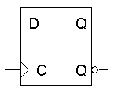
Positive edge triggering
This is called a positive edge-triggered flip-flop.
The flip-flop output Q changes only after the positive edge of C.
The change is based on the flip-flop input values that were present right at the positive edge of the clock signal.
The D flip-flop’s behavior is similar to that of a D latch except for the positive edge-triggered nature, which is not explicit in this table.

Slide 16



Clock Response in Latch and Flip-Flop
Latch: level sensitive (a)
Flip-flop: edge sensitive (b) and (c)

Slide 17
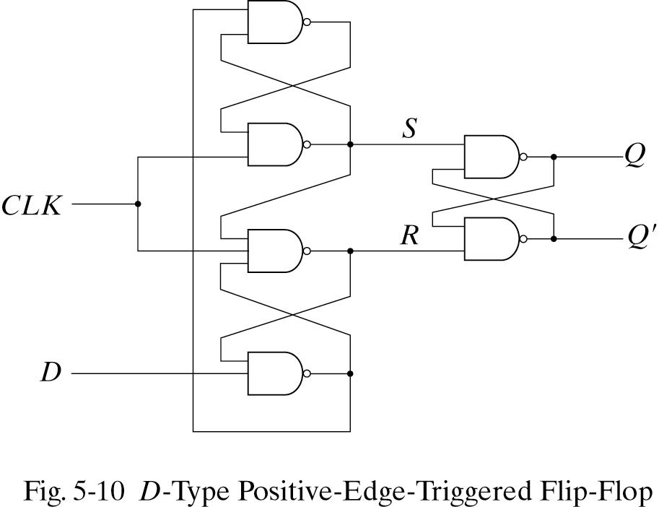
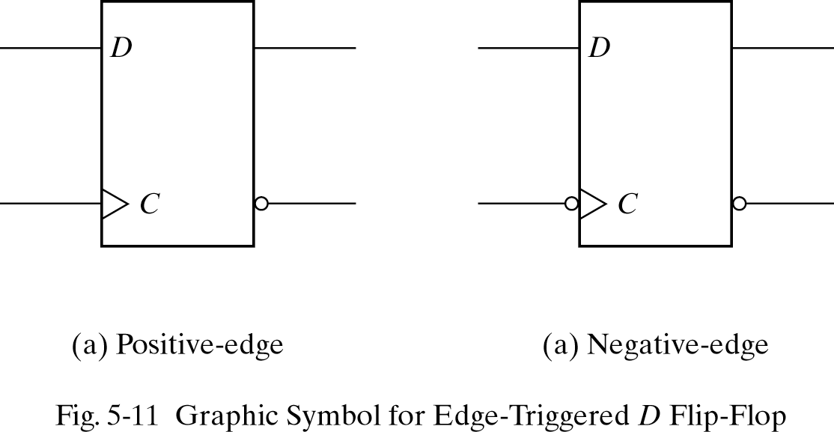
Edge-Triggered D Flip-Flop
3 SR Latches

Slide 18
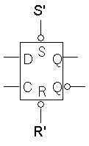
Direct inputs
One last thing to worry about… what is the starting value of Q?
We could set the initial value synchronously, at the next positive clock edge, but this actually makes circuit design more difficult.
Instead, most flip-flops provide direct, or asynchronous, inputs that let you immediately set or clear the state.
You would “reset” the circuit once, to initialize the flip-flops.
The circuit would then begin its regular, synchronous operation.
Here is a D flip-flop with active-low direct inputs.
Direct inputs to set or reset the flip-flop
S’R’ = 11 for “normal” operation of the D flip-flop

Slide 19
Our example with flip-flops
We can use the flip-flops’ direct inputs to initialize them to 0000.
During the clock cycle, the ALU outputs 0001, but this does not affect the flip-flops yet.
+1
S
C
Q₀
G₀
ALU
G
X
0000
D
Q
Flip-flops
C
+1
S
C
Q₀
G₀
ALU
G
X
0001
0000
D
Q
Flip-flops
C

Slide 20
Example continued
The ALU output is copied into the flip-flops at the next positive edge of the clock signal.
The flip-flops automatically “shut off,” and no new data can be written until the next positive clock edge... even though the ALU produces a new output.
+1
S
C
Q₀
G₀
ALU
G
X
0001
0001
D
Q
Flip-flops
C
+1
S
C
Q₀
G₀
ALU
G
X
0010
0001
D
Q
Flip-flops
C

Slide 21
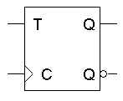
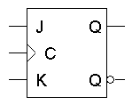
Flip-flop variations
We can make different versions of flip-flops based on the D flip-flop, just like we made different latches based on the S’R’ latch.
A JK flip-flop has inputs that act like S and R, but the inputs JK=11 are used to complement the flip-flop’s current state.
A T flip-flop can only maintain or complement its current state.

Slide 22
Characteristic tables
The tables that we’ve made so far are called characteristic tables.
They show the next state Q(t+1) in terms of the current state Q(t) and the inputs.
For simplicity, the control input C is not usually listed.
Again, these tables don’t indicate the positive edge-triggered behavior of the flip-flops that we’ll be using.

Slide 23
Characteristic equations
We can also write characteristic equations, where the next state Q(t+1) is defined in terms of the current state Q(t) and inputs.
Q(t+1) = D
Q(t+1) = K’Q(t) + JQ’(t)
Q(t+1) = T’Q(t) + TQ’(t)
= T ⊕ Q(t)

Slide 24
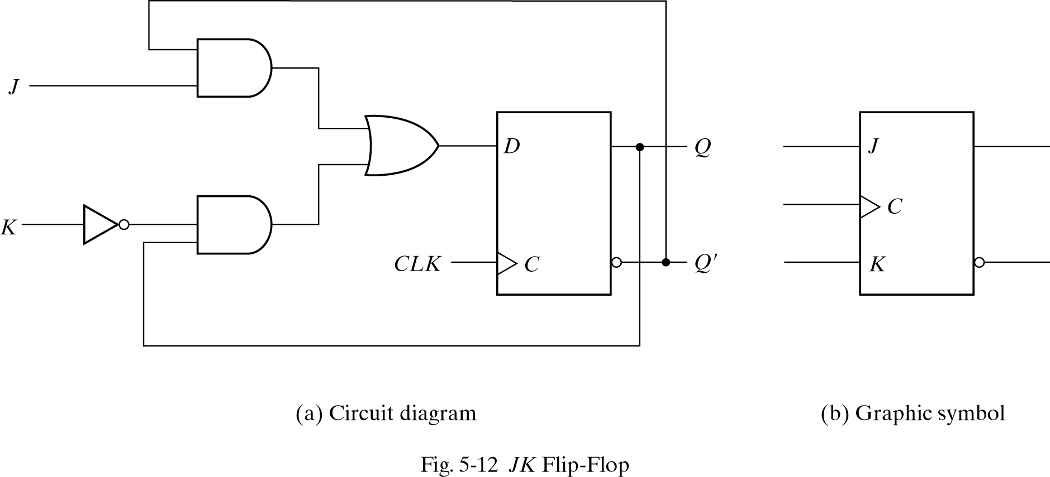
JK Flip-Flop

Slide 25
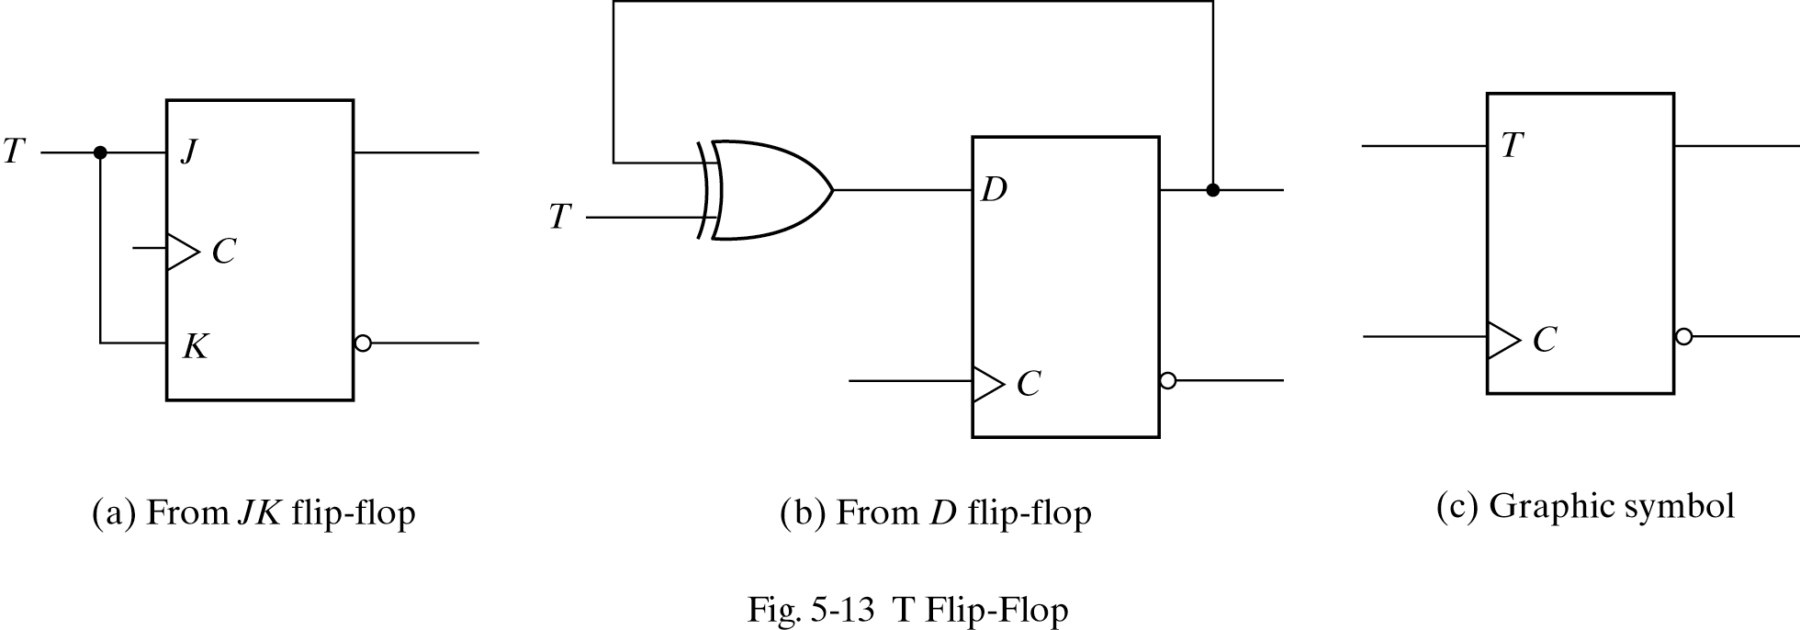
T Flip-Flop

Slide 26
Flip flop timing diagrams
“Present state” and “next state” are relative terms.
In the example JK flip-flop timing diagram on the left, you can see that at the first positive clock edge, J=1, K=1 and Q(1) = 1.
We can use this information to find the “next” state, Q(2) = Q(1)’.
Q(2) appears right after the first positive clock edge, as shown on the right. It will not change again until after the second clock edge.
1 2 3 4
1 2 3 4
C
J
K
Q
C
J
K
Q
These values at clock cycle 1...
… determine the “next” Q

Slide 27
“Present” and “next” are relative
Similarly, the values of J, K and Q at the second positive clock edge can be used to find the value of Q during the third clock cycle.
When we do this, Q(2) is now referred to as the “present” state, and Q(3) is now the “next” state.
1 2 3 4
1 2 3 4
C
J
K
Q
C
J
K
Q

Slide 28
Positive edge triggered
One final point to repeat: the flip-flop outputs are affected only by the input values at the positive edge.
In the diagram below, K changes rapidly between the second and third positive edges.
But it’s only the input values at the third clock edge (K=1, and J=0 and Q=1) that affect the next state, so here Q changes to 0.
This is a fairly simple timing model. In real life there are “setup times” and “hold times” to worry about as well, to account for internal and external delays.
1 2 3 4
C
J
K
Q

Slide 29
Summary
To use memory in a larger circuit, we need to:
Keep the latches disabled until new values are ready to be stored.
Enable the latches just long enough for the update to occur.
A clock signal is used to synchronize circuits. The cycle time reflects how long combinational operations take.
Flip-flops further restrict the memory writing interval, to just the positive edge of the clock signal.
This ensures that memory is updated only once per clock cycle.
There are several different kinds of flip-flops, but they all serve the same basic purpose of storing bits.
In the next, we’ll talk about how to analyze and design sequential circuits that use flip-flops as memory.

