Slide 1
Chapter 4. Combinational Logic Part A

Slide 2
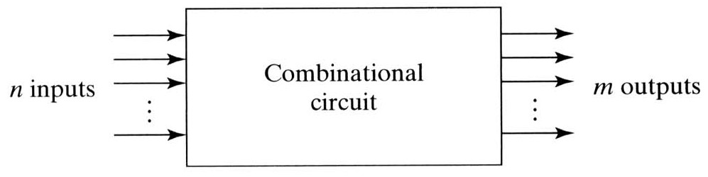
Combinational Logics
Logic Circuits
Combinational circuit
Output depends on the present inputs.
No feedback line and no storage element
Sequential circuit
Combinational circuit + Storage elements
Output depends on present inputs as well as past inputs.
→ the time sequence of inputs and internal states
Discussed later.

Slide 3
Basic circuit analysis and design
We have learned all the prerequisite material:
Truth tables and Boolean expressions describe functions.
Expressions can be converted into hardware circuits.
Boolean algebra and K-maps help simplify expressions and circuits.
Now, let us put all of these foundations to good use, to analyze and design some larger circuits.

Slide 4
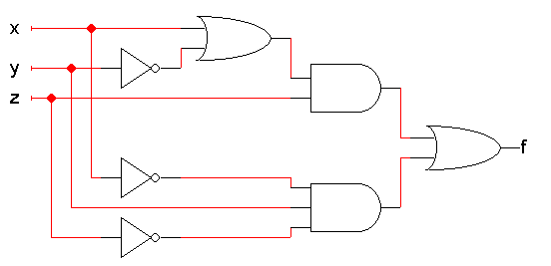
Circuit analysis
Circuit analysis involves figuring out what some circuit does.
Every circuit computes some function, which can be described with Boolean expressions or truth tables.
So, the goal is to find an expression or truth table for the circuit.
The first thing to do is figure out what the inputs and outputs of the overall circuit are.
This step is often overlooked!
The example circuit here has three inputs x, y, z and one output f.

Slide 5
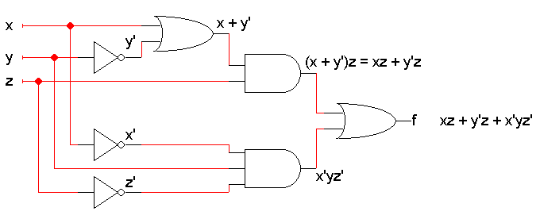
Write algebraic expressions...
Next, write expressions for the outputs of each individual gate, based on that gate’s inputs.
Start from the inputs and work towards the outputs.
It might help to do some algebraic simplification along the way.
Here is the example again.
We did a little simplification for the top AND gate.
You can see the circuit computes f(x,y,z) = xz + y’z + x’yz’

Slide 6
...or make a truth table
It’s also possible to find a truth table directly from the circuit.
Once you know the number of inputs and outputs, list all the possible input combinations in your truth table.
A circuit with n inputs should have a truth table with 2^{n} rows.
Our example has three inputs, so the truth table will have 2³ = 8 rows. All the possible input combinations are shown.

Slide 7

Simulating the circuit
Then you can simulate the circuit, either by hand or with a program, to find the output for each possible combination of inputs.
For example, when xyz = 101, the gate outputs would be as shown below.
Use truth tables for AND, OR and NOT to find the gate outputs.
For the final output, we find that f(1,0,1) = 1.
1
1
1
0
1
1
0
1
0
0

Slide 8
Finishing the truth table
Doing the same thing for all the other input combinations yields the complete truth table.
This is simple, but tedious.

Slide 9
Expressions and truth tables
Remember that if you already have a Boolean expression, you can use that to easily make a truth table.
For example, since we already found that the circuit computes the function f(x,y,z) = xz + y’z + x’yz’, we can use that to fill in a table:
We show intermediate columns for the terms xz, y’z and x’yz’.
Then, f is obtained by just OR’ing the intermediate columns.

Slide 10
Truth tables and expressions
The opposite is also true: it’s easy to come up with an expression if you already have a truth table.
We saw that you can quickly convert a truth table into a sum of minterms expression. The minterms correspond to the truth table rows where the output is 1.
You can then simplify this sum of minterms if desired—using a K-map, for example.
f(x,y,z) = x’y’z + x’yz’ + xy’z + xyz
= m₁ + m₂ + m₅ + m₇

Slide 11



Circuit analysis summary
After finding the circuit inputs and outputs, you can come up with either an expression or a truth table to describe what the circuit does.
You can easily convert between expressions and truth tables.
Find the circuit’s
inputs and outputs
Find a Boolean
expression
for the circuit
Find a truth table
for the circuit

Slide 12
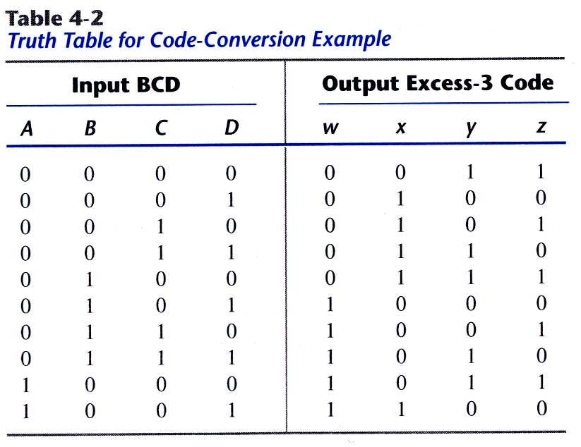
Example: Code Conversion
From BCD to 3-excess code

Slide 13
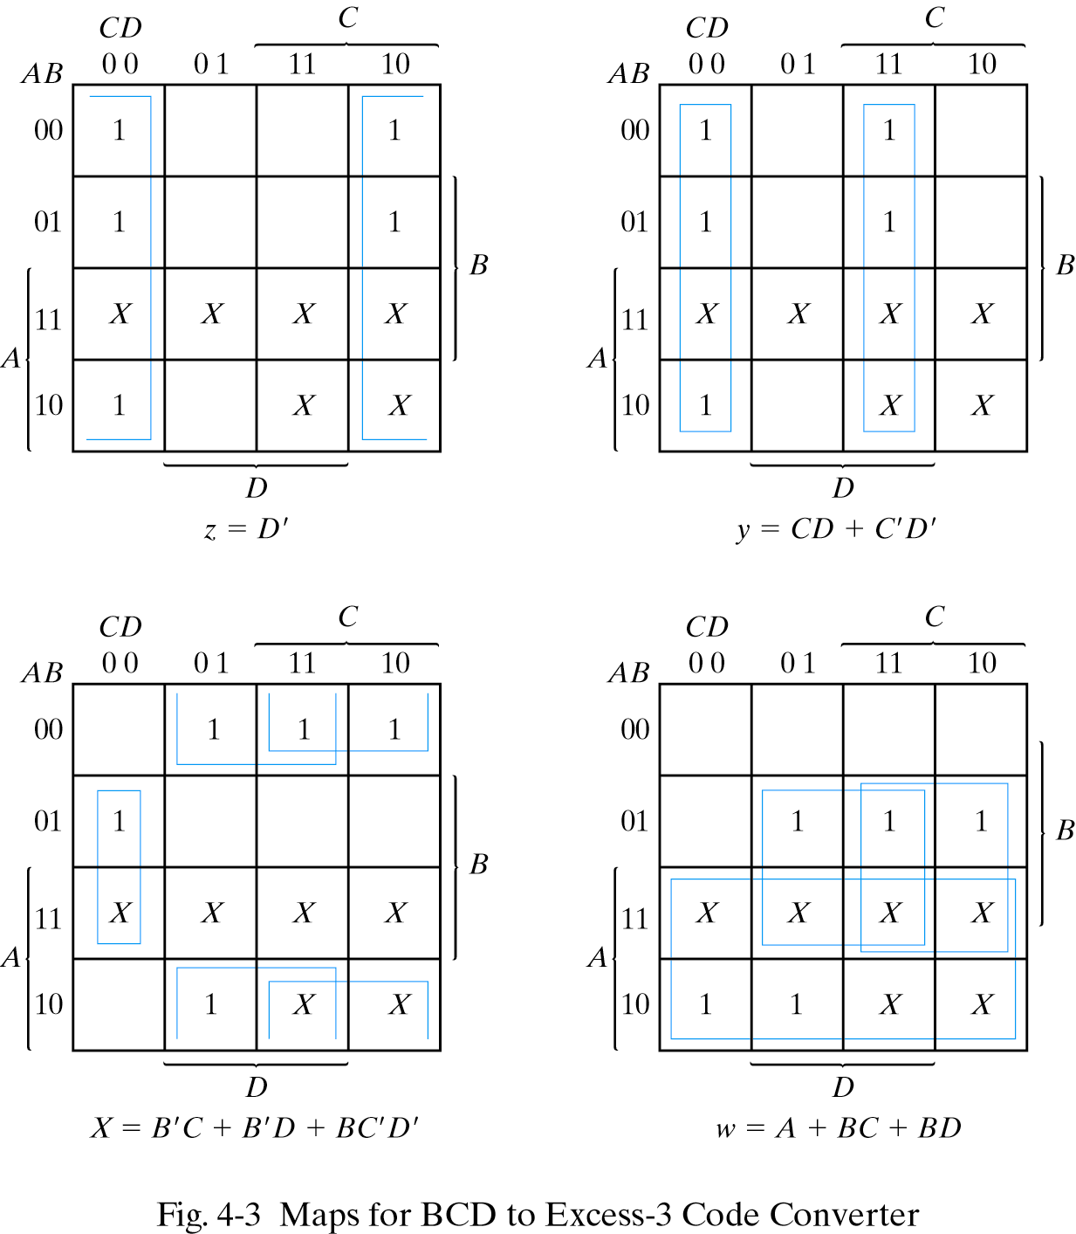
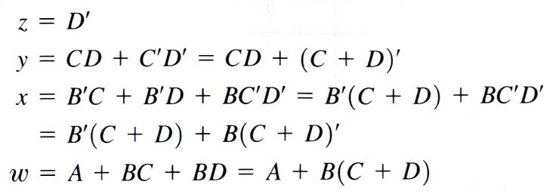
K-maps

Slide 14
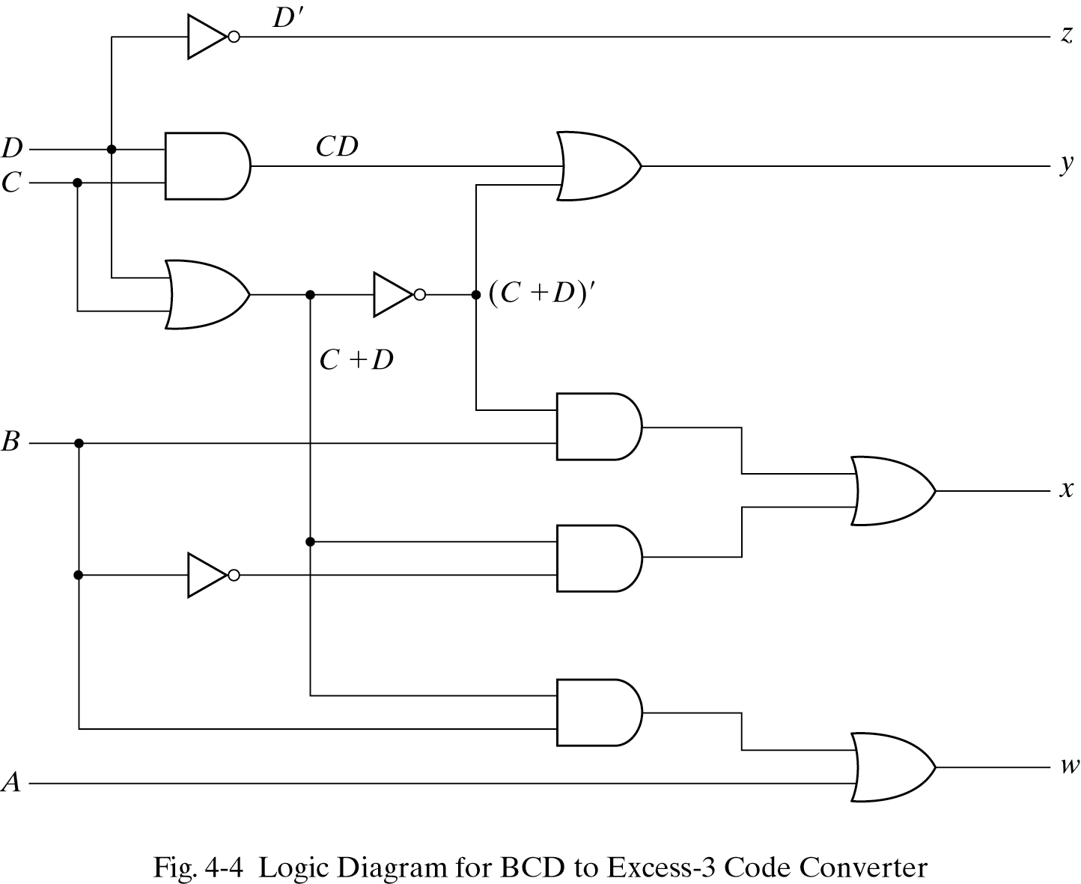
Logic Diagram for Code Converter

Slide 15
Binary addition by hand
You can add two binary numbers one column at a time starting from the right, just as you add two decimal numbers.
But remember that it’s binary. For example, 1 + 1 = 10 and you have to carry!
The initial carry
in is implicitly 0
1 1 1 0 Carry in
1 0 1 1 Augend
+ 1 1 1 0 Addend
1 1 0 0 1 Sum
most significant
bit, or MSB
least significant
bit, or LSB

Slide 16
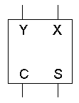
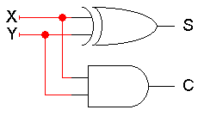
Adding two bits
We’ll make a hardware adder by copying the human addition algorithm.
We start with a half adder, which adds two bits and produces a two-bit result: a sum (the right bit) and a carry out (the left bit).
Here are truth tables, equations, circuit and block symbol.
0 + 0 = 0
0 + 1 = 1
1 + 0 = 1
1 + 1 = 10
C = XY
S = X’ Y + X Y’
= X ⊕ Y
Be careful! Now we’re using + for both arithmetic addition and the logical OR operation.

Slide 17
Adding three bits
But what we really need to do is add three bits: the augend and addend, and the carry in from the right.
1 1 1 0
1 0 1 1
+ 1 1 1 0
1 1 0 0 1
0 + 0 + 0 = 00
0 + 0 + 1 = 01
0 + 1 + 0 = 01
0 + 1 + 1 = 10
1 + 0 + 0 = 01
1 + 0 + 1 = 10
1 + 1 + 0 = 10
1 + 1 + 1 = 11
(These are the same functions from the decoder and mux examples.)

Slide 18
Full adder equations
A full adder circuit takes three bits of input, and produces a two-bit output consisting of a sum and a carry out.
Using Boolean algebra, we get the equations shown here.
XOR operations simplify the equations a bit.
We used algebra because you can’t easily derive XORs from K-maps.
S = Σm(1,2,4,7)
= X’ Y’ C_{in} + X’ Y C_{in}’ + X Y’ C_{in}’ + X Y C_{in}
= X’ (Y’ C_{in} + Y C_{in}’) + X (Y’ C_{in}’ + Y C_{in})
= X’ (Y ⊕ C_{in}) + X (Y ⊕ C_{in})’
= X ⊕ Y ⊕ C_{in}
C_{out} = Σm(3,5,6,7)
= X’ Y C_{in} + X Y’ C_{in} + X Y C_{in}’ + X Y C_{in}
= (X’ Y + X Y’) C_{in} + XY(C_{in}’ + C_{in})
= (X ⊕ Y) C_{in} + XY

Slide 19
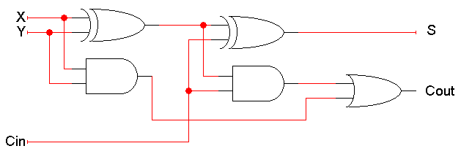
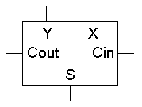
Full adder circuit
These things are called half adders and full adders because you can build a full adder by putting together two half adders!
S = X ⊕ Y ⊕ C_{in}
C_{out} = (X ⊕ Y) C_{in} + XY

Slide 20
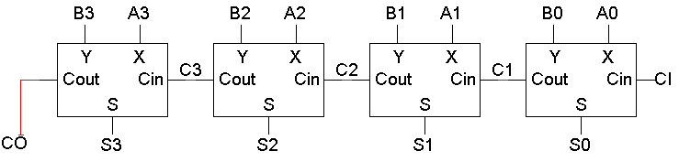
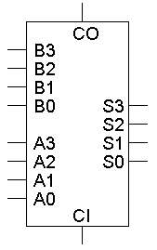
A 4-bit adder
Four full adders together make a 4-bit adder.
There are nine total inputs:
Two 4-bit numbers, A3 A2 A1 A0 and B3 B2 B1 B0
An initial carry in, CI
The five outputs are:
A 4-bit sum, S3 S2 S1 S0
A carry out, CO
Imagine designing a nine-input adder without this hierarchical structure—you’d have a 512-row truth table with five outputs!

Slide 21
An example of 4-bit addition
Let’s try our initial example: A=1011 (eleven), B=1110 (fourteen).
1 1 1 0 1 1 0 1
0
1
1
0
1 1
0
0
1
1. Fill in all the inputs, including CI=0
2. The circuit produces C1 and S0 (1 + 0 + 0 = 01)
3. Use C1 to find C2 and S1 (1 + 1 + 0 = 10)
4. Use C2 to compute C3 and S2 (0 + 1 + 1 = 10)
5. Use C3 to compute CO and S3 (1 + 1 + 1 = 11)
The final answer is 11001 (twenty-five).

Slide 22
Overflow
In this case, note that the answer (11001) is five bits long, while the inputs were each only four bits (1011 and 1110).
→ overflow
Although the answer 11001 is correct, we cannot use that answer in any subsequent computations with this 4-bit adder.
For unsigned addition, overflow occurs when the carry out is 1.

Slide 23
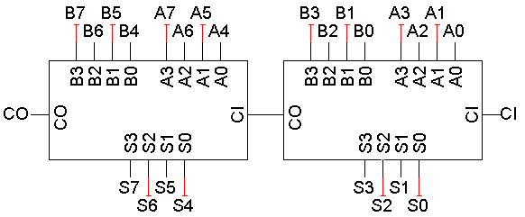
Hierarchical adder design
When you add two 4-bit numbers the carry in is always 0, so why does the 4-bit adder have a CI input?
One reason is so we can put 4-bit adders together to make even larger adders! This is just like how we put four full adders together to make the 4-bit adder in the first place.
Here is an 8-bit adder, for example.
CI is also useful for subtraction.

Slide 24

Gate delays
Every gate takes some small fraction of a second between the time inputs are presented and the time the correct answer appears on the outputs. This little fraction of a second is called a gate delay.
There are actually detailed ways of calculating gate delays that can get quite complicated, but for this class, let’s just assume that there’s some small constant delay that’s the same for all gates.
We can use a timing diagram to show gate delays graphically.
1
x
x’
0
gate delays

Slide 25
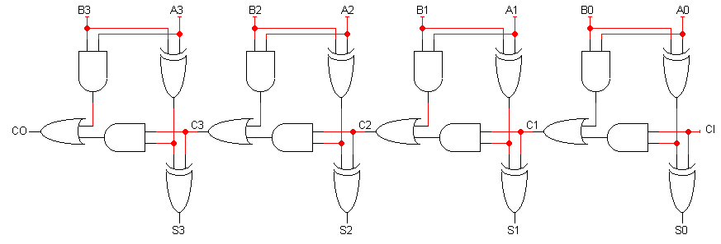
Delays in the ripple carry adder
The diagram below shows a 4-bit adder completely drawn out.
This is called a ripple carry adder, because the inputs A₀, B₀ and CI “ripple” leftwards until CO and S₃ are produced.
Ripple carry adders are slow!
Our example addition with 4-bit inputs required 5 “steps.”
There is a very long path from A₀, B₀ and CI to CO and S₃.
For an n-bit ripple carry adder, the longest path has 2n+1 gates.
Imagine a 64-bit adder. The longest path would have 129 gates!
1
9
8
7
6
5
4
3
2

Slide 26
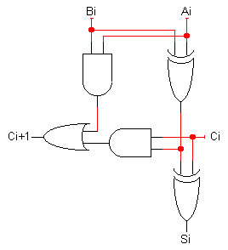
A faster way to compute carry outs
Instead of waiting for the carry out from all the previous stages, we could compute it directly with a two-level circuit, thus minimizing the delay.
First we define two functions.
The “generate” function g_{i} produces 1 when there must be a carry out from position i (i.e., when A_{i} and B_{i} are both 1).
g_{i} = A_{i}B_{i}
The “propagate” function p_{i} is true when, if there is an incoming carry, it is propagated (i.e, when A_{i}=1 or B_{i}=1, but not both).
p_{i} = A_{i} ⊕ B_{i}
Then we can rewrite the carry out function:
c_{i+1} = g_{i} + p_{i}c_{i}
g_{i}
p_{i}

Slide 27
Algebraic carry out
Let’s look at the carry out equations for specific bits, using the general equation from the previous page c_{i+1} = g_{i} + p_{i}c_{i}:
These expressions are all sums of products, so we can use them to make a circuit with only a two-level delay.
c₁ = g₀ + p₀c₀
c₂ = g₁ + p₁c₁
= g₁ + p₁(g₀ + p₀c₀)
= g₁ + p₁g₀ + p₁p₀c₀
c₃ = g₂ + p₂c₂
= g₂ + p₂(g₁ + p₁g₀ + p₁p₀c₀)
= g₂ + p₂g₁ + p₂p₁g₀ + p₂p₁p₀c₀
c₄ = g₃ + p₃c₃
= g₃ + p₃(g₂ + p₂g₁ + p₂p₁g₀ + p₂p₁p₀c₀)
= g₃ + p₃g₂ + p₃p₂g₁ + p₃p₂p₁g₀ + p₃p₂p₁p₀c₀
Ready to see the circuit?

Slide 28
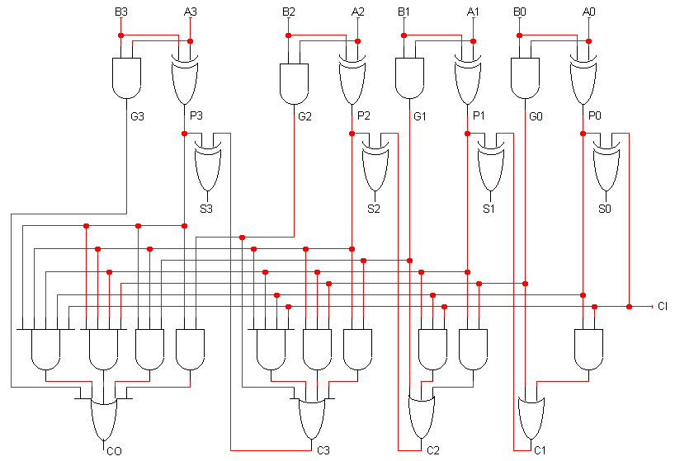
A 4-bit carry lookahead adder circuit
“carry-out”, not “c-zero”

Slide 29
Carry lookahead adders
By adding more hardware,
Reducing the number of levels in the circuit
Speeding things up.
We can “cascade” carry lookahead adders, just like ripple carry adders.
We’d have to do carry lookahead between the adders too.
How much faster is this?
For a 4-bit adder, not much. There are 4 gates in the longest path of a carry lookahead adder, versus 9 gates for a ripple carry adder.
But if we do the cascading properly, a 16-bit carry lookahead adder could have only 8 gates in the longest path, as opposed to 33 for a ripple carry adder.
Newer CPUs these days use 64-bit adders. That’s 12 vs. 129 gates!
The delay of a carry lookahead adder grows logarithmically with the size of the adder, while a ripple carry adder’s delay grows linearly.
The trade-off between complexity and performance
Ripple carry adders are simpler, but slower.
Carry lookahead adders are faster but more complex.

