Slide 1
Chapter 4. Combinational Logic Part B

Slide 2
Subtraction
The arithmetic we did so far was limited to unsigned (positive) integers.
We’ll consider negative numbers and subtraction.
With negative numbers, we’ll be able to do subtraction using the adders we made last time, because A - B = A + (-B).

Slide 3
One’s complement representation
A different approach, one’s complement, negates numbers by complementing each bit of the number.
We keep the sign bits: 0 for positive numbers, and 1 for negative. The sign bit is complemented along with the rest of the bits.
Examples:
1101₂ = 13₁₀ (a 4-bit unsigned number)
0 1101 = +13₁₀ (a positive number in 5-bit one’s complement)
1 0010 = -13₁₀ (a negative number in 5-bit one’s complement)
0100₂ = 4₁₀ (a 4-bit unsigned number)
0 0100 = +4₁₀ (a positive number in 5-bit one’s complement)
1 1011 = -4₁₀ (a negative number in 5-bit one’s complement)

Slide 4
One’s complement addition
To add one’s complement numbers:
First do unsigned addition on the numbers, including the sign bits.
Then take the carry out and add it to the sum.
Two examples:
0111 (+7)
+ 1011 + (-4)
1 0010
0010
+ 1
0011 (+3)
0011 (+3)
+ 0010 + (+2)
0 0101
0101
+ 0
0101 (+5)

Slide 5
Two’s complement
Our final idea is two’s complement. To negate a number, complement each bit (just as for ones’ complement) and then add 1.
Examples:
1101₂ = 13₁₀ (a 4-bit unsigned number)
0 1101 = +13₁₀ (a positive number in 5-bit two’s complement)
1 0010 = -13₁₀ (a negative number in 5-bit ones’ complement)
1 0011 = -13₁₀ (a negative number in 5-bit two’s complement)
0100₂ = 4₁₀ (a 4-bit unsigned number)
0 0100 = +4₁₀ (a positive number in 5-bit two’s complement)
1 1011 = -4₁₀ (a negative number in 5-bit ones’ complement)
1 1100 = -4₁₀ (a negative number in 5-bit two’s complement)

Slide 6
More about two’s complement
Two other equivalent ways to negate two’s complement numbers:
You can subtract an n-bit two’s complement number from 2^{n}.
You can complement all of the bits to the left of the rightmost 1.
01101 = +13₁₀ (a positive number in two’s complement)
10011 = -13₁₀ (a negative number in two’s complement)
00100 = +4₁₀ (a positive number in two’s complement)
11100 = -4₁₀ (a negative number in two’s complement)
1 0 0 0 0 0
- 0 1 1 0 1 (+13₁₀)
1 0 0 1 1 (-13₁₀)
1 0 0 0 0 0
- 0 0 1 0 0 (+4₁₀)
1 1 1 0 0 (-4₁₀)

Slide 7
Two’s complement addition
Negating a two’s complement number takes a bit of work, but addition is much easier than with the other two systems.
To find A + B, you just have to:
Do unsigned addition on A and B, including their sign bits.
Ignore any carry out.
For example, to find 0111 + 1100, or (+7) + (-4):
First add 0111 + 1100 as unsigned numbers:
Discard the carry out (1).
The answer is 0011 (+3).
0 1 1 1
+ 1 1 0 0
1 0 0 1 1

Slide 8
Another two’s complement example
To further convince you that this works, let’s try adding two negative numbers—1101 + 1110, or (-3) + (-2) in decimal.
Adding the numbers gives 11011:
Dropping the carry out (1) leaves us with the answer, 1011 (-5).
1 1 0 1
+ 1 1 1 0
1 1 0 1 1

Slide 9
Why does this work?
For n-bit numbers, the negation of B in two’s complement is 2^{n} - B (this is one of the alternative ways of negating a two’s-complement number).
A - B = A + (-B)
= A + (2^{n} - B)
= (A - B) + 2^{n}
If A ≥ B, then (A - B) is a positive number, and 2^{n} represents a carry out of 1. Discarding this carry out is equivalent to subtracting 2^{n}, which leaves us with the desired result (A - B).
If A < B, then (A - B) is a negative number and we have 2^{n} - (A - B). This corresponds to the desired result, -(A - B), in two’s complement form.

Slide 10
Ranges of the signed number systems
How many negative and positive numbers can be represented in each of the different systems on the previous page?
In general, with n-bit numbers including the sign, the ranges are:

Slide 11
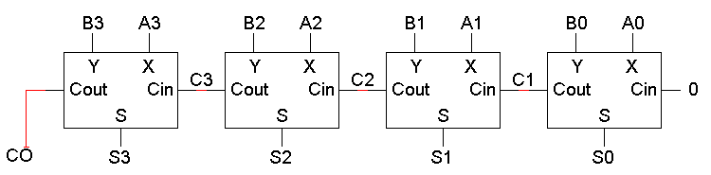
Our four-bit unsigned adder circuit
Here is the four-bit unsigned addition circuit.

Slide 12
Making a subtraction circuit
We could build a subtraction circuit directly, similar to the way we made unsigned adders yesterday.
However, by using two’s complement we can convert any subtraction problem into an addition problem. Algebraically,
A - B = A + (-B)
So to subtract B from A, we can instead add the negation of B to A.
This way we can re-use the unsigned adder hardware.

Slide 13
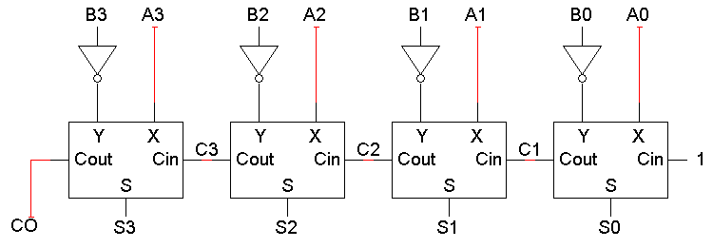
A two’s complement subtraction circuit
To find A - B with an adder, we’ll need to:
Complement each bit of B.
Set the adder’s carry in to 1.
The net result is A + B’ + 1, where B’ + 1 is the two’s complement negation of B.
Remember that A3, B3 and S3 here are actually sign bits.

Slide 14
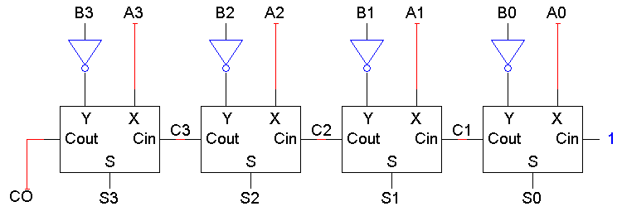
Small differences
The only differences between the adder and subtractor circuits are:
The subtractor has to negate B3 B2 B1 B0.
The subtractor sets the initial carry in to 1, instead of 0.
It’s not too hard to make one circuit that does both addition and subtraction.

Slide 15
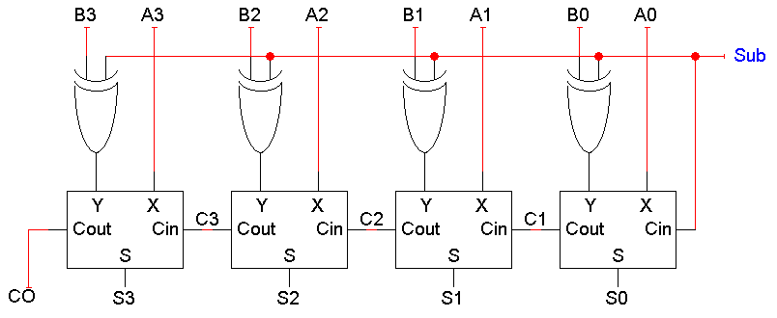
An adder-subtractor circuit
XOR gates let us selectively complement the B input.
X ⊕ 0 = X X ⊕ 1 = X’
When Sub = 0, the XOR gates output B3 B2 B1 B0 and the carry in is 0. The adder output will be A + B + 0, or just A + B.
When Sub = 1, the XOR gates output B3’ B2’ B1’ B0’ and the carry in is 1. Thus, the adder output will be a two’s complement subtraction, A - B.

Slide 16
Signed overflow
With two’s complement and a 4-bit adder, for example, the largest representable decimal number is +7, and the smallest is -8.
What if you try to compute 4 + 5, or (-4) + (-5)?
We cannot just include the carry out to produce a five-digit result, as for unsigned addition. If we did, (-4) + (-5) would result in +23!
Also, unlike the case with unsigned numbers, the carry out cannot be used to detect overflow.
In the example on the left, the carry out is 0 but there is overflow.
Conversely, there are situations where the carry out is 1 but there is no overflow.
0 1 0 0 (+4)
+ 0 1 0 1 (+5)
0 1 0 0 1 (-7)
1 1 0 0 (-4)
+ 1 0 1 1 (-5)
1 0 1 1 1 (+7)

Slide 17
Detecting signed overflow
The easiest way to detect signed overflow is to look at all the sign bits.
Overflow occurs only in the two situations above:
If you add two positive numbers and get a negative result.
If you add two negative numbers and get a positive result.
Overflow cannot occur if you add a positive number to a negative number. Do you see why?
How to detect an overflow?
Observing the carry-in and the carry-out of the sign bit position
0 1 0 0 (+4)
+ 0 1 0 1 (+5)
0 1 0 0 1 (-7)
1 1 0 0 (-4)
+ 1 0 1 1 (-5)
1 0 1 1 1 (+7)

Slide 18
Sign extension
In everyday life, decimal numbers are assumed to have an infinite number of 0s in front of them. This helps in “lining up” numbers.
To subtract 231 and 3, for instance, you can imagine:
231
- 003
228
You need to be careful in extending signed binary numbers, because the leftmost bit is the sign and not part of the magnitude.
If you just add 0s in front, you might accidentally change a negative number into a positive one!
For example, going from 4-bit to 8-bit numbers:
0101 (+5) should become 0000 0101 (+5).
But 1100 (-4) should become 1111 1100 (-4).
The proper way to extend a signed binary number is to replicate the sign bit, so the sign is preserved.

Slide 19
Subtraction summary
A good representation for negative numbers makes subtraction hardware much easier to design.
Two’s complement is used most often (although signed magnitude shows up sometimes, such as in floating-point systems, which we’ll discuss on Wednesday).
Using two’s complement, we can build a subtractor with minor changes to the adder from last week.
We can also make a single circuit which can both add and subtract.
Overflow is still a problem, but signed overflow is very different from the unsigned overflow we mentioned last time.
Sign extension is needed to properly “lengthen” negative numbers.
Tomorrow we’ll use most of the ideas we’ve seen so far to build an ALU – an important part of a processor.

Slide 20
Decimal Adder
Some digital systems represent decimal numbers in binary coded form
→ use BCD code
Inputs and Outputs
Input: two 4-bit BCD number and 1 carry-in
Output: 1 BCD number and 1 carry-out
Intermediate output: 5-bit binary output
Needs to convert binary code to BCD code
Max number of output = 9 + 9 + 1 = 19

Slide 21
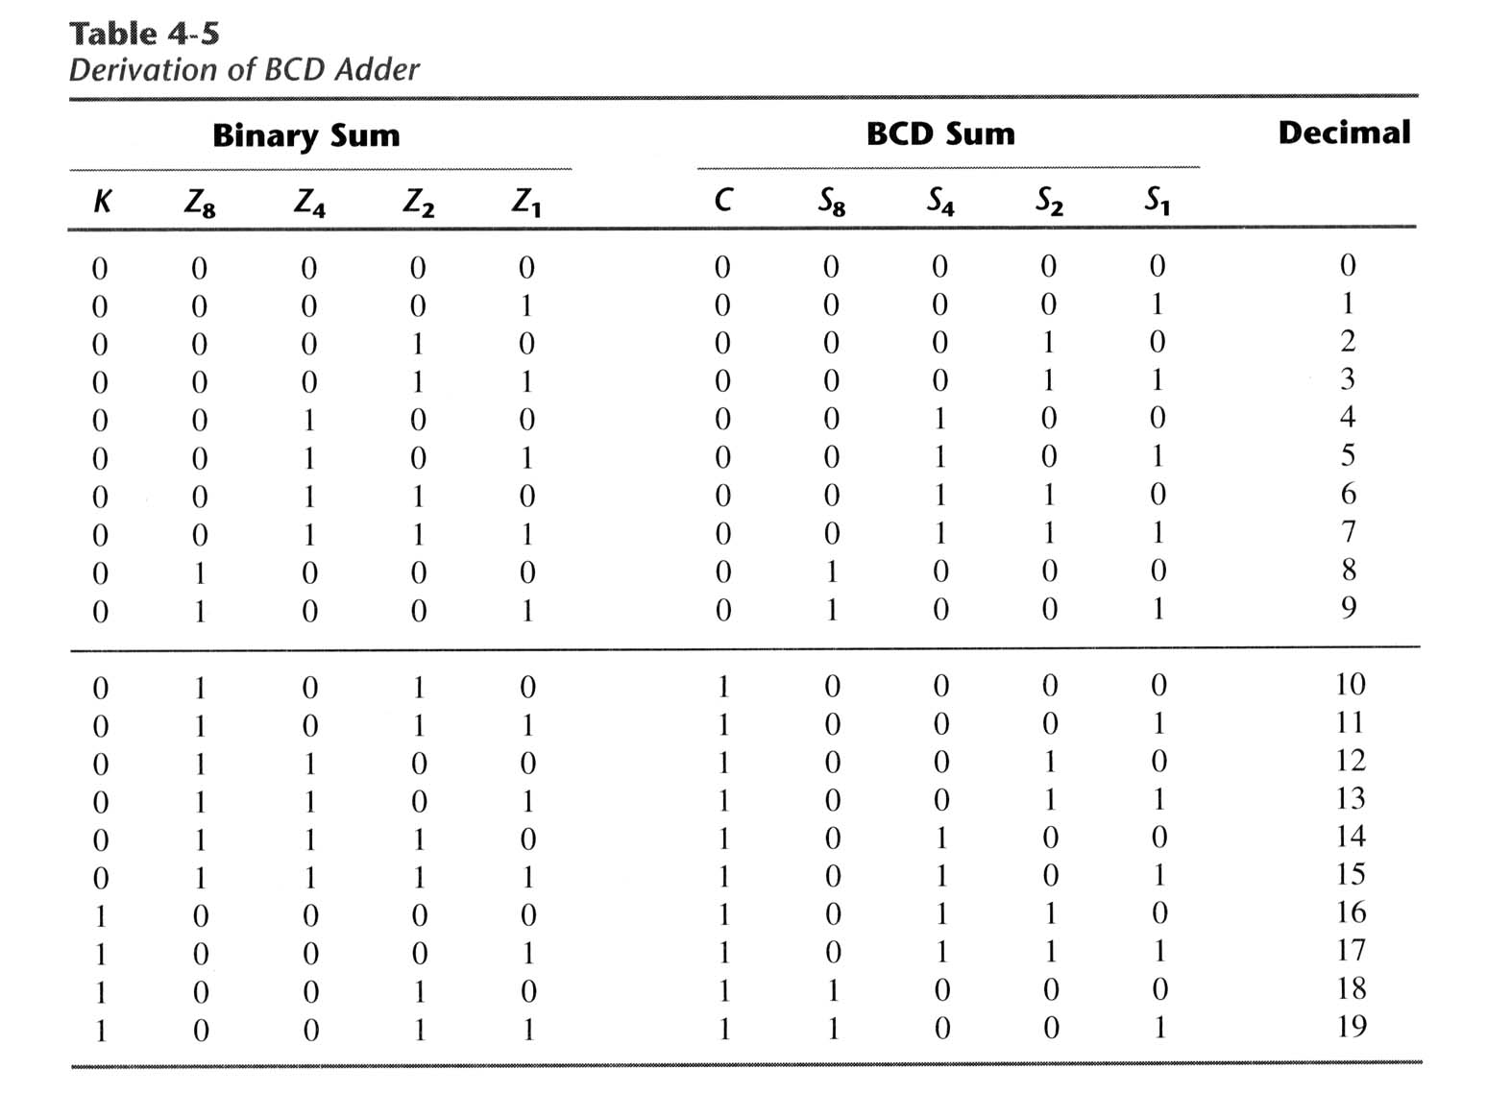

Slide 22
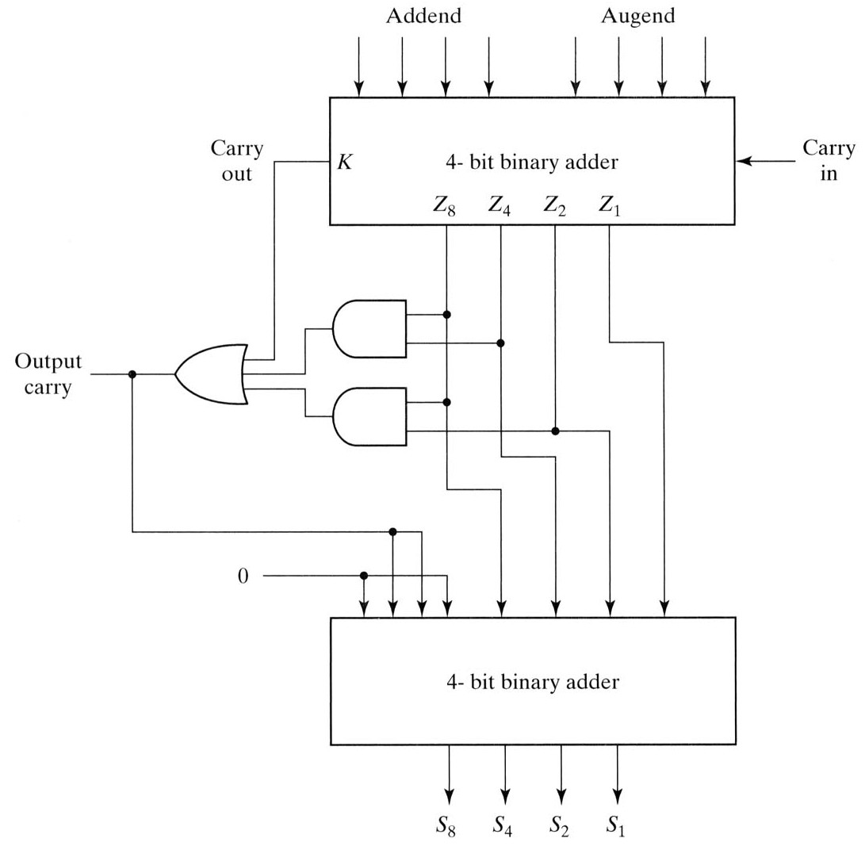
Block Diagram of BCD Adder
Sum of BCD adder
10~19
Needs to adjust sum
Carry-out
C = K + Z₈ Z₄ + Z₈ Z₂

Slide 23
Multiplication
Multiplication can’t be that hard!
It’s just repeated addition.
If we have adders, we can do multiplication also.
Remember that the AND operation is equivalent to multiplication on two bits:

Slide 24
Binary multiplication example
Since we always multiply by either 0 or 1, the partial products are always either 0000 or the multiplicand (1101 in this example).
There are four partial products which are added to form the result.
We can add them in pairs, using three adders.
Even though the product has up to 8 bits, we can use 4-bit adders if we “stagger” them leftwards, like the partial products themselves.
1 1 0 1 Multiplicand
x 0 1 1 0 Multiplier
0 0 0 0 Partial products
1 1 0 1
1 1 0 1
+ 0 0 0 0
1 0 0 1 1 1 0 Product

Slide 25
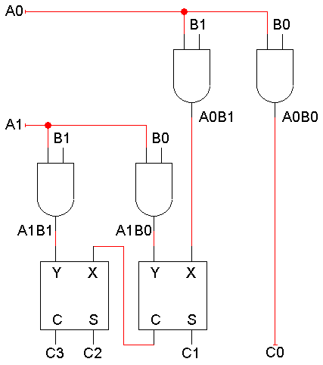
A 2x2 binary multiplier
The AND gates produce the partial products.
For a 2-bit by 2-bit multiplier, we can just use two half adders to sum the partial products. In general, though, we’ll need full adders.
Here C₃-C₀ are the product, not carries!

Slide 26
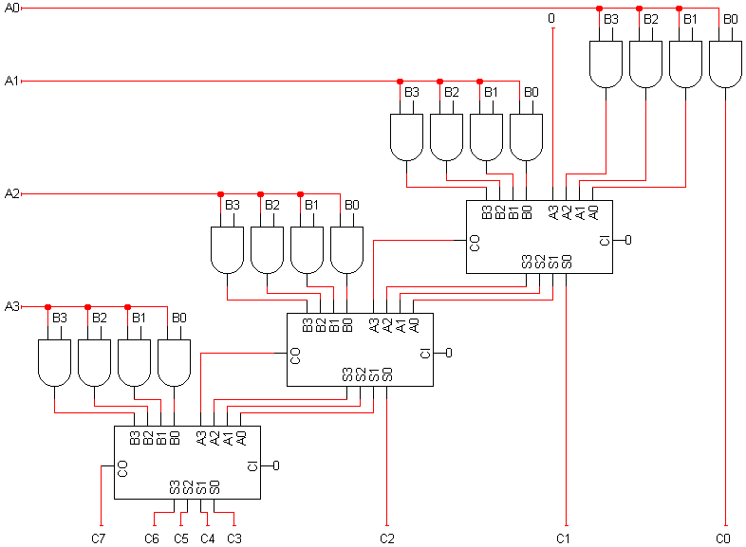
A 4x4 multiplier circuit

Slide 27
More on multipliers
Notice that this 4-bit multiplier produces an 8-bit result.
We could just keep all 8 bits.
Or, if we needed a 4-bit result, we could ignore C4-C7, and consider it an overflow condition if the result is longer than 4 bits.
Multipliers are very complex circuits.
In general, when multiplying an m-bit number by an n-bit number:
There are n partial products, one for each bit of the multiplier.
This requires n-1 adders, each of which can add m bits (the size of the multiplicand).
The circuit for 32-bit or 64-bit multiplication would be huge!

Slide 28
Multiplication: a special case
In decimal, an easy way to multiply by 10 is to shift all the digits to the left, and tack a 0 to the right end.
128 x 10 = 1280
We can do the same thing in binary. Shifting left is equivalent to multiplying by 2:
11 x 10 = 110 (in decimal, 3 x 2 = 6)
Shifting left twice is equivalent to multiplying by 4:
11 x 100 = 1100 (in decimal, 3 x 4 = 12)
As an aside, shifting to the right is equivalent to dividing by 2.
110 ÷ 10 = 11 (in decimal, 6 ÷ 2 = 3)

Slide 29
Addition and multiplication summary
Adder and multiplier circuits mimic human algorithms for addition and multiplication.
Adders and multipliers are built hierarchically.
We start with half adders or full adders and work our way up.
Building these functions from scratch with truth tables and K-maps would be pretty difficult.
The arithmetic circuits impose a limit on the number of bits that can be added. Exceeding this limit results in overflow.
There is a tradeoff between simple but slow circuits (ripple carry adders) and complex but fast circuits (carry lookahead adders).
Multiplication and division by powers of 2 can be handled with simple shifting.

