Slide 1
Chapter 5. Synchronous Sequential Logic Part C

Slide 2
Sequential circuit analysis
In the last class, we started talking about latches and flip-flops, which are basic one-bit memory units.
Today we’ll talk about sequential circuit analysis and design.
First, we’ll see how to analyze and describe sequential circuits.
State tables show the inputs, outputs, and flip-flop state changes for sequential circuits.
State diagrams are an alternative but equivalent way of showing the same information.
Inputs
Combinational
circuit
Outputs
Memory

Slide 3
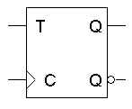
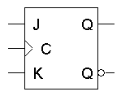
Review: Flip-flop variations
We can make different versions of flip-flops based on the D flip-flop, just like we made different latches based on the S’R’ latch.
A JK flip-flop has inputs that act like S and R, but the inputs JK=11 are used to complement the flip-flop’s current state.
A T flip-flop can only maintain or complement its current state.

Slide 4
Review: Characteristic tables
The tables that we’ve made so far are called characteristic tables.
They show the next state Q(t+1) in terms of the current state Q(t) and the inputs.
For simplicity, the control input C is not usually listed.
Again, these tables don’t indicate the positive edge-triggered behavior of the flip-flops that we’ll be using.

Slide 5
Review: Characteristic equations
We can also write characteristic equations, where the next state Q(t+1) is defined in terms of the current state Q(t) and inputs.
Q(t+1) = D
Q(t+1) = K’Q(t) + JQ’(t)
Q(t+1) = T’Q(t) + TQ’(t)
= T ⊕ Q(t)

Slide 6
Review: Flip flop timing diagrams
“Present state” and “next state” are relative terms.
In the example JK flip-flop timing diagram on the left, you can see that at the first positive clock edge, J=1, K=1 and Q(1) = 1.
We can use this information to find the “next” state, Q(2) = Q(1)’.
Q(2) appears right after the first positive clock edge, as shown on the right. It will not change again until after the second clock edge.
1 2 3 4
1 2 3 4
C
J
K
Q
C
J
K
Q
These values at clock cycle 1...
… determine the “next” Q

Slide 7
Review: “Present” and “next” are relative
Similarly, the values of J, K and Q at the second positive clock edge can be used to find the value of Q during the third clock cycle.
When we do this, Q(2) is now referred to as the “present” state, and Q(3) is now the “next” state.
1 2 3 4
1 2 3 4
C
J
K
Q
C
J
K
Q

Slide 8
Review: Positive edge triggered
One final point to repeat: the flip-flop outputs are affected only by the input values at the positive edge.
In the diagram below, K changes rapidly between the second and third positive edges.
But it’s only the input values at the third clock edge (K=1, and J=0 and Q=1) that affect the next state, so here Q changes to 0.
This is a fairly simple timing model. In real life there are “setup times” and “hold times” to worry about as well, to account for internal and external delays.
1 2 3 4
C
J
K
Q

Slide 9
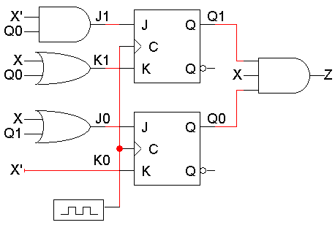
An example sequential circuit
Here is a sequential circuit with two JK flip-flops. There is one input, X, and one output, Z.
The values of the flip-flops (Q₁Q₀) form the state, or the memory, of the circuit.
The flip-flop outputs also go back into the primitive gates on the left. This fits the general sequential circuit diagram at the bottom.
X
Z
Inputs
Combinational
circuit
Outputs
Q0
Q1
Memory

Slide 10
How do you analyze a sequential circuit?
For a combinational circuit we could find a truth table, which shows how the outputs are related to the inputs.
A state table is the sequential analog of a truth table. It shows inputs and current states on the left, and outputs and next states on the right.
For a sequential circuit, the outputs are dependent upon not only the inputs, but also the current state of the flip-flops.
In addition to finding outputs, we also need to find the state of the flip-flops on the next clock cycle.

Slide 11
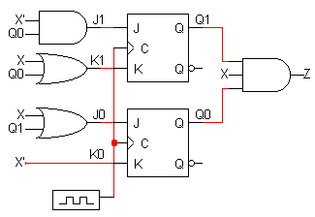
Analyzing our example circuit
A basic state table for our example circuit is shown below.
Remember that there is one input X, one output Z, and two flip-flops Q₁Q₀.
The present state Q₁Q₀ and the input will determine the next state and the output.

Slide 12
The outputs are easy
The output depends on the current state – Q0 and Q1 – as well as the inputs.
From the diagram, you can see that
Z = Q₁Q₀X
Output at the current time

Slide 13
Flip-flop input equations
Finding the next states is harder. To do this, we have to figure out how the flip-flops are changing.
Step 1:
Find Boolean expressions for the flip-flop inputs.
I.e. How do the inputs (say, J & K) to the flipflops
depend on the current state and input
Step 2:
Use these expressions to find the actual flip-flop input values for each possible combination of present states and inputs.
I.e. Fill in the state table (with new intermediate columns)
Step 3:
Use flip-flop characteristic tables or equations to find the next states, based on the flip-flop input values and the present states.

Slide 14
Step 1: Flip-flop input equations
For our example, the flip-flop input equations are:
J₁ = X’ Q₀
K₁ = X + Q₀
J₀ = X + Q₁
K₀ = X’
JK flip-flops each have two inputs, J and K. (D and T flip-flops have one input each.)

Slide 15
Step 2: Flip-flop input values
With these equations, we can make a table showing J₁, K₁, J₀ and K₀ for the different combinations of present state Q₁Q₀ and input X.
J₁ = X’ Q₀ J₀ = X + Q₁
K₁ = X + Q₀ K₀ = X’

Slide 16
Step 3: Find the next states
Finally, use the JK flip-flop characteristic tables or equations to find the next state of each flip-flop, based on its present state and inputs.
The general JK flip-flop characteristic equation is:
Q(t+1) = K’Q(t) + JQ’(t)
In our example circuit, we have two JK flip-flops, so we have to apply this equation to each of them:
Q₁(t+1) = K₁’Q₁(t) + J₁Q₁’(t)
Q₀(t+1) = K₀’Q₀(t) + J₀Q₀’(t)
We can also determine the next state for
each input/current state combination
directly from the characteristic table.

Slide 17
Step 3 concluded
Finally, here are the next states for Q₁ and Q₀, using these equations:
Q₁(t+1) = K₁’Q₁(t) + J₁Q₁’(t)
Q₀(t+1) = K₀’Q₀(t) + J₀Q₀’(t)

Slide 18
Getting the state table columns straight
The table starts with Present State and Inputs.
Present State and Inputs yield FF Inputs.
Present State and FF Inputs yield Next State, based on the flip-flop characteristic tables.
Present State and Inputs yield Output.
We really only care about FF Inputs in order to find Next State.

Slide 19
State diagrams
We can also represent the state table graphically with a state diagram.
A diagram corresponding to our example state table is shown below.
input
output
0/0
1/0
1/0
00
01
1/1
0/0
1/0
0/0
0/0
11
10
state

Slide 20
Sizes of state diagrams
Always check the size of your state diagrams.
If there are n flip-flops, there should be 2^{n} nodes in the diagram.
If there are m inputs, then each node will have 2^{m} outgoing arrows.
From each state
In our example,
We have two flip-flops, and thus four states or nodes.
There is one input, so each node has two outgoing arrows.
0/0
1/0
1/0
00
01
1/1
0/0
1/0
0/0
0/0
11
10

Slide 21
Sequential circuit analysis summary
To analyze sequential circuits, you have to:
Find Boolean expressions for the outputs of the circuit and the flip-flop inputs.
Use these expressions to fill in the output and flip-flop input columns in the state table.
Finally, use the characteristic equation or characteristic table of the flip-flop to fill in the next state columns.
The result of sequential circuit analysis is a state table or a state diagram describing the circuit.

