Slide 1
Chapter 5. Synchronous Sequential Logic Part D

Slide 2
Mealy and Moore Model
How to generate output function?
Mealy model
Output is a function of both the present state and input.
Mealy FSM (finite state machine)
Moore model
Output is a function of the present state only.
Moore FSM

Slide 3
State Reduction
Resulting in a reduction in the number of flip-flops in a sequential circuits
Keeping the external input-output requirements unchanged
Input-output sequences are important
Two states are equivalent if, for each member of the set of inputs, they give exactly the same output and send to the same state or equivalent state.

Slide 4
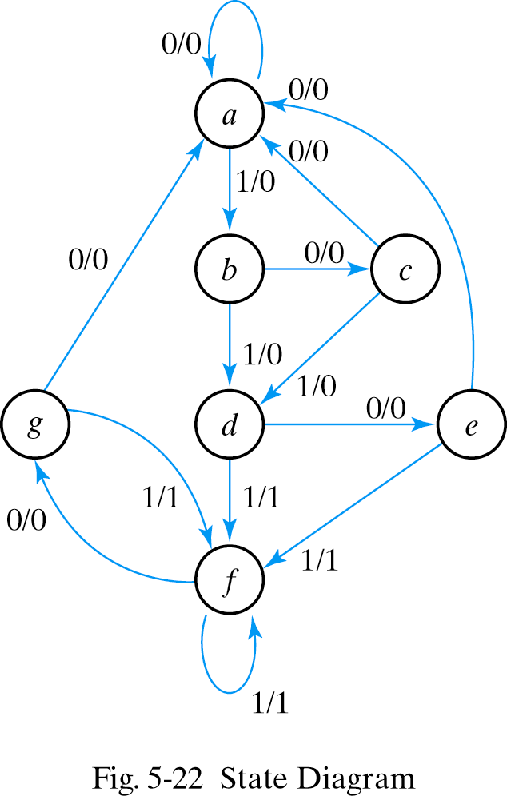
Example of state reduction
state a a b c d e f f g f g a
input 0 1 0 1 0 1 1 0 1 0 0
output 0 0 0 0 0 1 1 0 1 0 0

Slide 5
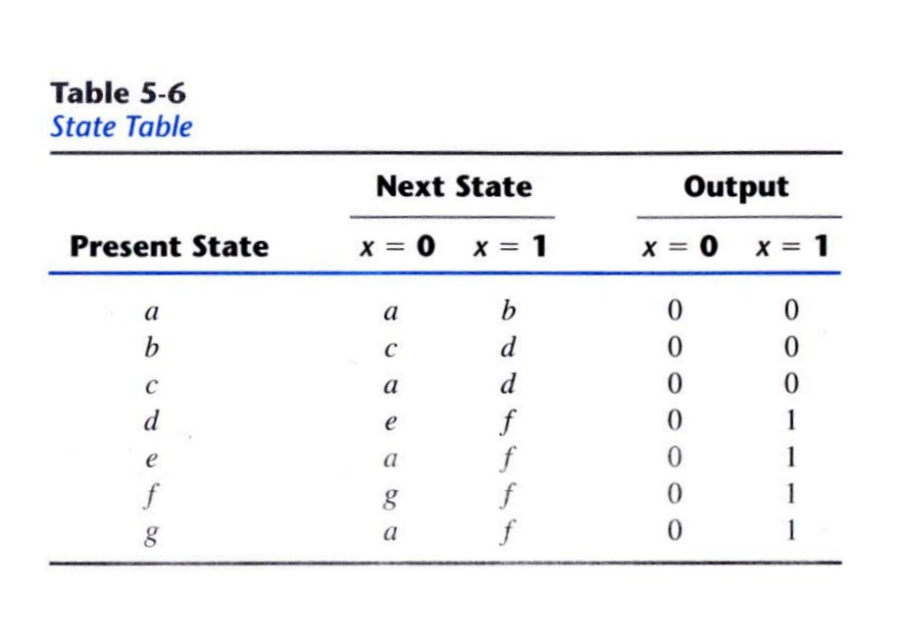
State table

Slide 6
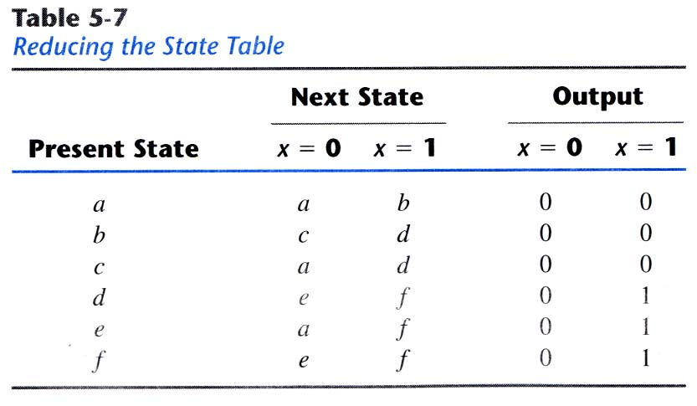
Reducing state table

Slide 7
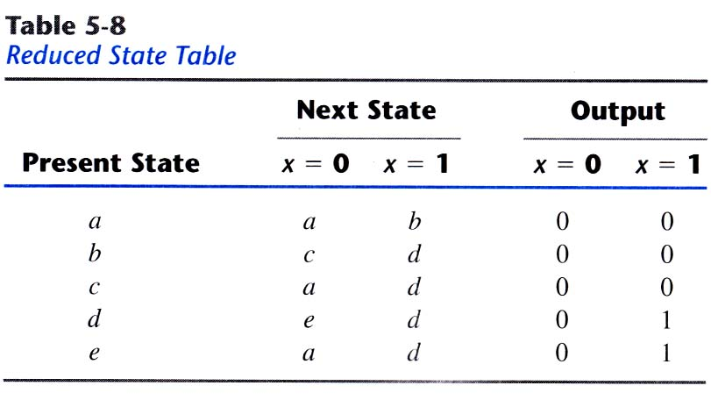
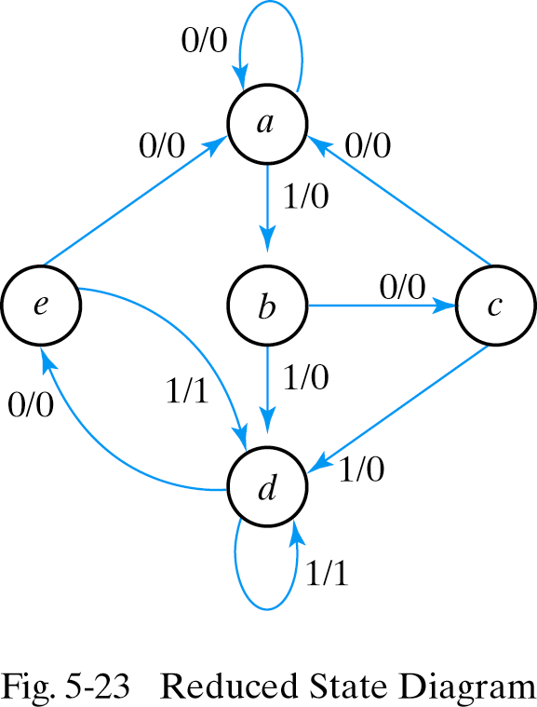
Reduced State

Slide 8
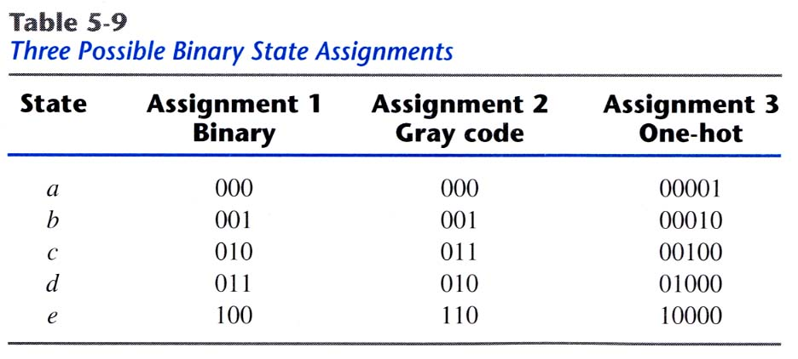
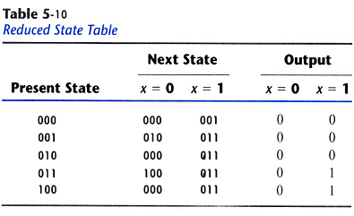
State Assignment
M states → ⎡log2 M⎤ bits

Slide 9
Sequential circuit design
Now let’s reverse the process: In sequential circuit design, we turn some description into a working circuit.
We first make a state table or diagram to express the computation.
Then we can turn that table or diagram into a sequential circuit.

Slide 10
Sequence recognizers
A sequence recognizer is a special kind of sequential circuit that looks for a special bit pattern in some input.
The recognizer circuit has only one input, X.
One bit of input is supplied on every clock cycle. For example, it would take 20 cycles to scan a 20-bit input.
This is an easy way to permit arbitrarily long input sequences.
There is one output, Z, which is 1 when the desired pattern is found.
Our example will detect the bit pattern “1001”:
Inputs: 1 1 1 0 0 1 1 0 1 0 0 1 0 0 1 1 0 …
Outputs: 0 0 0 0 0 1 0 0 0 0 0 1 0 0 1 0 0 …
Here, one input and one output bit appear every clock cycle.
This requires a sequential circuit because the circuit has to “remember” the inputs from previous clock cycles, in order to determine whether or not a match was found.

Slide 11
A basic state diagram
What state do we need for the sequence recognizer?
We have to “remember” inputs from previous clock cycles.
For example, if the previous three inputs were 100 and the current input is 1, then the output should be 1.
In general, we will have to remember occurrences of parts of the desired pattern—in this case, 1, 10, and 100.
We’ll start with a basic state diagram:
1/0
0/0
0/0
A
B
C
D

Slide 12
Step 1: Making a state table
The first thing you have to figure out is precisely how the use of state will help you solve the given problem.
Make a state table based on the problem statement. The table should show the present states, inputs, next states and outputs.
Sometimes it is easier to first find a state diagram and then convert that to a table.
This is usually the most difficult step. Once you have the state table, the rest of the design procedure is the same for all sequential circuits.
Sequence recognizers are especially hard! They’re the hardest example we’ll see in this class, so if you understand this you’re in good shape.

Slide 13
A basic state diagram
What state do we need for the sequence recognizer?
We have to “remember” inputs from previous clock cycles.
For example, if the previous three inputs were 100 and the current input is 1, then the output should be 1.
In general, we will have to remember occurrences of parts of the desired pattern—in this case, 1, 10, and 100.
We’ll start with a basic state diagram:
1/0
0/0
0/0
A
B
C
D

Slide 14
Overlapping occurrences of the pattern
What happens if we’re in state D (the last three inputs were 100), and the current input is 1?
The output should be a 1, because we’ve found the desired pattern.
But this last 1 could also be the start of another occurrence of the pattern! For example, 1001001 contains two occurrences of 1001.
To detect overlapping occurrences of the pattern, the next state should be B.
1/0
0/0
0/0
A
B
C
D
1/1

Slide 15
Filling in the other arrows
Remember that we need two outgoing arrows for each node, to account for the possibilities of X=0 and X=1.
The remaining arrows we need are shown in blue. They also allow for the correct detection of overlapping occurrences of 1001.
0/0
1/0
1/0
0/0
0/0
A
B
C
D
1/0
0/0
1/1

Slide 16
Finally, making the state table
0/0
1/0
1/0
0/0
0/0
A
B
C
D
1/0
0/0
1/1
Remember how the state diagram arrows correspond to rows of the state table:
present state
input/output
next state

Slide 17
Sequential circuit design procedure
Step 1:
Make a state table based on the problem statement. The table should show the present states, inputs, next states and outputs. (It may be easier to find a state diagram first, and then convert that to a table.)
Step 2:
Assign binary codes to the states in the state table, if you haven’t already. If you have n states, your binary codes will have at least
⎡log₂ n⎤ digits, and your circuit will have at least ⎡log₂ n⎤ flip-flops.
Step 3:
For each flip-flop and each row of your state table, find the flip-flop input values that are needed to generate the next state from the present state. You can use flip-flop excitation tables here.
Step 4:
Find simplified equations for the flip-flop inputs and the outputs.
Step 5:
Build the circuit!

Slide 18
Step 2: Assigning binary codes to states
We have four states ABCD, so we need at least two flip-flops Q₁Q₀.
The easiest thing to do is represent state A with Q₁Q₀ = 00, B with 01, C with 10, and D with 11.
The state assignment can have a big impact on circuit complexity, but we won’t worry about that too much in this class.

Slide 19
Step 3: Finding flip-flop input values
Next we have to figure out how to actually make the flip-flops change from their present state into the desired next state.
This depends on what kind of flip-flops you use!
We’ll use two JKs. For each flip-flip Q_{i}, look at its present and next states, and determine what the inputs J_{i} and K_{i} should be in order to make that state change.

Slide 20
Finding JK flip-flop input values
For JK flip-flops, this is a little tricky. Recall the characteristic table:
If the present state of a JK flip-flop is 0 and we want the next state to be 1, then we have two choices for the JK inputs:
We can use JK=10, to explicitly set the flip-flop’s next state to 1.
We can also use JK=11, to complement the current state 0.
So to change from 0 to 1, we must set J=1, but K could be either 0 or 1.
Similarly, the other possible state transitions can all be done in two different ways as well.

Slide 21
JK excitation table
An excitation table shows what flip-flop inputs are required in order to make a desired state change.
This is the same information that’s given in the characteristic table, but presented “backwards.”

Slide 22
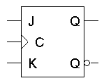
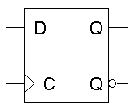
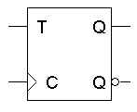
Excitation tables for all flip-flops

Slide 23
Back to the example
We can now use the JK excitation table on the right to find the correct values for each flip-flop’s inputs, based on its present and next states.

Slide 24
Step 4: Find equations for the FF inputs and output
Now you can make K-maps and find equations for each of the four flip-flop inputs, as well as for the output Z.
These equations are in terms of the present state and the inputs.
The advantage of using JK flip-flops is that there are many don’t care conditions, which can result in simpler MSP equations.
J₁ = X’ Q₀
K₁ = X + Q₀
J₀ = X + Q₁
K₀ = X’
Z = Q₁Q₀X

Slide 25
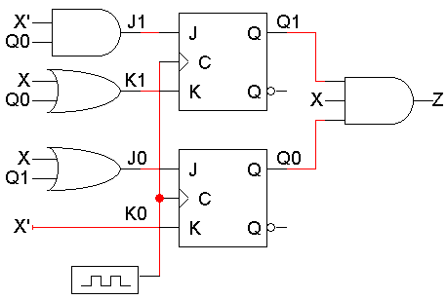
Step 5: Build the circuit
Lastly, we use these simplified equations to build the completed circuit.
J₁ = X’ Q₀
K₁ = X + Q₀
J₀ = X + Q₁
K₀ = X’
Z = Q₁Q₀X

Slide 26
Timing diagram
Here is one example timing diagram for our sequence detector.
The flip-flops Q₁Q₀ start in the initial state, 00.
On the first three positive clock edges, X is 1, 0, and 0. These inputs cause Q₁Q₀ to change, so after the third edge Q₁Q₀ = 11.
Then when X=1, Z becomes 1 also, meaning that 1001 was found.
The output Z does not have to change at positive clock edges. Instead, it may change whenever X changes, since Z = Q₁Q₀X.
1 2 3 4
CLK
Q₁
Q₀
X
Z

Slide 27
Building the same circuit with D flip-flops
What if you want to build the circuit using D flip-flops instead?
We already have the state table and state assignments, so we can just start from Step 3, finding the flip-flop input values.
D flip-flops have only one input, so our table only needs two columns for D₁ and D₀.

Slide 28
D flip-flop input values (Step 3)
The D excitation table is pretty boring; set the D input to whatever the next state should be.
You don’t even need to show separate columns for D₁ and D₀; you can just use the Next State columns.

Slide 29
Finding equations (Step 4)
You can do K-maps again, to find:
D₁ = Q₁ Q₀’ X’ + Q₁’ Q₀ X’
D₀ = X + Q₁ Q₀’
Z = Q₁ Q₀ X

Slide 30
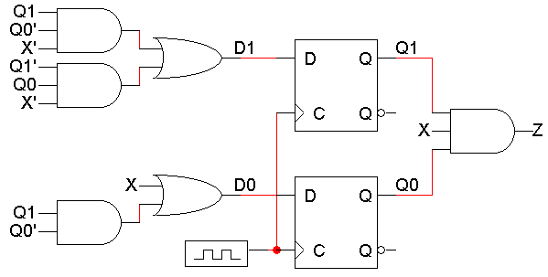
Building the circuit (Step 5)

Slide 31
Flip-flop comparison
JK flip-flops are good because there are many don’t care values in the flip-flop inputs, which can lead to a simpler circuit.
D flip-flops have the advantage that you don’t have to set up flip-flop inputs at all, since Q(t+1) = D. However, the D input equations are usually more complex than JK input equations
In practice, D flip-flops are used more often.
There is only one input for each flip-flop, not two.
There are no excitation tables to worry about.
D flip-flops can be implemented with slightly less hardware than JK flip-flops.

Slide 32
Summary
The basic sequential circuit design procedure:
Make a state table and, if desired, a state diagram. This step is usually the hardest.
Assign binary codes to the states if you didn’t already.
Use the present states, next states, and flip-flop excitation tables to find the flip-flop input values.
Write simplified equations for the flip-flop inputs and outputs and build the circuit.
Next, we’ll look at common examples of sequential circuits, including different types of counters.

