Slide 1


Commissioning of a Cylindrical Teflon Phantom for SBRT Delivery Quality Assurance
Ali Kakakhel
Karmanos Cancer Institute
Wayne State University School of Medicine
Detroit, MI
17 November 2011

Slide 2
Outline
Background
Purpose
Materials
Methods
Results
Conclusions
Acknowledgments
AK

Slide 3
Background
Currently treat lung patients with IMRT Stereotactic Body RadioTherapy (SBRT) protocol
Delivered on a Helical TomoTherapy (HT) system
May also be delivered using Varian RapidArc (RA)
Dose schedule is 12 Gy/fx over 4 fractions
Requires patient specific QA
AK

Slide 4
Background
Current protocol for DQA of SBRT cases
  Use the “cheese” phantom
    Cylindrical, Tissue equivalent
      Diameter: 30 cm
      Length: 18 cm
    Cut for placing a film
    Slots for ion chambers
      We place 5 mm ↑ , 10 mm ↓
  Two deliveries compared to TPS
    1st at full dose for absolute dose measurements using two ion chambers
    2nd at half dose for relative dose measurements using EDR2 film at the central plane
AK

Slide 5
Background
Current protocol poses challenges
  Typical doses saturate the EDR2 film used
    Saturation at ~7 Gy
    Hence the second delivery at half dose
  Single delivery times may approach 25 minutes
    Full DQA times may approach 1 hour
    Susceptible to overheating, output variation, etc.
  Leaf open time limitations¹
    Dose is scaled by scaling leaf open times
    Introduce errors?
    Small leaf open times are especially troublesome
  DQA performed on plans not delivered to patients!
¹Treatment Planning to Improve Delivery Accuracy And Patient Throughput in Helical Tomotherapy, D. C. Westerly et. al., Int. J. Rad. Onc. Biol. Phys. Vol. 74 No. 4 pp 1290-1297, 2009
AK

Slide 6
Purpose
Construct a new phantom that
  Remain a manage-able size
  Reduces dose to film plane
  Avoids LOT scaling and plan modification issues
Test the new phantom for viability in the DQA protocol for the SBRT IMRT plans
AK

Slide 7
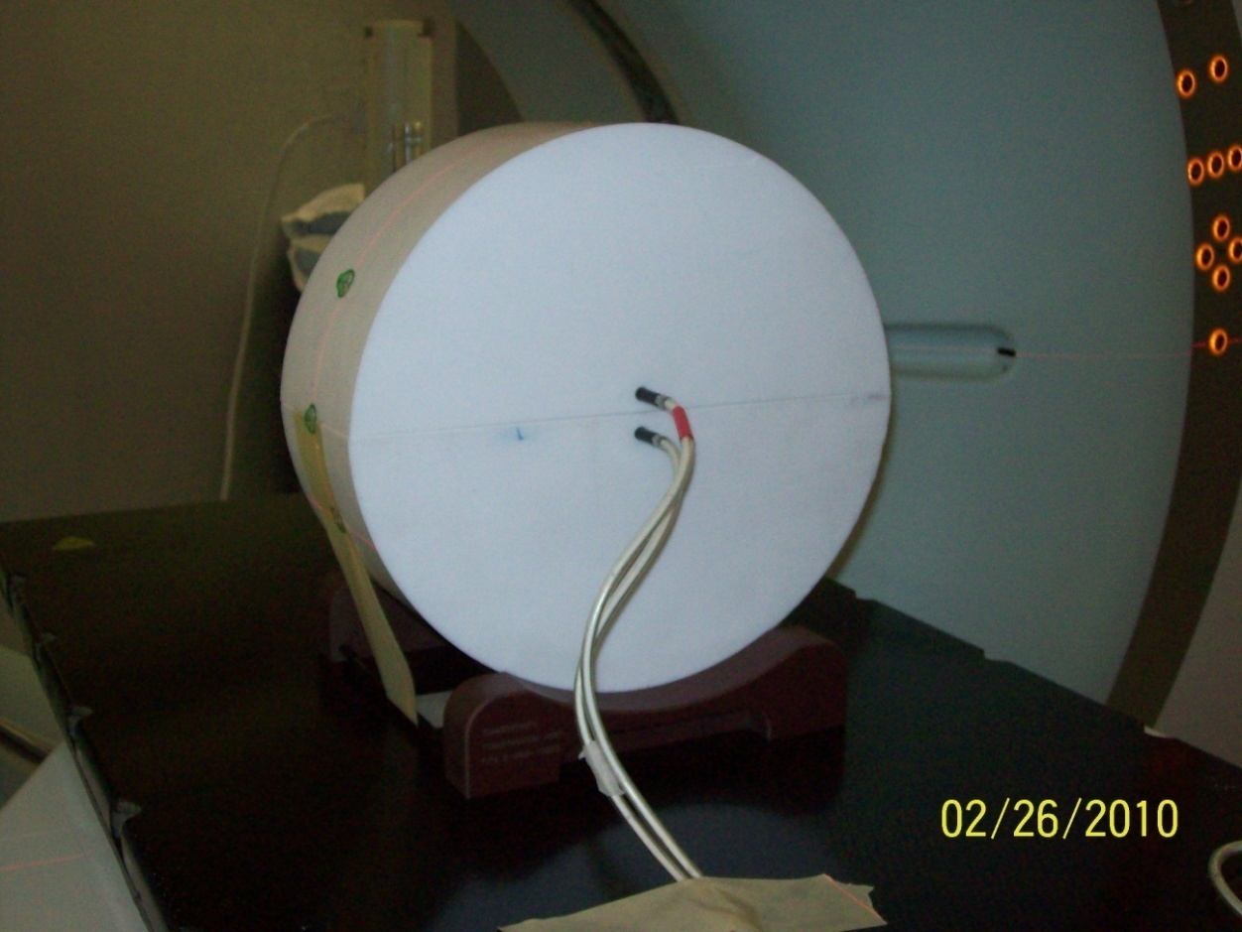
Materials
Our phantom
  Similar measurements to the HT “cheese” phantom
    Cylindrical, teflon
    Length: 10 cm
    Diameter: 30 cm
  Cut in half along the diameter allowing placement of a film (EDR2)
  Two holes drilled to the center for ion chambers
    Exradin A1SL ion chambers
    5 mm ↑ , 10 mm ↓ film plane
AK

Slide 8
Methods
Scan the phantom
  High density artifacts → use MVCT
Smooth images
  MVCT scan had too much noise
Calibrate the phantom
Compare DQA results of unsmoothed scan results to smoothed scan results
Compare DQA results to “cheese” phantom for passing SBRT plans
Compare DQA results to “cheese” phantom for failing SBRT plans
AK

Slide 9
Methods
RIT v3.4 for all film analysis
Passing criteria for all DQA plans:
  Point doses within 3% of TPS
  Film passes gamma analysis
    >90% pass rate
      3 mm DTA
      3% dose difference
AK

Slide 10
Methods – Smoothing
Matlab 2008b
Homogenized teflon pixel values
Average pixel value from a representative slice
  Ion chambers visible
  Film plane visible
  Clean of apparent artifacts
AK

Slide 11
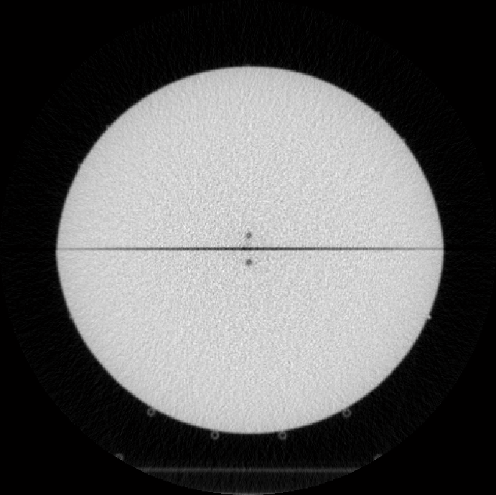
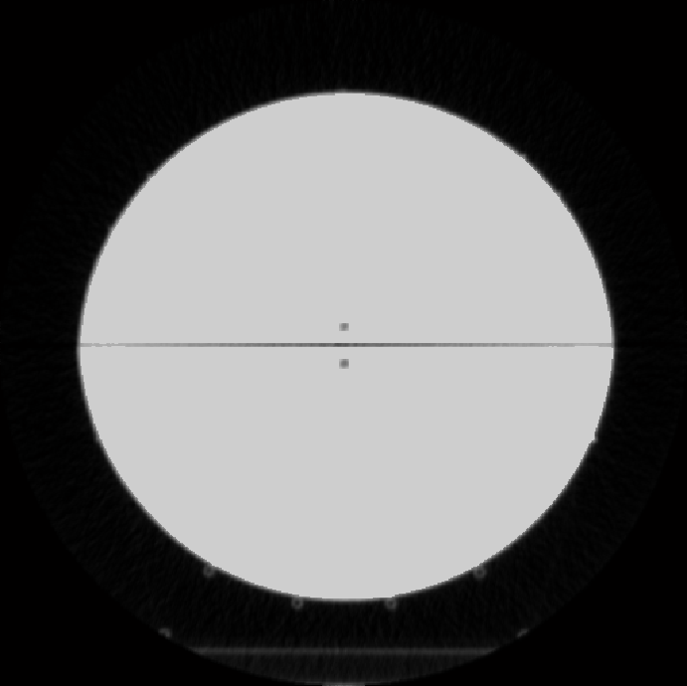
Sample Before & After
AK

Slide 12
Methods – Phantom Calibration
Density calibration curve needs extension
Eclipse and TomoTherapy
Cylindrical PTV calibration plan on new phantom
  Single centered cylindrical target
    Diameter: 9 cm
    Length: 6 cm
  2 Gy to 100% of the PTV
Measure the actual dose delivered
Calibration value adjusted and retested until matching delivered dose
Confirm by running the patient plan using new calibration value
AK

Slide 13
Methods – Smoothed vs Unsmoothed
Run using RA and HT
Perform DQAs on the sample patients using the smoothed phantom
Perform DQAs on the sample patients using the unsmoothed phantom
Compare mean and standard deviation:
  Point dose error change
  Gamma pass rate change
AK

Slide 14
Methods – Proof of Principle
Check isodose line agreement using the “cheese” phantom
  We expect great agreement
Check isodone line agreement using the new teflon phantom
  What will we see?
AK

Slide 15
Methods – Compare Passing Plans
6 sample SBRT lung patients retrospectively planned
  48 Gy to 100% of the PTV
  Recalculations of previously delivered plans
    → expected to pass DQA
  Teflon and “cheese” phantom
  RA and HT delivery
AK

Slide 16
Methods – Compare Failing Plans
Confirm new phantom can catch failing plans too
Teflon and “cheese” phantoms
HT only
6 sample patients retrospectively planned
  Plans scaled down to become failing
    Mean LOT < 100 ms¹
¹Treatment Planning to Improve Delivery Accuracy And Patient Throughput in Helical Tomotherapy, D. C. Westerly et. al., Int. J. Rad. Onc. Biol. Phys. Vol. 74 No. 4 pp 1290-1297, 2009
AK

Slide 17
Results
Phantom Calibration
Smoothed vs. Unsmoothed
Proof of Principle
Comparing passing plans
Comparing failing plans
AK

Slide 18
Results – Phantom Calibration
Extended CT# → relative e⁻/mass density curves
Eclipse TPS
  Initial: 888 HU → 1.867 r.e.d.
  Final: 888 HU → 1.803 r.e.d.
TomoTherapy TPS
  Initial: 888 HU → 2.2 g/cc
  Final: 888 HU → 1.964 g/cc
AK

Slide 19
Results – Smoothed vs Unsmoothed
TomoTherapy
 | Before | After
Point Dose Diff μ (σ) | 1.140% (1.333%) | 0.268% (1.184%)
γ Pass Rate μ (σ) | 94.450% (4.474%) | 96.817% (2.466%)
Varian RapidArc
 | Before | After
Point Dose Diff μ (σ) | 1.467% (1.282%) | 0.492% (1.414%)
γ Pass Rate μ (σ) | 93.813% (9.100%) | 98.563% (1.354%)
AK

Slide 20
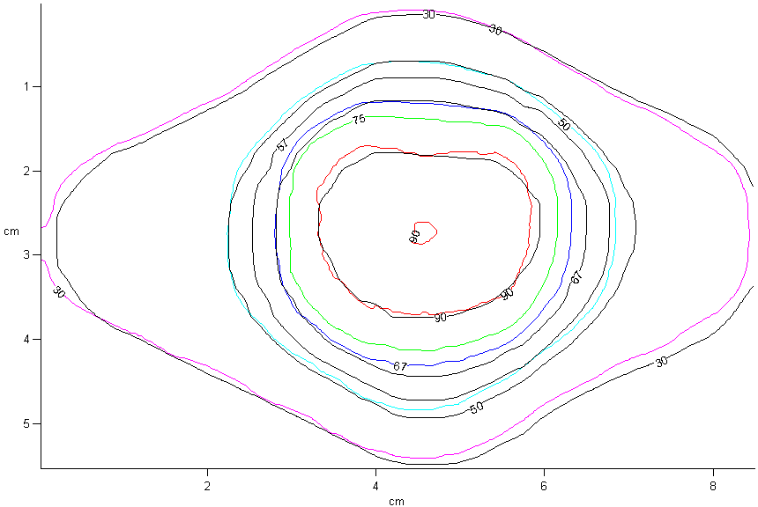
Results – Proof of Principle
Sample Cheese Isodose Comparison.
Black lines denote TPS values
Colored lines denote measured values
AK

Slide 21
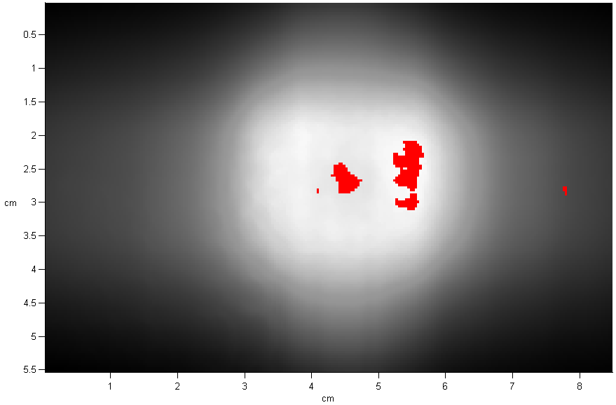
Results – Proof of Principle
Sample Cheese Gamma Analysis: 99.14%
Red denotes points that failed the gamma analysis.
10% threshold, 3 mm DTA, 3% dose difference
AK

Slide 22
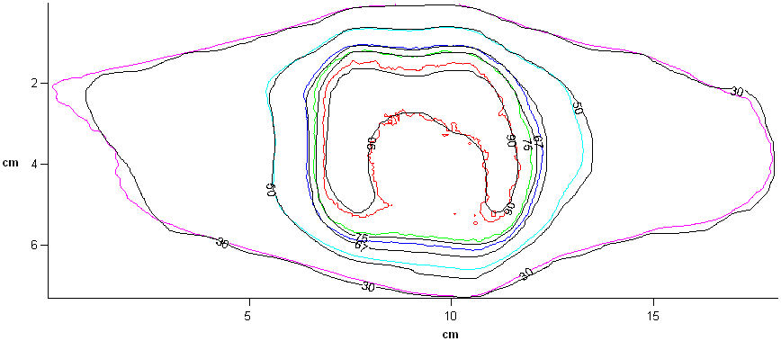
Results – Proof of Principle
Sample Teflon Isodose Comparison.
Black lines denote TPS values
Colored lines denote measured values
AK

Slide 23
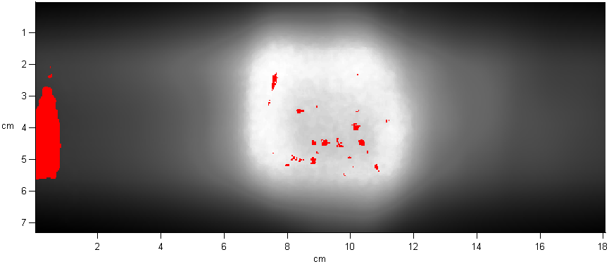
Results – Proof of Principle
Sample Teflon Gamma Analysis: 98.23%
Red denotes points that failed the gamma analysis.
10% threshold, 3 mm DTA, 3% dose difference
AK

Slide 24
Results – Passing Plans Summary
Passing Plans – Point Doses (Mx/TPS)
 | RA |  | HT
 | Teflon | Cheese | Teflon | Cheese
mean | 0.5% | 1.2% | 0.3% | 0.3%
stdev | 1.4% | 1.0% | 1.2% | 1.1%
Passing Plans – Gamma Analysis
 | RA |  | HT
 | Teflon | Cheese | Teflon | Cheese
mean | 98.56% | 99.38% | 96.32% | 97.77%
stdev | 1.35% | 0.76% | 2.47% | 3.44%
AK

Slide 25
Results – Failing Plans Summary
Failing Plans – Point Doses |  | (Mx/TPS)
 | Teflon | Cheese
mean | 6.5% | 7.5%
stdev | 1.6% | 1.1%
Failing Plans – Gamma Analysis
 | Teflon | Cheese
mean | 100% | 99.97%
stdev | 0% | 0.8%
AK

Slide 26
Conclusions
New phantom meets the challenges posed
  Remain a manage-able size
  Reduces dose to film plane
  Avoids LOT scaling and plan modification issues
Both TPS can accurately calculate point doses, if commissioned appropriately
Both TPS can accurately calculate dose distributions
Comparable performance compared to the “cheese” phantom
Test the new phantom for viability in the DQA protocol for the SBRT IMRT plans
AK

Slide 27
Acknowledgments
Dr. Mike Snyder
Danielle Lack
Ross Starin
Ashleigh Weyh
AK

Slide 28
Questions?
AK
Notes:
Feedback?

Slide 29
Results – Summary
Smoothed Teflon Phantom
  Reduced dose to film plane below saturation
  Maintain a manage-able size
  Avoid LOT scaling issue
  Smoothing improved:
    TomoTherapy
      Mean point dose error: 1.140% → 0.268%
      Standard dev. point dose error: 1.333% → 1.184%
      Mean gamma pass rate: 94.450% → 96.817%
      Standard dev. gamma pass rate: 4.474% → 2.466%
      Better and more consistent agreement with TPS!
AK

Slide 30
Results – Summary
Smoothed Teflon Phantom
  Smoothing improved:
    RapidArc
      Mean point dose error: 1.467% → 0.492%
      Standard dev. point dose error: 1.282% → 1.414%
      Mean gamma pass rate: 93.813% → 98.563%
      Standard dev. gamma pass rate: 9.100% → 1.354%
      Better and more consistent agreement with TPS!
  Passing plans:
    Measured point doses agreed with TPS
    Measured dose distributions agreed with TPS
  Failing plans:
    Measured point doses disagreed with TPS
    Measured dose distributions agreed with TPS
AK

Slide 31
Results – Passing Plans Summary
Passing Plans – Point Doses (Mx/TPS)
 | Teflon |  | Cheese
 | RA | HT | RA | HT
μ | 0.995 | 0.997 | 1.012 | 0.997
σ | 0.014 | 0.012 | 0.010 | 0.011
Passing Plans – Gamma Analysis
 | Teflon |  | Cheese
 | RA | HT | RA | HT
μ | 98.56 | 96.82 | 99.38 | 97.77
σ | 1.35 | 2.47 | 0.76 | 3.44
AK

Slide 32
Results – Failing Plans Summary
Failing Plans – Point Doses |  | (Mx/TPS)
 | Teflon | Cheese
μ | 0.935 | 0.925
σ | 0.016 | 0.011
Failing Plans – Gamma Analysis
 | Teflon | Cheese
μ | 100 | 99.97
σ | 0 | 0.8
AK

Slide 33
Results – Comparing Passing Plans
Teflon Gamma Analysis
Patient # | RA | HT
1 | 99.81 | 94.92
2 | 99.92 | 92.94
3 | 96.17 | 98.23
4 | 98.62 | 97.25
5 | 98.43 | 97.81
6 | 98.43 | 99.75
μ = 98.56
σ = 1.35
μ = 96.82
σ = 2.47
AK

Slide 34
Results – Comparing Passing Plans
“Cheese” Phantom Point Dose Results
Patient # | RA Mx/TPS | HT Mx/TPS
1 top | 1.013 | NA
bottom | NA | 0.976
2 top | 1.016 | 0.992
bottom | NA | NA
3 top | 1.019 | 1.006
bottom | NA | 1.009
4 top | 1.008 | 0.990
bottom | 1.015 | 1.000
5 top | 1.001 | 1.013
bottom | 1.015 | 0.997
6 top | 0.995 | 0.991
bottom | 1.028 | 1.016
μ = 1.012
σ = 0.010
μ = 0.997
σ = 0.011
AK

Slide 35
Results – Comparing Passing Plans
“Cheese” Gamma Analysis
Patient # | RA | HT
1 | 99.83 | 90.90
2 | 99.05 | 99.14
3 | 98.03 | 98.21
4 | 99.44 | 99.87
5 | 100.00 | 100.00
6 | 99.95 | 98.51
μ = 99.38
σ = 0.76
μ = 97.77
σ = 3.44
AK

Slide 36
Results – Comparing Failing Plans
Patient # | Teflon Mx/TPS | Cheese Mx/TPS
1 | 0.924 | 0.908
2 | 0.930 | 0.917
3 | 0.961 | 0.929
4 | 0.917 | 0.924
5 | 0.943 | 0.937
6 | 0.932 | 0.936
μ = 0.935
σ = 0.016
μ = 0.925
σ = 0.011
AK

Slide 37
Results – Comparing Failing Plans
Patient # | Teflon Gamma % | Cheese Gamma %
1 | 100 | 100
2 | 100 | 100
3 | 100 | 100
4 | 100 | 100
5 | 100 | 100
6 | 100 | 99.8
AK

Slide 38
Preliminary Octavius Results
Patient # | RA Mx/TPS eclipse | RA Mx/TPS PTW | HT Mx/TPS Tomo | HT Mx/TPS PTW
1 | 1.025 | 1.020 | 0.988 | 1.008
2 | 1.034 | 1.023 | 0.978 | 0.970
3 | 1.024 | 1.017 | 0.998 | 1.035
4 | 1.022 | 1.017 | 0.955 | 0.960
5 | 1.028 | 1.024 | 0.960 | 0.966
6 | 1.021 | 1.015 | 0.939 | 0.959
AK

Slide 39
Preliminary Octavius Results
Patient # | RA Gamma PTW | RA Gamma RIT | HT Gamma PTW | HT Gamma RIT
1 | 95.60 | 90.16 | 100.00 | 91.41
2 | 95.90 | 90.21 | 91.70 | 93.14
3 | 97.20 | 90.02 | 88.20 | 90.50
4 | 99.50 | 92.13 | 87.60 | 92.75
5 | 99.50 | 94.60 | 90.10 | 91.70
6 | 62.80 | 94.77 | 97.50 | 91.93
AK

