Slide 1
Behind the Fame
Hayley

Slide 2
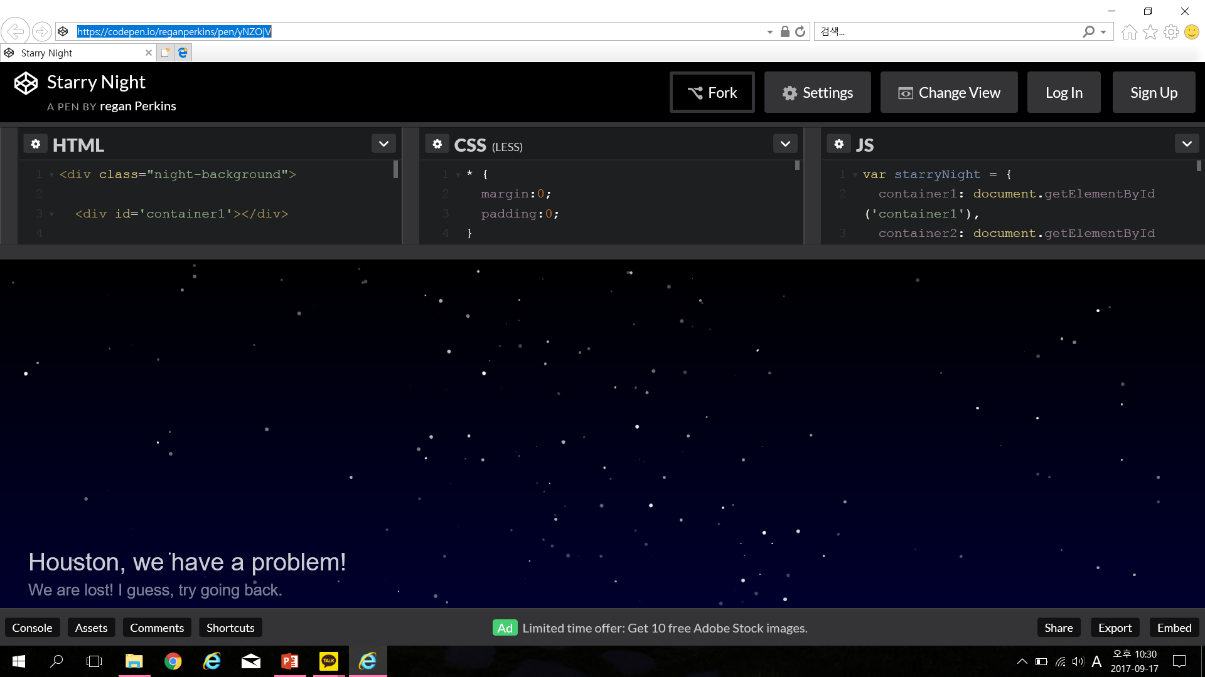
첫화면
팬덤이 무서웠어요
모든 아이돌 == 별
별들이 화면 안에서 반짝반짝 거리는 화면으로 시작
(소스코드 있는데 아마 분명히 안 돌아갈테니 따로 공부해야해요)

Slide 3
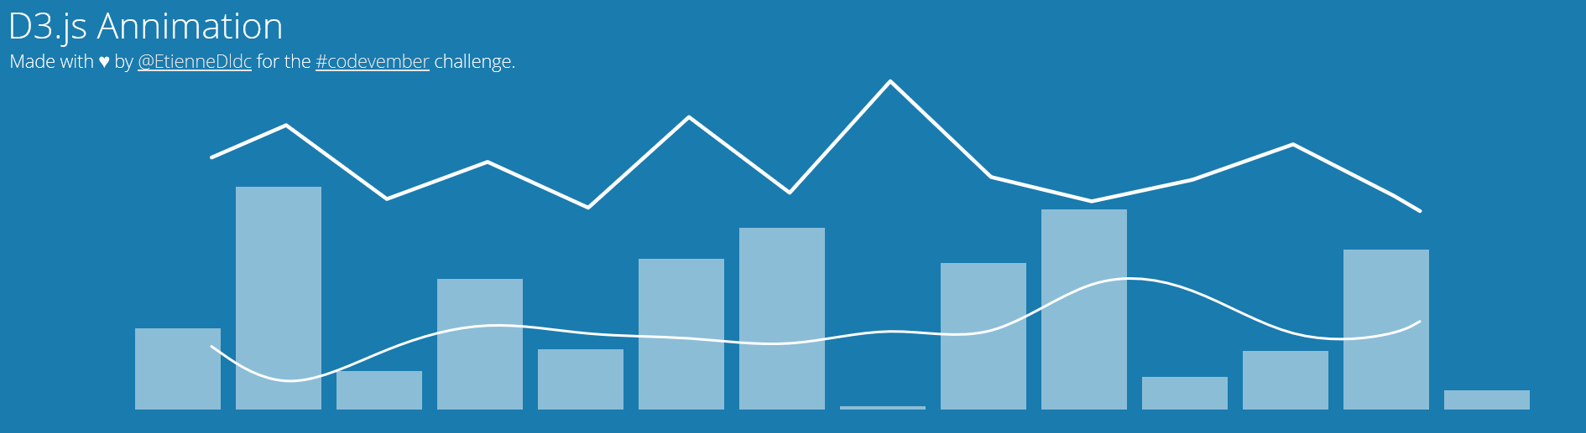
두번째 화면
아래가 영감 source (D3로 구현가능)
라인바 하나가 직선으로 가다가, 해당 아이돌이 뜬 연도가 나오면 푸슉 뛰어오른다

Slide 4
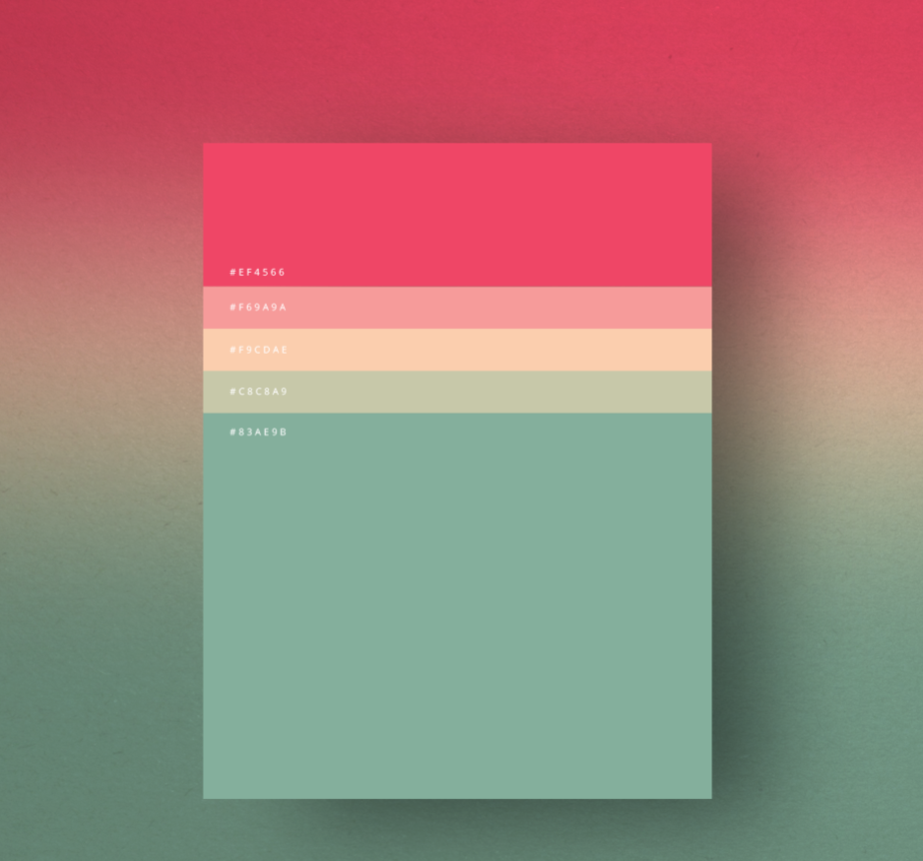

두번째 화면 – 구현 예시
100 Day Passed
샤이니
AMIGO (2008)
누난 너무 예뻐
Stop
여기서 듣기
기능 구현

Slide 5


두번째 화면 – 구현 예시
100 Day Passed
샤이니
AMIGO(2008)
누난 너무 예뻐
Stop
여기서 듣기
기능 구현

Slide 6

2010
All the others All the others All the others All the others All the others All the others All the others All the others All the others All the others All the others
All the others All the others All the others All the others All the others All the others All the others All the others All the others All the others All the others
All the others All the others All the others All the others All the others All the others All the others All the others All the others All the others All the others
All the others All the others All the others All the others All the others All the others All the others All the others All the others All the others All the others
All the others All the others All the others All the others All the others All the others All the others All the others All the others All the others All the others
All the others All the others All the others All the others All the others
2011
All the others All the others All the others All the others All the others All the others All the others All the others All the others All the others All the others
All the others All the others All the others All the others All the others All the others All the others All the others All the others All the others All the others
All the others All the others All the others All the others All the others All the others All the others All the others All the others All the others All the others
All the others All the others All the others All the others All the others All the others All the others All the others All the others All the others All the others
All the others All the others All the others All the others All the others All the others All the others All the others All the others All the others All the others
All the others All the others All the others All the others All the others
2012
All the others All the others All the others All the others All the others All the others All the others All the others All the others All the others All the others
All the others All the others All the others All the others All the others All the others All the others All the others All the others All the others All the others
All the others All the others All the others All the others All the others All the others All the others All the others All the others All the others All the others
All the others All the others All the others All the others All the others All the others All the others All the others All the others All the others All the others
All the others All the others All the others All the others All the others All the others All the others All the others All the others All the others All the others
All the others All the others All the others All the others All the others
2013
All the others All the others All the others All the others All the others All the others All the others All the others All the others All the others All the others
All the others All the others All the others All the others All the others All the others All the others All the others All the others All the others All the others
All the others All the others All the others All the others All the others All the others All the others All the others All the others All the others All the others
All the others All the others All the others All the others All the others All the others All the others All the others All the others All the others All the others
All the others All the others All the others All the others All the others All the others All the others All the others All the others All the others All the others
All the others All the others All the others All the others All the others
마우스 호버링 시
해당 아이돌 멤버, 데뷔연도 등장
멤버 : 태희, 태희, 태희, 태희
데뷔연도 : 2017

