Slide 1

DATABASE HARDENING

Slide 2
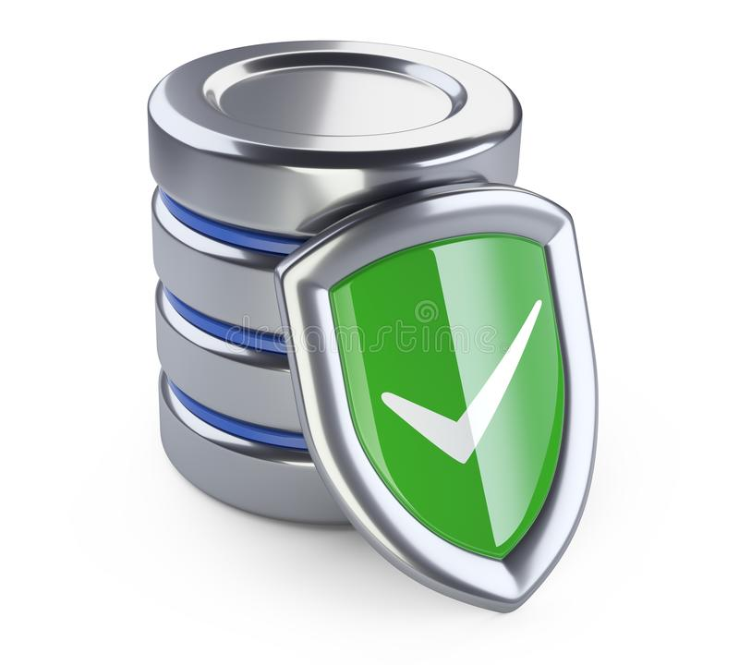
INTRODUCTION
What is Database Hardening?
Database Hardening is the process of analyzing and configuring your database options, account, settings, and tools to increase security.
What is SQL Hardening?
The SQL Server Hardening utility allows you to harden or roll back the SQL Server security on Logger and Administration & Data Server/HDS components. The Harden option disables unwanted services and features.
Untuk apa kita buat hardening? -Kurangkan risiko system dan vulnerability dalam satu server database. -Dapat analyze dan dan terus fix problem atau any vuln dekat sql server kita. -Untuk protect private data dan system server daripada loss, kena leaked atau terjadi unauthorized access to the database.

Slide 3

CONTOH-CONTOH DATABASE IN SQL
MySql Database
Oracle Database
MariaDB
Microsoft Sql Server
SQLite

Slide 4
HOW TO HARDENING THE DATABASE?

Slide 5
Change default password for administrator and another user that can gain access to the database
Use database and web applications firewall
Using default network ports
Use real-time database monitoring

Slide 6
AUDIT LOGGING

Slide 7
WHAT IS AUDIT LOGGING?
Audit log atau dipanggil sebagai ‘audit trail’ adalah satu record activity events atau apa-apa changes dekat specific activity.
Audit log capture activity siapa yang buat any activity, activity apa that is performed, and how the system responded, timestamp, destination, source address, user login info.
All logins to operating system and database servers, successful or unsuccessful, are logged. These logs are retained for at least one year.
Audit log sangat penting dekat administrator dan auditors untuk detect any suspicious activity dan boleh troubleshoot terus any problem.

Slide 8
PERIMETER CONTROL

Slide 9
Perimeter Controls
Network diagram reviews
Firewall implementation and hardening
Routers
Wireless access
DMZ recommendations
Two-factor authentication

Slide 10

THANK YOU!!!

