Slide 1





SQLi ATTACKING PRESENT & DEMO

Slide 2



1. Introduction to Sql Injection Attack

Slide 3
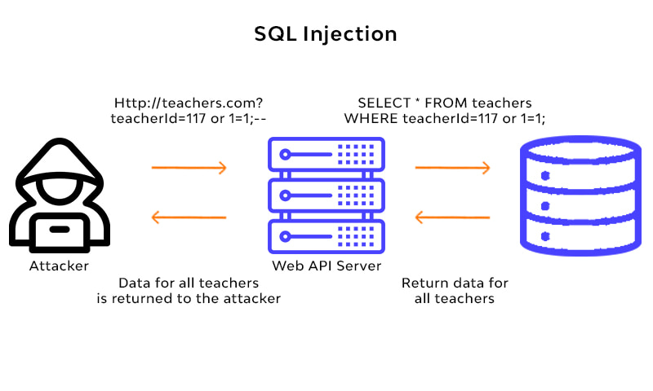
SQL INJECTION
Apa itu Sql Injections?
SQL injection is a code injection technique used to attack data-driven applications, in which malicious SQL statements are inserted into an entry field for execution.
Macam mana sql injection terjadi?
Client akan taip satu command di url dianggap sebagai sql command yang akan di ‘inject’ dekat data-plane input dan akan effect request execution satu-satu web.
Contoh, web tu akan display request sesuai dengan input kita di url. Let say, php?id=1 di parameter url, code tu akan dihantar di sql back-end server, dan web tu akan display data yang ada dalam id=1 dekat web apps untuk client baca dan lihat.

Slide 4
TYPES OF SQL INJECTION ATTACK
Error-Based SQLi
Produce error messages
Time-based
Sql query attack the database and make it wait for a period of seconds if the statement is true based on what we put.
Union-based SQLi
Used UNION statement to attack and pull out database from server
Boolean-based
Depends on the query if true or false

Slide 5








DEMONSTRATION SQL INJECTION

