Slide 1

AI Coach

Slide 2
Task Description
we are build our very own bicep curl tracker let's take a deep look at

Slide 3
Demo

Slide 4
Contribution
estimating poses
extract our joint coordinates
calculate the angles between our joints

Slide 5
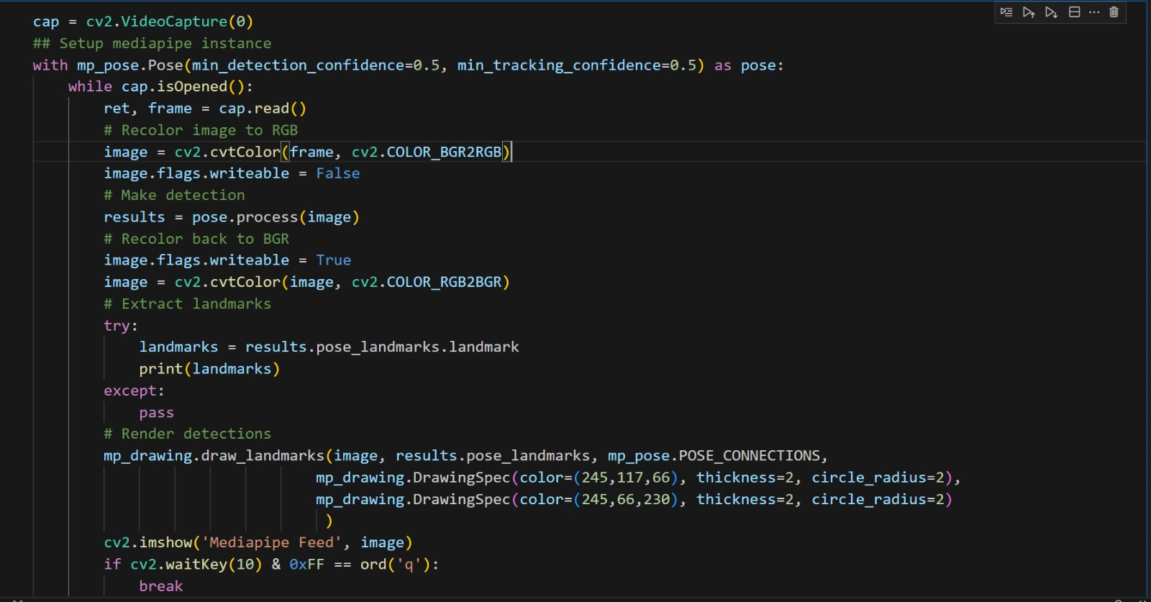
Data
1 - Collection of body landmarks

Slide 6
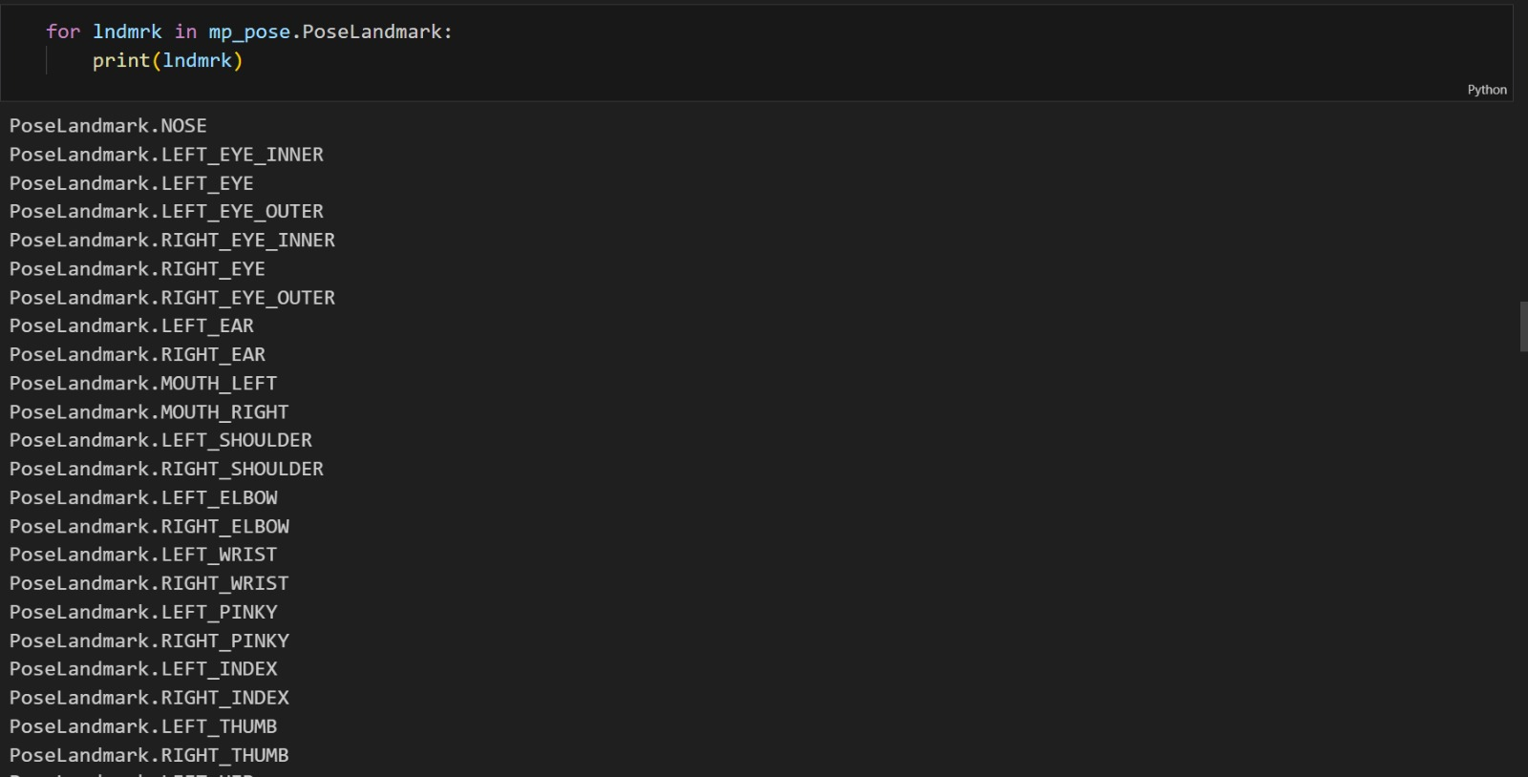
2 – detected all body landmarks

Slide 7
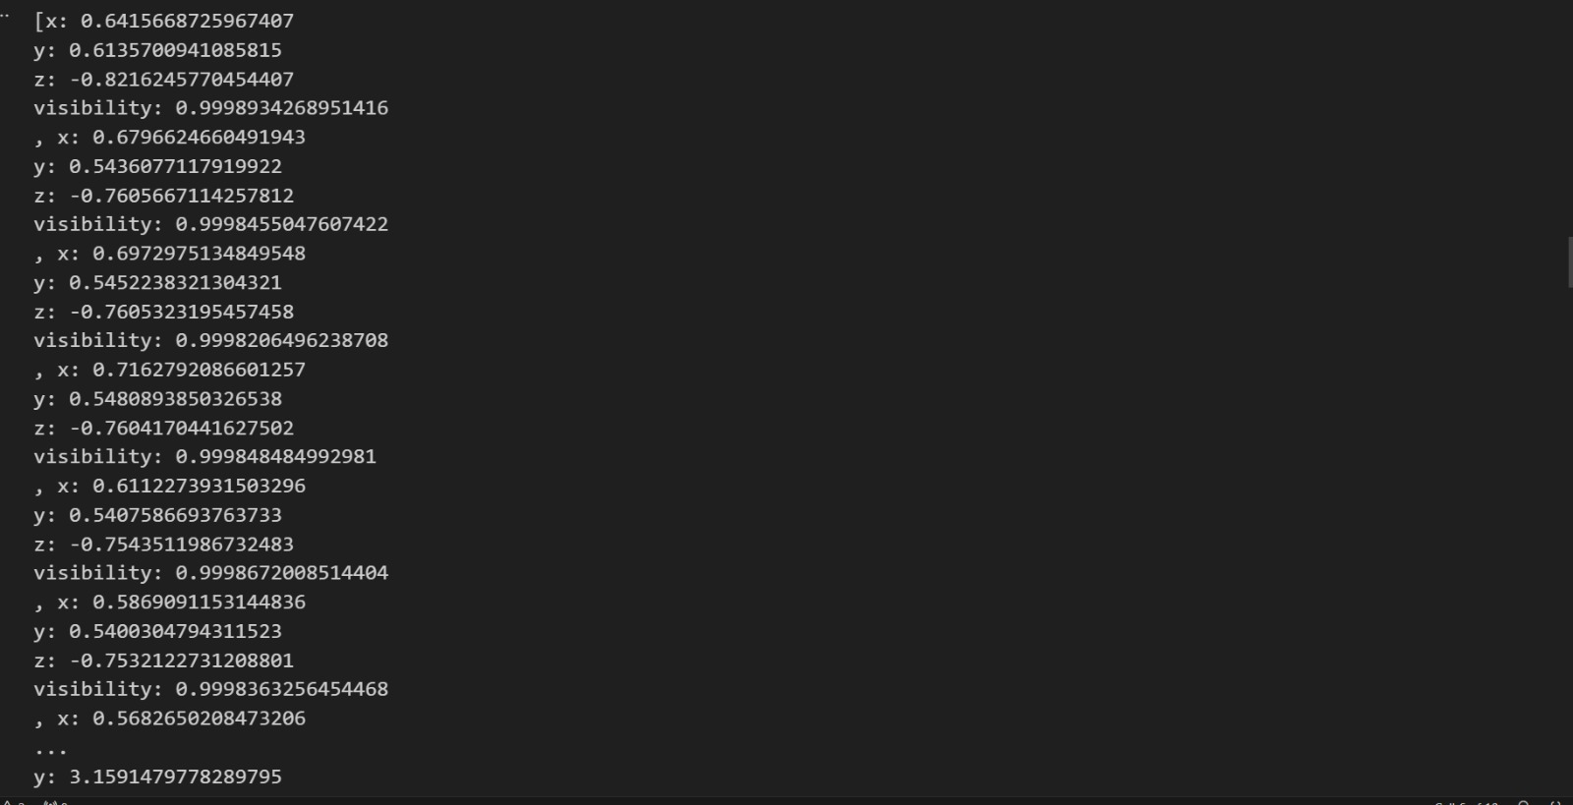
3 – we've got the coordinates for each and every landmark within our body

Slide 8
Architecture
Data collection
Recolor image to RGB
Make detection
Incerment curl counter if angle less then 30
Extract landmarks
Curl counter variables
Calculate angle
Get coordinates

Slide 9
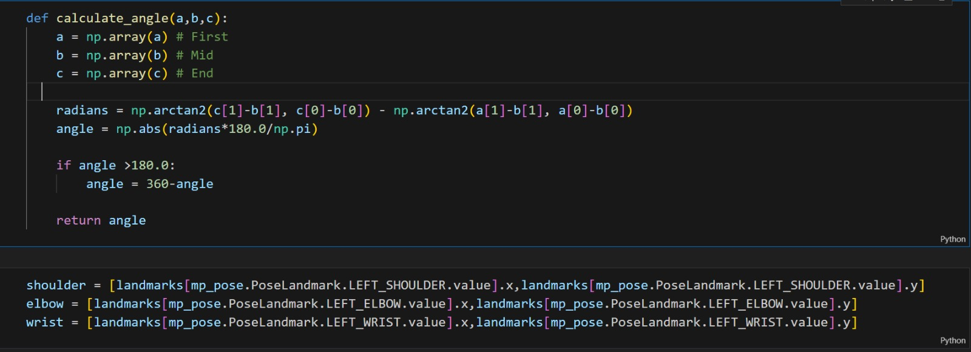
Method
calculate our angle and we used a little bit of trig we then went and extracted our threedifferent coordinates our shoulder our elbow and our wrist and then we used our calculated angle function toactually be able to do that

Slide 10
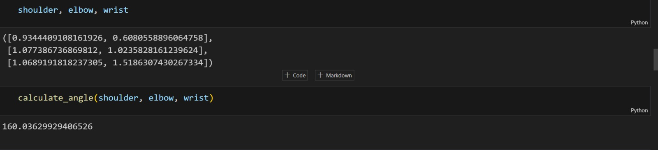

Slide 11
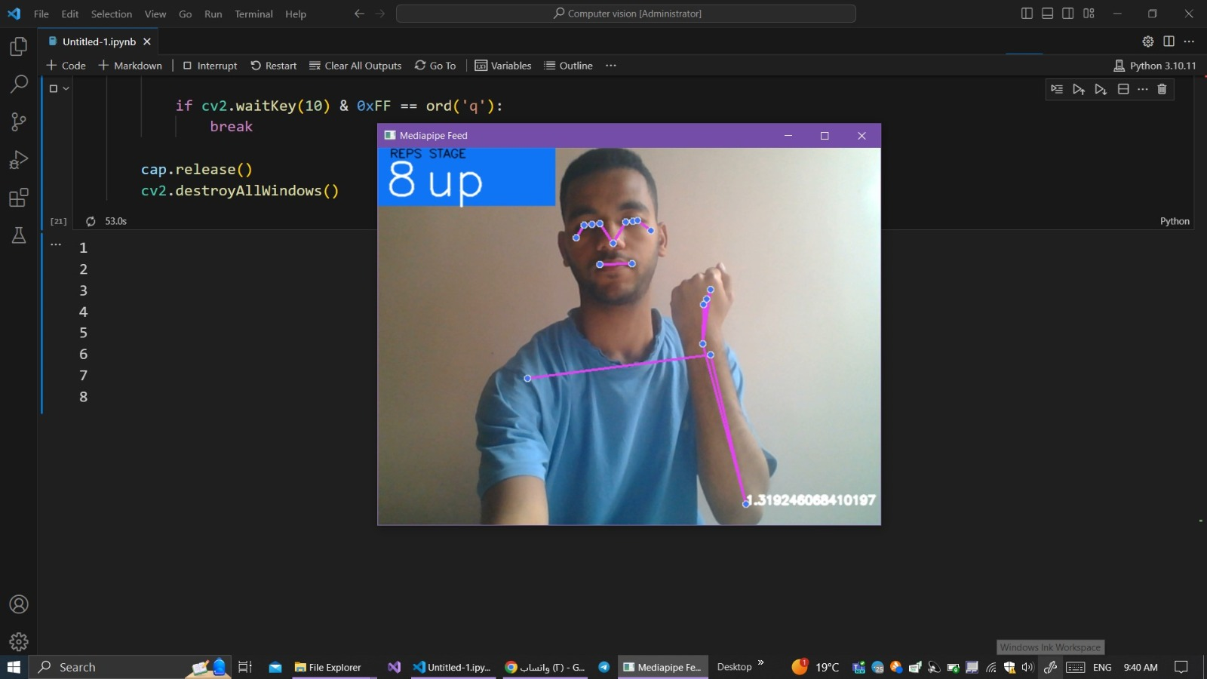
Result
What we want to do is when we're at the bottom of our crease, we'll say this is the bottom position And then once we cross a certain angle threshold we'll say we're now at the topPosition which represents one curl .

