Slide 1
Data analysis PROJECT
1. Research question : How much do cars cost in Istanbul based on certain features ?
2. In this data analysis project I applied some concepts I learned in statistics course on cars data.
3. I applied some statistics concepts on cars data collected from sahibinden website.
4. I applied Normality tests, ANOVA test, hypothesis tests, nonparametric test, Goodness of fit tests and visualization.
5. Also I applied machine learning by using linear regression model.

Slide 2
Abstract
In this project, we study a linear regression model to predict the car prices. this dataset consists of information cars listed on Sahibinden. We try to predict car prices between used and new and putting in some factors such as the brand, fuel it takes, how many kilometers it has passed, the year it was created, its case type (weather its an suv,sedan,etc..),the gear, the color and obviously the model. In this report we used a number of statistical ways to analyze the dataset that we collected. Some of which include diagrams, test of normality, sampling, point estimation, confidence intervals, correlation, data visualization, hypotheses tests, anova test, goodness of fit test and last but not least we pre-processed the dataset in order to be able to use linear regression model to predict car prices in Istanbul.

Slide 3

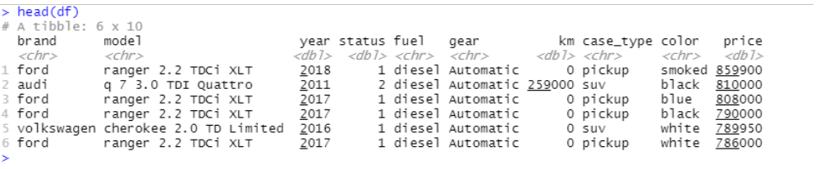



Data collection: For starters, we need to have a look at the dataset and understand its size, attribute names and the dataType. The following features are shown in the picture attached below. By collecting the data manually from sahibinden, we have collected 197 rows of data with 10 columns of features.

Slide 4
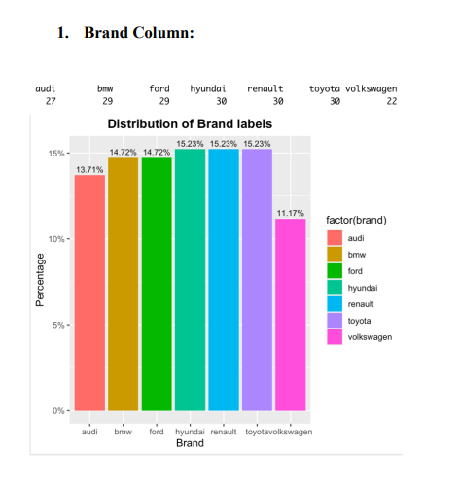
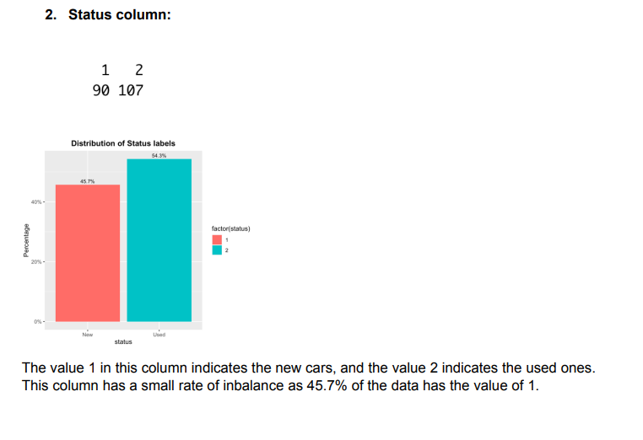
Exploratory data analysis: The data has 0 null values and 0 duplicated rows and the Balance of the categorical columns is as follows

Slide 5
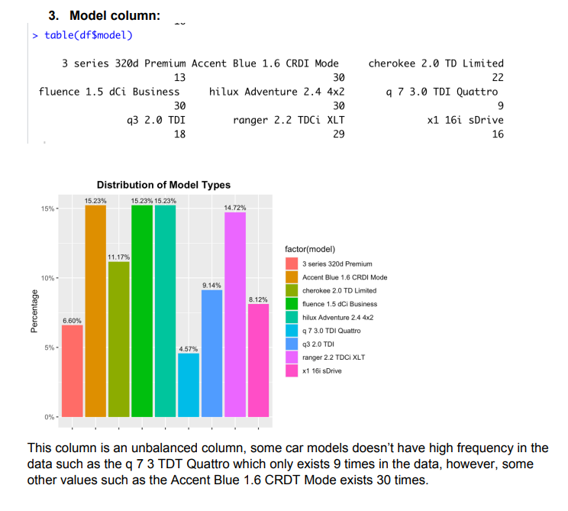
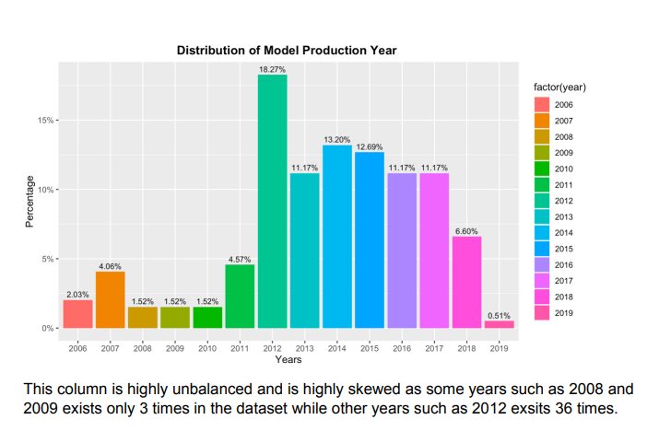

Slide 6
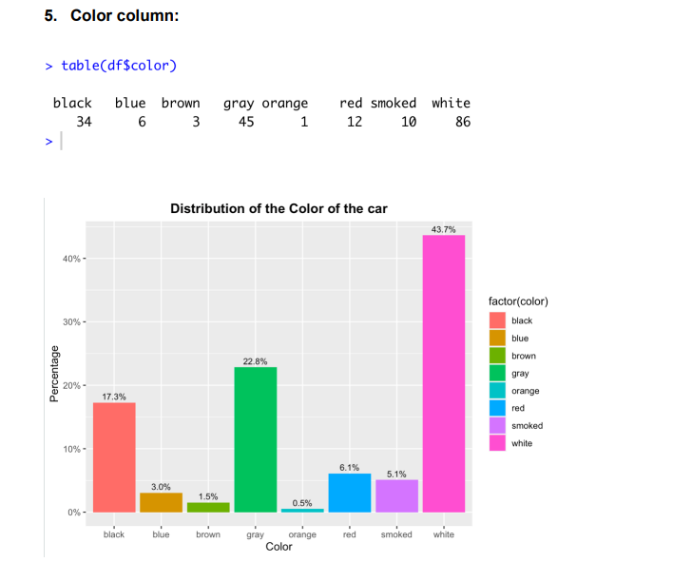
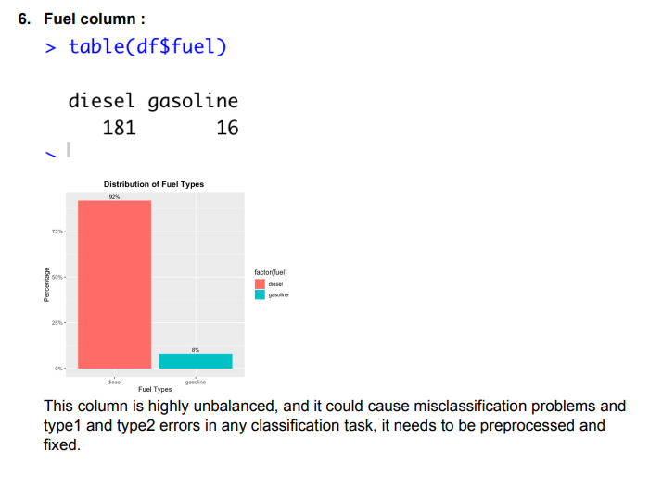

Slide 7
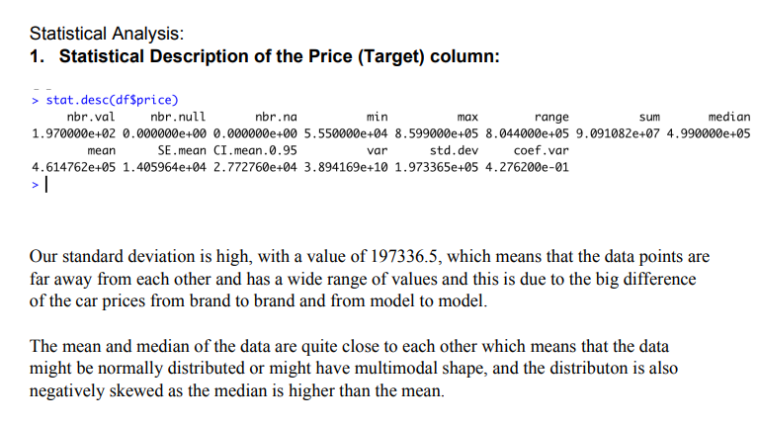

Slide 8
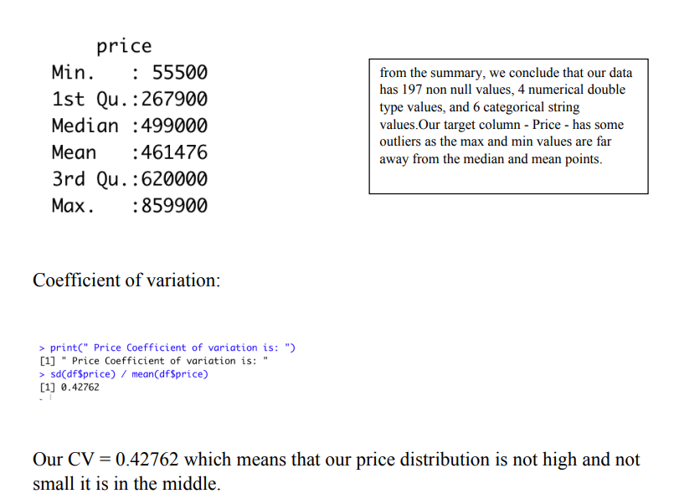

Slide 9
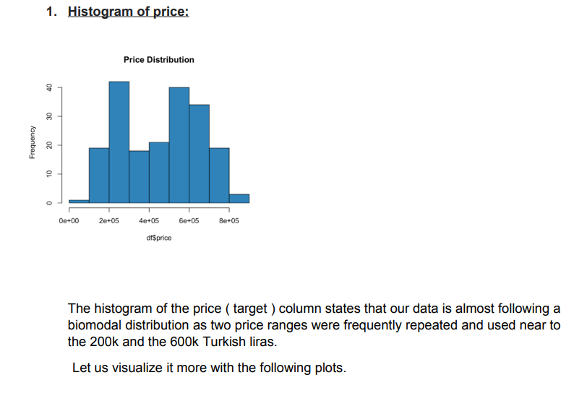
Normality Tests:

Slide 10
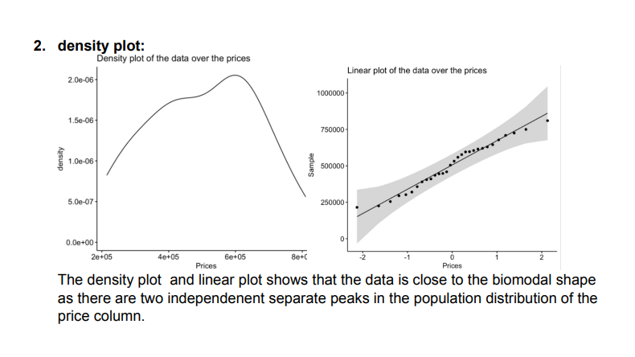

Slide 11
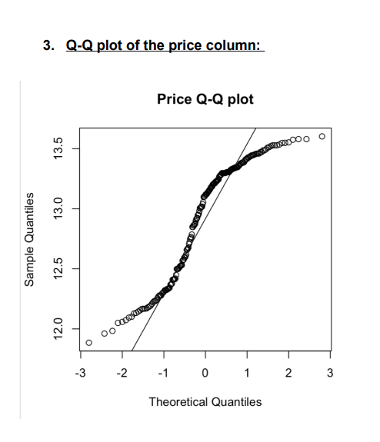

Slide 12
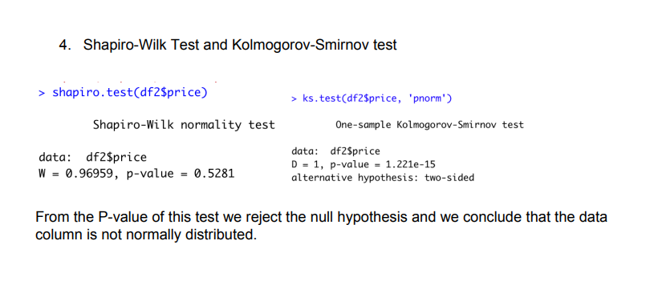

Slide 13
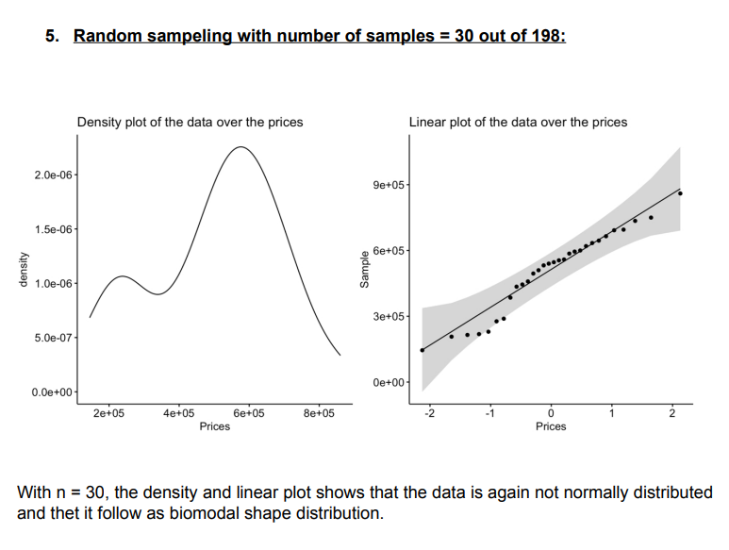

Slide 14
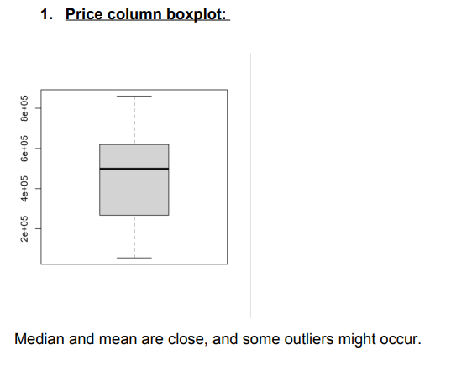
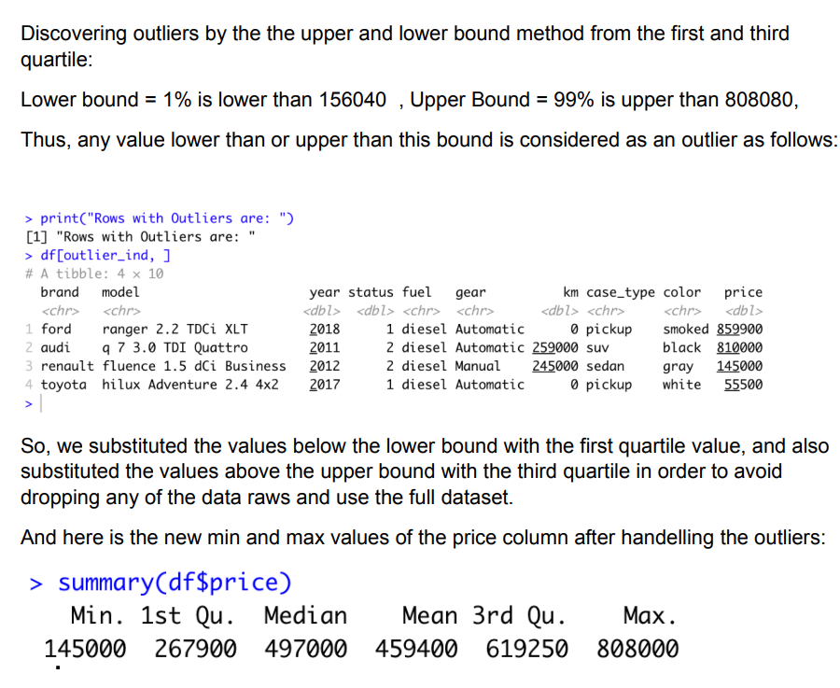
Outliers and boxplots:

Slide 15
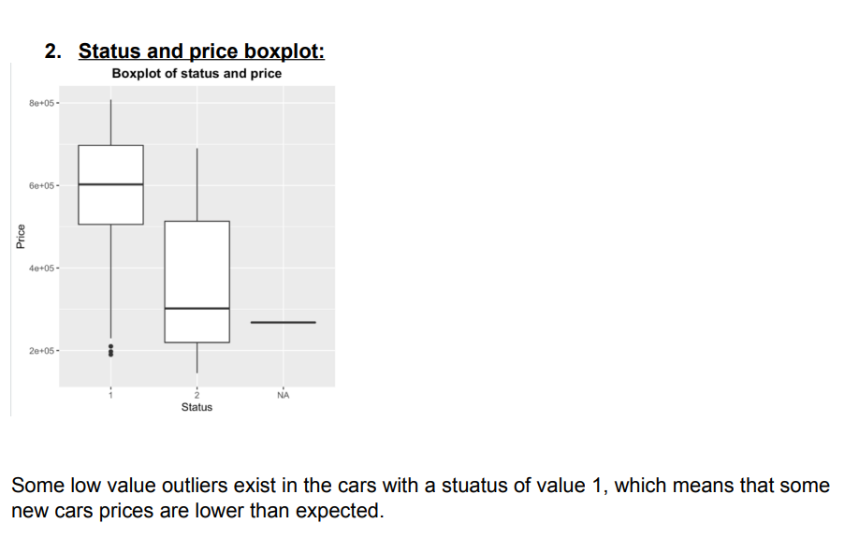

Slide 16
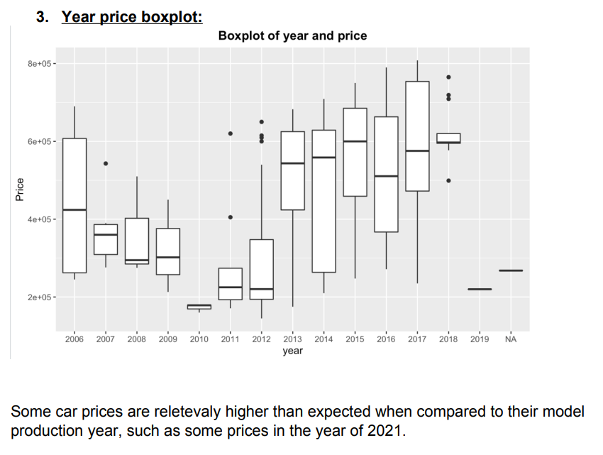

Slide 17
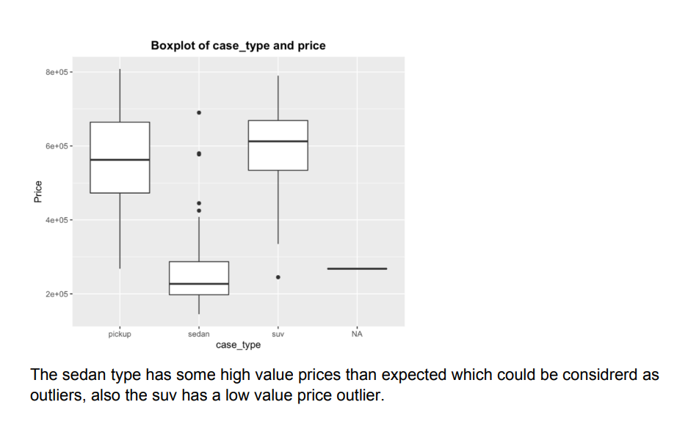
4. Case type and price boxplot

Slide 18
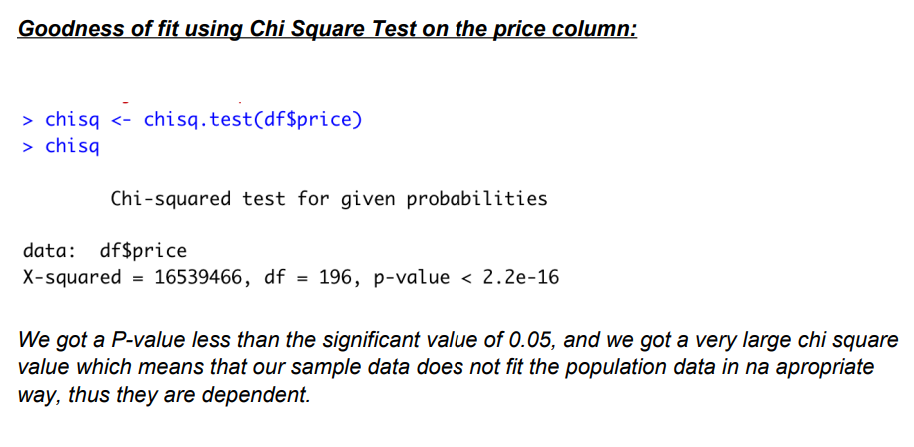
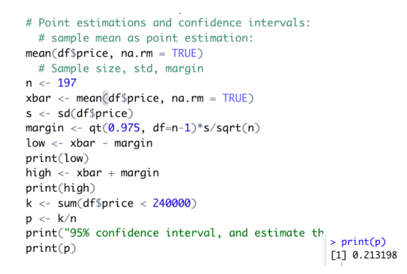

Slide 19
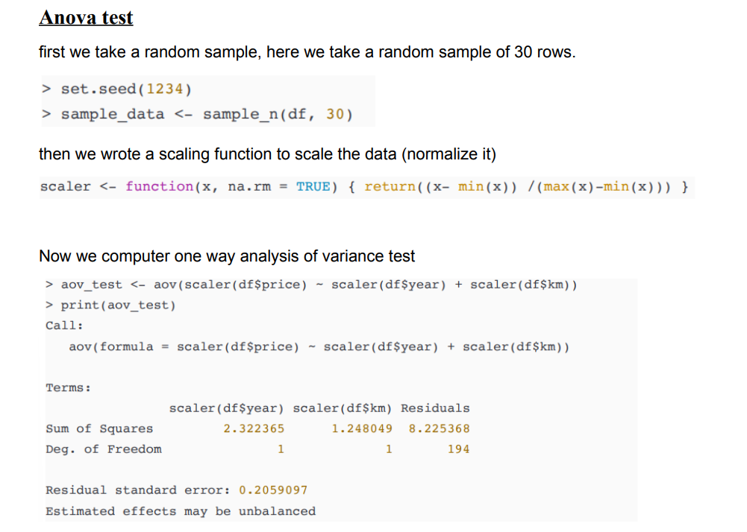

Slide 20
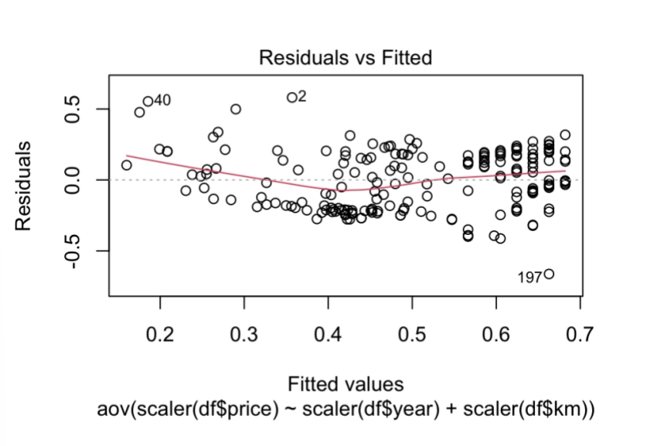

Slide 21

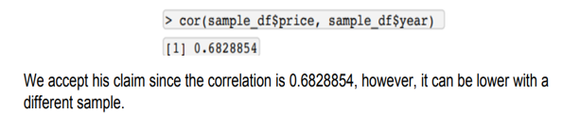
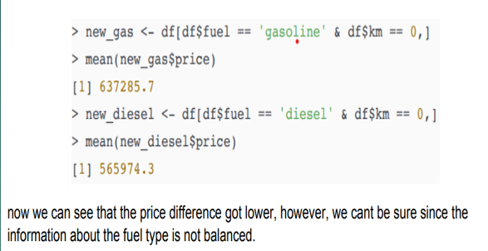
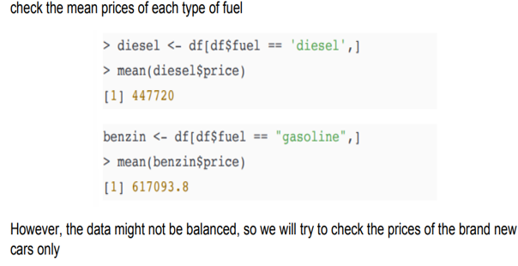

Hypothesis test

Slide 22
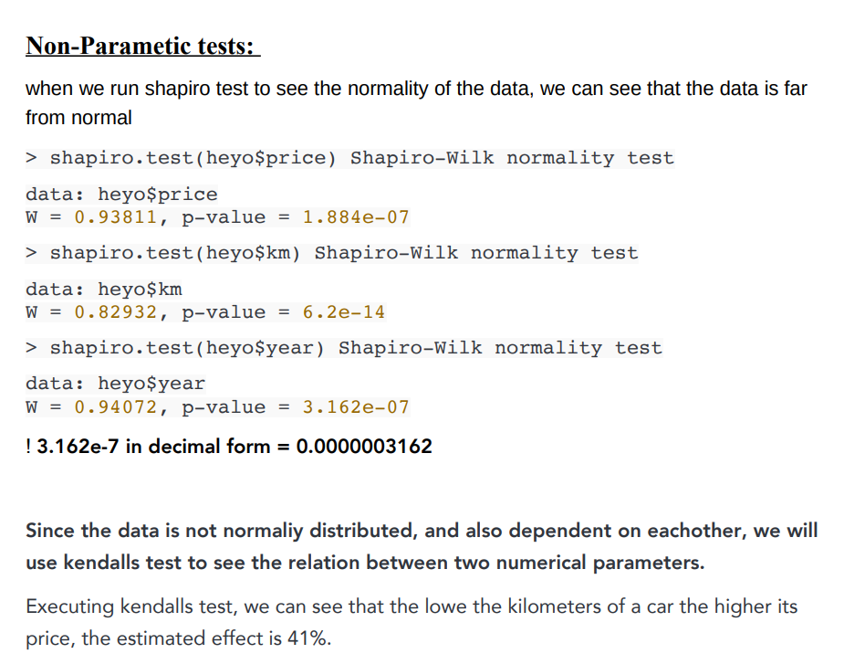
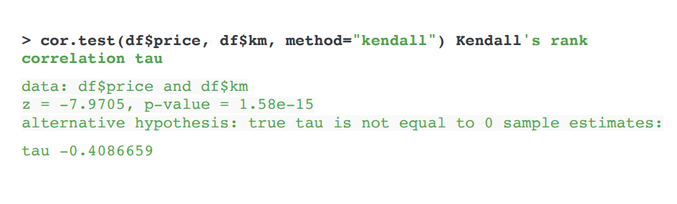

Slide 23
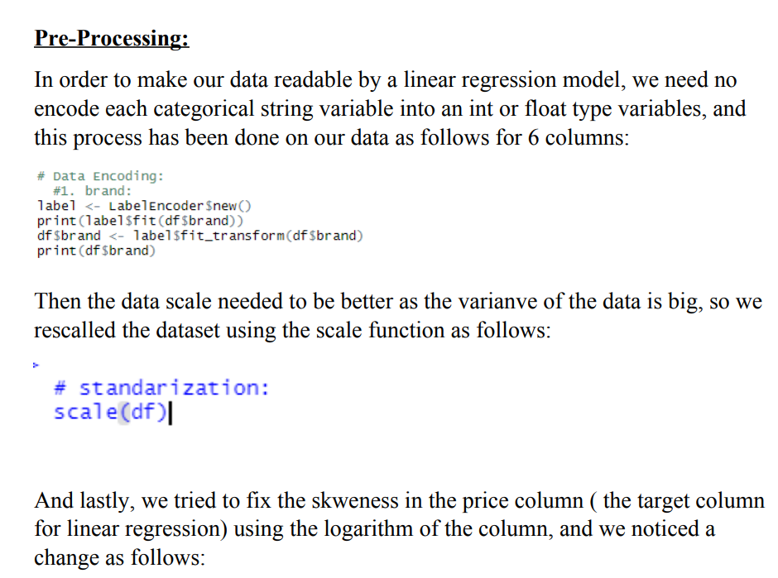
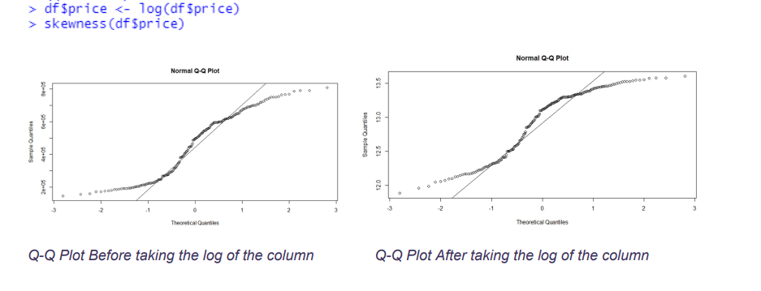

Slide 24
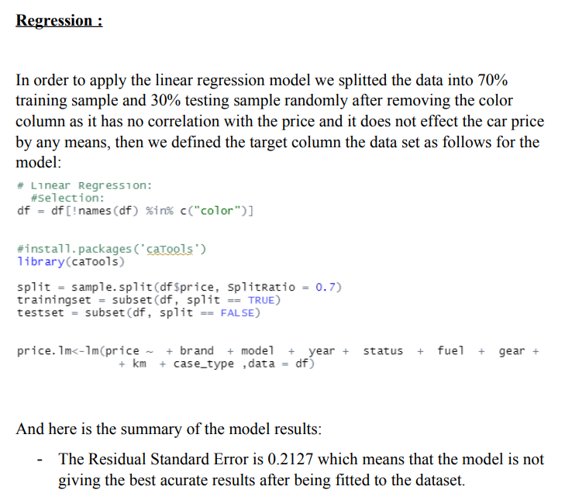
The Multiple R-Squared Error is 0.8

Slide 25
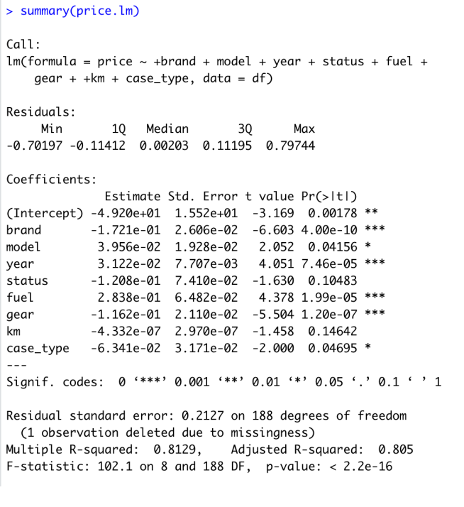

Slide 26
