Slide 1
Maximal Clique of Hamming Graph

Slide 2
Project target:
To calculate the maximal clique of hamming distance
By using C++ programming language

Slide 3
Used Libraries:
include <iostream> include <vector>
include <chrono> include <math.h>

Slide 4
Used Methods:
Main() Hamming_distance()
Brute_force() Bron_kerbosch()

Slide 5
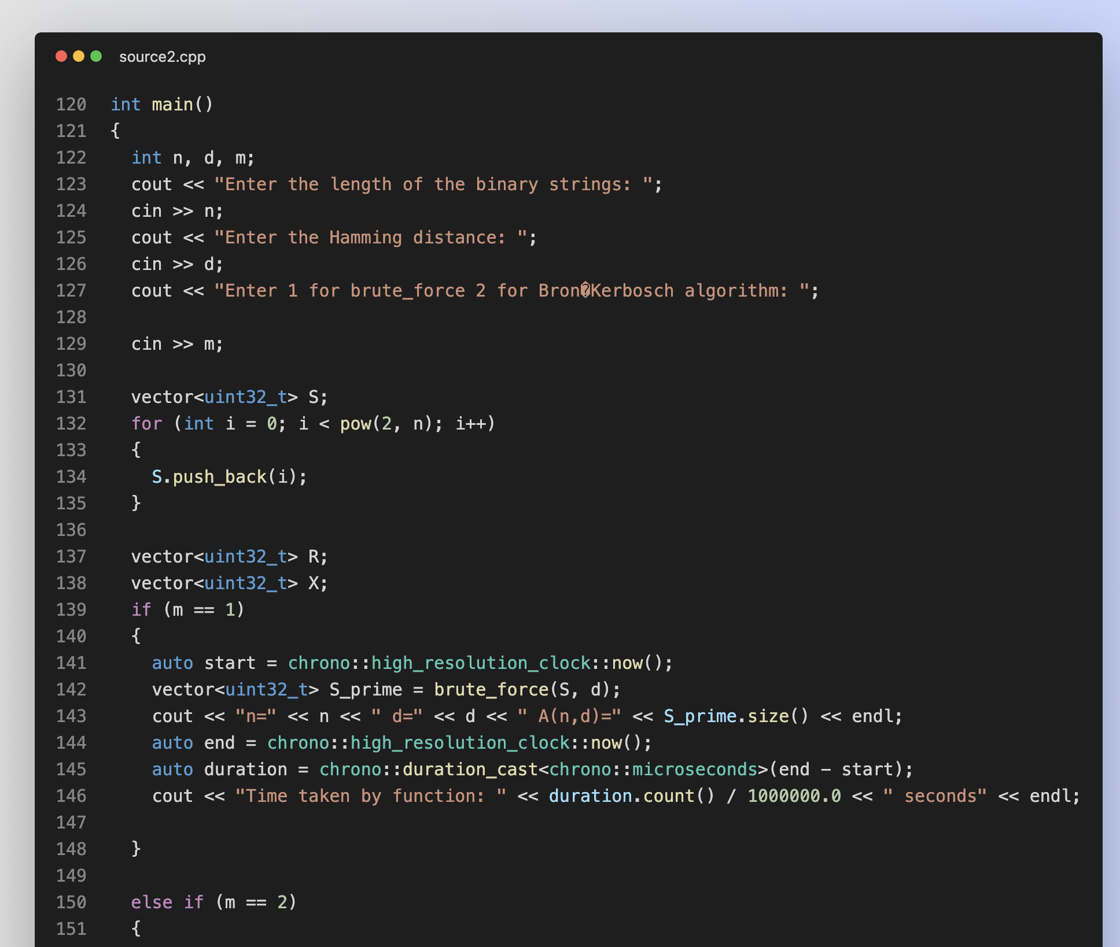
Main()

Slide 6
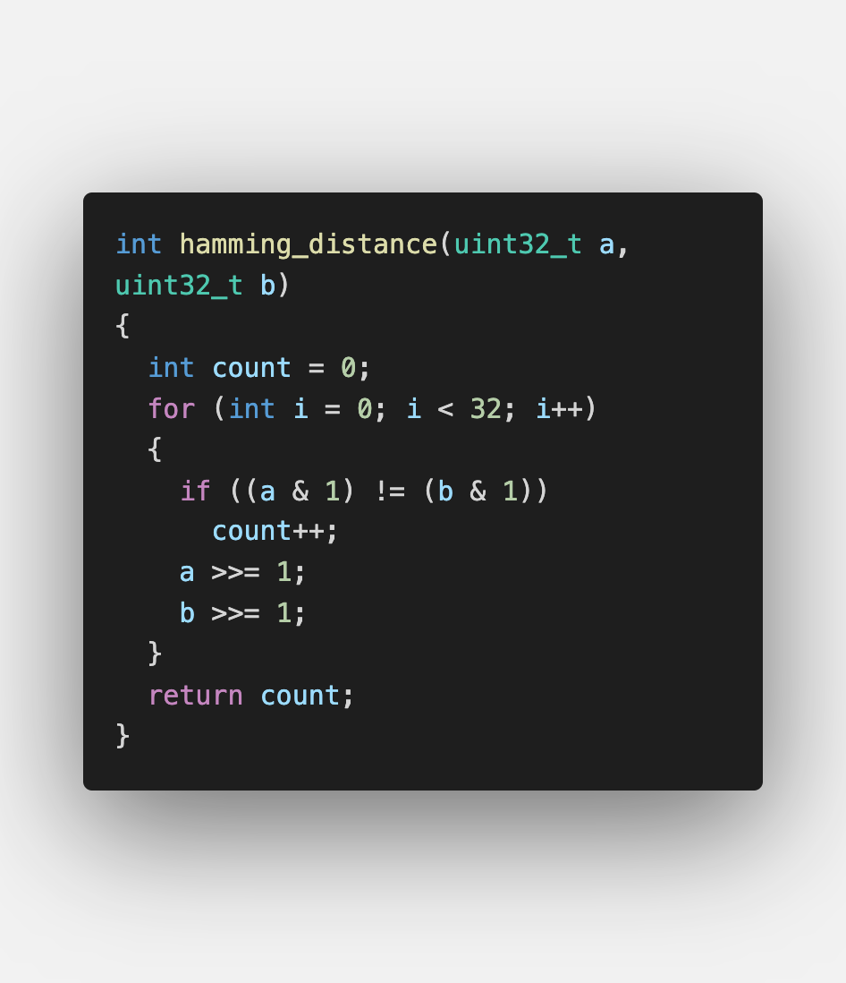
Hamming_distance()

Slide 7
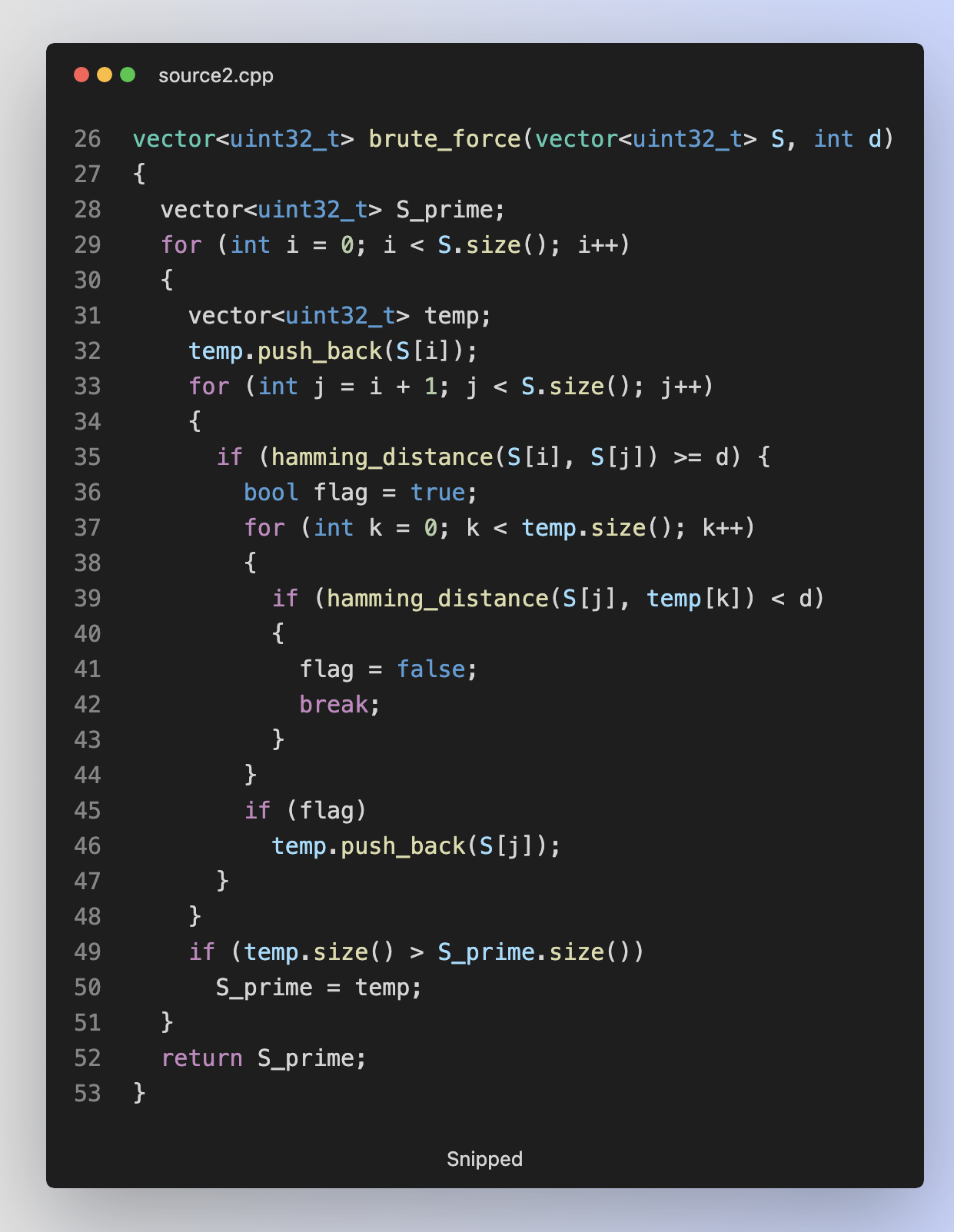
Brute_force()

Slide 8
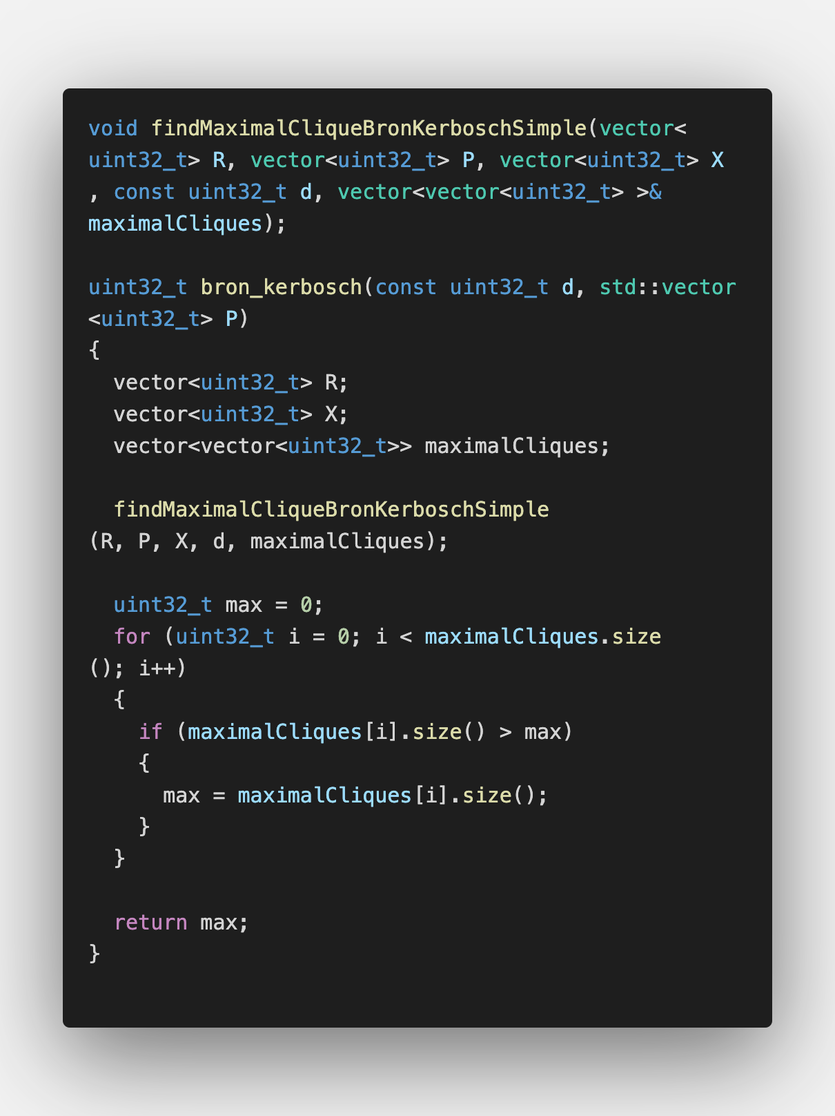
Bron_kerbosch()

Slide 9
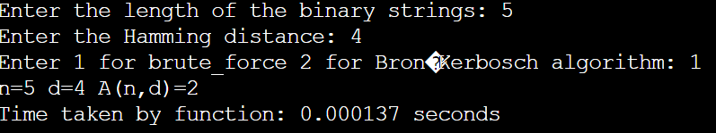
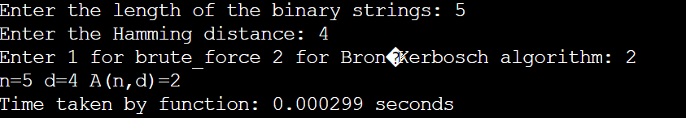
Some code outputs

Slide 10

Thank you

